Slide 1

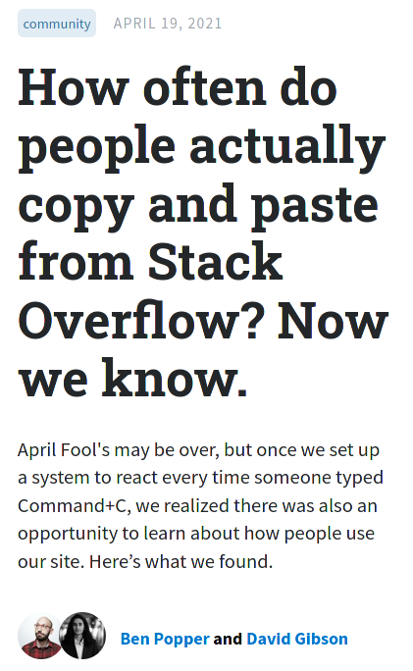
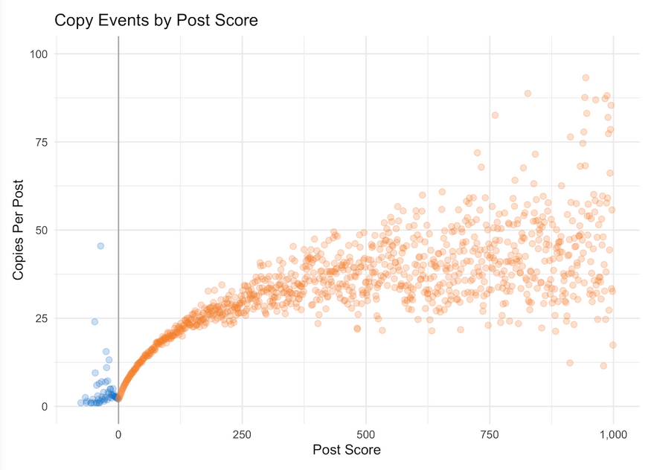
www.linkedin.com/in/dennisbakhuis

Slide 2




www.linkedin.com/in/dennisbakhuis
Click and hold the applaud button for immediate satisfaction!

