Slide 1
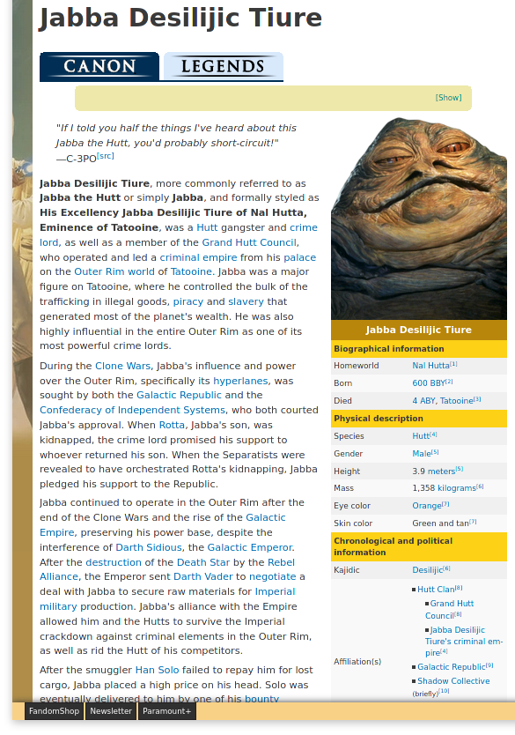
Description
Sidebar information
All links
to other pages

Slide 2
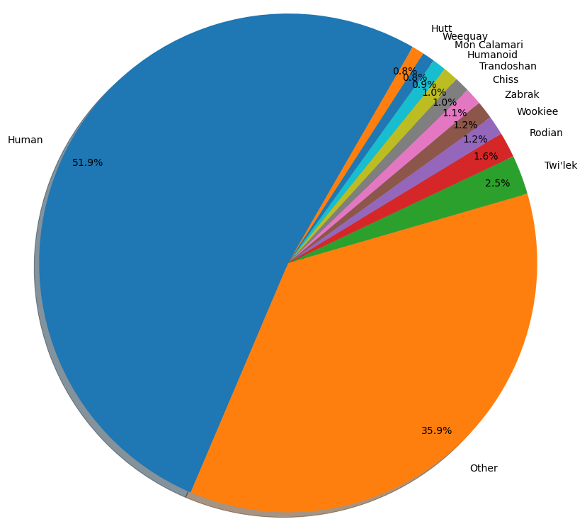
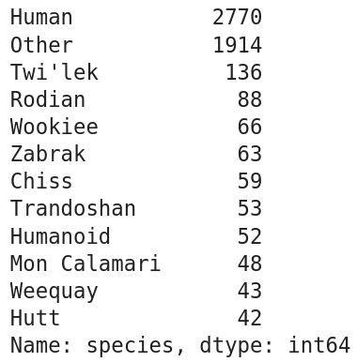

Slide 3
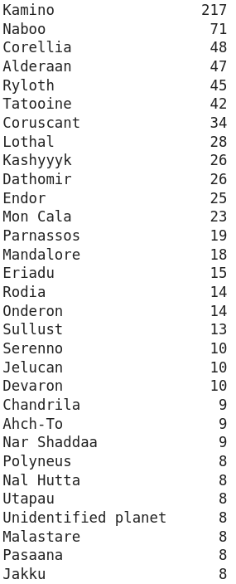
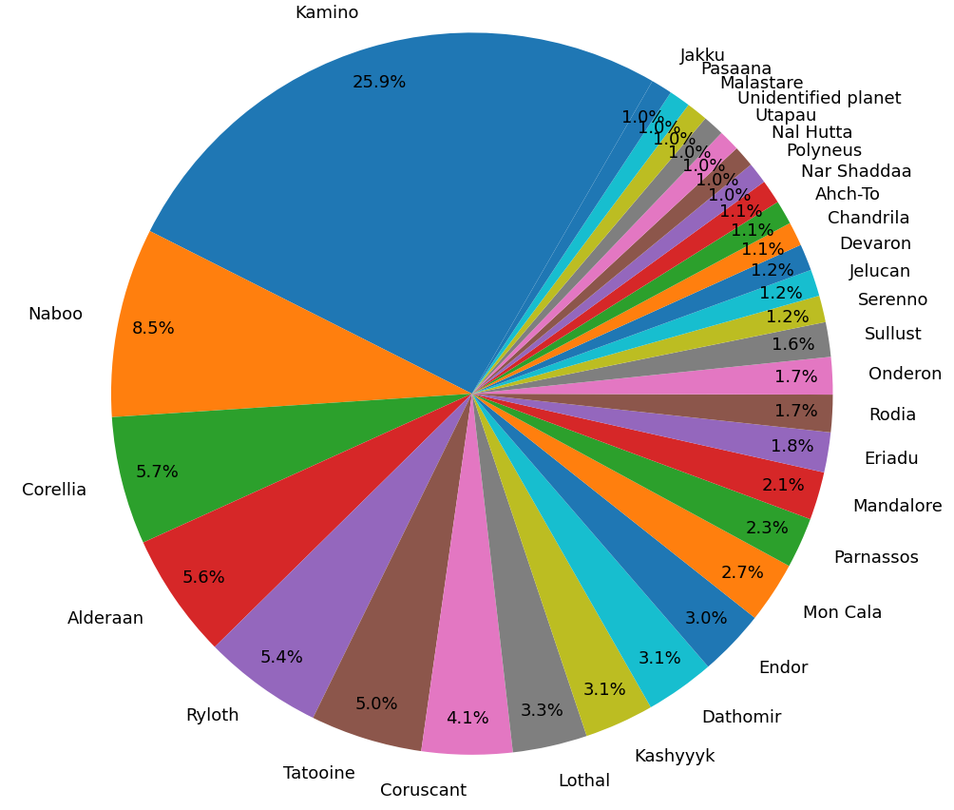

Slide 4
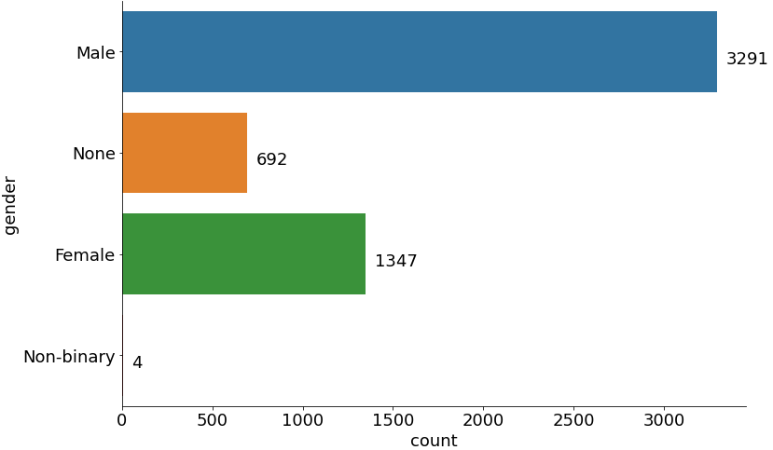

Keo Venzee

Slide 5
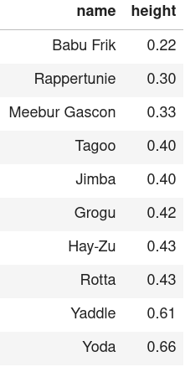
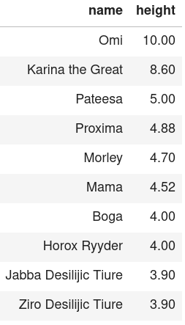
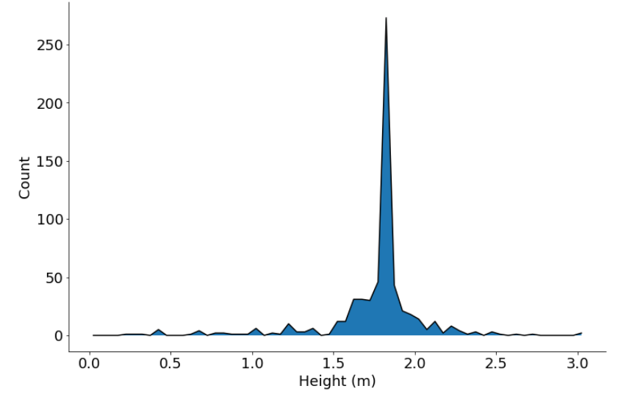


Slide 6
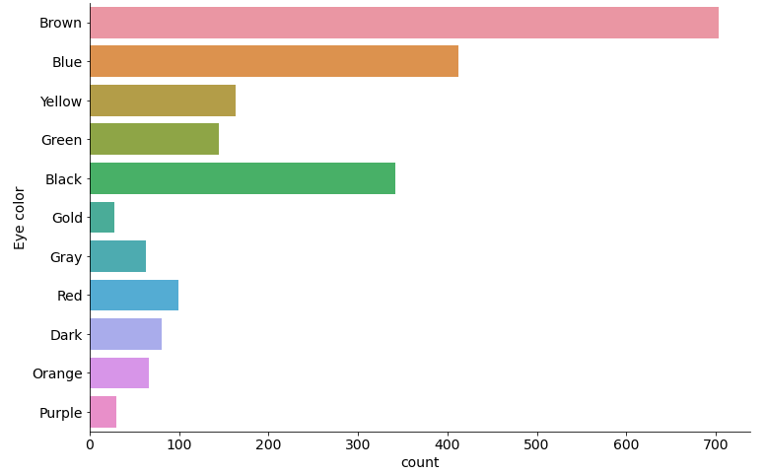
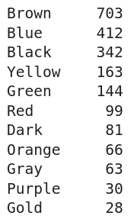

Slide 7
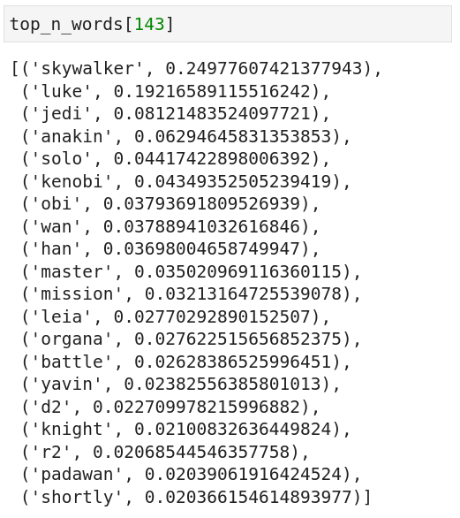
Jedi Knight
Padawan
Mission
Luke Skywalker
Anakin Skywalker
Obi-wan Kenobi
Jedi Master
Leia Organa
Han Solo
Battle of Yavin

Slide 8
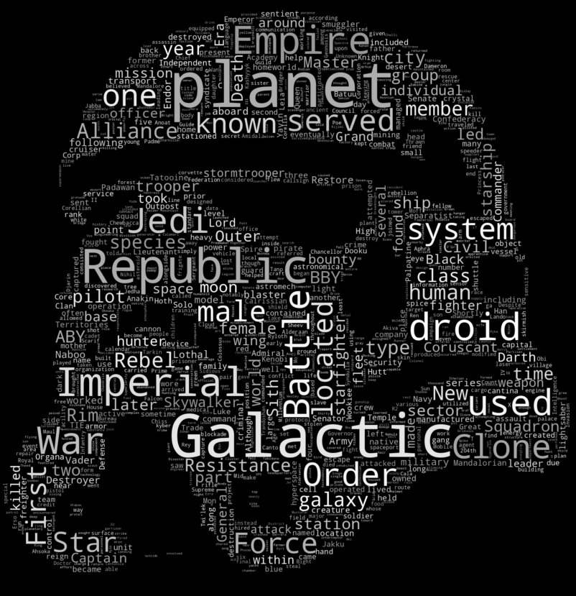
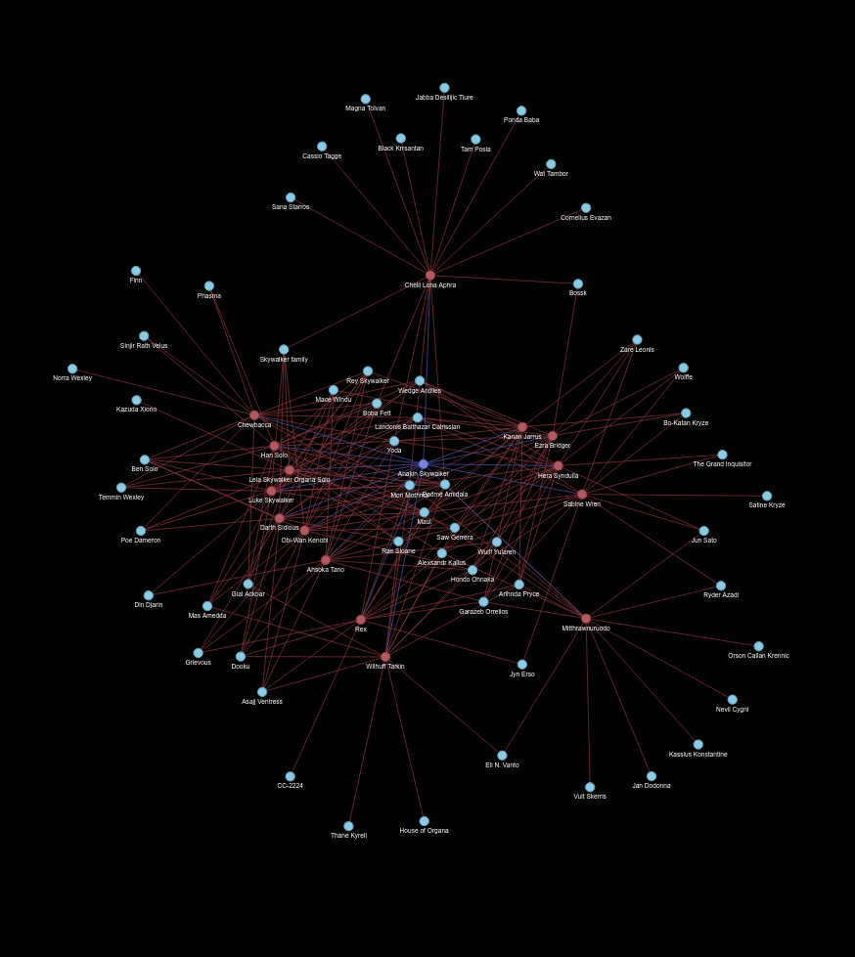
Wookieepedia data Analysis
May the fourth 2021
www.linkedin.com/in/dennisbakhuis

Slide 11
Star Wars Data Science
May the fourth 2021
www.linkedin.com/in/dennisbakhuis

