Slide 1
Design Patterns
Dennis Krupitsky, Matthew Connelly, Andrew Teterycz

Slide 2
What is a Design Pattern?
Design patterns aim to provide a solution to commonly occurring problems that programmers come across during software design
A design pattern is not similar to the functions and libraries we are provided with in a programming language, you can’t just find a piece of code and put it into your program
They are general concepts that solve particular problems, so you can use the pattern details to create a solution that accommodates your program, a pattern concept can be the same for two programs, but the code that is used will most likely be different
Its basically like you’re being handed a blueprint with the results and features of a pattern being visible, but the implementation is up to you

Slide 3
Types of Pattern Designs we will discuss
Structural Patterns : These patterns allow you to assemble objects and class into larger structures, but allow them to be flexible and efficient
- Bridge Pattern
- Adapter Pattern
Behavioral Patterns: These patterns involve algorithms, and assigning responsibilities between objects
- Observer
- Iterator
Creational Patterns: -These patterns utilize several object creation mechanisms, that allow greater flexibility and recycling of existing code
-Factory Method Pattern
-Singleton Pattern
-Prototype Pattern

Slide 4

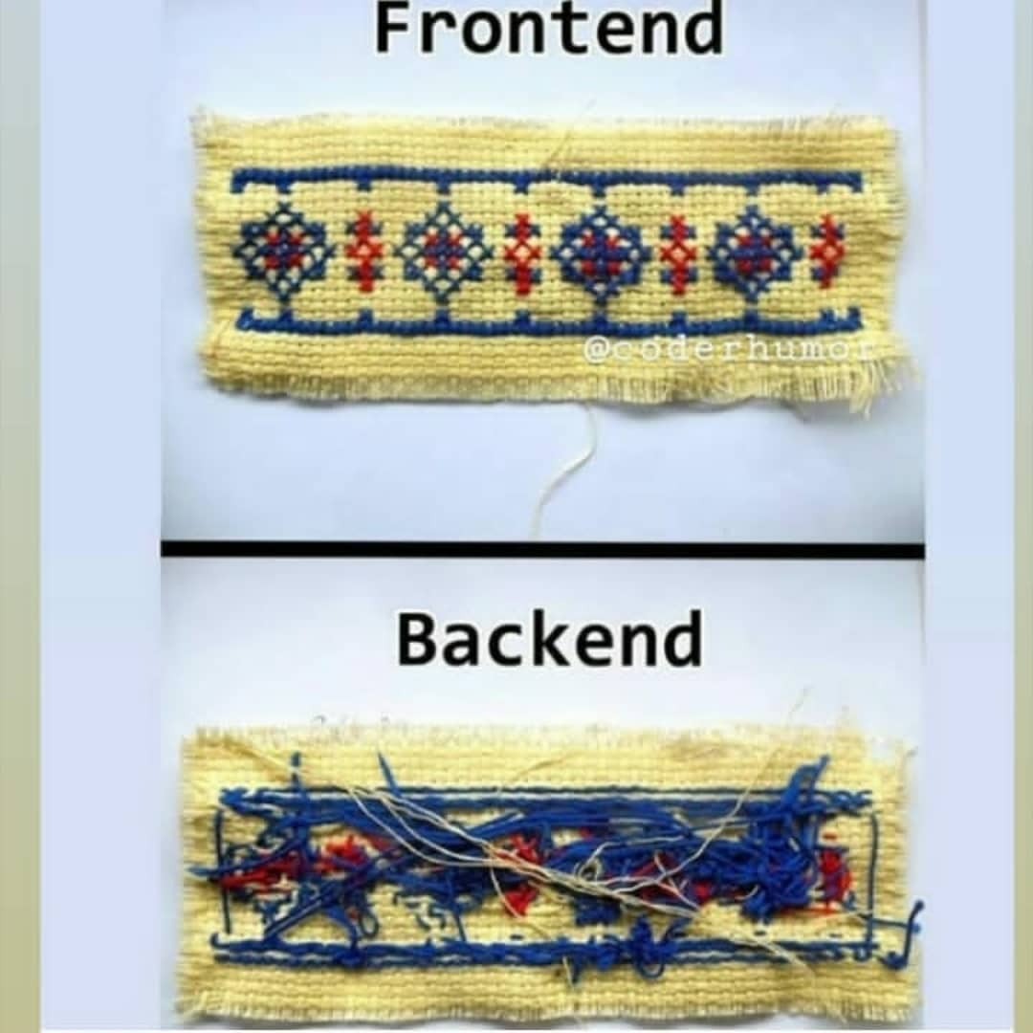
Structural Design Pattern: Bridge
Building a program or app is awesome, but as you create an app you must consider the user compatibility, along with back end functionality
This design pattern allows a large class, or set of related classes to be split into 2 hierarchies
Introducing Abstraction and Implementation as a part of the Bridge Design Pattern
Abstraction is also referred to as an interface, which allows the user to interact with program through graphical icons and visual indicators
Interfaces are not supposed to do any of the real work of the program, it is supposed to delegate that to the back end which is referred to as the implementation layer or platform
Abstraction is represented by a GUI (Graphical User Interface), and the implementation is the underlying operating system code or an API (application programming interface) which runs in response to GUI interaction

Slide 5
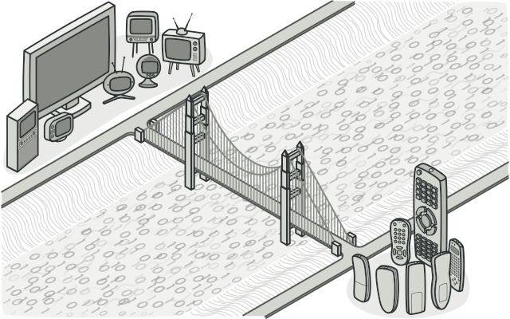
Design Pattern – Bridge ctnd.
Utilizing this method you can extend your application into two directions:
- Having multiple GUIs with the same API for different Users
- Having a GUI with multiple APIs to use the app with different
In order to keep this kind of method organized, you would implement specific interface-platform into separate classes.
It could get quite extensive as the creation of more and more GUIs and APIs would require the creation of more and more classes
The Remote/Television example is great as it demonstrates this design pattern, the TV is represented as the implementation (API) which work based on the actions of the Remote which is represented as the abstraction (GUI)
This design pattern is quite useful as you can create abstractions and implementations which can be developed independently from each other
It is also very useful as you can separate responsibilities so you don’t have huge clustered classes, as the abstraction can focus on high-level logic, and focus on platform details in the implementation

Slide 6
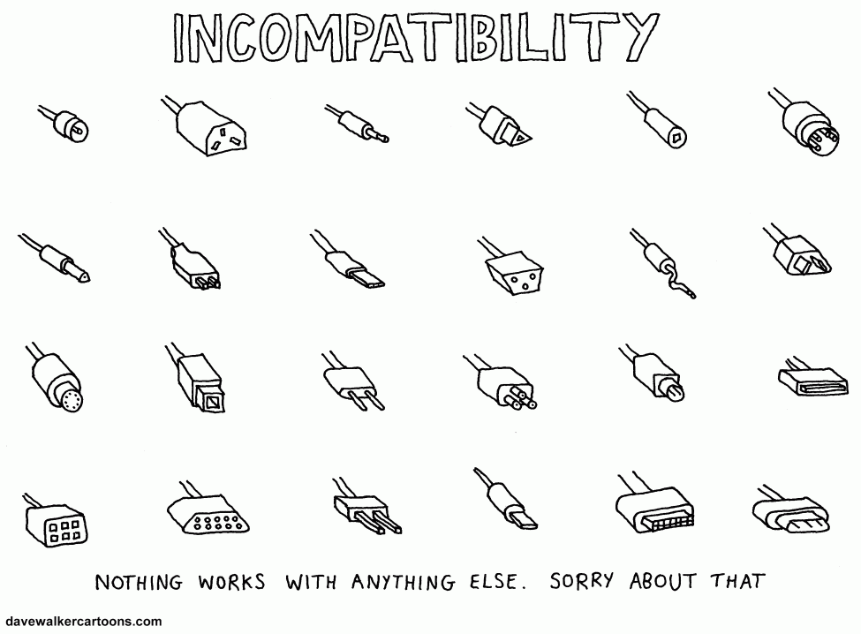
Structural Design Pattern: Adapter
When creating programs, your classes can get quite extensive, and advanced class features allow us to implement these classes to work together, but what happens when the interfaces of 2 classes are incompatible with one another
A great real life example is the experience a person has when traveling abroad to a foreign country. You are certain you’ve packed all necessitates, arrive at your destination, and boom your electronic chargers are deemed useless. What do you now need to use? You need an adapter to match the outlets in the country
You need the same thing when developing software, in order to allow one object to understand another object, you must create an adaptor that will convert its interface
It is always good to re-use code throughout your program, so you’re not reinventing the wheel every time, and this pattern allows you to basically create an abstraction that can translate an old component to work within a new system

Slide 7
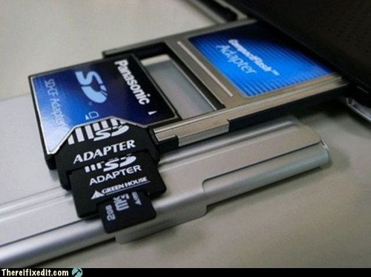
Design Pattern – Adapter ctnd.
An adapter wraps the object, so the complexity of the conversion is hidden, and the wrapped object is not aware of the adapter
An example of this is if you had an object that utilizes meters or kilometers, and you wrapped it with an adapter to convert the data into another metric unit (cm, inches, etc.) for a different object to utilize
There is a process of how an adaptor allows different interfaces to collaborate
1. The adapter has an interface that is compatible with the existing object
2. With the interface the exiting object can call the adapters methods
3. When an adapter is called, it passes the request made by the existing object to the other object, but it in the format and order that the other object expects
All things considered, adapters are very useful as they allow you to extend your code in different ways without altering it, because they serve as translators between your existing code and a legacy class, a 3rd party class or any class with a weird interface

Slide 8
Behavioral Pattern: Observer
For this pattern, there will be an object known as the subject. This will maintain a list of observers, which are objects dependent on the subject.
The observers are “interested” in any changes that may occur to the subject.
The subject is responsible for notifying observers about changes to it state.
Observers can be added to and removed from the subject’s list when they need to know about subject’s state.
Concept
Implementation
Subject
Observer
Observer
Observer
Subject
Observer
Observer
Observer

Slide 9
Behavioral Pattern: Observer ctnd.
The subject object is in control of the observer list. An observer will be added to the list through one of subject’s methods.
Each observer has an update interface. The subject can send notification data to the observer and the observer will handle the data through this interface.
Both the subject and observers can keep references to one another: the subject maintains its list and the observer keeps a reference to the subject.
An example implementation: when the subject’s state has changed, it may iterate through its observer list and implement each observer’s update interface
Subject Object
notifyObservers()
{
for(observer in observerList)
observer.update(data);
}
observerList[]
notifyObservers()

Slide 10
Behavioral Pattern: Iterator
An iterator lets you traverse a collection without exposing its underlying form; how you get from one item to the next is abstracted away.
An example would be a tree, which can be traversed depth-first (”up/down” a branch) or breadth-first (“left/right” along leaves). An iterator can be made for each of these methods and used as needed.
An iterator encapsulates all data pertaining to the traversal: where it is in the collection, how many items are left, the algorithm used and more.
Iterator
nextItem()
{
// collection-specific algorithm will be implemented here
}
Iterable Object
Collection
currentItem
nextItem()
prevItem()

Slide 11
Behavioral Pattern: Iterator contd.
Iterators are meant to work with any type of collection, provided the collection can facilitate the given method of iteration.
This makes for reusable client code: a new collection would not need to be modified if introduced, but instead a new iterator could be created.
The length or size of a collection does not need to be known ahead of time; an iterator can continue to traverse a collection until nothing is returned.
The type of the collection is not important to the iterator, but the “shape” is.
C++ Iterator:
For(auto i : container)
// operations on i
Type is inferred, method of iteration is abstracted away.

Slide 12
Creational Pattern: Factory Method
Problems that the factory method solves:
How can an object be created so that subclasses can redefine which class to instantiate?
How can a class defer instantiation to subclasses?
The Factory Method design pattern describes how to solve such problems:
Define a separate operation (factory method) for creating an object.
Create an object by calling a factory method.

Slide 13
Factory Method Pattern ctnd
This enables writing of subclasses to change the way an object is created (to redefine which class to instantiate).
Based on the type passed into the Factory object, we are returning the original concrete object as an interface.
A factory method is just an addition to a Factory class.
It creates the object of the class through interfaces but on the other hand, it also lets the subclass decide which class is instantiated.

Slide 14
Creational Pattern: Singleton
The singleton design pattern solves problems like:
How can it be ensured that a class has only one instance?
How can the sole instance of a class be accessed easily?
How can a class control its instantiation?
How can the number of instances of a class be restricted?
The singleton design pattern describes how to solve such problems:
Hide the constructor of the class.
Define a public static operation (getInstance()) that returns the sole instance of the class.

Slide 15
Singleton Pattern ctnd
Common uses:
The abstract factory, builder, and prototype patterns can use singletons in their implementation.
Facade objects are often singletons because only one facade object is required.
State objects are often singletons.
Singletons are often preferred to global variables because:
○ They do not pollute the global namespace (or, in languages with nested namespaces, their containing namespace) with unnecessary variables.
○ They permit lazy allocation and initialization, whereas global variables in many languages will always consume resources.

Slide 16
Creational Pattern: Prototype
How can objects be created so that which objects to create can be specified at run-time?
How can dynamically loaded classes be instantiated?
Creating objects directly within the class that requires (uses) the objects is inflexible because it commits the class to particular objects at compile-time and makes it impossible to specify which objects to create at run-time.
Define a Prototype object that returns a copy of itself.
Create new objects by copying a Prototype object.
This enables configuration of a class with different Prototype objects, which are copied to create new objects, and even more, Prototype objects can be added and removed at run-time.

Slide 17
References:
Design Patterns: Refactoring Guru (2014-2019): https://refactoring.guru/design-patterns/adapter
Learning JavaScript Design Patterns (Vol. 1.7.0): https://addyosmani.com/resources/essentialjsdesignpatterns/book/
http://designpattern.co.il/Factory.html
http://w3sdesign.com/?gr=c03&ugr=proble#gf
http://w3sdesign.com/?gr=c04&ugr=proble

