Slide 1
11.08.2020
The Impact of Variance on
Black-Scholes Model
Risk Management
Thomas Zellerer
Dennis Blaufuss | Sergen Bayraktar | Sebastian Kokich
Walter-Hesselbach-Straße 54 | Schillerstr. 65 | Buchholzerstr. 20
60389 Frankfurt am Main | 63329 Egelsbach | 56154 Boppard
1200621 | 1178960 | 1214646

Slide 2
Contents
Theoretical Background | Black-Scholes Model
Theoretical Background | Greeks
Estimation Strategies
Setting
Analysis

Slide 3
Theoretical Background
Black-Scholes Model – Asset Assumptions
European-type option
Riskless asset with constant rate of return
Asset
Random walk of return rate
No dividends

Slide 4
Theoretical Background
Black-Scholes Model – Market Assumptions
Frictionless
Borrow anytime at risk free rate
Market
Absence of arbitrage opportunities

Slide 5




Theoretical Background
Black-Scholes Model – Formulas
Black-Scholes Equation
$$\frac{∂V}{∂t}=rV−S\frac{∂V}{∂S}−\frac{σ^{2}S^{2}}{2}∙\frac{∂^{2}V}{∂S^{2}}$$
Call-price
Put-price
$$S∙N\left(d_{1}\right)−E∙N(d_{2})∙e^{−rt}$$
$$E∙e^{−rt}∙N\left(−d_{2}\right)−S∙N(−d_{1})$$
V = Value of option
S = stock price
N = cumulative standard normal distribution
E = excercising price
r = riskless rate of return
t = time until maturity date
e = natural exponential function
With:
$$d_{1}=\frac{ln(\frac{S}{E})+(r+\frac{σ^{2}}{2})∙t}{σ∙\sqrt{t}}$$
$$d_{2}=d_{1}−σ∙\sqrt{t}$$

Slide 6
Contents
Theoretical Background | Black-Scholes Model
Theoretical Background | Greeks
Estimation Strategies
Setting
Analysis

Slide 7
Theoretical Background
Greeks
Greeks
First-order Greeks
Second-order Greeks
Using partial derivation, certain variables can be determined
These variabls are called greeks
There are two types of greeks:
First-order Greeks
Second-order Greeks
measure how the value of an option changes when one of the parameters affecting the option price changes
measure how the value of a first order Greek changes when one of the parameters affecting the option price changes

Slide 8
Theoretical Background
First- and Second-order Greeks
Delta
Rho
Greeks
Vega
Theta
Gamma

Slide 9

Theoretical Background
Greeks – Vega
Vega
measures the sensitivity of the option price to volatility
Volatility
The higher the volatility in the underlying, the more value an option has
Formula
$v_{CALL,PUT}=\frac{∂CALL}{∂σ}=\frac{∂PUT}{∂σ}=\frac{S\sqrt{\frac{t}{2π}}}{ⅇ \frac{{d_{1}}^{2}}{2}}$
Maturity
Sensitivity also depends on the expiration date
The shorter the time to maturity, the lower the Vega

Slide 10
Contents
Theoretical Background | Black-Scholes Model
Theoretical Background | Greeks
Estimation Strategies
Setting
Analysis

Slide 11

Estimation Strategies
Historical Volatility – General
What is it?
How is it calculated?
Statistical measure of realized returns´ spread over a period of time
Indicator for risk
Averaged Returns (µ) Standard Deviation (ℴ)
Maximum Likelihood Formula: $$f\left(x(1),x(2),…,x(n) ⃒ℴ, µ \right)=\prod_{i=1}^{n}{\frac{1}{ ℴ\sqrt{2π}}e^{−\frac{({x\left(i\right)−µ)}^{2}}{{2ℴ}^{2}}}}$$
Averaged Returns: $$µ=\frac{\sum_{i=1}^{n}{r(i)}}{n}$$
Standard Deviation: $$ℴ=\sqrt{\frac{\sum_{i=1}^{n}{{\left(r\left(i\right)−µ\right)}^{2}}}{n}}$$

Slide 12
Estimation Strategies
Historical Volatility – Assessment
Good comparison
Simple
Constant volatility only usefull for short-term maturities
Standard Error
Advantages
Markets possibly change suddenly
Large considered sample
Disadvantages

Slide 13
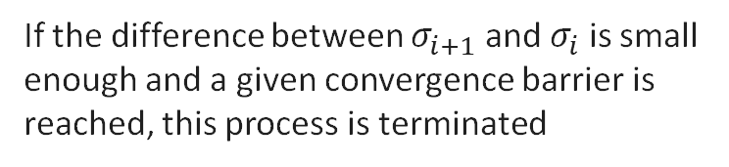

Estimation Strategies
Implied Volatility
Implied volatility is the expected fluctuation margin of the underlying of an option
First a value for the implied volatility is estimated. Then the Vega is used to achieve a progressive approximation of the actual implied volatility
when markets rise, volatility falls and when market falls, values rise
$$σ_{i+1}=\frac{σ_{i}−C\left(σ_{i}\right)−C_{m}}{\frac{∂C}{{∂σ}_{i}}}$$
The implied volatility can be calculated using the Newton/Raphson method
If the difference between $σ_{i+1}$ and $σ_{i}$ is small enough and a given convergence barrier is reached, this process is terminated

Slide 14
Contents
Theoretical Background | Black-Scholes Model
Theoretical Background | Greeks
Estimation Strategies
Setting
Analysis

Slide 15



Setting
Stockdata of Apple Inc. 2010 – today
Annualialized volatility based on previous 250 trading days
Chicago Board Options Exchange‘s volatility index of S&P 500 VIX
Retrieving data via quantmod in R from yahoo finance
Strike of option is value of underlying at time of issue
Riskfree rate is assumed to be 1% flat

Slide 16
Contents
Theoretical Background | Black-Scholes Model
Theoretical Background | Greeks
Estimation Strategies
Setting
Analysis

Slide 17
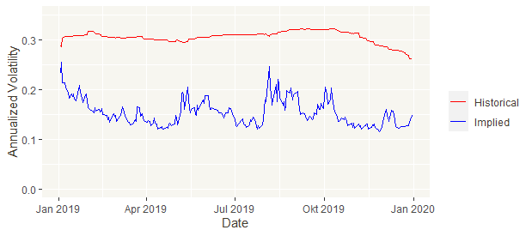
Analysis
Annualized volatility
Welch‘s T-test: significant difference in means

Slide 18
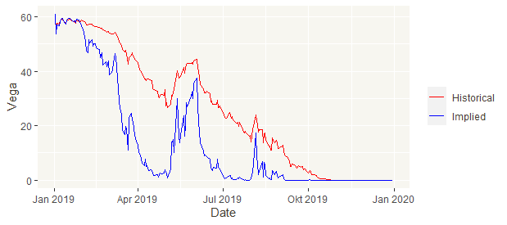
Analysis
Vega
Welch‘s T-test: significant difference in means

Slide 19
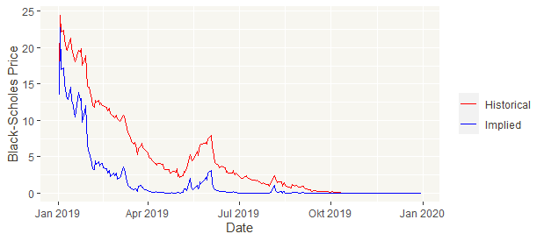
Analysis
Black-Scholes prices for put option
Welch‘s T-test: significant difference in means

Slide 20
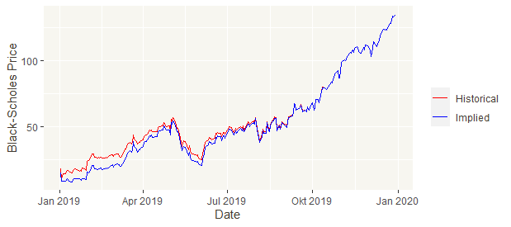
Analysis
Black-Scholes prices for call option
T-test: NO significant difference in means

Slide 21
Analysis
Black-Scholes pricing conspicuousness
Conspicuousness
Thoughts
Solution
Put prices are significantally different
Call prices are NOT
Is Put-Call-parity still given?
Testing for historical and implied volatility
Fullfilled
Closer look to y-achsis
Call option strongly in the money
Thus small changes have less impact

Slide 22
11.08.2020
Dennis Blaufuss | Sergen Bayraktar | Sebastian Kokich
Walter-Hesselbach-Straße 54 | Schillerstr. 65 | Buchholzerstr. 20
60389 Frankfurt am Main | 63329 Egelsbach | 56154 Boppard
1200621 | 1178960 | 1214646

