Slide 1
Progress on the GEM-TPC Project
Dennis Feng

Slide 2
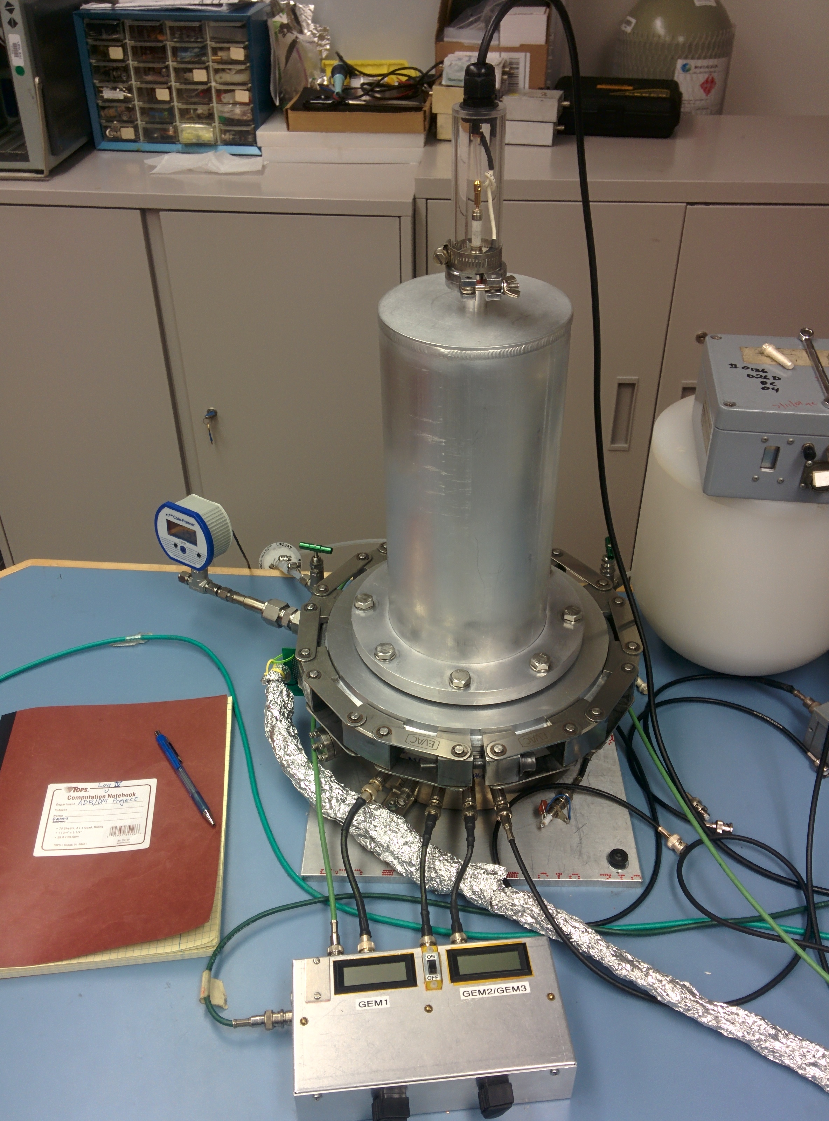
The GEM-TPC Project
End goal: Use our TPC (time projection chamber) for directional detection of WIMPs (dark matter)
  First, preliminary sources (cosmic rays, neutrons): calculate direction & energy from gathered data (position, ToT, width of the track)

Slide 3
Review on how it works
Side View of Test Vessel
ArCO2 gas
Electric field
inside test
vessel
Two GEMs
FE-I4 Chip

Slide 4
Review on how it works
Side View
Hits on FE-I4
row
FE-I4 Chip
col

Slide 5
Review on how it works
Side View
Hits on FE-I4
FE-I4 Chip

Slide 6
Review on how it works
Side View
Hits on FE-I4
FE-I4 Chip

Slide 7
Review on how it works
Side View
Hits on FE-I4
FE-I4 Chip

Slide 8
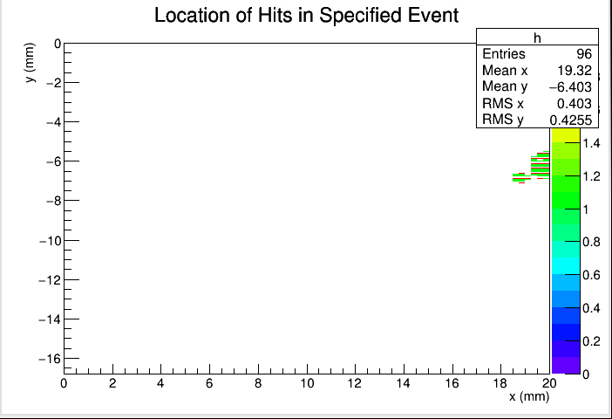
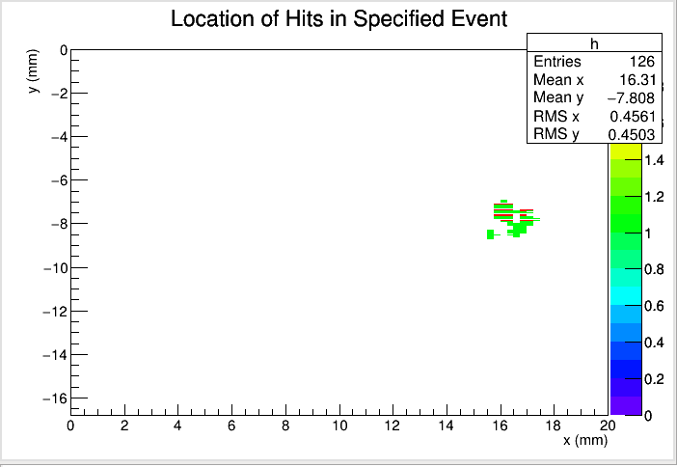
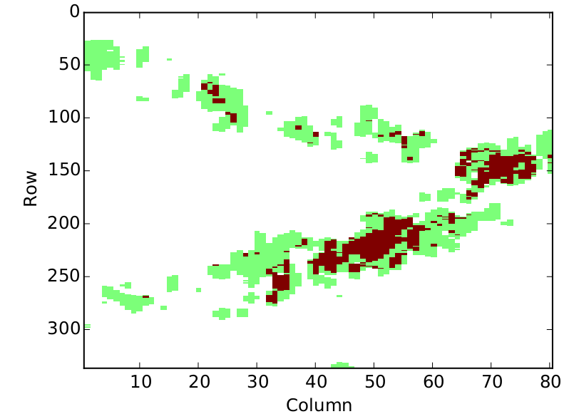
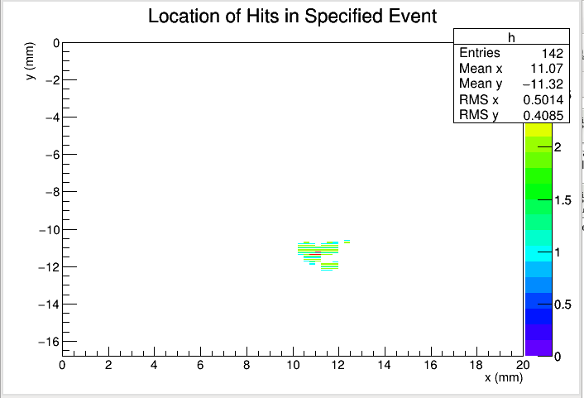
Progress from last time
Last time:
  DAQ working properly
  2D occupancy plot of events
  Time slices of each event
Fig 2: Progressing time slices of a single event
Fig 1: 2D occupancy plot

Slide 9
Progress from last time
Progress:
  3D reconstruction of events
  Best fit line (least chi-square) to fit each track
  Filter for good events
  Reorganized my code

Slide 10
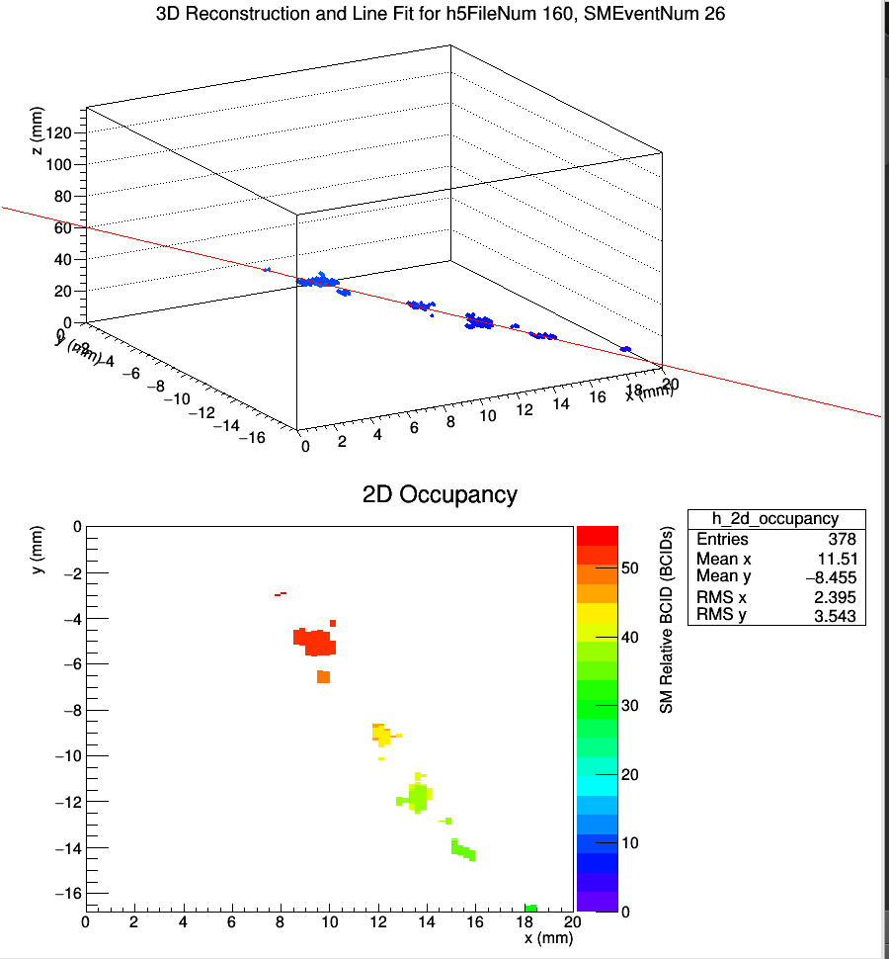
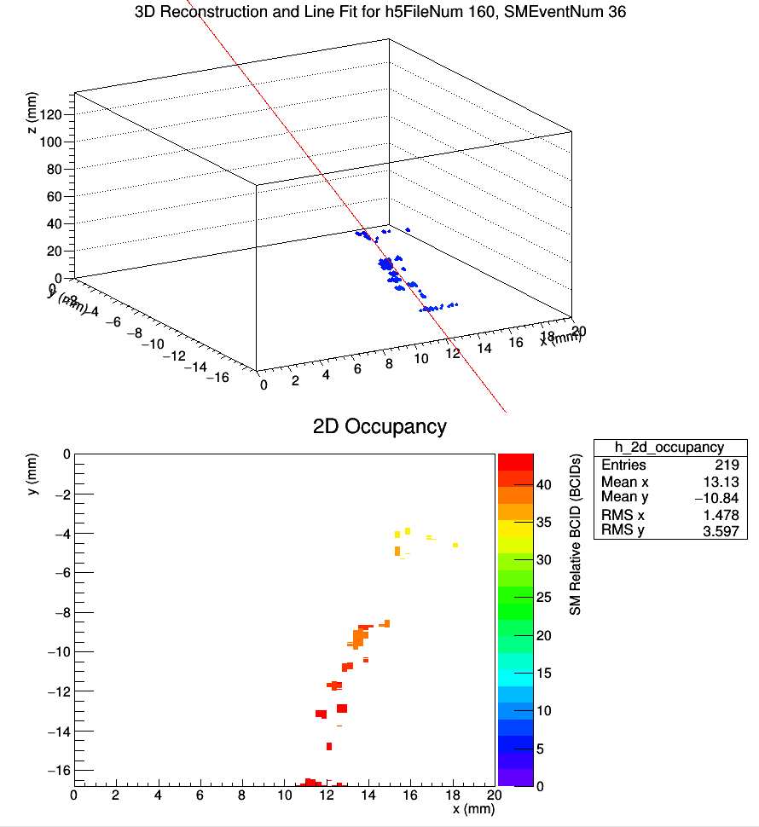
3D Reconstruction of Events
Fig 3: Examples of 3D reconstructed tracks, with best fit lines

Slide 11
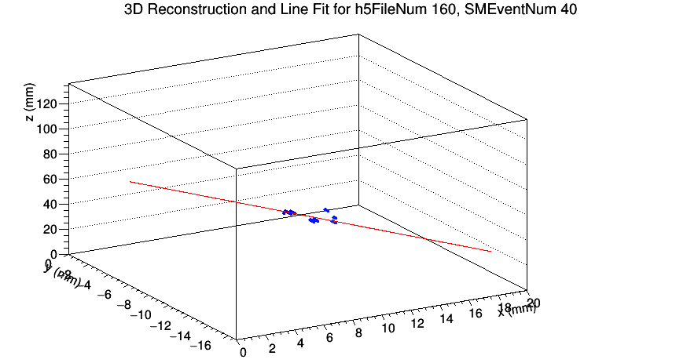
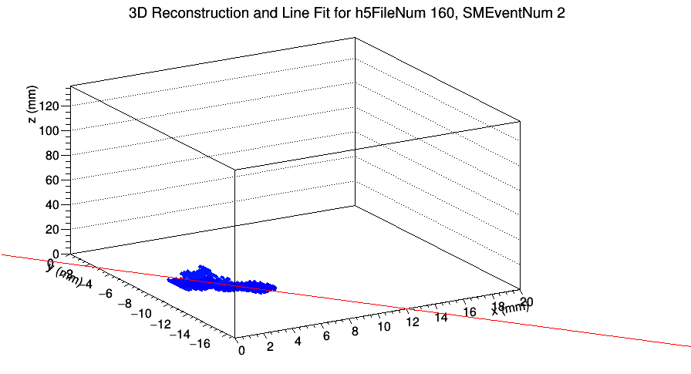
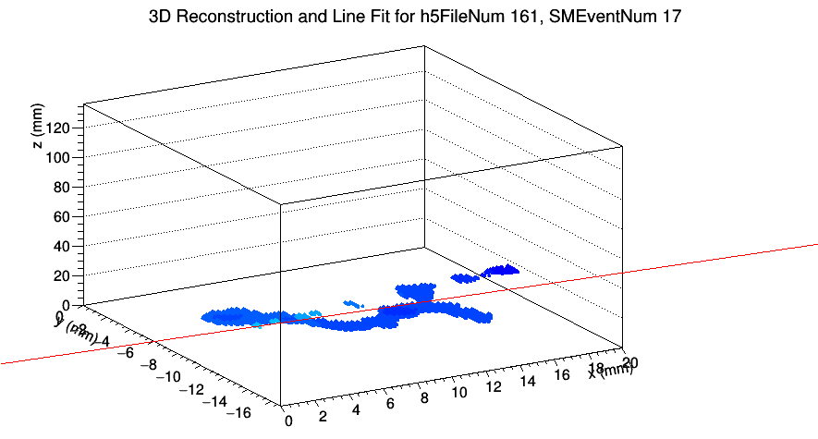
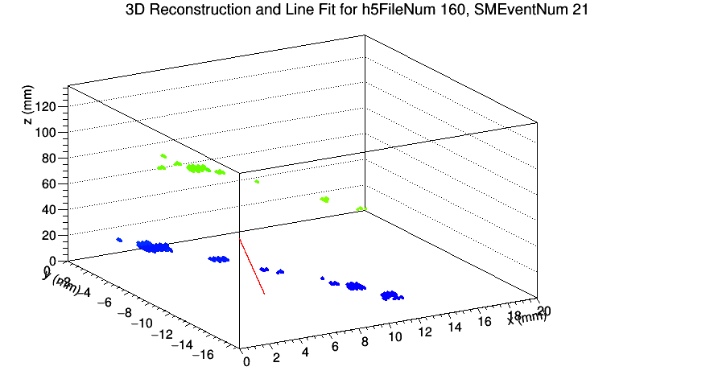
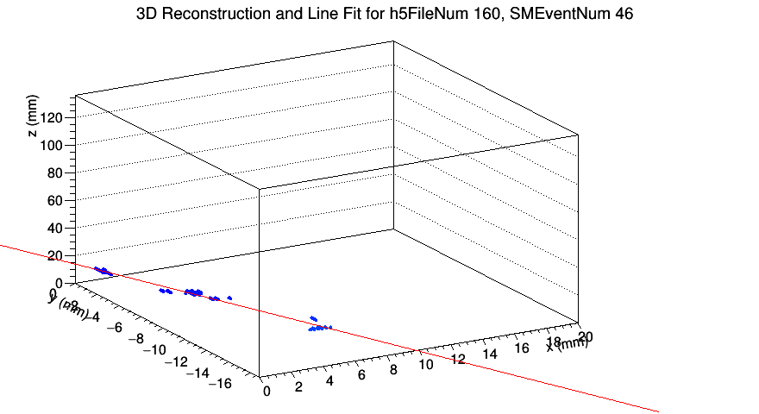
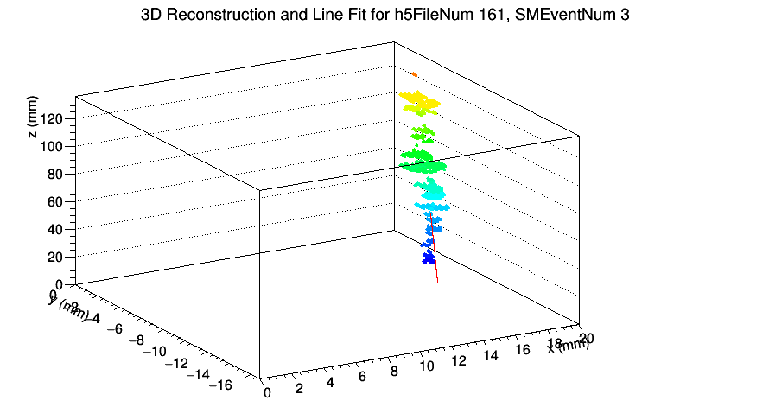
Filter with “good event” criteria
Unfiltered tracks:
Fig 4: A sample of unfiltered tracks

Slide 12
Filter with “good event” criteria
Criteria to filter out bad events:
  num_hits < 50 // might just be noise
  chi_square / DoF >= 0.5 // hits are relatively close to best fit line
  length_track < 5.0 // minimum length

Slide 13
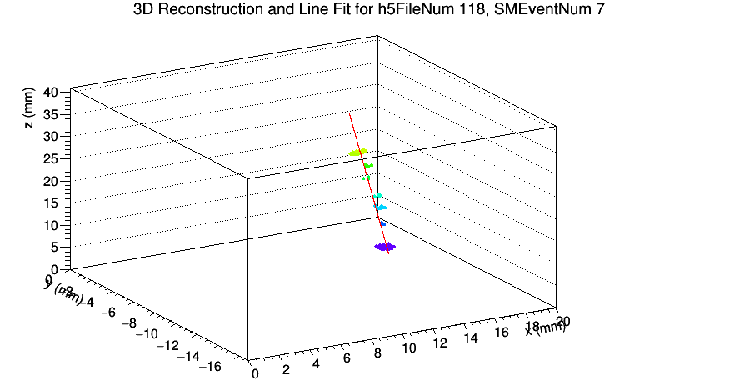
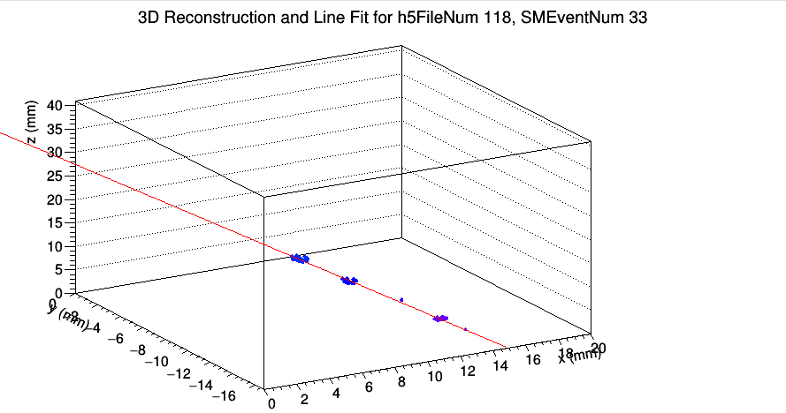
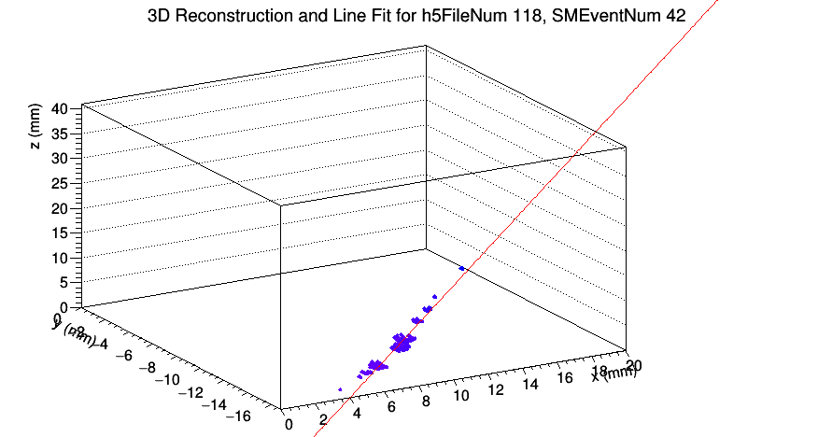
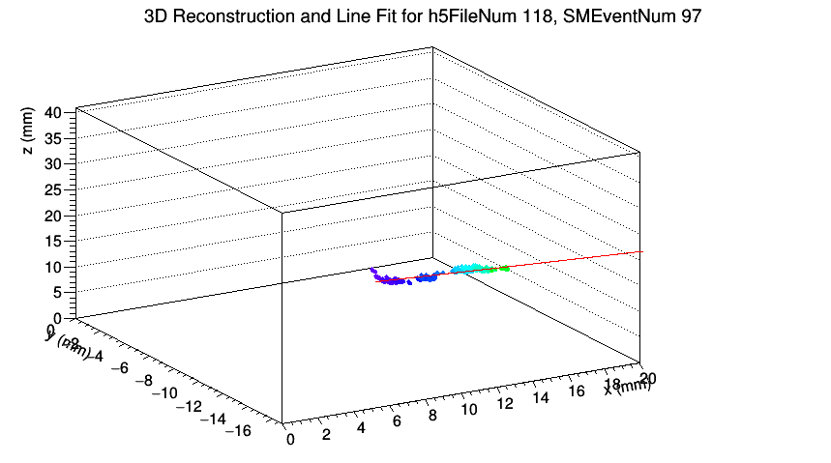
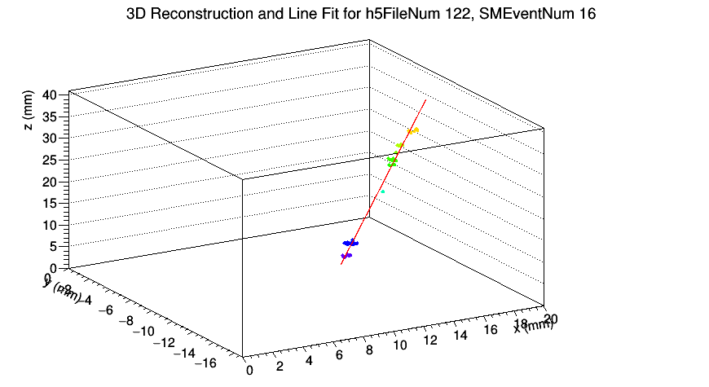
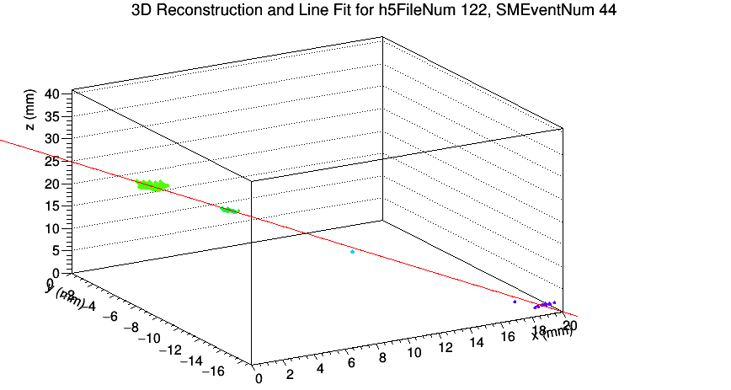
Filter with “good event” criteria
Filtered tracks:
Fig 5: A sample of filtered tracks

Slide 14
Current Work
Studying the diffusion of the tracks to figure out the absolute z-position
  Without this, we can only know the relative z-positions (relative to the first hit of the track) of the hits, and not the absolute z-positions (relative to the bottom of the TPC)

Slide 15
Diffusion of the tracks
As an electron cluster drifts downward through the gas, random walk causes the cluster to increase in size and become more diffuse
We can relate the increase in size with the distance the cluster traveled (aka the absolute z-position)

Slide 16
Diffusion of the tracks
3D View of Chip and Electron Cluster
2D Top View of the FE-I4
FE-I4

Slide 17
Diffusion of the tracks
3D View of Chip and Electron Cluster
2D Top View of the FE-I4
FE-I4

Slide 18
Diffusion of the tracks
3D View of Chip and Electron Cluster
2D Top View of the FE-I4
FE-I4

Slide 19
Diffusion of the tracks
3D View of Chip and Electron Cluster
2D Top View of the FE-I4
FE-I4

Slide 20
Diffusion of the tracks
3D View of Chip and Electron Clusters
at the Initial Time
Readout of the Event
(Occupancy Plot)
Readout
Note: The clusters on the left drift less
distance than clusters on the right,
so the readout occupancy shows
that the left clusters are smaller.
FE-I4

Slide 21
Analysis of Diffusion
Break each track into 2 mm segments
Find RMS of d for each segment
Plot RMS of d vs drift distance (z)
  Hopefully, we'll be able to see a trend
d
2 mm

Slide 22
Extra Slides

Slide 23
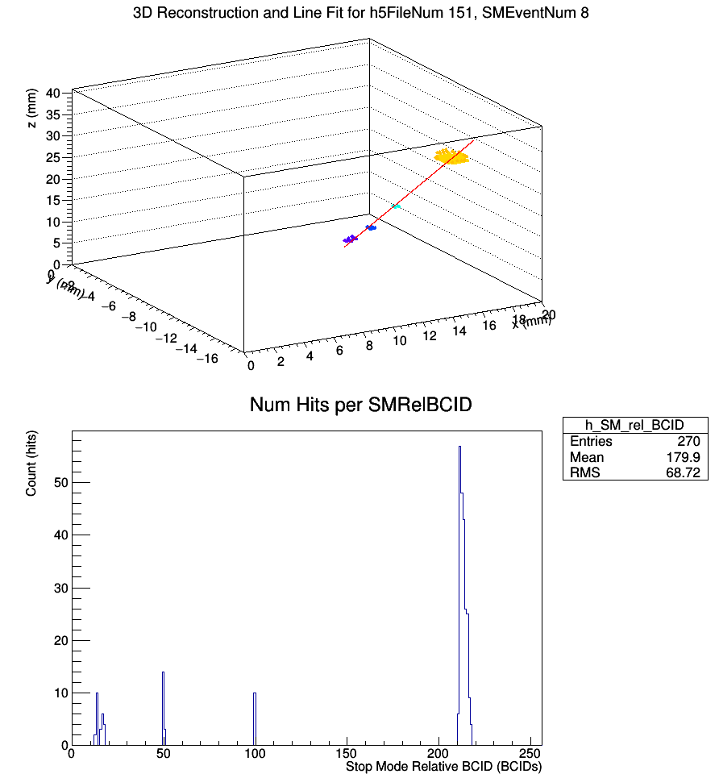
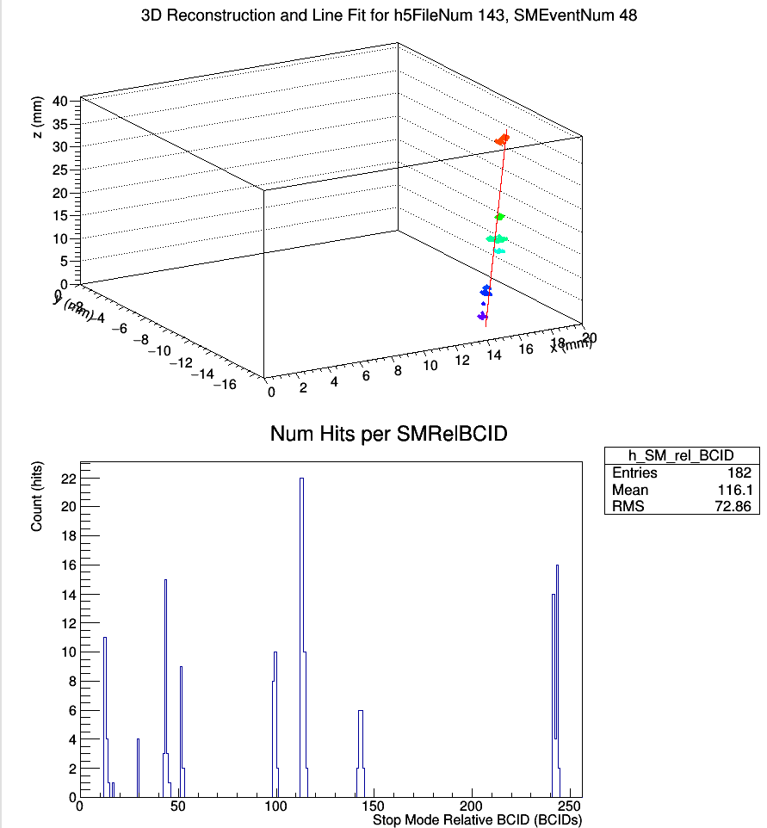
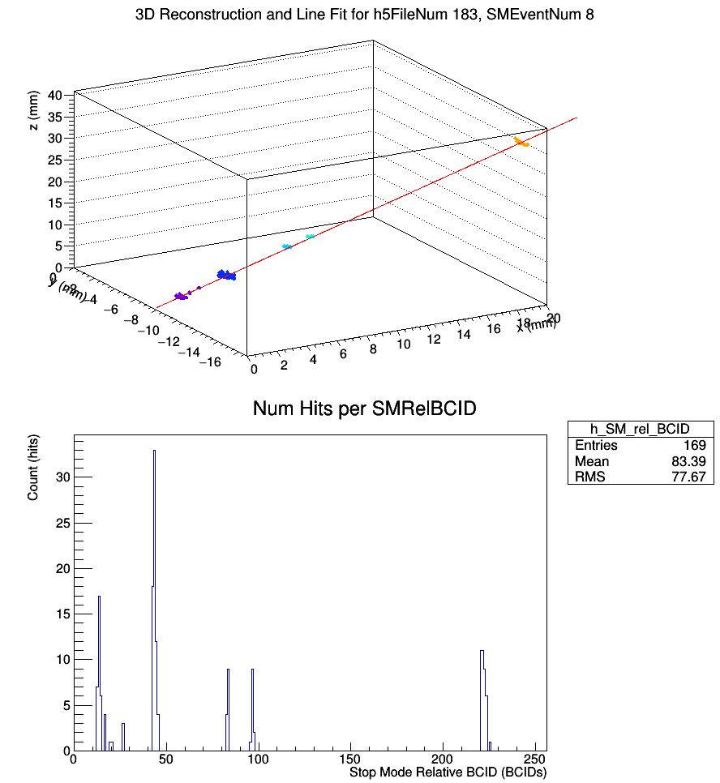
Hits vs BCID Plots
Fig 6: Hits vs BCID plots of several events

