Slide 1
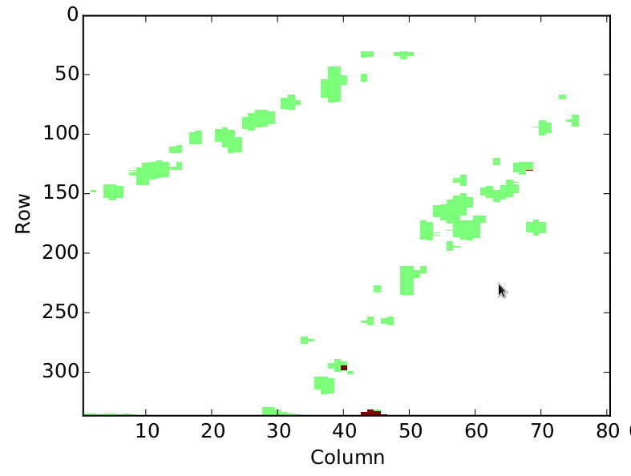
Progress: Cosmic Ray Events
Dennis Feng

Slide 2
The TPC Project
End goal: Use our TPC (time projection chamber) for directional detection of WIMPs (dark matter)
  First, preliminary sources (cosmic rays, neutrons): calculate direction & energy from gathered data (position, ToT, cluster size and spacing)

Slide 3
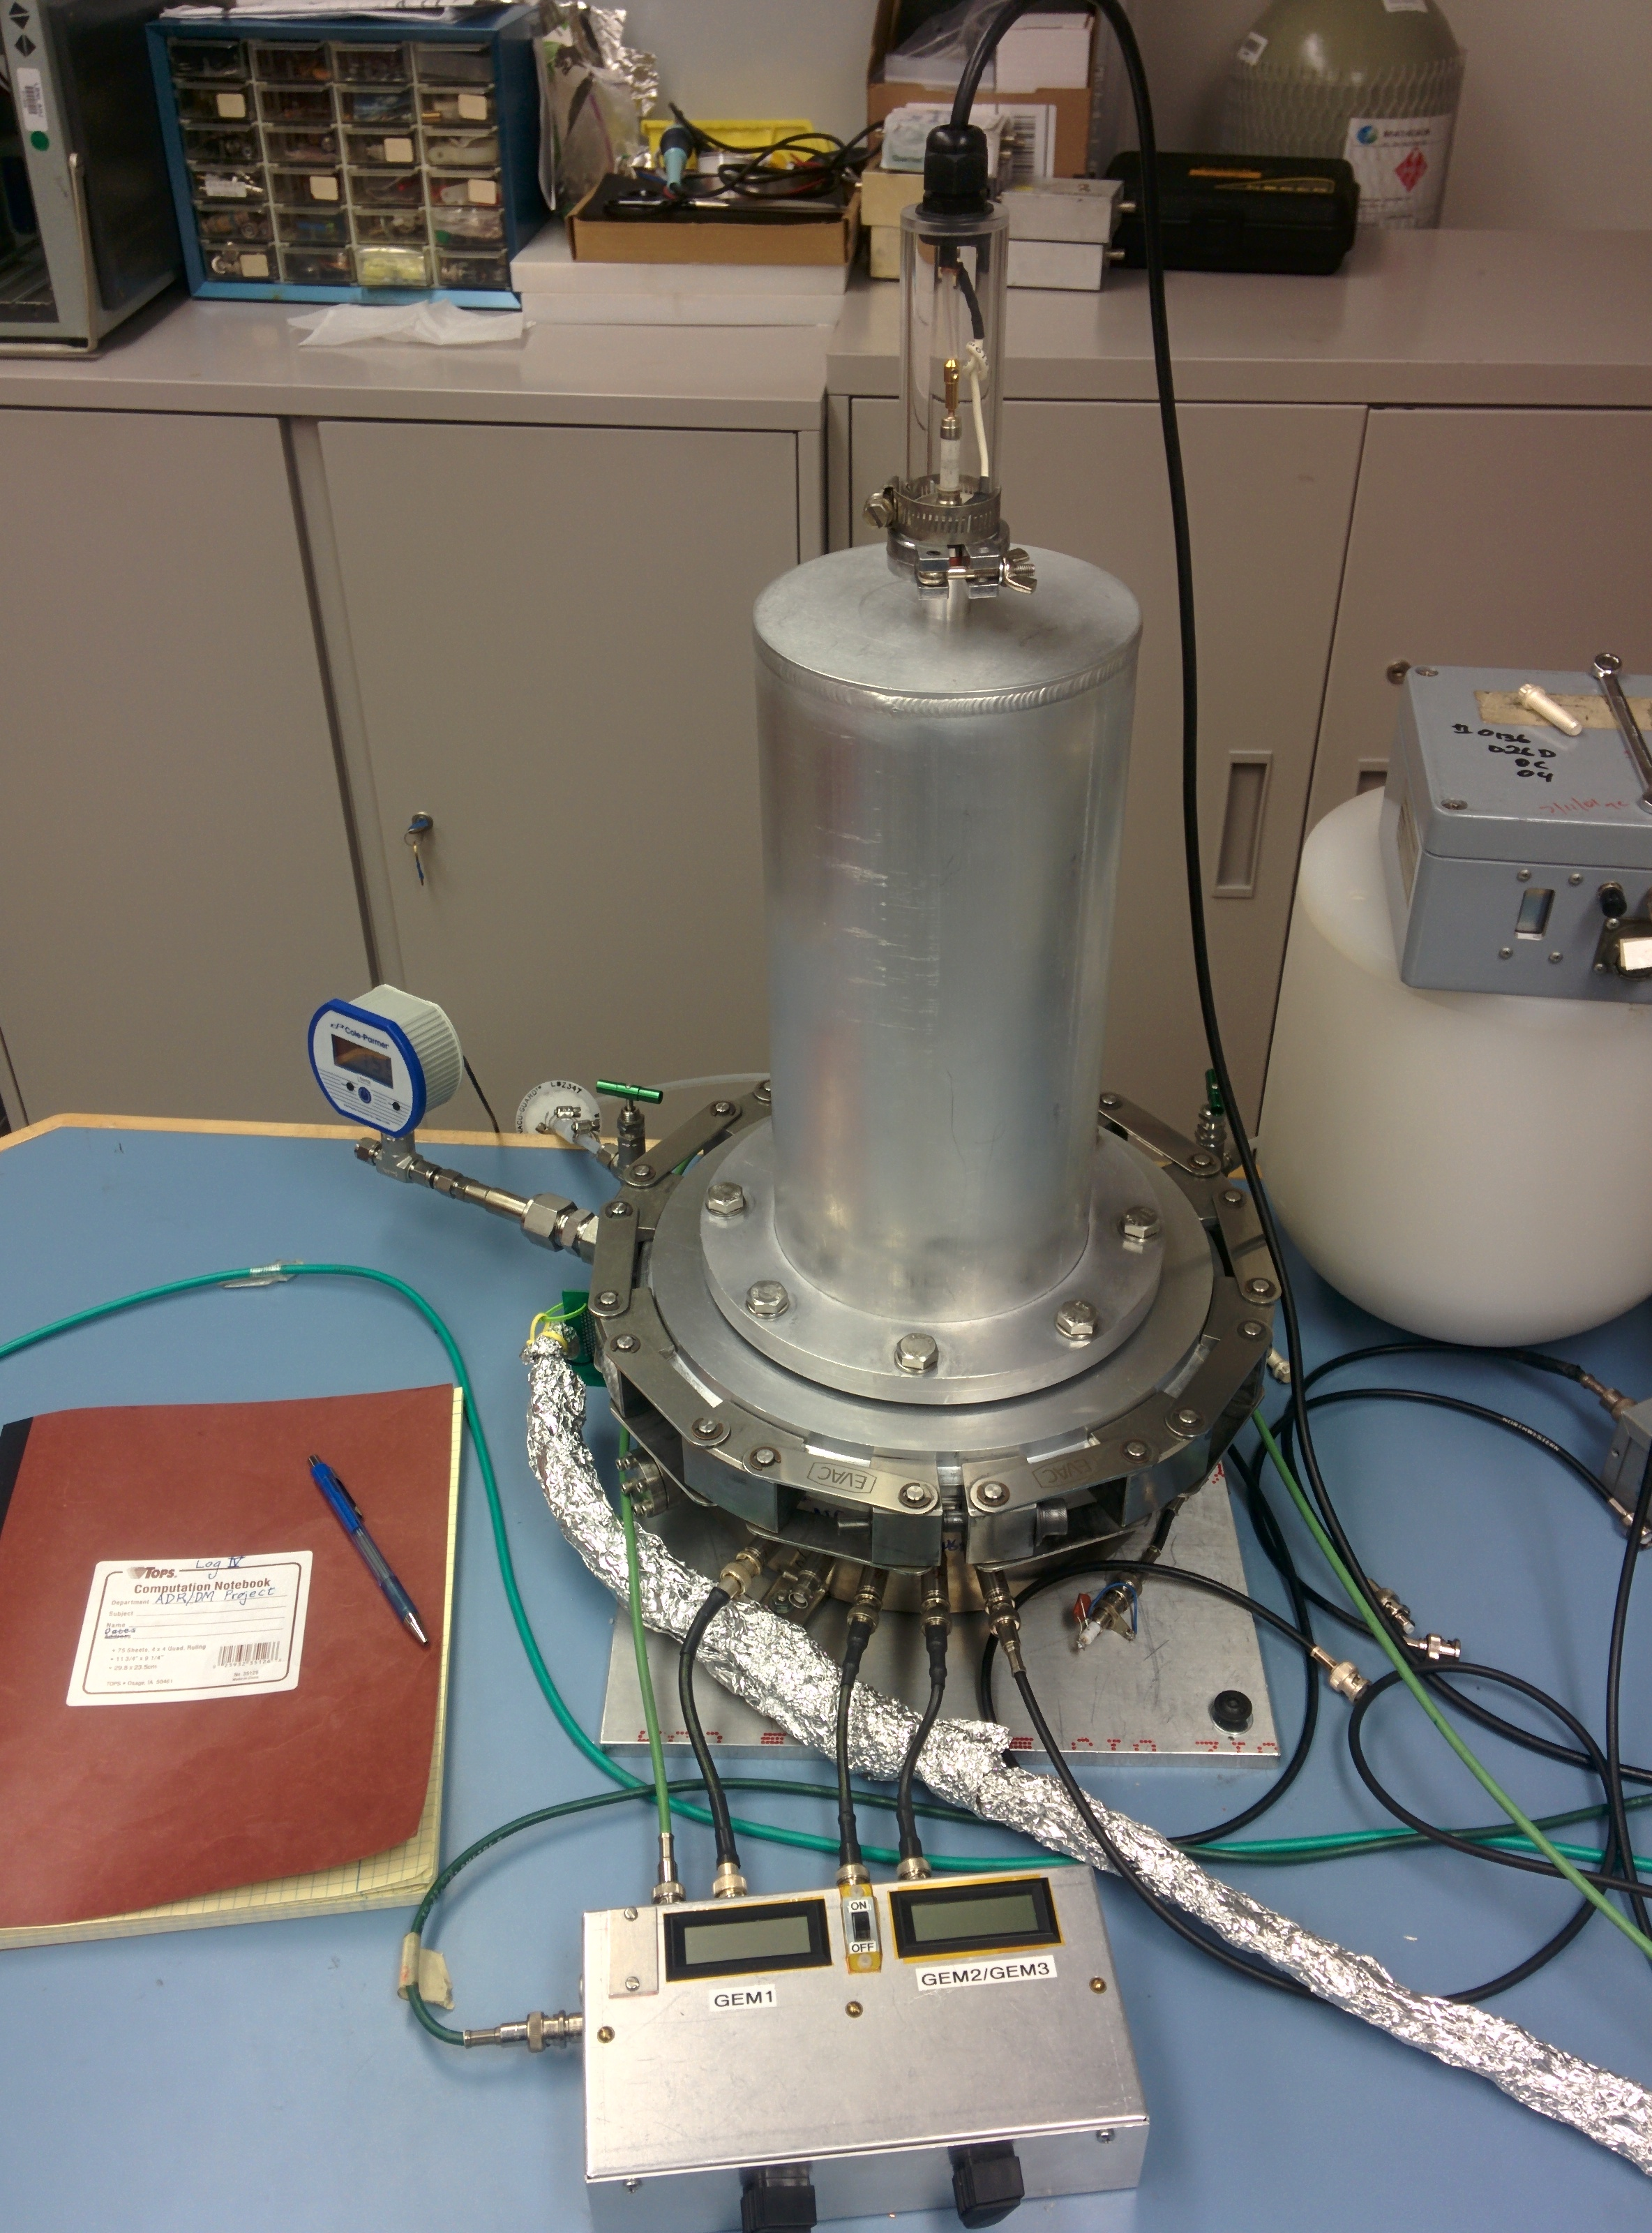
The TPC (Time Projection Chamber)

Slide 4
How the TPC works
Diagram: Side View of Test Vessel
Let's say a cosmic ray (CR) goes into test vessel
Collides w/ gas atom, so gas atom moves in certain direction, ionizing electrons along its track
Electrons drift downward in the shape of the track, and multiply via the GEMs (gas electron multiplier).
All those electrons (still in shape of track) drift to FE-I4 and are read out
*Note: Based on timing and drift velocity, we can traceback the z coordinates of hits on the track -- Therefore, we have x, y, and z!
ArCO2 gas
Electric field
inside test
vessel
Two GEMs
FE-I4 Chip

Slide 5
How the TPC works
Let's say a cosmic ray (CR) goes into test vessel
Collides w/ gas atom, so gas atom moves in certain direction, ionizing electrons along its track
Electrons drift downward in the shape of the track, and multiply via the GEMs (gas electron multiplier).
All those electrons (still in shape of track) drift to FE-I4 and are read out
*Note: Based on timing and drift velocity, we can find the z coordinates of hits on the track -- Therefore, we have x, y, and z!
ArCO2 gas
Electric field
inside test
vessel
Two GEMs
FE-I4 Chip

Slide 6
How the TPC works
Let's say a cosmic ray (CR) goes into test vessel
Collides w/ gas atom, so gas atom moves in certain direction, ionizing electrons along its track
Electrons drift downward in the shape of the track, and multiply via the GEMs (gas electron multiplier).
All those electrons (still in shape of track) drift to FE-I4 and are read out
*Note: Based on timing and drift velocity, we can find the z coordinates of hits on the track -- Therefore, we have x, y, and z!
ArCO2 gas
Electric field
inside test
vessel
Two GEMs
FE-I4 Chip

Slide 7
How the TPC works
Let's say a cosmic ray (CR) goes into test vessel
Collides w/ gas atom, so gas atom moves in certain direction, ionizing electrons along its track
Electrons drift downward in the shape of the track, and multiply via the GEMs (gas electron multiplier).
All those electrons (still in shape of track) drift to FE-I4 and are read out
*Note: Based on timing and drift velocity, we can find the z coordinates of hits on the track -- Therefore, we have x, y, and z!
ArCO2 gas
Electric field
inside test
vessel
Two GEMs
FE-I4 Chip

Slide 8
How the TPC works
Let's say a cosmic ray (CR) goes into test vessel
Collides w/ gas atom, so gas atom moves in certain direction, ionizing electrons along its track
Electrons drift downward in the shape of the track, and multiply via the GEMs (gas electron multiplier).
All those electrons (still in shape of track) drift to FE-I4 and are read out
*Note: Based on timing and drift velocity, we can find the z coordinates of hits on the track -- Therefore, we have x, y, and z!
ArCO2 gas
Electric field
inside test
vessel
Two GEMs
FE-I4 Chip

Slide 9
How the TPC works
Let's say a cosmic ray (CR) goes into test vessel
Collides w/ gas atom, so gas atom moves in certain direction, ionizing electrons along its track
Electrons drift downward in the shape of the track, and multiply via the GEMs (gas electron multiplier).
All those electrons (still in shape of track) drift to FE-I4 and are read out
*Note: Based on timing and drift velocity, we can find the z coordinates of hits on the track -- Therefore, we have x, y, and z!
ArCO2 gas
Electric field
inside test
vessel
Two GEMs
FE-I4 Chip

Slide 10
My Part
My part: currently working on software and DAQ
  Putting raw data in a format (ROOT TTree) that allows for easier calculation
    Calc z from relative_BCID (timing)
  Making scripts for looking at events (via histograms) and for analysis

Slide 11
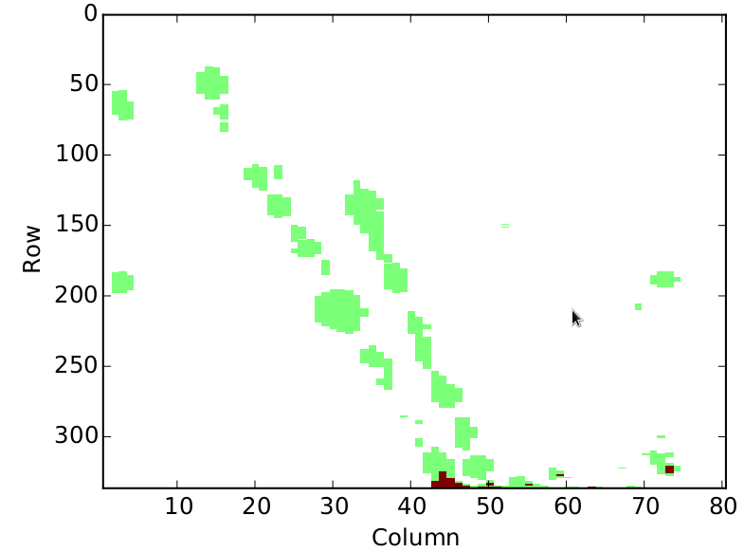
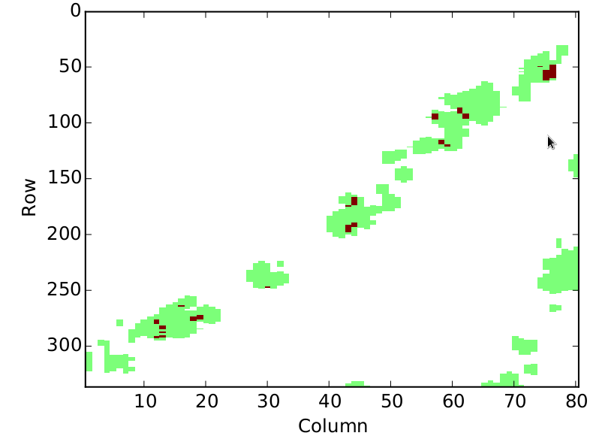
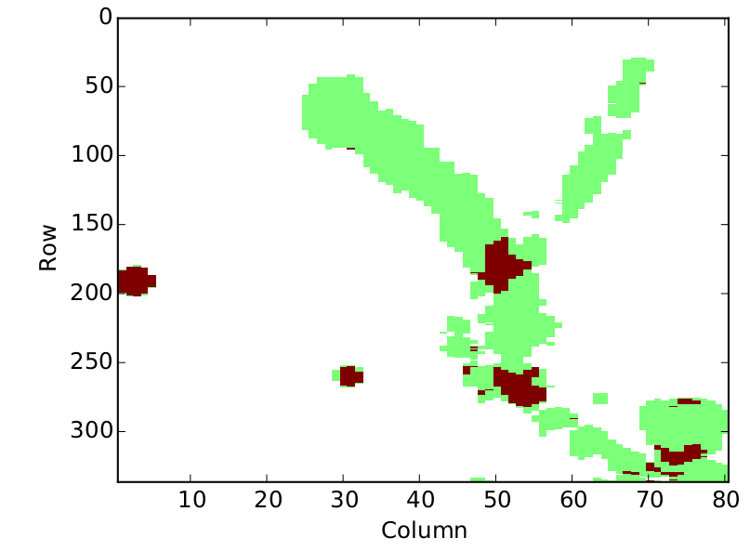
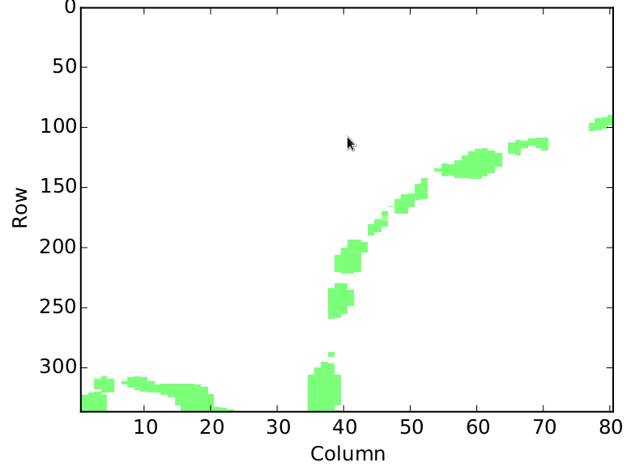
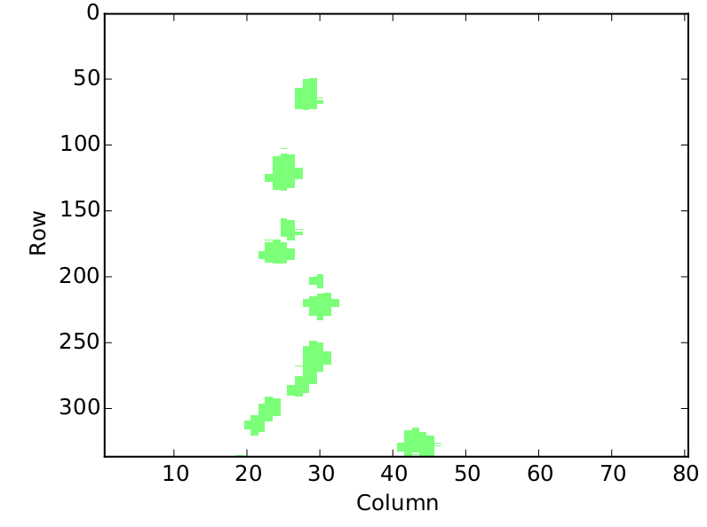
Examples of Cosmic Ray Events
775
2D Histograms: Hits on the FE-I4 for each scan
module_test 384
750
378
909
223

Slide 12
Event Viewer Intro
Side View
Hits on FE-I4
row
FE-I4 Chip
col

Slide 13
Event Viewer Intro
FE-I4 Chip

Slide 14
Event Viewer Intro
FE-I4 Chip

Slide 15
Event Viewer Intro
FE-I4 Chip

Slide 16
Event Viewer Intro
FE-I4 Chip

Slide 17
Event Viewer Intro
FE-I4 Chip

Slide 18
Event Viewer Intro
FE-I4 Chip

Slide 19
Event Viewer Intro
FE-I4 Chip

Slide 20
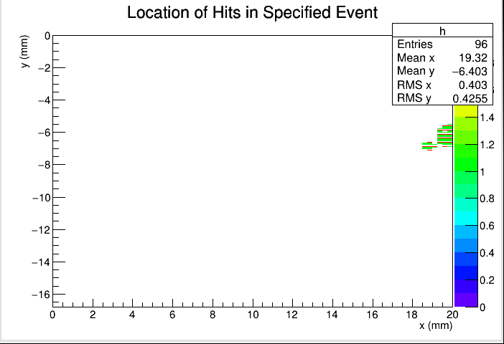
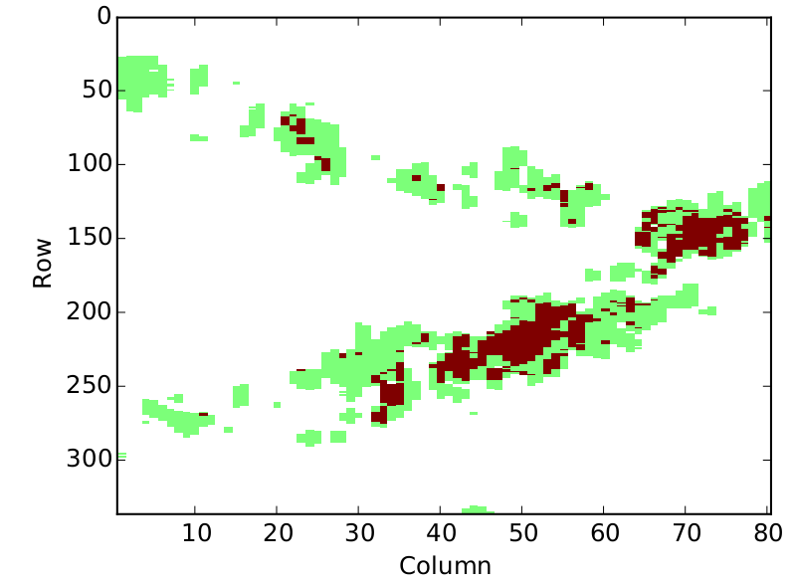
Event Viewer
module_test 745

Slide 21
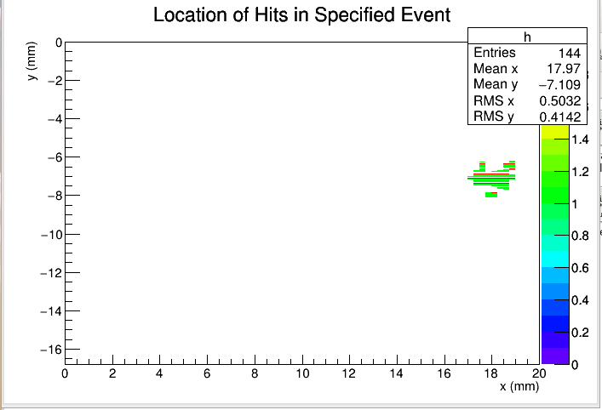
Event Viewer

Slide 22
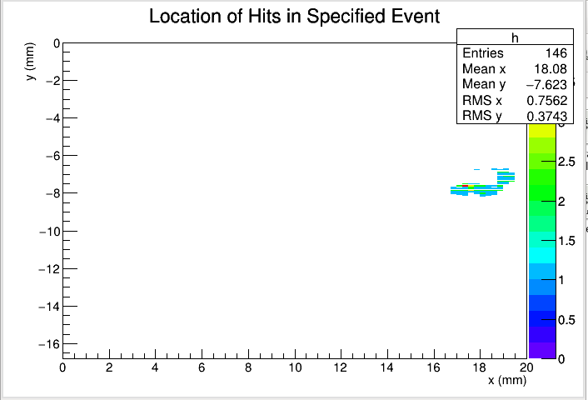
Event Viewer

Slide 23
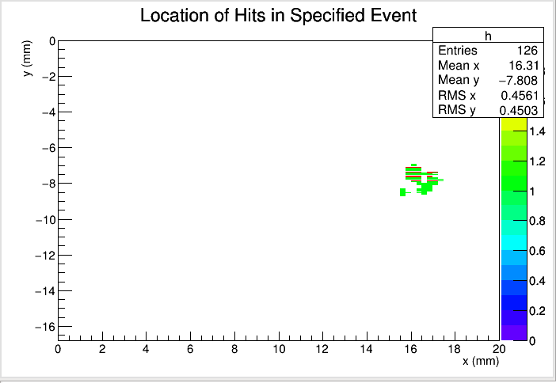
Event Viewer

Slide 24
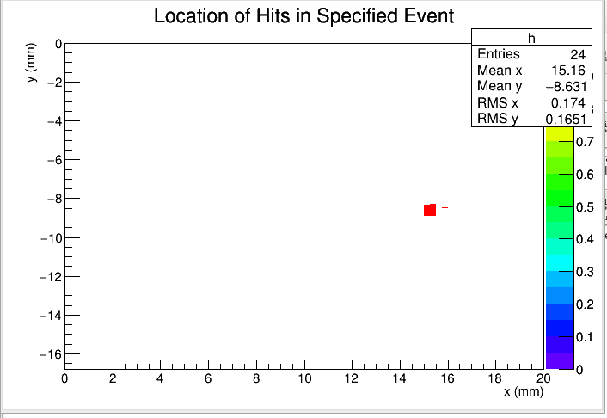
Event Viewer

Slide 25
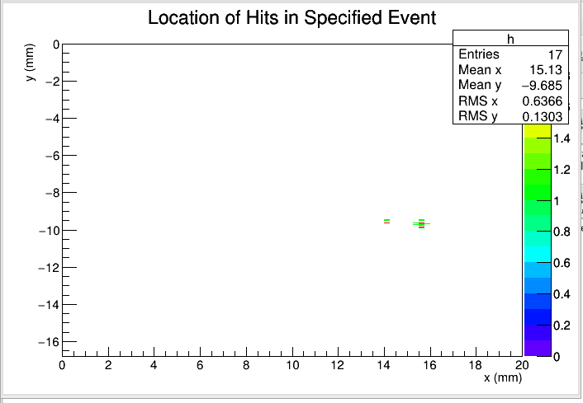
Event Viewer

Slide 26
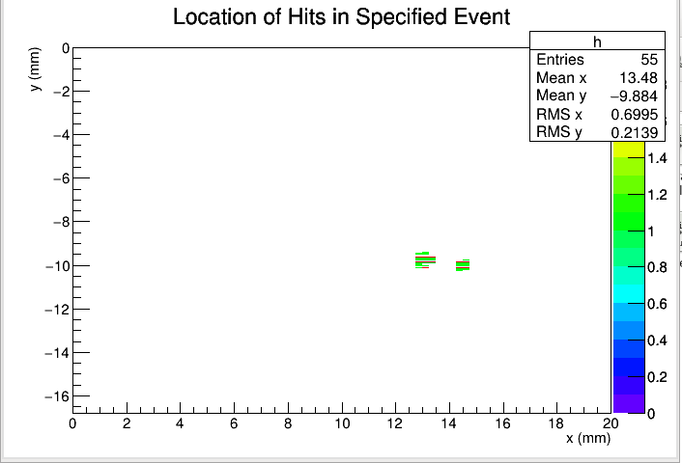
Event Viewer

Slide 27
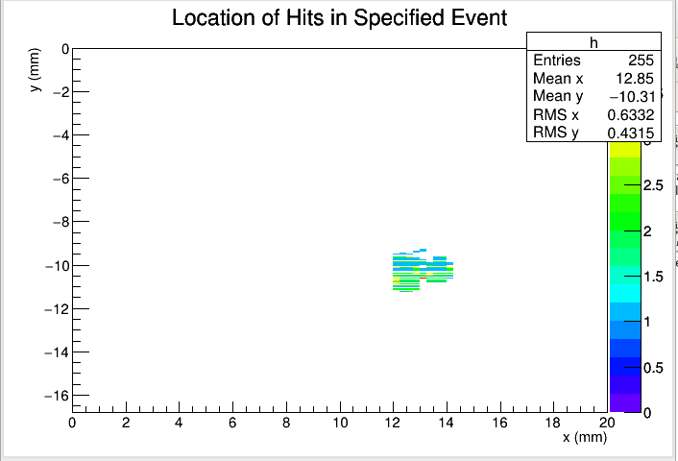
Event Viewer

Slide 28
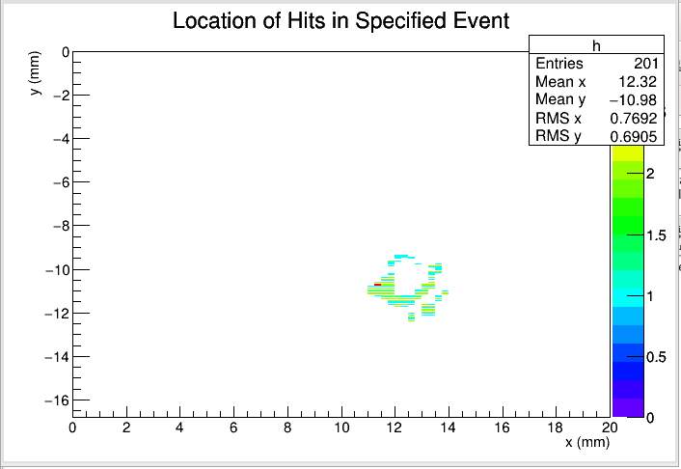
Event Viewer

Slide 29
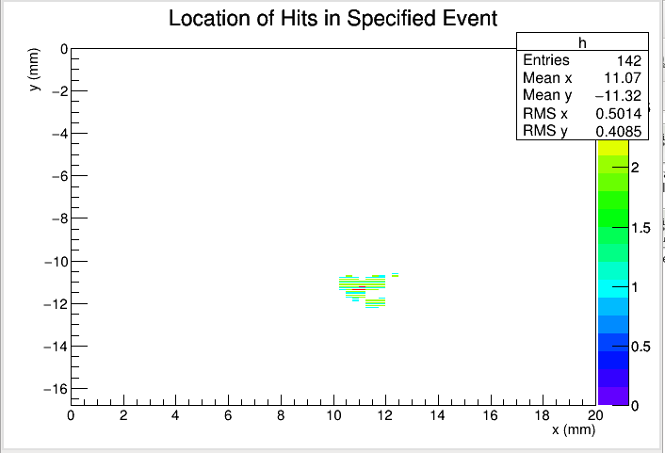
Event Viewer

Slide 30
Next Steps
Line fitting
  Finds the equation of the best fit line for each event
Cluster finding
  Identifies each individual cluster
  Calculates average RMS radius and gap length

Slide 31
Credits
Used pyBAR for raw data output graphs
Used ROOT for scripting the event viewer program

