Slide 1



AI-BASED ASSIGNMENT GRADING SYSTEM
Presented By,
Dennis Cyrus J (811722104027)
Elvin Joseph B (811722104039)
Harrish Raghavendaar R R (811722104051)
Jeevan T (811722104063)
Guided By,
Mrs.G.Rajendra Kannammal
Assistant Professor,CSE
DD/MM/YYYY

Slide 2
ABSTRACT
This project is an AI-powered assignment grading system that automates the evaluation of student assignments.
Students upload their assignments in PDF format, and PDF.js extracts the text.
Teachers input grading criteria, and Groq’s Llama 3 AI model evaluates the assignment.
The AI generates a grade and detailed feedback, ensuring fair and consistent grading.
DD/MM/YYYY

Slide 3
OBJECTIVE
Automate Assignment Evaluation – Extract text from PDF assignments and analyze them using AI.
Enable Custom Grading Criteria – Teachers can set grading parameters like clarity, structure, and accuracy.
Provide Instant Feedback – Students receive real-time grades and improvement suggestions.
Enhance Educational Efficiency – Saves time and effort for teachers, making grading faster and smarter
DD/MM/YYYY

Slide 4
LITERATURE SURVEY
S.No. | Paper Title | Year | Remark
1 | Grade Like a Human: Rethinking Automated Assessment with Large Language Models | 2021 | Discusses use of LLMs to mimic human-like grading behavior.
2 | Beyond Human Subjectivity and Error: A Novel AI Grading System | 2020 | Proposes an AI-based system to eliminate human bias in evaluation.
3 | Grading Exams Using Large Language Models: A Comparison | 2022 | Compares multiple LLMs for grading accuracy and consistency.
DD/MM/YYYY

Slide 5
EXISTING SYSTEM
User
Document
LLM
Text conversion
Upload
Generate
Scores
DD/MM/YYYY

Slide 6
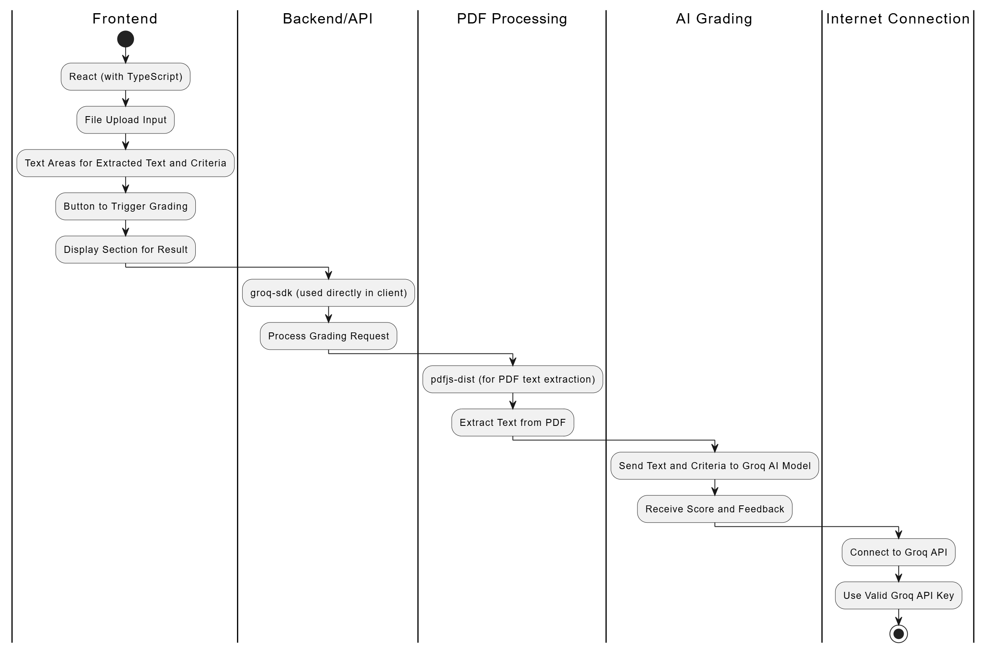
PROPOSED SYSTEM
DD/MM/YYYY

Slide 7
MODULE 1 : User Management
. Purpose: To manage authentication and role-based access.
Details:
Login System: Provides secure login for both staff and students.
Role Separation:
Staff (Teachers): Can create assignments, upload rubrics, and view results.
Students: Can view assignments, upload submissions, and view their graded results.
Session Management: Maintains login sessions using cookies or tokens for consistent user experience.
DD/MM/YYYY

Slide 8
MODULE 2 : Assignment Creation
Purpose: To allow staff to define and distribute assignments.
Details:
Assignment Setup: Teachers input:
Assignment title
Description/guidelines
Grading rubric (criteria and weights)
Rubric Format: Structured as JSON or form inputs for AI evaluation compatibility.
Unique Upload Link: Generates a secure link for each assignment for student submissions.
DD/MM/YYYY

Slide 9
MODULE 3 : PDF Upload & Text Extraction
. Purpose: To allow students to upload their work and extract its text for grading.
Details:
File Upload:
Supports PDF (can be enhanced to include DOCX).
Verifies file type and size.
Text Extraction:
Uses PDF.js to extract text from uploaded PDFs.
Handles formatting issues and multiple pages.
Pre-processing:
May clean text (remove headers/footers) before sending to grading module.
DD/MM/YYYY

Slide 10
MODULE 4 : AI Grading
. Purpose: To evaluate student assignments using AI based on the rubric provided.
Details:
Integration with Groq AI API:
Sends extracted text and rubric for evaluation.
Receives a score and feedback (explanations/comments).
Rubric Matching:
Aligns rubric criteria to specific sections of text.
Feedback Storage:
Stores graded results in database for later viewing.
Transparency:
Shows students the marks and comments for each rubric criterion.
DD/MM/YYYY

Slide 11
MODULE 5 : Results Display
. Purpose: To present grading outcomes and enable review for both staff and students.
Details:
Submission Listing: Shows all student submissions with status and timestamps.
Score & Feedback Display: Presents rubric-based scores and AI-generated comments.
Teacher Review: Allows manual override, comments, and marking for re-evaluation.
Student View: Students can view their grades and detailed feedback securely.
Analytics: Provides class performance summary and criterion-wise insights.
DD/MM/YYYY

Slide 12
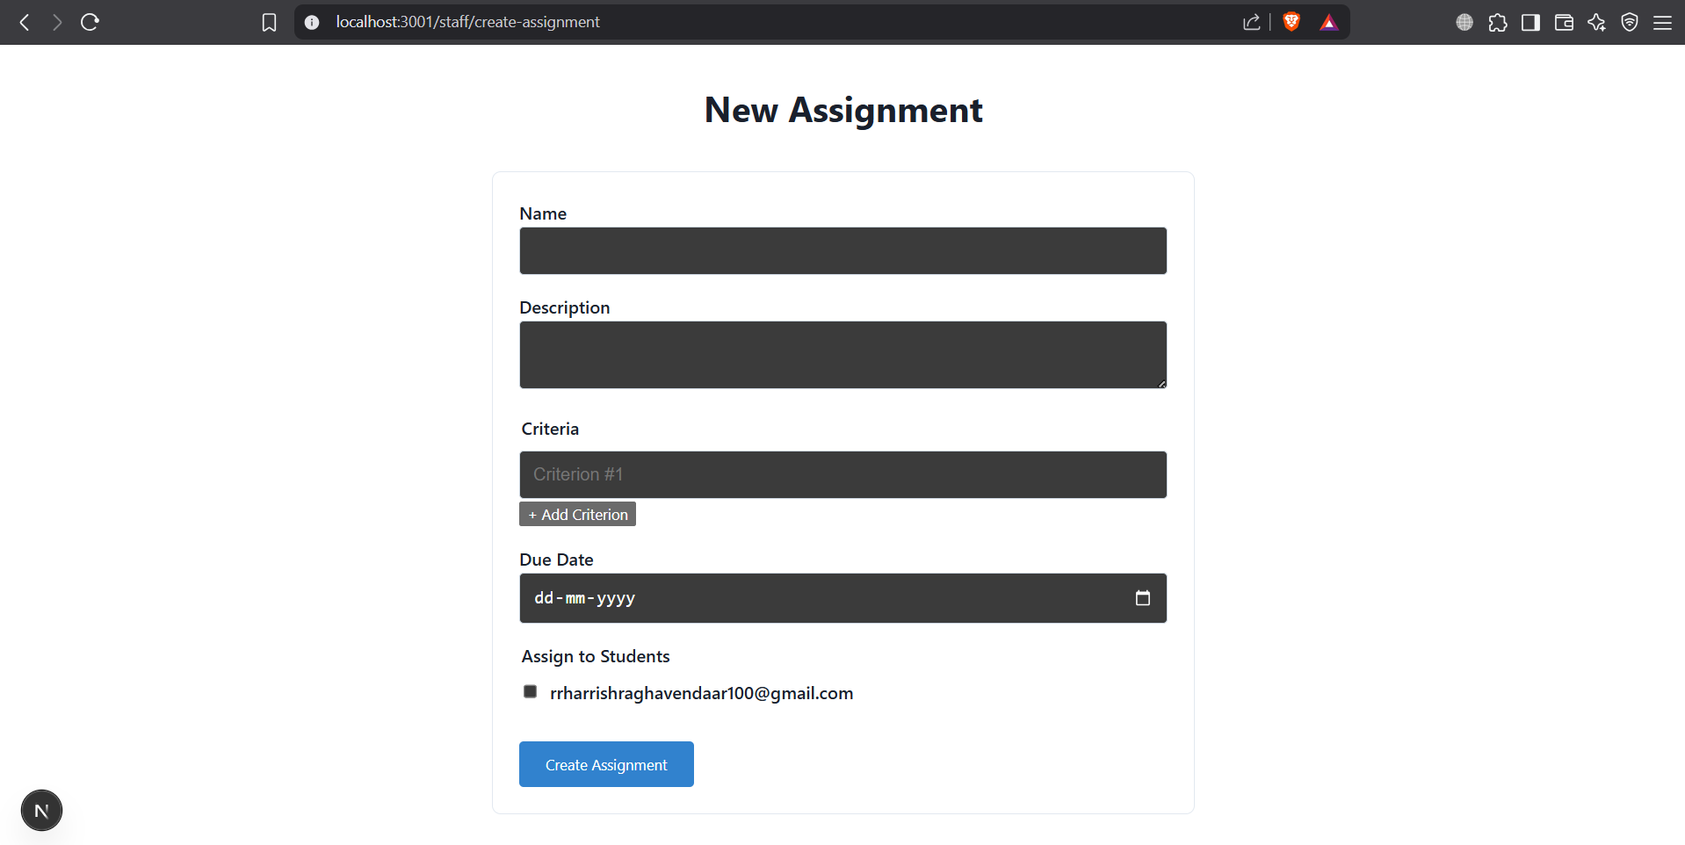
OUTPUT
DD/MM/YYYY

Slide 13
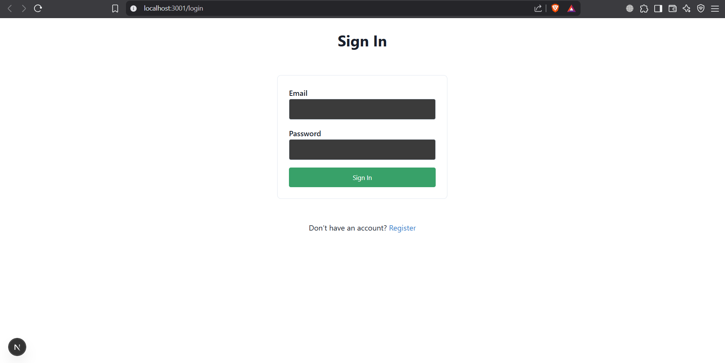
OUTPUT
DD/MM/YYYY

Slide 14
CONCLUSION & FUTURE ENHANCEMENT
Separating the Assignment Grader into distinct Uploading & Text Conversion, Student, and Teacher modules improves organization, scalability, reusability, and maintainability, making the system more efficient and user-friendly.
Future Enhancement:
Add login for staff and students
Allow students to upload other file types (like Word documents)
Show grading results with comments
Save submissions and results online
Let teachers edit or reuse rubrics
DD/MM/YYYY

Slide 15
REFERENCES
Xie, W., Niu, J., Xue, C. J., & Guan, N. (2024). Grade Like a Human: Rethinking Automated Assessment with Large Language Models. arXiv preprint arXiv:2405.19694. ARXIV.ORG
Gobrecht, A., Tuma, F., Möller, M., Zöller, T., Zakhvatkin, M., Wuttig, A., Sommerfeldt, H., & Schütt, S. (2024). Beyond Human Subjectivity and Error: A Novel AI Grading System. arXiv preprint arXiv:2405.04323.
Grading Exams Using Large Language Models: A Comparison.
DD/MM/YYYY

Slide 16

DD/MM/YYYY

