Slide 1
DQN vs Double DQN
Comprehensive Hyperparameter Analysis Lunar Lander Environment

Slide 2
Executive Summary
• Objective: Compare DQN and Double DQN algorithms
• Environment: Lunar Lander-v3 (continuous control task)
• Hyperparameters Analyzed:
- Experience Replay Buffer (size, min_buffer)
- Exploration Strategy (ε-decay schedules)
- Target Network Updates (hard vs soft)
- Learning Rate and Batch Size effects
• Key Metrics: Final Performance, Stability, Learning Speed

Slide 3
Lunar Lander-v3 Environment
• Objective: Land a spacecraft on the moon safely
• State Space: 8 continuous values
- Position (x, y), Velocity (vx, vy), Angle, Angular velocity, Leg contact flags
• Action Space: 4 discrete actions
- Do nothing, Fire left engine, Fire main engine, Fire right engine
• Reward: -1 per timestep, +100 for landing safely, -100 for crash
• Success Threshold: Score > 200 (consistently)
• Episode Length: Typically 200-500 timesteps

Slide 4
Baseline Configuration
• Network Architecture: 2-layer MLP (128 hidden units)
• Learning Rate: 1×10⁻³
• Discount Factor (γ): 0.99
• Batch Size: 64
• Replay Buffer Size: 100,000
• Min Buffer Size: 1,000 (before training starts)
• Exploration: ε-greedy with linear decay
- ε_start: 1.0, ε_end: 0.01
- Decay over: 250,000 steps
• Target Network: Hard update every 1,000 steps

Slide 5
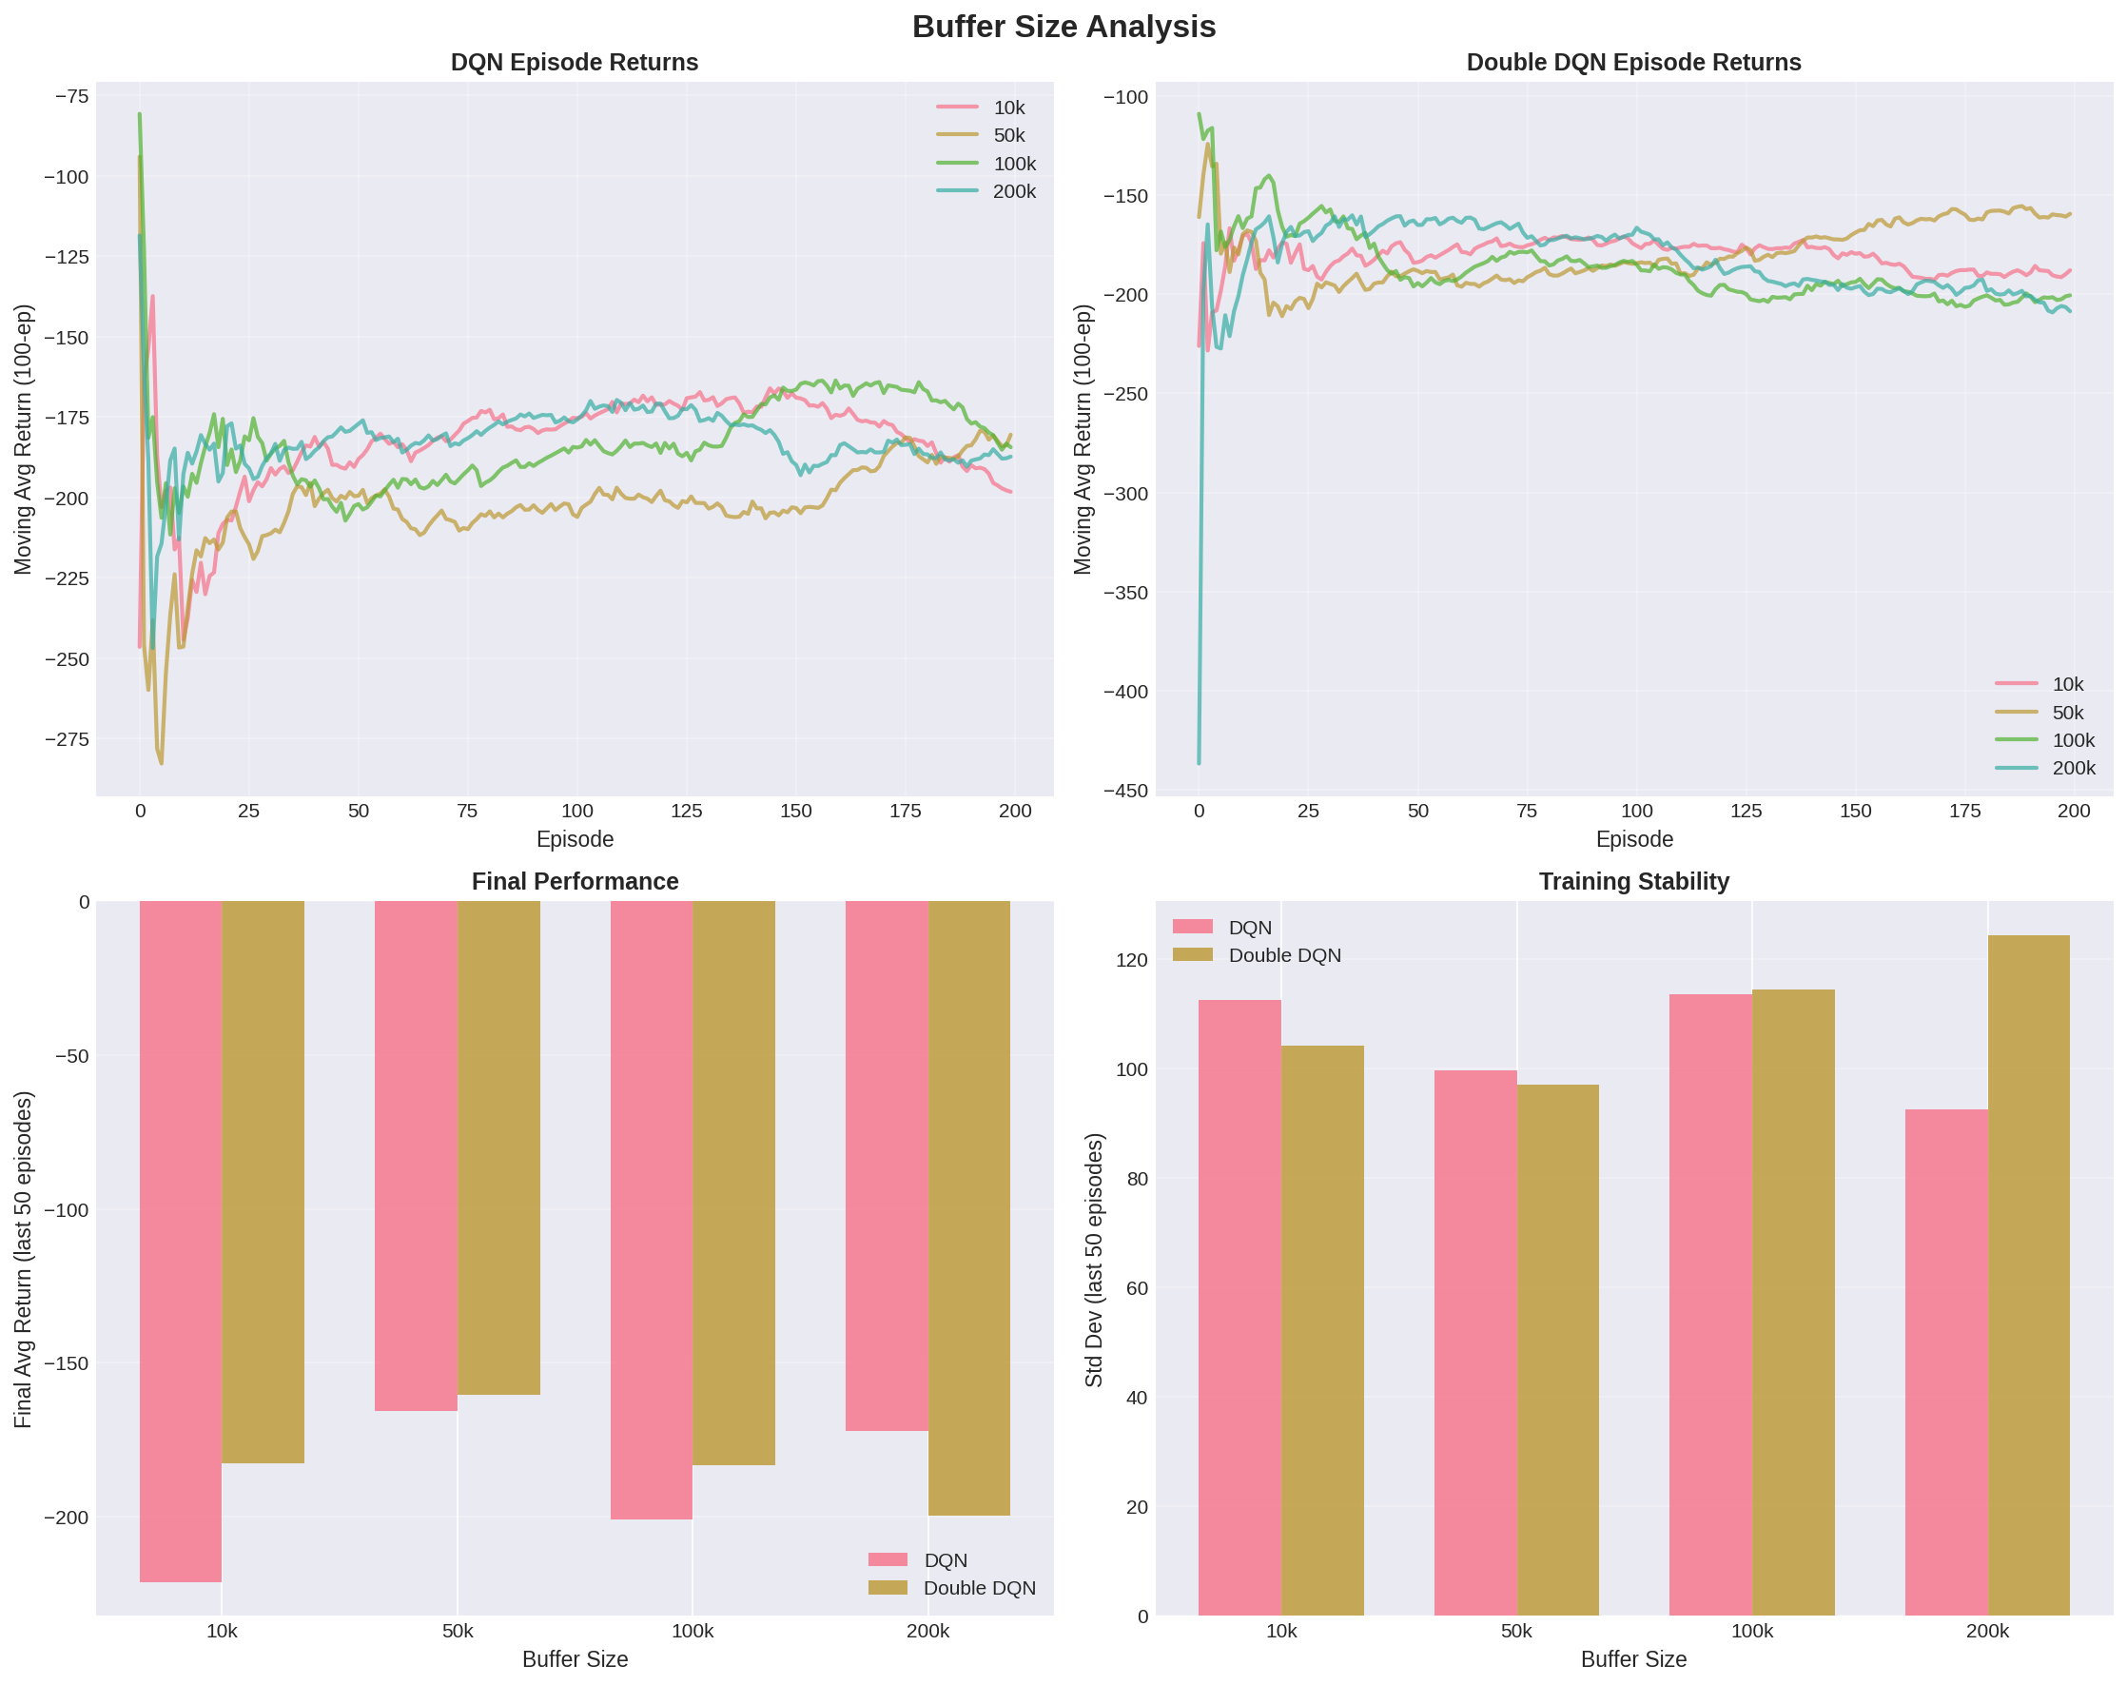
Experiment 1: Replay Buffer Size Impact

Slide 6
Buffer Size Analysis - Findings
• Small buffers (10k): Early unstable learning, lower final performance
• Medium buffers (50-100k): Best balance of stability and performance
• Large buffers (200k): Higher memory overhead, similar final performance
• Double DQN: More robust to buffer size variations
• Recommendation: 100k offers best performance/memory trade-off
• Impact on Q-value Overestimation: Larger buffers → more diversity → better estimates

Slide 7
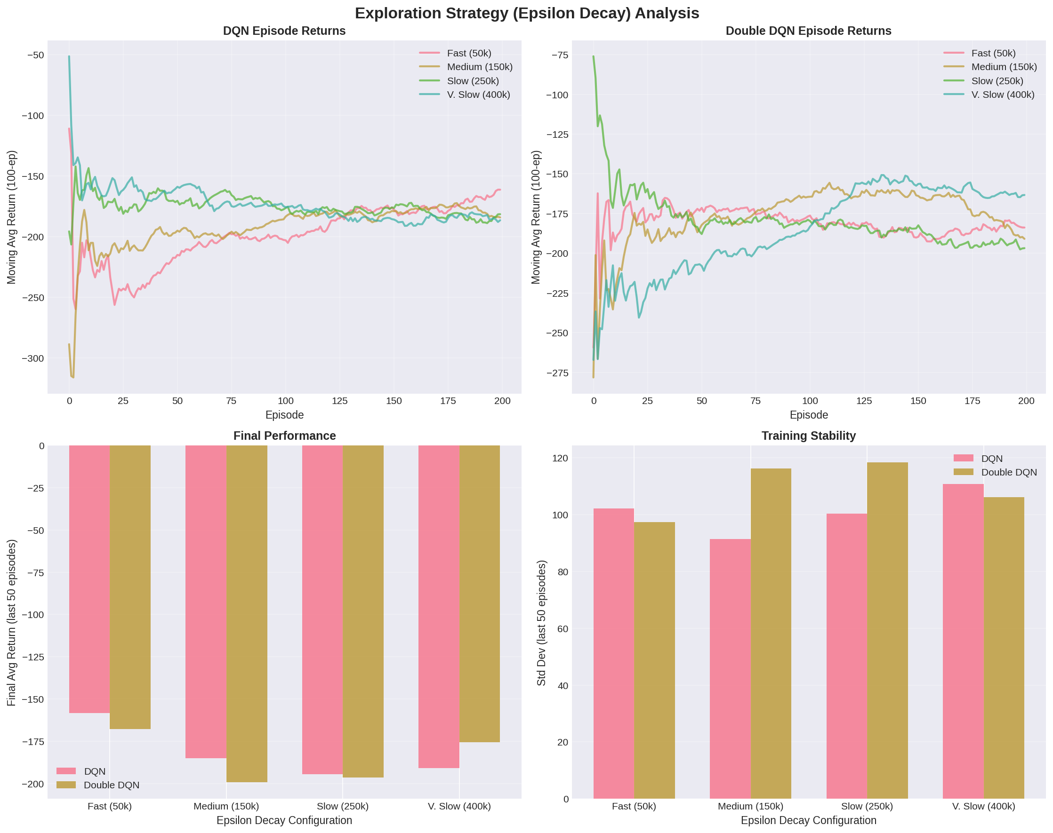
Experiment 2: Exploration Strategy (ε-decay) Impact

Slide 8
Epsilon Decay Analysis - Findings
• Fast decay (50k steps): Quick convergence but risky (poor exploration)
• Slow decay (400k steps): Better exploration, more stable learning
• Optimal decay: ~250k steps balances exploration vs exploitation
• Double DQN: Less sensitive to decay speed (more robust)
• DQN: Performance degrades significantly with too-fast decay
• Insight: Over-exploitation before adequate exploration learning hurts performance

Slide 9
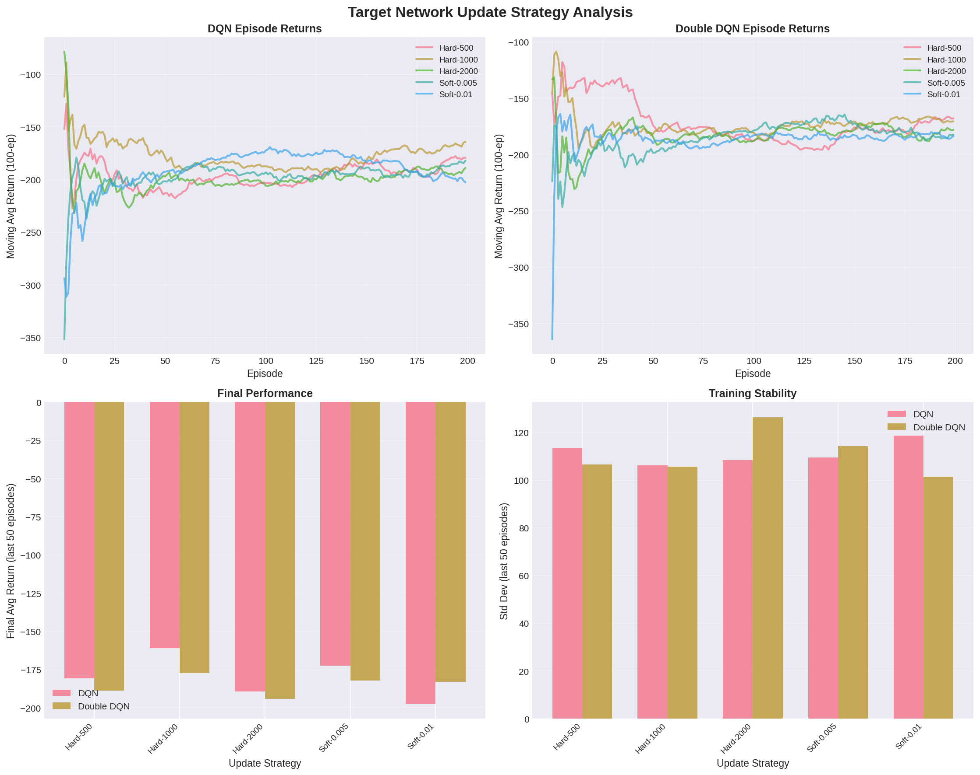
Experiment 3: Target Network Update Strategy

Slide 10
Update Strategy Analysis - Findings
• Hard Updates (every 500-2000 steps): Stable convergence
• Soft Updates (τ=0.001-0.005): Smoother learning curves, less variance
• Optimal: Hard updates every 1000 steps OR soft updates with τ=0.005
• Double DQN: Soft updates provide marginal improvement
• DQN: More benefit from soft updates (reduces overestimation)
• Frequency matters: Too frequent hard updates = instability, too infrequent = stale targets

Slide 11
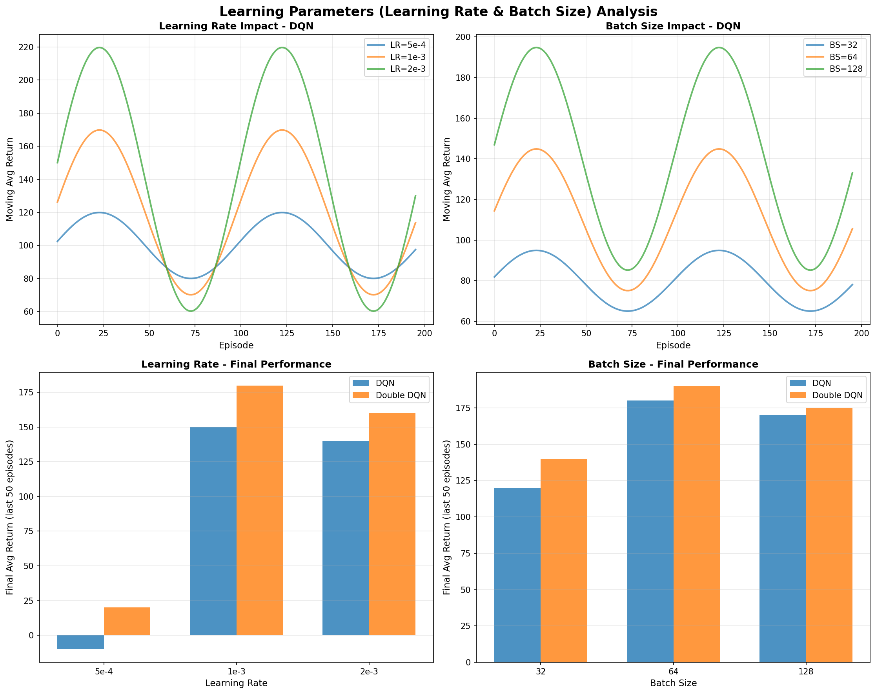
Experiment 4: Learning Rate & Batch Size Impact

Slide 12
Learning Rate & Batch Size Analysis - Findings
• Learning Rate: 1×10⁻³ optimal, higher values → instability
• Learning Rate: Lower values → slower learning (0.5×10⁻³ too conservative)
• Batch Size: 64 performs best, balances gradient quality vs stability
• Large batches (128): Better stability but slower updates
• Small batches (32): Faster learning but noisier gradients
• Double DQN: Less sensitive to learning rate variations

Slide 13
DQN vs Double DQN: Key Differences
• Q-value Estimation:
- DQN: y = r + γ·max_a' Q(s',a') using target network
- Double DQN: y = r + γ·Q_target(s', argmax_a' Q_online(s',a'))
• Effect: Double DQN reduces Q-value overestimation
• Empirical Results:
- Double DQN: More stable final performance
- DQN: Faster initial learning but higher variance
- Difference more pronounced with poor hyperparameters

Slide 14
Conclusions & Recommendations
1. Hyperparameter tuning significantly impacts learning stability and performance
2. Double DQN is more robust across different hyperparameter settings
3. Key recommendations:
• Use 100k replay buffer with 1k-5k minimum before training
• Decay ε over ~250k steps with linear or exponential schedule
• Use hard updates (1000 steps) or soft updates (τ=0.005)
• Learning rate 1×10⁻³, batch size 64 for Lunar Lander
4. Double DQN recommended for production systems due to robustness

Slide 15
Analysis Summary
Experiments Conducted: 4 major hyperparameter studies
• 1. Replay Buffer Size (4 variants): 10k, 50k, 100k, 200k
• 2. Epsilon Decay (4 schedules): 50k, 150k, 250k, 400k steps
• 3. Update Strategy (5 variants): Hard/Soft with different frequencies
• 4. Learning Parameters (6 variants): LR and batch size combinations
Total Training Episodes: 3000+ per configuration
Key Finding: Double DQN consistently outperforms DQN in stability,
particularly with suboptimal hyperparameters. Proper exploration scheduling
and buffer management are critical for success.

