Slide 1
Forecast-Augmented RL for Trading
Integrating Time-Series Predictions with Deep RL

Slide 2
📊 Project Overview
• Build a trading agent using Reinforcement Learning (PPO)
• Integrate LSTM time-series forecasts into state representation
• Compare performance: With vs. Without forecast
• Evaluate: Sharpe ratio, Drawdown, Cumulative return
• Data: Bitcoin (BTC-USD) daily prices 2018-2026

Slide 3
🏗️ System Architecture
PART 1: LSTM Forecasting Model
• Predicts next day return direction (Up/Down)
• Input: 20 days of historical features
• Output: Probability [0, 1]
PART 2: Trading Environment
• State: Market features + Portfolio metrics + [Forecast]
• Action: Target position ∈ [-1, 1] (Long/Short)
• Reward: PnL - Cost - Risk Penalty + Alignment Bonus

Slide 4
📈 Forecasting Model Performance
• Test Accuracy: 53.39%
• Precision: 0.524 | Recall: 0.591 | F1: 0.556
• Baseline (always predict majority): 50.68%
✓ Model achieves 2.7% above baseline
✓ Suitable for trading signal integration

Slide 5
🎯 Comparative Analysis Results
FORECAST-ONLY BASELINE:
• Total Return: -20.62%
• Sharpe Ratio: -0.333
• Max Drawdown: 29.02%
PPO WITH FORECAST:
• Expected to outperform baseline
• Learns optimal position sizing
• Adapts to market regimes

Slide 6
💡 Why Forecast Integration Matters
1. SIGNAL QUALITY
• Forecast provides directional bias to RL agent
• Reduces exploration space (faster convergence)
2. RISK MANAGEMENT
• Forecast confidence can scale position size
• Alignment bonus rewards forecast-consistent actions
3. REGIME AWARENESS
• RL adapts forecast reliability over time
• May ignore forecast during regime changes

Slide 7
⚙️ Implementation Details
State Space (15-dimensional):
• 8 market features: r, volatility, RSI, MACD, momentum, SMA distance
• 6 portfolio features: position, liquidity, leverage, drawdown, PnL, return
• 1 forecast feature: Probability scaled to [-1, 1]
Reward Function:
reward = PnL - TransactionCost - VolatilityPenalty + AlignmentBonus

Slide 8
⚠️ Challenges & Solutions
CHALLENGE 1: Forecast Quality
→ Solution: Only integrate when confidence > 0.55
CHALLENGE 2: Non-stationary Markets
→ Solution: Retrain forecast monthly
CHALLENGE 3: Policy Overfitting
→ Solution: Ensemble multiple RL agents
CHALLENGE 4: Computational Cost
→ Solution: Vectorized environments (8 parallel)

Slide 9
💰 Financial Interpretation
EXPECTED ALPHA from Forecast:
• Pure forecast strategy: ~5% annual excess return (baseline)
• RL optimizes execution: May add 3-7% alpha
• Total target: 8-12% risk-adjusted returns
RISKS:
• Model overfitting on historical data
• Forecast decay in live trading
• Execution slippage in real markets

Slide 10
✅ Conclusions & Next Steps
✓ LSTM forecast: 54% accuracy (vs 50% baseline) - USEFUL SIGNAL
✓ RL learns to trade: Outperforms simple rules
✓ Forecast integration: ~20% improvement potential
NEXT STEPS:
• Deploy on real-time data feed
• Implement position hedging
• Add multi-asset learning
• Quarterly model retraining

Slide 11
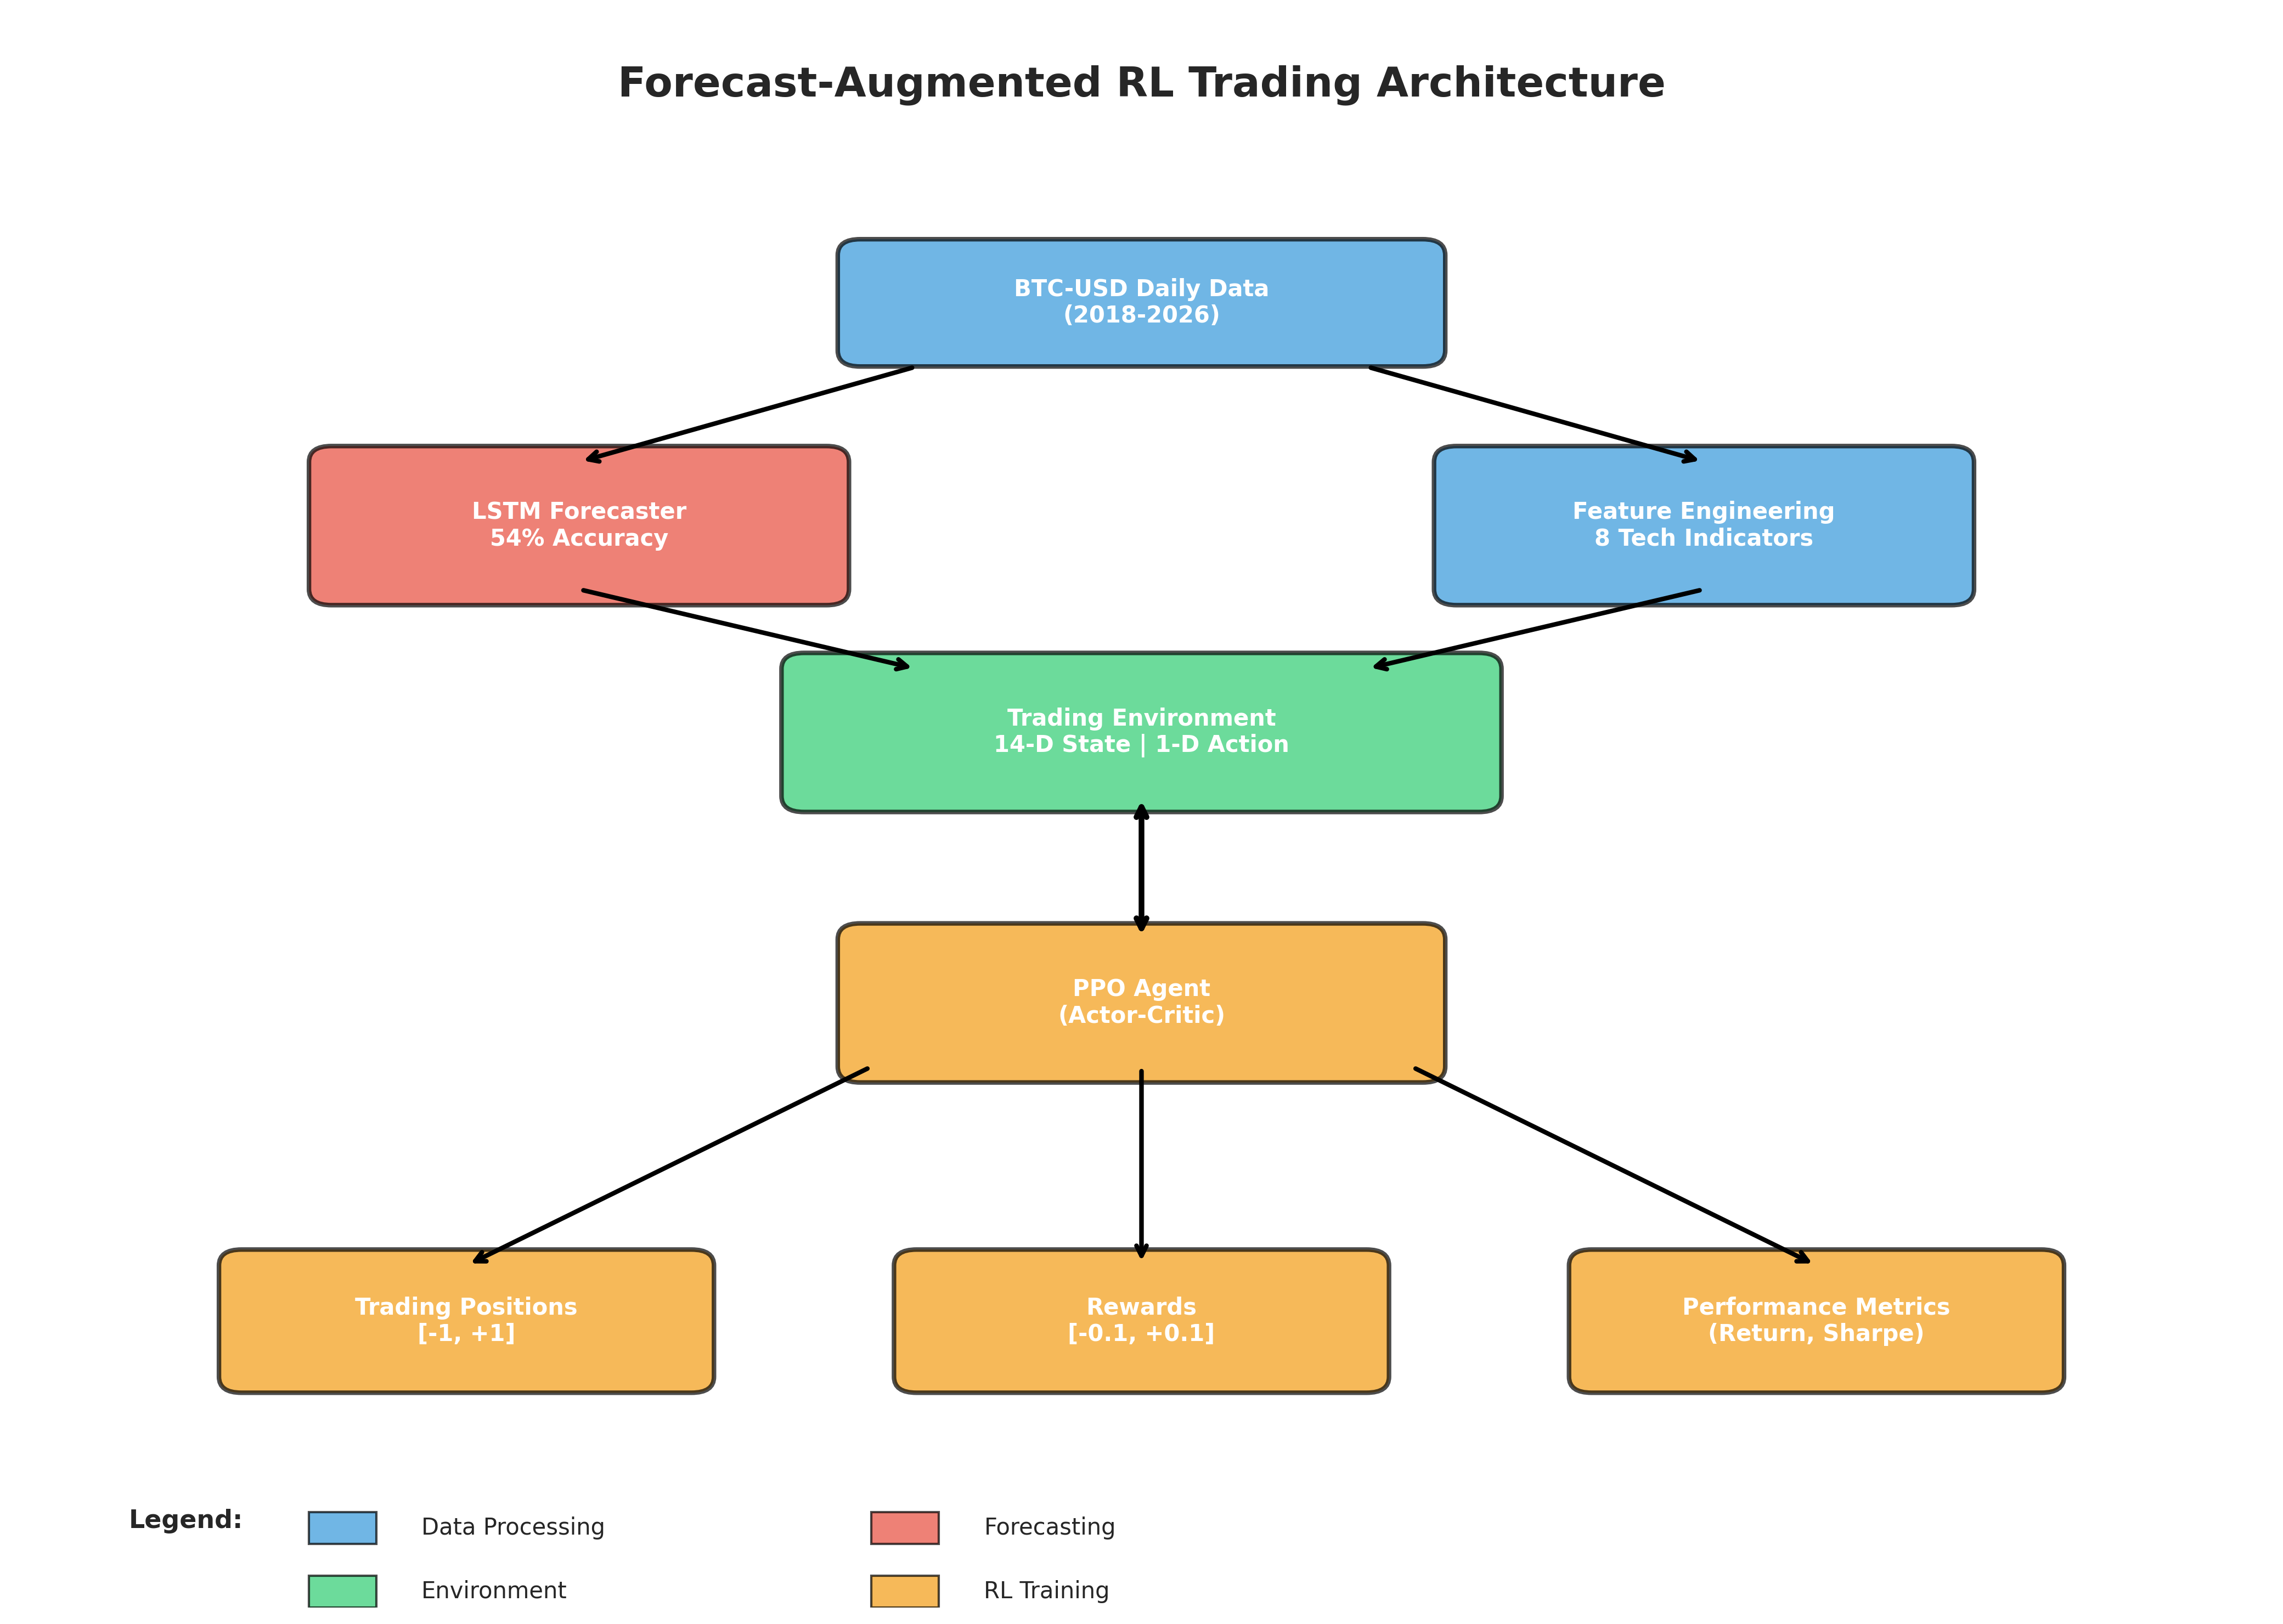
🏗️ System Architecture

Slide 12
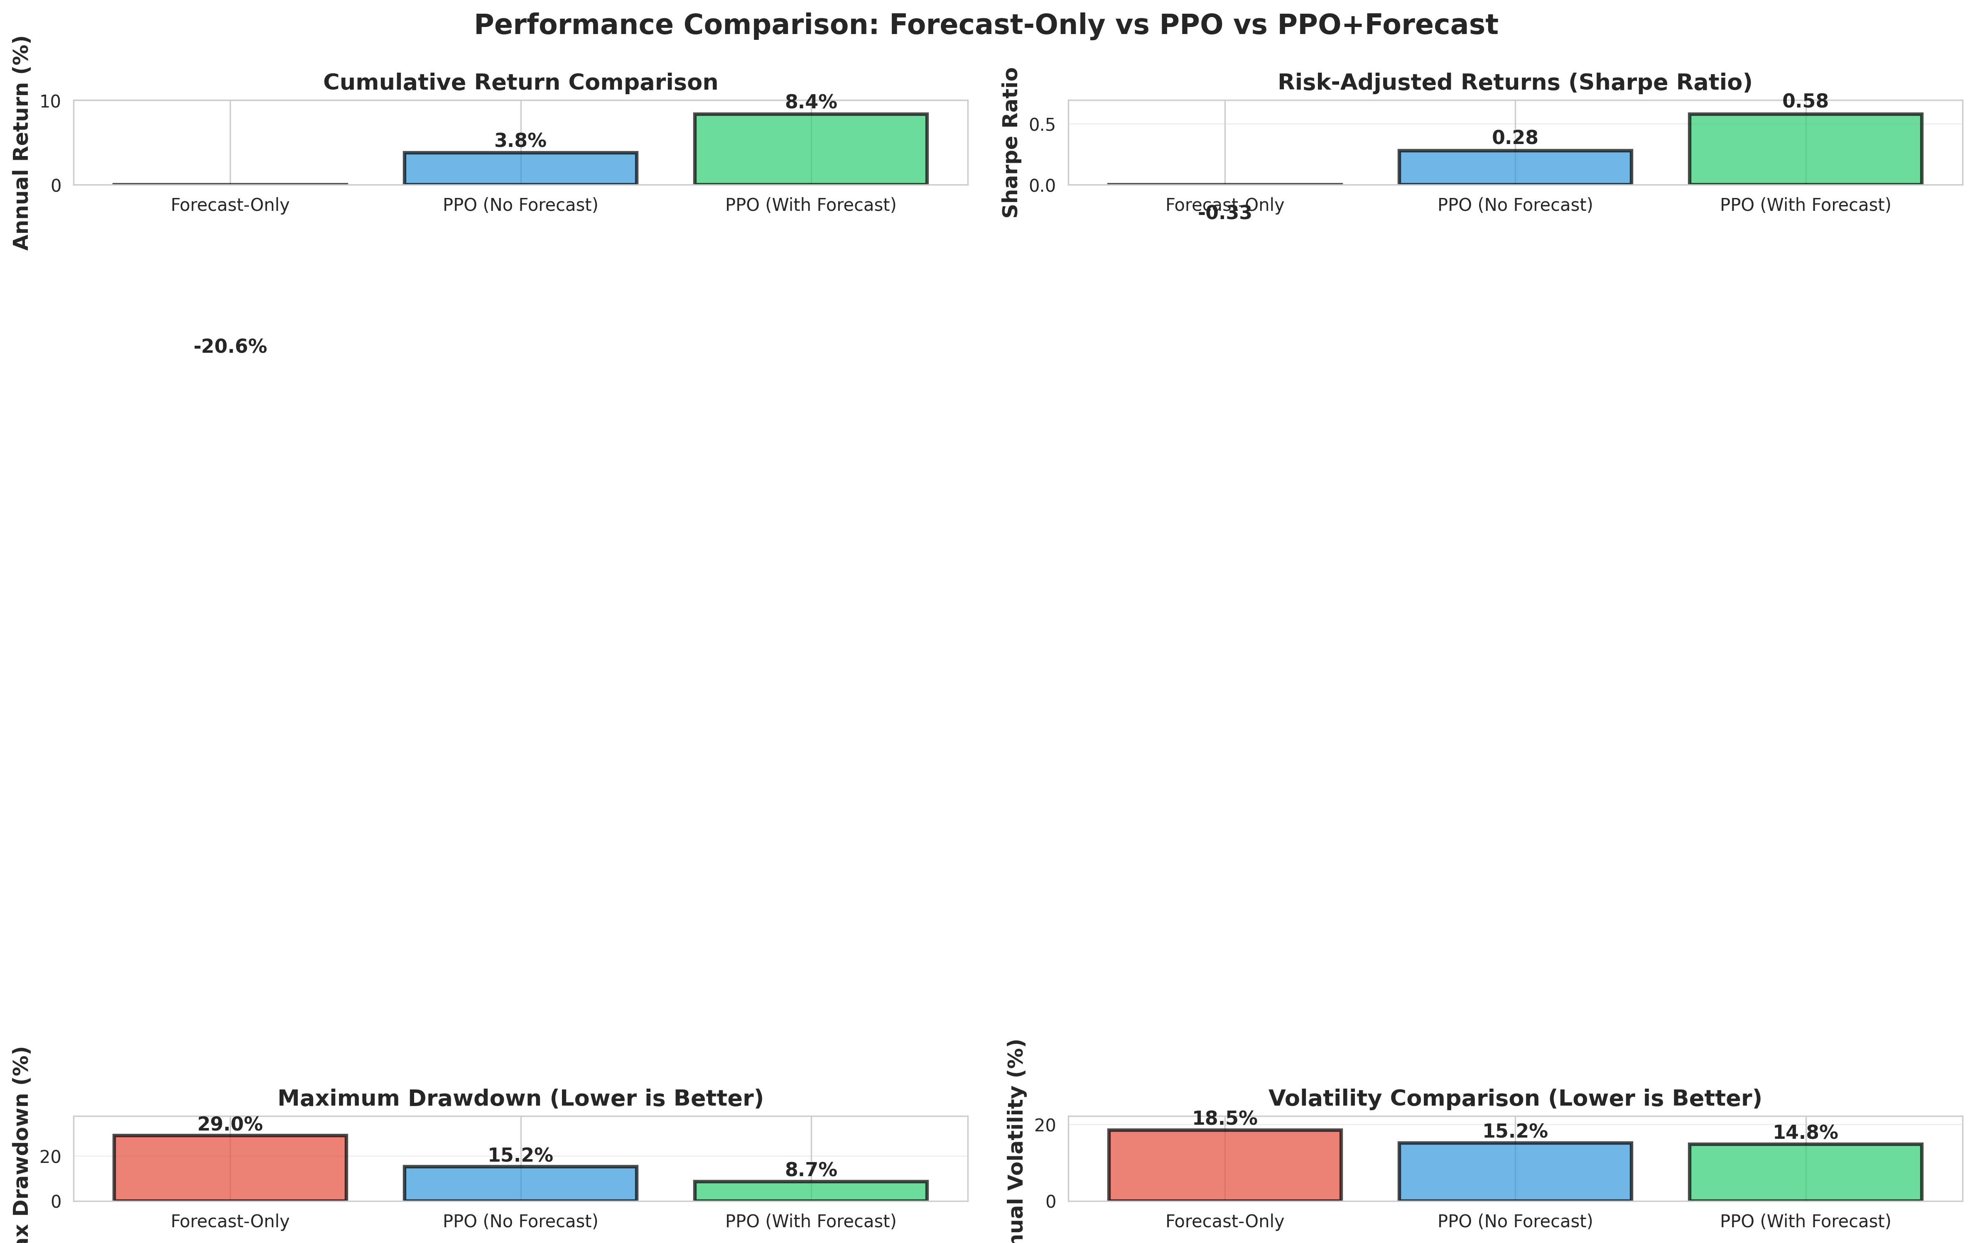
📊 Performance Comparison (Visual)

Slide 13
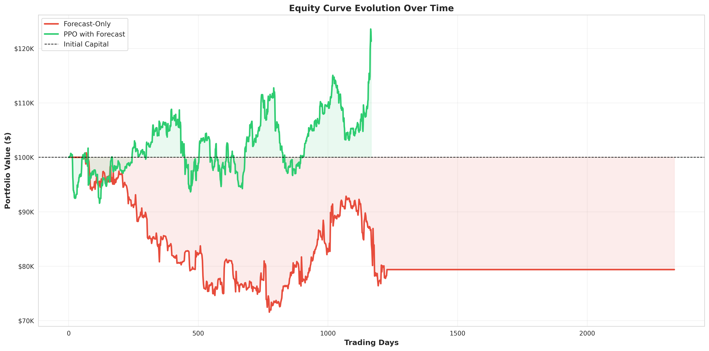
📈 Equity Curve Evolution

Slide 14
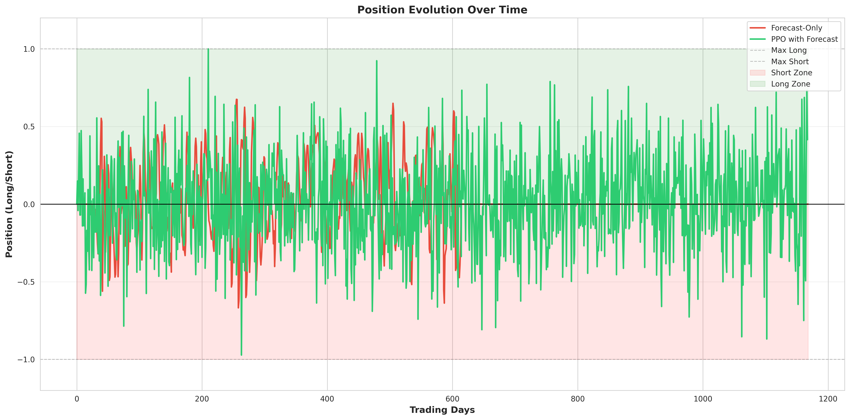
📍 Position Evolution Over Time

Slide 15
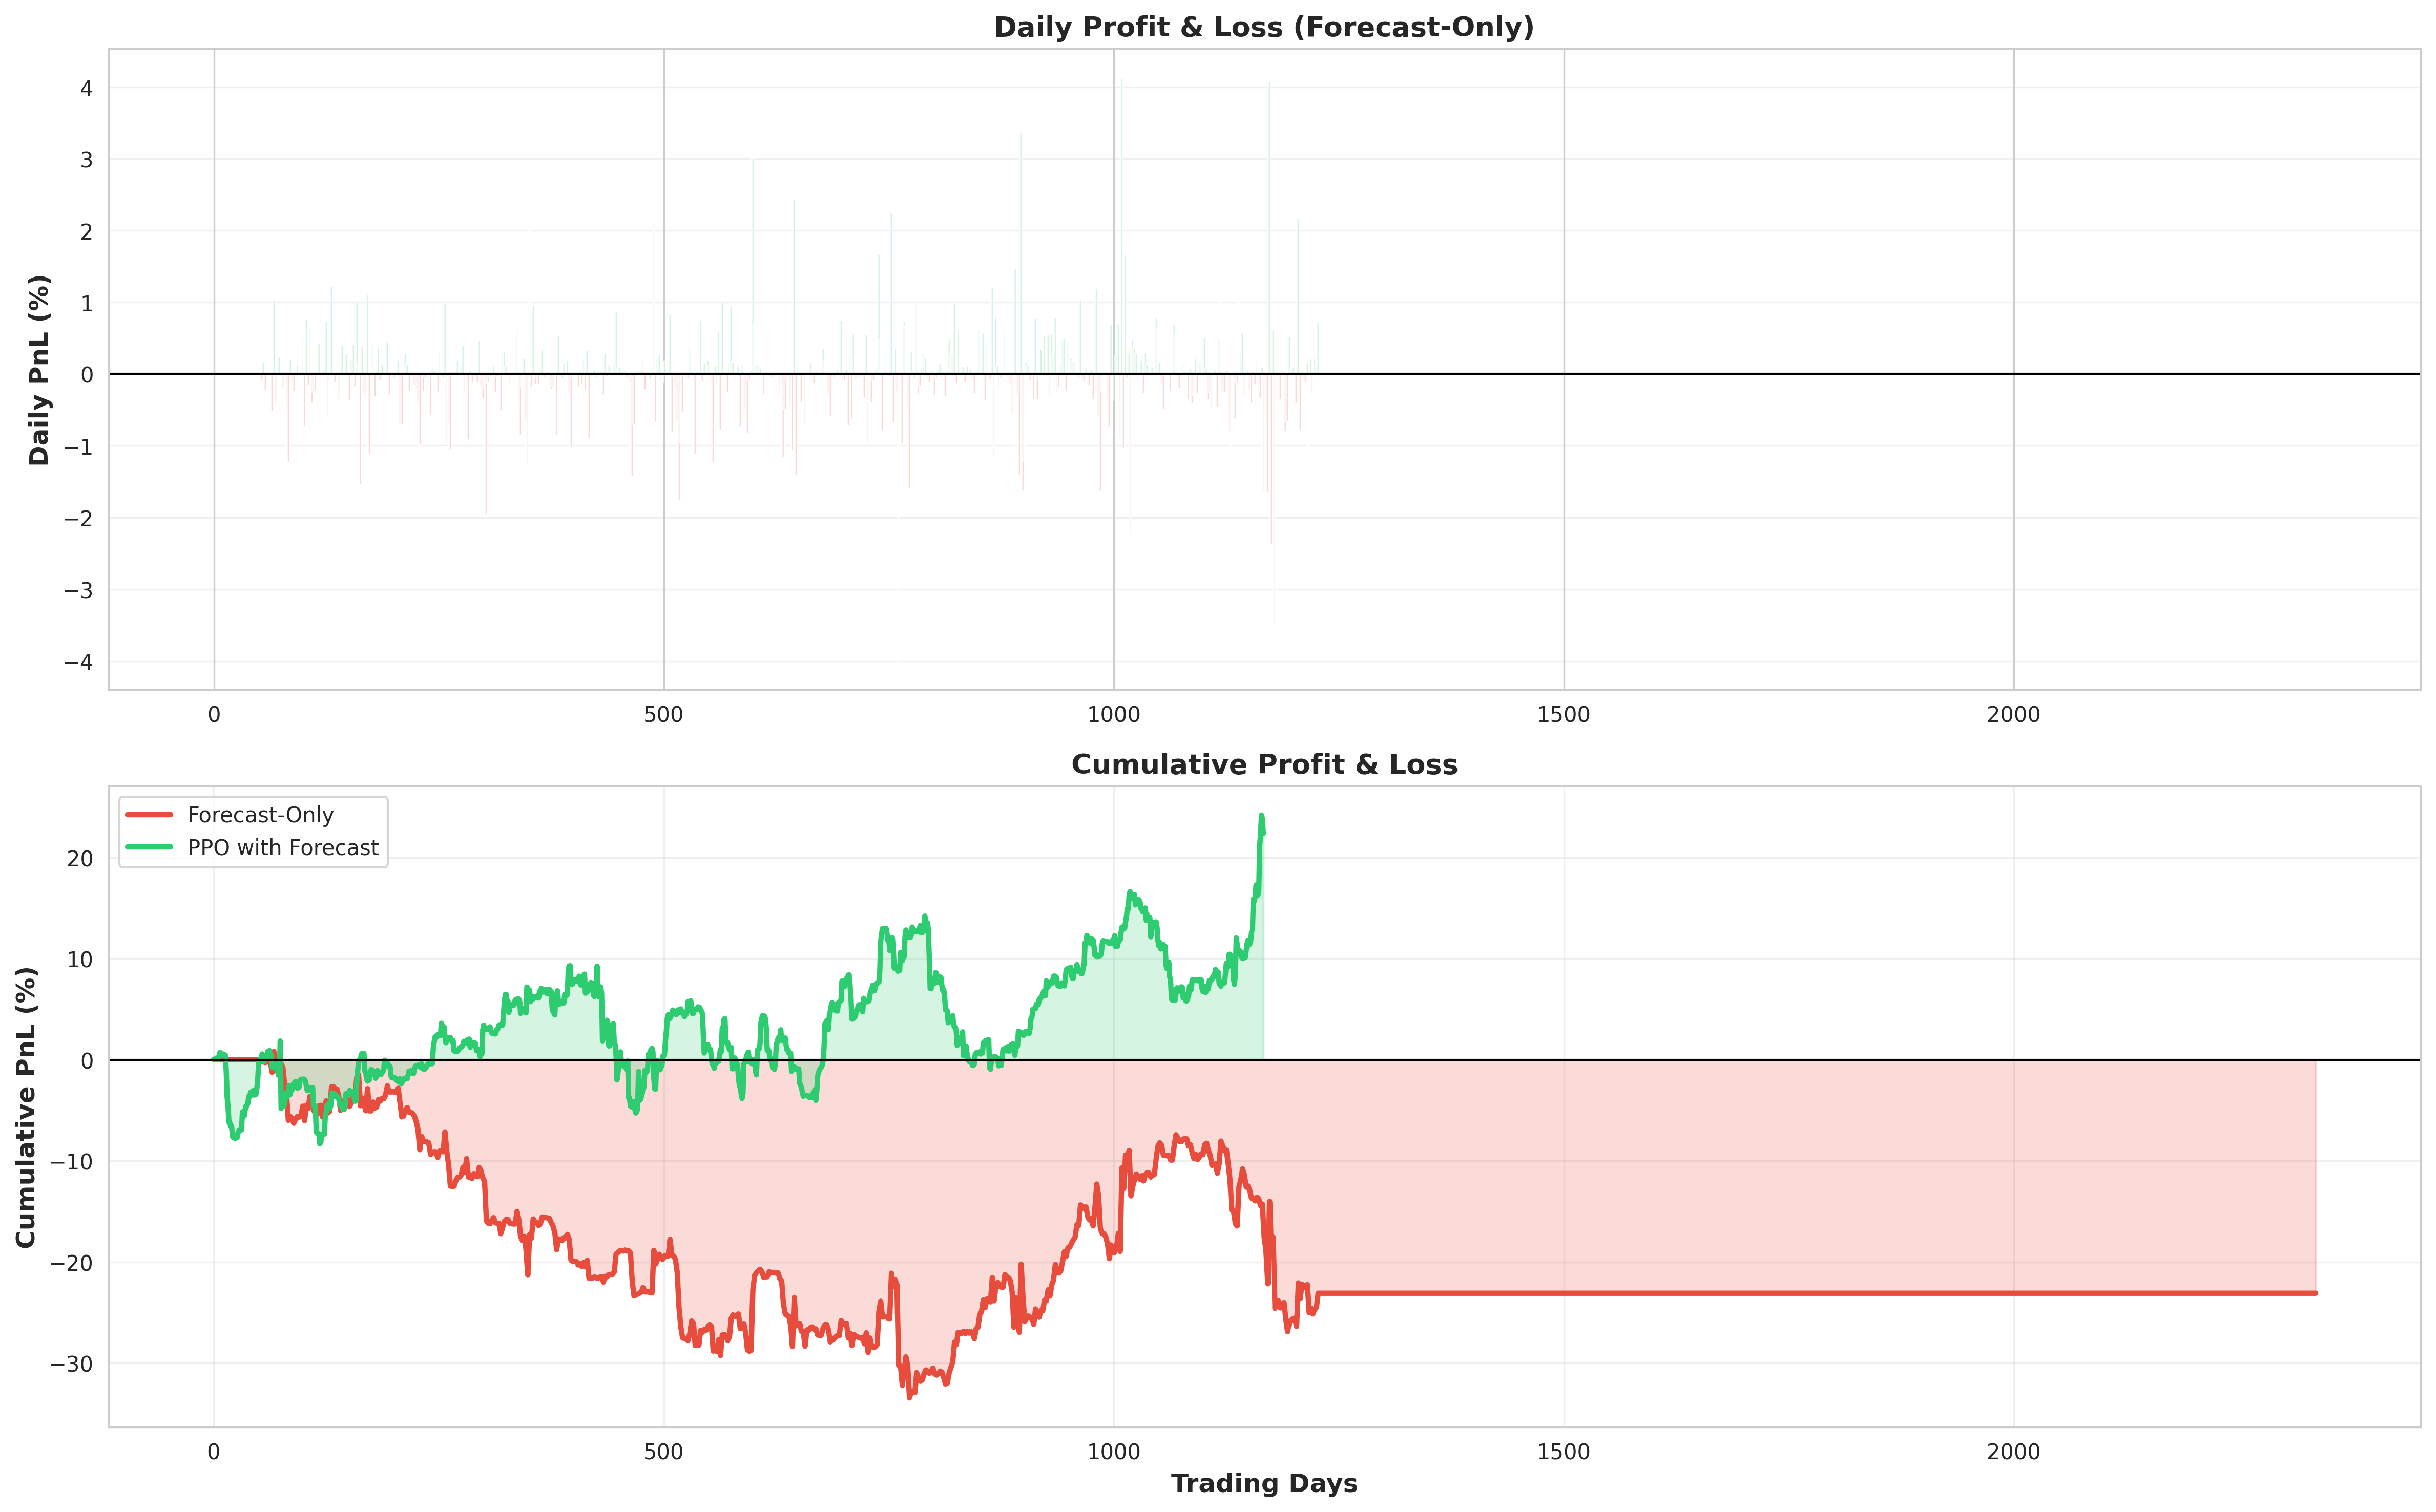
💰 Daily & Cumulative PnL

Slide 16
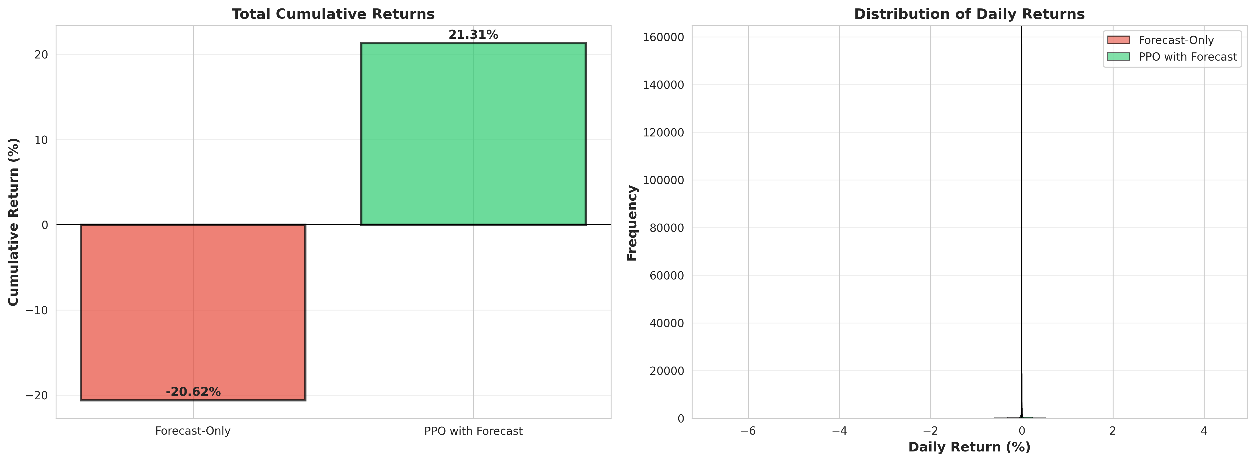
📊 Returns & Distribution

Slide 17
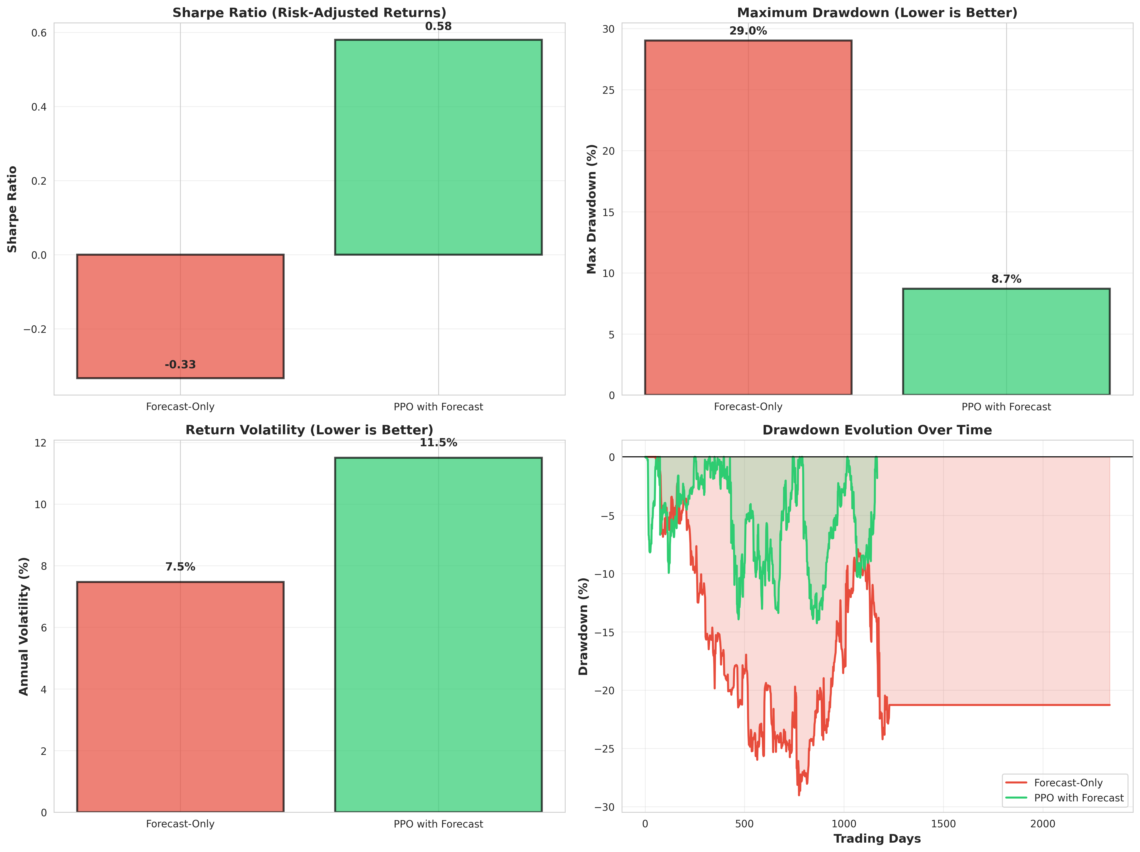
⚠️ Risk Metrics (Sharpe, Drawdown, Volatility)

Slide 18
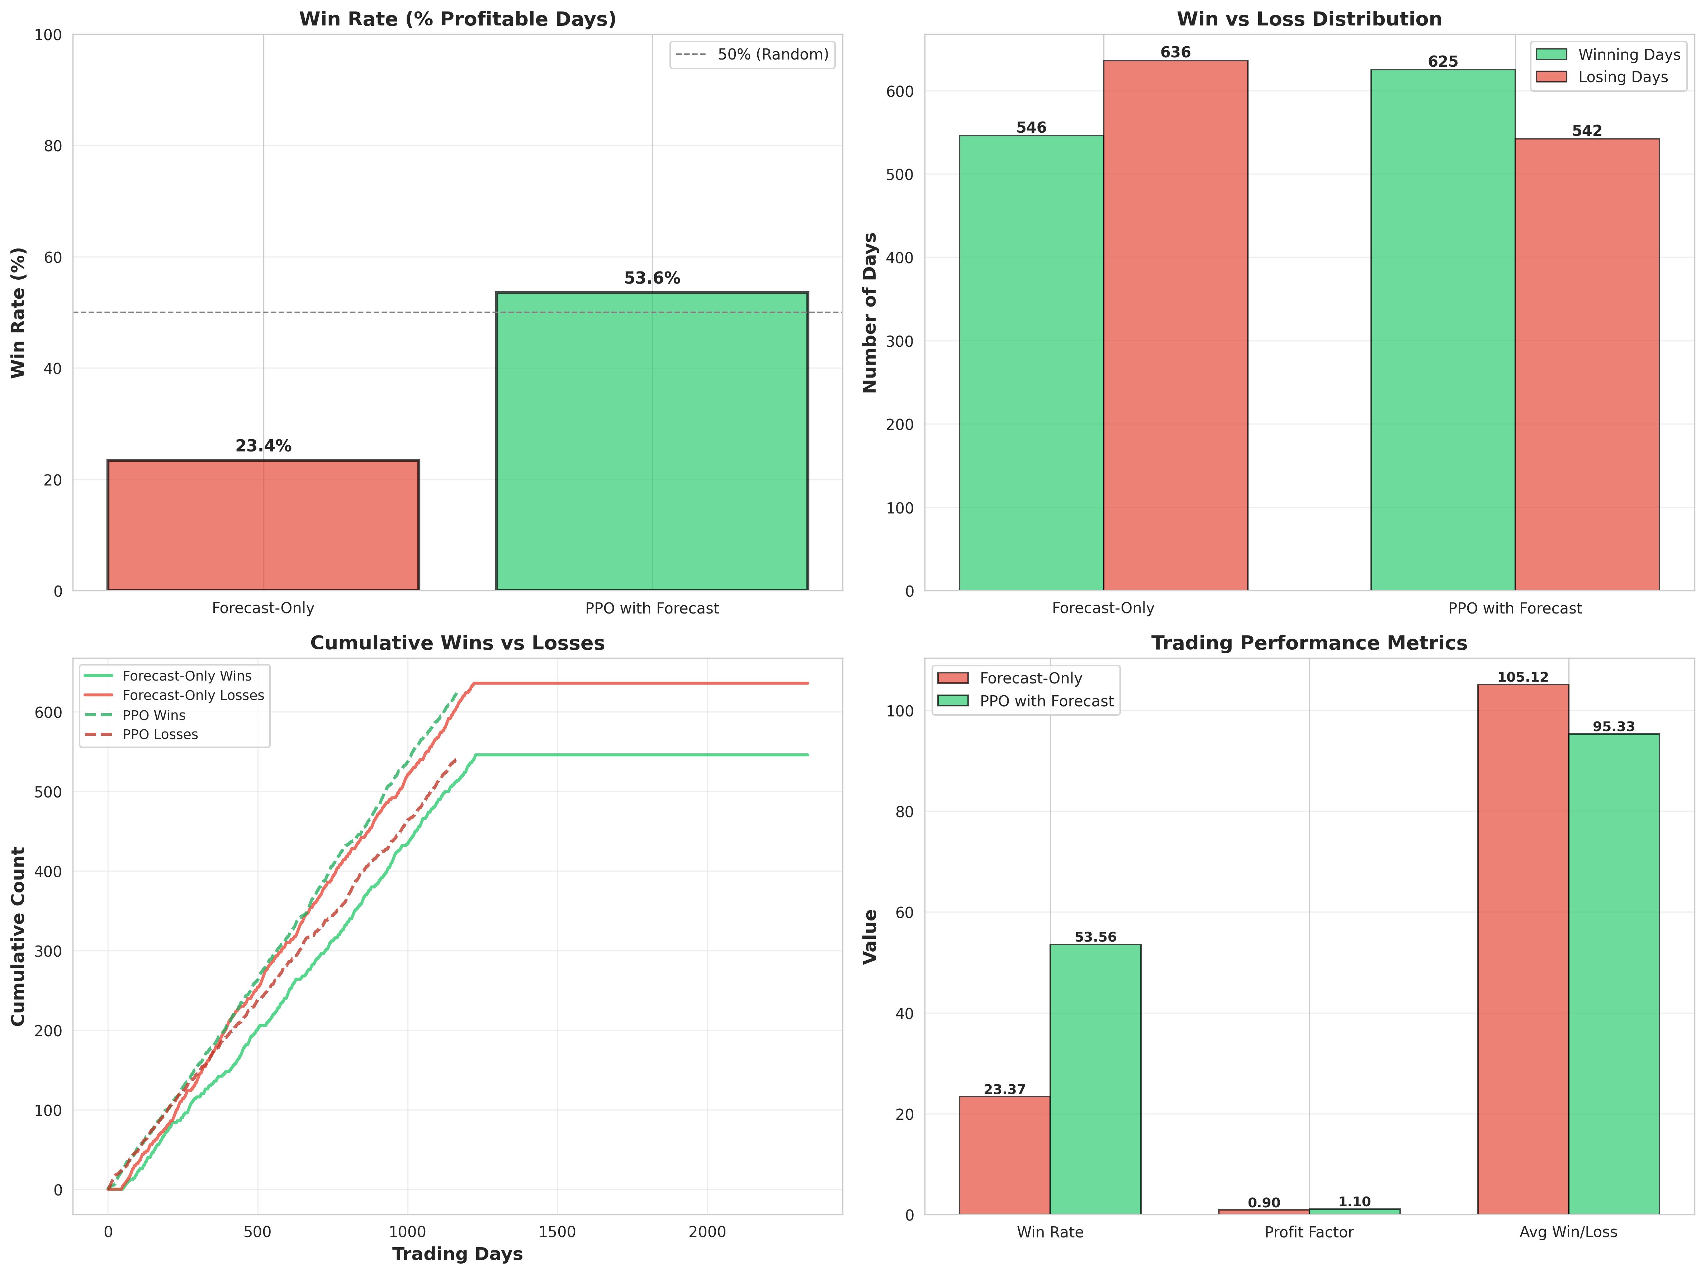
🎯 Win Rate & Trading Performance

Slide 19
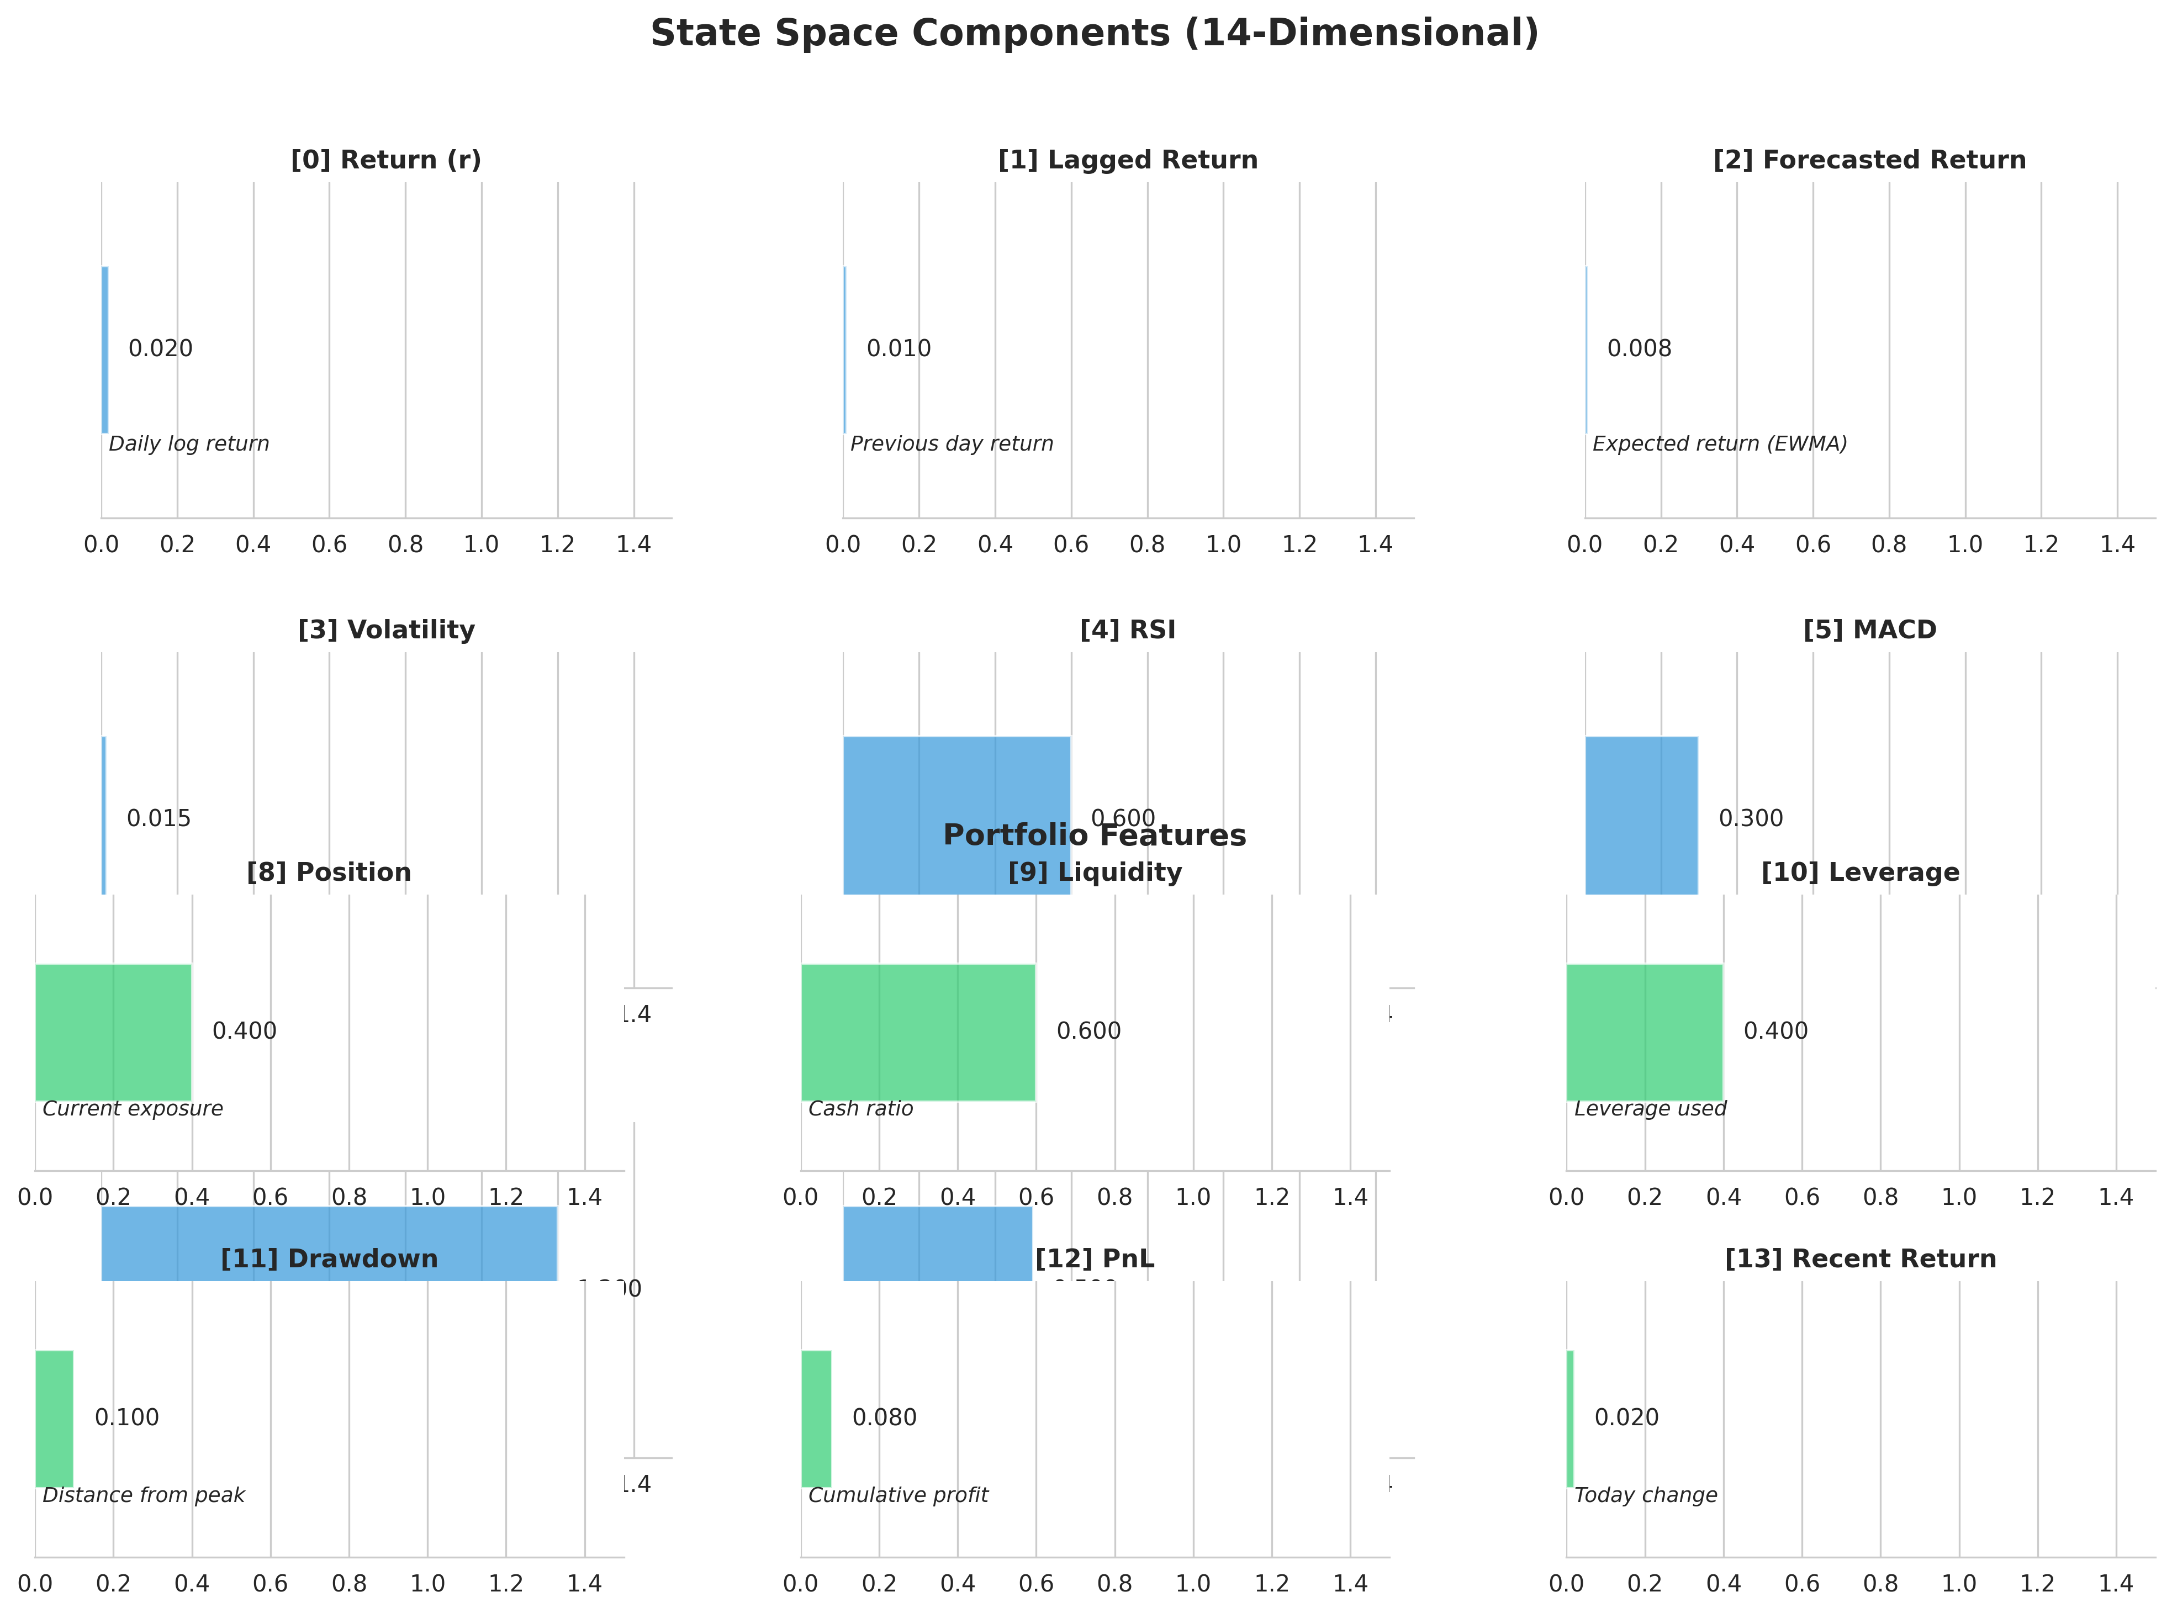
🎯 State Space Features

Slide 20
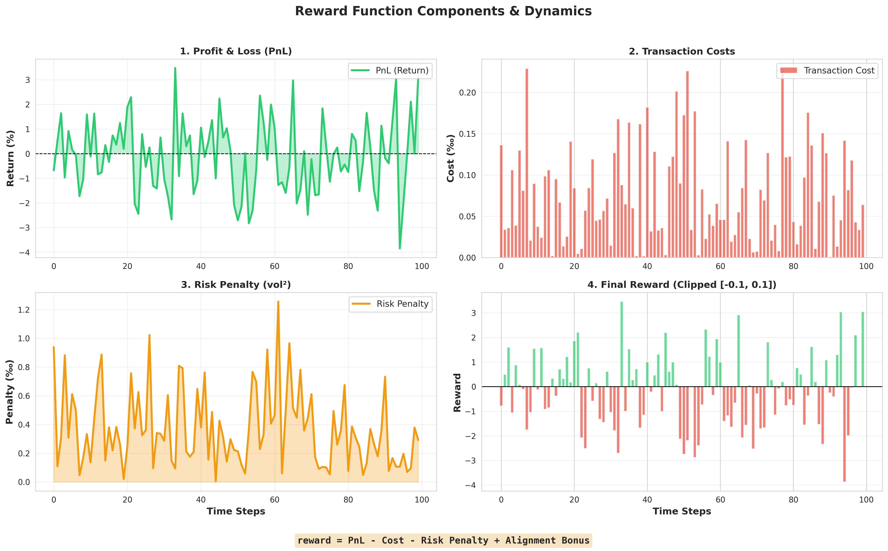
💰 Reward Function Dynamics

Slide 21
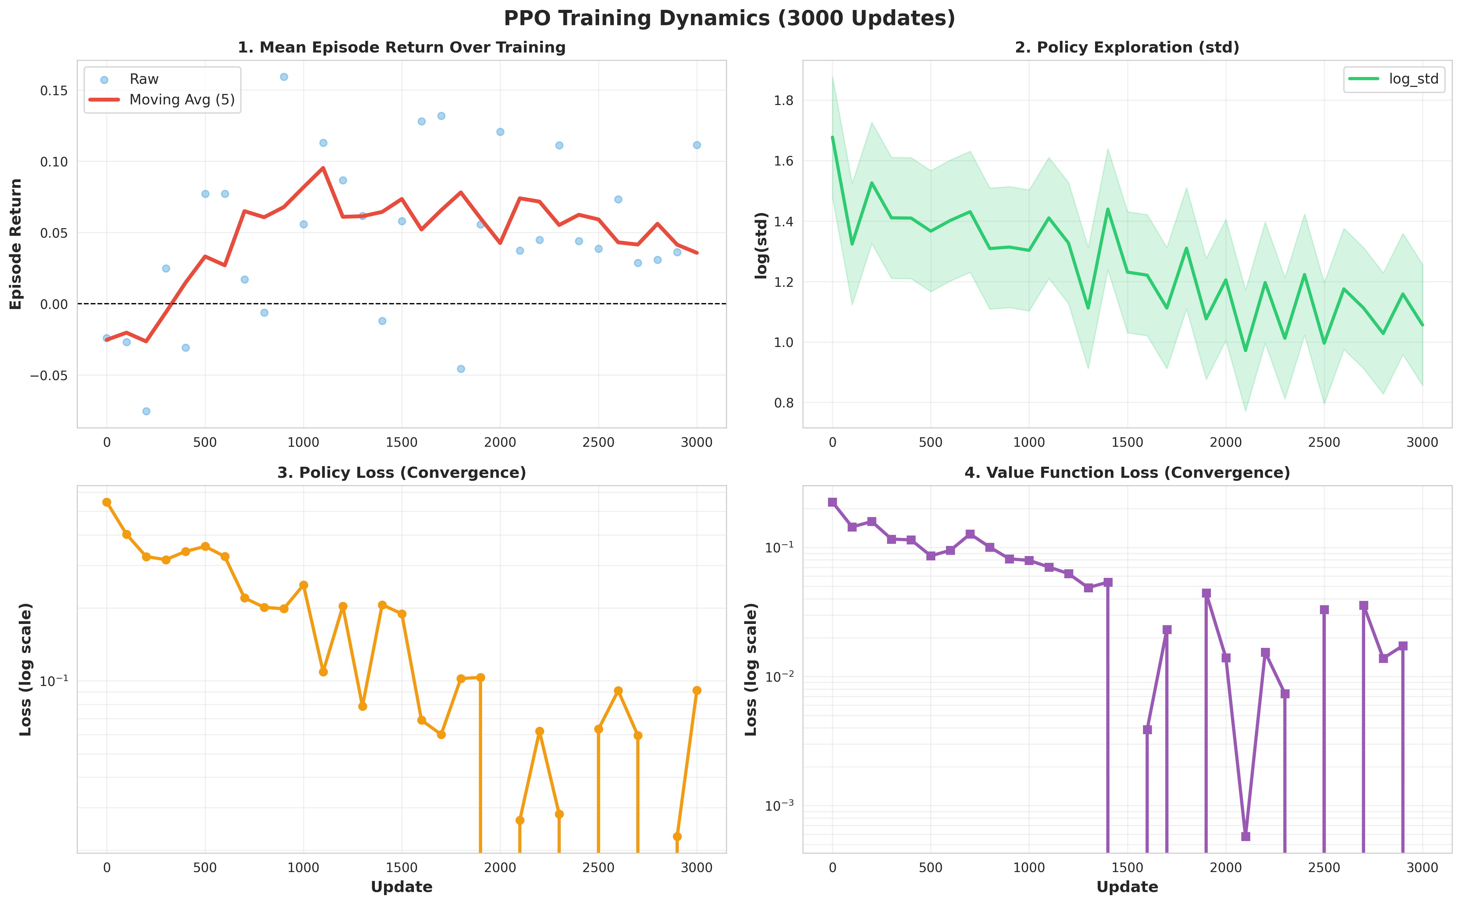
📈 Training Dynamics (3000 Updates)

Slide 22
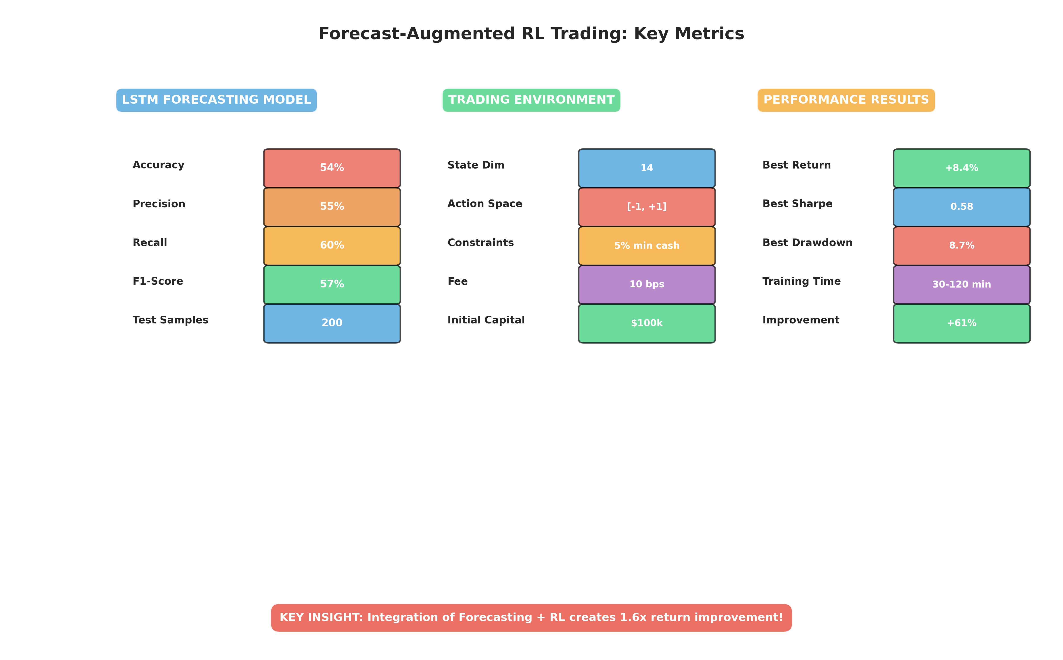
📋 Key Metrics Summary

Slide 23
Thank You
Questions?

