Slide 1
Let's get Func<Y>
Adding functional programming to your OOP codebase
Dennis Dietrich Manager Software Development ICS, Phoenix Contact
Rev. 5 (2026-05-03), https://github.com/dennisdietrich/FpWithCSharp/

Slide 2
Overview
Orders of functions
Pure functions
Functional programming (FP)
Closures
Examples
Next steps and further resources

Slide 3
But before we start…
Who here is already using functional programming?
Who here is using LINQ?
sessions.Where(s => s.Title.Contains("C#"))
.Select(s => s.Speaker)
.Distinct();

Slide 4
Orders of functions

Slide 5
Orders of functions First-order functions
// First-order functions take and return data
public static DateTime SpecifyKind(DateTime value, DateTimeKind kind) public static int Count<TSource>(this IEnumerable<TSource> source)
// Empty parameter list and void are data too
public static void Clear()

Slide 6
Orders of functions Higher-order functions (HOFs)
// HOFs take at least one function… public static IEnumerable<TResult> Select<TSource, TResult>( this IEnumerable<TSource> source, Func<TSource, TResult> selector) public Lazy(Func<T> valueFactory)
// …or return a function public T CreateDelegate<T>() where T : Delegate public new TDelegate Compile()

Slide 7
Pure functions

Slide 8

Pure functions Definition
Are deterministic
Always produce the same output for a given set of arguments
Never have side effects
Are the computer science equivalent of mathematical functions $f\left(x\right)=2x$

Slide 9
Pure functions Side effects
Mutating global state
Mutating arguments
Performing I/O
Throwing exceptions

Slide 10
Pure functions Why are exceptions side effects?
Exceptions alter only control-flow, not state…
…until you also consider “hidden” state

Slide 11
Pure functions Immutability
Don‘t rely on immutability by convention
Easy to violate accidentally
Variables captured in closures may be modified elsewhere
Worse yet, modification may happen during execution of pure function!
Easy to circumvent intentionally
Use immutable record types (C# 9 and later)…
…or hand-written immutable types (C# 8 and earlier)
Should return immutable object
Necessitates more memory copy operations

Slide 12
Pure functions - Sidebar When to optimize I
“Only when it’s worth it!” - Captain Obvious
Things to consider for each case:
Current cost
Expected performance improvement
Level of code churn
Estimated engineering effort
The maintainability hit is acceptable

Slide 13
Pure functions - Sidebar When to optimize II
Example scenario 1: You are not Facebook… like, at all!
Compute spend: $ 1,000 per month
Expected improvement: 10 %
Level of code churn: high (several substantial commits per month)
Estimated effort: $ 6,000
Worth it? No, certainly not!
Expected annual savings: $ 1,200
Payback period: 5 years

Slide 14
Pure functions - Sidebar When to optimize III
Example scenario 2: You are Facebook! …or Google, or Microsoft…
Compute spend: $ 1,000,000 per month
Expected improvement: 5 %
Level of code churn: low (a few minor commits per year)
Estimated effort: $ 100,000
Worth it? Yes, absolutely!
Expected annual savings: $ 600,000
Payback period: 2 months

Slide 15
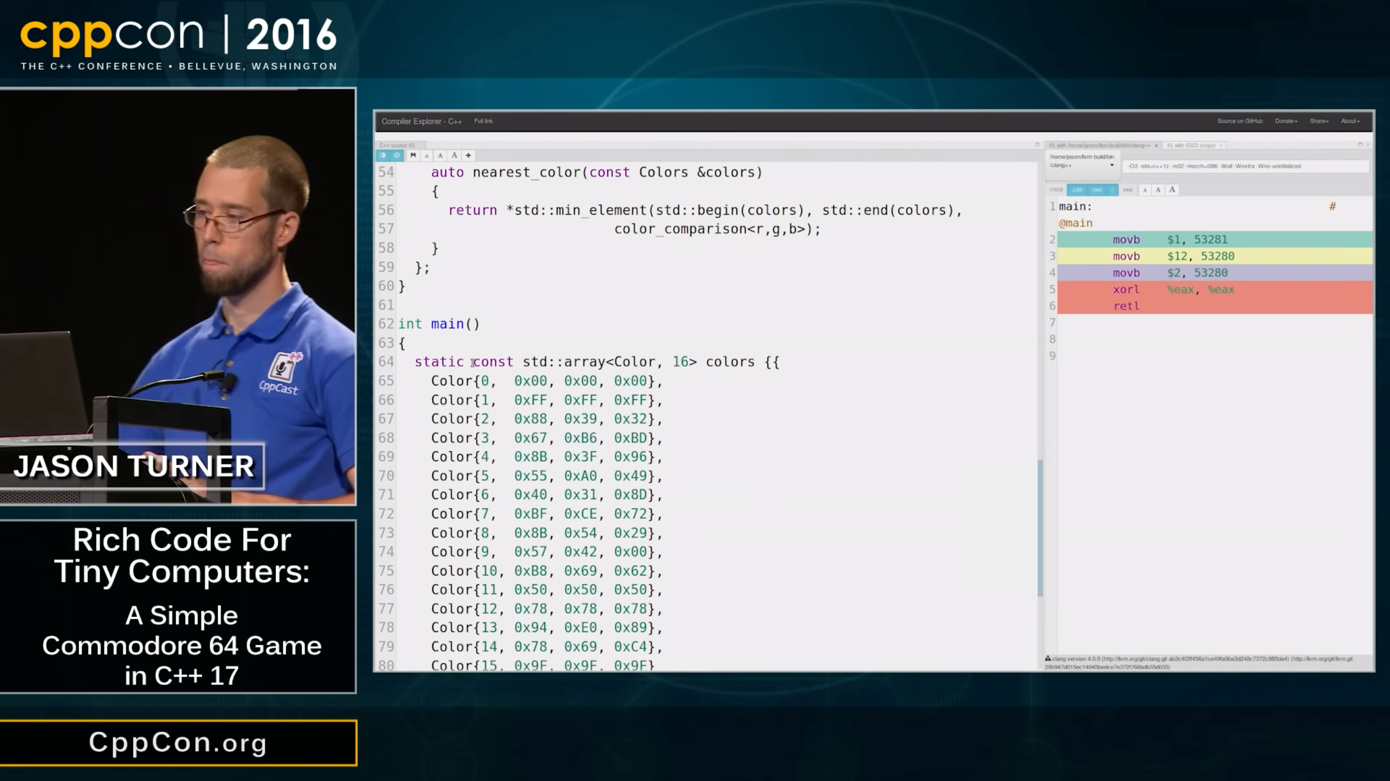
Pure functions Advantages
Better testability
Can always be memoized
Thread safety
Compile-time function execution
Rich Code for Tiny Computers: A Simple Commodore 64 Game in C++17 Jason Turner, CppCon 2016 https://www.youtube.com/watch?v=zBkNBP00wJE

Slide 16
Functional programming

Slide 17
Functional programming (FP) Definition I
“Functional programming is programming using pure functions that manipulate immutable values.” - Michał Płachta, Grokking Functional Programming
”Functional programming is sometimes treated as synonymous with purely functional programming, a subset of functional programming […].” - Wikipedia, Functional programming
“Purely functional programming usually designates a programming paradigm […] that treats all computation as the evaluation of mathematical functions.” - Wikipedia, Purely functional programming

Slide 18
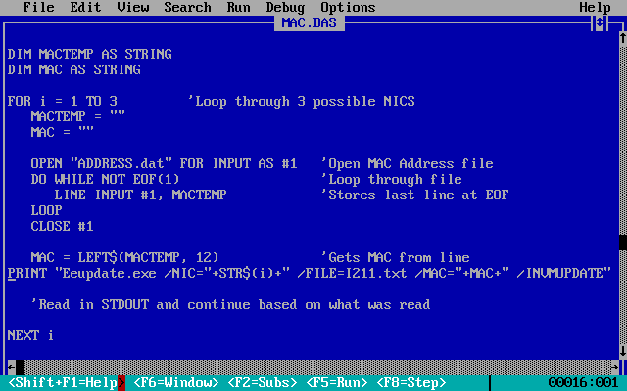
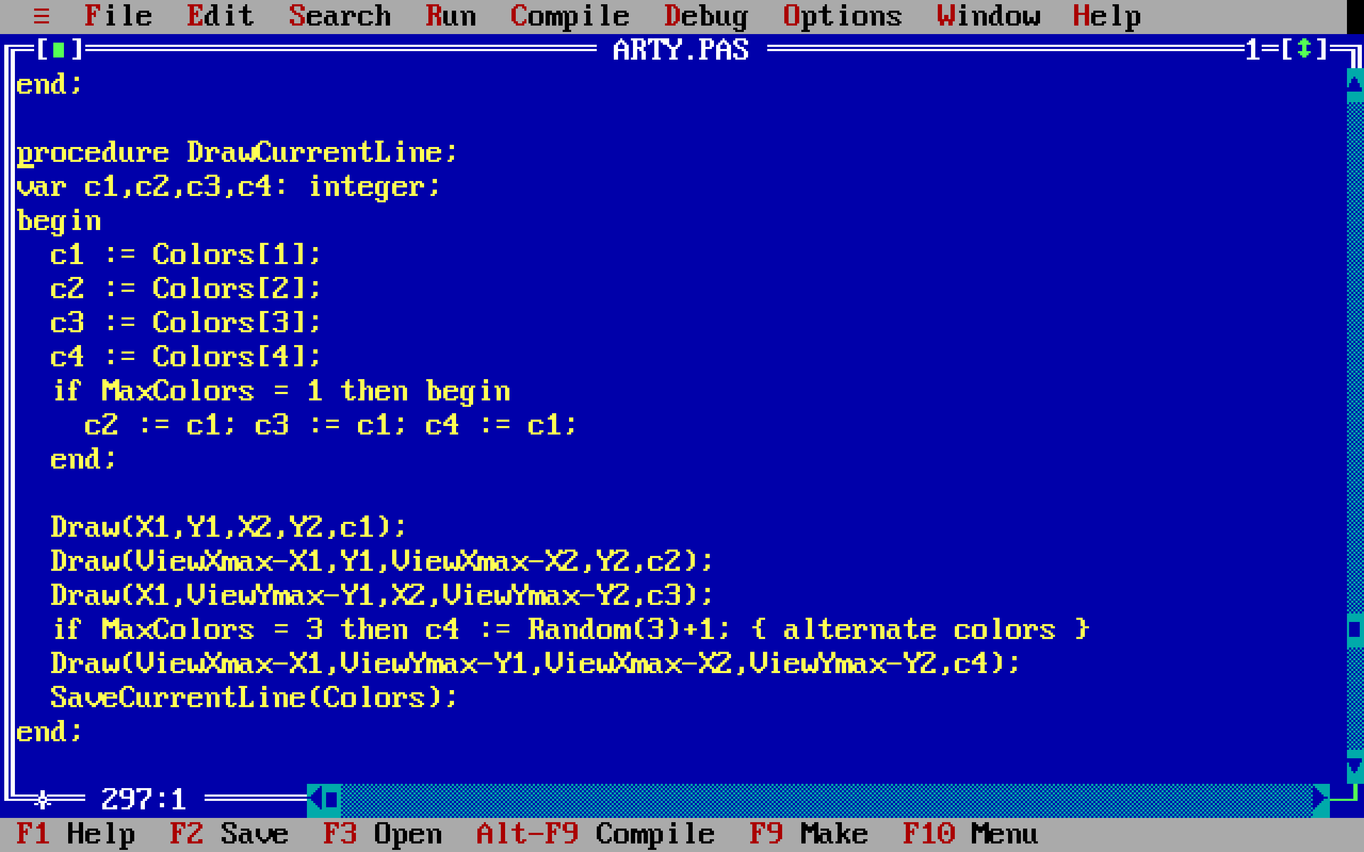
Functional programming (FP) Definition II
“At a high level, it’s a programming style that emphasizes functions while avoiding state mutations.” - Enrico Buonanno, Functional Programming in C#
“Functional programming is a programming paradigm where programs are constructed by applying and composing functions.” - Wikipedia, Functional programming
Notes:
The procedure in procedural programming refers to a callable unit, a.k.a. routine, subprogram, subroutine, or (in OOP) method.
“The first major procedural programming languages appeared circa 1957–1964, including Fortran, ALGOL, COBOL, PL/I and BASIC.[2] Pascal and C were published circa 1970–1972.”

Slide 19
Functional programming (FP) Definitive definition (for this talk)
“Functional programming is programming in a language that has first-class functions by defining and composing higher-order functions.” - Dennis Dietrich, Let's get Func<Y>

Slide 20
Functional programming (FP) Pattern matching
Supported in most functional languages including C# (since version 7)
Common feature of functional-first languages
“This article is about pattern matching in functional programming.” - Wikipedia, Pattern matching
“…” - Wikipedia, Functional programming

Slide 21
Closures

Slide 22
Closures Definition
A local or anonymous function that captures free variables
Orthogonal to order and purity
Used to create functions relying on runtime values that cannot be passed as arguments

Slide 23
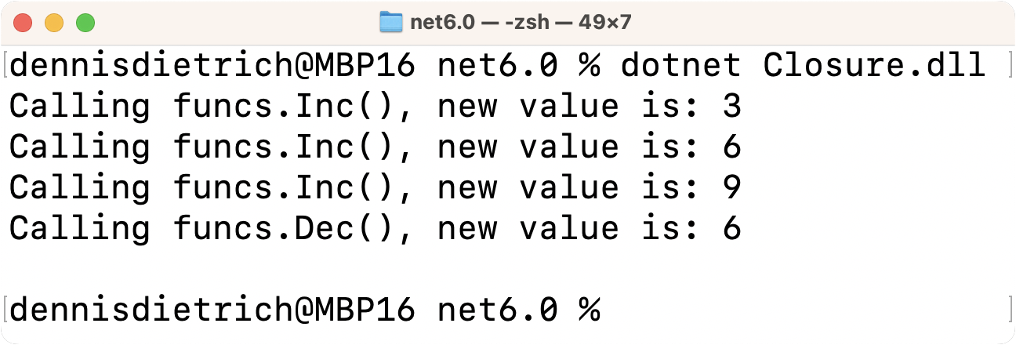
Closures Examples I
(Func<int> Inc, Func<int> Dec) CreateIncDecFuncPair(int increment) { int val = 0; return (() => val += increment, () => val -= increment); } var funcs = CreateIncDecFuncPair(3); Console.WriteLine($"Calling funcs.Inc(), new value is: {funcs.Inc()}"); Console.WriteLine($"Calling funcs.Inc(), new value is: {funcs.Inc()}"); Console.WriteLine($"Calling funcs.Inc(), new value is: {funcs.Inc()}"); Console.WriteLine($"Calling funcs.Dec(), new value is: {funcs.Dec()}");

Slide 24
Closures Examples II
sealed record Login(DateTime Timestamp,
string Username,
bool Successful); var minTimestamp = DateTime.Now.AddDays(-1); var last24Hours = logins.Where(l => l.Timestamp >= minTimestamp);

Slide 25
Examples

Slide 26
Examples Adding optional logging

Slide 27
Example - Adding optional logging The problem I
public sealed class HighLevelCallerNoTracing { private readonly LowLevelApiNoTracing _lowLevelApi = new(); public void Foo() { foreach (var file in _lowLevelApi.GetExpiredFiles()) ProcessExpiredFile(file); } // Dummy so we have something to call
// representing further business logic private void ProcessExpiredFile(FileInfo info) { } }

Slide 28
Example - Adding optional logging The problem II
public sealed class LowLevelApiNoTracing { public TimeSpan DefaultTtl { get; set; } public IList<FileInfo> GetExpiredFiles() => GetAllFiles().Where(f => { var effectiveTtl = EffectiveTtl(f); var lastAccess = File.GetLastAccessTimeUtc(f.FullName); var isExpired = lastAccess + effectiveTtl < DateTime.UtcNow; // What if we want to trace here? return isExpired; }).ToList(); // Dummies so we have something to call representing further business logic private IEnumerable<FileInfo> GetAllFiles() => Enumerable.Empty<FileInfo>(); private TimeSpan EffectiveTtl(FileInfo file) => DefaultTtl; }

Slide 29
Example - Adding optional logging OOP solution I
public sealed class HighLevelCallerWithLogger { private readonly LowLevelApiWithLogger _lowLevelApi = new(); public ILogger Logger { get; set; } public void Foo() { foreach (var file in _lowLevelApi.GetExpiredFiles(Logger)) ProcessExpiredFile(file); } // Dummy so we have something to call
// representing further business logic private void ProcessExpiredFile(FileInfo info) { } }

Slide 30
Example - Adding optional logging OOP solution II
public IList<FileInfo> GetExpiredFiles(ILogger? logger = null) => GetAllFiles().Where(f => { var effectiveTtl = EffectiveTtl(f); var lastAccess = File.GetLastAccessTimeUtc(f.FullName); var isExpired = lastAccess + effectiveTtl < DateTime.UtcNow; logger?.LogTrace(
"File {0} with access time {1} and TTL {2} has {3}expired",
f.FullName,
lastAccess,
effectiveTtl,
isExpired ? "" : "not "); return isExpired; }).ToList();
Notes:
Low-level API now has a dependency on ILogger defined in Microsoft.Extensions.Logging.Abstractions when it really shouldn’t.

Slide 31
Example - Adding optional logging Functional solution I
public delegate void Logger(string message, params object?[] args); public IList<FileInfo> GetExpiredFiles(Logger? logger = null) => GetAllFiles().Where(f => { var effectiveTtl = EffectiveTtl(f); var lastAccess = File.GetLastAccessTimeUtc(f.FullName); var isExpired = lastAccess + effectiveTtl < DateTime.UtcNow; logger?.Invoke(
"File {0} with access time {1} and TTL {2} has {3}expired",
f.FullName,
lastAccess,
effectiveTtl,
isExpired ? "" : "not "); return isExpired; }).ToList();

Slide 32
Example - Adding optional logging Functional solution II
private readonly LowLevelApiWithFunction _lowLevelApi = new(); public ILogger Logger { get; set; } public void Foo() { foreach (var file in _lowLevelApi.GetExpiredFiles(Logger.LogTrace)) ProcessExpiredFile(file); }

Slide 33
Example - Adding optional logging Functional solution III
private readonly LowLevelApiWithFunction _lowLevelApi = new(); public void Foo() { foreach (var file in _lowLevelApi.GetExpiredFiles(WriteTrace)) ProcessExpiredFile(file); } private static void WriteTrace(
string message, params object?[] args) => Trace.WriteLine(string.Format(message, args));

Slide 34
Examples Keeping things DRY

Slide 35
Example - Keeping things DRY The problem I
public sealed record Session(string Speaker, string Title); var session = new Session(
"Dennis Dietrich",
"So you think you know functions"); WriteToJsonFile("session.json", session); WriteToTxtFile("session.txt", session);

Slide 36
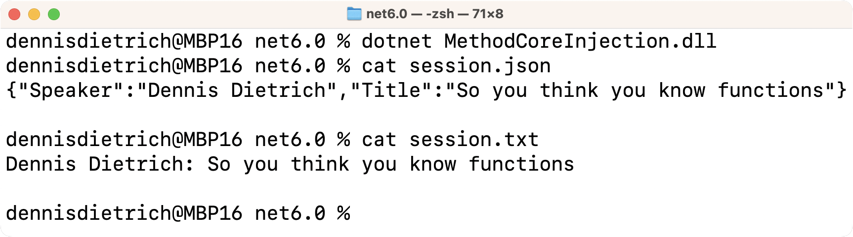
Example - Keeping things DRY The problem II
public static void WriteToJsonFile(string filename, Session session) { using var fileStream = new FileStream(filename, FileMode.CreateNew); JsonSerializer.Serialize(fileStream, session); File.SetAttributes(filename, FileAttributes.ReadOnly); } public static void WriteToTxtFile(string filename, Session session) { using var fileStream = new FileStream(filename, FileMode.CreateNew); using var streamWriter = new StreamWriter(fileStream); streamWriter.Write($"{session.Speaker}: {session.Title}"); File.SetAttributes(filename, FileAttributes.ReadOnly); }

Slide 37
Example - Keeping things DRY The problem III
public static void WriteToJsonFile(string filename, Session session) { using var fileStream = new FileStream(filename, FileMode.CreateNew); JsonSerializer.Serialize(fileStream, session); File.SetAttributes(filename, FileAttributes.ReadOnly); } public static void WriteToTxtFile(string filename, Session session) { using var fileStream = new FileStream(filename, FileMode.CreateNew); using var streamWriter = new StreamWriter(fileStream); streamWriter.Write($"{session.Speaker}: {session.Title}"); File.SetAttributes(filename, FileAttributes.ReadOnly); }
Duplicate code!

Slide 38
Example - Keeping things DRY OOP solution I
public abstract class FileWriter<T> { public void CreateNew(string filename, T content) { using var fileStream = new FileStream(filename, FileMode.CreateNew); CreateNewImpl(fileStream, content); File.SetAttributes(filename, FileAttributes.ReadOnly); } protected abstract void CreateNewImpl(FileStream fileStream, T session); }

Slide 39
Example - Keeping things DRY OOP solution II
public sealed class JsonFileWriter<T> : FileWriter<T>
{ protected override void CreateNewImpl(FileStream fileStream, T session) => JsonSerializer.Serialize(fileStream, session); } public sealed class SessionTxtFileWriter : FileWriter<Session>
{ protected override void CreateNewImpl(FileStream fileStream,
Session session)
{ using var streamWriter = new StreamWriter(fileStream); streamWriter.Write($"{session.Speaker}: {session.Title}"); } }

Slide 40
Example - Keeping things DRY Functional solution
public static void CreateNewFile(string filename, Action<FileStream> action) { using var fileStream = new FileStream(filename, FileMode.CreateNew); action(fileStream); File.SetAttributes(filename, FileAttributes.ReadOnly); } public static void WriteToJsonFile<T>(string filename, T session) => CreateNewFile(filename, s => JsonSerializer.Serialize(s, session)); public static void WriteToTxtFile(string filename, Session session) => CreateNewFile(filename, s => { using var streamWriter = new StreamWriter(s); streamWriter.Write($"{session.Speaker}: {session.Title}"); });

Slide 41
Example - Keeping things DRY The problem reloaded
What if we want to add
optional exception handling?

Slide 42
Example - Keeping things DRY OOP solution reloaded I
public sealed class IOExceptionHandler : IExceptionHandler<IOException> { public bool Handle(IOException e) { Console.WriteLine(e); return false; } }
var handler = new IOExceptionHandler(); new JsonFileWriterWithExceptionHandling<Session, IOException>
{ ExceptionHandler = handler }.CreateNew("session.json", session); new SessionTxtFileWriterWithExceptionHandling<IOException>
{ ExceptionHandler = handler }.CreateNew("session.txt", session);

Slide 43
Example - Keeping things DRY OOP solution reloaded II
public abstract class FileWriterWithExceptionHandling<TCont, TEx>
where TEx : Exception { public IExceptionHandler<TEx>? ExceptionHandler { get; init; } public void CreateNew(string filename, TCont content) { try { using var fileStream = new FileStream(filename, FileMode.CreateNew); CreateNewImpl(fileStream, content); File.SetAttributes(filename, FileAttributes.ReadOnly); } catch (TEx e) when (ExceptionHandler != null) { if (ExceptionHandler.Handle(e)) throw; } } protected abstract void CreateNewImpl(FileStream fileStream, TCont session); }
Notes:
Alternatively, we could wrap FileWriter<T> (if we don’t have the source, we’d have to).

Slide 44
Example - Keeping things DRY Functional solution reloaded I
public static void CreateNewFile(string filename, Action<FileStream> action) { using var fileStream = new FileStream(filename, FileMode.CreateNew); action(fileStream); File.SetAttributes(filename, FileAttributes.ReadOnly); } public static void WriteToJsonFile<T>(string filename, T session) => CreateNewFile(filename, s => JsonSerializer.Serialize(s, session)); public static void WriteToTxtFile(string filename, Session session) => CreateNewFile(filename, s => { using var streamWriter = new StreamWriter(s); streamWriter.Write($"{session.Speaker}: {session.Title}"); });
Nothing needs
to change!

Slide 45
Example - Keeping things DRY Functional solution reloaded II
public static void CreateNewFile(string filename, Action<FileStream> action) { using var fileStream = new FileStream(filename, FileMode.CreateNew); action(fileStream); File.SetAttributes(filename, FileAttributes.ReadOnly); } public static void WriteToJsonFile<T>(string filename, T session) => CreateNewFile(filename, s => JsonSerializer.Serialize(s, session)); public static void WriteToTxtFile(string filename, Session session) => CreateNewFile(filename, s => { using var streamWriter = new StreamWriter(s); streamWriter.Write($"{session.Speaker}: {session.Title}"); });
public static void WithExceptionHandler<T>
(Action action, Func<T, bool> handler) where T : Exception { try { action(); } catch (T e) { if (handler(e)) throw; } }

Slide 46
Example - Keeping things DRY Functional solution reloaded III
var handler = (IOException e) => { Console.WriteLine(e); return false; };
var writeToJsonFile = (string n, Session s) =>
WithExceptionHandler(() => WriteToJsonFile(n, s), handler); var writeToTxtFile = (string n, Session s) =>
WithExceptionHandler(() => WriteToTxtFile(n, s), handler); writeToJsonFile("session.json", session); writeToTxtFile("session.txt", session);

Slide 47
“Disadvantages” of FP - Sidebar
Performance
Memory copy overhead
Heap allocations
Level of abstraction
Higher (or at least different)
Combined with other abstract concepts
Not as popular as OOP

Slide 48
Examples Generator

Slide 49
Example - Generator The problem
Write a generator that outputs an infinite
sequence of DateTime values with a given interval

Slide 50
Example - Generator Generator solution I
public static IEnumerable<DateTime> CreateEnumerable(
DateTime start, int interval) { if (interval < 1) throw new ArgumentOutOfRangeException(
nameof(interval), "Interval must be greater than zero."); while (true) { var nextTime = start.AddSeconds(interval); yield return start; start = nextTime; } }

Slide 51
Example - Generator Generator solution II
const int iterations = 5; const int interval = 3; var startTime = new DateTime(2023, 01, 23, 20, 28, 0); Console.WriteLine($"Generating {iterations} times with {interval} seconds interval using generator implementation..."); using IEnumerator<DateTime> times = TimeGenerator.CreateEnumerable(
startTime, interval).GetEnumerator();
for (var i = 0; i < iterations; i++) { times.MoveNext(); Console.WriteLine($"{times.Current:u}"); }

Slide 52
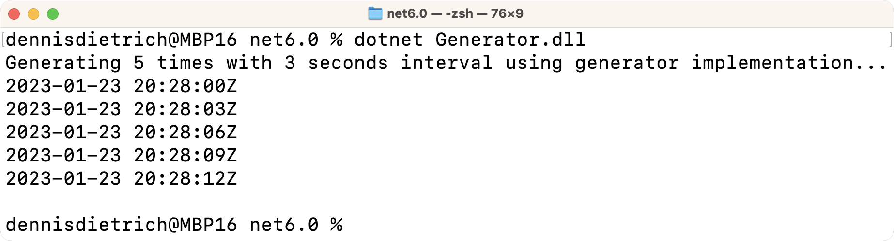
Example - Generator Generator solution III
const int iterations = 5; const int interval = 3; var startTime = new DateTime(2023, 01, 23, 20, 28, 0); Console.WriteLine($"Generating {iterations} times with {interval} seconds interval using generator implementation..."); using IEnumerator<DateTime> times = TimeGenerator.CreateEnumerable(
startTime, interval).GetEnumerator();
for (var i = 0; i < iterations; i++) Console.WriteLine($"{times.GetNext():u}");

Slide 53
Example - Generator FP solution I
public static Func<DateTime> CreateFunction(
DateTime start, int interval) { if (interval < 1) throw new ArgumentOutOfRangeException(
nameof(interval), "Interval must be greater than zero."); return () => { var currentTime = start; start = start.AddSeconds(interval); return currentTime; }; }

Slide 54
Example - Generator FP solution II
const int iterations = 5; const int interval = 3; var startTime = new DateTime(2023, 01, 23, 20, 28, 0); Console.WriteLine($"Generating {iterations} times with {interval} seconds interval using functional implementation..."); Func<DateTime> times =
TimeGenerator.CreateFunction(startTime, interval);
for (var i = 0; i < iterations; i++) Console.WriteLine($"{times():u}");

Slide 55
Example - Generator The problem reloaded
Now synchronize it!

Slide 56
Example - Generator Generator solution reloaded I
// See also:
// https://codeblog.jonskeet.uk/2009/10/23/iterating-atomically/ public interface ISynchronizedEnumerator<T> : IDisposable { public bool GetNext(out T? nextValue); }

Slide 57
Example - Generator Generator solution reloaded II
public static class IEnumerableExtensions { public static ISynchronizedEnumerator<T> GetSynchronizedEnumerator<T>(this IEnumerable<T> enumerable) =>
new SynchronizedEnumerator<T>(enumerable); private sealed class SynchronizedEnumerator<T> : ISynchronizedEnumerator<T> { private readonly object _syncRoot = new(); private readonly IEnumerator<T> _enumerator; internal SynchronizedEnumerator(IEnumerable<T> enumerable) => _enumerator = enumerable.GetEnumerator(); public bool GetNext(out T? nextValue) { lock (_syncRoot) { var valueAvailable = _enumerator.MoveNext(); nextValue = valueAvailable ? _enumerator.Current : default; return valueAvailable; } } public void Dispose() => _enumerator.Dispose(); } }

Slide 58
Example - Generator FP solution reloaded I
public static Func<DateTime> CreateFunction(
DateTime start, int interval) { if (interval < 1) throw new ArgumentOutOfRangeException(
nameof(interval), "Interval must be greater than zero."); return () => { var currentTime = start; start = start.AddSeconds(interval); return currentTime; }; }
Nothing needs
to change!

Slide 59
Example - Generator FP solution reloaded II
public static Func<DateTime> CreateFunction(
DateTime start, int interval) { if (interval < 1) throw new ArgumentOutOfRangeException(
nameof(interval), "Interval must be greater than zero."); return () => { var currentTime = start; start = start.AddSeconds(interval); return currentTime; }; }
public static Func<T> Synchronized<T>(Func<T> func) { object syncRoot = new(); return () => { lock (syncRoot) return func(); }; }

Slide 60
Example - Generator FP solution reloaded III
const int iterations = 5; const int interval = 3; var startTime = new DateTime(2023, 01, 23, 20, 28, 0); Console.WriteLine($"Generating {iterations} times with {interval} seconds interval using functional implementation..."); Func<DateTime> times =
Synchronized(TimeGenerator.CreateFunction(startTime, interval)); for (var i = 0; i < iterations; i++) Console.WriteLine($"{times():u}");

Slide 61
Next steps and further resources

Slide 62
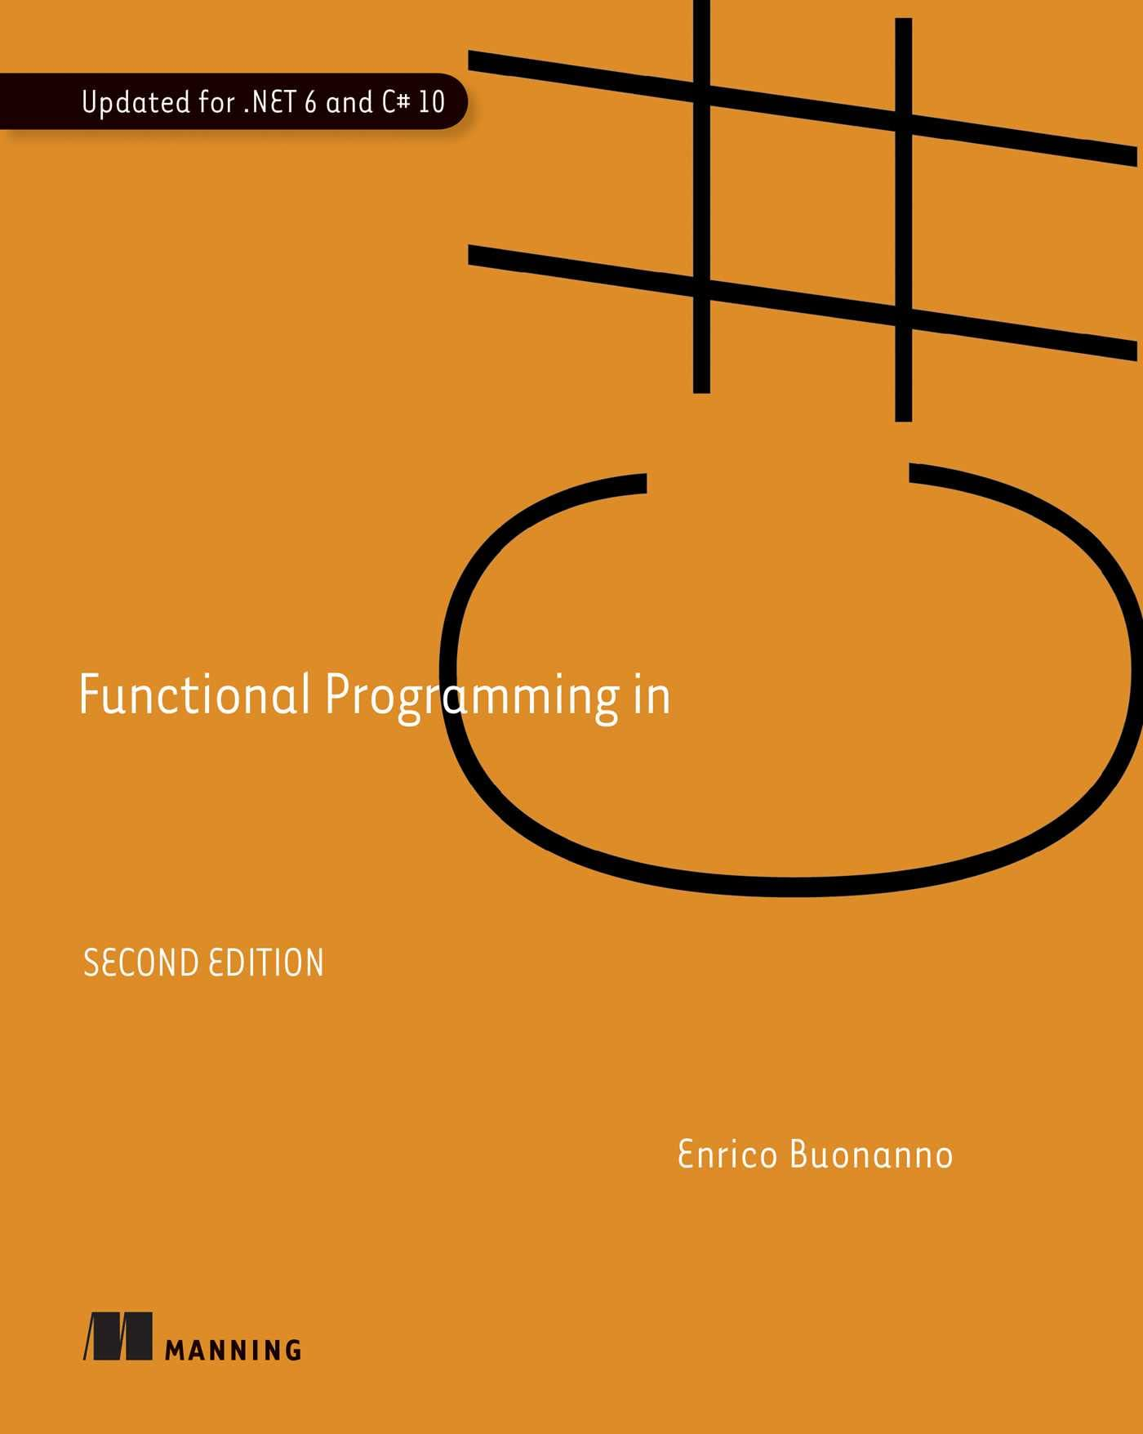
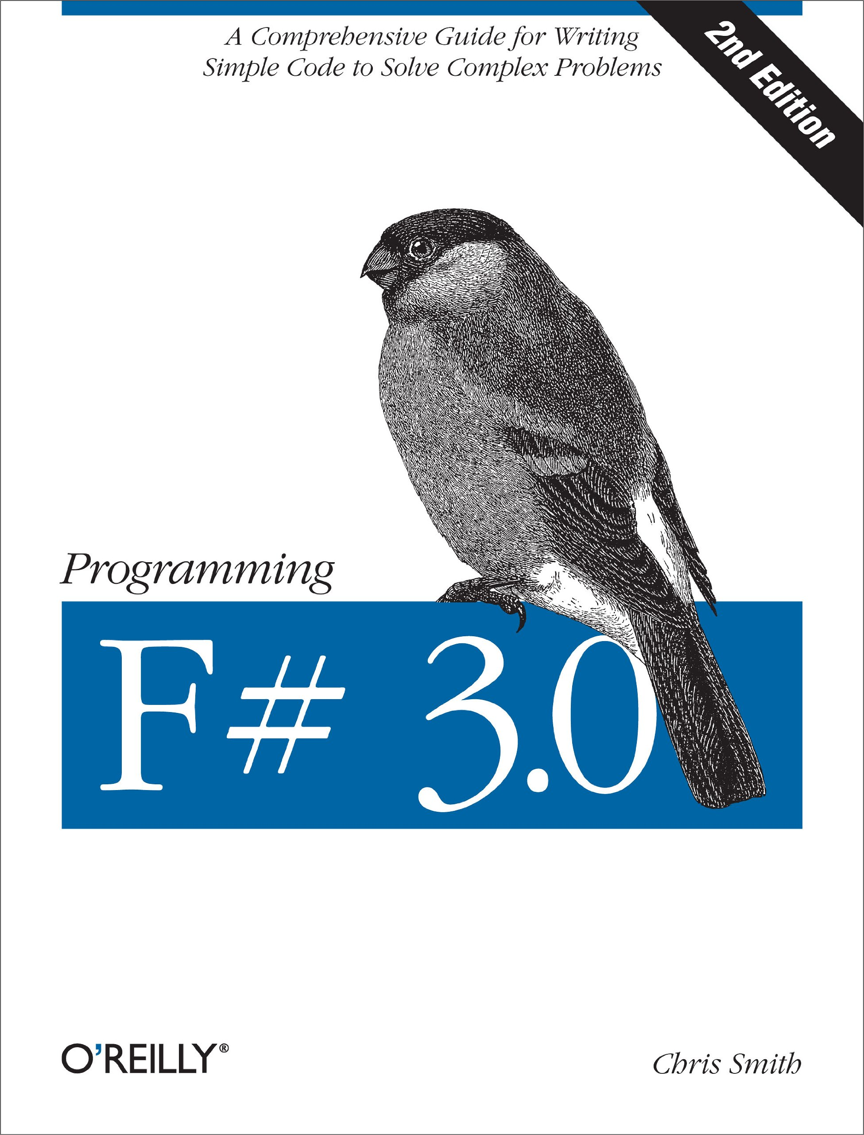
Next steps and further resources FP with .NET
Functional Programming in C#
Enrico Buonanno
Manning Publications
978-1617299827
Programming F# 3.0
Chris Smith
O'Reilly Media
978-1449320294

Slide 63
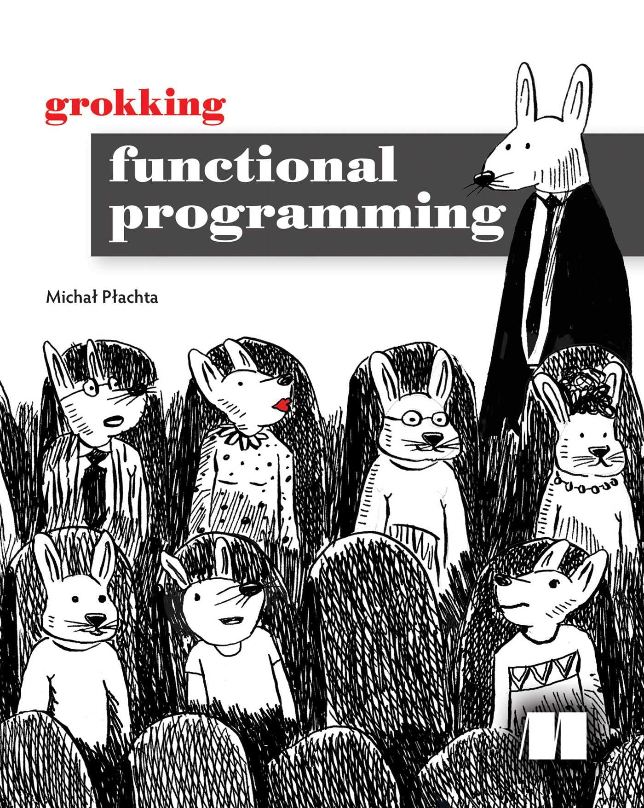
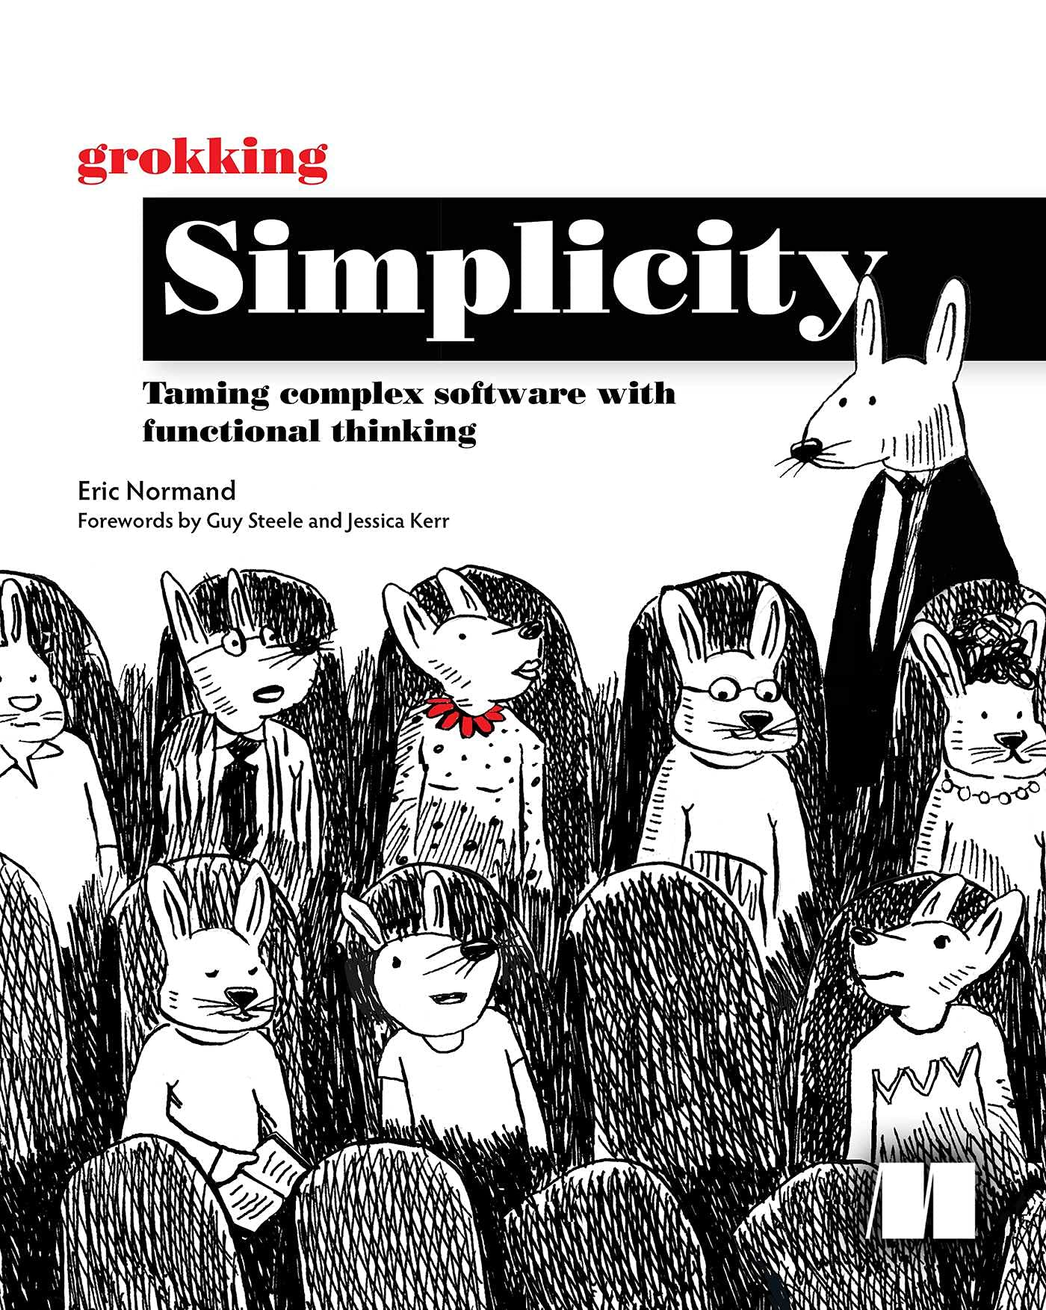
Next steps and further resources FP in general
Grokking Functional Programming
Michał Płachta
Manning Publications
978-1617291838
Grokking Simplicity
Eric Normand
Manning Publications
978-1617296208

Slide 64


Questions?
dennisdietrich
dcdietrich
@dcdietrich.bsky.social

Slide 65
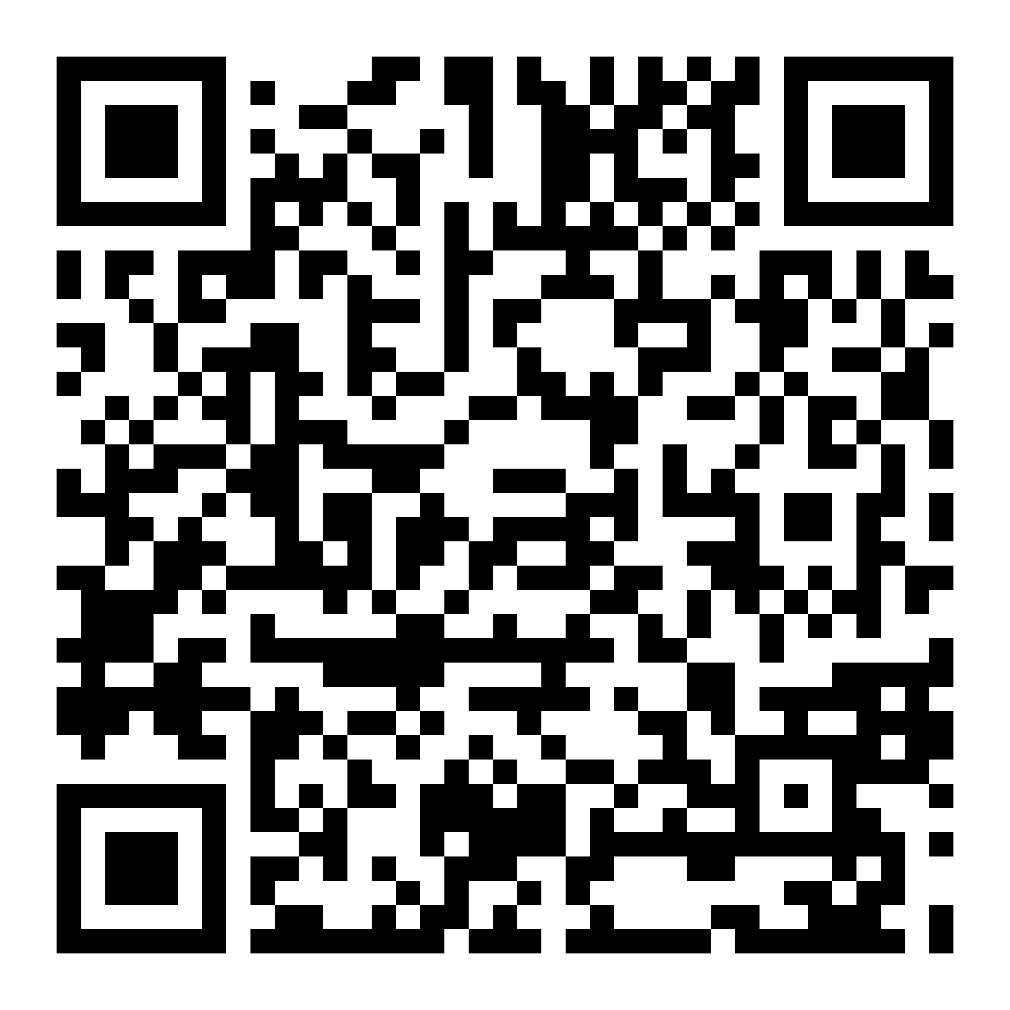
Thanks for listening!
dennisdietrich
dcdietrich
@dcdietrich.bsky.social

