Slide 1
Let's get Func<Y>
Adding functional programming to your OOP codebase
Dennis Dietrich Senior Software Engineer, Microsoft
Rev. 1 (2023-??-??), https://github.com/dennisdietrich/FpWithCSharp/

Slide 2
Overview
Orders of functions
Pure functions
Functional programming (FP)
Closures
Examples
Next steps and further resources

Slide 3
But before we start…
Who here is already using functional programming?
Who here is using LINQ?
sessions.Where(s => s.Title.Contains("C#"))
.Select(s => s.Speaker)
.Distinct();

Slide 4
Orders of functions

Slide 5
Orders of functions First-order functions
// First-order functions take and return data // Examples:
public static DateTime SpecifyKind(DateTime value, DateTimeKind kind) public static int Count<TSource>(this IEnumerable<TSource> source)
// Instance method with hidden this parameter public char[] ToCharArray()
// Empty parameter list and void are data too
public static void Clear()

Slide 6
Orders of functions Higher-order functions (HOFs)
// HOFs take at least one function or return a function // Examples:
public static IEnumerable<TResult> Select<TSource, TResult>( this IEnumerable<TSource> source, Func<TSource, TResult> selector) public Lazy(Func<T> valueFactory)
public static IServiceCollection AddTransient<TService>( this IServiceCollection services, Func<IServiceProvider, TService> implementationFactory) where TService : class

Slide 7
Pure functions

Slide 8
Pure functions Definition
Always produce the same output for a given set of arguments
Never have side effects

Slide 9
Pure functions Side effects
Mutating global state
Mutating arguments
Performing I/O
Throwing exceptions

Slide 10
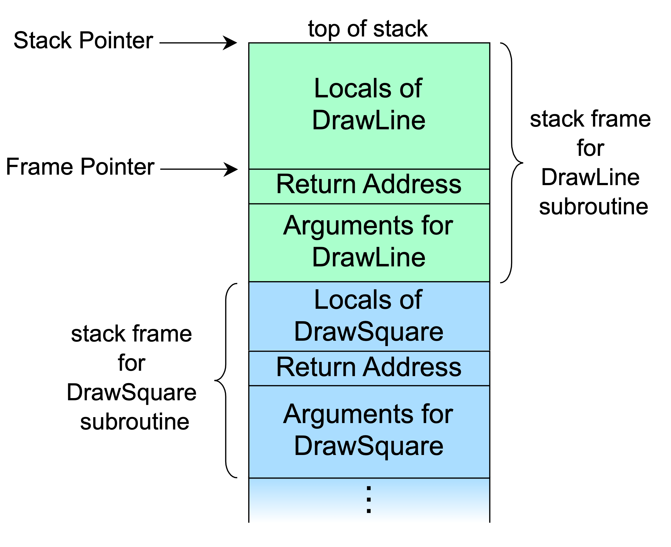
Pure functions Why are exceptions side effects?
Exceptions alter only control-flow, not state…
…unless you also consider “hidden” state (and you should)

Slide 11
Pure functions Immutability
Don‘t rely on immutability by convention
Easy to violate accidentally
Values captures in closures my be modified elsewhere
Worse yet, modification may happen during execution of pure function!
Easy to circumvent intentionally
Use immutable record types (C# 9 and later)…
…or hand-written immutable types (C# 8 and earlier)
Should return immutable object

Slide 12
Sidebar When to optimize for performance

Slide 13
Pure functions Advantages
Don

Slide 14
Sidebar Referential transparency

Slide 15
Sidebar Compile-time function execution

Slide 16
Functional programming

Slide 17
Functional programming (FP) Definition

Slide 18
Functional programming (FP) Pattern matching

Slide 19
Closures

Slide 20
Closures Partial application

Slide 21
Examples

Slide 22
Sidebar The “problem” with FP

Slide 23
Next steps and further resources

Slide 24
Next steps and further resources More FP with C#

Slide 25
Next steps and further resources Functional(-first) languages

Slide 26
Next steps and further resources Learning more about FP

Slide 27



Questions?
dennisdietrich
dcdietrich
@dc@social.advancedsoftware.engineering

Slide 28
Thanks for listening!
dennisdietrich
dcdietrich
@dc@social.advancedsoftware.engineering

