Slide 1
Election Political Online Sentiment
Presenter: Dennis Hsu
CS 262
November 30, 2016

Slide 2
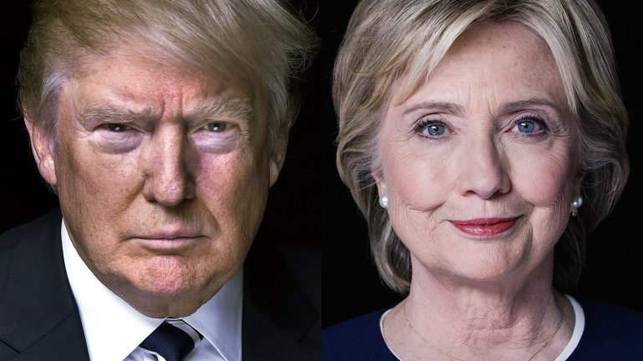
Outline
Introduction
Background
Current Solution
Randomization Techniques
Implementation
Experiment Results
Conclusion/Future Work

Slide 3
Introduction
Problem: Polls showing support for election political candidates are always changing and rarely accurate
Polls are based on voluntary surveys
Social Media, such as Twitter, provides an excellent source for data mining
Current Sentiment for each candidate
Not just voluntary
Goal: To use Twitter to get the current online sentiment for political candidates (Clinton, Trump)

Slide 4
Introduction
Limitations
Online Sentiment only
Vocal/Active Twitter users
“Echo Chamber” problem
Online does not represent the silent majority
Contribution: applied randomization to decrease amount of tweets stored to represent the current online sentiment/support for each political candidate

Slide 5
Background
Techniques, Tools used
Sentiment Analysis—used to label tweets as positive or negative
Natural Language Processing—convert text/tweets into features
Machine Learning—used to classify whether each tweet supports or not supports the candidate

Slide 6
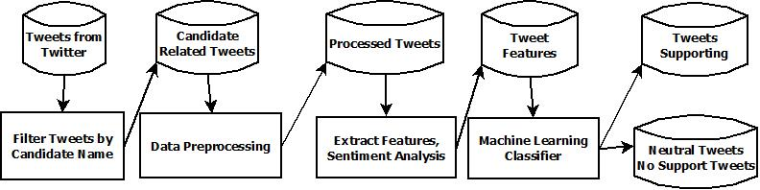
Previous Solution
Pipeline(Before)

Slide 7
Current Solution
Steps
Filter Tweets related to the candidate –(contains “Hillary Clinton” or “Donald Trump”)
Preprocess each Tweet into features—Sentiment Analysis, N-grams
Train Classifier separately for each candidate with labeled data (1 for support, 0 for oppose)
Use Train Classifier on an incoming stream of candidate-related tweets
Get current online sentiment for the candidate

Slide 8
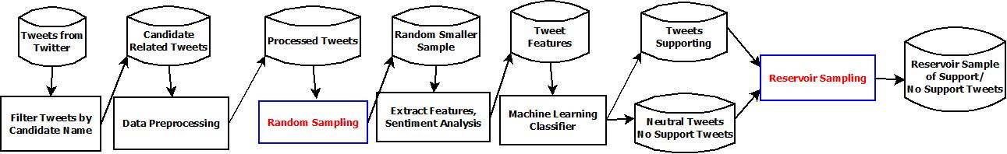
Randomization Applied
Pipeline(Randomization)

Slide 9
Randomization Techniques
Randomization
Filter Tweets related to the candidate –(contains “Hillary Clinton” or “Donald Trump”)
Preprocess each Tweet into features—Sentiment Analysis, N-grams
Train Classifier separately for each candidate with labeled data (1 for support, 0 for oppose)
Random smaller sample used instead of a larger set
Use Train Classifier on an incoming stream of candidate-related tweets
Get current online sentiment for the candidate
Reservoir Sampling—keep a smaller sample of tweets to represent larger set

Slide 10
Randomization Techniques
Random smaller sample used instead of a larger set
Decrease time to train classifier
Goal: Maintain accuracy of classifier
Expectation: Drop in accuracy of classifier
Reservoir Sampling—keep a smaller sample of tweets to represent larger set
Online: Smaller Sample to keep to represent current set of classified tweets
Goal: Reduce amount of tweets needed to be kept
Expectation: Reservoir Sample should closely represent all tweets classified

Slide 11
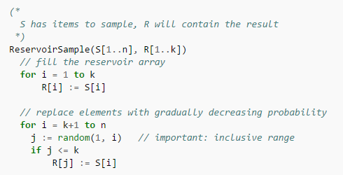
Reservoir Sampling
Keep the first tweet in memory
When the i-th tweet arrives (for i>1):
with probability 1/i, keep the new item(discard an old tweet)
With probability 1 – 1/i, keep old items(ignore new tweet)
Induction:
when there is only one item, it is kept with probability 1
when there are 2 items, each of them is kept with probability ½
when there are 3 items, the third item is kept with probability 1/3, and each of the previous 2 items is also kept with probability (1/2)(1-1/3) = (1/2)(2/3) = 1/3
by induction, it is easy to prove that when there are n items, each item is kept with probability 1/n
From: https://en.wikipedia.org/wiki/Reservoir_sampling

Slide 12
Implementation
My Laptop was stolen Dec.5th evening, lost data/results/powerpoint; had to redo it from scratch; All of the following slides were from the before results(will have update slides later)
Tweepy—Filtered tweets related to “Hillary Clinton” and “Donald Trump”
1,000,000 tweets per candidate filtered on election day (Nov 8, 2016) and day before (Nov 7)
Dataset—“Hillary Clinton”
Labeled tweets for training
402 tweets used to train classifier
Smaller random sample: 200 tweets used to train classifier
Balanced dataset: half positive, half negative/neutral

Slide 13
Implementation
Tweet Pre-Processing to reduce noise, spam—Regex, Natural Language ToolKit(NLTK)
Filter out tweets with links; filter out retweets
Remove similar tweets
Similarity Index: 0.6 was found to be the best
Used Python’s diff library SequenceMatcher
Remove symbols, punctuation
Tokenization into words
Lemmatization—Base form of words to reduce noise

Slide 14
Implementation--Example
Example filter
Removed
RT @joshtpm: Hillary Clinton's popular vote lead now stands at 2.654 million votes, a 2 percentage point lead over Donald Trump, 48.2% to 4…
"CPAC 2013: Donald Trump: Immigration reform is a ‘suicide mission’ for GOP" http://t.co/WdMLJcXZLL by @SethMcLaughlin1
Kept
'A lot depends on who the real Donald Trump is.' - @BT_SDSC @PerthUSAsia #perthusasiatalks
a lot depends on who the real Donald Trump is perthusasiatalks

Slide 15
Implementation—Get Features
Sentiment Analysis—lexicons—get a sentiment score for each tweet
Sentiwordnet—combine positive/negative scores
AFINN—get sum of scores
N-grams—convert text into set of n-grams as features
Unigrams, bigrams—convert into sets of one word/two words as well as one character/two characters
Combine together into set of features
Convert features into a feature matrix using a vectorizer

Slide 16
Implementation--Classifier
Train Classifier using feature matrix generated from labeled tweets
Classifiers used
Gaussian Naïve Bayes(gnb)
Support Vector Classifier(svc)
Logistic Regression(lgr)
k-Nearest Neighbors(knn)
Decision Tree(dtc)
Stochastic Gradient Descent(sgd)
Random Forest Classifier(rfc)
Ensemble Classifier(gNB,SVC,LGR,kNN,DT,SGD)—(soft voc, hard voc)
Hard: majority vote
Soft: weighted probabilities of the vote
Cross Validation(5-fold)—split dataset into 5 and trained/tested 5 times; collected f1 score

Slide 17
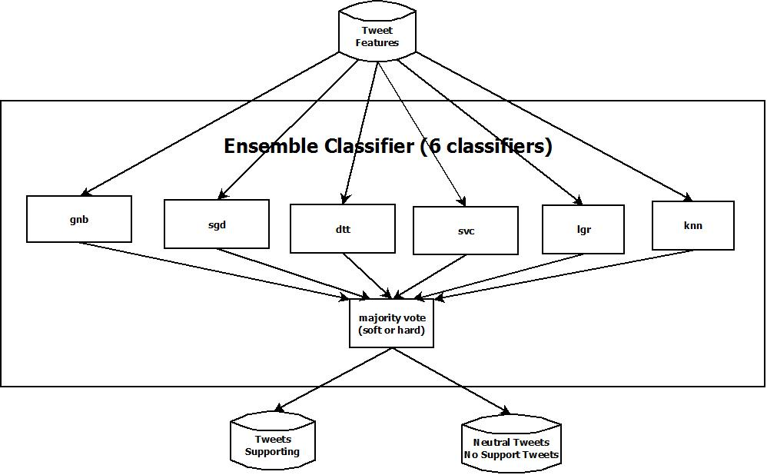
Ensemble Classifier

Slide 18
Implementation—Resevoir Sample
Size of all tweets: 10,000
Size of Reservoir Sample: 1,000
Based on the algorithm in one of the previous slides, implementation was done
Loaded first 1000 tweets (if count < 1000)
Picked random number
If random number is less than or equal to 999, do replacement
r = random.randint(0, count) if r < 999: #do prediction and replacement
Compared with taking a random sample of 1000 from all tweets so far each time a new tweet comes in

Slide 19
Experiment Results—Old
Stolen Laptop: Lost dataset,results, graphs, tweets of Hillary Clinton and Donald Trump from Election Days
Data below was from what I remembered and presentation
Testing of smaller sample used to classify: Hillary Clinton
402 tweets: best classifier was Ensemble Classifier(~71-72%)
200 tweets: best classifier was SVC(~71%)
Testing of smaller sample kept: Hillary Clinton
From what I remember, Hillary had an approval rating of around 42% with full 10,000 tweets
Random Smaller Sample of 1000: approval rating varied above and below the full set, but error average was 1.8%
Reservoir Sampling of 1000: approval rating was below the full 10,000 tweets, but only by average error rate of 1.2%

Slide 20
Experiment Results—New(After Presentation)
(Update: Since laptop was stolen, I have re-mined tweets again this time focusing on Donald Trump (Tweets from Dec. 6th) and his current support
Labeled sample of 400 tweets (200 positive, 200 negative)
Compare With smaller random sample of 200 tweets for training
For reservoir sample testing: used 6000 tweets this time around of Donald Trump from Dec. 6, 2016
Tested accuracy comparison of averages for 400 tweet-classifier on total, reservoir, and random sampling

Slide 21
Experiment Results—400 Sample Size; (f1 scores for each classifier)
count(word+score)(2-3) 93.146s
svc: 0.649561568085
gnb: 0.5208608176
lgr: 0.641805527404
sgd: 0.632294487482
knn: 0.466596353505
dtc: 0.571007872994
rfc: 0.463463336887
soft voc: 0.594174633452
hard voc: 0.608975062333
tfidf(char+score)(1-4) 102.172s
svc: 0.689612222526
gnb: 0.601457339317
lgr: 0.694846586696
sgd: 0.579201178901
knn: 0.596530272476
dtc: 0.583951333026
rfc: 0.575218866183
soft voc: 0.674683097813
hard voc: 0.696358144974
tfidf(word+score)(1-3) 107.248s
svc: 0.684670519728
gnb: 0.559498762542
lgr: 0.679301918208
sgd: 0.584666727607
knn: 0.600343549055
dtc: 0.528953643075
rfc: 0.533389033991
soft voc: 0.60144131876
hard voc: 0.679381774203

Slide 22
Experiment Results—200 sample size
tfidf(word+score)(1-3) 15.493s
svc: 0.519064566296
gnb: 0.59594614386
lgr: 0.520354460224
sgd: 0.642713979644
knn: 0.541998670405
dtc: 0.472733477694
rfc: 0.4963818842
soft voc: 0.55935552889
hard voc: 0.573636373611
tfidf(char+score)(1-4) 21.516s
svc: 0.569200893497
gnb: 0.635151969981
lgr: 0.577686740766
sgd: 0.536354228685
knn: 0.546332346768
dtc: 0.587154029445
rfc: 0.491128224627
soft voc: 0.6133339599
hard voc: 0.613755190686
tfidf(char_wb+score)(1-4) 13.687s
svc: 0.555067332602
gnb: 0.60772945497
lgr: 0.540404076944
sgd: 0.548920894017
knn: 0.543829672625
dtc: 0.566337112722
rfc: 0.598614631165
soft voc: 0.645151324792
hard voc: 0.598973556753

Slide 23
Experiment Results—Reservoir
6000 Tweets(Total) Run time: 102.007 seconds
1000 Tweet Random Sampling runtime: 118.039 seconds
1000 Tweet Reservoir Sampling runtime:54.332 seconds

Slide 24
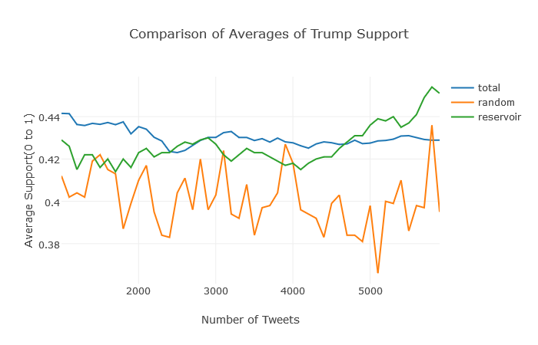
Experiment Results—Reservoir
Total versus Reservoir:
0.044179291646% avg. error
Total versus Random:
0.067820708354% avg. error

Slide 25
Conclusion & Future Work
Have tested two random sampling techniques to improve time of pipeline
Used random smaller sample to train classifier to decrease time taken while maintaining accuracy—found out larger sample is better than smaller sample (obviously)
Used reservoir sampling to decrease amount of tweets needed to be kept (save space) as well as save time compared to taking a random sample each time
Can be applied to other social media; pull dataset from Yelp, Facebook, etc.
Can be used in other political elections or even on approval ratings for bills/propositions
Future work
Apply to Donald Trump Tweets over more time
Apply to another elected official/candidate
Change classifier into 3 classes: positive, neutral, negative and retest pipeline and randomization

Slide 26
References
Fan Yu. Melody Moh. Teng-Sheng Moh. “Towards Extracting Drug-Effect Relation from Twitter: A Supervised Learning Approach.” IEEE International Conference on Intelligent Data and Security to be held New York. April 2016. Accessed Nov 2016.
Liang Wu (MSCS), Teng-Sheng Moh and Natalia Khuri, "Twitter Opinion Mining for Adverse Drug Reactions," Proceedings of the 2015 IEEE International Conference on Big Data (BigData), Santa Clara, California, Oct. 2015, pp.1570-1574. Accessed Nov 2016. http://ieeexplore.ieee.org/xpl/articleDetails.jsp?arnumber=7363922
Tweepy. Last Retrieved on Nov 2016. http://www.tweepy.org
“Reservoir Sampling”. Wikipedia. Last Retrieved Dec 2016. https://en.wikipedia.org/wiki/Reservoir_sampling
Stefano Baccianella et. al. “SENTIWORDNET 3.0: An Enhanced Lexical Resource for Sentiment Analysis and Opinion Mining”. Istituto di Scienza e Tecnologie dell’Informazione. Last Retrieved Nov 2016. http://nmis.isti.cnr.it/sebastiani/Publications/LREC10.pdf , http://sentiwordnet.isti.cnr.it/
Finn Årup Nielsen. “AFINN”. Informatics and Mathematical Modelling, Technical University of Denmark. Last Retrieved Dec 2016. http://www2.imm.dtu.dk/pubdb/views/publication_details.php?id=6010
W. B. Cavnar, and J. M. Trenkle, “N-Gram-Based Text Categorization”, in Proceedings of SDAIR-94, 3rd Annual Symposium on Document Analysis and Information Retrieval, Las Vegas, NV, pp. 161-175, 1994. Accessed Jun 2016. http://odur.let.rug.nl/~vannoord/TextCat/textcat.pdf
Code: https://github.com/denniseh7/CS262

