Slide 1


P
1
Preparation for Calculus
Copyright © Cengage Learning. All rights reserved.

Slide 2

1.1
Graphs and Models
Copyright © Cengage Learning. All rights reserved.

Slide 3
Objectives
Sketch the graph of an equation.
Find the intercepts of a graph.
Test a graph for symmetry with respect to an axis and the origin.
Find the points of intersection of two graphs.
Interpret mathematical models for real-life data.

Slide 4
The Graph of an Equation

Slide 5
The Graph of an Equation
Consider the equation 3x + y = 7. The point (2, 1) is a solution point of the equation because the equation is satisfied (is true) when 2 is substituted for x and 1 is substituted for y. This equation has many other solutions, such as (1, 4) and (0, 7).
To find other solutions systematically, solve the original equation for y.
y = 7 – 3x Analytic approach

Slide 6

The Graph of an Equation
Then construct a table of values by substituting several values of x.
Numerical approach
From the table, you can see that (0, 7), (1, 4), (2, 1),
(3, –2), and (4, –5) are solutions of the original equation
3x + y = 7.

Slide 7
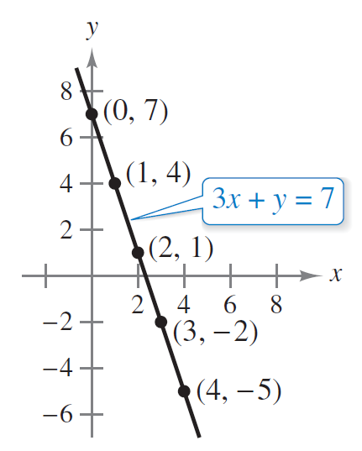
The Graph of an Equation
Like many equations, this equation has an infinite number of solutions. The set of all solution points is the graph of the equation, as shown in Figure 1.1.
Figure 1.1

Slide 8
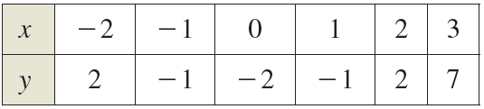
Example 1 – Sketching a Graph by Point Plotting
Sketch the graph of y = x² – 2.
Solution:
First construct a table of values. Next, plot the points shown in the table.

Slide 9
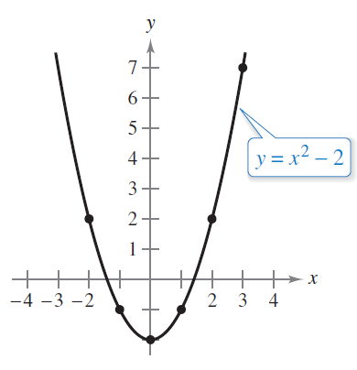
Example 1 – Solution
cont’d
Then connect the points with a smooth curve, as shown in Figure 1.2. This graph is a parabola.
The parabola y = x² – 2
Figure 1.2

Slide 10
Intercepts of a Graph

Slide 11
Intercepts of a Graph
Two types of solution points that are especially useful in graphing an equation are those having zero as their x- or y-coordinate.
Such points are called intercepts because they are the points at which the graph intersects the x- or y-axis.
The point (a, 0) is an x-intercept of the graph of an equation when it is a solution point of the equation.

Slide 12
Intercepts of a Graph
To find the x-intercepts of a graph, let y be zero and solve the equation for x.
The point (0, b) is a y-intercept of the graph of an equation when it is a solution point of the equation.
To find the y-intercepts of a graph, let x be zero and solve the equation for y.

Slide 13
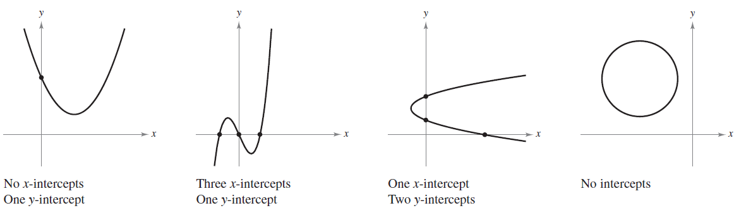
Intercepts of a Graph
It is possible for a graph to have no intercepts, or it might have several. For instance, consider the four graphs shown in Figure 1.5.
Figure 1.5

Slide 14



Example 2 – Finding x- and y-Intercepts
Find the x- and y-intercepts of the graph of y = x³ – 4x.
Solution:
To find the x-intercepts, let y be zero and solve for x.
Let y be zero.
Factor.
Solve for x.

Slide 15
Example 2 – Solution
cont’d
Because this equation has three solutions, you can conclude that the graph has three x-intercepts:
(0, 0), (2, 0), and (–2, 0).
x-intercepts
To find the y-intercepts, let x be zero. Doing this produces y = 0. So, the y-intercept is
(0, 0).
y-intercept

Slide 16
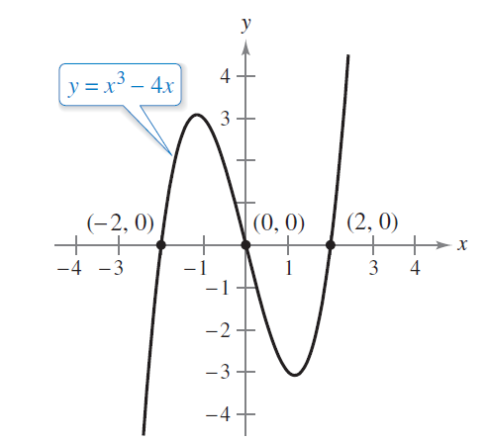
Example 2 – Solution
cont’d
See Figure 1.6.
Intercepts of a graph
Figure 1.6

Slide 17
Symmetry of a Graph

Slide 18
Symmetry of a Graph
Knowing the symmetry of a graph before attempting to sketch it is useful because you need only half as many points to sketch the graph.
The three types of symmetry can be used to help sketch the graphs of equations.

Slide 19
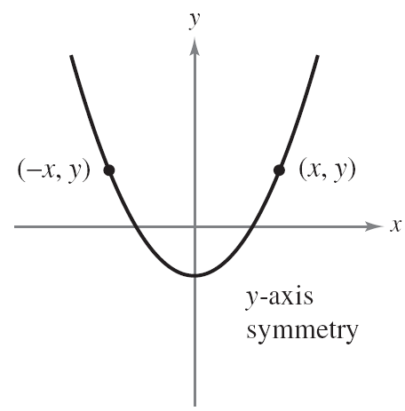
Symmetry of a Graph
1. A graph is symmetric with respect to the y-axis if, whenever (x, y) is a point on the graph, then (–x, y) is also a point on the graph. This means that the portion of the graph to the left of the y-axis is a mirror image of the portion to the right of the y-axis.
Figure 1.7(a)

Slide 20
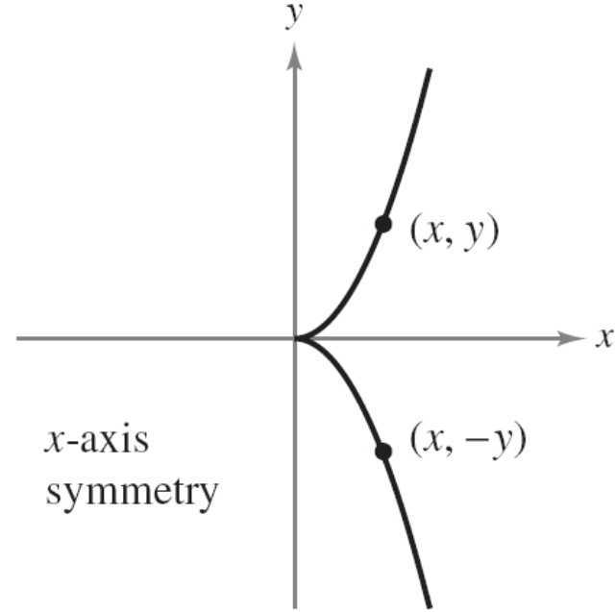
Symmetry of a Graph
2. A graph is symmetric with respect to the x-axis if, whenever (x, y) is a point on the graph, then (x, –y) is also a point on the graph. This means that the portion of the graph below the x-axis is a mirror image of the portion above the x-axis.
Figure 1.7(b)

Slide 21
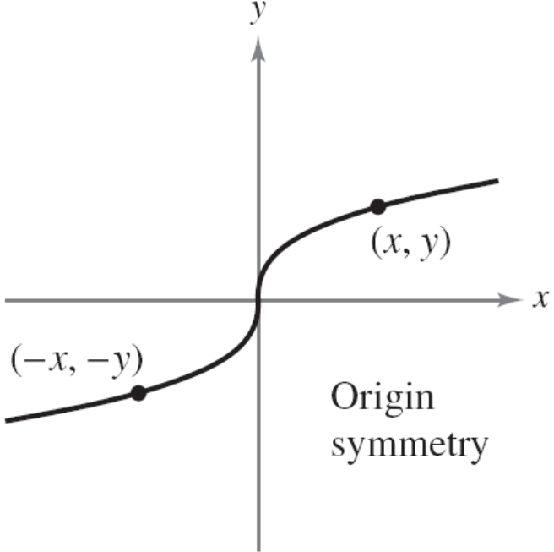
Symmetry of a Graph
3. A graph is symmetric with respect to the origin if, whenever (x, y) is a point on the graph, then (–x, –y) is also a point on the graph. This means that the graph is unchanged by a rotation of 180º about the origin.
Figure 1.7(c)

Slide 22
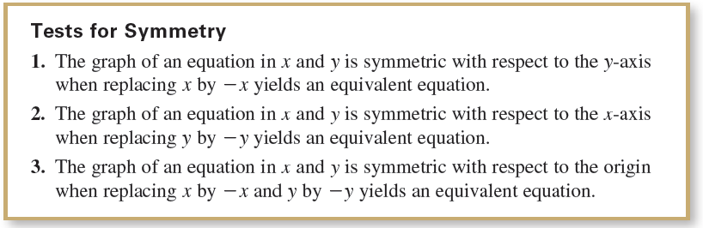
Symmetry of a Graph

Slide 23
Symmetry of a Graph
The graph of a polynomial has symmetry with respect to
the y-axis when each term has an even exponent (or is a
constant). For instance, the graph of
y = 2x⁴ – x² + 2
has symmetry with respect to the y-axis. Similarly, the
graph of a polynomial has symmetry with respect to the
origin when each term has an odd exponent.

Slide 24



Example 3 – Testing for Symmetry
Test the graph of y = 2x³ – x for symmetry with respect to (a) the y-axis and (b) the origin.
Solution:
a.
Because replacing x by –x does not yield an equivalent equation, you can conclude that the graph of y = 2x³ – x is not symmetric with respect to the y-axis.
Write original equation.
Replace x by –x.
Simplify. This result is not an equivalent equation.

Slide 25




Example 3 – Solution
cont’d
b.
Write original equation.
Replace x by –x and y by –y.
Simplify.
Equivalent equation.

Slide 26
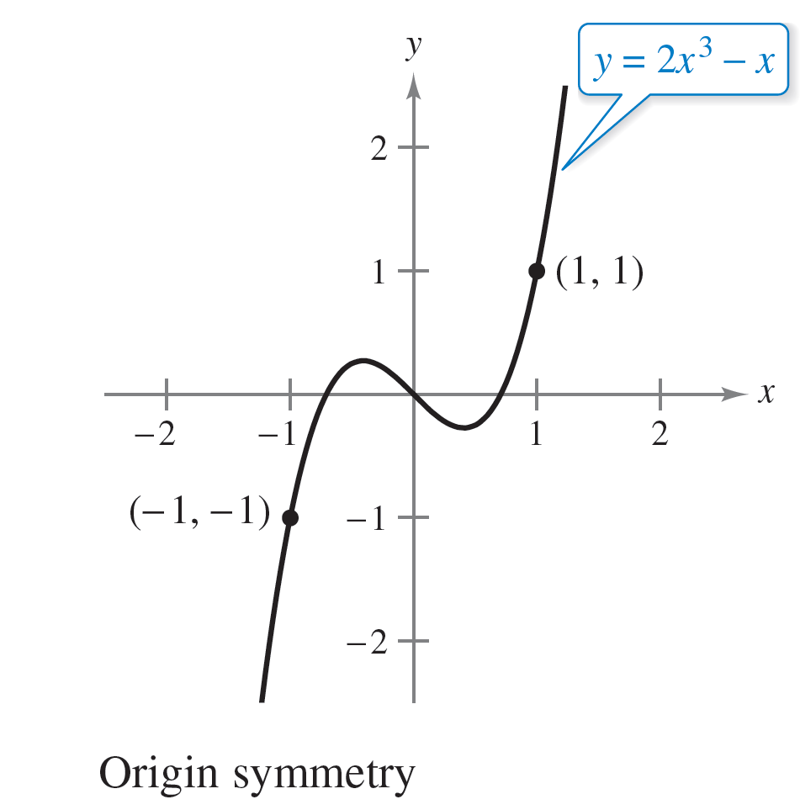
Example 3 – Solution
cont’d
Because replacing x by –x and y by –y yields an equivalent equation, you can conclude that the graph of y = 2x³ – x is symmetric with respect to the origin, as shown in Figure 1.8.
Figure 1.8

Slide 27
Points of Intersection

Slide 28
Points of Intersection
A point of intersection of the graphs of two equations is a point that satisfies both equations.
You can find the point(s) of intersection of two graphs by solving their equations simultaneously.

Slide 29
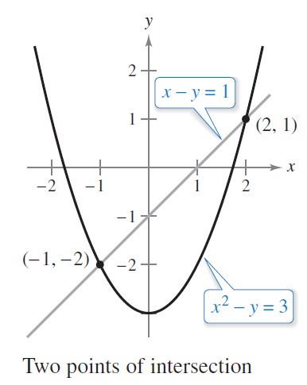
Example 5 – Finding Points of Intersection
Find all points of intersection of the graphs of
x² – y = 3 and x – y = 1.
Solution:
Begin by sketching the graphs
of both equations in the same
rectangular coordinate system,
as shown in Figure 1.10.
Figure 1.10

Slide 30






Example 5 – Solution
cont’d
From the figure, it appears that the graphs have two points of intersection. You can find these two points as follows.
Solve first equation for y.
Solve second equation for y.
Equate y-values.
Write in general form.
Factor.
Solve for x.

Slide 31
Example 5 – Solution
cont’d
The corresponding values of y are obtained by substituting
x = 2 and x = –1 into either of the original equations.
Doing this produces two points of intersection:
(2, 1) and (–1, –2). Points of intersection

Slide 32
Mathematical Models

Slide 33
Mathematical Models
Real-life applications of mathematics often use equations as mathematical models.
In developing a mathematical model to represent actual data, you should strive for two (often conflicting)
goals––accuracy and simplicity.
That is, you want the model to be simple enough to be workable, yet accurate enough to produce meaningful results.

Slide 34
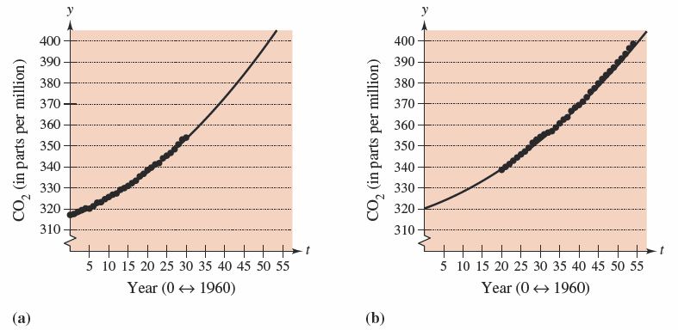
Example 6 – Comparing Two Mathematical Models
The Mauna Loa Observatory in Hawaii records the carbon dioxide concentration y (in parts per million) in Earth’s atmosphere. The January readings for various years are shown in Figure 1.11.
Figure 1.11

Slide 35
Example 6 – Comparing Two Mathematical Models
cont’d
In the July 1990 issue of Scientific American, these data were used to predict the carbon dioxide level in Earth’s atmosphere in the year 2035, using the quadratic model
where t = 0 represents 1960, as shown in Figure 1.11(a).

Slide 36
Example 6 – Comparing Two Mathematical Models
cont’d
The data shown in Figure 1.11(b) represent the years 1980 through 2014 and can be modeled by
where t = 0 represents 1960.
What was the prediction given in the Scientific American
article in 1990? Given the second model for 1980 through
2014, does this prediction for the year 2035 seem accurate?

Slide 37
Example 6 – Solution
To answer the first question, substitute t = 75 (for 2035) into the first model.
So, the prediction in the Scientific American article was
that the carbon dioxide concentration in Earth’s atmosphere would reach about 470 parts per million in the year 2035.

Slide 38
Example 6 – Solution
cont’d
Using the model for the 1980–2014 data, the prediction for the year 2035 is
So, based on the model for 1980–2014, it appears that the 1990 prediction was too high.

