Slide 1


P
1
Preparation for Calculus
Copyright © Cengage Learning. All rights reserved.

Slide 2

Linear Models and Rates of Change
1.2
Copyright © Cengage Learning. All rights reserved.

Slide 3
Objectives
Find the slope of a line passing through two points.
Write the equation of a line with a given point and slope.
Interpret slope as a ratio or as a rate in a real-life application.
Sketch the graph of a linear equation in slope-intercept form.
Write equations of lines that are parallel or perpendicular to a given line.

Slide 4
The Slope of a Line

Slide 5
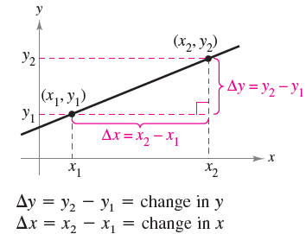
The Slope of a Line
The slope of a nonvertical line is a measure of the number of units the line rises (or falls) vertically for each unit of horizontal change from left to right.
Consider the two points
(x₁, y₁) and (x₂, y₂) on the
line in Figure 1.12.
Figure 1.12

Slide 6
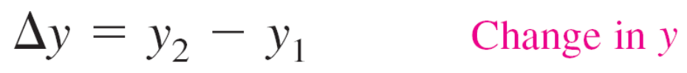

The Slope of a Line
As you move from left to right along this line, a vertical
change of
units corresponds to a horizontal change of
units. (The symbol Δ is the uppercase Greek letter delta, and the symbols Δy and Δx are read “delta y” and “delta x.”)

Slide 7
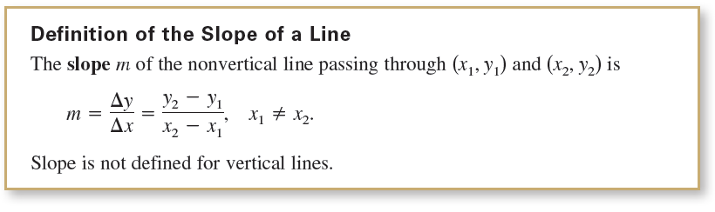
The Slope of a Line

Slide 8

The Slope of a Line
When using the formula for slope, note that
So, it does not matter in which order you subtract as long as you are consistent and both “subtracted coordinates” come from the same point.

Slide 9
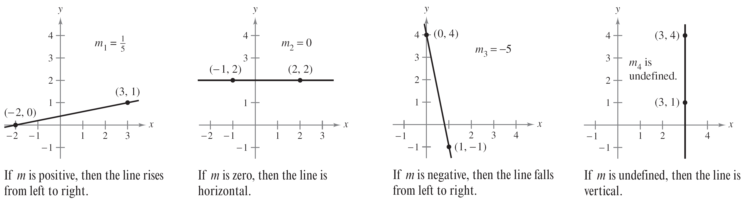
The Slope of a Line
Figure 1.13 shows four lines: one has a positive slope, one has a slope of zero, one has a negative slope, and one has an “undefined” slope.
In general, the greater the absolute value of the slope of a line, the steeper the line.
Figure 1.13

Slide 10
Equations of Lines

Slide 11
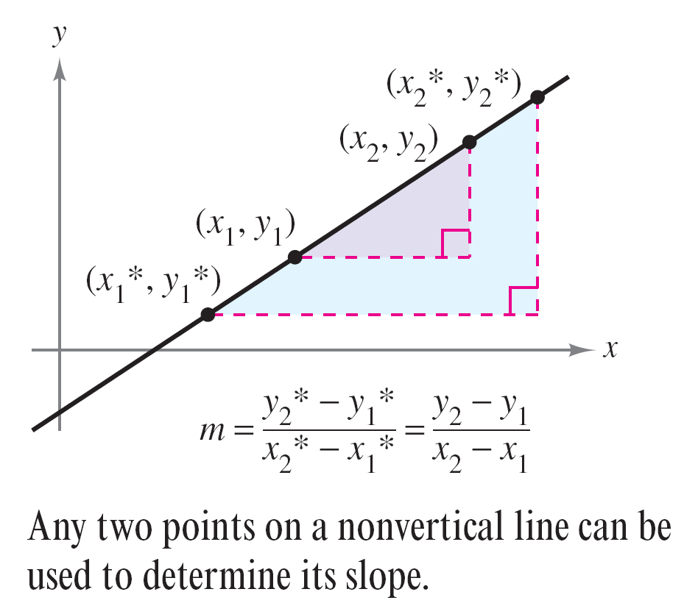
Equations of Lines
Any two points on a nonvertical line can be used to calculate its slope.
This can be verified from the similar triangles shown in
Figure 1.14.
Figure 1.14

Slide 12

Equations of Lines
If (x₁, y₁) is a point on a nonvertical line that has a slope of m and (x, y) is any other point on the line, then
This equation in the variables x and y can be rewritten in the form
y – y₁ = m(x – x₁)
which is the point-slope form of the equation of a line.

Slide 13
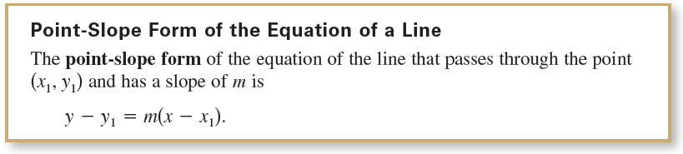
Equations of Lines

Slide 14
Example 1 – Finding an Equation of a Line
Find an equation of the line that has a slope of 3 and
passes through the point (1, –2). Then sketch the line.
Solution:

Slide 15
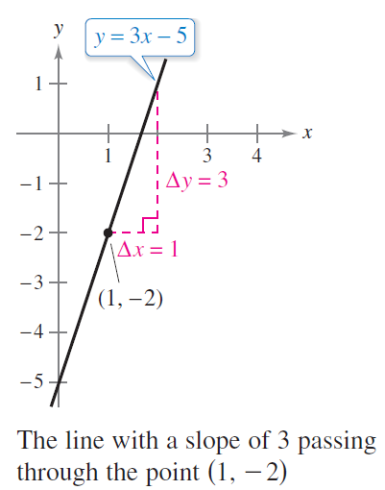
Example 1 – Solution
cont’d
To sketch the line, first plot the point (1, –2). Then, because
the slope is m = 3, you can locate a second point on the line
by moving one unit to the right and three units upward, as
shown in Figure 1.15.
Figure 1.15

Slide 16
Ratios and Rates of Change

Slide 17
Ratios and Rates of Change
The slope of a line can be interpreted as either a ratio or a rate.
If the x- and y-axes have the same unit of measure, then the slope has no units and is a ratio.
If the x- and y-axes have different units of measure, then the slope is a rate or rate of change.

Slide 18
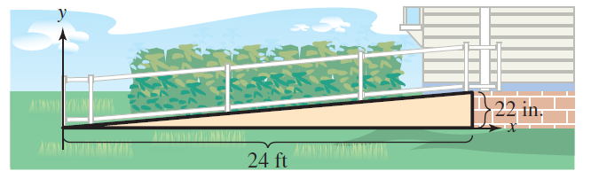
Example 2 – Using Slope as a Ratio
The maximum recommended slope of a wheelchair ramp is 1/12. A business installs a wheelchair ramp that rises to a height of 22 inches over a length of 24 feet, as shown in Figure 1.16. Is the ramp steeper than recommended?
Figure 1.16

Slide 19



Example 2 – Solution
The length of the ramp is 24 feet or 12(24) = 288 inches.
The slope of the ramp is the ratio of its height (the rise) to its length (the run).
Because the slope of the ramp is less than 1/12 ≈ 0.083, the ramp is not steeper than recommended. Note that the slope is a ratio and has no units.

Slide 20

Example 3 – Using Slope as a Rate of Change
The population of Oregon was about 3,831,000 in 2010 and about 3,970,000 in 2014. Find the average rate of change of the population over this four-year period. What will the population of Oregon be in 2024?
Solution:
Over this four-year period, the average rate of change of the population of Oregon was

Slide 21


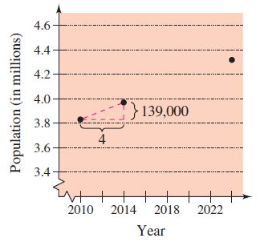
Example 3 – Solution
cont’d
Assuming that Oregon’s
population continues to
increase at this same rate
for the next 10 years, it will
have a 2024 population of
about 4,318,000.
(See Figure 1.17.)
Population of Oregon
Figure 1.17

Slide 22
Ratios and Rates of Change
The rate of change found in Example 3 is an average rate of change. An average rate of change is always calculated over an interval.

Slide 23
Graphing Linear Models

Slide 24
Graphing Linear Models
Many problems in coordinate geometry can be classified into two basic categories:
1. Given a graph (or parts of it), find its equation.
2. Given an equation, sketch its graph.
For lines, problems in the first category can be solved by using the point-slope form. The point-slope form, however, is not especially useful for solving problems in the second category.

Slide 25
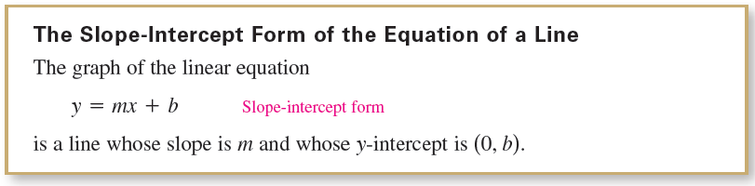
Graphing Linear Models
The form that is better suited to sketching the graph of a line is the slope-intercept form of the equation of a line.

Slide 26
Example 4 – Sketching Lines in the Plane
Sketch the graph of each equation.
a. y = 2x + 1
b. y = 2
c. 3y + x – 6 = 0

Slide 27
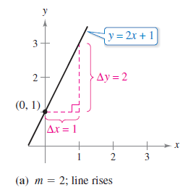
Example 4(a) – Solution
cont’d
Because b = 1, the y-intercept is (0, 1).
Because the slope is m = 2, you know that the line rises two units for each unit it moves to the right, as shown in Figure 1.18(a).
Figure 1.18

Slide 28
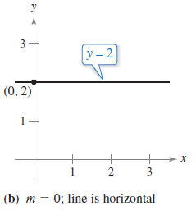
Example 4(b) – Solution
cont’d
By writing the equation y = 2 in slope-intercept form
y = (0)x + 2
you can see that the slope is
m = 0 and the y-intercept is (0, 2).
Because the slope is zero, you
know that the line is horizontal,
as shown in Figure 1.18(b).
Figure 1.18

Slide 29
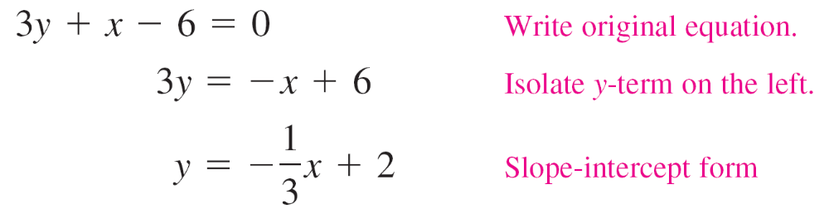
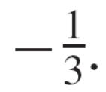
Example 4(c) – Solution
cont’d
Begin by writing the equation in slope-intercept form.
In this form, you can see that the y-intercept is (0, 2)
and the slope is m = This This means that the line falls one
unit for every three units it moves to the right.

Slide 30
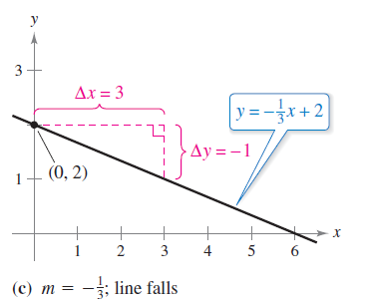
Example 4(c) – Solution
cont’d
This is shown in Figure 1.18(c).
Figure 1.18

Slide 31

Graphing Linear Models
Because the slope of a vertical line is not defined, its equation cannot be written in the slope-intercept form. However, the equation of any line can be written in the general form
where A and B are not both zero. For instance, the vertical line
can be represented by the general form

Slide 32
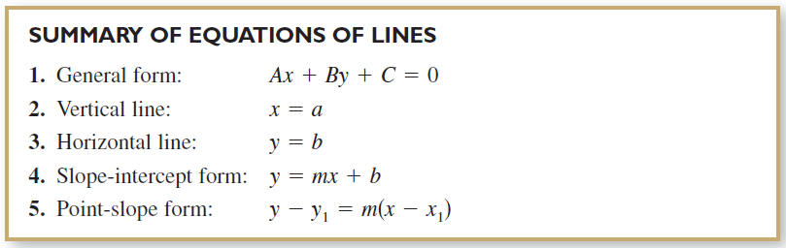
Graphing Linear Models

Slide 33
Parallel and Perpendicular Lines

Slide 34
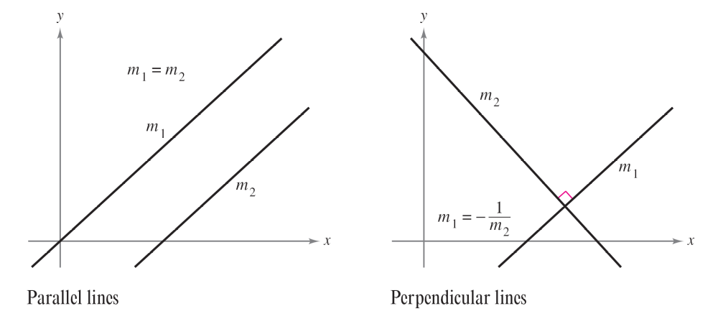
Parallel and Perpendicular Lines
The slope of a line is a convenient tool for determining whether two lines are parallel or perpendicular, as shown in Figure 1.19.
Figure 1.19

Slide 35
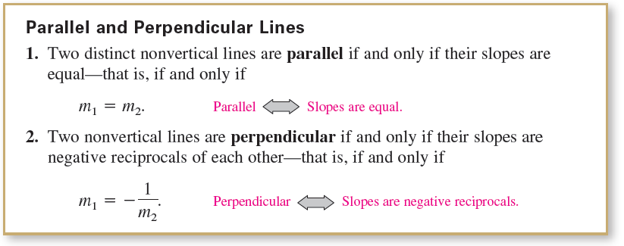
Parallel and Perpendicular Lines
Specifically, nonvertical lines with the same slope are parallel, and nonvertical lines whose slopes are negative reciprocals are perpendicular.

Slide 36
Example 5 – Finding Parallel and Perpendicular Lines
Find the general forms of the equations of the lines that pass through the point (2, –1) and are
(a) parallel to the line
2x – 3y = 5
(b) perpendicular to the line
2x – 3y = 5.

Slide 37

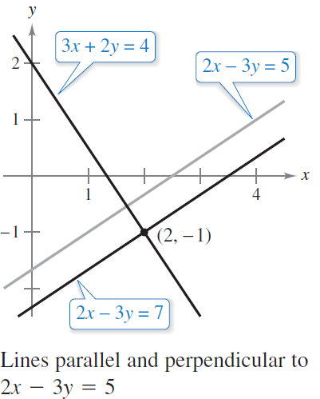

Example 5 – Solution
Begin by writing the linear equation 2x – 3y = 5 in
slope-intercept form.
So, the given line has a slope
of (See Figure 1.20.)
Figure 1.20

Slide 38


Example 5 – Solution
cont’d
a. The line through (2, –1) that is parallel to the given line
also has a slope of 2/3.
Note the similarity to the equation of the given line,
2x – 3y = 5.

Slide 39


Example 5 – Solution
cont’d
b. Using the negative reciprocal of the slope of the given line, you can determine that the slope of a line perpendicular to the given line is –3/2.

