Slide 1


P
1
Preparation for Calculus
Copyright © Cengage Learning. All rights reserved.

Slide 2

1.3
Functions and Their Graphs
Copyright © Cengage Learning. All rights reserved.

Slide 3
Objectives
Use function notation to represent and evaluate a function.
Find the domain and range of a function.
Sketch the graph of a function.
Identify different types of transformations of functions.
Classify functions and recognize combinations of functions.

Slide 4
Functions and Function Notation

Slide 5
Functions and Function Notation
A relation between two sets X and Y is a set of ordered
pairs, each of the form (x, y), where x is a member of
X and y is a member of Y.
A function from X to Y is a relation between X and Y that
has the property that any two ordered pairs with the same
x-value also have the same y-value.
The variable x is the independent variable, and the
variable y is the dependent variable.

Slide 6
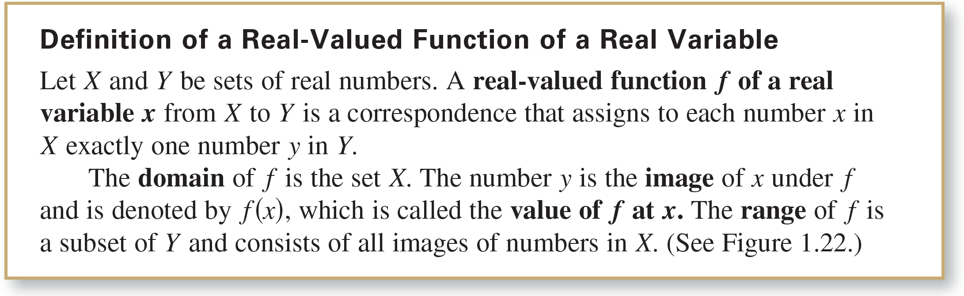
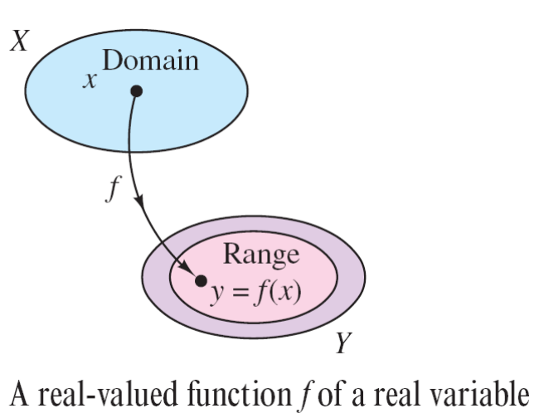
Functions and Function Notation
Figure 1.22

Slide 7

Functions and Function Notation
Functions can be specified in a variety of ways. However, you will concentrate primarily on functions that are given by equations involving the dependent and independent variables. For instance, the equation
defines y, the dependent variable, as a function of x,
the independent variable.

Slide 8
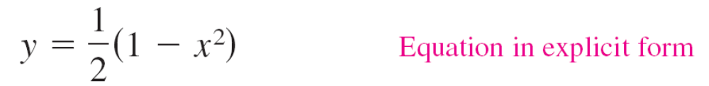
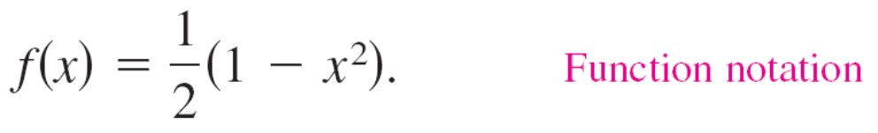
Functions and Function Notation
To evaluate this function (that is, to find the y-value that
corresponds to a given x-value), it is convenient to isolate y
on the left side of the equation.
Using f as the name of the function, you can write this
equation as
The original equation, x² + 2y = 1, implicitly defines y as a
function of x. When you solve the equation for y, you are
writing the equation in explicit form.

Slide 9

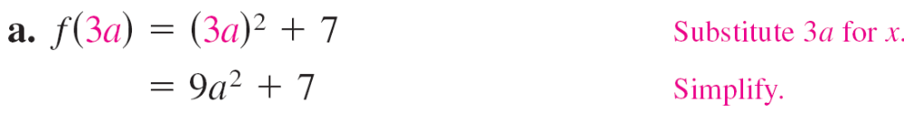
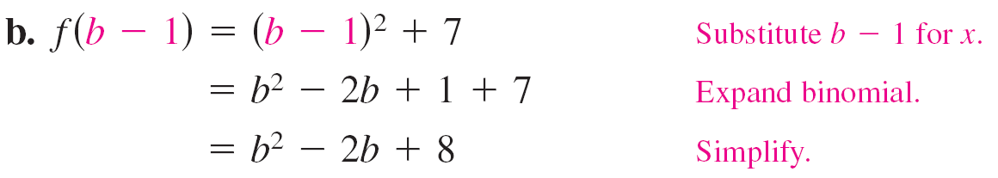
Example 1 – Evaluating a Function
For the function f defined by f (x) = x² + 7, evaluate each expression.
Solution:

Slide 10
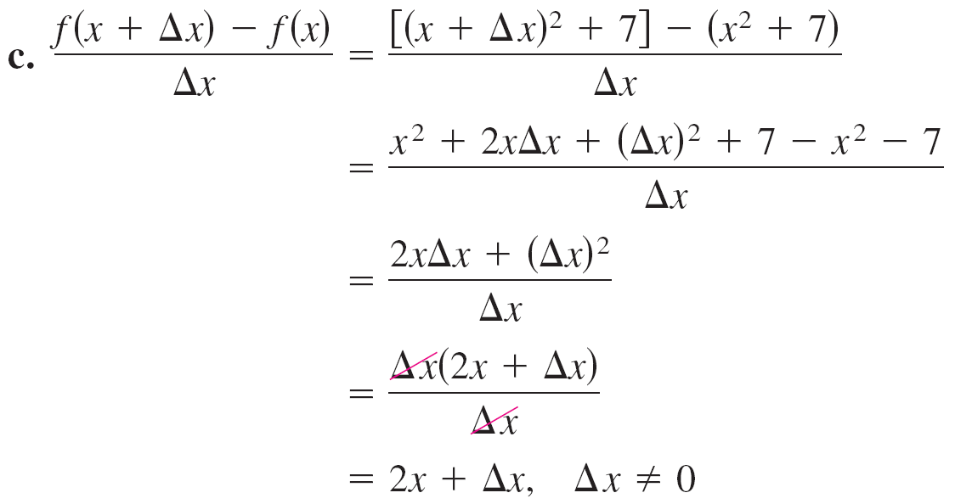
Example 1 – Solution
cont’d

Slide 11
The Domain and Range of a Function

Slide 12
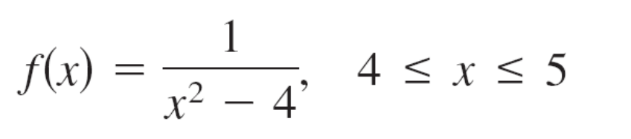
The Domain and Range of a Function
The domain of a function can be described explicitly, or it
may be described implicitly by an equation used to define
the function.
The implied domain is the set of all real numbers for
which the equation is defined, whereas an explicitly defined
domain is one that is given along with the function.
For example, the function
has an explicitly defined domain given by {x: 4 ≤ x ≤ 5}.

Slide 13
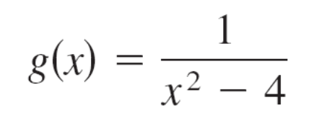
The Domain and Range of a Function
On the other hand, the function
has an implied domain that is the set {x: x ≠ ±2}.

Slide 14
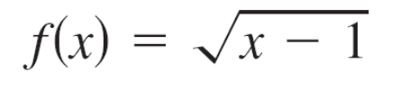


Example 2 – Finding the Domain and Range of a Function
Find the domain and range of each function.
Solution:
a. The domain of the function
is the set of all x-values for which x – 1 ≥ 0, which is the interval [1, ).
To find the range, observe that is never negative.

Slide 15
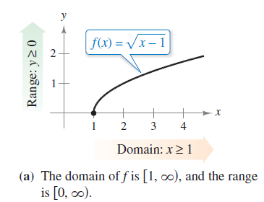
Example 2 – Solution
cont’d
So, the range is the interval [0, ), as shown in
Figure 1.23(a).
Figure 1.23

Slide 16

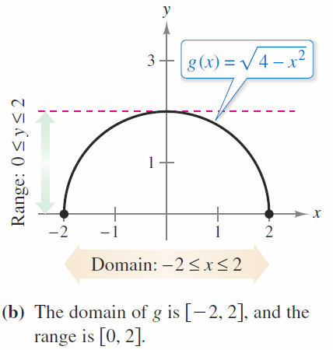

Example 2 – Solution
cont’d
b. The domain of the function
is the set of all values for which 4 – x² ≥ 0, or x² ≤ 4.
So, the domain of g is the interval [–2, 2].
To find the range, observe
that is never
negative and is at most 2.
So, the range is the
interval [0, 2], as shown
in Figure 1.23(b).
Figure 1.23

Slide 17
The Domain and Range of a Function
A function from X to Y is one-to-one when to each y-value
in the range there corresponds exactly one x-value in the
domain.
A function from X to Y is onto when its range consists of
all of Y.

Slide 18
The Graph of a Function

Slide 19
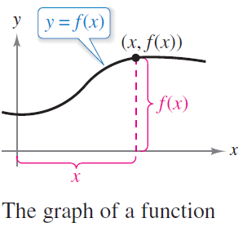
The Graph of a Function
The graph of the function y = f (x) consists of all points
(x, f (x)), where x is in the domain of f. In Figure 1.25, note
that
x = the directed distance from
the y-axis
and
f (x) = the directed distance from
the x-axis.
Figure 1.25

Slide 20
The Graph of a Function
A vertical line can intersect the graph of a function of x at
most once.
This observation provides a convenient visual test, called
the Vertical Line Test, for functions of x.
That is, a graph in the coordinate plane is the graph of a
function of x if and only if no vertical line intersects the
graph at more than one point.

Slide 21
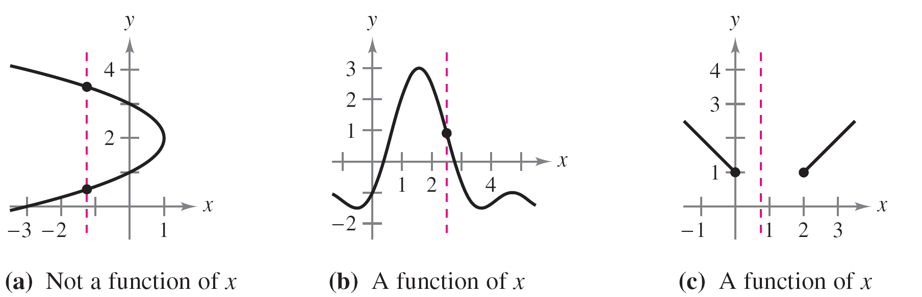
The Graph of a Function
For example, in Figure 1.26(a), you can see that the graph
does not define y as a function of x because a vertical line
intersects the graph twice, whereas in Figures 1.26(b) and
(c), the graphs do define y as a function of x.
Figure 1.26

Slide 22
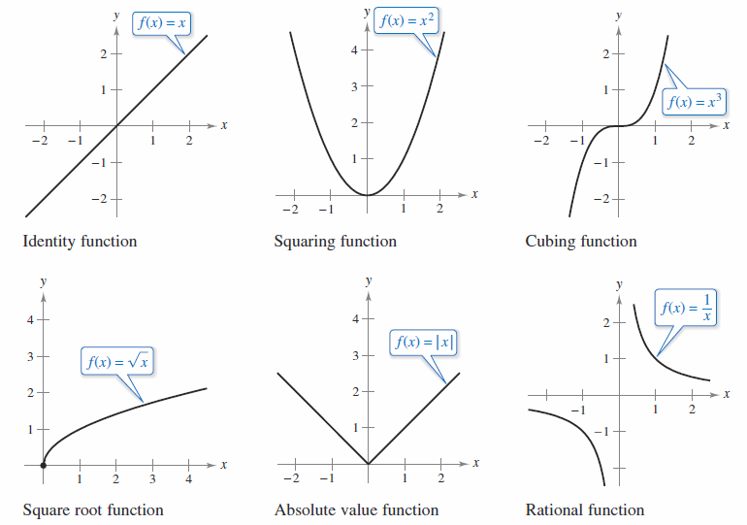
The Graph of a Function
Figure 1.27 shows the graphs of six basic functions.
The graphs of six basic functions
Figure 1.27

Slide 23
Transformations of Functions

Slide 24
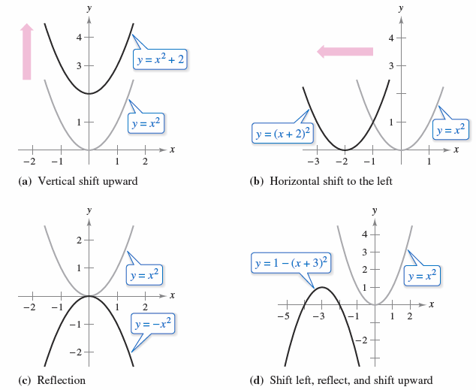
Transformations of Functions
Some families of graphs have the same basic shape.
For example, compare the graph of y = x² with the graphs
of the four other quadratic functions shown in Figure 1.28.
Figure 1.28

Slide 25
Transformations of Functions
Each of the graphs in Figure 1.28 is a transformation of
the graph of y = x².
The three basic types of transformations illustrated by
these graphs are vertical shifts, horizontal shifts, and
reflections.
Function notation lends itself well to describing
transformations of graphs in the plane.

Slide 26

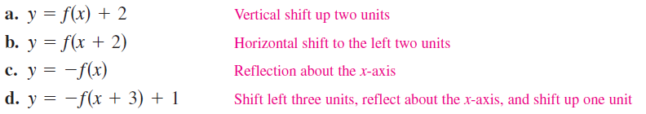
Transformations of Functions
For instance, using
as the original function, the transformations shown in
Figure 1.28 can be represented by these equations.

Slide 27
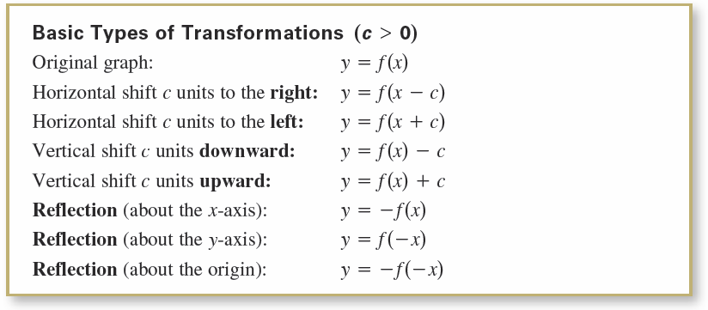
Transformations of Functions

Slide 28
Classifications and Combinations of Functions

Slide 29
Classifications and Combinations of Functions
By the end of the eighteenth century, mathematicians and
scientists had concluded that many real-world phenomena
could be represented by mathematical models taken from a
collection of functions called elementary functions.
Elementary functions fall into three categories.
1. Algebraic functions (polynomial, radical, rational)
2. Trigonometric functions (sine, cosine, tangent, and so on)
3. Exponential and logarithmic functions

Slide 30

Classifications and Combinations of Functions
The most common type of algebraic function is a
polynomial function
where n is a nonnegative integer.
The numbers a_{i} are coefficients, with a_{n} the leading
coefficient and a₀ the constant term of the polynomial
function.
If a_{n} ≠ 0, then n is the degree of the polynomial function.

Slide 31
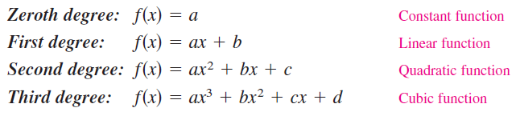
Classifications and Combinations of Functions
The zero polynomial f (x) = 0 is not assigned a degree.
It is common practice to use subscript notation for
coefficients of general polynomial functions, but for
polynomial functions of low degree, these simpler
forms are often used. (Note that a ≠ 0.)
Although the graph of a nonconstant polynomial function
can have several turns, eventually the graph will rise or fall
without bound as x moves to the right or left.

Slide 32
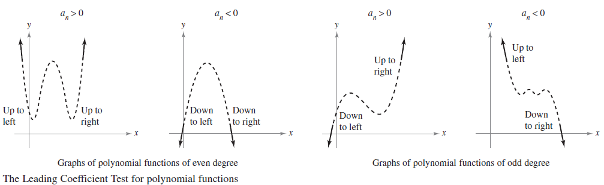
Classifications and Combinations of Functions
Whether the graph of
eventually rises or falls can be determined by the function’s
degree (odd or even) and by the leading coefficient a_{n}, as
indicated in Figure 1.29.
Figure 1.29

Slide 33
Classifications and Combinations of Functions
Note that the dashed portions of the graphs indicate that
the Leading Coefficient Test determines only the right
and left behavior of the graph.

Slide 34

Classifications and Combinations of Functions
Just as a rational number can be written as the quotient
of two integers, a rational function can be written as the
quotient of two polynomials. Specifically, a function f is
rational when it has the form
where p(x) and q(x) are polynomials.

Slide 35

Classifications and Combinations of Functions
Polynomial functions and rational functions are examples of
algebraic functions.
An algebraic function of x is one that can be expressed as
a finite number of sums, differences, multiples, quotients,
and radicals involving x^{n}.
For example, is algebraic. Functions that are
not algebraic are transcendental.
For instance, the trigonometric functions are transcendental.

Slide 36

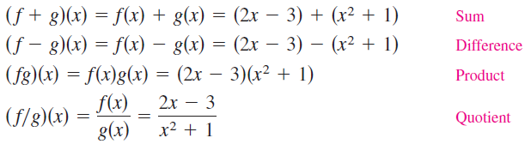
Classifications and Combinations of Functions
Two functions can be combined in various ways to create
new functions. For example, given
you can form the functions shown.
You can combine two functions in yet another way, called
composition. The resulting function is called a
composite function.

Slide 37
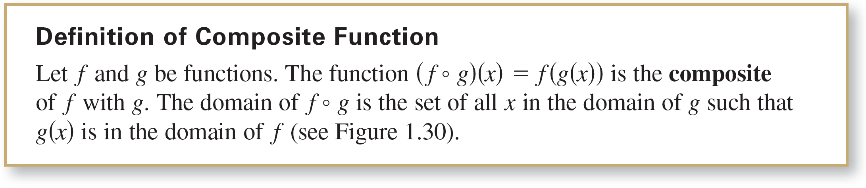
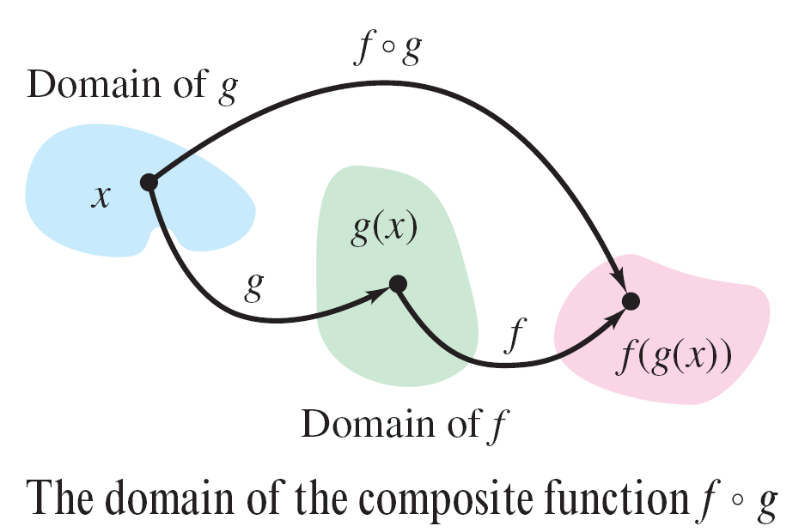
Classifications and Combinations of Functions
Figure 1.30
The composite of f with g is generally not the same as the
composite of g with f.

Slide 38








Example 4 – Finding Composite Functions
For f (x) = 2x – 3 and g(x) = x² + 1, find each composite
function.
a. f ◦ g b. g ◦ f
Solution:

Slide 39









Example 4 – Solution
cont’d

Slide 40

Classifications and Combinations of Functions
An x-intercept of a graph was defined to be a point (a, 0) at
which the graph crosses the x-axis. If the graph represents
a function f, then the number a is a zero of f.
In other words, the zeros of a function f are the solutions of
the equation f(x) = 0. For example, the function
has a zero at x = 4 because f (4) = 0.

Slide 41
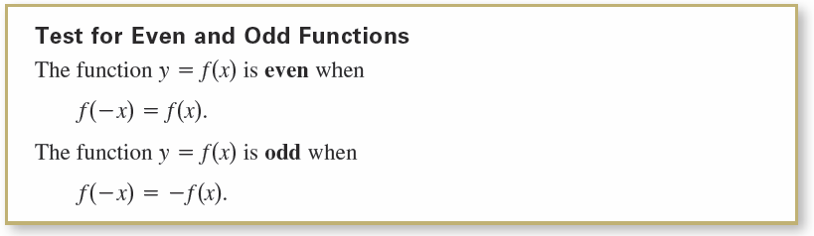
Classifications and Combinations of Functions
In the terminology of functions, a function y = f(x) is even when its graph is symmetric with respect to the y-axis, and is odd when its graph is symmetric with respect to the origin.
The symmetry tests yield the following test for even and odd functions.

Slide 42
Example 5 – Even and Odd Functions and Zeros of Functions
Determine whether each function is even, odd, or neither. Then find the zeros of the function.
Solution:
a. This function is odd because

Slide 43
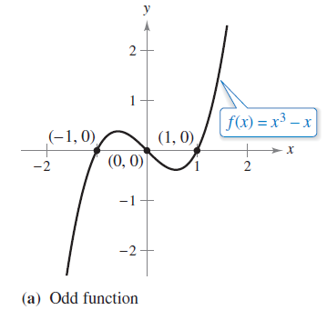
Example 5 – Solution
cont’d
The zeros of f are
See Figure 1.31(a).
Figure 1.31

Slide 44

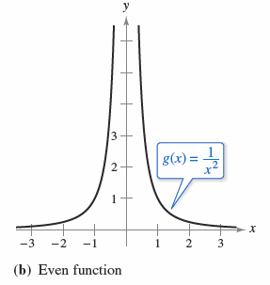
Example 5 – Solution
cont’d
b. This function is even because
This function does not have
zeros because 1/x² is positive
for all x in the domain, as
shown in Figure 1.31(b).
Figure 1.31

Slide 45
Example 5 – Solution
cont’d
c. Substituting –x for x produces
Because h(x) = –x² – x – 1 and –h(x) = x² + x + 1,
you can conclude that
and

Slide 46
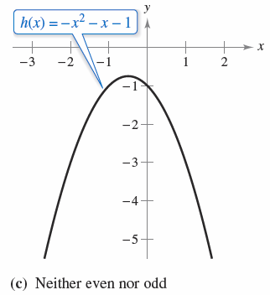
Example 5 – Solution
cont’d
So, the function is neither even nor odd. This function
does not have zeros because –x² – x – 1 is negative for
all x, as shown in Figure 1.31(c).
Figure 1.31

