Slide 1


P
1
Preparation for Calculus
Copyright © Cengage Learning. All rights reserved.

Slide 2

Review of Trigonometric Functions
1.4
Copyright © Cengage Learning. All rights reserved.

Slide 3
Objectives
Describe angles and use degree measure.
Use radian measure.
Understand the definitions of the six trigonometric functions.
Evaluate trigonometric functions.
Solve trigonometric equations.
Graph trigonometric functions.

Slide 4
Angles and Degree Measure

Slide 5
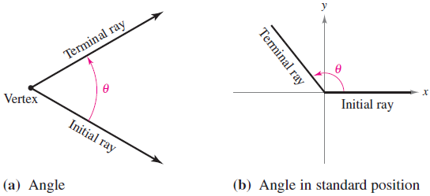
Angles and Degree Measure
An angle has three parts: an initial ray (or side), a terminal ray, and a vertex (the point of intersection of the two rays), as shown in Figure 1.32(a).
An angle is in standard position when its initial ray coincides with the positive x-axis and its vertex is at the origin, as shown in Figure 1.32(b).
Figure 1.32

Slide 6
Angles and Degree Measure
It is assumed that you are familiar with the degree measure of an angle.
It is common practice to use θ (the lowercase Greek letter theta) to represent both an angle and its measure.
Angles between 0° and 90° are acute, and angles between 90° and 180° are obtuse.

Slide 7
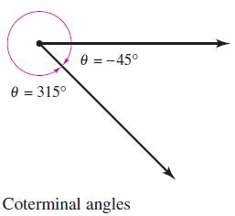
Angles and Degree Measure
Positive angles are measured counterclockwise, and negative angles are measured clockwise. For instance, Figure 1.33 shows an angle whose measure is –45°.
Figure 1.33

Slide 8
Angles and Degree Measure
You cannot assign a measure to an angle by simply knowing where its initial and terminal rays are located. To measure an angle, you must also know how the terminal ray was revolved.
For example, Figure 1.33 shows that the angle measuring –45° has the same terminal ray as the angle measuring 315°. Such angles are coterminal.
In general, if θ is any angle, then θ + n(360), n is a nonzero integer, is coterminal with θ.

Slide 9
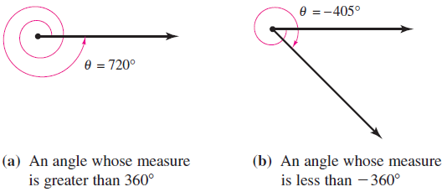
Angles and Degree Measure
An angle that is larger than 360° is one whose terminal ray has been revolved more than one full revolution counterclockwise, as shown in Figure 1.34(a).
You can form an angle whose measure is less than –360° by revolving a terminal ray more than one full revolution clockwise, as shown in Figure 1.34(b).
Figure 1.34

Slide 10
Radian Measure

Slide 11
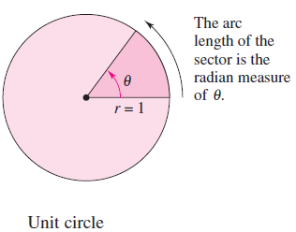
Radian Measure
To assign a radian measure to an angle θ, consider θ to be
a central angle of a circle of radius 1, as shown in
Figure 1.35.
The radian measure of θ is then defined to be the length of the arc of the sector. Because the circumference of a circle is 2π r, the circumference of a unit circle (of radius 1) is 2π.
Figure 1.35

Slide 12
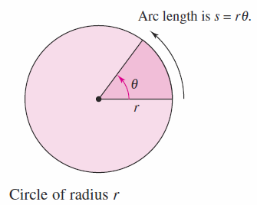
Radian Measure
This implies that the radian measure of an angle measuring 360° is 2π. In other words, 360° = 2π radians.
Using radian measure for θ, the length s of a circular arc of radius r is s = rθ, as shown in Figure 1.36.
Figure 1.36

Slide 13
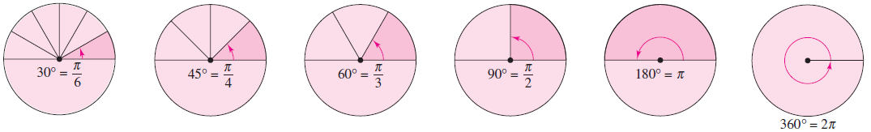
Radian Measure
You should know the conversions of the common angles shown in Figure 1.37.
For other angles, use the fact that 180° is equal to π radians.
Radian and degree measures for several common angles
Figure 1.37

Slide 14










Example 1 – Conversions Between Degrees and Radians

Slide 15






Example 1 – Conversions Between Degrees and Radians
cont’d

Slide 16
The Trigonometric Functions

Slide 17
The Trigonometric Functions
There are two common approaches to the study of trigonometry. In one, the trigonometric functions are defined as ratios of two sides of a right triangle.
In the other, these functions are defined in terms of a point on the terminal ray of an angle in standard position.
The six trigonometric functions, sine, cosine, tangent, cotangent, secant, and cosecant (abbreviated as sin, cos, tan, cot, sec, and csc, respectively), are defined from both viewpoints.

Slide 18
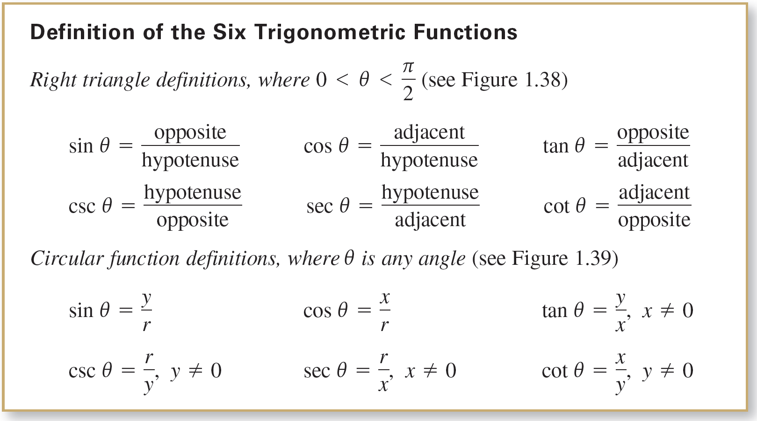
The Trigonometric Functions

Slide 19
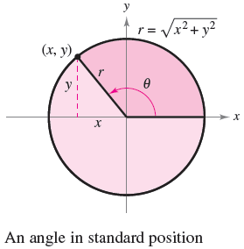
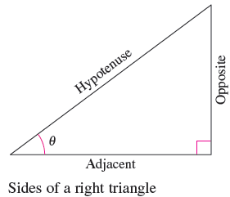
The Trigonometric Functions
Figure 1.38
Figure 1.39

Slide 20
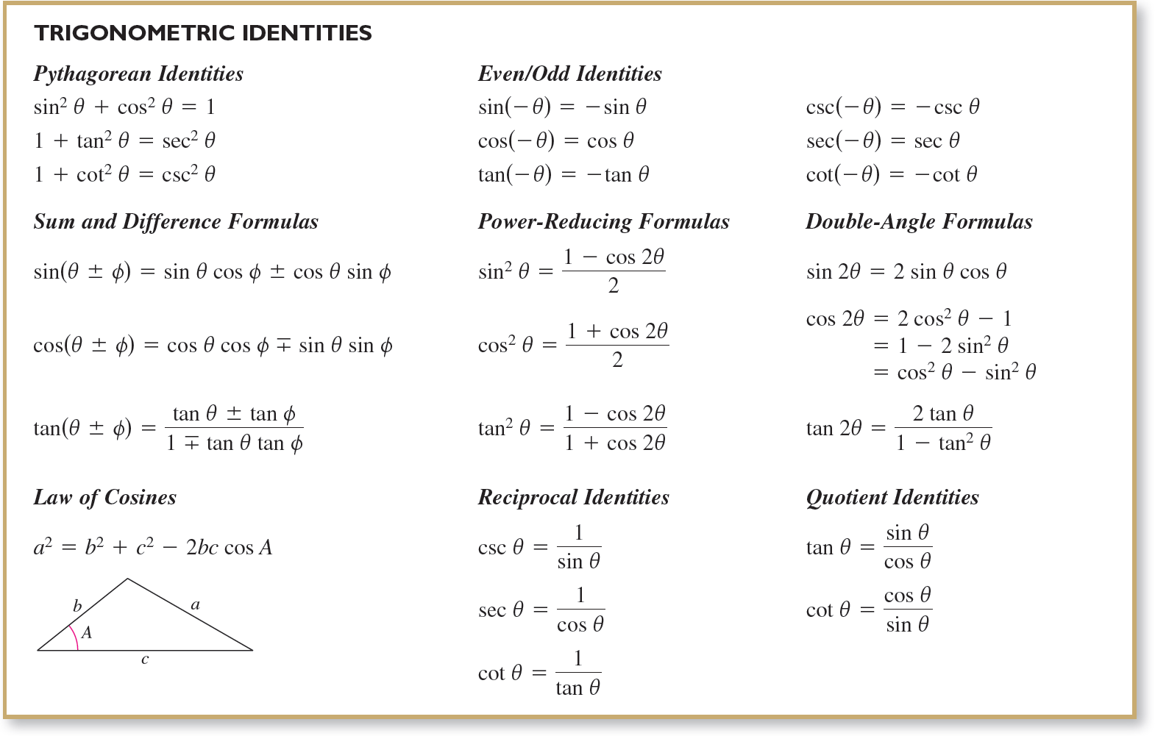
The Trigonometric Functions
The trigonometric identities listed below are direct consequences of the definitions.

Slide 21
Evaluating Trigonometric Functions

Slide 22
Evaluating Trigonometric Functions
There are two ways to evaluate trigonometric functions:
decimal approximations with a graphing utility and
exact evaluations using trigonometric identities and formulas from geometry.
When using a graphing utility to evaluate a trigonometric function, remember to set the graphing utility to the appropriate mode—degree mode or radian mode.

Slide 23
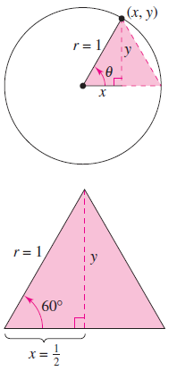

Example 2 – Exact Evaluation of Trigonometric Functions
Evaluate the sine, cosine, and tangent of π /3.
Solution:
Because 60° = π /3 radians, you can draw
an equilateral triangle with sides of length
1 and θ as one of its angles, as shown in
Figure 1.40.
Because the altitude of this triangle
bisects its base, you know that
Figure 1.40

Slide 24













Example 2 – Solution
cont’d
Using the Pythagorean Theorem, you obtain
Now, knowing the values of x, y, and r, you can write the following.

Slide 25
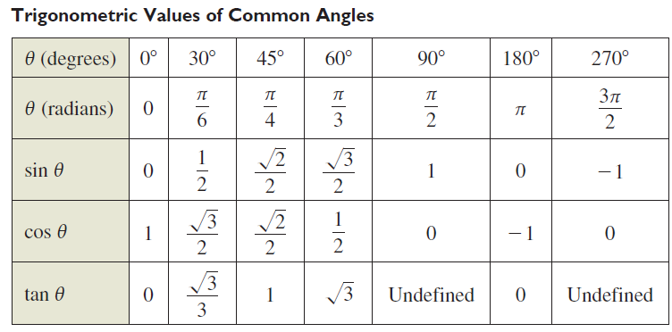
Evaluating Trigonometric Functions
The degree and radian measures of several common angles are shown in the table below, along with the
corresponding values of the sine, cosine, and tangent.

Slide 26
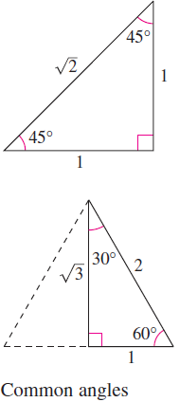
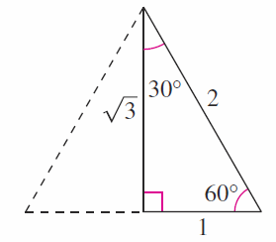
Evaluating Trigonometric Functions
See Figure 1.41.
Figure 1.41

Slide 27








Example 3 – Using Trigonometric Identities

Slide 28
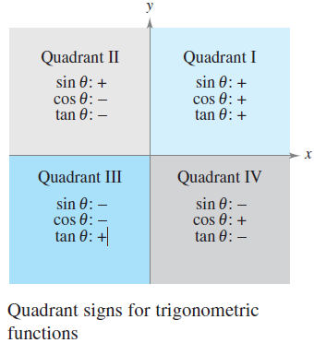
Evaluating Trigonometric Functions
The quadrant signs for the sine, cosine, and tangent functions are shown in Figure 1.42.
Figure 1.42

Slide 29
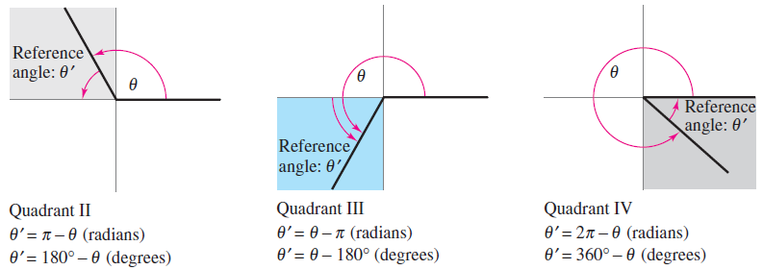
Evaluating Trigonometric Functions
To find the angles in quadrants other than the first quadrant, you can use the concept of a reference angle (see Figure 1.43), with the appropriate quadrant sign.
Figure 1.43

Slide 30


Evaluating Trigonometric Functions
For instance, the reference angle for 3π /4 is π /4, and because the sine is positive in Quadrant II, you can write
Similarly, because the reference angle for 330° is 30°, and the tangent is negative in Quadrant IV, you can write

Slide 31
Solving Trigonometric Equations

Slide 32
Solving Trigonometric Equations
How would you solve the equation sinθ = 0?
You know that θ = 0 is one solution, but this is not the only solution. Any one of the following values of θ is also a solution.
You can write this infinite solution set as {nπ : n is an integer}.

Slide 33


Example 4 – Solving a Trigonometric Equation
Solve the equation
Solution:
To solve the equation, you should consider that the sine function is negative in Quadrants III and IV and that
So, you are seeking values of θ in the third and fourth quadrants that have a reference angle of π /3.

Slide 34

Example 4 – Solution
cont’d
In the interval [0, 2π ], the two angles fitting these criteria are,
By adding integer multiples of 2π to each of these solutions, you obtain the following general solution.

Slide 35
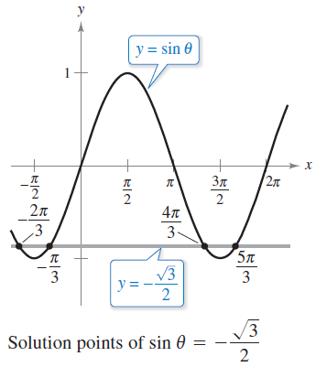
Example 4 – Solution
cont’d
See Figure 1.44.
Figure 1.44

Slide 36
Graphs of Trigonometric Functions

Slide 37
Graphs of Trigonometric Functions
A function f is periodic when there exists a positive real number p such that f (x + p) = f (x) for all x in the domain of f.
The least such positive value of p is the period of f. The sine, cosine, secant, and cosecant functions each have a period of 2π, and the other two trigonometric functions, tangent and cotangent, have a period of π, as shown in Figure 1.45.

Slide 38
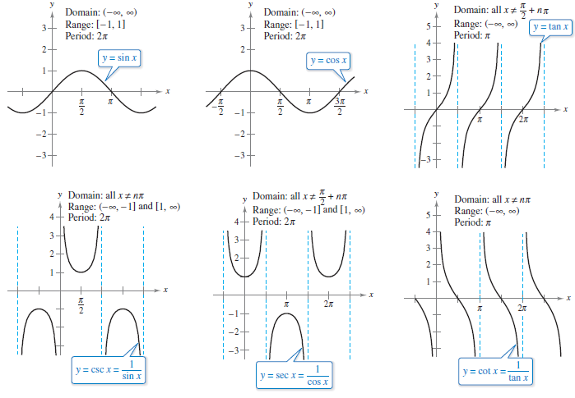
Graphs of Trigonometric Functions
The graphs of the six trigonometric functions
Figure 1.45

Slide 39
Graphs of Trigonometric Functions
Note in Figure 1.45 that the maximum value of sin x and cos x is 1 and the minimum value is –1.
The graphs of the functions y = a sin bx and y = a cos bx
oscillate between –a and a, and so have an amplitude of |a|.
Furthermore, because bx = 0 when x = 0 and bx = 2π
when x = 2π /b, it follows that the functions
y = a sin bx and y = a cos bx each have a period of 2π /|b|.

Slide 40
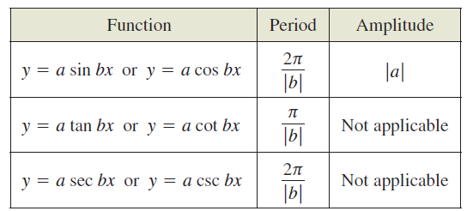
Graphs of Trigonometric Functions
The table below summarizes the amplitudes and periods of some types of trigonometric functions.

Slide 41



Example 6 – Sketching the Graph of a Trigonometric Function
Sketch the graph of f (x) = 3 cos 2x.
Solution:
The graph of f (x) = 3 cos 2x has an amplitude of 3 and a period of 2π /2 = π.
Using the basic shape of the graph of the cosine function, sketch one period of the function on the interval [0, π ], using the following pattern.

Slide 42
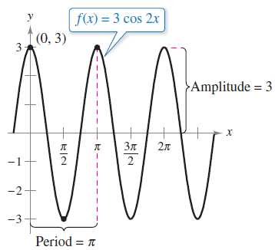
Example 6 – Solution
cont’d
By continuing this pattern, you can sketch several cycles of the graph, as shown in Figure 1.46.
Figure 1.46

Slide 43
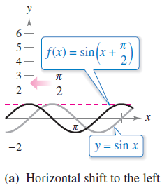
Example 7 – Shifts of Graphs of Trigonometric Functions
a. To sketch the graph of f (x) = sin(x + π /2), shift the graph
of y = sin x to the left π /2 units, as shown in
Figure 1.47(a).
Transformations of the graph of y = sin x
Figure 1.47

Slide 44
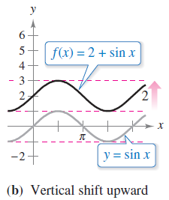
Example 7 – Shifts of Graphs of Trigonometric Functions
cont’d
b. To sketch the graph of f (x) = 2 + sin x, shift the graph of
y = sin x upward two units, as shown in Figure 1.47(b).
Transformations of the graph of y = sin x
Figure 1.47

Slide 45
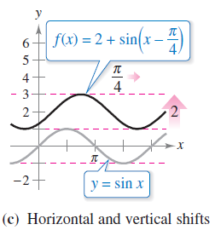
Example 7 – Shifts of Graphs of Trigonometric Functions
cont’d
c. To sketch the graph of f (x) = 2 + sin(x – π /4), shift the
graph of y = sin x upward two units and to the right π /4
units, as shown in Figure 1.47(c).
Transformations of the graph of y = sin x
Figure 1.47

