Slide 1


P
1
Preparation for Calculus
Copyright © Cengage Learning. All rights reserved.

Slide 2

1.5
Inverse Functions
Copyright © Cengage Learning. All rights reserved.

Slide 3
Objectives
Verify that one function is the inverse function of another function.
Determine whether a function has an inverse function.
Develop properties of the six inverse trigonometric functions.

Slide 4
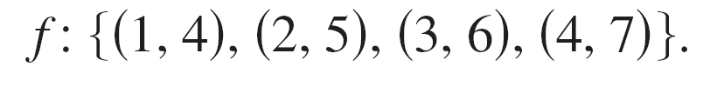
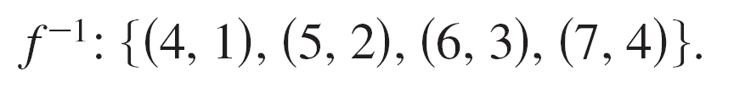
Inverse Functions
The function f (x) = x + 3 from A = {1, 2, 3, 4} to B = {4, 5, 6, 7} can be written as
By interchanging the first and second coordinates of each ordered pair, you can form the inverse function of f. This function is denoted by f ^{–1}, which is read as “ f inverse.”
It is a function from B to A, and can be written as

Slide 5
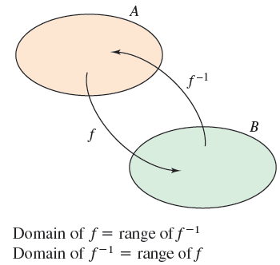
Inverse Functions
Note that the domain of f is equal to the range of f ^{–1}, and vice versa, as shown in Figure 1.48. The functions f and f ^{–1} have the effect of “undoing” each other. That is, when you form the composition of f with f ^{–1} or the composition of f ^{–1} with f, you obtain the identity function.
f (f ^{–1}(x)) = x and f ^{–1}(f (x)) = x
Figure 1.48

Slide 6
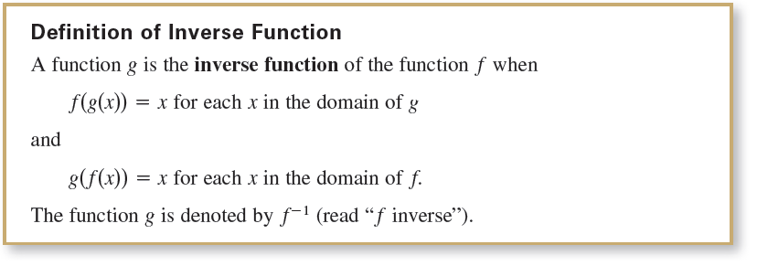
Inverse Functions

Slide 7
Inverse Functions
Here are some important observations about inverse functions.
1. If g is the inverse function of f, then f is the inverse
function of g.
2. The domain of f ^{–1} is equal to the range of f, and the
range of f ^{–1} is equal to the domain of f.
3. A function need not have an inverse function, but when it
does, the inverse function is unique.

Slide 8
Inverse Functions
You can think of f ^{–1} as undoing what has been done by f.
For example, subtraction can be used to undo addition, and division can be used to undo multiplication. So,
are inverse functions of each other and
are inverse functions of each other.

Slide 9
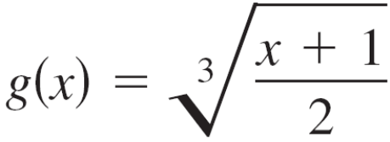

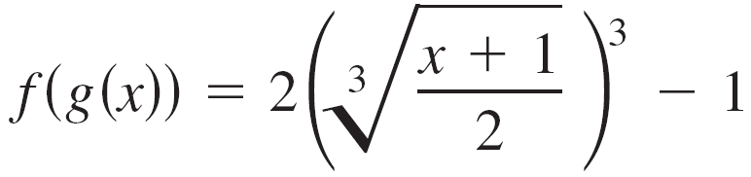
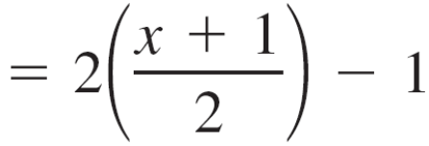
Example 1 – Verifying Inverse Functions
Show that the functions are inverse functions of each other.
and
Solution:
Because the domains and ranges of both f and g consist of all real numbers, you can conclude that both composite functions exist for all x.
The composition of f with g is

Slide 10


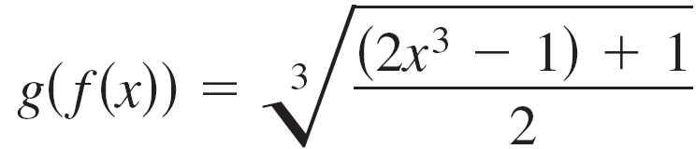
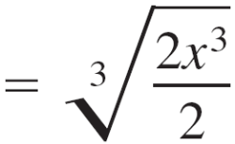


Example 1 – Solution
cont'd
The composition of g with f is

Slide 11
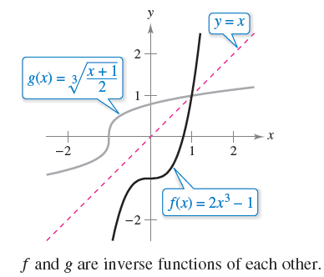
Example 1 – Solution
cont'd
Because f (g(x)) = x and g(f (x)) = x, you can conclude that f and g are inverse functions of each other (see Figure 1.49).
Figure 1.49

Slide 12
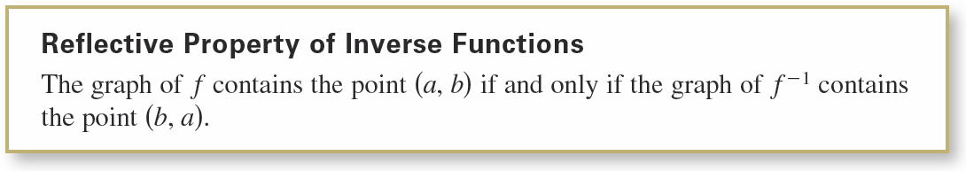
Inverse Functions
In Figure 1.49, the graphs of f and g = f ^{–1} appear to be mirror images of each other with respect to the line y = x. The graph of f ^{–1} is a reflection of the graph of f in the line y = x.
This idea is generalized in the following definition.

Slide 13
Existence of an Inverse Function

Slide 14
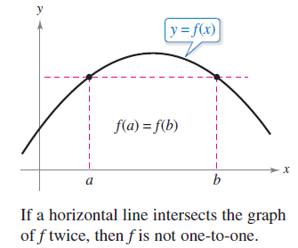
Existence of an Inverse Function
Not every function has an inverse function, and the Reflective Property of Inverse Functions suggests a graphical test for those that do—the Horizontal Line Test for an inverse function.
This test states that a function
f has an inverse function if and
only if every horizontal line
intersects the graph of f at
most once (see Figure 1.51).
Figure 1.51

Slide 15

Existence of an Inverse Function
The next definition formally states why the Horizontal Line Test is valid.

Slide 16
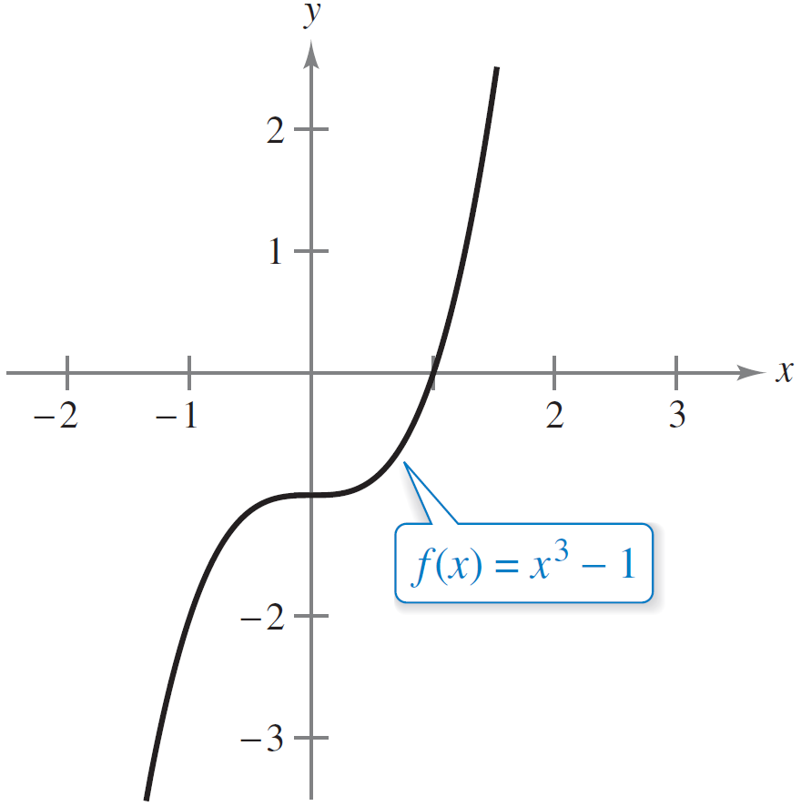
Example 2 – The Existence of an Inverse Function
Which of the functions has an inverse function?
a. f (x) = x³ – 1 b. f (x) = x³ – x + 1
Solution:
a. From the graph of f shown in
Figure 1.52(a), it appears
that f is one-to-one over its
entire domain.
Because f is one-to-one over its entire
domain, it has an inverse function.
Figure 1.52(a)

Slide 17



Example 2 – Solution
cont'd
To verify this, suppose that there exist x₁ and x₂ such
that f (x₁) = f (x₂). By showing that x₁ = x₂, it follows that f
is one-to-one.
f (x₁) = f (x₂)
x₁ = x₂
Because f is one-to-one, you can conclude that f must
have an inverse function.

Slide 18
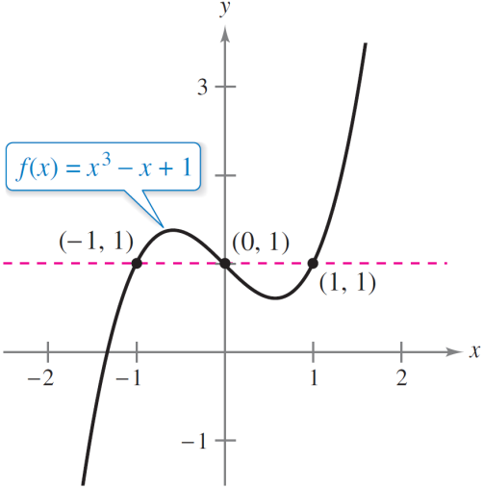
Example 2 – Solution
cont'd
b. From the graph of f shown in
Figure 1.52(b), you can see
that the function does not
pass the Horizontal Line Test.
In other words, it is not
one-to-one.
For instance, f has the same value when x = –1, 0, and 1.
f (–1) = f (1) = f (0) = 1
Therefore, f does not have an inverse function.
Because f is not one-to-one, it does not have an inverse function.
Figure 1.52(b)
Not one-to-one

Slide 19
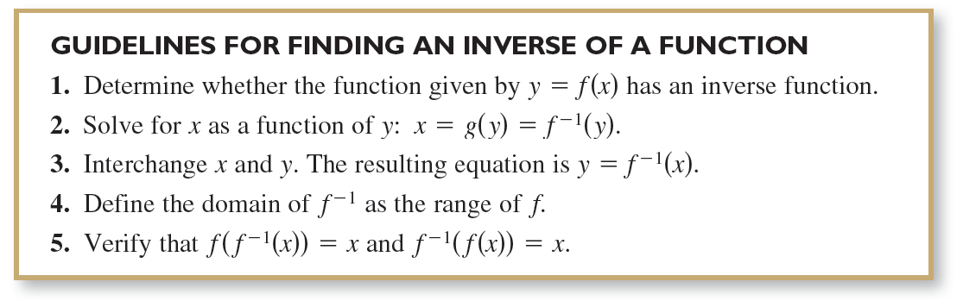
Existence of an Inverse Function
The following guidelines suggest a procedure for finding an inverse function.

Slide 20

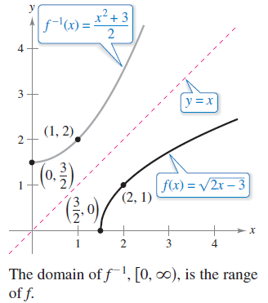
Example 3 – Finding an Inverse Function
Find the inverse function of
Solution:
The function has an inverse
function because it is one-to-one
on its entire domain, , as
shown in Figure 1.53.
Figure 1.53

Slide 21
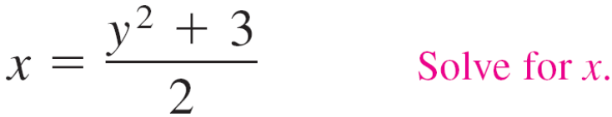
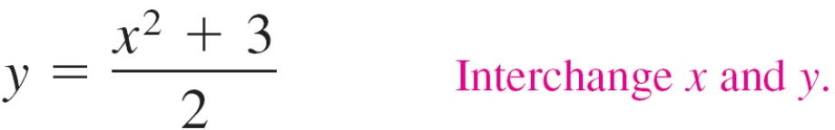
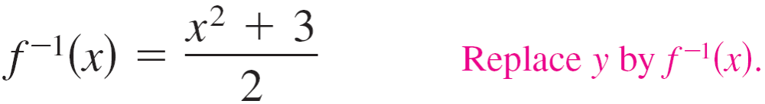
Example 3 – Solution
cont'd
To find an equation for the inverse function, let y = f (x) and solve for x in terms of y.

Slide 22

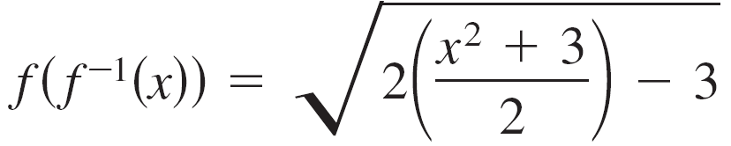

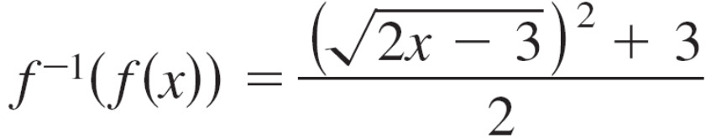
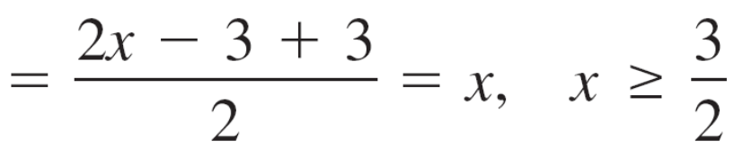
Example 3 – Solution
cont'd
The domain of f ^{–1} is the range of f, which is .
You can verify this result by showing that f (f ^{–1}(x)) = x and
f ^{–1}(f (x)) = x.

Slide 23
Existence of an Inverse Function
Consider a function that is not one-to-one on its domain.
By restricting the domain to an interval on which the function is one-to-one, you can conclude that the new function has an inverse function on the restricted domain.

Slide 24
Example 4 – Testing Whether a Function Is One-to-One
Show that the sine function
f(x) = sin x
is not one-to-one on the entire real number line. Then show that f is one-to-one on the closed interval [–π /2, π /2].
Solution:
It is clear that f is not one-to-one, because many different x-values yield the same y-value.
For instance,
sin 0 = 0 = sin π.

Slide 25
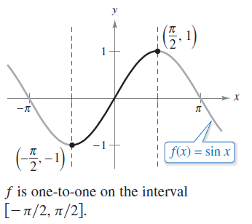
Example 4 – Solution
cont'd
Moreover, from the graph of f (x) = sin x in Figure 1.54, you can see that when f is restricted to the interval [–π /2, π /2], the restricted function is one-to-one.
Figure 1.54

Slide 26
Inverse Trigonometric Functions

Slide 27
Inverse Trigonometric Functions
From the graphs of the six basic trigonometric functions, you can see that they do not have inverse functions.
The functions that are called “inverse trigonometric functions” are actually inverses of trigonometric functions whose domains have been restricted.

Slide 28
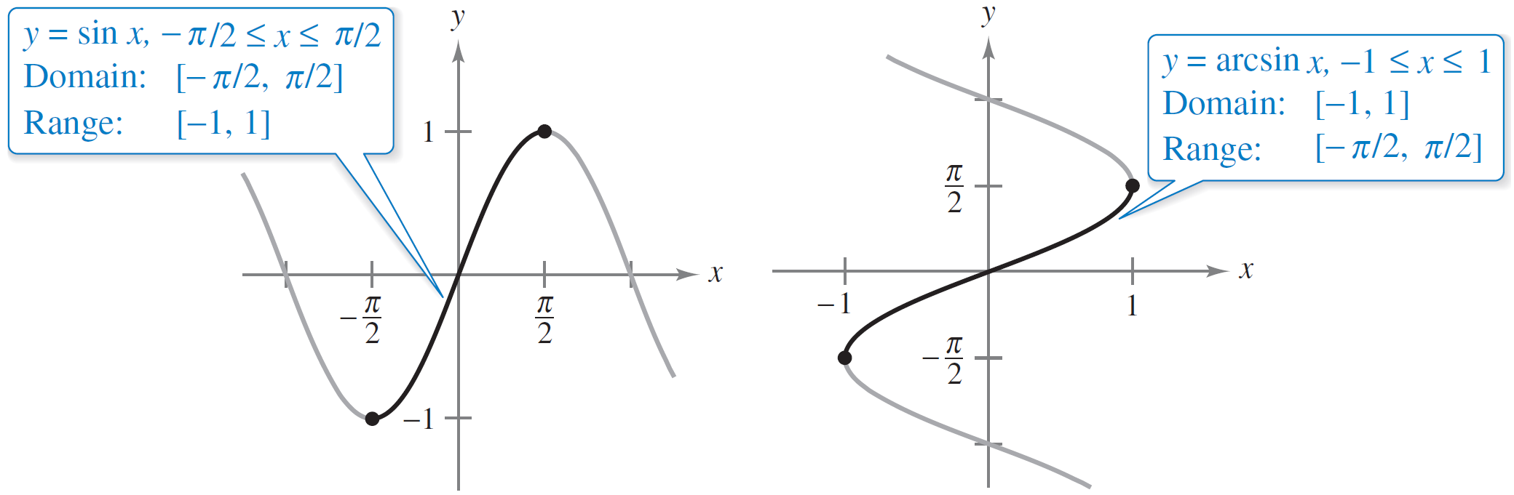
Inverse Trigonometric Functions
For instance, the sine function is one-to-one on the interval [–π /2, π /2] as shown in Figure 1.55.
(a)
(b)
Figure 1.55

Slide 29


Inverse Trigonometric Functions
On this interval, you can define the inverse of the restricted sine function as
y = arcsin x if and only if sin y = x
where
–1 ≤ x ≤ 1 and ≤ arcsin x ≤ .
From Figures 1.55 (a) and (b), you can see that you can obtain the graph of y = arcsin x by reflecting the graph of
y = sin x in the line y = x on the interval [–π /2, π /2].

Slide 30
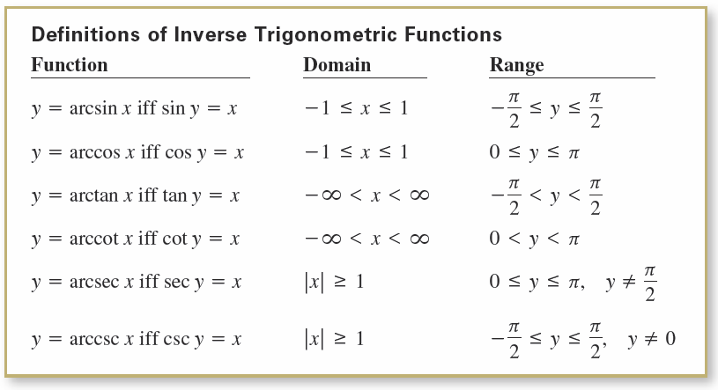
Inverse Trigonometric Functions
Under suitable restrictions, each of the six trigonometric functions is one-to-one and so has an inverse function, as indicated in the following definition. (The term “iff ” is used to represent the phrase “if and only if.”)

Slide 31
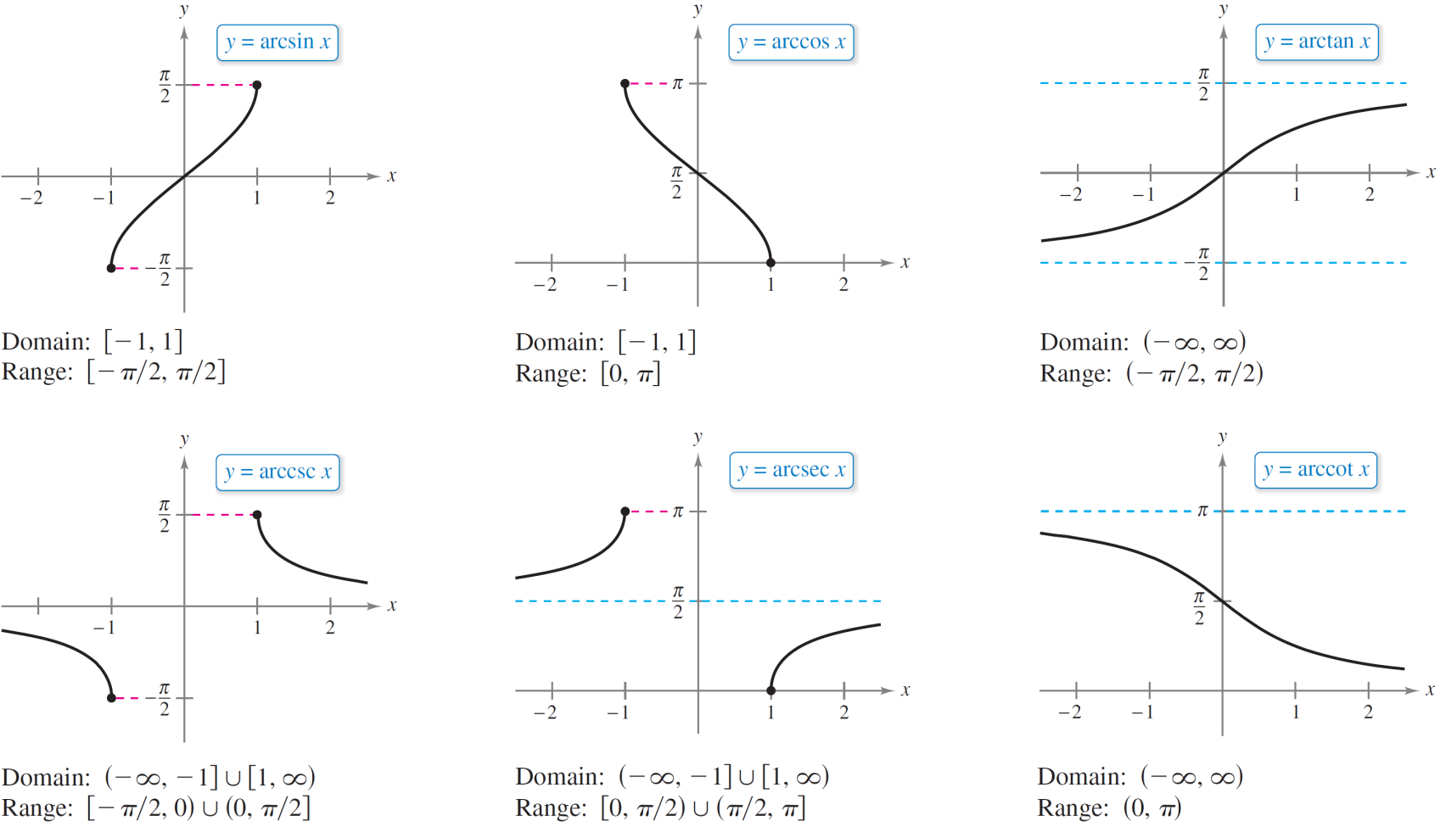
Inverse Trigonometric Functions
The graphs of the six inverse trigonometric functions are shown in Figure 1.56.
Figure 1.56

Slide 32
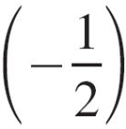

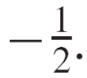
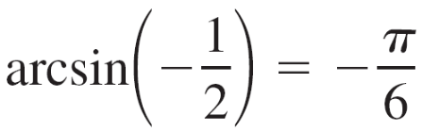
Example 5 – Evaluating Inverse Trigonometric Functions
Evaluate each expression.
a. arcsin b. arccos 0
c. arctan d. arcsin(0.3)
Solution:
a. By definition, y = arcsin implies that sin y =
In the interval [–π /2, π /2], the correct value of y is –π /6.

Slide 33
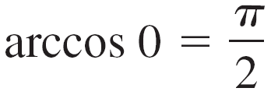

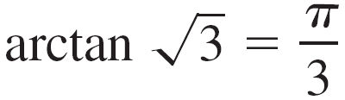
Example 5 – Solution
cont'd
b. By definition, y = arccos 0 implies that cos y = 0. In the
interval [0, π ], you have y = π /2.
c. By definition, y = arctan implies that tan y = . In
the interval (–π /2, π /2), you have y = π /3.
d. Using a calculator set in radian mode produces
arcsin(0.3) ≈ 0.3047.

Slide 34
Inverse Trigonometric Functions
Inverse functions have the properties
f (f ^{–1}(x)) = x and f ^{–1}(f (x)) = x.
When applying these properties to inverse trigonometric functions, remember that the trigonometric functions have inverse functions only in restricted domains.
For x-values outside these domains, these two properties do not hold.
For example, arcsin(sin π) is equal to 0, not π.

Slide 35
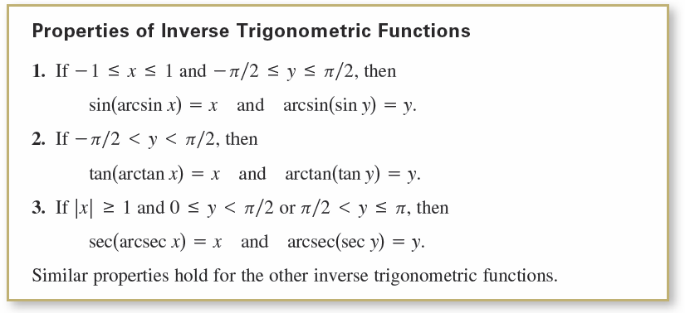
Inverse Trigonometric Functions

