Slide 1


P
1
Preparation for Calculus
Copyright © Cengage Learning. All rights reserved.

Slide 2

Exponential and Logarithmic
Functions
1.6
Copyright © Cengage Learning. All rights reserved.

Slide 3
Objectives
Develop and use properties of exponential functions.
Understand the definition of the number e.
Understand the definition of the natural logarithmic function, and develop and use properties of the natural logarithmic function.

Slide 4
Exponential Functions

Slide 5
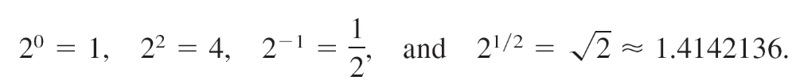
Exponential Functions
An exponential function involves a constant raised to a power, such as f (x) = 2^{x}. You already know how to evaluate 2^{x} for rational values of x. For instance,
For irrational values of x, you can define 2^{x} by considering a sequence of rational numbers that approach x.
A full discussion of this process would not be appropriate
now, but here is the general idea.

Slide 6


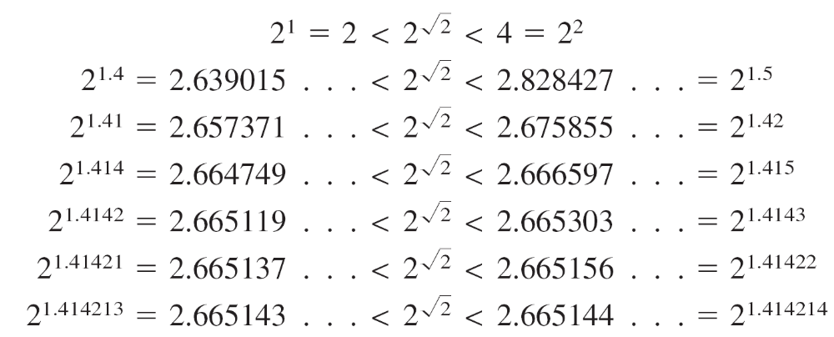
Exponential Functions
To define the number note that
and consider the numbers below (which are of the form 2^{r}, where r is rational).

Slide 7


Exponential Functions
From these calculations, it seems reasonable to conclude
that
In practice, you can use a calculator to approximate
numbers such as
In general, you can use any positive base a, a ≠ 1, to define an exponential function. So, the exponential function with base a is written as f (x) = a^{x}.
Exponential functions, even those with irrational values of x, obey the familiar properties of exponents.

Slide 8
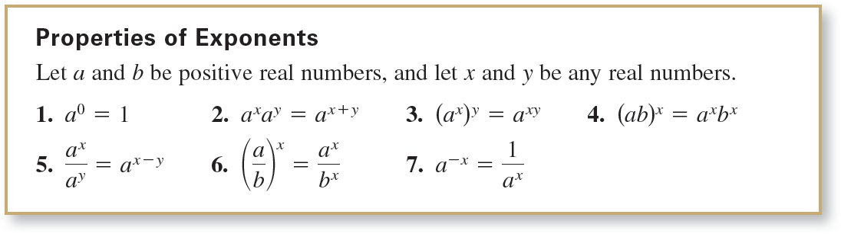
Exponential Functions

Slide 9
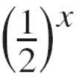
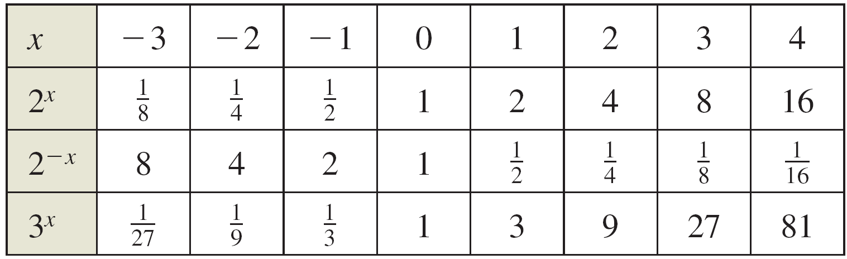
Example 2 – Sketching Graphs of Exponential Functions
Sketch the graphs of the functions
f (x) = 2^{x}, g(x) = = 2^{–x}, and h (x) = 3^{x}.
Solution:
To sketch the graphs of these functions by hand, you can complete a table of values, plot the corresponding points, and connect the points with smooth curves.

Slide 10
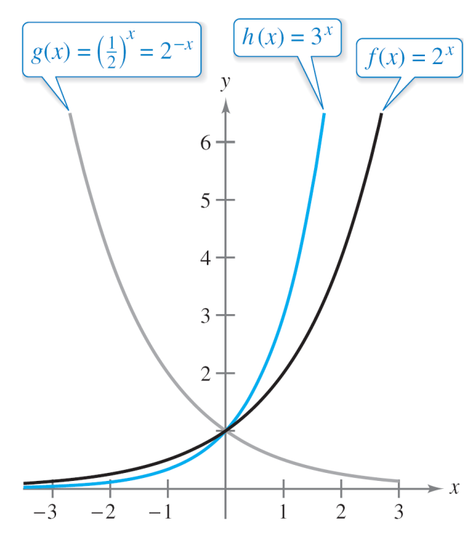
Example 2 – Solution
cont’d
Another way to graph these functions is to use a graphing utility. In either case, you should obtain graphs similar to those shown in Figure 1.58.
Figure 1.58

Slide 11
Example 2 – Solution
cont’d
Note that the graphs of f and h are increasing, and the graph of g is decreasing. Also, the graph of h is increasing
more rapidly than the graph of f.

Slide 12
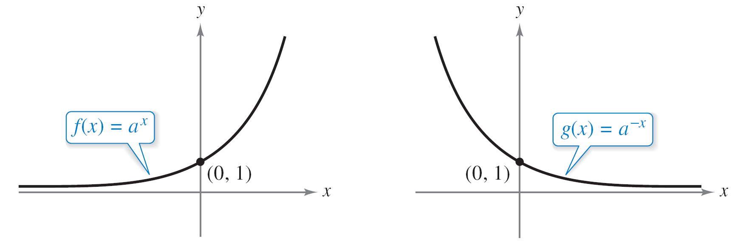
Exponential Functions
The shapes of the graphs in Figure 1.58 are typical of the exponential functions f (x) = a^{x} and g (x) = a^{–x} where a > 1, as shown in Figure 1.59.
Figure 1.59

Slide 13
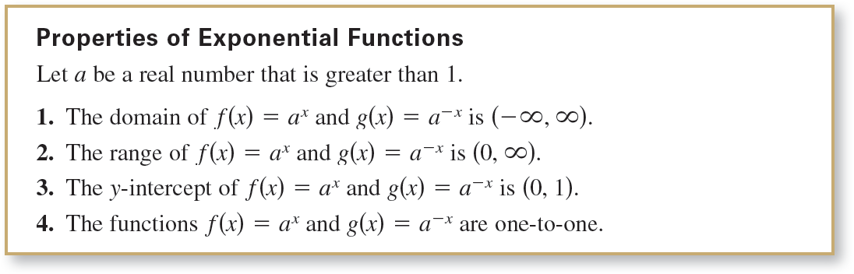
Exponential Functions

Slide 14
The Number e

Slide 15
The Number e
In calculus, the natural (or convenient) choice for a base of an exponential number is the irrational number e, whose decimal approximation is
e ≈ 2.71828182846.
This choice may seem anything but natural. The convenience of this particular base, however, will become apparent as you continue in this course.

Slide 16
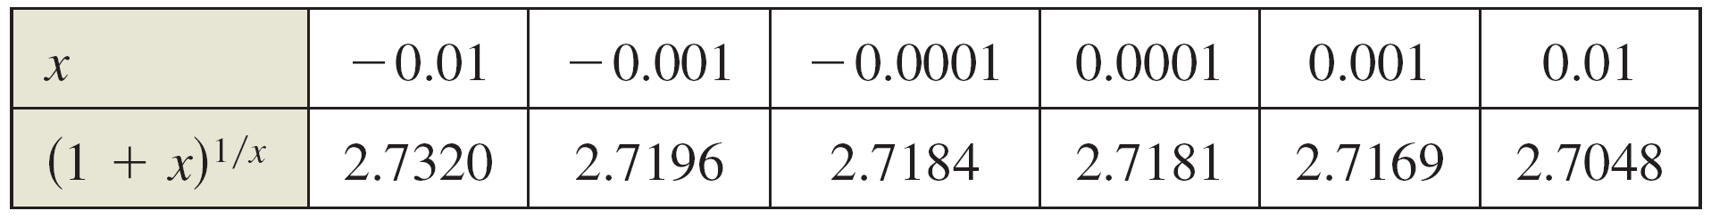
Example 3 – Investigating the Number e
Describe the behavior of the function f (x) = (1 + x)^{1/x} at values of x that are close to 0.
Solution:
One way to examine the values of f (x) near 0 is to construct a table.

Slide 17
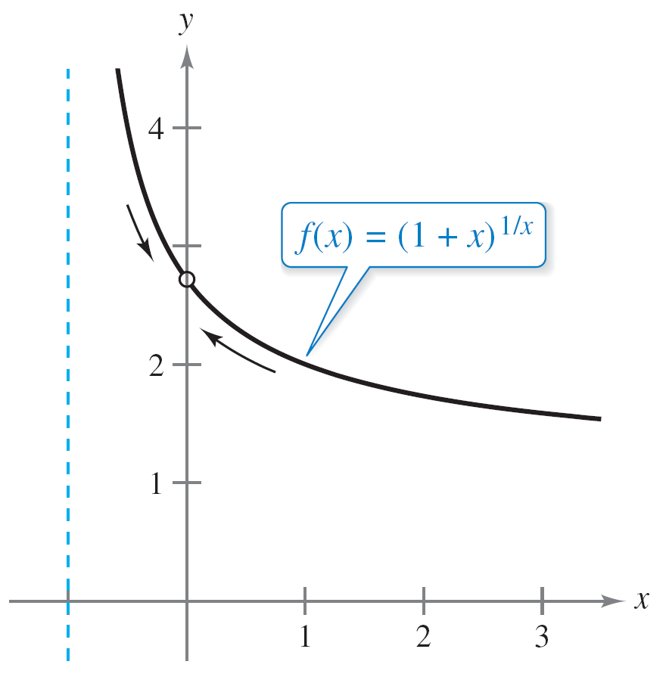
Example 3 – Solution
cont’d
From the table, it appears that the closer x gets to 0, the closer (1 + x)^{1/x} gets to e. The graph of f shown in
Figure 1.60 supports this conclusion.
Figure 1.60

Slide 18
Example 3 – Solution
cont’d
Try using a graphing calculator to obtain this graph. Then zoom in closer and closer to x = 0. Although f is not defined when x = 0, it is defined for x-values that are arbitrarily close to zero.
By zooming in, you can see that the value of f (x) gets closer and closer to e ≈ 2.71828182846 as x gets closer and closer to 0.

Slide 19

Example 3 – Solution
cont’d
Later, when you study limits, you will learn that this result can be written as
which is read as “the limit of (1 + x)^{1/x} as x approaches
0 is e.”

Slide 20
The Natural Logarithmic Function

Slide 21
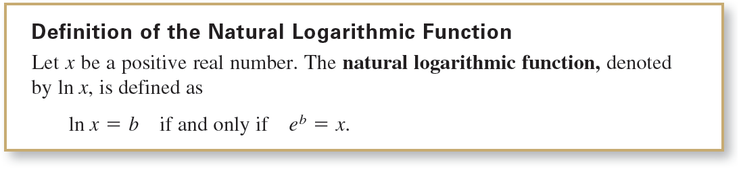
The Natural Logarithmic Function
Because the natural exponential function
f (x) = e^{x}
is one-to-one, it must have an inverse function. This inverse function is called the natural logarithmic function. The domain of the natural logarithmic function is the set of positive real numbers.

Slide 22

The Natural Logarithmic Function
The definition of the natural logarithmic function tells you that a logarithmic equation can be written in an equivalent exponential form, and vice versa.
Here are some examples.
Logarithmic Form Exponential Form
ln 1 = 0 e⁰ = 1
ln e = 1 e¹ = e
ln e^{–1} = –1 e^{–1} =

Slide 23
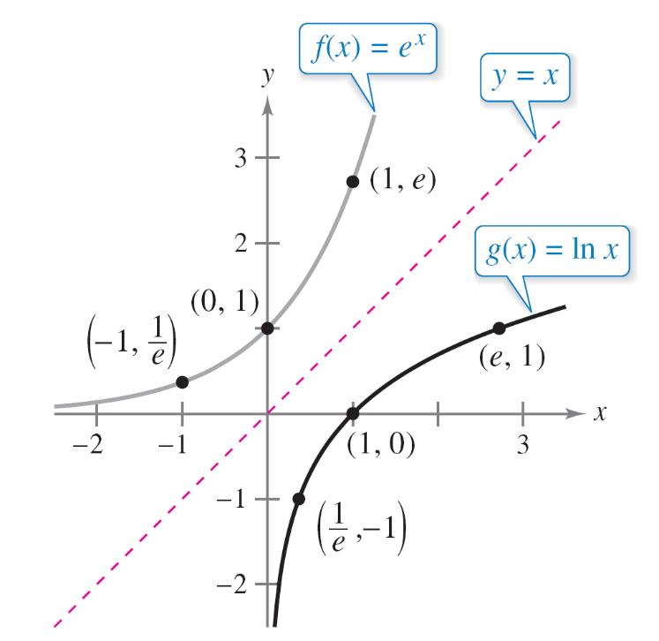
The Natural Logarithmic Function
Because the function g (x) = ln x is defined to be the inverse function of f (x) = e^{x}, it follows that the graph of the natural logarithmic function is a reflection of the graph of the natural exponential function in the line y = x as shown in Figure 1.62.
Figure 1.62

Slide 24
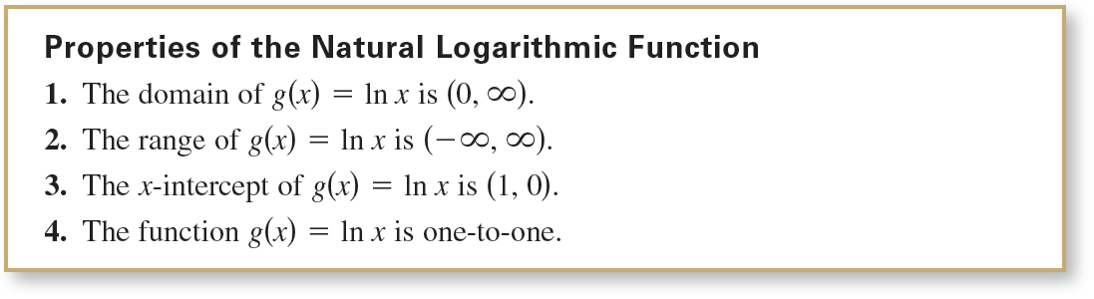
The Natural Logarithmic Function
Several other properties of the natural logarithmic function also follow directly from its definition as the inverse of the natural exponential function.

Slide 25

The Natural Logarithmic Function
Because f (x) = e^{x} and g (x) = ln x are inverses of each other, you can conclude that

Slide 26
The Natural Logarithmic Function
One of the properties of exponents states that when you multiply two exponential functions (having the same base), you add their exponents.
For instance,
e^{x}e^{y} = e^{x} ⁺ ^{y}.
The logarithmic version of this property states that the natural logarithm of the product of two numbers is equal to the sum of the natural logs of the numbers.
That is,
ln xy = ln x + ln y.

Slide 27
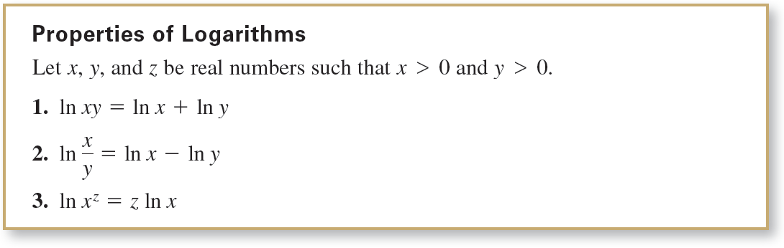
The Natural Logarithmic Function
This property and the properties dealing with the natural log of a quotient and the natural log of a power are listed here.

Slide 28
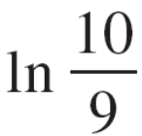


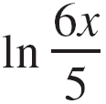
Example 5 – Expanding Logarithmic Expressions
a. = ln 10 – ln 9
b. = ln(3x + 2)^{1/2}
= ln(3x + 2)
c. = ln(6x) – ln 5
= ln 6 + ln x – ln 5
Property 2
Rewrite with rational exponent.
Property 3
Property 2
Property 1

Slide 29
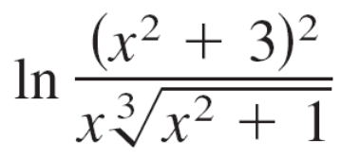

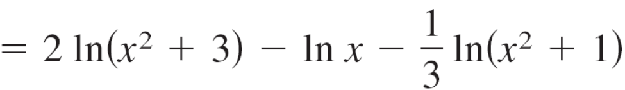
Example 5 – Expanding Logarithmic Expressions
cont’d
d.

Slide 30
The Natural Logarithmic Function
When using the properties of logarithms to rewrite logarithmic functions, you must check to see whether the domain of the rewritten function is the same as the domain of the original function.
For instance, the domain of f (x) = ln x² is all real numbers except x = 0, and the domain of g(x) = 2 ln x is all positive real numbers.

