Slide 1


2
Limits and Their Properties
Copyright © Cengage Learning. All rights reserved.

Slide 2

Finding Limits Graphically and Numerically
2.2
Copyright © Cengage Learning. All rights reserved.

Slide 3
Objectives
Estimate a limit using a numerical or graphical approach.
Learn different ways that a limit can fail to exist.
Study and use a formal definition of limit.

Slide 4
An Introduction to Limits

Slide 5

An Introduction to Limits
To sketch the graph of the function
for values other than x = 1, you can use standard curve-sketching techniques. At x = 1, however, it is not clear what to expect.

Slide 6
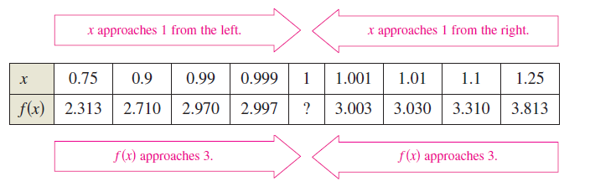
An Introduction to Limits
To get an idea of the behavior of the graph of f near x = 1, you can use two sets of x-values–one set that approaches 1 from the left and one set that approaches 1 from the right, as shown in the table.

Slide 7
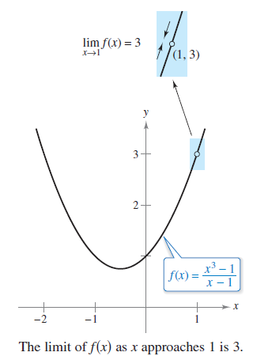

An Introduction to Limits
The graph of f is a parabola that has a hole at the point (1, 3), as shown in the Figure 2.5.
Although x cannot equal 1, you can move arbitrarily close to 1, and as a result f(x) moves arbitrarily close to 3.
Using limit notation, you can write
Figure 2.5
This is read as “the limit of f(x) as x approaches 1 is 3.”

Slide 8

An Introduction to Limits
This discussion leads to an informal definition of limit.
If f(x) becomes arbitrarily close to a single number L as x approaches c from either side, then the limit of f(x) as x approaches c is L.
This limit is written as

Slide 9
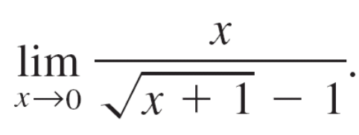
Example 1 – Estimating a Limit Numerically
Evaluate the function at several
x-values near 0 and use the results to estimate the limit

Slide 10
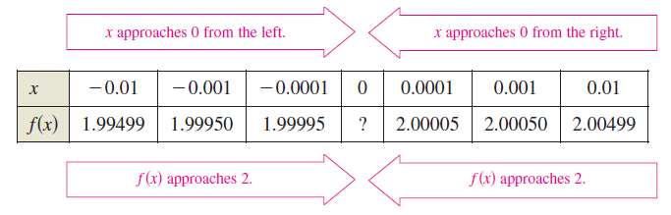
Example 1 – Solution
The table lists the values of f(x) for several x-values near 0.
From the results shown in the table, you can estimate the limit to be 2.

Slide 11
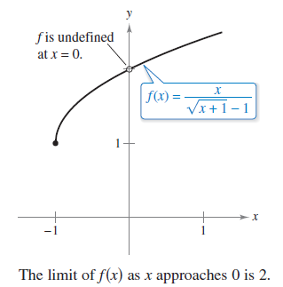
Example 1 – Solution
cont’d
This limit is reinforced by the graph of f shown in Figure 2.6.
Figure 2.6

Slide 12
Limits That Fail to Exist

Slide 13

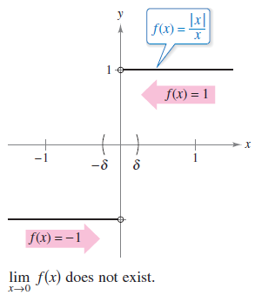



Example 3 – Different Right and Left Behavior
Show that the limit does not exist.
Solution:
Consider the graph of the function
In Figure 2.8 and from the definition
of absolute value,
you can see that
Figure 2.8

Slide 14

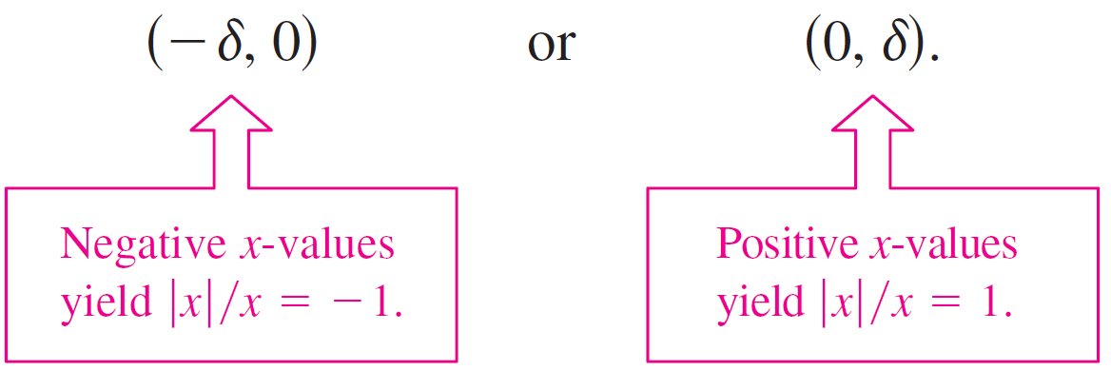
Example 3 – Solution
cont’d
So, no matter how close x gets to 0, there will be both positive and negative x-values that yield f(x) = 1 or
f(x) = –1.
Specifically, if (the lowercase Greek letter delta) is a positive number, then for x-values satisfying the inequality 0 < | x | < , you can classify the values of | x | / x as –1 or 1 on the intervals

Slide 15
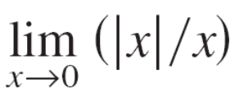
Example 3 – Solution
cont’d
Because | x | / x approaches a different number from the right side of 0 than it approaches from the left side, the limit does not exist.

Slide 16
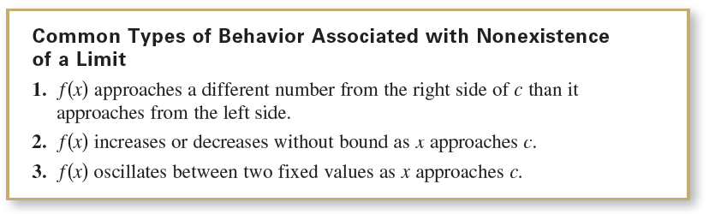
Limits That Fail to Exist

Slide 17
A Formal Definition of Limit

Slide 18
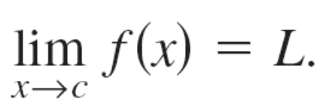
A Formal Definition of Limit
Let’s take another look at the informal definition of limit. If f(x) becomes arbitrarily close to a single number L as x approaches c from either side, then the limit of f(x) as x approaches c is L, is written as
At first glance, this definition looks fairly technical. Even so, it is informal because exact meanings have not yet been given to the two phrases
“f(x) becomes arbitrarily close to L”
and
“x approaches c.”

Slide 19

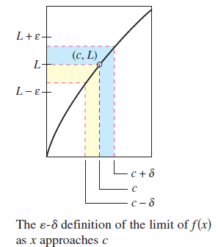

A Formal Definition of Limit
The first person to assign mathematically rigorous meanings to these two phrases was Augustin-Louis Cauchy. His definition of limit is the standard used today.
In Figure 2.12, let (the lower case Greek letter epsilon) represent
a (small) positive number.
Then the phrase “f(x) becomes arbitrarily close to L” means that
f(x) lies in the interval (L – , L + ).
Figure 2.12

Slide 20




A Formal Definition of Limit
Using absolute value, you can write this as
Similarly, the phrase “x approaches c” means that there exists a positive number such that x lies in either the interval or the interval
This fact can be concisely expressed by the double inequality

Slide 21


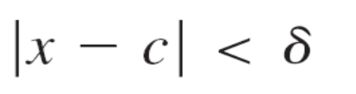

A Formal Definition of Limit
The first inequality
expresses the fact that The second inequality
says that x is within a distance of c.

Slide 22
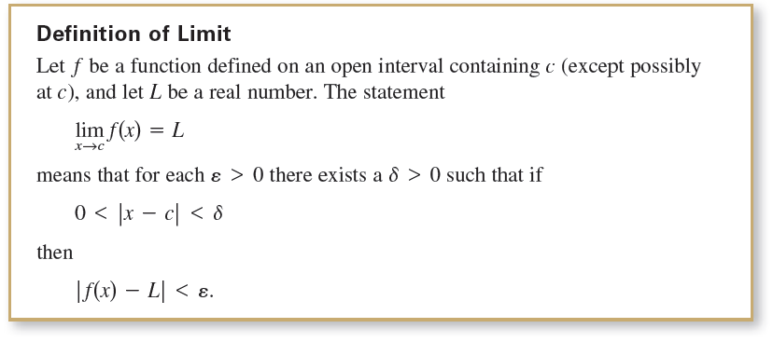
A Formal Definition of Limit

Slide 23
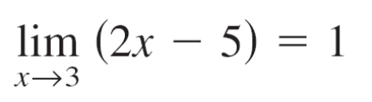

Example 6 – Finding a δ for a Given ε
Given the limit
find δ such that whenever
Solution:
In this problem, you are working with a given value of
ε –namely, ε = 0.01.
To find an appropriate δ, try to establish a connection
between the absolute values

Slide 24


Example 6 – Solution
cont’d
Notice that
Because the inequality is equivalent to
you can choose
This choice works because
implies that

Slide 25
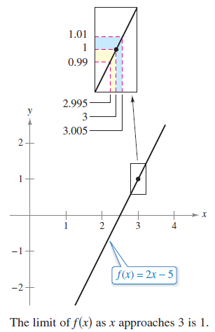
Example 6 – Solution
cont’d
As you can see in Figure 2.13, for x-values within 0.005 of 3 (x ≠ 3), the values of f (x) are within 0.01 of 1.
Figure 2.13

