Slide 1


P
2
Limits and Their Properties
Copyright © Cengage Learning. All rights reserved.

Slide 2

2.3
Evaluating Limits Analytically
Copyright © Cengage Learning. All rights reserved.

Slide 3
Objectives
Evaluate a limit using properties of limits.
Develop and use a strategy for finding limits.
Evaluate a limit using the dividing out technique.
Evaluate a limit using the rationalizing technique.
Evaluate a limit using the Squeeze Theorem.

Slide 4
Properties of Limits

Slide 5

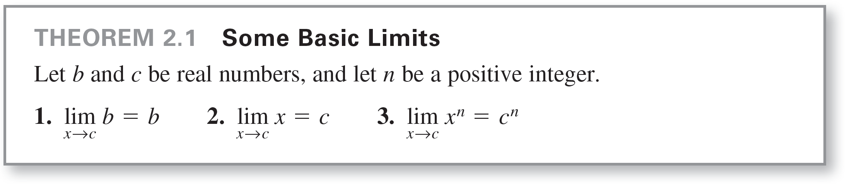
Properties of Limits
The limit of f (x) as x approaches c does not depend on the value of f at x = c. It may happen, however, that the limit is precisely f (c). In such cases, you can evaluate the limit by direct substitution. That is,
Such well-behaved functions are continuous at c.

Slide 6

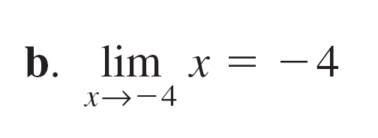

Example 1 – Evaluating Basic Limits

Slide 7
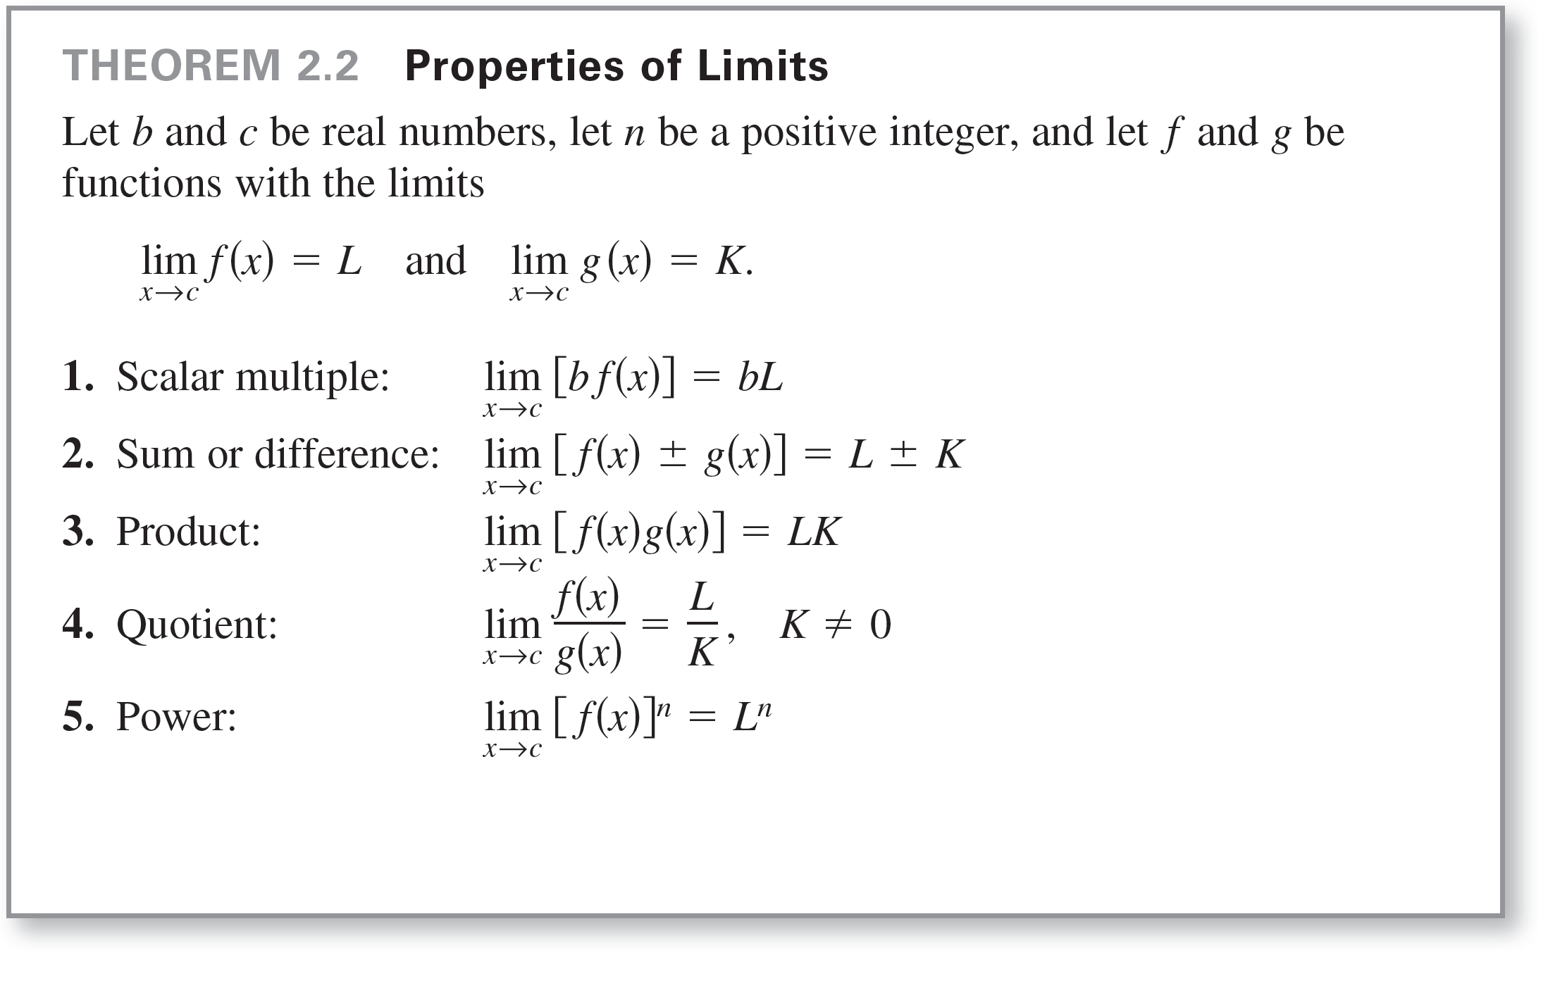
Properties of Limits

Slide 8


Example 2 – The Limit of a Polynomial
Find the limit:
Solution:

Slide 9
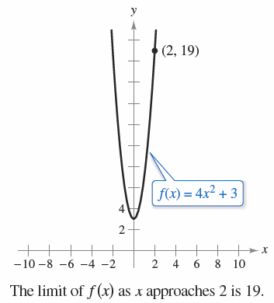
Example 2 – Solution
cont’d
This limit is reinforced by the graph of f (x) = 4x² + 3 shown in Figure 2.17.
Figure 2.17

Slide 10

Properties of Limits
The limit (as x approaches 2) of the polynomial function
p(x) = 4x² + 3 is simply the value of p at x = 2.
This direct substitution property is valid for all polynomial
and rational functions with nonzero denominators.

Slide 11
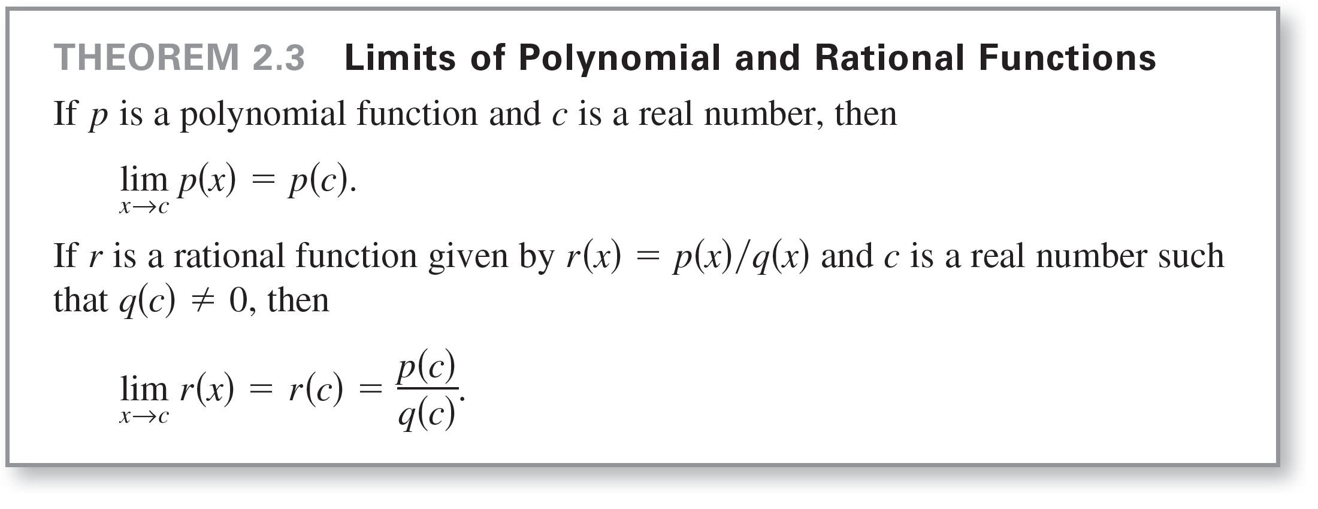
Properties of Limits

Slide 12
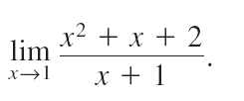
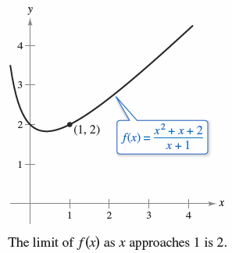


Example 3 – The Limit of a Rational Function
Find the limit:
Solution:
Because the denominator is not 0 when x = 1, you can
apply Theorem 2.3 to obtain
Figure 2.18

Slide 13
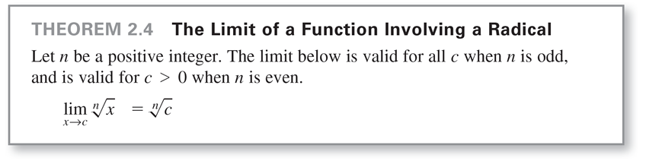
Properties of Limits
Polynomial functions and rational functions are two of the
three basic types of algebraic functions.
The next theorem deals with the limit of the third type of algebraic function—one that involves a radical.

Slide 14
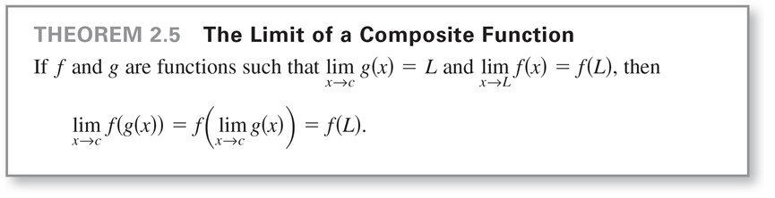
Properties of Limits
The next theorem greatly expands your ability to evaluate limits because it shows how to analyze the limit of a composite function.

Slide 15


Example 4 – The Limit of a Composite Function
Find the limit.
Solution:
a. Because
you can conclude that

Slide 16

Example 4 – Solution
cont’d
b. Because
you can conclude that

Slide 17
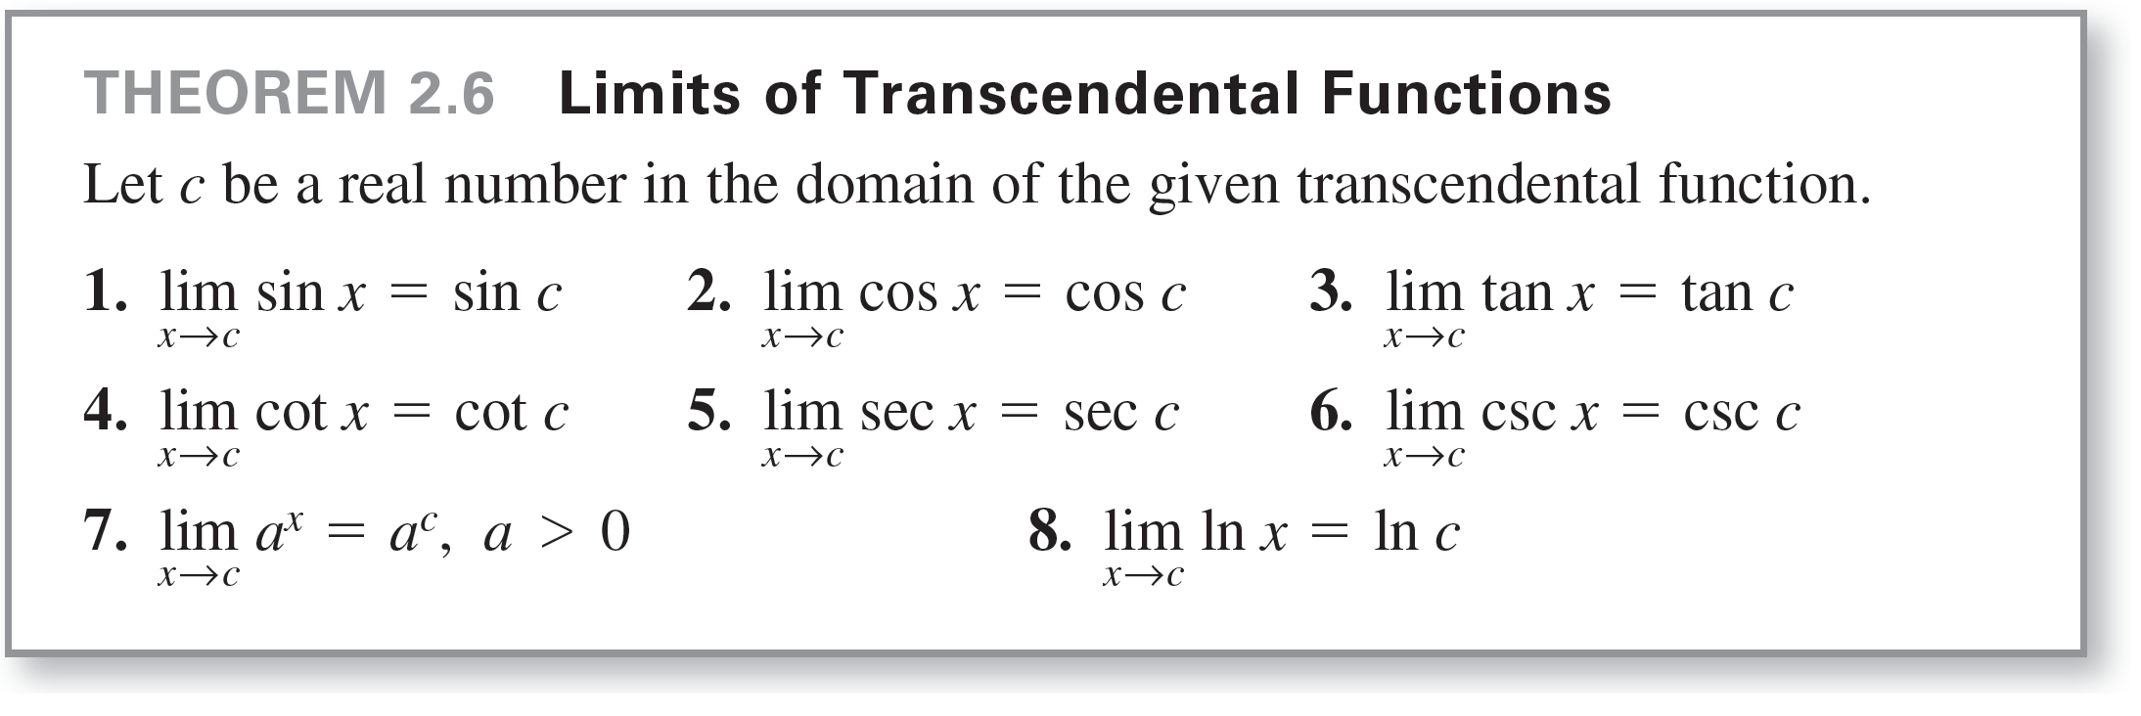
Properties of Limits
You have seen that the limits of many algebraic functions can be evaluated by direct substitution.
The basic transcendental functions (trigonometric, exponential, and logarithmic) also possess this desirable quality, as shown in the below theorem.

Slide 18
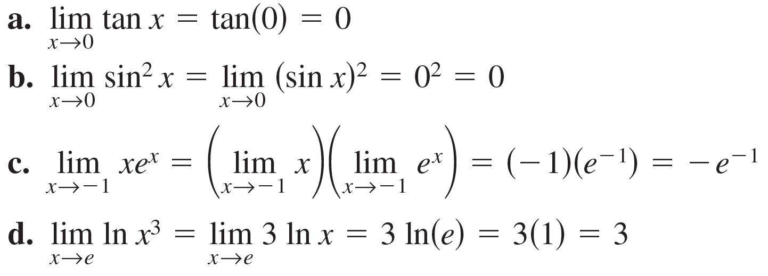
Example 5 – Limits of Transcendental Functions

Slide 19
A Strategy for Finding Limits

Slide 20
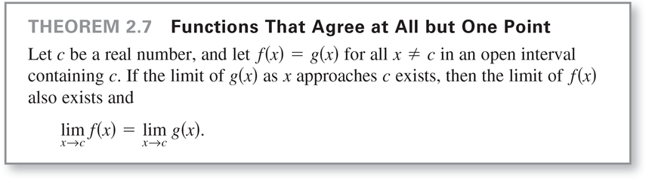
A Strategy for Finding Limits
You studied several types of functions whose limits can be evaluated by direct substitution. This knowledge, together with the next theorem, can be used to develop a strategy for finding limits.

Slide 21


Example 6 – Finding the Limit of a Function
Find the limit.
Solution:
Let f (x) = (x³ – 1) /(x – 1)
By factoring and dividing out common factors, you can rewrite f as

Slide 22
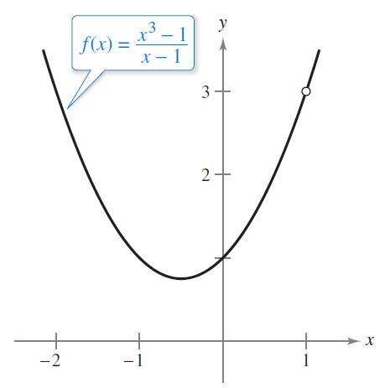
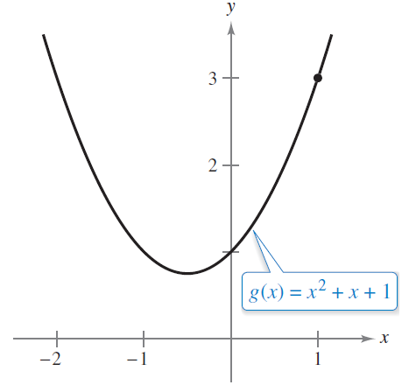
Example 6 – Solution
cont’d
So, for all x-values other than x = 1, the functions f and g agree, as shown in Figure 2.19.
f and g agree at all but one point.
Figure 2.19

Slide 23

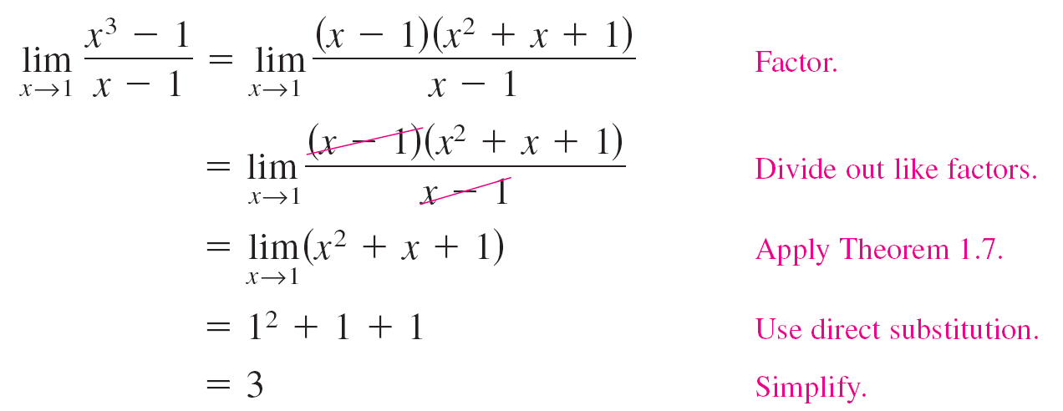
Example 6 – Solution
cont’d
Because exists, you can apply Theorem 2.7 to
conclude that f and g have the same limit at x = 1.

Slide 24
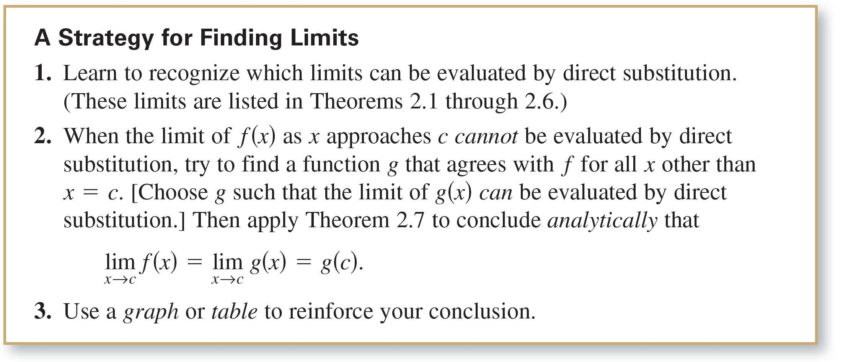
A Strategy for Finding Limits

Slide 25
Dividing Out Technique

Slide 26
Dividing Out Technique
Another procedure for finding a limit analytically is the dividing out technique. This technique involves diving out common factors.

Slide 27

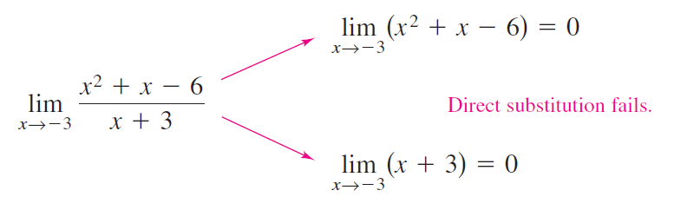
Example 7 – Dividing Out Technique
Find the limit:
Solution:
Although you are taking the limit of a rational function, you cannot apply Theorem 2.3 because the limit of the denominator is 0.

Slide 28



Example 7 – Solution
cont’d
Because the limit of the numerator is also 0, the numerator and denominator have a common factor of (x + 3).
So, for all x ≠ –3, you can divide out this factor to obtain
Using Theorem 2.7, it follows that

Slide 29
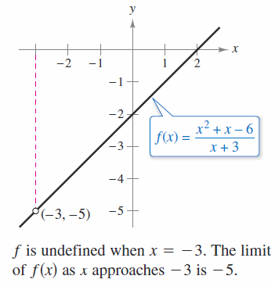
Example 7 – Solution
cont’d
This result is shown graphically in Figure 2.20. Note that the graph of the function f coincides with the graph of the function g(x) = x – 2, except that the graph of f has a hole at the point (–3, –5).
Figure 2.20

Slide 30
Dividing Out Technique
In Example 7, direct substitution produced the meaningless
fractional form 0/0. An expression such as 0/0 is called an
indeterminate form because you cannot (from the form
alone) determine the limit.
When you try to evaluate a limit and encounter this form,
remember that you must rewrite the fraction so that the
new denominator does not have 0 as its limit. One way to
do this is to divide out common factors.

Slide 31
Rationalizing Technique

Slide 32



Rationalizing Technique
Another way to find a limit analytically is the rationalizing technique, which involves rationalizing either the numerator or denominator of a fractional expression. We know that rationalizing the numerator (denominator) means multiplying the numerator and denominator by the conjugate of the numerator (denominator).
For instance, to rationalize the numerator of
multiply the numerator and denominator by the conjugate of
which is

Slide 33

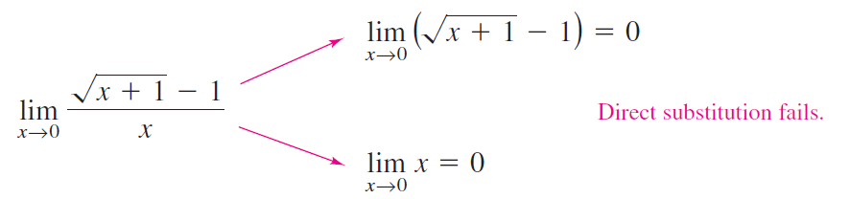
Example 8 – Rationalizing Technique
Find the limit:
Solution:
By direct substitution, you obtain the indeterminate form 0/0.

Slide 34
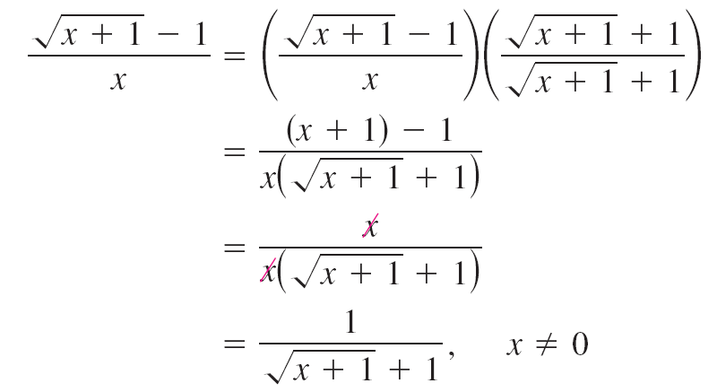
Example 8 – Solution
cont’d
In this case, you can rewrite the fraction by rationalizing the numerator.

Slide 35
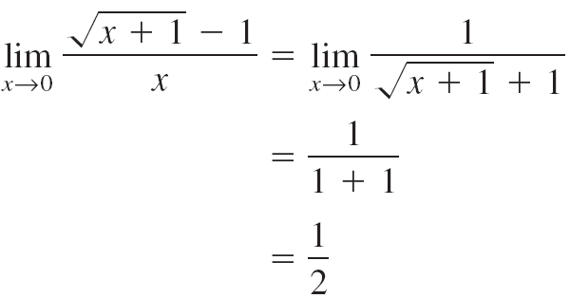
Example 8 – Solution
cont’d
Now, using Theorem 2.7, you can evaluate the limit
as shown.

Slide 36
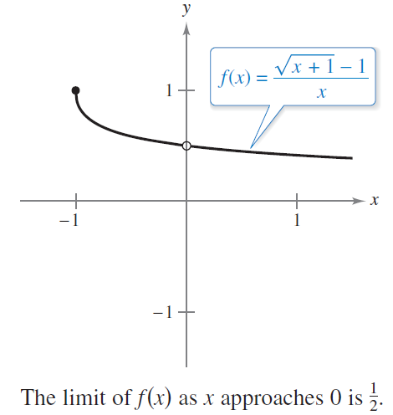
Example 8 – Solution
cont’d
A table or a graph can reinforce your conclusion that the
limit is 1/2 . (See Figure 2.21.)
Figure 2.21

Slide 37
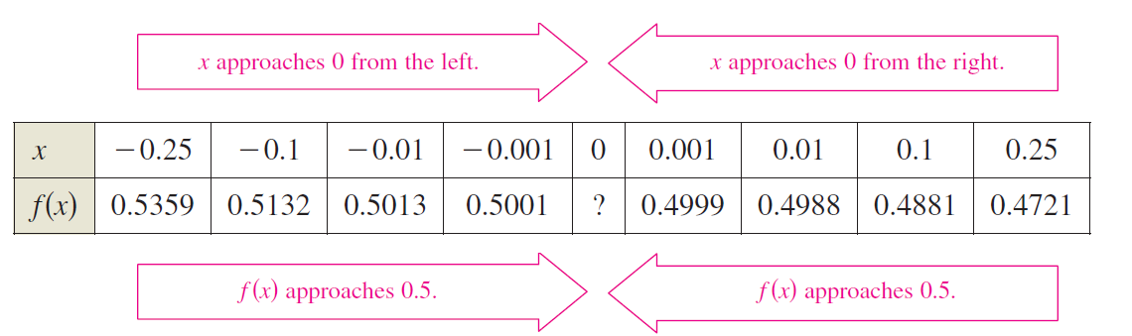
Example 8 – Solution
cont’d

Slide 38
The Squeeze Theorem

Slide 39
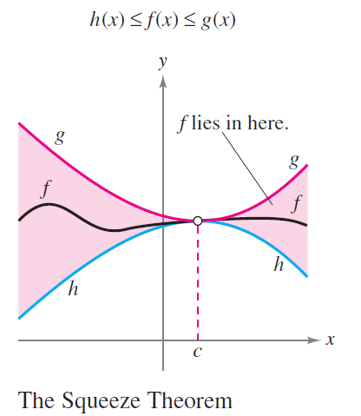
The Squeeze Theorem
The next theorem concerns the limit of a function that is squeezed between two other functions, each of which has the same limit at a given x-value, as shown in Figure 2.22.
Figure 2.22

Slide 40
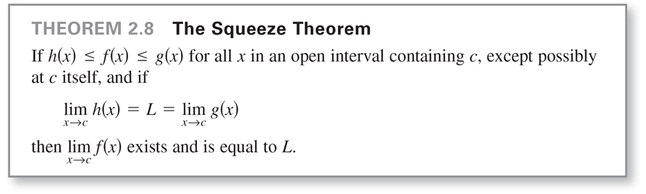
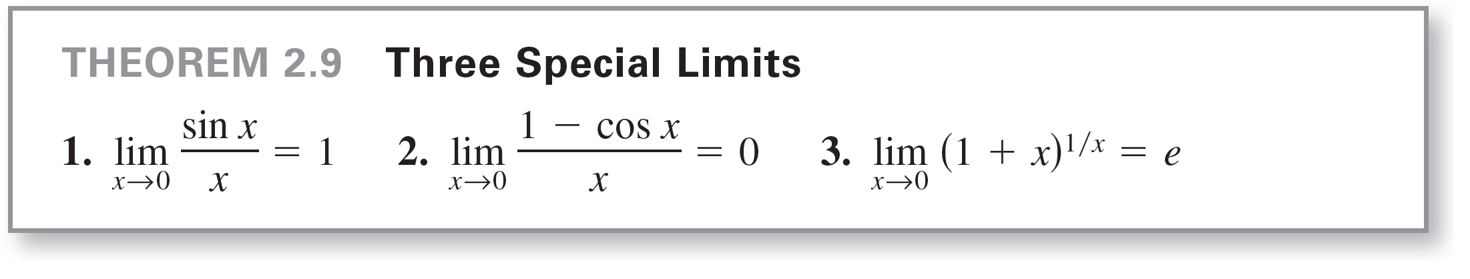
The Squeeze Theorem
The Squeeze Theorem is also called the Sandwich Theorem or the Pinching Theorem.

Slide 41
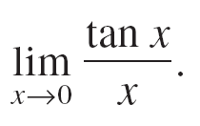

Example 9 – A Limit Involving a Trigonometric Function
Find the limit:
Solution:
Direct substitution yields the indeterminate form 0/0.
To solve this problem, you can write tan x as (sin x)/(cos x) and obtain

Slide 42
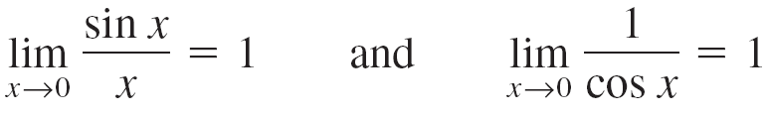
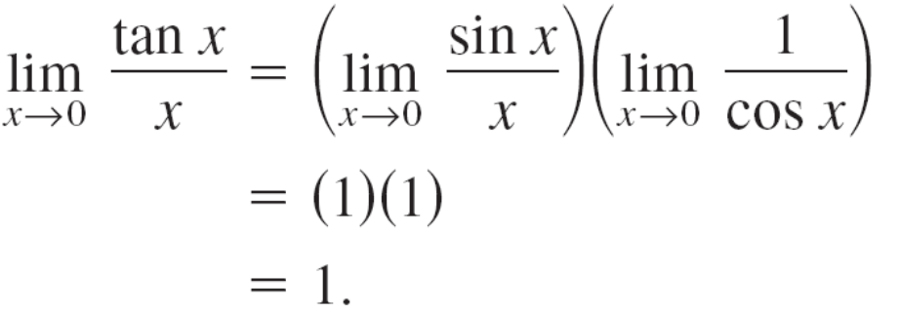
Example 9 – Solution
cont’d
Now, because
you can obtain

Slide 43
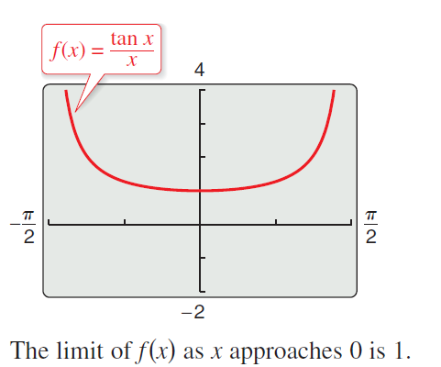
Example 9 – Solution
cont’d
See Figure 2.24.
Figure 2.24

