Slide 1


2
Limits and Their Properties
Copyright © Cengage Learning. All rights reserved.

Slide 2

Continuity and One-Sided Limits
2.4
Copyright © Cengage Learning. All rights reserved.

Slide 3
Objectives
Determine continuity at a point and continuity on an open interval.
Determine one-sided limits and continuity on a closed interval.
Use properties of continuity.
Understand and use the Intermediate Value Theorem.

Slide 4
Continuity at a Point and on an Open Interval

Slide 5
Continuity at a Point and on an Open Interval
In mathematics, the term continuous has much the same meaning as it has in everyday usage.
Informally, to say that a function f is continuous at x = c means that there is no interruption in the graph of f at c.
That is, its graph is unbroken at c, and there are no holes, jumps, or gaps.

Slide 6
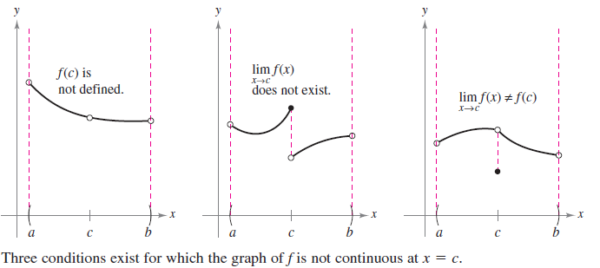
Continuity at a Point and on an Open Interval
Figure 2.26 identifies three values of x at which the graph of f is not continuous. At all other points in the interval (a, b), the graph of f is uninterrupted and continuous.
Figure 2.26

Slide 7
Continuity at a Point and on an Open Interval
In Figure 2.26, it appears that continuity at x = c can be destroyed by any one of three conditions.
1. The function is not defined at x = c.
2. The limit of f(x) does not exist at x = c.
3. The limit of f(x) exists at x = c, but it is not equal to f(c).

Slide 8
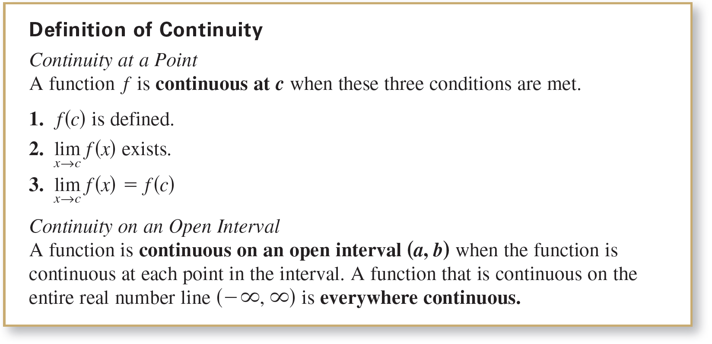
Continuity at a Point and on an Open Interval
If none of the three conditions is true, then the function f
is called continuous at c, as indicated in the following important definition below.

Slide 9
Continuity at a Point and on an Open Interval
Consider an open interval I that contains a real number c.
If a function f is defined on I (except possibly at c), and f is not continuous at c, then f is said to have a discontinuity
at c.
Discontinuities fall into two categories: removable and nonremovable.
A discontinuity at c is called removable when f can be made continuous by appropriately defining (or redefining) f(c).

Slide 10
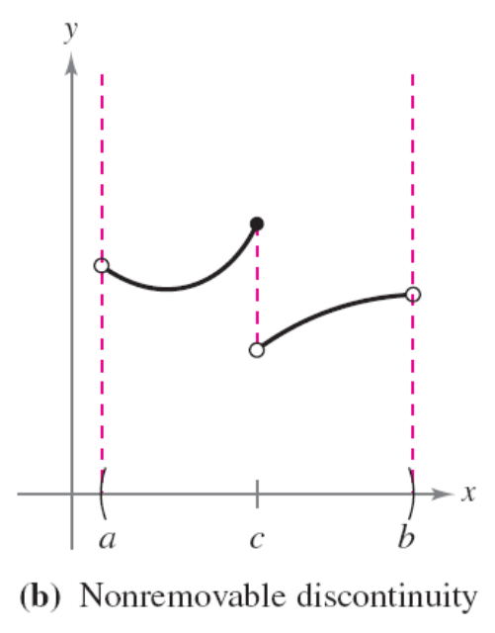
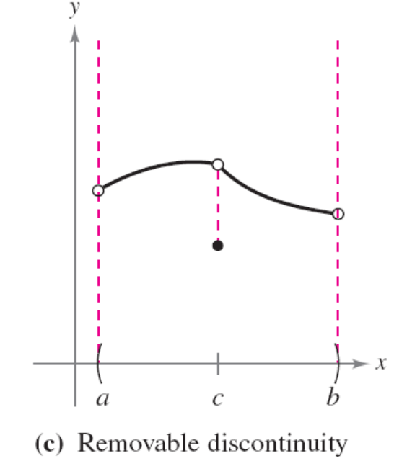
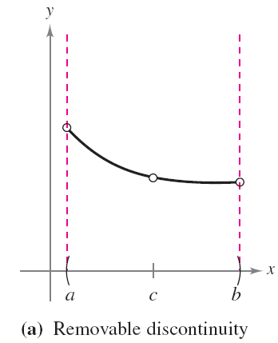
Continuity at a Point and on an Open Interval
For instance, the functions shown in Figures 2.27(a) and (c) have removable discontinuities at c and the function shown in Figure 2.27(b) has a nonremovable discontinuity at c.
Figure 2.27

Slide 11
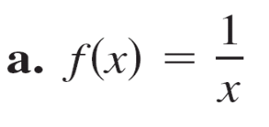
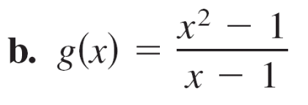

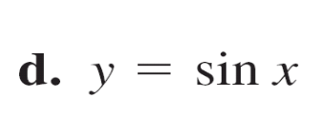
Example 1 – Continuity of a Function
Discuss the continuity of each function.

Slide 12
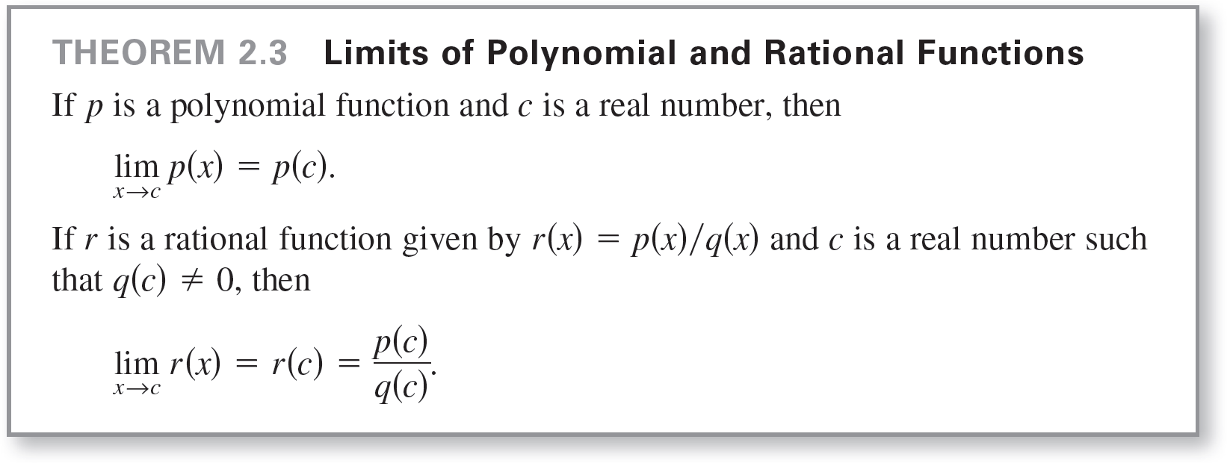
Example 1(a) – Solution
The domain of f is all nonzero real numbers.
From Theorem 2.3, you can conclude that f is continuous at every x-value in its domain.

Slide 13
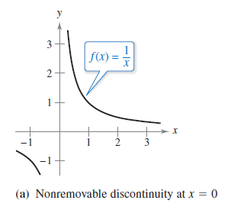
Example 1(a) – Solution
cont’d
At x = 0, f has a nonremovable discontinuity, as shown in
Figure 2.28(a).
In other words, there is no way to define f (0) so as to make the function continuous at x = 0.
Figure 2.28

Slide 14
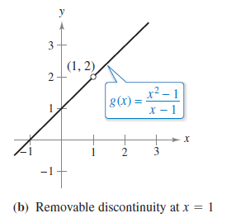
Example 1(b) – Solution
cont’d
The domain of g is all real numbers except x = 1.
From Theorem 2.3, you can conclude that g is continuous at every x-value in its domain.
At x = 1, the function has a
removable discontinuity, as
shown in Figure 2.28(b).
By defining g(1) as 2, the
“redefined” function is
continuous for all real numbers.
Figure 2.28

Slide 15


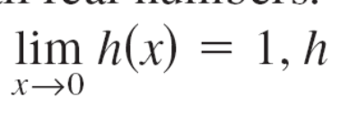
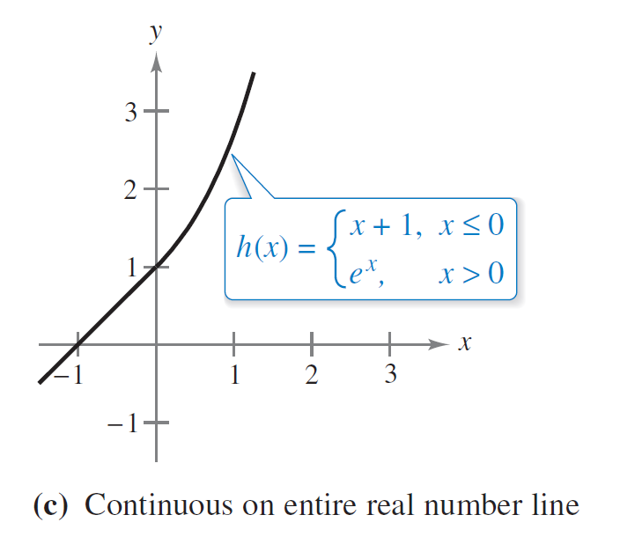
Example 1(c) – Solution
cont’d
The domain of h is all real numbers. The function h is continuous on and , and because , h is continuous on the entire real number line, as shown in
Figure 2.28(c).
Figure 2.28

Slide 16
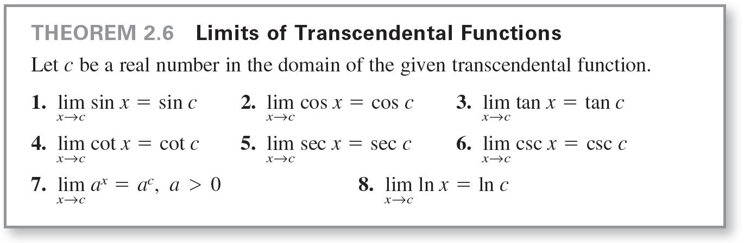
Example 1(d) – Solution
cont’d
The domain of y is all real numbers.

Slide 17

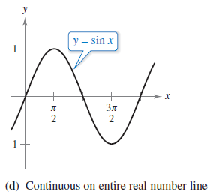
Example 1(d) – Solution
cont’d
From Theorem 2.6, you can conclude that the function is continuous on its entire domain, , as shown in
Figure 2.28(d).
Figure 2.28

Slide 18
One-Sided Limits and Continuity on a Closed Interval

Slide 19
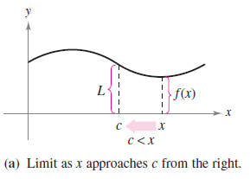
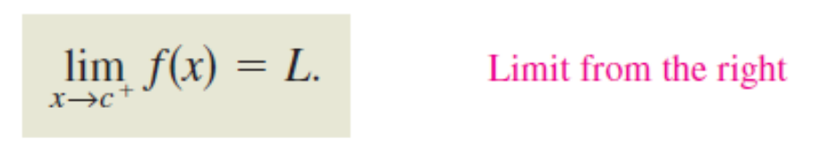
One-Sided Limits and Continuity on a Closed Interval
To understand continuity on a closed interval, you first need to look at a different type of limit called a one-sided limit.
For instance, the limit from the right (or right-hand limit) means that x approaches c from values greater than c
[see Figure 2.29(a)].
This limit is denoted as
Figure 2.29

Slide 20
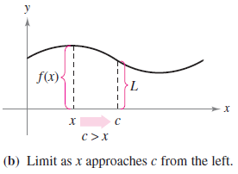
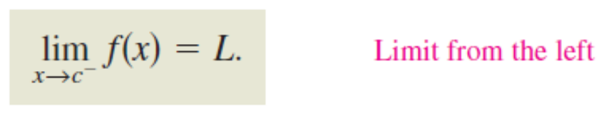
One-Sided Limits and Continuity on a Closed Interval
Similarly, the limit from the left (or left-hand limit) means that x approaches c from values less than c
[see Figure 2.29(b)].
This limit is denoted as
Figure 2.29

Slide 21
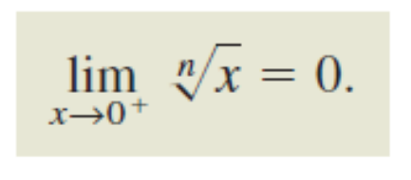
One-Sided Limits and Continuity on a Closed Interval
One-sided limits are useful in taking limits of functions involving radicals.
For instance, if n is an even integer, then

Slide 22

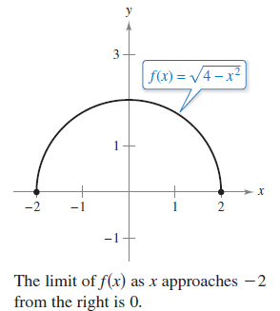

Example 2 – A One-Sided Limit
Find the limit of f(x) = as x approaches –2 from the right.
Solution:
As shown in Figure 2.30, the
limit as x approaches –2 from
the right is
Figure 2.30

Slide 23



One-Sided Limits and Continuity on a Closed Interval
One-sided limits can be used to investigate the behavior of step functions.
One common type of step function is the greatest integer function , defined as
For instance, and

Slide 24
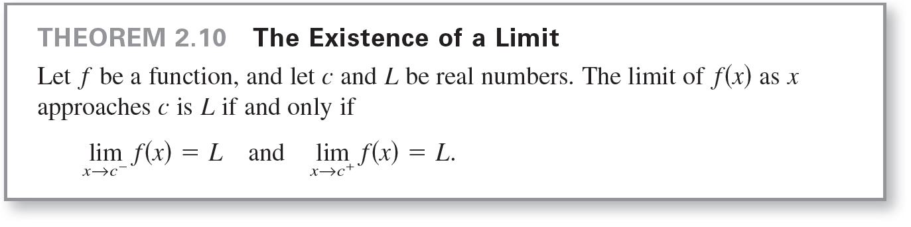
One-Sided Limits and Continuity on a Closed Interval
When the limit from the left is not equal to the limit from the
right, the (two-sided) limit does not exist. The next theorem
makes this more explicit.

Slide 25
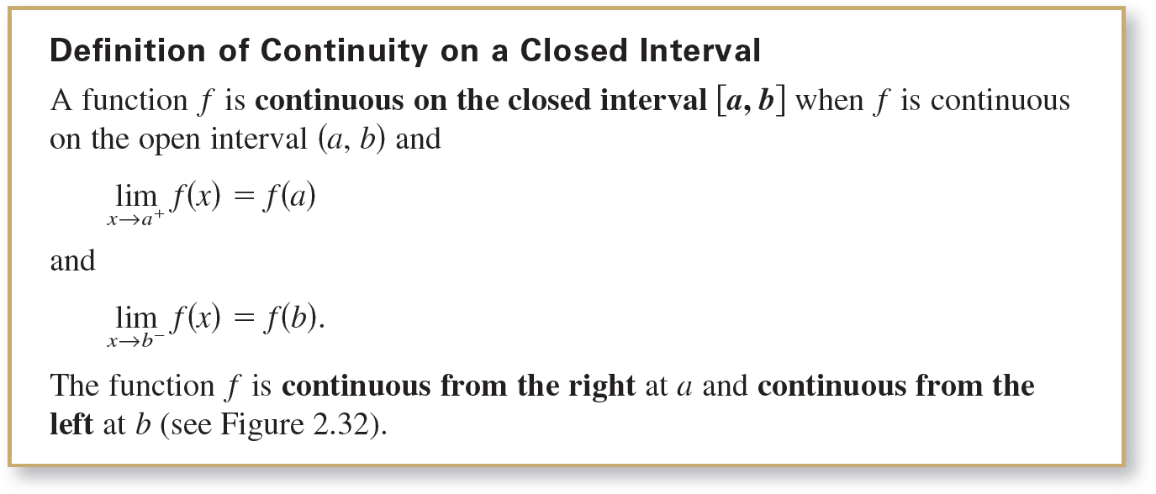
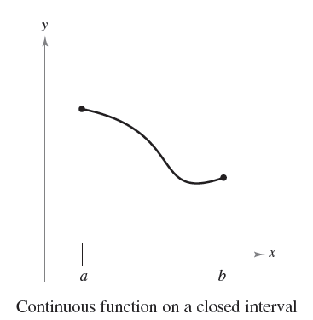
One-Sided Limits and Continuity on a Closed Interval
The concept of a one-sided limit allows you to extend
the definition of continuity to closed intervals. Basically,
a function is continuous on a closed interval when it is continuous in the interior of the interval and exhibits
one-sided continuity at the endpoints. This is stated formally in the next definition.
Figure 2.32

Slide 26
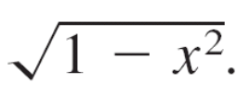
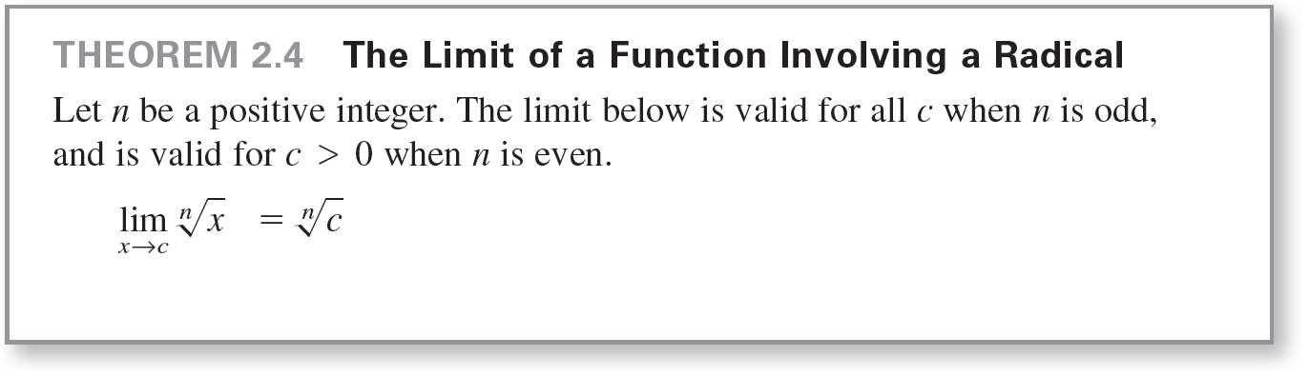
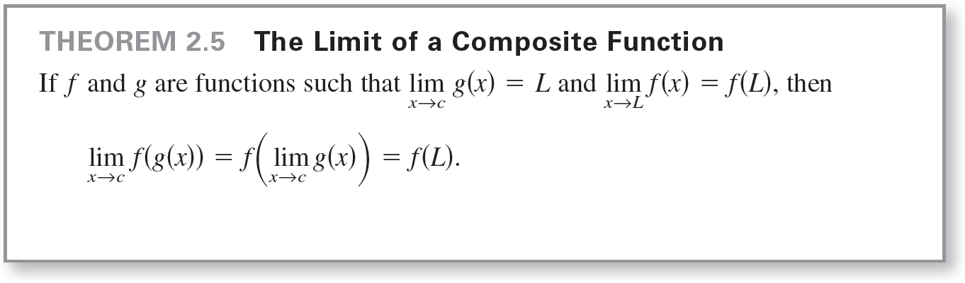
Example 4 – Continuity on a Closed Interval
Discuss the continuity of f(x) =
Solution:
The domain of f is the closed interval [–1, 1]. At all points
in the open interval (–1, 1), the continuity of f follows from
Theorems 2.4 and 2.5.

Slide 27
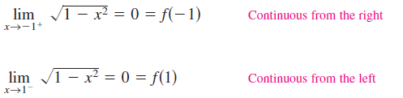
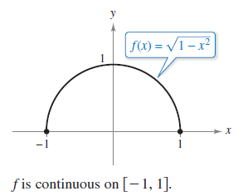
Example 4 – Solution
cont’d
Moreover, because
and
you can conclude that f is
continuous on the closed interval
[–1, 1], as shown in Figure 2.33.
Figure 2.33

Slide 28
Properties of Continuity

Slide 29
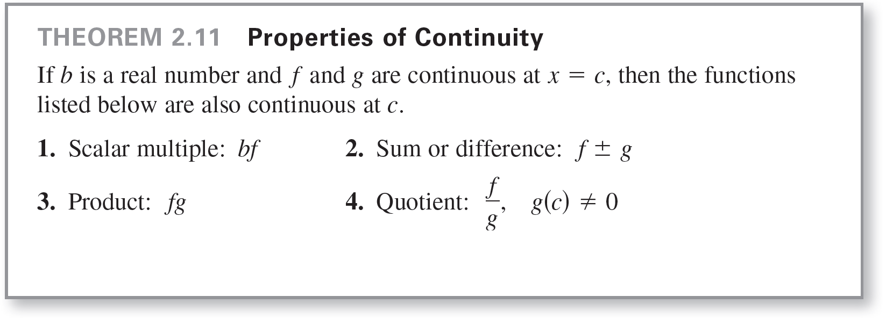
Properties of Continuity

Slide 30
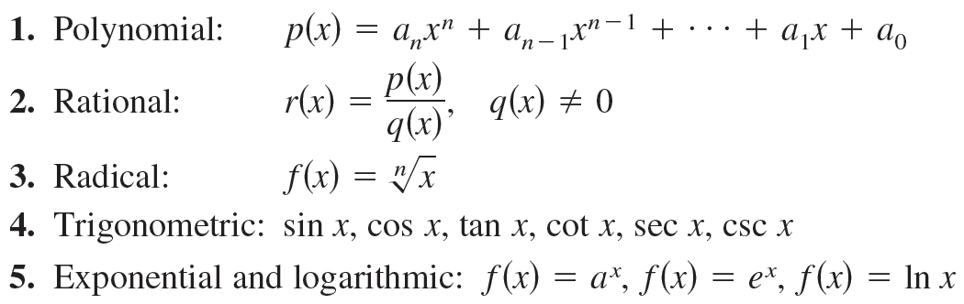
Properties of Continuity
The list below summarizes the functions you have studied so far that are continuous at every point in their domains.
By combining Theorem 2.11 with this list, you can
conclude that a wide variety of elementary functions are
continuous at every point in their domains.

Slide 31
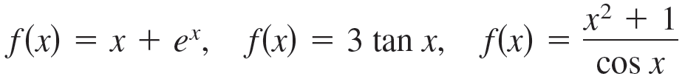
Example 6 – Applying Properties of Continuity
By Theorem 2.11, it follows that each of the functions below is continuous at every point in its domain.

Slide 32
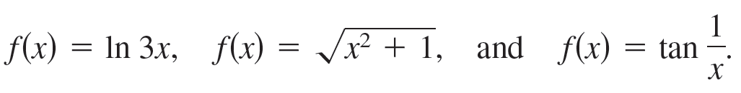
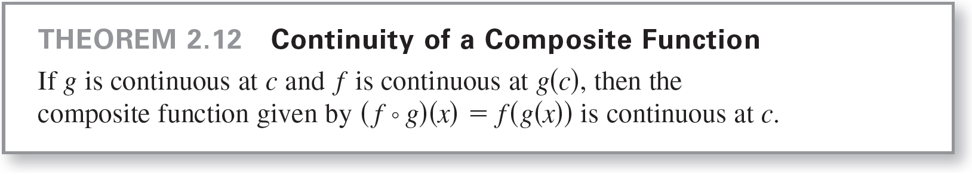
Properties of Continuity
The next theorem, which is a consequence of Theorem 2.5, allows you to determine the continuity of composite functions such as

Slide 33
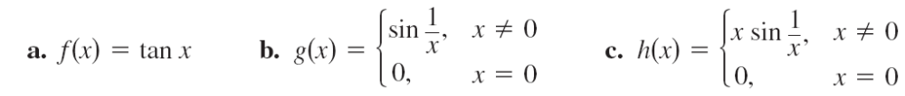
Example 7 – Testing for Continuity
Describe the interval(s) on which each function is continuous.

Slide 34

Example 7(a) – Solution
The tangent function f(x) = tan x is undefined at
At all other points f is continuous.

Slide 35

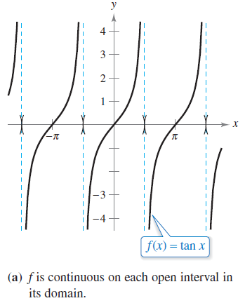
Example 7(a) – Solution
cont’d
So, f(x) = tan x is continuous on the open intervals
as shown in Figure 2.34(a).
Figure 2.34

Slide 36
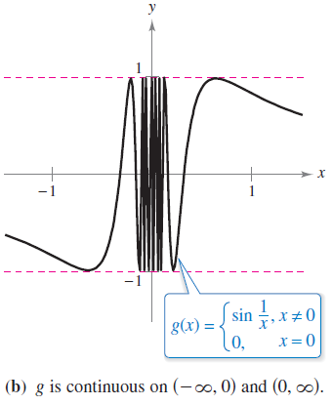

Example 7(b) – Solution
cont’d
Because y = 1/x is continuous except at x = 0 and the sine function is continuous for all real values of x, it follows that y = sin (1/x) is continuous at all real values except x = 0.
At x = 0, the limit of g(x) does
not exist.
So, g is continuous on the intervals
as shown in
Figure 2.34(b).
Figure 2.34

Slide 37
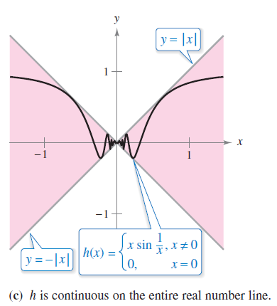


Example 7(c) – Solution
cont’d
This function is similar to the function in part (b) except that the oscillations are damped by the factor x.
Using the Squeeze Theorem, you obtain
and you can conclude that
So, h is continuous on the entire
real number line, as shown in
Figure 2.34(c).
Figure 2.34

Slide 38
The Intermediate Value Theorem

Slide 39
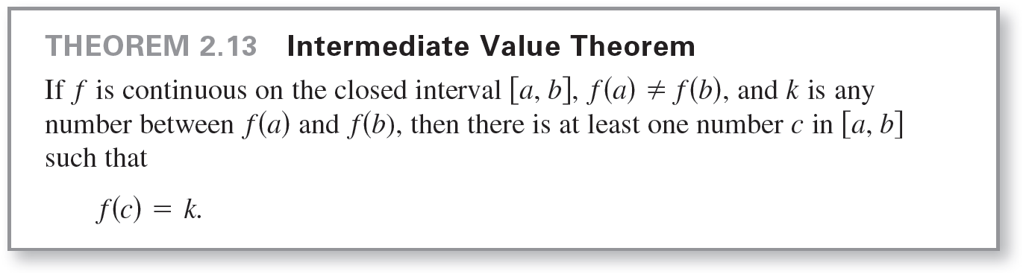
The Intermediate Value Theorem
Theorem 2.13 is an important theorem concerning the
behavior of functions that are continuous on a closed
interval.

Slide 40
The Intermediate Value Theorem
The Intermediate Value Theorem tells you that at least one number c exists, but it does not provide a method for finding c. Such theorems are called existence theorems.
A proof of this theorem is based on a property of real numbers called completeness.
The Intermediate Value Theorem states that for a continuous function f, if x takes on all values between a and b, then f(x) must take on all values between f(a) and f(b).

Slide 41
The Intermediate Value Theorem
As an example of the application of the Intermediate Value Theorem, consider a person’s height. A girl is 5 feet tall on her thirteenth birthday and 5 feet 2 inches tall on her fourteenth birthday.
Then, for any height h between 5 feet and 5 feet 2 inches, there must have been a time t when her height was exactly h.
This seems reasonable because human growth is continuous and a person’s height does not abruptly change from one value to another.

Slide 42
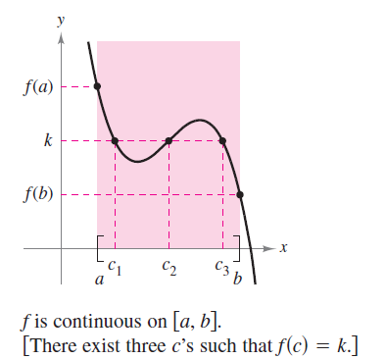
The Intermediate Value Theorem
The Intermediate Value Theorem guarantees the existence of at least one number c in the closed interval [a, b] .
There may, of course, be more than
one number c such that f(c) = k
as shown in Figure 2.35.
Figure 2.35

Slide 43
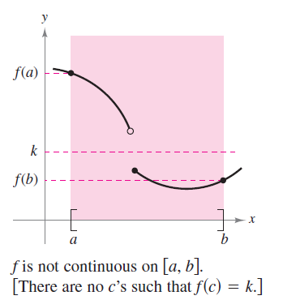
The Intermediate Value Theorem
A function that is not continuous does not necessarily exhibit the intermediate value property.
For example, the graph of the
function shown in Figure 2.36 jumps
over the horizontal line y = k and for
this function there is no value of
c in [a, b] such that f(c) = k.
Figure 2.36

Slide 44
The Intermediate Value Theorem
The Intermediate Value Theorem often can be used to locate the zeros of a function that is continuous on a closed interval.
Specifically, if f is continuous on [a, b] and f(a) and f(b) differ in sign, then the Intermediate Value Theorem guarantees the existence of at least one zero of f in the closed interval [a, b].

Slide 45

Example 8 – An Application of the Intermediate Value Theorem
Use the Intermediate Value Theorem to show that the polynomial function has a zero in the interval [0, 1].
Solution:
Note that f is continuous on the closed interval [0, 1].
Because
it follows that f(0) < 0 and f(1) > 0.

Slide 46

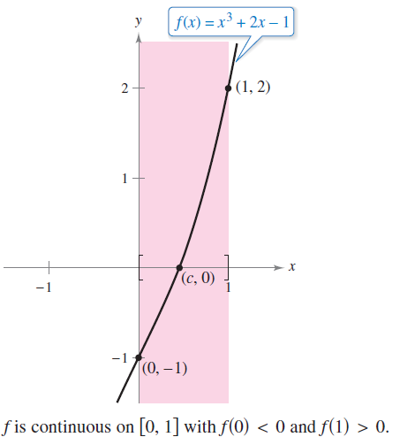
Example 8 – Solution
cont’d
You can therefore apply the Intermediate Value Theorem to conclude that there must be some c in [0, 1] such that
as shown in Figure 2.37.
Figure 2.37

Slide 47
The Intermediate Value Theorem
The bisection method for approximating the real zeros of a continuous function is similar to the method used in
Example 8.
If you know that a zero exists in the closed interval [a, b], then the zero must lie in the interval [a, (a + b)/2] or
[(a + b)/2, b].
From the sign of f([a + b]/2), you can determine which interval contains the zero.
By repeatedly bisecting the interval, you can “close in” on the zero of the function.

