Slide 1


P
2
Limits and Their Properties
Copyright © Cengage Learning. All rights reserved.

Slide 2

2.5
Infinite Limits
Copyright © Cengage Learning. All rights reserved.

Slide 3
Objectives
Determine infinite limits from the left and from the right.
Find and sketch the vertical asymptotes of the graph of a function.

Slide 4
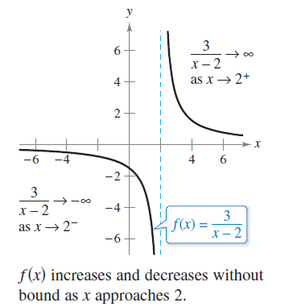
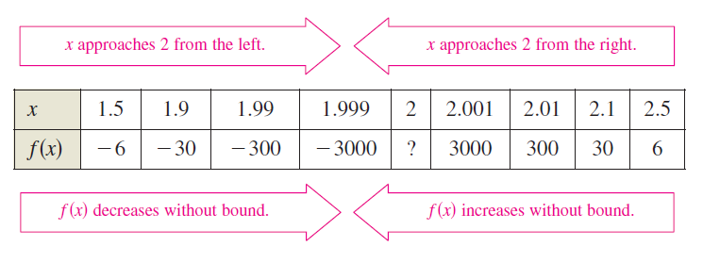
Infinite Limits
Consider the function f(x)= 3/(x – 2). From Figure 2.38 and the table, you can see that f(x) decreases without bound as x approaches 2 from the left, and f(x) increases without bound as x approaches 2 from the right.
Figure 2.38

Slide 5
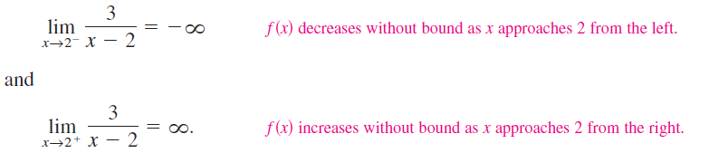
Infinite Limits
This behavior is denoted as
and
The symbols and refer to positive infinity and negative infinity, respectively.
These symbols do not represent real numbers. They
are convenient symbols used to describe unbounded conditions more concisely.

Slide 6
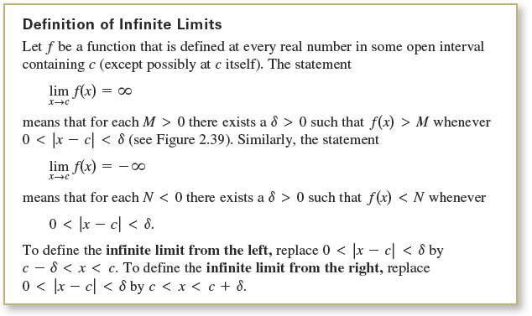
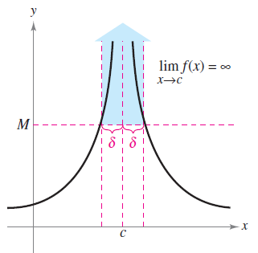
Infinite Limits
A limit in which f(x) increases or decreases without bound as x approaches c is called an infinite limit.
Infinite limits
Figure 2.39

Slide 7
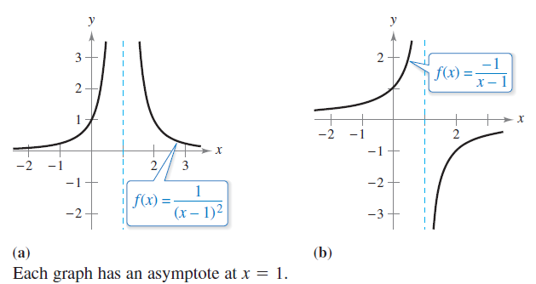
Example 1 – Determining Infinite Limits from a Graph
Determine the limit of each function shown in Figure 2.40 as x approaches 1 from the left and from the right.
Figure 2.40

Slide 8
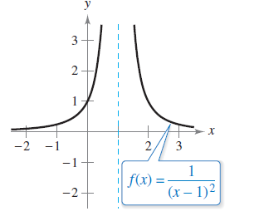

Example 1(a) – Solution
When x approaches 1 from the left or the right, (x – 1)² is a small positive number.
Thus, the quotient 1/(x – 1)² is a large positive number, and f(x) approaches infinity from each side of x = 1.
So, you can conclude that
Figure 2.40(a) confirms this analysis.
The graph has an asymptote at x = 1.
Figure 2.40(a)

Slide 9
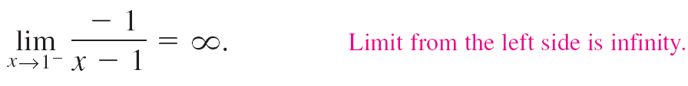

Example 1(b) – Solution
cont’d
When x approaches 1 from the left, x – 1 is a small negative number.
Thus, the quotient –1/(x – 1) is a large positive number, and f(x) approaches infinity from the left of x = 1.
So, you can conclude that
When x approaches 1 from the right, x – 1 is a small positive number.

Slide 10

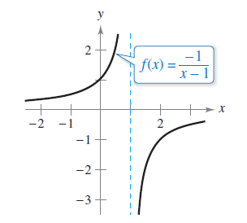
Example 1(b) – Solution
cont’d
Thus, the quotient –1/(x – 1) is a large negative number, and f (x) approaches negative infinity from the right of x = 1.
So, you can conclude that
Figure 2.40(b) confirms this analysis.
The graph has an asymptote at x = 1.
Figure 2.40(b)

Slide 11
Vertical Asymptotes

Slide 12
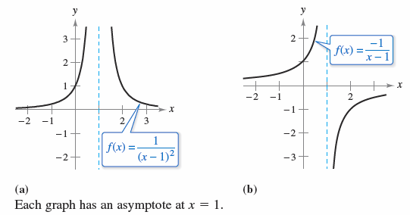
Vertical Asymptotes
If it were possible to extend the graphs in Figure 2.40
toward positive and negative infinity, you would see that
each graph becomes arbitrarily close to the vertical line
x = 1. This line is a vertical asymptote of the graph of f.
Figure 2.40

Slide 13
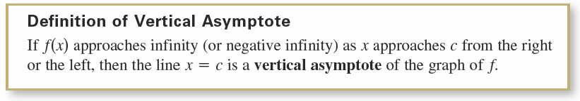
Vertical Asymptotes
In Example 1, note that each of the functions is a
quotient and that the vertical asymptote occurs at a
number at which the denominator is 0 (and the
numerator is not 0). The next theorem generalizes this
observation.

Slide 14
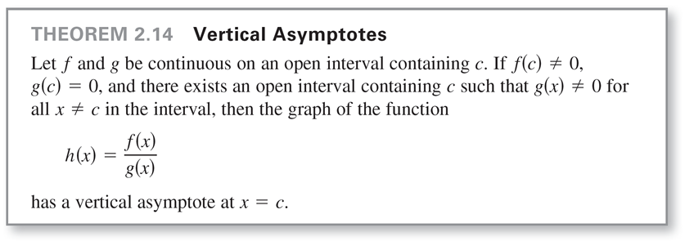
Vertical Asymptotes

Slide 15

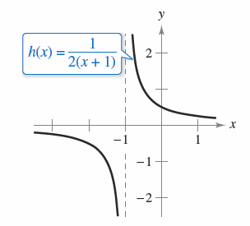
Example 2 – Finding Vertical Asymptotes
a. When x = –1, the denominator of is 0 and
the numerator is not 0.
So, by Theorem 2.14, you can conclude that x = –1 is a
vertical asymptote, as shown in Figure 2.41(a).
Function with vertical asymptotes
Figure 2.41(a)

Slide 16

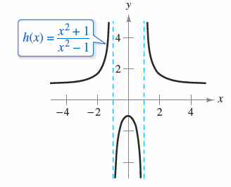
Example 2 – Finding Vertical Asymptotes
cont’d
b. By factoring the denominator as
we can see that the denominator is 0 at x = –1 and
x = 1.
Also, because the numerator is
not 0 at these two points, you can
apply Theorem 2.14 to conclude
that the graph of f has two vertical
asymptotes, as shown in
figure 2.41(b).
Function with vertical asymptotes
Figure 2.41(b)

Slide 17

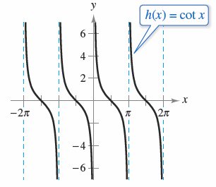
Example 2 – Finding Vertical Asymptotes
cont’d
c. By writing the cotangent function in the form
we can apply Theorem 2.14 to
conclude that vertical asymptotes
occur at all values of x such that
sin x = 0 and cos x ≠ 0, as shown
in Figure 2.41(c).
So, the graph of this function has infinitely many vertical
asymptotes. These asymptotes occur at x = nπ, where n
is an integer.
Function with vertical asymptotes
Figure 2.41(c)

Slide 18
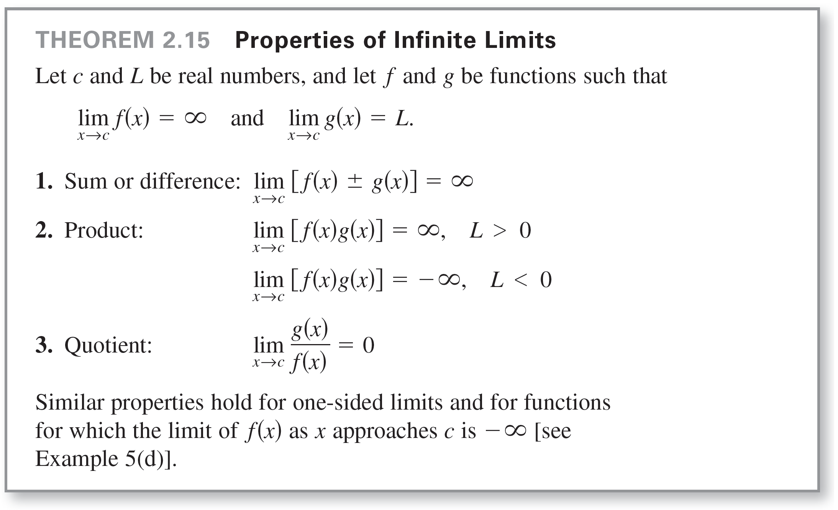
Vertical Asymptotes

Slide 19








Example 5 – Determining Limits
a. Because you can write
b. Because you can write
c. Because you can write
d. Because you can write

