Slide 1


P
3
Differentiation
Copyright © Cengage Learning. All rights reserved.

Slide 2

The Derivative and the Tangent Line Problem
3.1
Copyright © Cengage Learning. All rights reserved.

Slide 3
Objectives
Find the slope of the tangent line to a curve at a point.
Use the limit definition to find the derivative of a function.
Understand the relationship between differentiability and continuity.

Slide 4
The Tangent Line Problem

Slide 5
The Tangent Line Problem
Calculus grew out of four major problems that European mathematicians were working on during the seventeenth century.
1. The tangent line problem
2. The velocity and acceleration problem
3. The minimum and maximum problem
4. The area problem
Each problem involves the notion of a limit, and calculus can be introduced with any of the four problems.

Slide 6
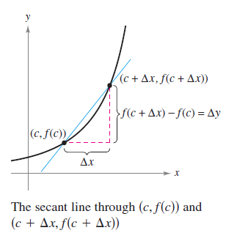
The Tangent Line Problem
What does it mean to say that a line is tangent to a curve at a point? Essentially, the problem of finding the tangent line at a point P boils down to the problem of finding the slope of the tangent line at point P.
You can approximate this slope
using a secant line through
the point of tangency and a
second point on the curve,
as shown in Figure 3.3.
Figure 3.3

Slide 7

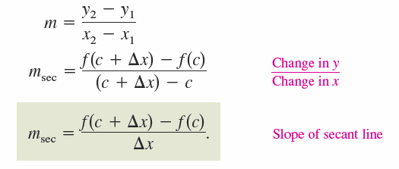
The Tangent Line Problem
If (c, f(c)) is the point of tangency and
is a second point on the graph of f, then the slope of the secant line through the two points is given by substitution into the slope formula
The right-hand side of this equation is a difference quotient. The denominator Δx is the change in x, and the numerator Δy = f(c + Δx) – f(c) is the change in y.

Slide 8
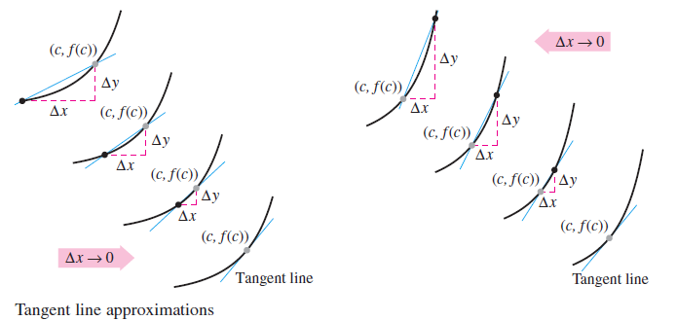
The Tangent Line Problem
You can obtain more and more accurate approximations of the slope of the tangent line by choosing points closer and closer to the point of tangency, as shown in Figure 3.4.
Tangent line approximations
Figure 3.4

Slide 9
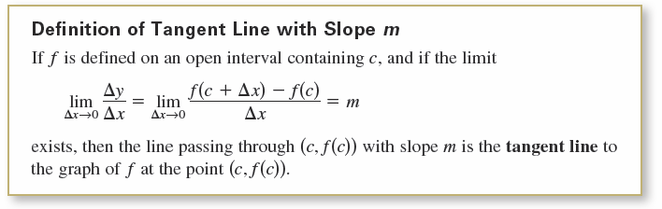
The Tangent Line Problem
The slope of the tangent line to the graph of f at the point
(c, f (c)) is also called the slope of the graph of f at x = c.

Slide 10





Example 1 – The Slope of the Graph of a Linear Function
To find the slope of the graph of f (x) = 2x – 3 when c = 2,
you can apply the definition of the slope of a tangent line,
as shown.

Slide 11
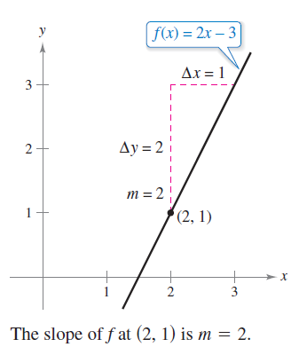
Example 1 – The Slope of the Graph of a Linear Function
cont’d
The slope of f at (c, f(c)) = (2, 1) is m = 2, as shown in Figure 3.5. Notice that the limit definition of the slope of f agrees with the definition of the slope of a line.
Figure 3.5

Slide 12

The Tangent Line Problem
The definition of a tangent line to a curve does not cover the possibility of a vertical tangent line.
For vertical tangent lines, you can use the following definition.
If f is continuous at c and
then the vertical line x = c passing through (c, f (c)) is a vertical tangent line to the graph of f.

Slide 13
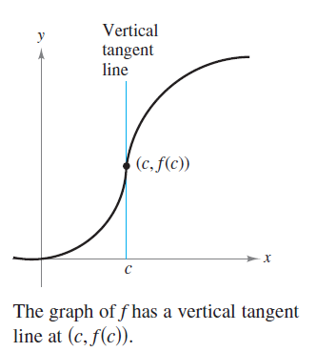
The Tangent Line Problem
For example, the function shown in Figure 3.7 has a vertical tangent line at (c, f (c)).
Figure 3.7

Slide 14
The Tangent Line Problem
When the domain of f is the closed interval [a, b], you can extend the definition of a vertical tangent line to include the endpoints by considering continuity and limits from the right (for x = a) and from the left (for x = b).

Slide 15
The Derivative of a Function

Slide 16
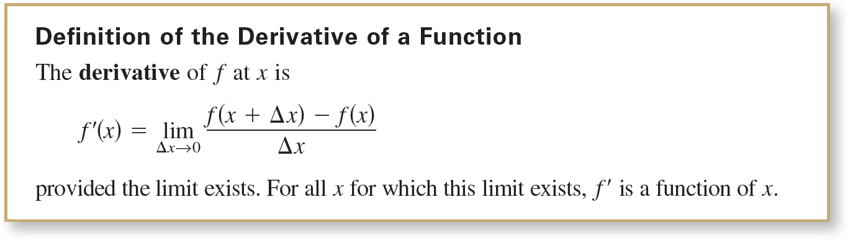
The Derivative of a Function
The limit used to define the slope of a tangent line is also used to define one of the two fundamental operations of calculus—differentiation.
Be sure you see that the derivative of a function of x is also a function of x. This “new” function gives the slope of the tangent line to the graph of f at the point (x, f(x)), provided that the graph has a tangent line at this point.

Slide 17
The Derivative of a Function
The derivative can also be used to determine the instantaneous rate of change (or simply the rate of change) of one variable with respect to another.
The process of finding the derivative of a function is called differentiation. A function is differentiable at x when its derivative exists at x and is differentiable on an open interval (a, b) when it is differentiable at every point in the interval.

Slide 18


The Derivative of a Function
In addition to f ′(x), other notations are used to denote the derivative of y = f(x). The most common are
The notation dy/dx is read as “the derivative of y with respect to x” or simply “dy, dx.” Using limit notation, you can write

Slide 19
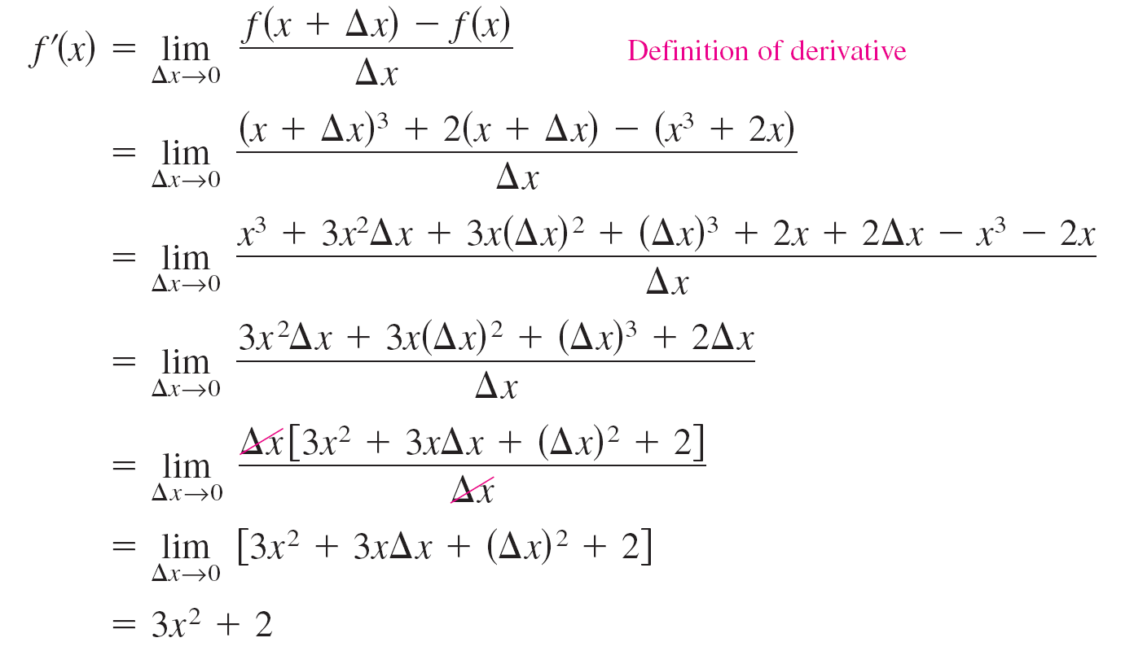
Example 3 – Finding the Derivative by the Limit Process
To find the derivative of f(x) = x³ + 2x, use the definition of the derivative as shown.

Slide 20
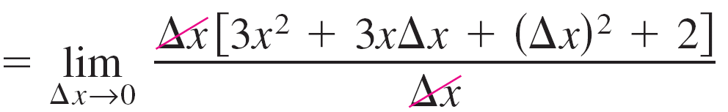
Example 3 – Finding the Derivative by the Limit Process
cont’d

Slide 21
Differentiability and Continuity

Slide 22

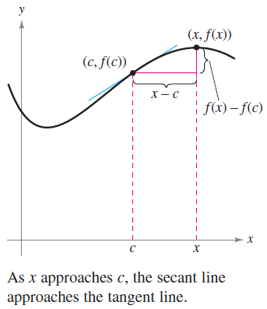
Differentiability and Continuity
The alternative limit form of the derivative is useful in investigating the relationship between differentiability and continuity. The derivative of f at c is
provided this limit exists
(see Figure 3.10).
Figure 3.10

Slide 23
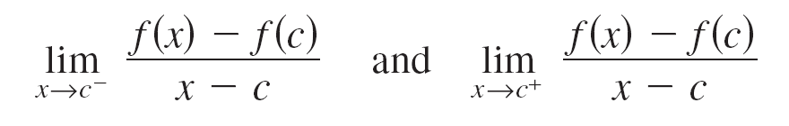
Differentiability and Continuity
Note that the existence of the limit in this alternative form
requires that the one-sided limits
and
exist and are equal.

Slide 24
Differentiability and Continuity
These one-sided limits are called the derivatives from the left and from the right, respectively.
It follows that f is differentiable on the closed interval
[a, b] when it is differentiable on (a, b) and when the derivative from the right at a and the derivative from the
left at b both exist.
When a function is not continuous at x = c, it is also not differentiable at x = c.

Slide 25

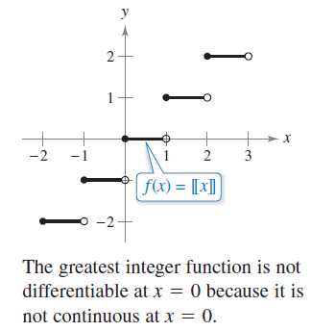
Differentiability and Continuity
For instance, the greatest integer function is not continuous at x = 0, and so it is not differentiable at x = 0 (see Figure 3.11).
Figure 3.11

Slide 26


Differentiability and Continuity
You can verify this by observing that
and
Although it is true that differentiability implies continuity,
the converse is not true.
That is, it is possible for a function to be continuous at x = c and not differentiable at x = c.

Slide 27

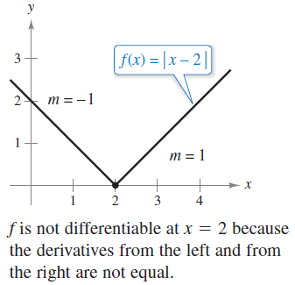
Example 6 – A Graph with a Sharp Turn
The function shown in Figure 3.12, is continuous at x = 2.
Figure 3.12

Slide 28
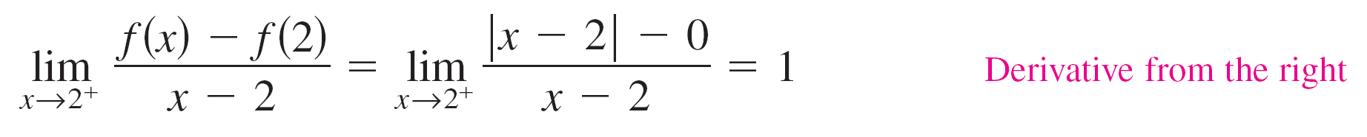
Example 6 – A Graph with a Sharp Turn
cont’d
The one-sided limits, however,
and
are not equal.
So, f is not differentiable at x = 2 and the graph of f does not have a tangent line at the point (2, 0).

Slide 29
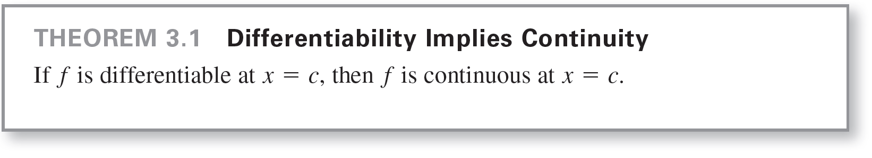
Differentiability and Continuity
A function that is not differentiable at a point at which its graph has a sharp turn or a vertical tangent line.
The relationship between continuity and differentiability is summarized below.
1. If a function is differentiable at x = c, then it is continuous at x = c. So, differentiability implies continuity.
2. It is possible for a function to be continuous at x = c and not be differentiable at x = c. So, continuity does not imply differentiability.

