Slide 1


P
3
Differentiation
Copyright © Cengage Learning. All rights reserved.

Slide 2

Basic Differentiation Rules and Rates of Change
3.2
Copyright © Cengage Learning. All rights reserved.

Slide 3
Objectives
Find the derivative of a function using the Constant Rule.
Find the derivative of a function using the Power Rule.
Find the derivative of a function using the Constant Multiple Rule.
Find the derivative of a function using the Sum and Difference Rules.

Slide 4
Objectives
cont’d
Find the derivatives of the sine function and of the cosine function.
Find the derivatives of exponential functions.
Use derivatives to find rates of change.

Slide 5
The Constant Rule

Slide 6
The Constant Rule
In this section, you will be introduced to several “differentiation rules” that allow you to find derivatives without the direct use of the limit definition.

Slide 7
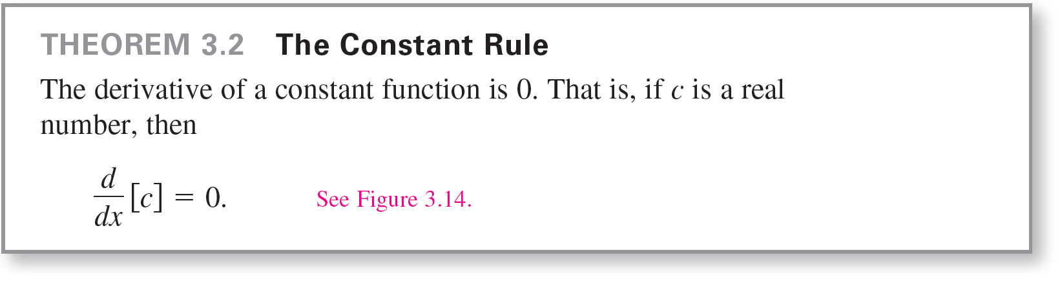
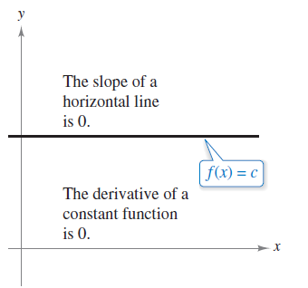
The Constant Rule
Notice that the Constant Rule is equivalent to saying that the slope of a horizontal
line is 0. This demonstrates the relationship between slope and derivative.
Figure 3.14

Slide 8

Example 1 – Using the Constant Rule

Slide 9
The Power Rule

Slide 10
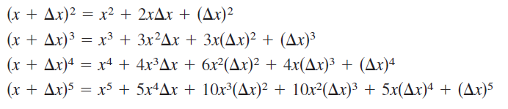
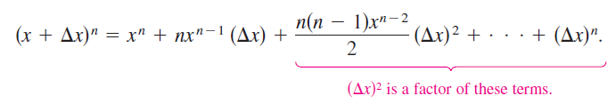
The Power Rule
Before proving the next rule, it is important to review the procedure for expanding a binomial.
The general binomial expansion for a positive integer n is
This binomial expansion is used in proving a special case of the Power Rule.

Slide 11
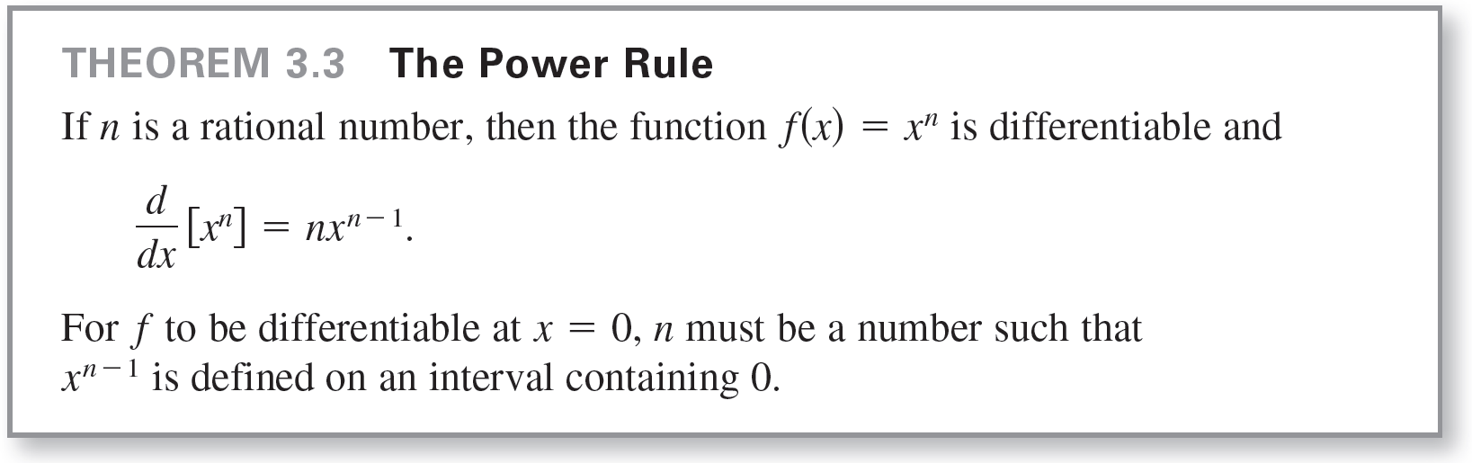
The Power Rule

Slide 12

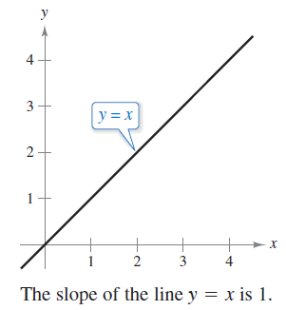
The Power Rule
When using the Power Rule, the case for which n = 1 is best thought of as a separate differentiation rule. That is,
This rule is consistent with the fact
that the slope of the line y = x is 1,
as shown in Figure 3.15.
Figure 3.15

Slide 13

Example 2 – Using the Power Rule

Slide 14
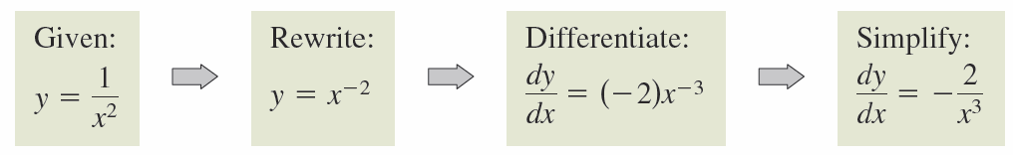
The Power Rule
In Example 2(c), note that before differentiating, 1/x² was rewritten as x^{–2}. Rewriting is the first step in many differentiation problems.

Slide 15
The Constant Multiple Rule

Slide 16
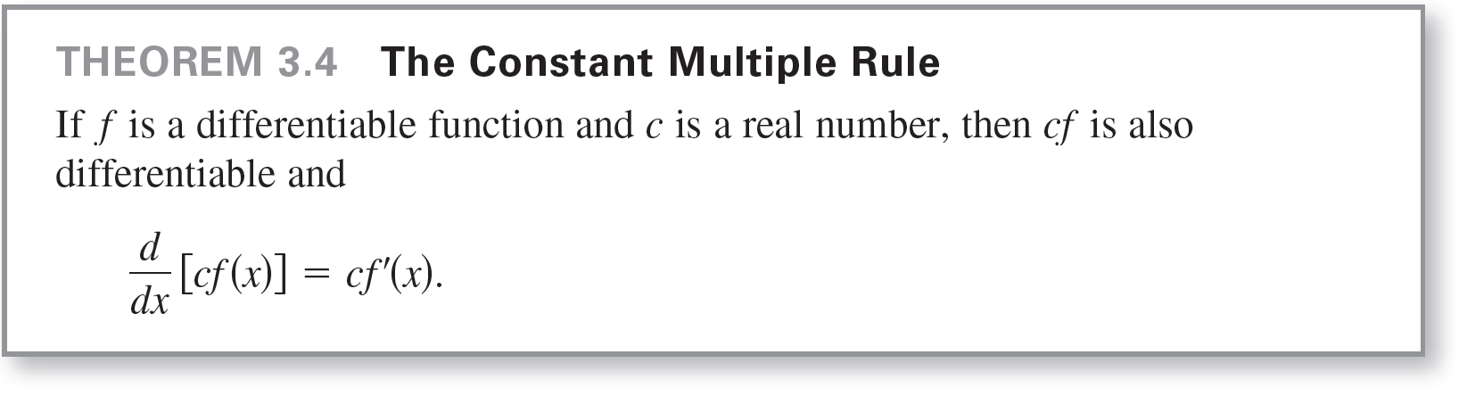
The Constant Multiple Rule

Slide 17



Example 5 – Using the Constant Multiple Rule

Slide 18

The Constant Multiple Rule
The Constant Multiple Rule and the Power Rule can be combined into one rule. The combination rule is

Slide 19
The Sum and Difference Rules

Slide 20
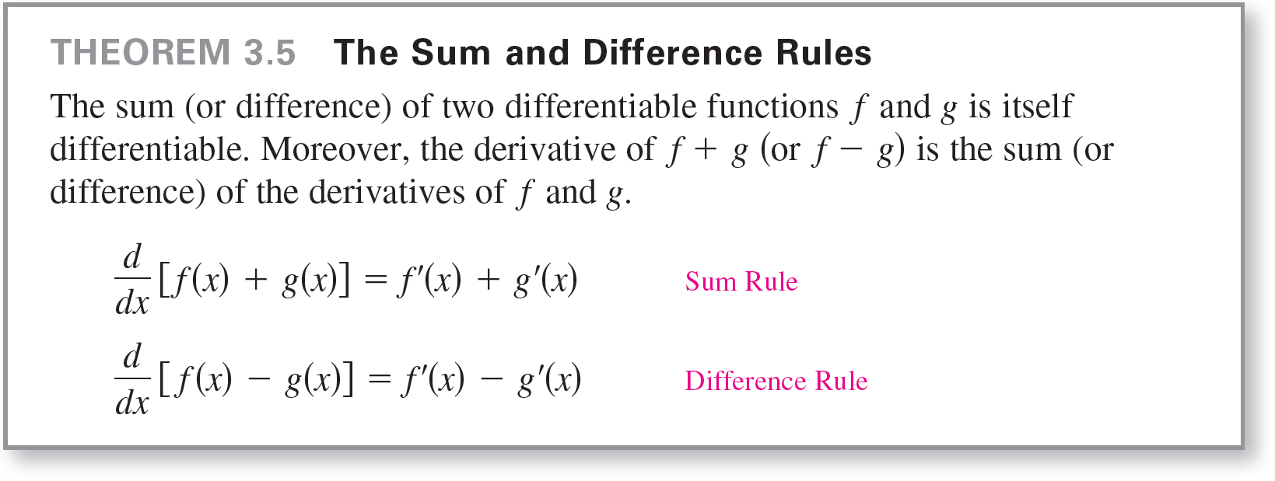
The Sum and Difference Rules

Slide 21


Example 7 – Using the Sum and Difference Rules

Slide 22
Derivatives of the Sine and Cosine Functions

Slide 23
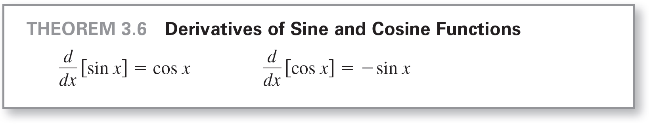
Derivatives of the Sine and Cosine Functions

Slide 24


Example 8 – Derivatives Involving Sines and Cosines

Slide 25
Derivatives of Exponential Functions

Slide 26

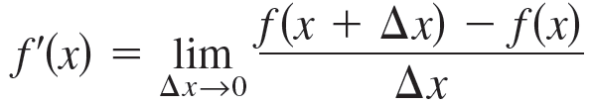
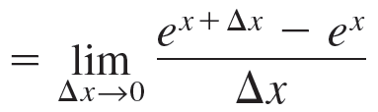
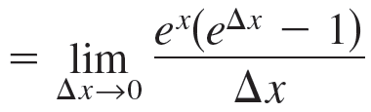
Derivatives of Exponential Functions
One of the most intriguing (and useful) characteristics of the natural exponential function is that it is its own derivative. Consider the following argument.
Let

Slide 27




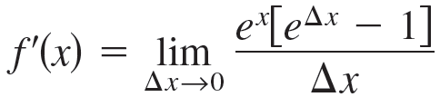
Derivatives of Exponential Functions
The definition of e
tells you that for small values of Δx, you have
which implies that
Replacing by this approximation produces the following.

Slide 28
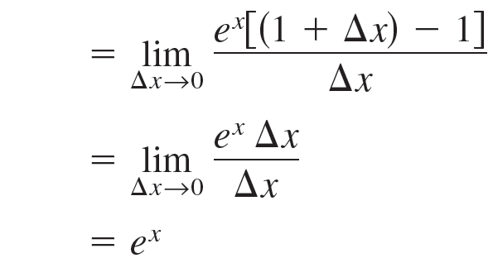
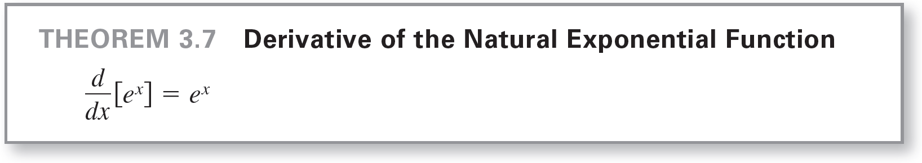
Derivatives of Exponential Functions
This result is stated in the next theorem.

Slide 29


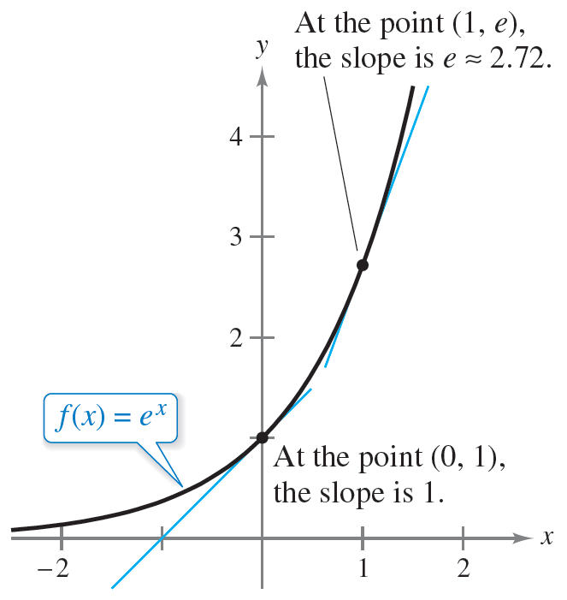
Derivatives of Exponential Functions
You can interpret Theorem 3.7 graphically by saying that the slope of the graph of at any point
is equal to the y-coordinate of the point, as shown in
Figure 3.20.
Figure 3.20

Slide 30
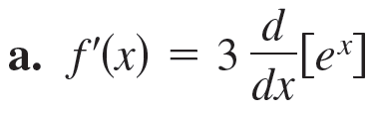

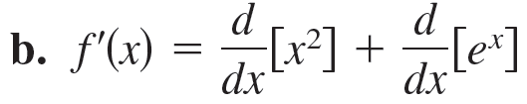

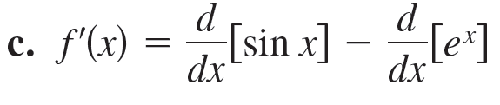

Example 9 – Derivatives Involving Exponential Functions
Find the derivative of each function.
Solution:

Slide 31
Rates of Change

Slide 32
Rates of Change
You have seen how the derivative is used to determine slope.
The derivative can also be used to determine the rate of change of one variable with respect to another.
Applications involving rates of change occur in a wide variety of fields.
A few examples are population growth rates, production rates, water flow rates, velocity, and acceleration.

Slide 33
Rates of Change
A common use for rate of change is to describe the motion of an object moving in a straight line.
In such problems, it is customary to use either a horizontal or a vertical line with a designated origin to represent the line of motion.
On such lines, movement to the right (or upward) is considered to be in the positive direction, and movement to the left (or downward) is considered to be in the negative direction.

Slide 34
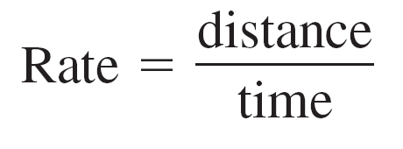

Rates of Change
The function s that gives the position (relative to the origin) of an object as a function of time t is called a position function.
If, over a period of time Δt, the object changes its position by the amount Δs = s(t + Δt) – s(t) then, by the familiar formula
the average velocity is

Slide 35
Example 10 – Finding Average Velocity of a Falling Object
A billiard ball is dropped from a height of 100 feet. The ball’s height s at time t is the position function
s = –16t² + 100 Position function
where s is measured in feet and t is measured in seconds. Find the average velocity over each of the following time intervals.
a. [1, 2] b. [1, 1.5] c. [1, 1.1]

Slide 36
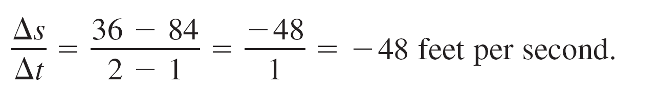
Example 10(a) – Solution
For the interval [1, 2], the object falls from a height of
s(1) = –16(1)² + 100 = 84 feet to a height of
s(2) = –16(2)² + 100 = 36 feet.
The average velocity is

Slide 37
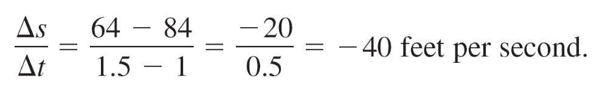
Example 10(b) – Solution
cont’d
For the interval [1, 1.5], the object falls from a height of 84 feet to a height of
s(1.5) = –16(1.5)² + 100 = 64 feet.
The average velocity is

Slide 38
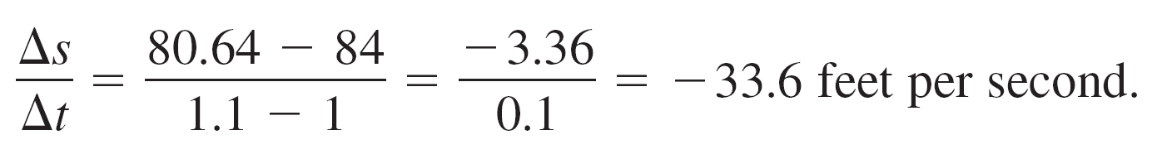
Example 10(c) – Solution
cont’d
For the interval [1, 1.1], the object falls from a height of 84 feet to a height of
s(1.1) = –16(1.1)² + 100 = 80.64 feet.
The average velocity is
Note that the average velocities are negative, indicating that the object is moving downward.

Slide 39
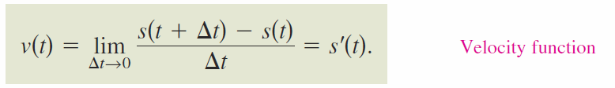
Rates of Change
In general, if s = s(t) is the position function for an object moving along a straight line, then velocity of the object at time t is
In other words, the velocity function is the derivative of the position function. Velocity can be negative, zero, or positive.
The speed of an object is the absolute value of its velocity. Speed cannot be negative.

Slide 40
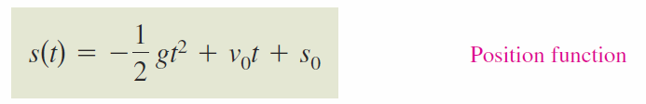
Rates of Change
The position of a free-falling object (neglecting air resistance) under the influence of gravity can be represented by the equation
where s₀ is the initial height of the object, v₀ is the initial velocity of the object, and g is the acceleration due to gravity.
On Earth, the value of g is approximately 32 feet per second per second or 9.8 meters per second per second.

Slide 41
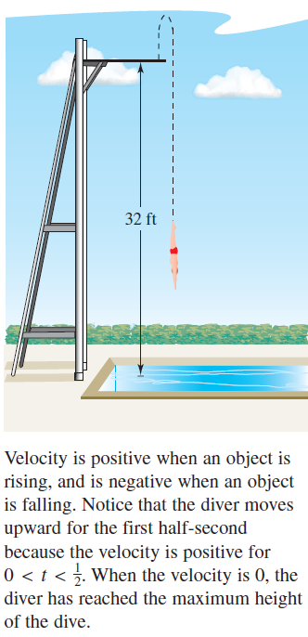
Example 11 – Using the Derivative to Find Velocity
At time t = 0 seconds, a diver jumps from
a platform diving board that is 32 feet
above the water (see Figure 3.22).
The initial Velocity of the diver is
16 feet per second.
When does the diver hit the water?
What is the diver’s velocity at impact?
Figure 3.22

Slide 42

Example 11 – Solution
Begin by writing an equation to represent the position of
the diver. Using the position function given above with
g = 32 feet per second per second, v₀ = 16 feet per second, and s₀ = 32 feet, you can write

Slide 43
Example 11 – Solution
cont’d
To find the time t when the diver hits the water, let s = 0 and solve for t.
–16t² + 16t + 32 = 0 Set position function equal to 0.
–16(t + 1)(t – 2) = 0 Factor.
t = –1 or 2 Solve for t.
Because t ≥ 0, choose the positive value to conclude that
the diver hits the water at t = 2 seconds.

Slide 44
Example 11 – Solution
cont’d
The velocity at time t is given by the derivative
So, the velocity at time is t = 2 is
Notice that the unit for s ′(t) is the unit for s (feet) divided by the unit for t (seconds). In general, the unit for f ′(x) is the unit for f divided by the unit for x.

