Slide 1


P
3
Differentiation
Copyright © Cengage Learning. All rights reserved.

Slide 2

3.3
Product and Quotient Rules and Higher-Order Derivatives
Copyright © Cengage Learning. All rights reserved.

Slide 3
Objectives
Find the derivative of a function using the Product Rule.
Find the derivative of a function using the Quotient Rule.
Find the derivative of a trigonometric function.
Find a higher-order derivative of a function.

Slide 4
The Product Rule

Slide 5
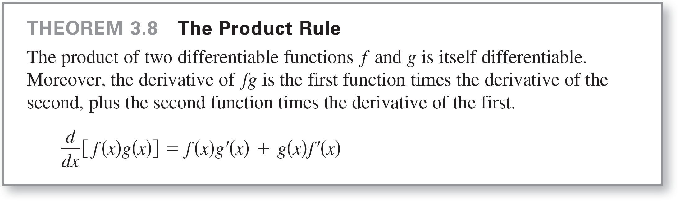
The Product Rule
You learned that the derivative of the sum of two functions is simply the sum of their derivatives. The rules for the derivatives of the product and quotient of two functions are not as simple.

Slide 6


The Product Rule
The Product Rule can be extended to cover products
involving more than two factors. For example, if f, g, and h
are differentiable functions of x, then
So, the derivative of y = x² sin x cos x is

Slide 7
The Product Rule
The derivative of a product of two functions is not (in
general) given by the product of the derivatives of the two
functions.

Slide 8

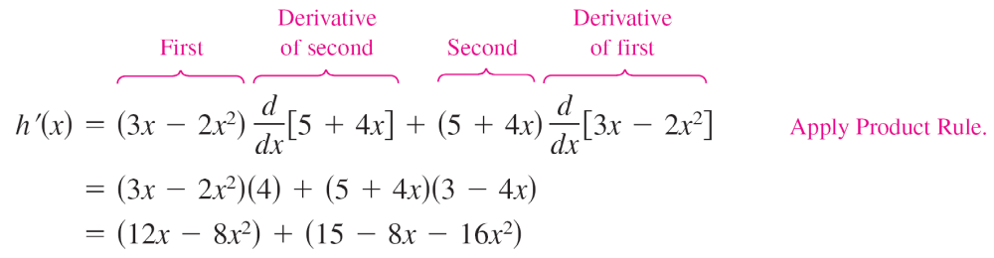

Example 1 – Using the Product Rule
Find the derivative of
Solution:

Slide 9
The Quotient Rule

Slide 10
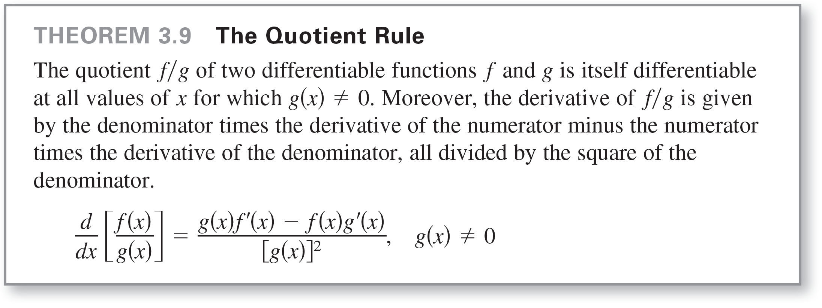
The Quotient Rule

Slide 11
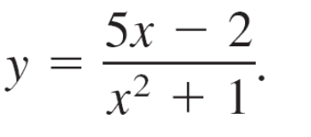
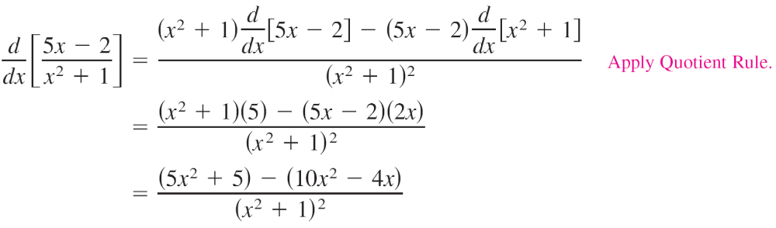
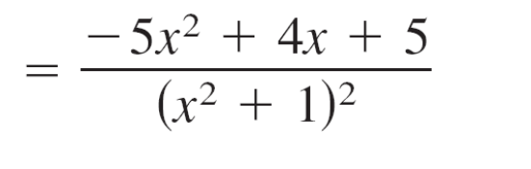
Example 4 – Using the Quotient Rule
Find the derivative of
Solution:

Slide 12
Derivatives of Trigonometric Functions

Slide 13
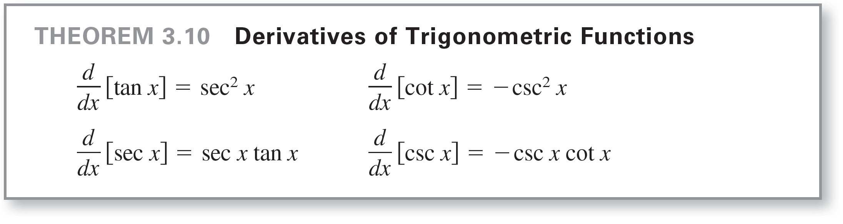
Derivatives of Trigonometric Functions
Knowing the derivatives of the sine and cosine functions, you can use the Quotient Rule to find the derivatives of the four remaining trigonometric functions.

Slide 14
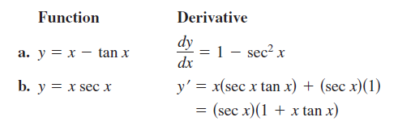
Example 8 – Differentiating Trigonometric Functions

Slide 15
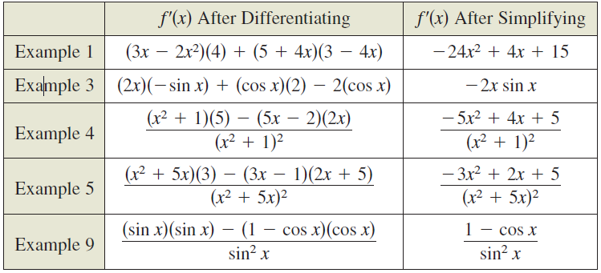
Derivatives of Trigonometric Functions
The summary below shows that much of the work in obtaining a simplified form of a derivative occurs after differentiating. Note that two characteristics of a simplified form are the absence of negative exponents and the combining of like terms.

Slide 16
Higher-Order Derivatives

Slide 17
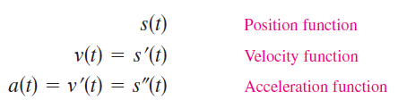
Higher-Order Derivatives
Just as you can obtain a velocity function by differentiating a position function, you can obtain an acceleration function by differentiating a velocity function.
Another way of looking at this is that you can obtain an acceleration function by differentiating a position function twice.

Slide 18
Higher-Order Derivatives
The function a(t) is the second derivative of s(t) and is denoted by s"(t).
The second derivative is an example of a higher-order derivative.
You can define derivatives of any positive integer order. For instance, the third derivative is the derivative of the second derivative.

Slide 19
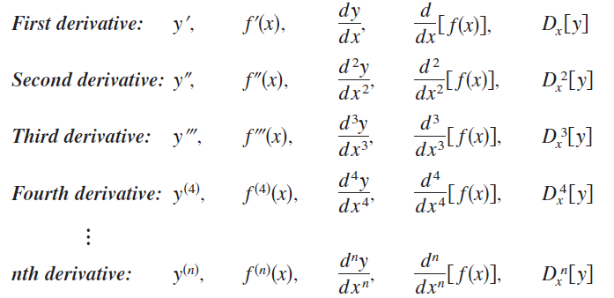
Higher-Order Derivatives
Higher-order derivatives are denoted as shown below.

Slide 20
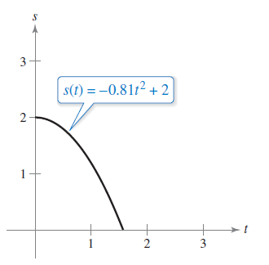
Example 10 – Finding the Acceleration Due to Gravity
Because the moon has no atmosphere, a falling object on the moon encounters no air resistance. In 1971, astronaut David Scott demonstrated that a feather and a hammer fall at the same rate on the moon. The position function for each of these falling objects is
s(t) = –0.81t² + 2
where s(t) is the height in meters
and t is the time in seconds. What
is the ratio of Earth’s gravitational
force to the moon’s?

Slide 21
Example 10 – Solution
To find the acceleration, differentiate the position function twice.
s(t) = –0.81t² + 2 Position function
s'(t) = –1.62t Velocity function
s"(t) = –1.62 Acceleration function
Because s"(t) = −g, the acceleration due to gravity on the moon is g = 1.62 meters per second per second.

Slide 22

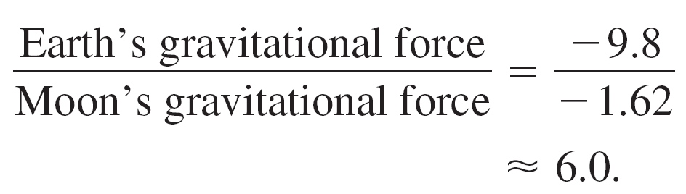
Example 10 – Solution
cont’d
The acceleration due to gravity on Earth is 9.8 meters per second per second, so the ratio of Earth’s gravitational force to the moon’s is

