Slide 1


P
3
Differentiation
Copyright © Cengage Learning. All rights reserved.

Slide 2

3.4
The Chain Rule
Copyright © Cengage Learning. All rights reserved.

Slide 3
Objectives
Find the derivative of a composite function using the Chain Rule.
Find the derivative of a function using the General Power Rule.
Simplify the derivative of a function using algebra.
Find the derivative of a transcendental function using the Chain Rule.

Slide 4
Objectives
Find the derivative of a function involving the natural logarithmic function.
Define and differentiate exponential functions that have bases other than e.

Slide 5
The Chain Rule
We have yet to discuss one of the most powerful differentiation rules—the Chain Rule.
This rule deals with composite functions and adds a surprising versatility to the rules that we have discussed.

Slide 6
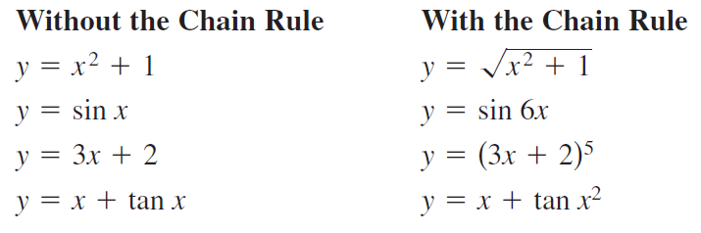
The Chain Rule
For example, compare the functions shown below. Those on the left can be differentiated without the Chain Rule, and those on the right are best differentiated with the Chain Rule.
Basically, the Chain Rule states that if y changes dy/du times as fast as u, and u changes du/dx times as fast as x, then y changes (dy/du)(du/dx) times as fast as x.

Slide 7
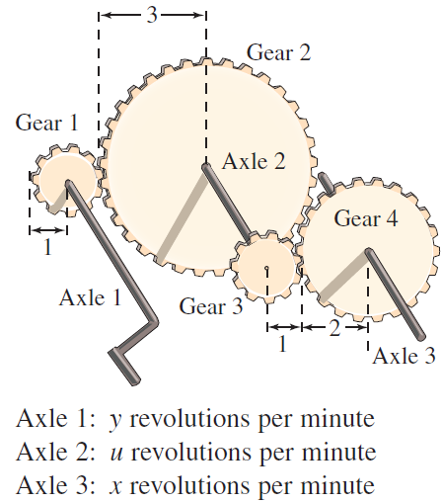
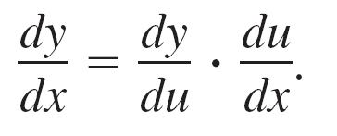
Example 1 – The Derivative of a Composite Function
A set of gears is constructed so that the second and third gears are on the same axle (see Figure 3.24).
As the first axle revolves, it drives the second axle, which in turn drives the third axle.
Let y, u, and x represent the numbers of revolutions per minute of the first, second, and third axles, respectively. Find dy/du, du/dx, and dy/dx, and show that
Figure 3.24

Slide 8
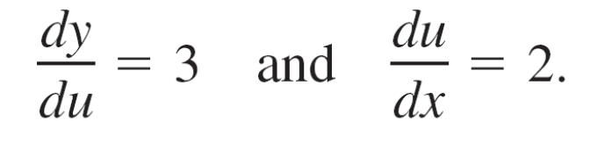
Example 1 – Solution
Because the circumference of the second gear is three times that of the first, the first axle must make three revolutions to turn the second axle once.
Combining these two results, you know that the first axle must make six revolutions to turn the third axle once.
Similarly, the second axle must make two revolutions to turn the third axle once, and you can write

Slide 9
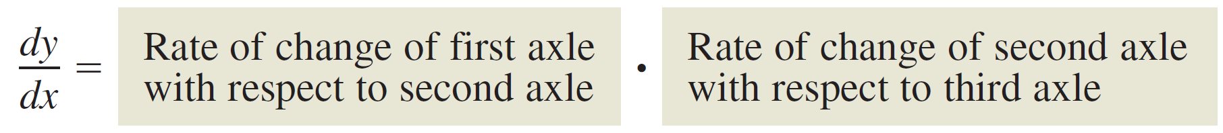



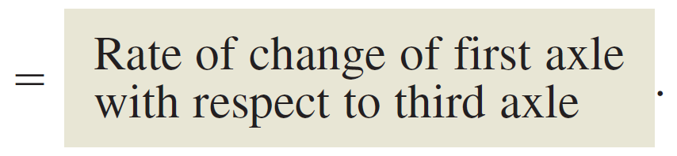
Example 1 – Solution
cont’d
So, you can write
In other words, the rate of change of y with respect to x is the product of the rate of change of y with respect to u and the rate of change of u with respect to x.

Slide 10
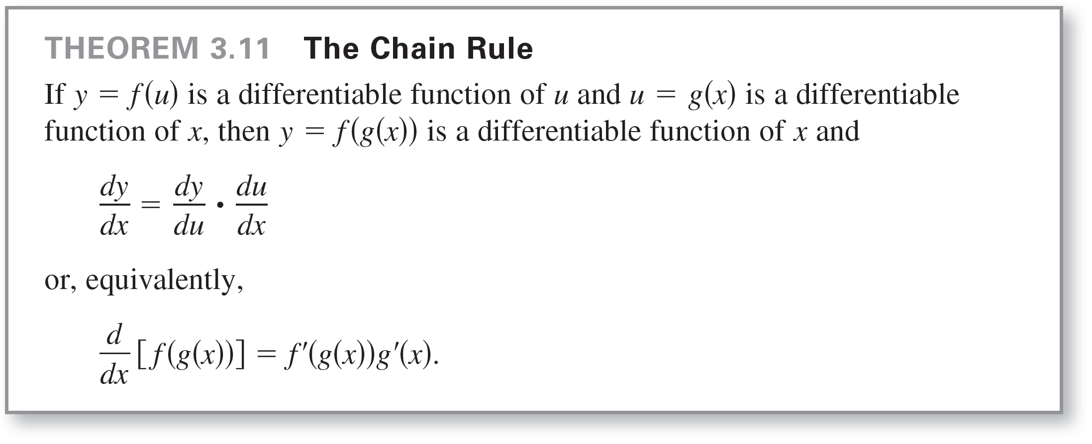
The Chain Rule
Example 1 illustrates a simple case of the Chain Rule.
The general rule is stated in the next theorem.

Slide 11
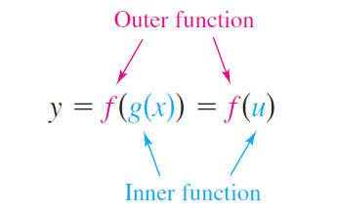

The Chain Rule
When applying the Chain Rule, it is helpful to think of the composite function f ◦ g as having two parts–an inner part and an outer part.
The derivative of y = f (u) is the derivative of the outer function (at the inner function u) times the derivative of the inner function.

Slide 12
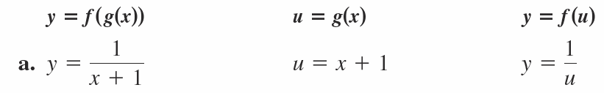
Example 2 – Decomposition of a Composite Function

Slide 13
The General Power Rule

Slide 14
The General Power Rule
The function y = [u(x)]^{n} is one of the most common types of composite functions.
The rule for differentiating such functions is called the General Power Rule, and it is a special case of the Chain Rule.

Slide 15
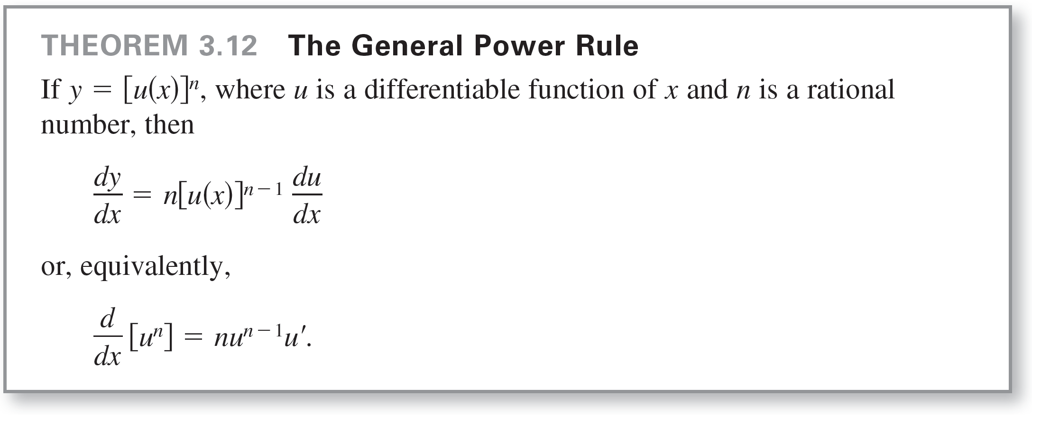
The General Power Rule

Slide 16
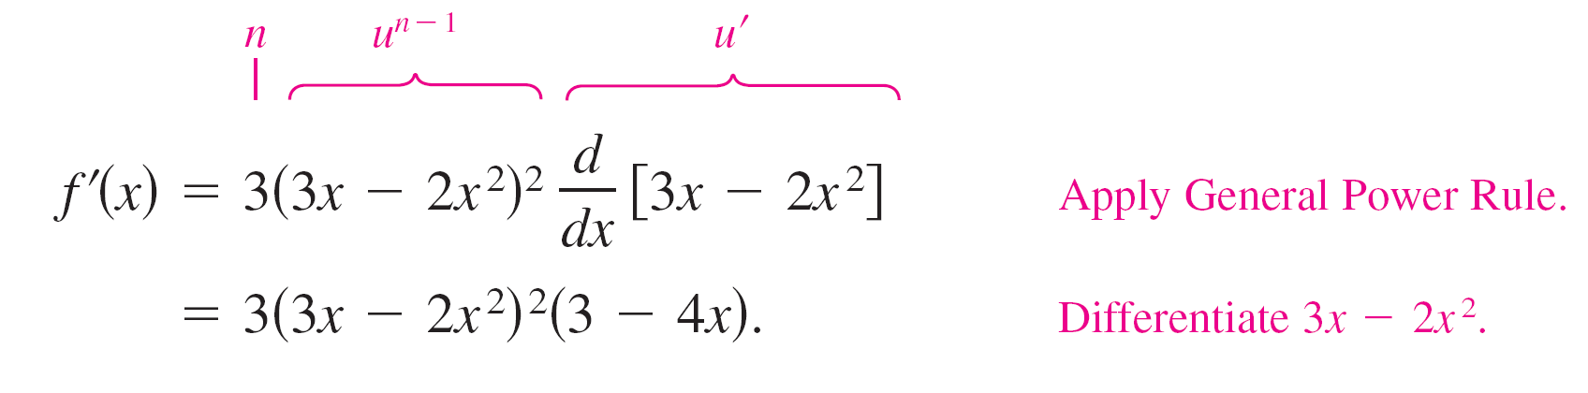
Example 4 – Applying the General Power Rule
Find the derivative of f(x) = (3x – 2x²)³.
Solution:
Let u = 3x – 2x².
Then f(x) = (3x – 2x²)³ = u³
and, by the General Power Rule, the derivative is

Slide 17
Simplifying Derivatives

Slide 18
Simplifying Derivatives
The next three examples demonstrate techniques for simplifying the “raw derivatives” of functions involving products, quotients, and composites.

Slide 19


Example 7 – Simplifying by Factoring Out the Least Powers
Find the derivative of
Solution:

Slide 20
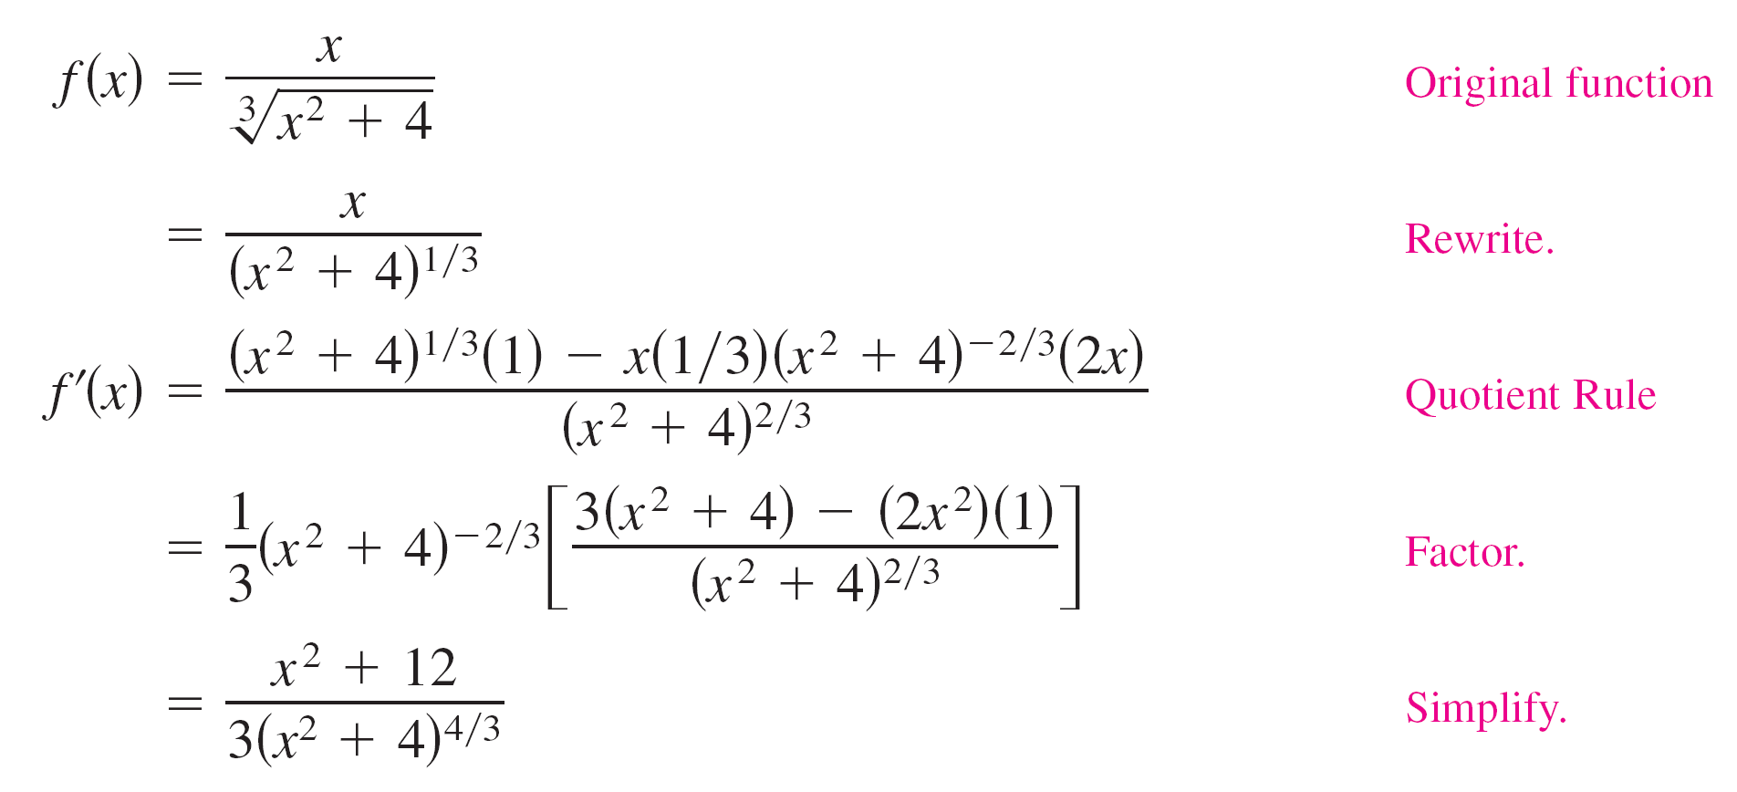
Example 8 – Simplifying the Derivative of a Quotient

Slide 21
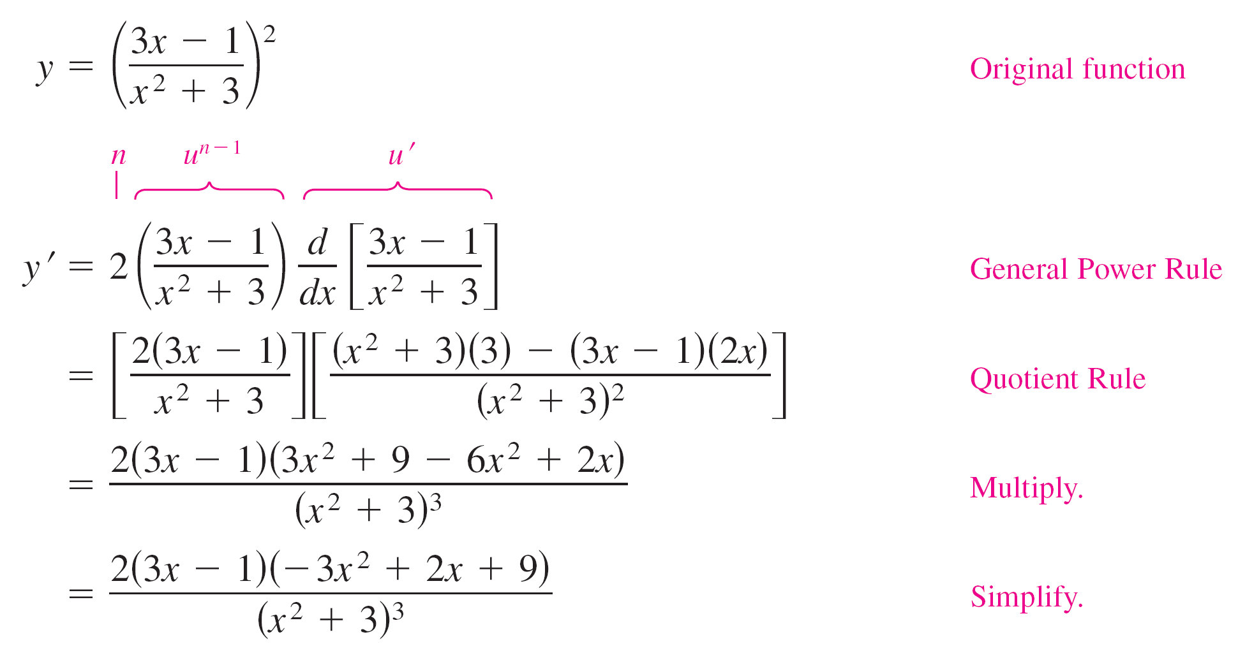
Example 9 – Simplifying the Derivative of a Power

Slide 22
Transcendental Functions and the Chain Rule

Slide 23
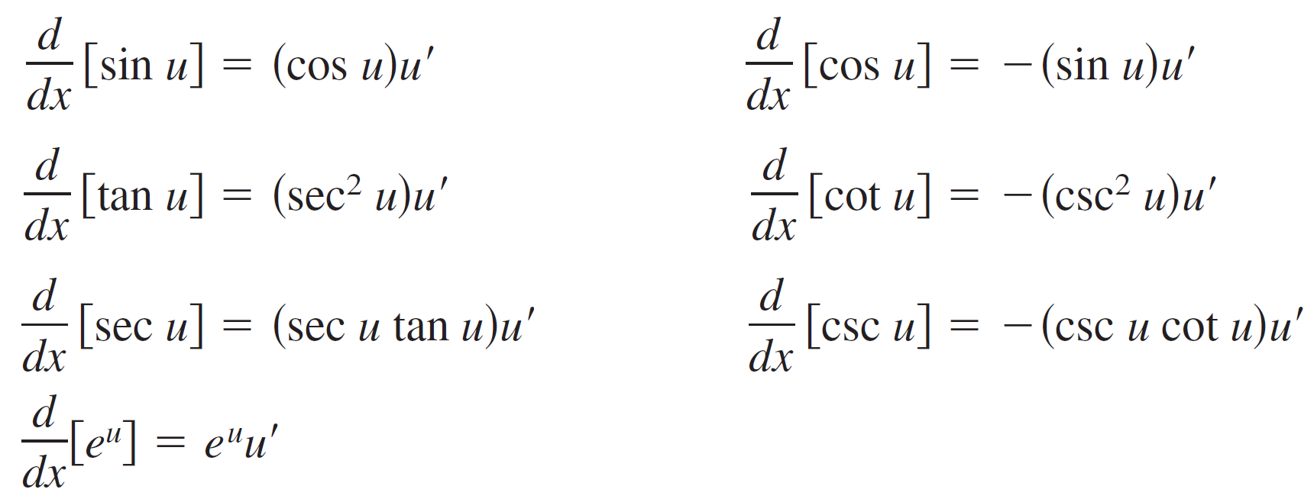
Transcendental Functions and the Chain Rule
The “Chain Rule versions” of the derivatives of the six trigonometric functions and the natural exponential function are as follows.

Slide 24
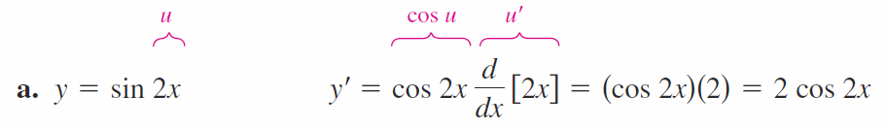
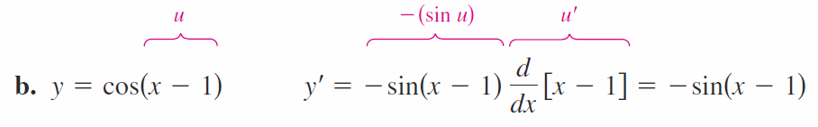
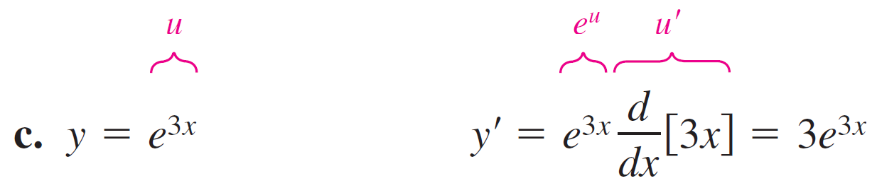
Example 10 – The Chain Rule and Transcendental Functions

Slide 25
The Derivative of the Natural Logarithmic Function

Slide 26
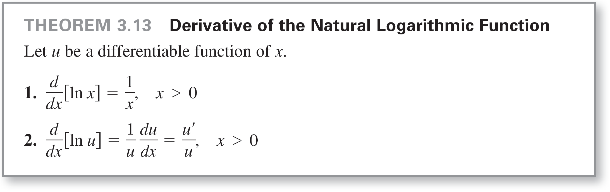
The Derivative of the Natural Logarithmic Function
The derivatives of algebraic functions have been algebraic and derivatives of transcendental functions have been transcendental. The following theorem looks at an unusual situation in which the derivative of a transcendental function is algebraic. Specifically, the derivative of the natural logarithmic function is the algebraic function 1/x.

Slide 27
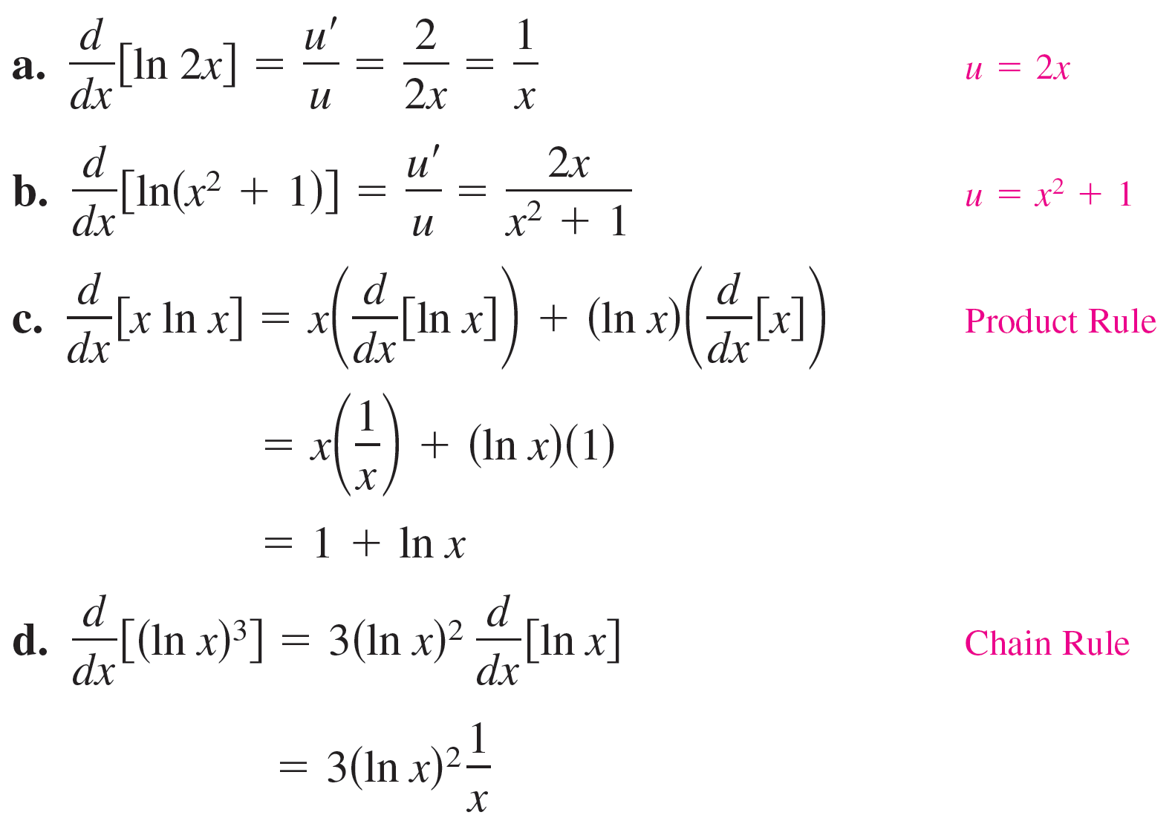
Example 13 – Differentiation of Logarithmic Functions

Slide 28
Example 13 – Differentiation of Logarithmic Functions
cont’d

Slide 29
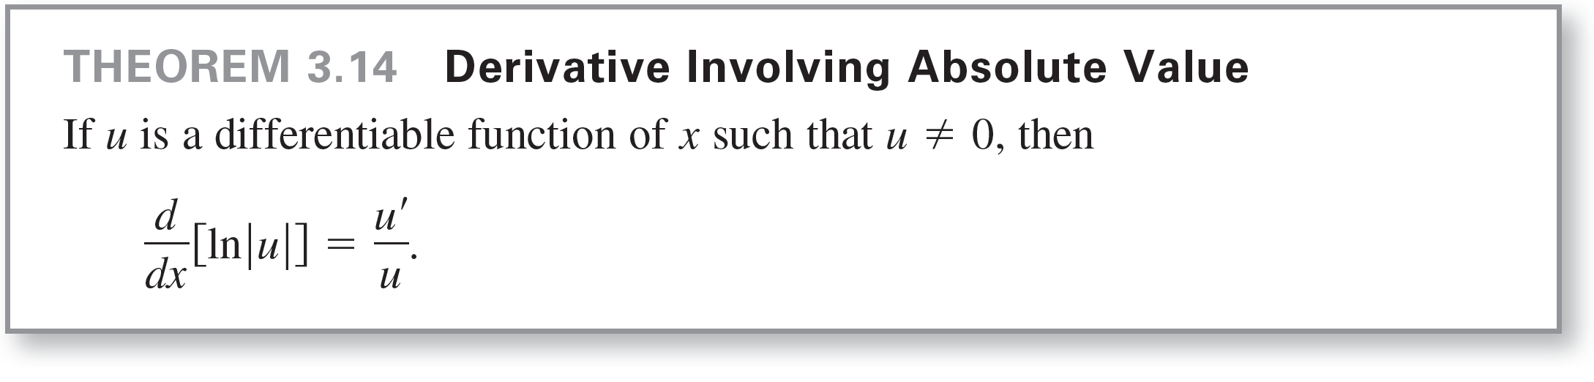
The Derivative of the Natural Logarithmic Function
Because the natural logarithm is undefined for negative numbers, you will often encounter expressions of the form ln|u|.
Theorem 3.14 states that you can differentiate functions of the form y = ln|u| as though the absolute value notation was not present.

Slide 30
Bases Other than e

Slide 31
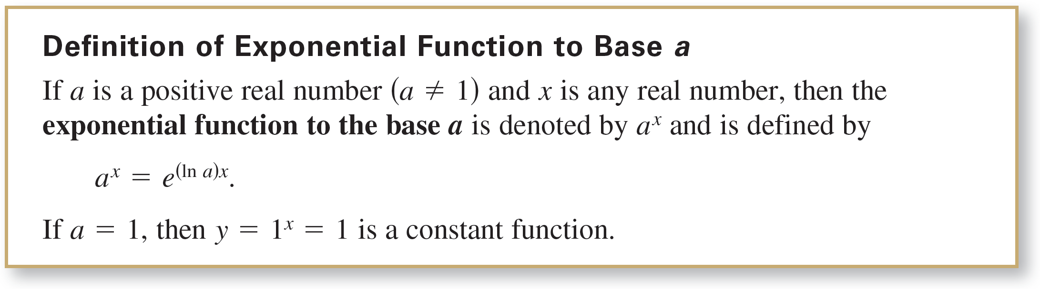
Bases Other than e
The base of the natural exponential function is e. This “natural” base can be used to assign a meaning to a general base a.

Slide 32
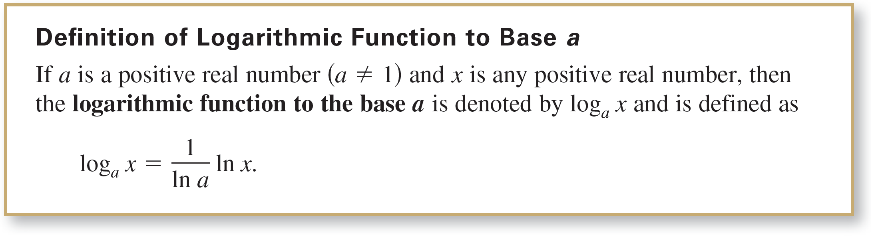
Bases Other than e
Logarithmic functions to bases other than e can be defined in much the same way as exponential functions to other bases are defined.

Slide 33
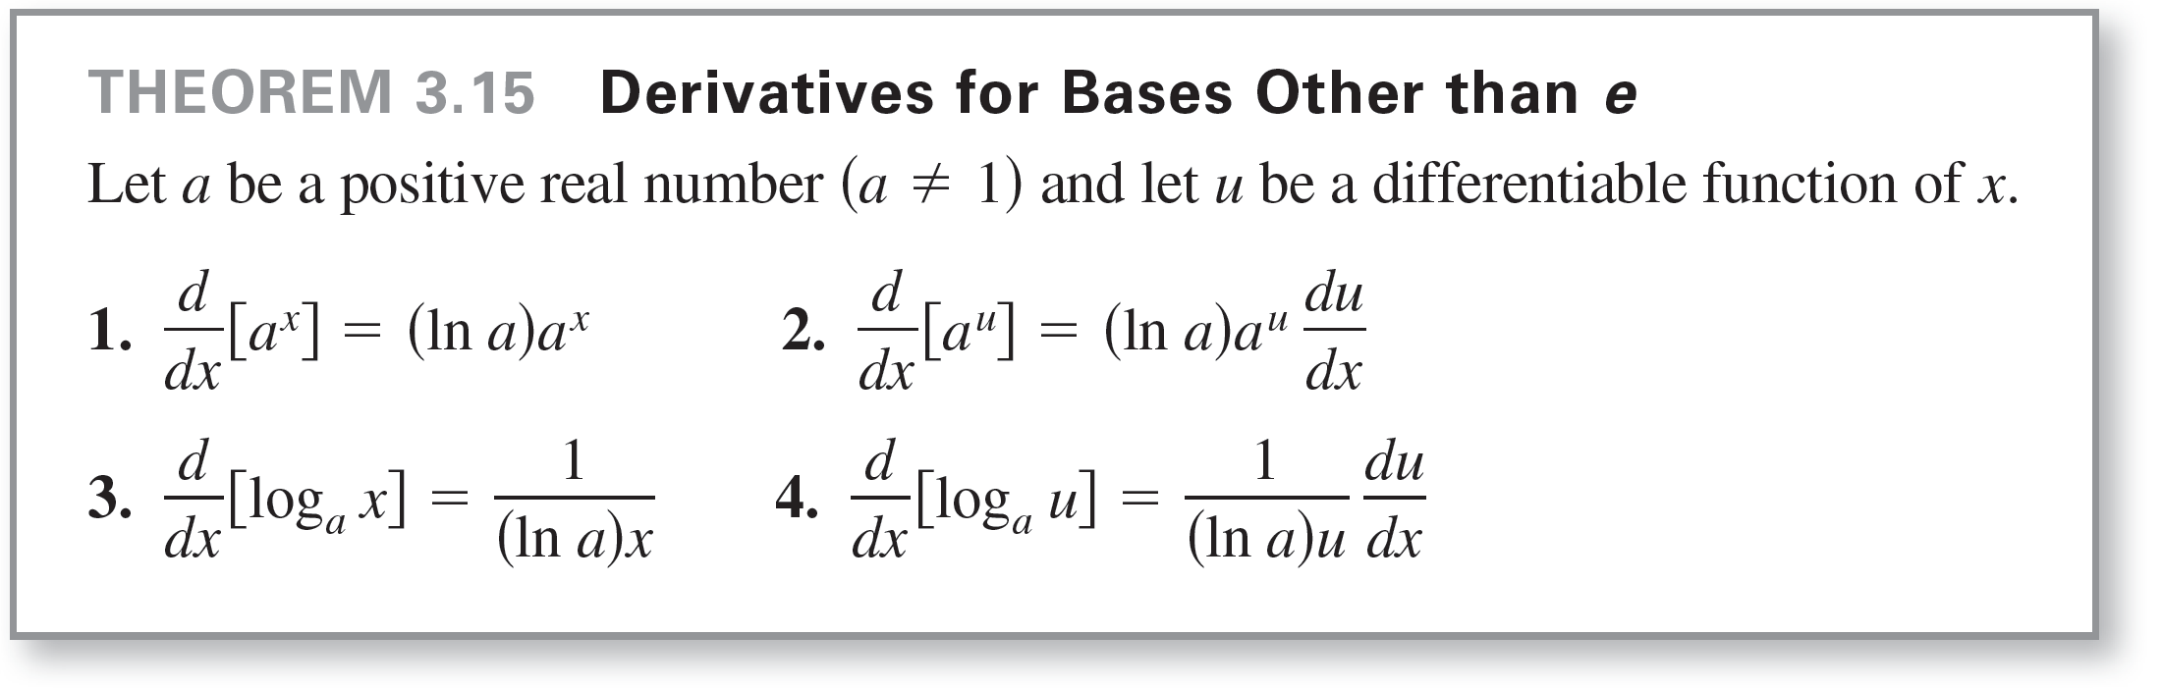
Bases Other than e
To differentiate exponential and logarithmic functions to other bases, you have two options:
(1) use the definitions of a^{x} and log_{a} x and differentiate using the rules for the natural exponential and logarithmic functions, or
(2) use the differentiation rules for bases other than e given in the following theorem.

Slide 34
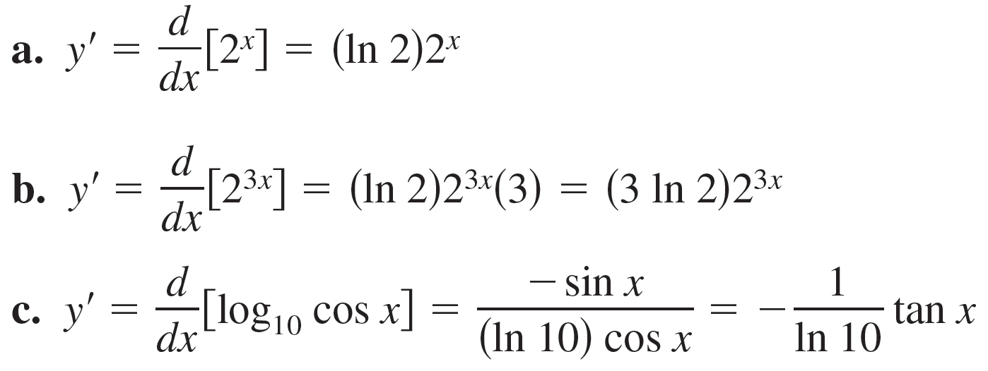
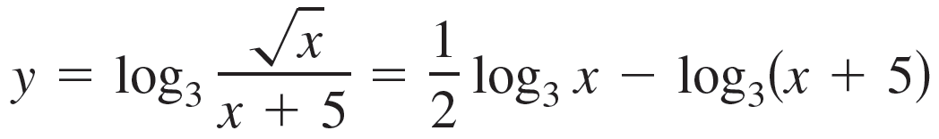
Example 16 – Differentiating Functions to Other Bases
d. After rewriting the function below using logarithmic
properties

Slide 35
Example 16 – Differentiating Functions to Other Bases
cont’d
You can apply Theorem 3.15 to find the derivative of the function.

Slide 36
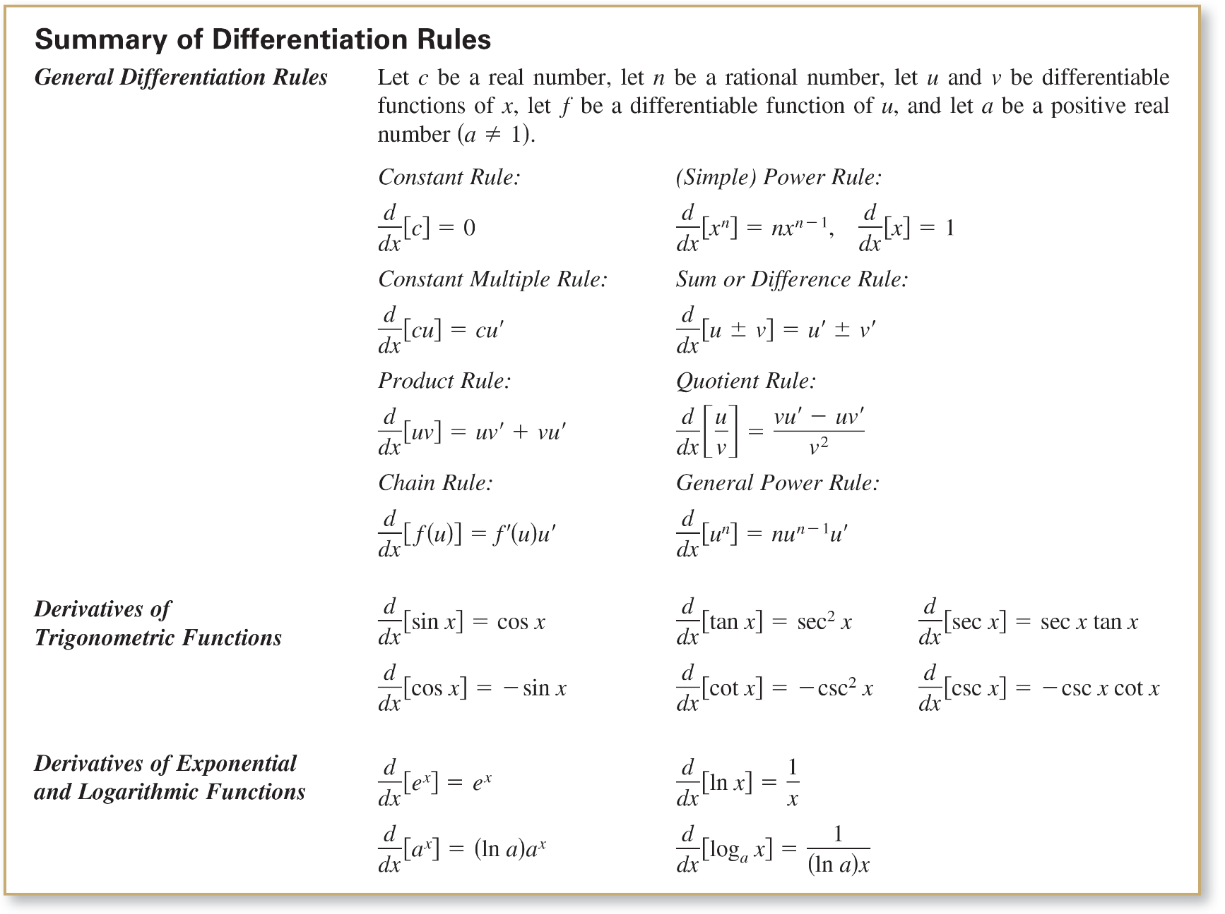
Bases Other than e

