Slide 1


P
3
Differentiation
Copyright © Cengage Learning. All rights reserved.

Slide 2

3.5
Implicit Differentiation
Copyright © Cengage Learning. All rights reserved.

Slide 3
Objectives
Distinguish between functions written in implicit form and explicit form.
Use implicit differentiation to find the derivative of a function.
Find derivatives of functions using logarithmic differentiation.

Slide 4
Implicit and Explicit Functions

Slide 5

Implicit and Explicit Functions
Most functions have been expressed in explicit form.
For example, in the equation , the variable y is explicitly written as a function of x.
Some functions, however, are only implied by an equation. For instance, the function y = 1/x is defined implicitly by the equation
xy = 1. Implicit form

Slide 6
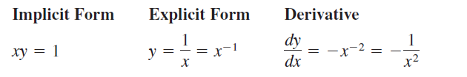
Implicit and Explicit Functions
To find dy/dx for this equation, you can write y explicitly as a function of x and then differentiate.
This strategy works whenever you can solve for the function explicitly.
You cannot, however, use this procedure when you are unable to solve for y as a function of x.

Slide 7

Implicit and Explicit Functions
For instance, how would you find dy/dx for the equation
For this equation, it is difficult to express y as a function of x
explicitly. To find dy/dx, you can use implicit
differentiation.

Slide 8
Implicit and Explicit Functions
To understand how to find dy/dx implicitly, you must realize that the differentiation is taking place with respect to x.
This means that when you differentiate terms involving x alone, you can differentiate as usual.
However, when you differentiate terms involving y, you must apply the Chain Rule, because you are assuming that y is defined implicitly as a differentiable function of x.

Slide 9
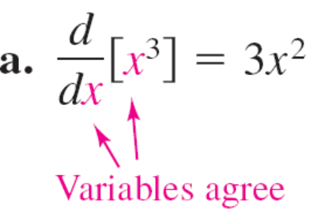
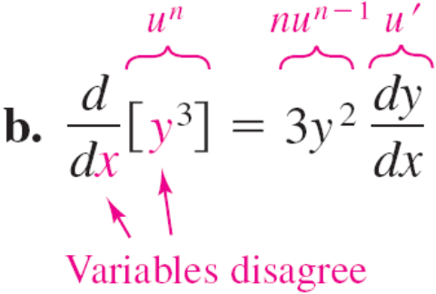
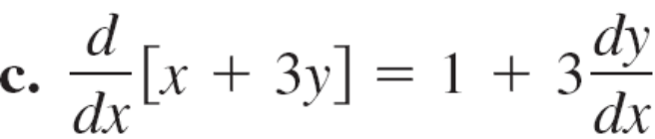
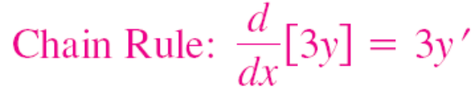
Example 1 – Differentiating with Respect to x

Slide 10
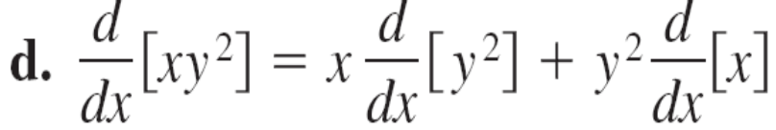


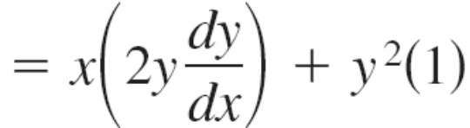



Example 1 – Differentiating with Respect to x
cont’d

Slide 11
Implicit Differentiation

Slide 12
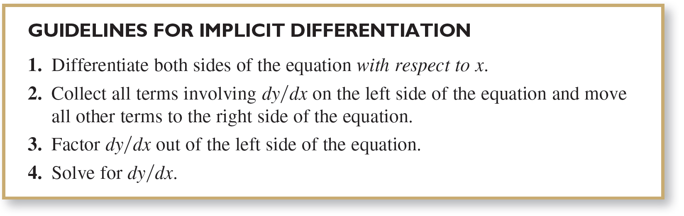
Implicit Differentiation

Slide 13
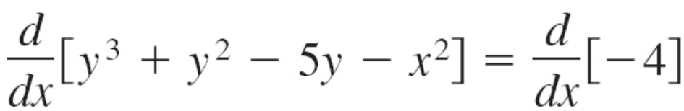
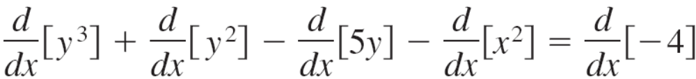

Example 2 – Implicit Differentiation
Find dy/dx given that y³ + y² – 5y – x² = –4.
Solution:
1. Differentiate both sides of the equation with respect to x.

Slide 14

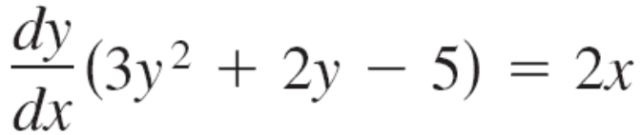
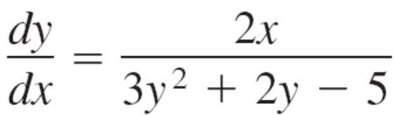
Example 2 – Solution
cont’d
2. Collect the dy/dx terms on the left side of the equation and move all other terms to the right side of the equation.
3. Factor dy/dx out of the left side of the equation.
4. Solve for dy/dx by dividing by (3y² + 2y – 5).

Slide 15
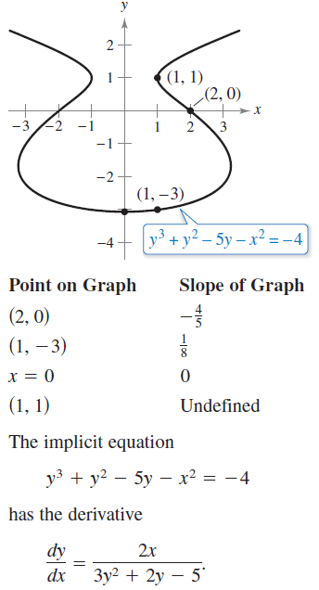
Implicit Differentiation
To see how you can use an
implicit derivative, consider
the graph shown in Figure 3.26.
From the graph, you can see that
y is not a function of x. Even so,
the derivative found in Example 2
gives a formula for the slope of the
tangent line at a point on this graph.
The slopes at several points on the
graph are shown below the graph.
Figure 3.26

Slide 16
Implicit Differentiation
It is meaningless to solve for dy/dx in an equation that has no solution points. (For example, x² + y² = –4 has no solution points.)
If, however, a segment of a graph can be represented by a differentiable function, then dy/dx will have meaning as the slope at each point on the segment.
Recall that a function is not differentiable at (a) points with vertical tangents and (b) points at which the function is not continuous.

Slide 17



Example 5 – Finding the Slope of a Graph Implicitly
Determine the slope of the graph of 3(x² + y²)² = 100xy
at the point (3, 1).
Solution:

Slide 18

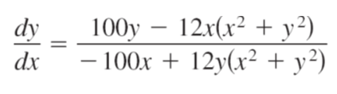
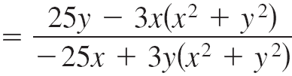
Example 5 – Solution
cont’d

Slide 19
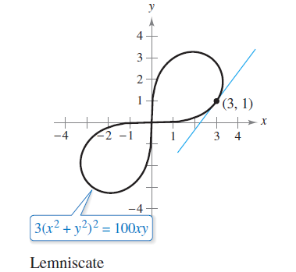
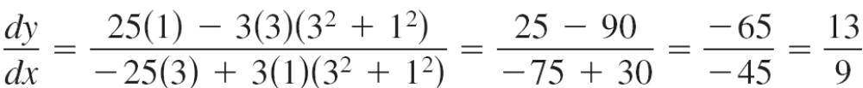
Example 5 – Solution
cont’d
At the point (3, 1), the slope of the graph is as shown in
Figure 3.29. This graph is called a lemniscate.
Figure 3.29

Slide 20
Logarithmic Differentiation

Slide 21
Logarithmic Differentiation
On occasion, it is convenient to use logarithms as aids in differentiating nonlogarithmic functions. This procedure is called logarithmic differentiation.

Slide 22






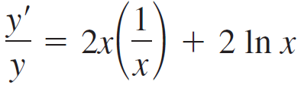

Example 10 – Logarithmic Differentiation
Find the derivative of y = x^{2x}, x > 0.
Solution:
Note that y > 0 for all x > 0. So, ln y is defined.

Slide 23
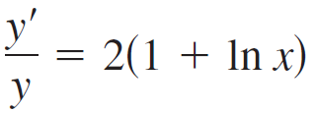





Example 10 – Solution
cont’d

Slide 24
Logarithmic Differentiation
Here are some guidelines for using logarithmic differentiation. In general, use logarithmic differentiation when differentiating (1) a function involving many factors or (2) a function having both a variable base and a variable exponent.

