Slide 1


P
3
Differentiation
Copyright © Cengage Learning. All rights reserved.

Slide 2

Derivatives of Inverse
Functions
3.6
Copyright © Cengage Learning. All rights reserved.

Slide 3
Objectives
Find the derivative of an inverse function.
Differentiate an inverse trigonometric function.

Slide 4
Derivative of an Inverse Function

Slide 5
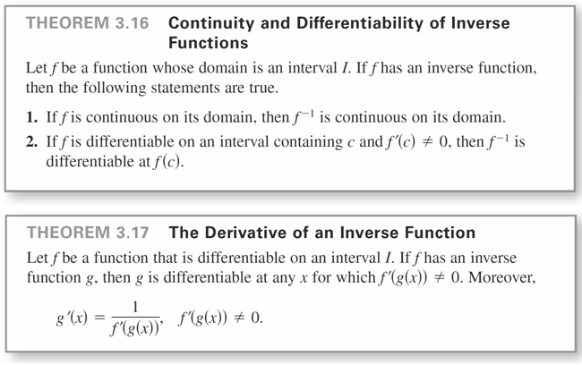
Derivative of an Inverse Function
The next two theorems discuss the derivative of an inverse function.

Slide 6
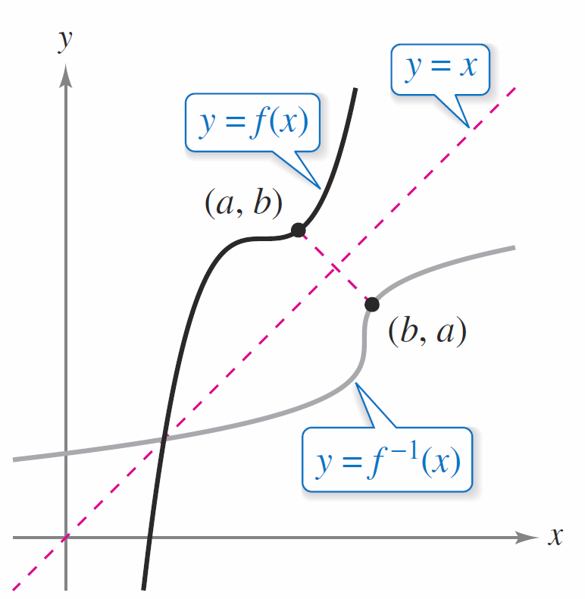
Derivative of an Inverse Function
The reasonableness of Theorem 3.16 follows from the reflective property of inverse functions, as shown in
Figure 3.32.
The graph of f ^{–1} is a reflection of
the graph of f in the line y = x.
Figure 3.32

Slide 7
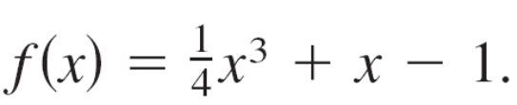
Example 1 – Evaluating the Derivative of an Inverse Function
Let
a. What is the value of f ^{–1}(x) when x = 3?
b. What is the value of (f ^{–1})′(x) when x = 3?
Solution:
Notice that f is one-to-one and therefore has an inverse function.
a. Because f (2) = 3, you know that f ^{–1}(3) = 2.

Slide 8
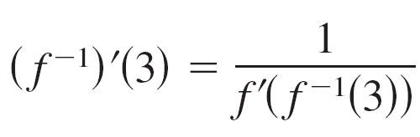
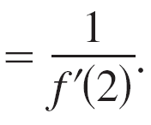

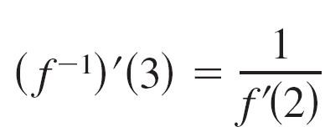
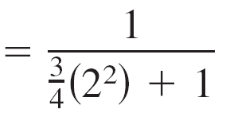
Example 1 – Solution
cont’d
b. Because the function f is differentiable and has an inverse function, you can apply Theorem 3.17
(with g = f ^{–1}) to write
Moreover, using you can conclude that

Slide 9
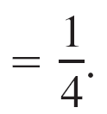
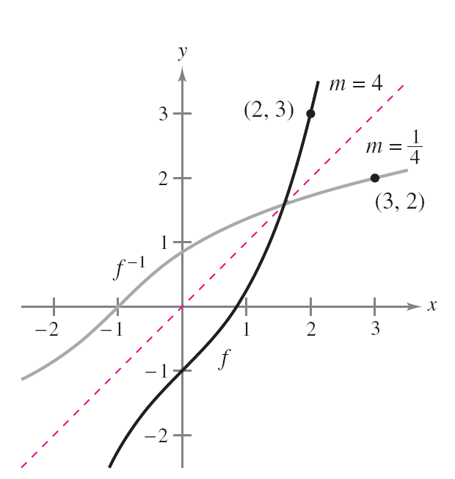
Example 1 – Solution
cont’d
See Figure 3.33.
The graphs of the inverse functions f and f ^{–1}
have reciprocal slopes at points (a, b) and (b, a).
Figure 3.33

Slide 10

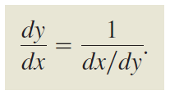
Derivative of an Inverse Function
In Example 1, note that at the point (2, 3), the slope of the graph of f is m = 4 and at the point (3, 2), the slope of the graph of f ^{–1} is m = , as shown in Figure 3.33.
This reciprocal relationship (which follows from Theorem 3.17) is sometimes written as

Slide 11
Derivative of an Inverse Function
When determining the derivative of an inverse function, you have two options: (1) you can apply Theorem 3.17, or
(2) you can use implicit differentiation.

Slide 12
Derivatives of Inverse Trigonometric Functions

Slide 13
Derivatives of Inverse Trigonometric Functions
You know that the derivative of the transcendental function
f (x) = ln x is the algebraic function f ′(x) = 1/x.
You will now see that the derivatives of the inverse trigonometric functions also are algebraic (even though the inverse trigonometric functions are themselves transcendental).

Slide 14
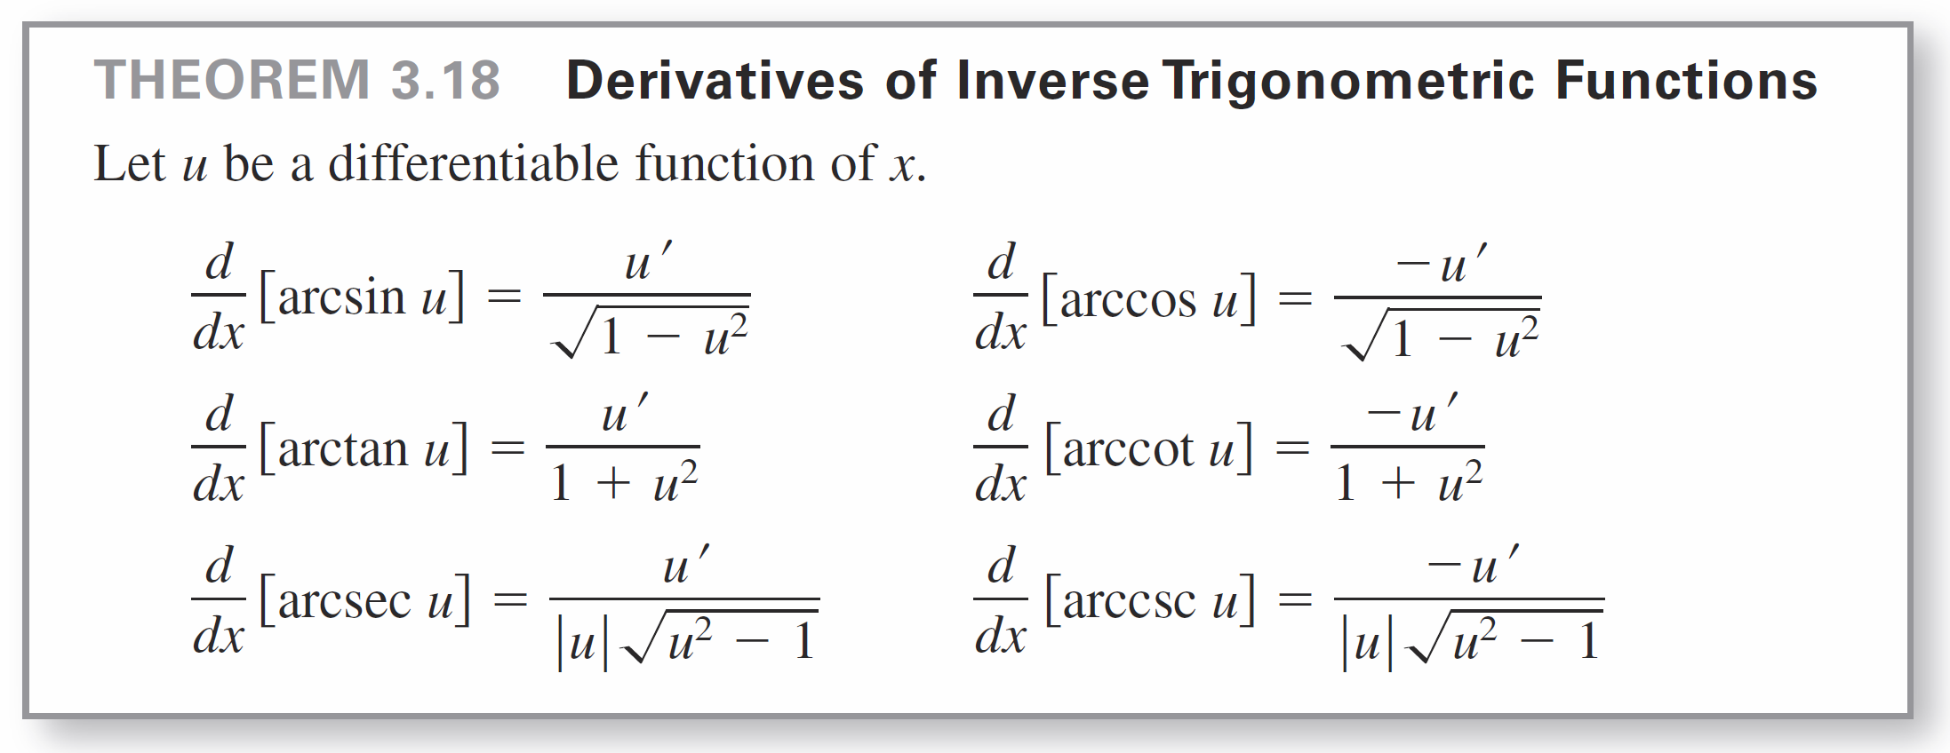
Derivatives of Inverse Trigonometric Functions
The following theorem lists the derivatives of the six inverse trigonometric functions. Note that the derivatives of arccos u, arccot u, and arccsc u are the negatives of the derivatives of arcsin u, arctan u, and arcsec u, respectively.

Slide 15
Derivatives of Inverse Trigonometric Functions
There is no common agreement on the definition of arcsec x (or arccsc x) for negative values of x. For this section, the range of arcsecant was defined to preserve the reciprocal identity arcsec x = arccos(1/x). For example, to evaluate arcsec(–2), you can write
arcsec(–2) = arccos(–0.5) ≈ 2.09.
One of the consequences of the definition of the inverse secant function given in this section is that its graph has a positive slope at every x-value in its domain. This accounts for the absolute value sign in the formula for the derivative of arcsec x.

Slide 16
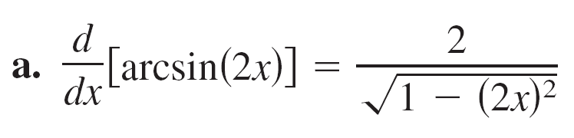
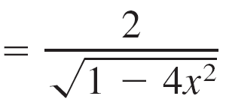
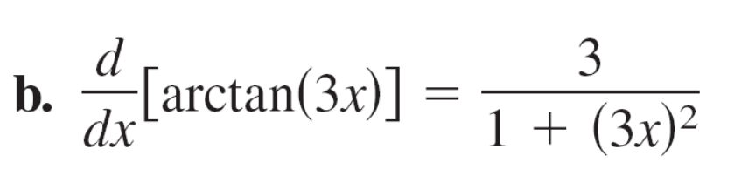
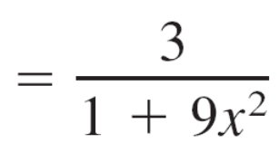
Example 4 – Differentiating Inverse Trigonometric Functions

Slide 17
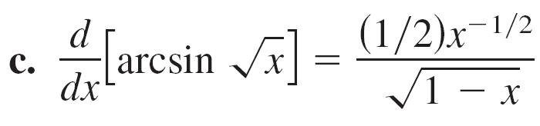
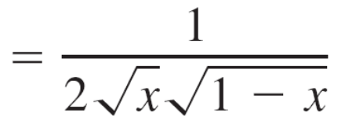
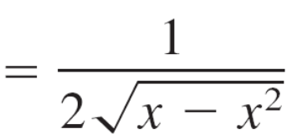
Example 4 – Differentiating Inverse Trigonometric Functions
cont’d

Slide 18
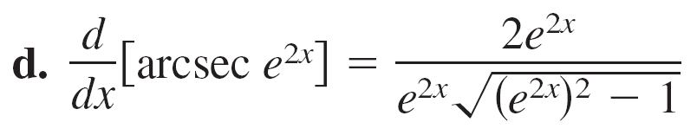
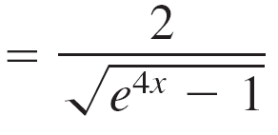
Example 4 – Differentiating Inverse Trigonometric Functions
cont’d
The absolute value sign is not necessary because
e^{2x} > 0.

