Slide 1

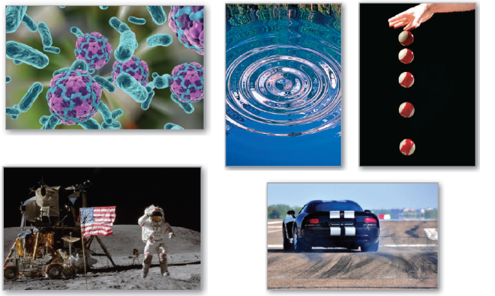
P
3
Differentiation
Copyright © Cengage Learning. All rights reserved.

Slide 2

3.7
Related Rates
Copyright © Cengage Learning. All rights reserved.

Slide 3
Objectives
Find a related rate.
Use related rates to solve real-life problems.

Slide 4
Finding Related Rates

Slide 5
Finding Related Rates
You have seen how the Chain Rule can be used to find dy/dx implicitly.
Another important use of the Chain Rule is to find the
rates of change of two or more related variables that are changing with respect to time.

Slide 6
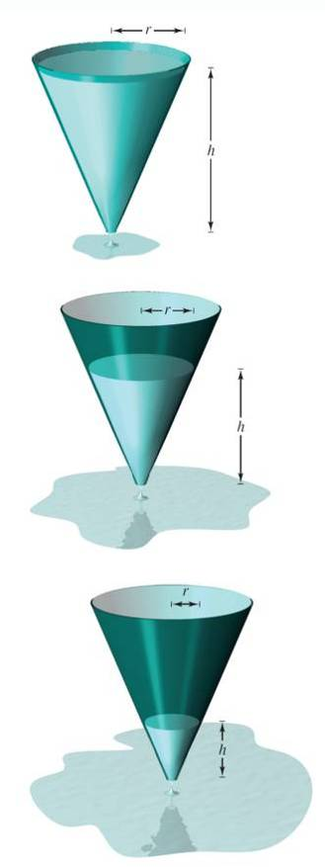



Finding Related Rates
For example, when water is drained out of a
conical tank (see Figure 3.36), the volume V,
the radius r, and the height h of the water
level are all functions of time t.
Knowing that these variables are related
by the equation
Figure 3.36

Slide 7



Finding Related Rates
You can differentiate implicitly with respect to t to obtain the related-rate equation
From this equation, you can see that the rate of change of
V is related to the rates of change of both h and r.

Slide 8
Example 1 – Two Rates That Are Related
The variables x and y are both differentiable functions of t and are related by the equation y = x² + 3. Find dy/dt when
x = 1, given that dx/dt = 2 when x = 1.
Solution:
Using the Chain Rule, you can differentiate both sides of the equation with respect to t.

Slide 9

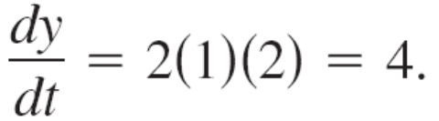
Example 1 – Solution
cont’d
When x = 1 and dx/dt = 2, you have

Slide 10
Problem Solving with Related Rates

Slide 11
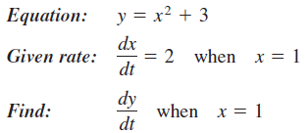
Problem Solving with Related Rates
In Example 1, you were given an equation that related the variables x and y and were asked to find the rate of change of y when x = 1.
In the next example, you must create a mathematical model from a verbal description.

Slide 12
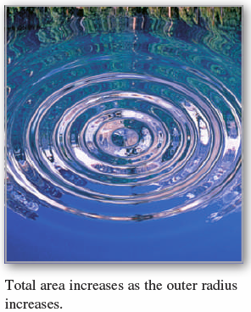
Example 2 – Ripples in a Pond
A pebble is dropped into a calm pond, causing ripples in the from of concentric circles, as shown in Figure 3.37.
The radius r of the outer ripple is increasing at a constant rate of 1 foot per second. When the radius is 4 feet, at what rate is the total area A of the disturbed water changing?
Figure 3.37

Slide 13




Example 2 – Solution
The variables r and A are related by
The rate of change of the radius r is dr / dt = 1.
With this information, you can proceed as in Example 1.

Slide 14


Example 2 – Solution
cont’d
When the radius is 4 feet, the area is changing at a rate of 8π square feet per second.

Slide 15
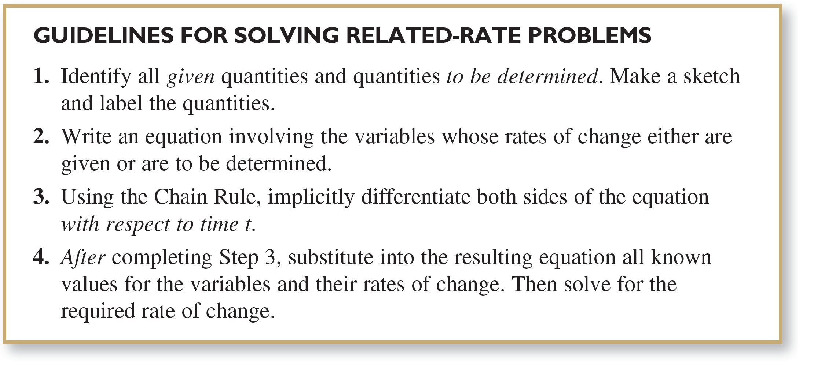
Problem Solving with Related Rates

Slide 16
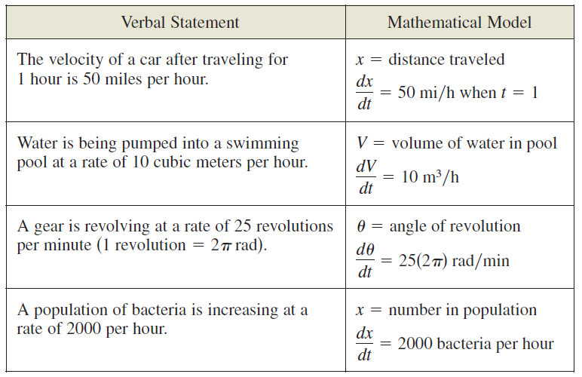
Problem Solving with Related Rates
The table below lists examples of mathematical models involving rates of change.

