Slide 1


P
3
Differentiation
Copyright © Cengage Learning. All rights reserved.

Slide 2

3.8
Newton’s Method
Copyright © Cengage Learning. All rights reserved.

Slide 3
Objective
Approximate a zero of a function using Newton’s Method.

Slide 4
Newton’s Method
The technique for approximating the real zeros of a function is called Newton’s Method, and it uses tangent lines to approximate the graph of the function near its
x-intercepts.
To see how Newton’s Method works, consider a function f that is continuous on the interval [a, b] and differentiable on the interval (a, b).
If f(a) and f(b) differ in sign, then, by the Intermediate Value Theorem, f must have at least one zero in the interval
(a, b).

Slide 5
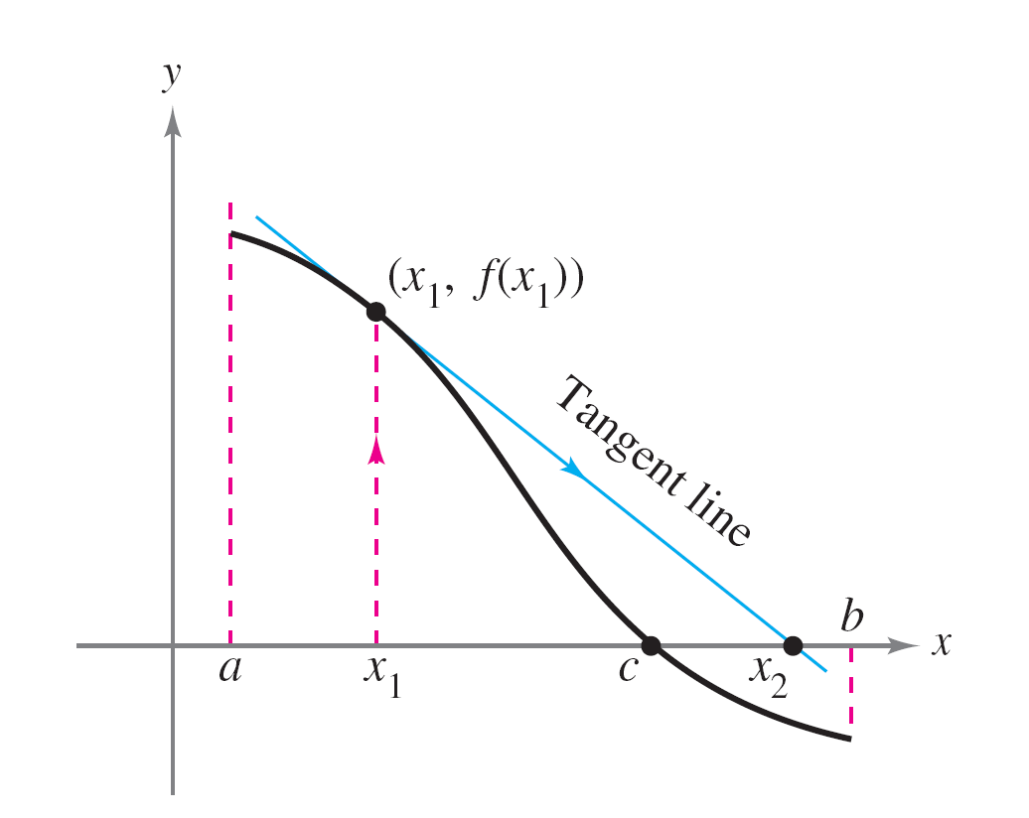
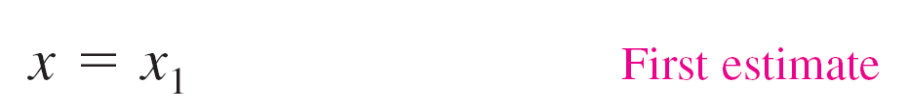
Newton’s Method
To estimate this zero, you choose
as shown in Figure 3.42(a).
Newton’s Method is based on the assumption that the graph
of f and the tangent line at (x₁, f(x₁)) both cross the x-axis at about the same point.
Figure 3.42(a)

Slide 6
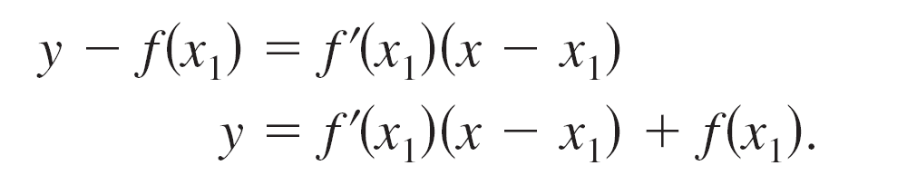
Newton’s Method
Because you can easily calculate the x-intercept for this tangent line, you can use it as a second (and, usually, better) estimate of the zero of f.
The tangent line passes through the point (x₁, f(x₁)) with a slope of f′(x₁).
In point-slope form, the equation of the tangent line is

Slide 7
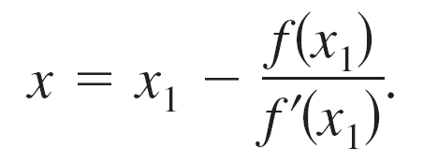
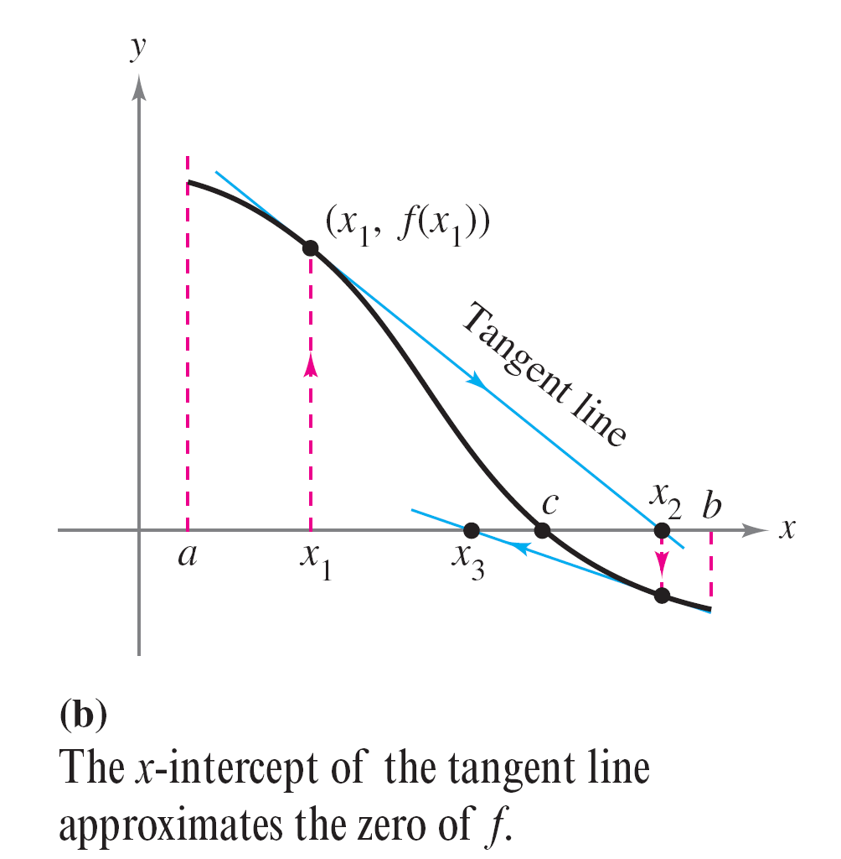
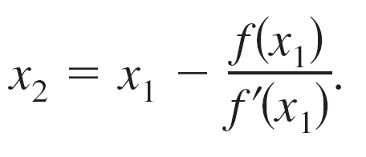
Newton’s Method
Letting y = 0 and solving for x produces
So, from the initial estimate x₁, you
obtain a new estimate
Figure 3.42(b)

Slide 8
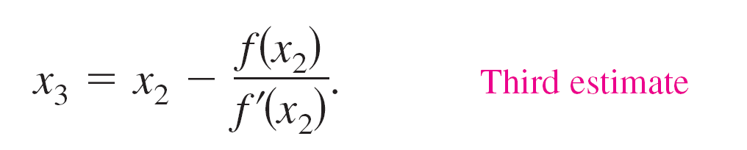
Newton’s Method
You can improve on x₂ and calculate yet a third estimate
Repeated application of this process is called Newton’s Method.

Slide 9
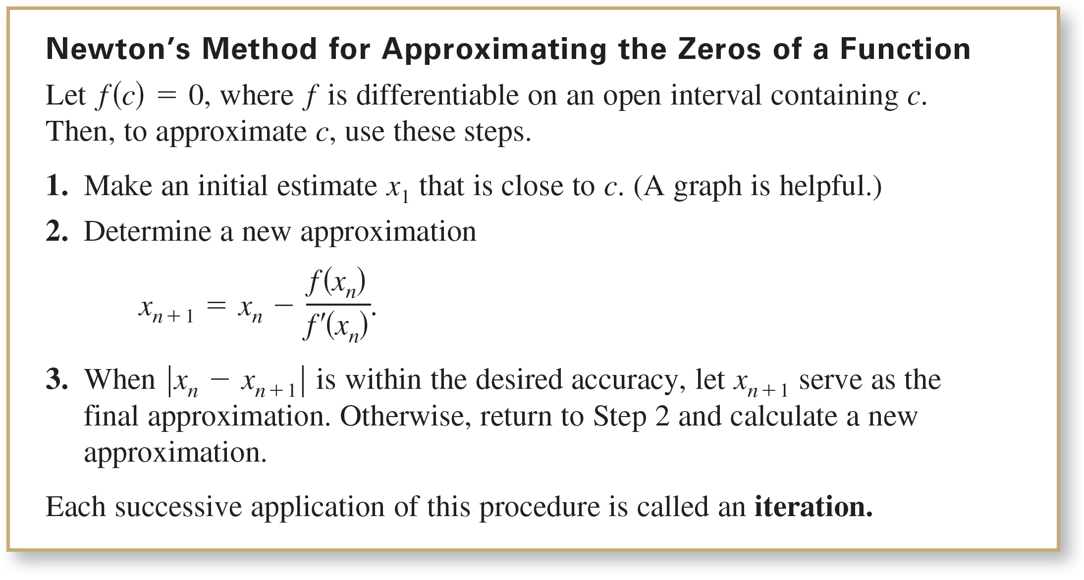
Newton’s Method

Slide 10
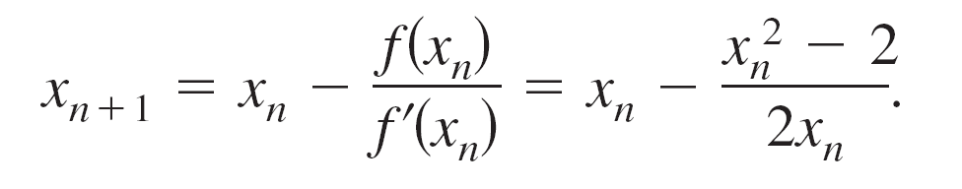
Example 1 – Using Newton’s Method
Calculate three iterations of Newton’s Method to approximate a zero of f(x) = x² – 2. Use x₁ = 1 as the initial guess.
Solution:
Because f(x) = x² – 2, you have f′(x) = 2x, and the iterative formula is

Slide 11
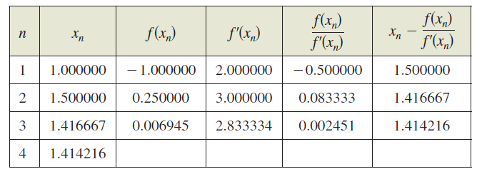
Example 1 – Solution
cont’d
The calculations for three iterations are shown in the table.

Slide 12


Example 1 – Solution
cont’d
Of course, in this case you know that the two zeros of the function are
To six decimal places,
So, after only three iterations of Newton’s Method, you have obtained an approximation that is within 0.000002 of an actual root.

Slide 13
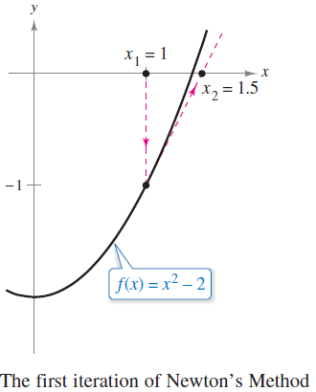
Example 1 – Solution
cont’d
The first iteration of this process is shown in Figure 3.43.
Figure 3.43

Slide 14
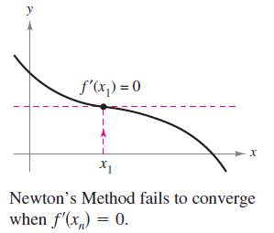
Newton’s Method
When, as in Example 1, the approximations approach a limit, the sequence of approximations x₁, x₂, x₃, . . . , x_{n}, . . . is said to converge. Moreover, when the limit is c, it can be shown that c must be a zero of f.
Newton’s Method does not
always yield a convergent
sequence.
One way it can fail to do so
is shown in the figure at right.

Slide 15
Newton’s Method
Because Newton’s Method involves division by f′(x_{n}), it is clear that the method will fail when the derivative is zero for any x_{n} in the sequence.
When you encounter this problem, you can usually overcome it by choosing a different value for x₁.
Another way Newton’s Method can fail is shown in the next example.

Slide 16

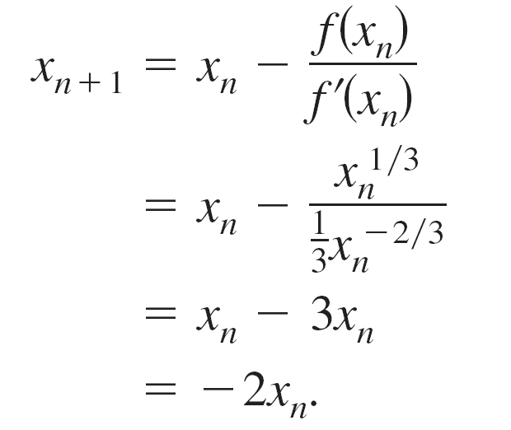
Example 3 – An Example in Which Newton’s Method Fails
The function f(x) = x^{1/3} is not differentiable at x = 0. Show that Newton’s Method fails to converge using x₁ = 0.1.
Solution:

Slide 17
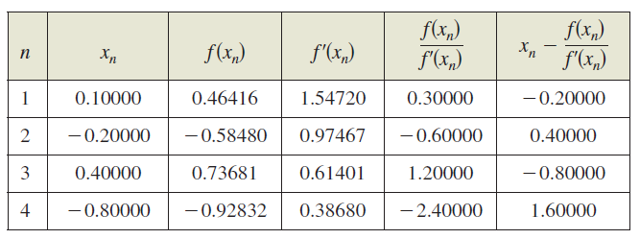
Example 3 – Solution
cont’d
The calculations are shown in the table.

Slide 18

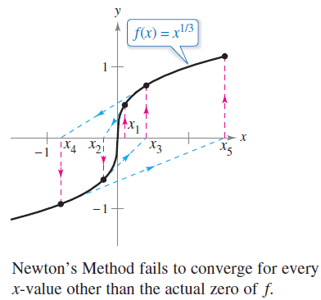
Example 3 – Solution
cont’d
The table and Figure 3.45 indicate that x_{n} continues to increase in magnitude as and so the limit of the sequence does not exist.
Figure 3.45

Slide 19

Newton’s Method
It can be shown that a condition sufficient to produce convergence of Newton’s Method to a zero of f is that
on an open interval containing the zero.

Slide 20
Newton’s Method
You have learned several techniques for finding the zeros of functions. The zeros of some functions, such as
f(x) = x³ – 2x² – x + 2
can be found by simple algebraic techniques, such as factoring.
The zeros of other functions, such as
f(x) = x³ – x + 1
cannot be found by elementary algebraic methods.

Slide 21
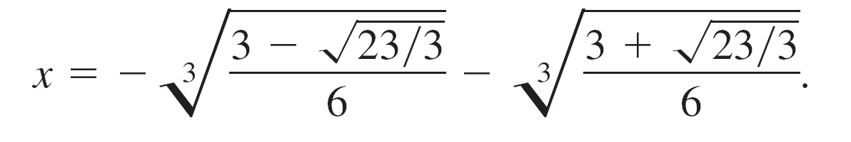
Newton’s Method
This particular function has only one real zero, and by using more advanced algebraic techniques, you can determine the zero to be
Because the exact solution is written in terms of square roots and cube roots, it is called a solution by radicals.

