Slide 1


4
Applications of Differentiation
P
Copyright © Cengage Learning. All rights reserved.

Slide 2

Rolle’s Theorem and the Mean Value Theorem
4.2
Copyright © Cengage Learning. All rights reserved.

Slide 3
Objectives
Understand and use Rolle’s Theorem.
Understand and use the Mean Value Theorem.

Slide 4
Rolle’s Theorem

Slide 5
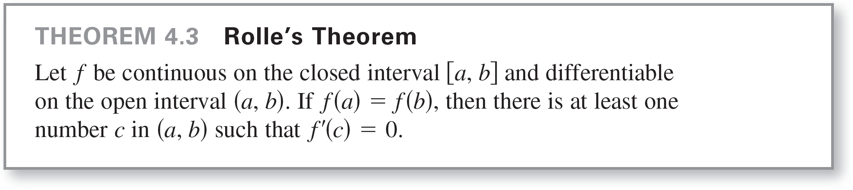
Rolle’s Theorem
The Extreme Value Theorem states that a continuous function on a closed interval [a, b] must have both a minimum and a maximum on the interval. Both of these values, however, can occur at the endpoints.
Rolle’s Theorem, named after the French mathematician Michel Rolle (1652–1719), gives conditions that guarantee the existence of an extreme value in the interior of a closed interval.

Slide 6
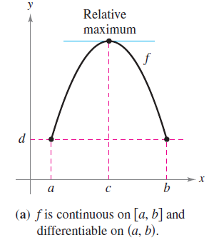
Rolle’s Theorem
From Rolle’s Theorem, you can see that if a function f is continuous on [a, b] and differentiable on (a, b), and if f(a) = f(b), then there must be at least one x-value between a and b at which the graph of f has a horizontal tangent, as shown in Figure 4.8(a).
Figure 4.8

Slide 7
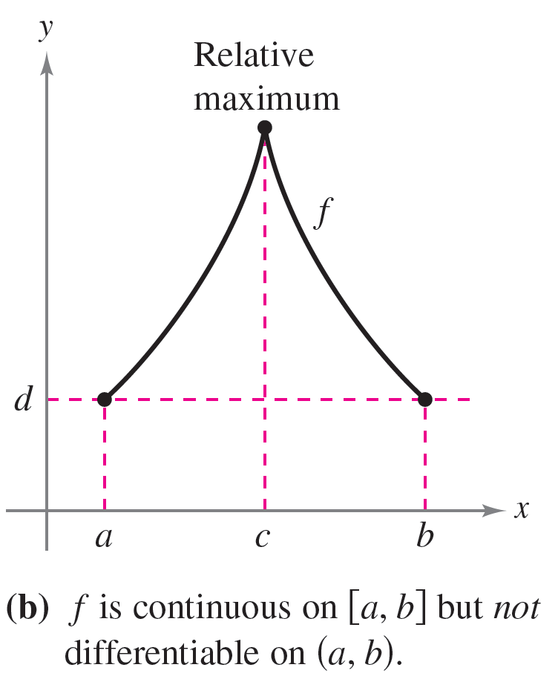
Rolle’s Theorem
When the differentiability requirement is dropped from Rolle’s Theorem, f will still have a critical number in (a, b), but it may not yield a horizontal tangent. Such a case is shown in Figure 4.8(b).
Figure 4.8

Slide 8
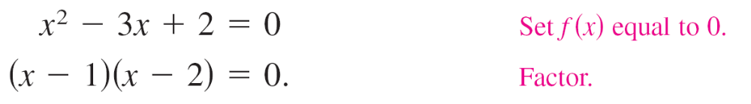

Example 1 – Illustrating Rolle’s Theorem
Find the two x-intercepts of
f(x) = x² – 3x + 2
and show that f ′(x) = 0 at some point between the two
x-intercepts.
Solution:
Note that f is differentiable on the entire real number line. Setting f(x) equal to 0 produces

Slide 9

Example 1 – Solution
cont’d
So, f(1) = f(2) = 0, and from Rolle’s Theorem you know that there exists at least one c in the interval (1, 2) such that
f ′(c) = 0.
To find such a c, differentiate f to obtain
and then determine that f ′(x) = 0 when x =

Slide 10
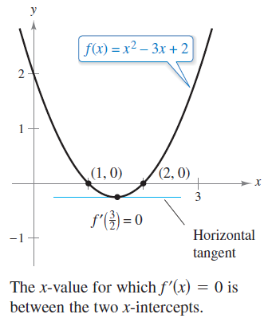
Example 1 – Solution
cont’d
Note that this x-value lies in the open interval (1, 2), as shown in Figure 4.9.
Figure 4.9

Slide 11
The Mean Value Theorem

Slide 12
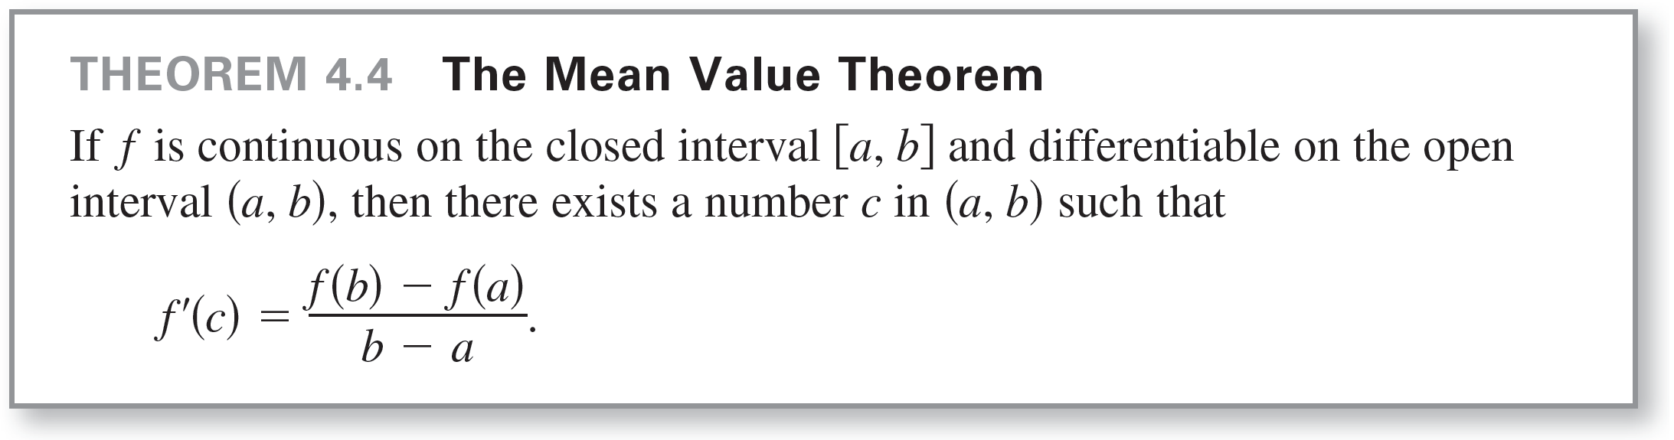
The Mean Value Theorem
Rolle’s Theorem can be used to prove another theorem—the Mean Value Theorem.

Slide 13
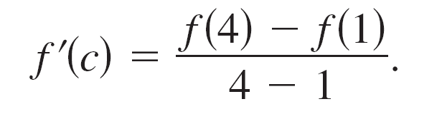

Example 3 – Finding a Tangent Line
For f(x) = 5 – (4/x), find all values of c in the open interval (1, 4) such that
Solution:
The slope of the secant line through (1, f(1)) and (4, f(4)) is
Note that the function satisfies the conditions of the Mean Value Theorem.

Slide 14

Example 3 – Solution
cont’d
That is, f is continuous on the interval [1, 4] and differentiable on the interval (1, 4).
So, there exists at least one number c in (1, 4) such that
f ′(c) = 1.
Solving the equation f ′(x) = 1 yields
which implies that x = ± 2.

Slide 15
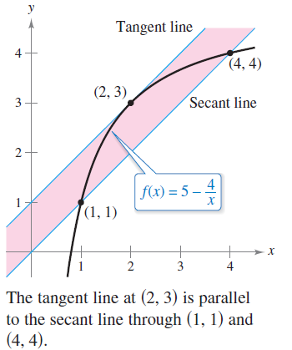
Example 3 – Solution
cont’d
So, in the interval (1, 4), you can conclude that c = 2, as shown in Figure 4.13.
Figure 4.13

Slide 16
The Mean Value Theorem
A useful alternative form of the Mean Value Theorem is:
If f is continuous on [a, b] and differentiable on (a, b),
then there exists a number c in (a, b) such that
Keep in mind that polynomial functions, rational functions, and transcendental functions are differentiable at all points in their domains.

