Slide 1


4
Applications of Differentiation
P
Copyright © Cengage Learning. All rights reserved.

Slide 2

A Summary of Curve Sketching
4.6
Copyright © Cengage Learning. All rights reserved.

Slide 3
Objective
Analyze and sketch the graph of a function.

Slide 4
Analyzing the Graph of a Function

Slide 5
Analyzing the Graph of a Function
When you are sketching the graph of a function, either by hand or with a graphing utility, remember that normally you cannot show the entire graph.
The decision as to which part of the graph you choose to show is often crucial.

Slide 6
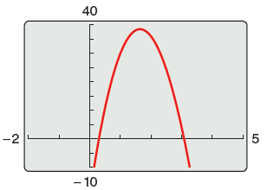
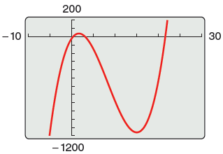

Analyzing the Graph of a Function
For instance, which of the viewing windows in Figure 4.43 better represents the graph of f(x) = x³ – 25x² + 74x – 20?
Figure 4.43

Slide 7
Analyzing the Graph of a Function
By seeing both views, it is clear that the second viewing window gives a more complete representation of the graph.
But would a third viewing window reveal other interesting portions of the graph?
To answer this, you need to use calculus to interpret the first and second derivatives.

Slide 8
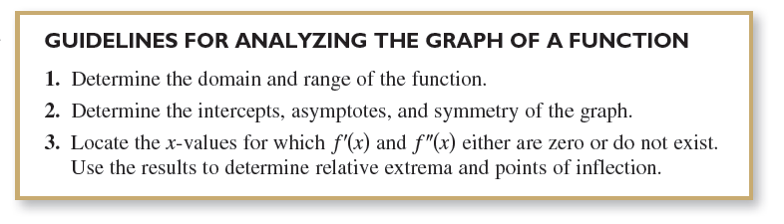
Analyzing the Graph of a Function
To determine a good viewing window for a function, use these guidelines to analyze its graph.

Slide 9
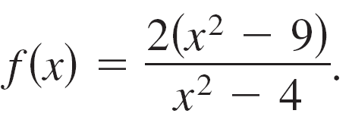

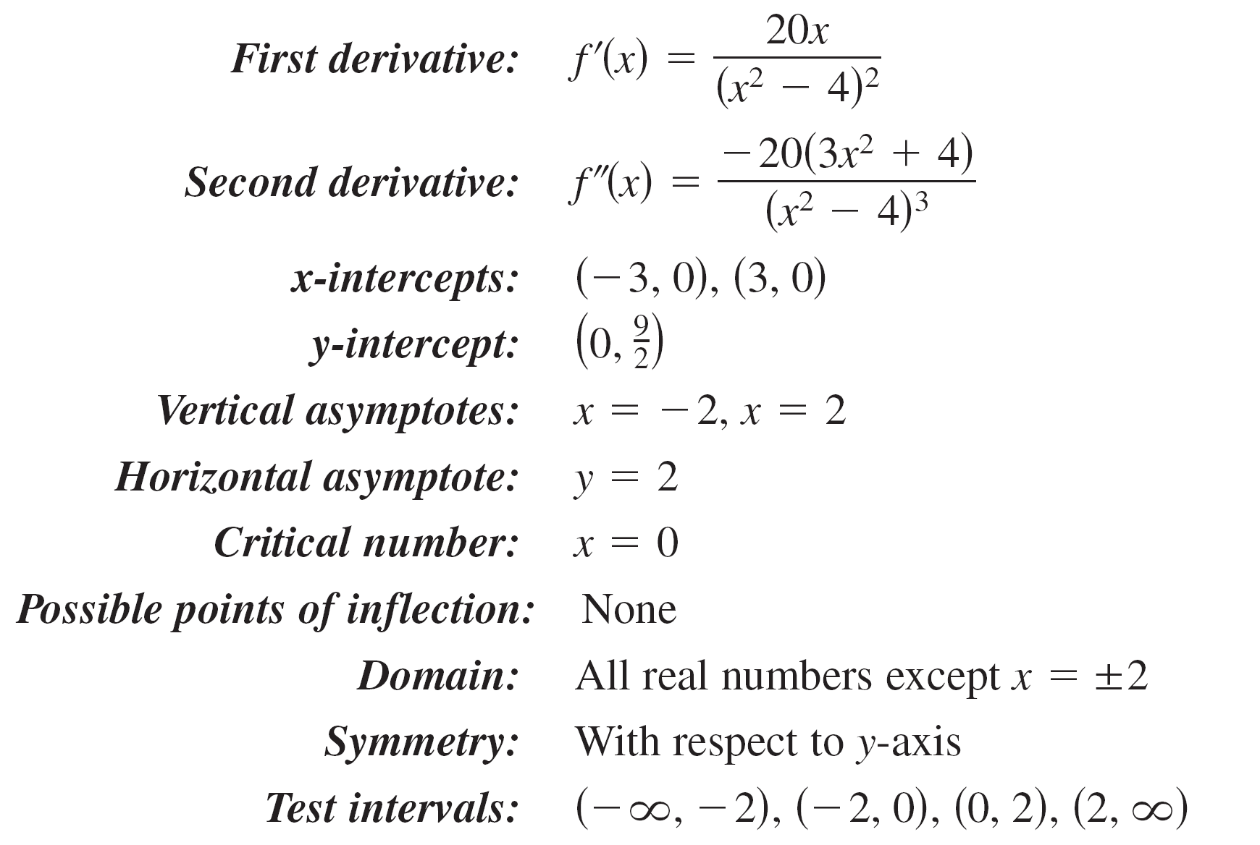
Example 1 – Sketching the Graph of a Rational Function
Analyze and sketch the graph of
Solution:

Slide 10
Example 1 – Solution
cont’d

Slide 11
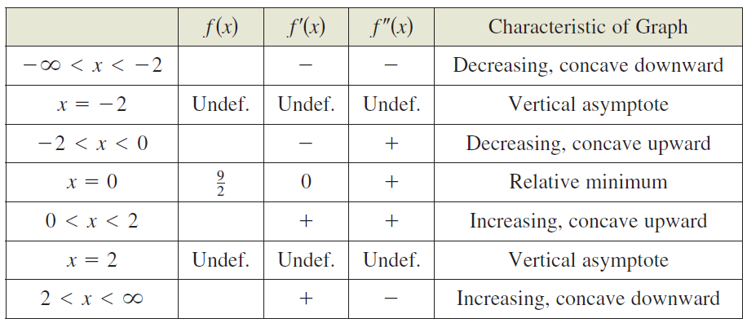
Example 1 – Solution
cont’d
The table shows how the test intervals are used to determine several characteristics of the graph.

Slide 12
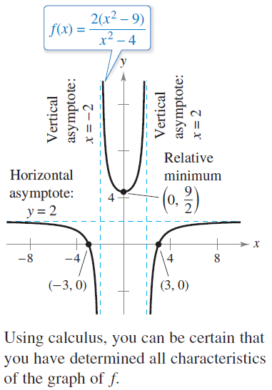
Example 1 – Solution
cont’d
The graph of f is shown in Figure 4.44.
Figure 4.44

Slide 13
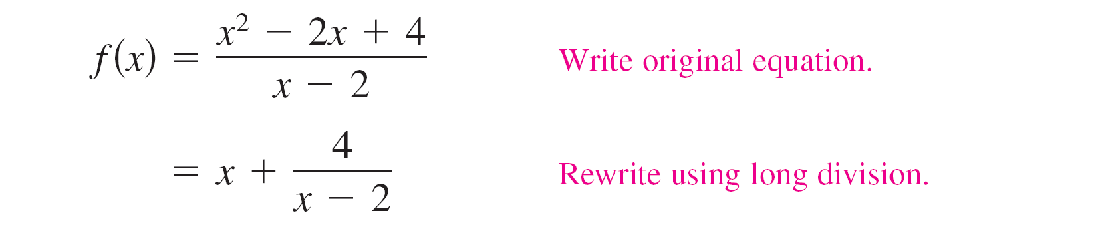
Analyzing the Graph of a Function
The graph of a rational function (having no common factors and whose denominator is of degree 1 or greater) has a slant asymptote when the degree of the numerator exceeds the degree of the denominator by exactly 1.
To find the slant asymptote, use long division to rewrite the rational function as the sum of a first-degree polynomial (the slant asymptote) and another rational function.

Slide 14

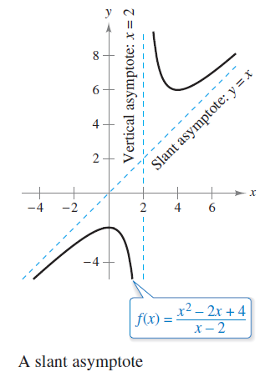
Analyzing the Graph of a Function
In Figure 4.47, note that the graph of f approaches the slant asymptote y = x as x approaches
Figure 4.47

