Slide 1


4
Applications of Differentiation
P
Copyright © Cengage Learning. All rights reserved.

Slide 2

4.8
Differentials
Copyright © Cengage Learning. All rights reserved.

Slide 3
Objectives
Understand the concept of a tangent line approximation.
Compare the value of the differential, dy, with the actual change in y, Δy.
Estimate a propagated error using a differential.
Find the differential of a function using differentiation formulas.

Slide 4
Tangent Line Approximations

Slide 5

Tangent Line Approximations
Consider a function f that is differentiable at c. The equation for the tangent line at the point (c, f(c)) is
and is called the tangent line approximation (or linear approximation) of f at c.
Because c is a constant, y is a linear function of x.

Slide 6
Tangent Line Approximations
Moreover, by restricting the values of x to those sufficiently close to c, the values of y can be used as approximations (to any desired degree of accuracy) of the values of the function f.
In other words, as x approaches c, the limit of y is f(c).

Slide 7
Example 1 – Using a Tangent Line Approximation
Find the tangent line approximation of
f(x) = 1 + sin x
at the point (0, 1). Then use a table to compare the
y-values of the linear function with those of f(x) on an open interval containing x = 0.
Solution:
The derivative of f is
f'(x) = cos x. First derivative

Slide 8

Example 1 – Solution
cont’d
So, the equation of the tangent line to the graph of f at the
point (0, 1) is
y = f(0) + f'(0)(x – 0)
y = 1 + (1)(x – 0)
y = 1 + x.

Slide 9
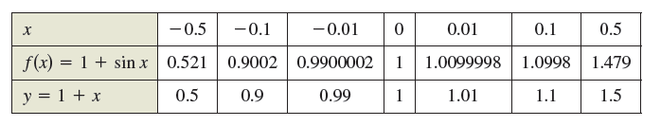
Example 1 – Solution
cont’d
The table compares the values of y given by this linear approximation with the values of f(x) near x = 0.
Notice that the closer x is to 0, the better the approximation.

Slide 10
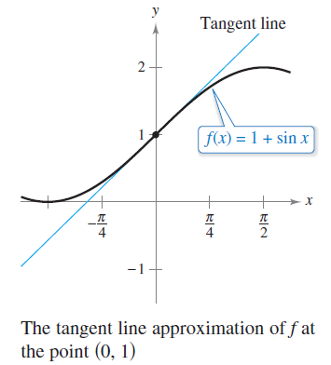
Example 1 – Solution
cont’d
This conclusion is reinforced by the graph shown in
Figure 4.62.
Figure 4.62

Slide 11
Differentials

Slide 12

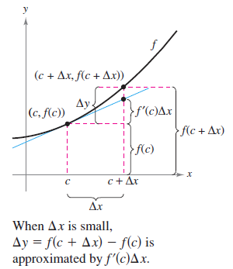
Differentials
When the tangent line to the graph of f at the point (c, f(c))
y = f(c) + f'(c)(x – c)
is used as an approximation of
the graph of f, the quantity
x – c is called the change in x,
and is denoted by Δx,
as shown in Figure 4.63.
Figure 4.63

Slide 13
Differentials
When Δx is small, the change in y (denoted by Δy) can be approximated as shown.
Δy = f(c + Δx) – f(c)
≈ f'(c)Δx
For such an approximation, the quantity Δx is traditionally denoted by dx and is called the differential of x.
The expression f'(x)dx is denoted by dy and is called the differential of y.

Slide 14
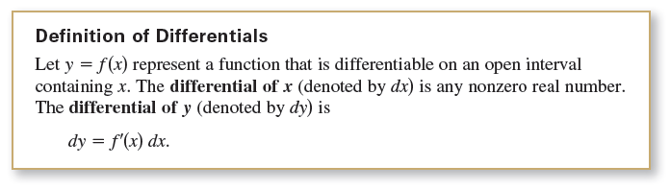

Differentials
In many types of applications, the differential of y can be used as an approximation of the change in y. That is,

Slide 15

Example 2 – Comparing Δy and dy
Let y = x². Find dy when x = 1 and dx = 0.01.
Compare this value with Δy for x = 1 and Δx = 0.01.
Solution:
Because y = f(x) = x², you have f'(x) = 2x, and the differential dy is
dy = f'(x)dx = f'(1)(0.01) = 2(0.01) = 0.02.
Now, using Δx = 0.01, the change in y is
Δy = f(x + Δx) – f(x) = f(1.01) – f(1)
= (1.01)² – 1² = 0.0201.

Slide 16
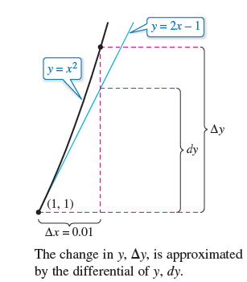
Example 2 – Solution
cont’d
Figure 4.64 shows the geometric comparison of dy and Δy.
You will see that the values become closer to each other
as dx (or Δx) approaches 0.
Figure 4.64

Slide 17
Error Propagation

Slide 18
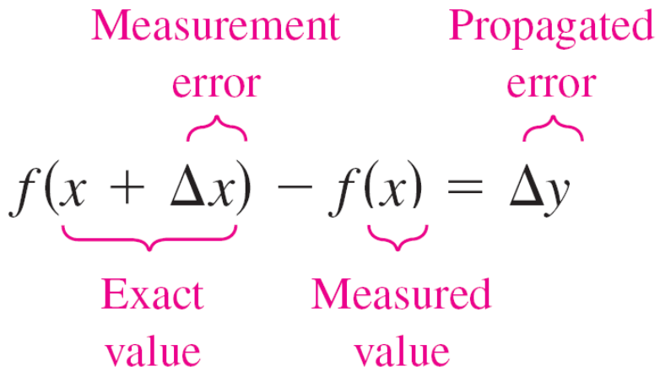
Error Propagation
If you let x represent the measured value of a variable and let x + Δx represent the exact value, then Δx is the error in measurement.
Finally, if the measured value x is used to compute another value f(x), the difference between f(x +Δx) and f(x) is the propagated error.

Slide 19
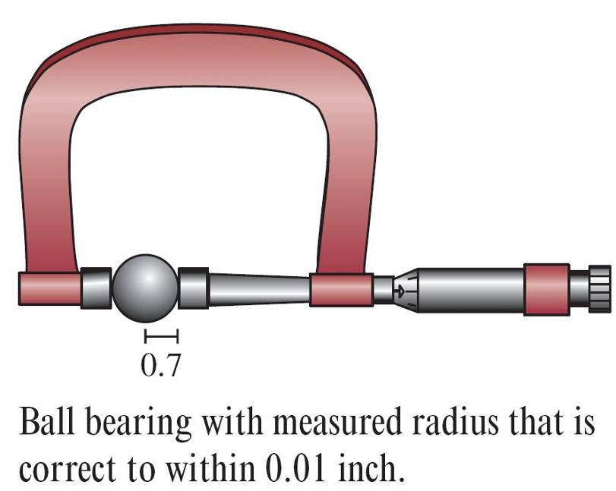
Example 3 – Estimation of Error
The measured radius of a ball bearing is 0.7 inch, as shown in the figure below. The measurement is correct to within 0.01 inch. Estimate the propagated error in the volume V of the ball bearing.

Slide 20









Example 3 – Solution
The formula for the volume of a sphere is
where r is the radius of the sphere.
So, you can write
and
To approximate the propagated error in the volume, differentiate V to obtain and write

Slide 21



Example 3 – Solution
cont’d
So, the volume has a propagated error of about 0.06 cubic inch.

Slide 22
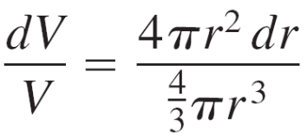

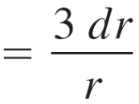



Error Propagation
The ratio
is called the relative error. The corresponding percent error is approximately 4.29%.

Slide 23
Calculating Differentials

Slide 24
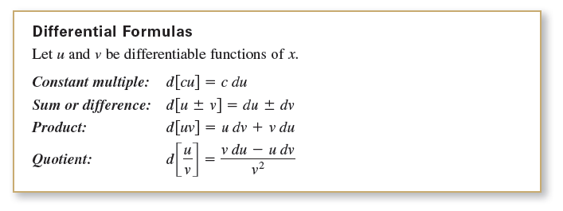
Calculating Differentials
Each of the differentiation rules can be written in differential form.

Slide 25



Example 4 – Finding Differentials

Slide 26

Calculating Differentials
The notation in Example 4 is called the Leibniz notation for derivatives and differentials, named after the German mathematician Gottfried Wilhelm Leibniz.
Differentials can be used to approximate function values. To do this for the function given by y = f(x), use the formula
which is derived from the approximation
Δy = f(x + Δx) – f(x) ≈ dy.
The key to using this formula is to choose a value for x that makes the calculations easier.

Slide 27

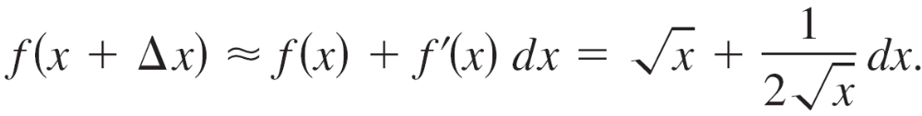

Example 7 – Approximating Function Values
Use differentials to approximate
Solution:
Using you can write
Now, choosing x = 16 and dx = 0.5, you obtain the following approximation.
So,

Slide 28


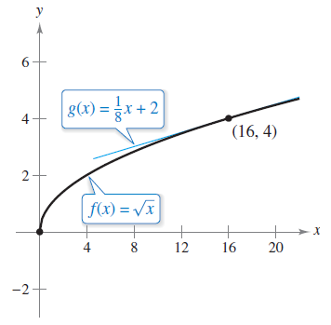
Calculating Differentials
The tangent line approximation to at x = 16 is the line
For x-values near 16, the graphs of f and g are close together, as shown in Figure 4.65.
Figure 4.65

