Slide 1


P
5
Integration
Copyright © Cengage Learning. All rights reserved.

Slide 2

Antiderivatives and Indefinite Integration
5.1
Copyright © Cengage Learning. All rights reserved.

Slide 3
Objectives
Write the general solution of a differential equation and use indefinite integral notation for antiderivatives.
Use basic integration rules to find antiderivatives.
Find a particular solution of a differential equation.

Slide 4
Antiderivatives

Slide 5

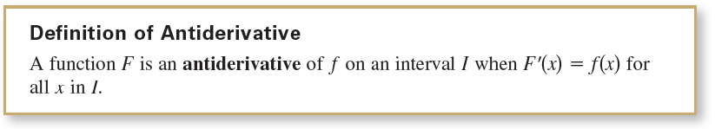
Antiderivatives
To find a function F whose derivative is f(x) = 3x², you might use your knowledge of derivatives to conclude that
The function F is an antiderivative of f.

Slide 6
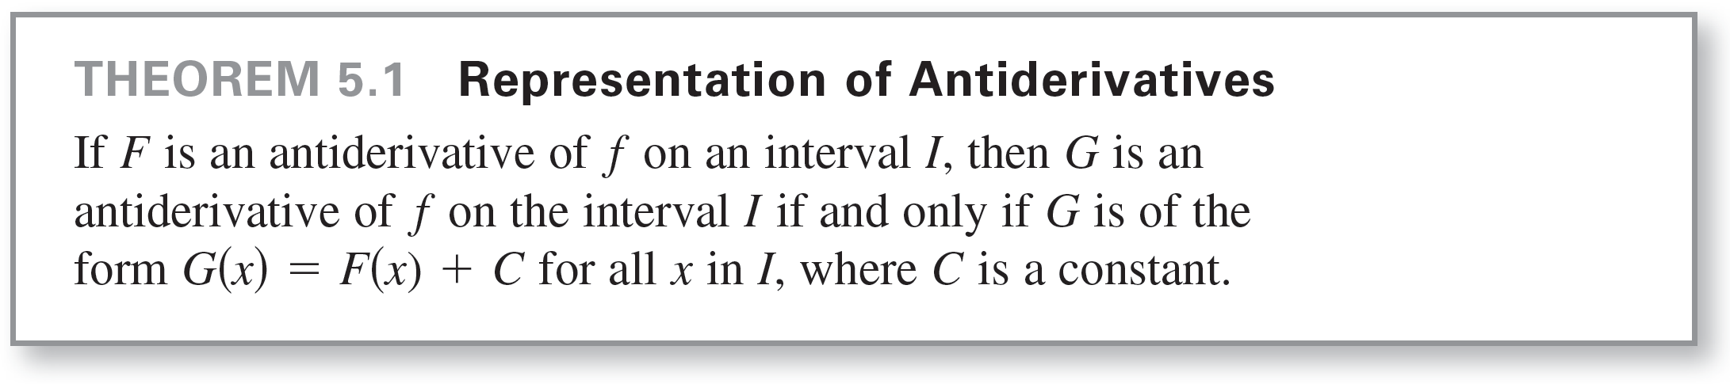
Antiderivatives
Note that F is called an antiderivative of f rather than the antiderivative of f. To see why, observe that
are all derivatives of f (x) = 3x². In fact, for any constant C, the function F(x)= x³ + C is an antiderivative of f.

Slide 7
Antiderivatives
Using Theorem 5.1, you can represent the entire family of antiderivatives of a function by adding a constant to a known antiderivative.
For example, knowing that
D_{x} [x²] = 2x
you can represent the family of all antiderivatives of f(x) = 2x by
G(x) = x² + C Family of all antiderivatives of f(x) = 2x
where C is a constant. The constant C is called the constant of integration.

Slide 8
Antiderivatives
The family of functions represented by G is the general antiderivative of f, and G(x) = x² + C is the general solution of the differential equation
G'(x) = 2x. Differential equation
A differential equation in x and y is an equation that involves x, y, and derivatives of y.
For instance, y' = 3x and y' = x² + 1 are examples of differential equations.

Slide 9
Example 1 – Solving a Differential Equation
Find the general solution of the differential equation
Solution:
To begin, you need to find a function whose derivative is 2.
One such function is
y = 2x. 2x is an antiderivative of 2.
Now, you can use Theorem 5.1 to conclude that the general solution of the differential equation is
y = 2x + C. General solution

Slide 10
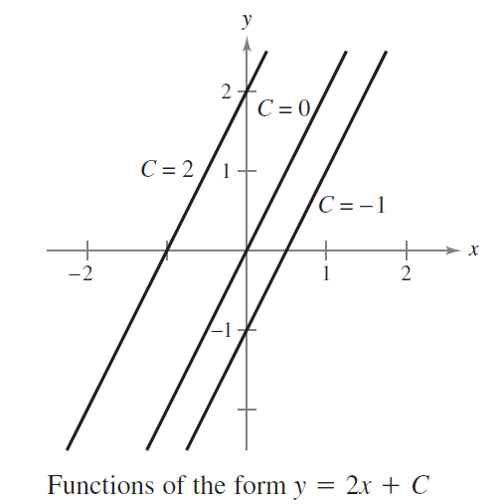
Example 1 – Solution
cont’d
The graphs of several functions of the form y = 2x + C
are shown in Figure 5.1.
Figure 5.1

Slide 11
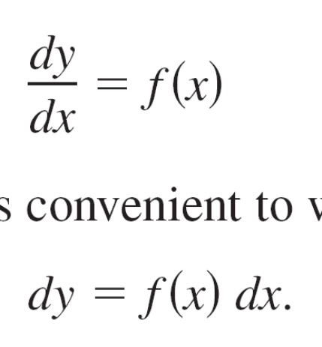
Antiderivatives
When solving a differential equation of the form
it is convenient to write it in the equivalent differential form
The operation of finding all solutions of this equation is
called antidifferentiation (or indefinite integration) and is
denoted by an integral sign ∫.

Slide 12
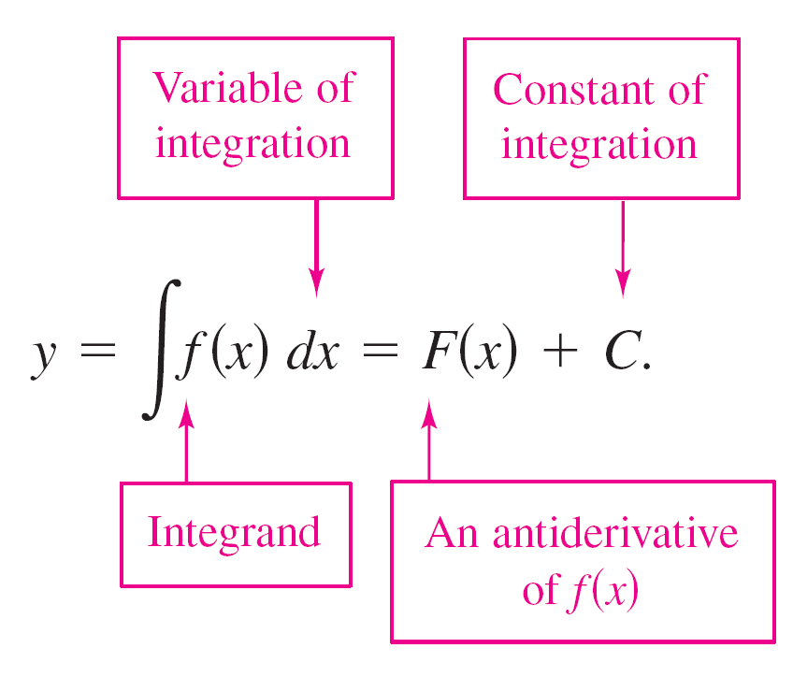
Antiderivatives
The general solution is denoted by
The expression ∫f(x)dx is read as the antiderivative of f with respect to x. So, the differential dx serves to identify x as the variable of integration. The term indefinite integral is a synonym for antiderivative.

Slide 13
Basic Integration Rules

Slide 14


Basic Integration Rules
The inverse nature of integration and differentiation can be verified by substituting F'(x) for f(x) in the indefinite integration definition to obtain
Moreover, if ∫f(x)dx = F(x) + C, then

Slide 15
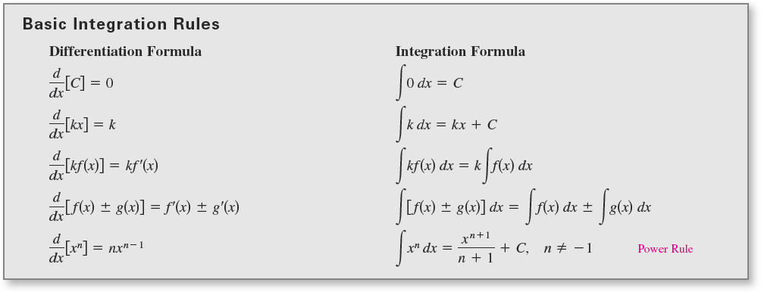
Basic Integration Rules
These two equations allow you to obtain integration formulas directly from differentiation formulas, as shown in the following summary.

Slide 16
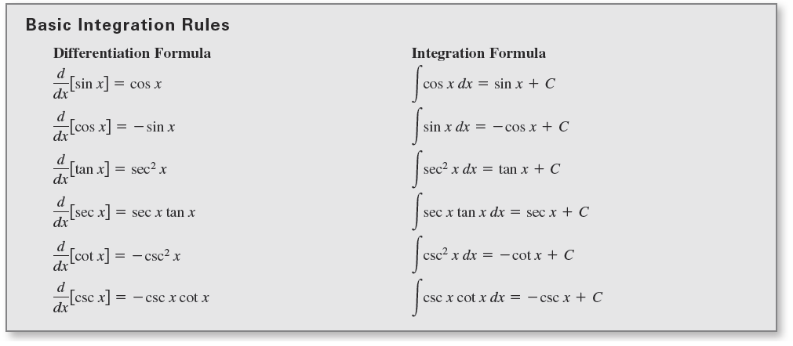
Basic Integration Rules
cont’d

Slide 17
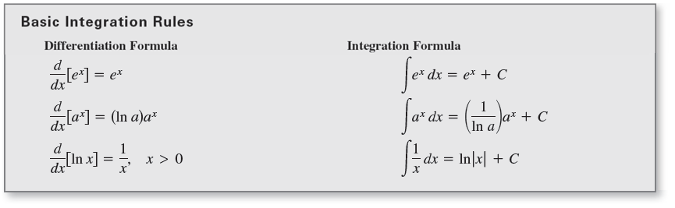
Basic Integration Rules
cont’d

Slide 18
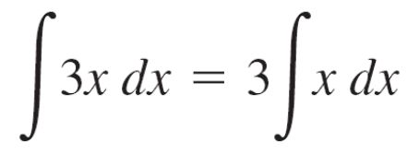

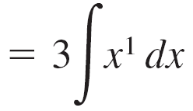

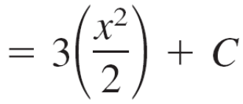

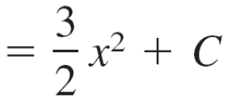

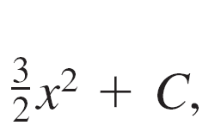
Example 2 – Describing Antiderivatives
The antiderivatives of 3x are of the form where C is any constant.

Slide 19
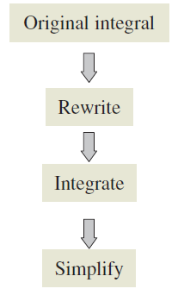
Basic Integration Rules
In Example 2, note that the general pattern of integration is similar to that of differentiation.

Slide 20
Initial Conditions and Particular Solutions

Slide 21
Initial Conditions and Particular Solutions
You have already seen that the equation y = ∫f(x)dx has
many solutions (each differing from the others by a
constant).
This means that the graphs of any two antiderivatives of f
are vertical translations of each other.

Slide 22
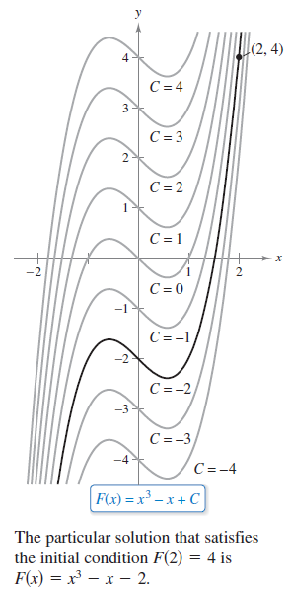
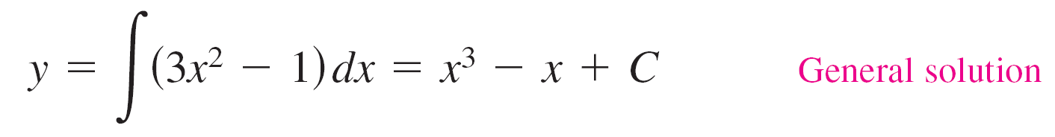
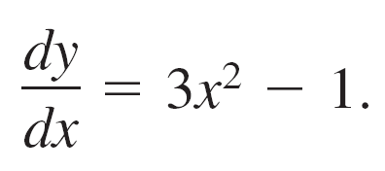
Initial Conditions and Particular Solutions
For example, Figure 5.2 shows the
graphs of several antiderivatives
of the form
for various integer values of C.
Each of these antiderivatives is a solution
of the differential equation
Figure 5.2

Slide 23
Initial Conditions and Particular Solutions
In many applications of integration, you are given enough information to determine a particular solution. To do this,
you need only know the value of y = F(x) for one value of x.
This information is called an initial condition.
For example, in Figure 5.2, only one curve passes through the point (2, 4).
To find this curve, you can use the general solution
F(x) = x³ – x + C General solution
and the initial condition
F(2) = 4. Initial condition

Slide 24
Initial Conditions and Particular Solutions
By using the initial condition in the general solution, you can determine that
F(2) = 8 – 2 + C = 4
which implies that C = –2.
So, you obtain
F(x) = x³ – x – 2. Particular solution

Slide 25
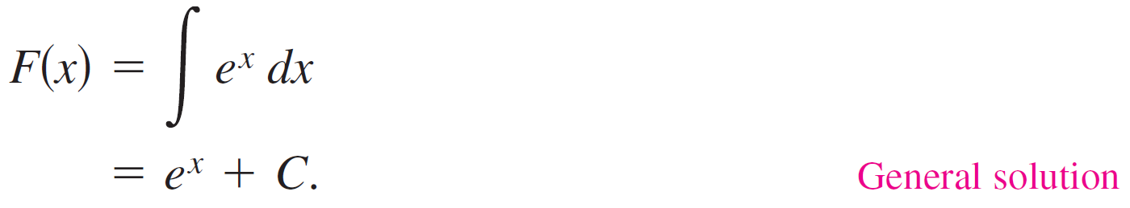
Example 8 – Finding a Particular Solution
Find the general solution of
F'(x) = e^{x} Differential equation
and find the particular solution that satisfies the initial condition
F(0) = 3. Initial condition
Solution:
To find the general solution, integrate to obtain

Slide 26
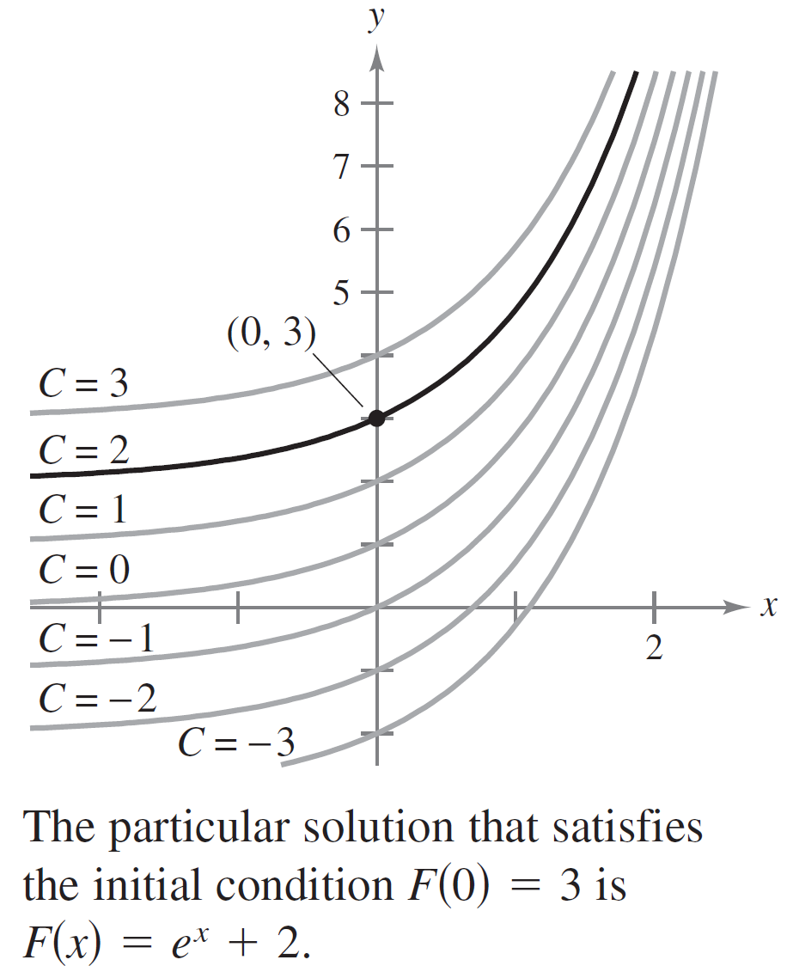
Example 8 – Solution
cont’d
Using the initial condition F(0) = 3, you can solve for C as follows.
F(0) = e⁰ + C
3 = 1 + C
2 = C
So, the particular solution is
F(x) = e^{x} + 2 Particular solution
as shown in Figure 5.3.
Note that Figure 5.3 also shows the solution curves that correspond to C = −3, −2, −1, 0, 1, and 3.
Figure 5.3

