Slide 1


P
5
Integration
Copyright © Cengage Learning. All rights reserved.

Slide 2

5.2
Area
Copyright © Cengage Learning. All rights reserved.

Slide 3
Objectives
Use sigma notation to write and evaluate a sum.
Understand the concept of area.
Approximate the area of a plane region.
Find the area of a plane region using limits.

Slide 4
Sigma Notation

Slide 5

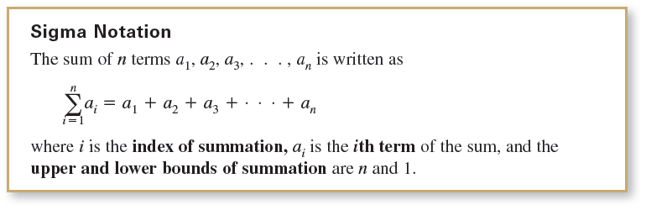
Sigma Notation
This section begins by introducing a concise notation for sums. This notation is called sigma notation because it uses the uppercase Greek letter sigma, written as

Slide 6




Example 1 – Examples of Sigma Notation

Slide 7

Example 1 – Examples of Sigma Notation
cont’d
From parts (a) and (b), notice that the same sum can be represented in different ways using sigma notation.

Slide 8
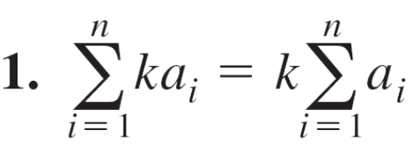
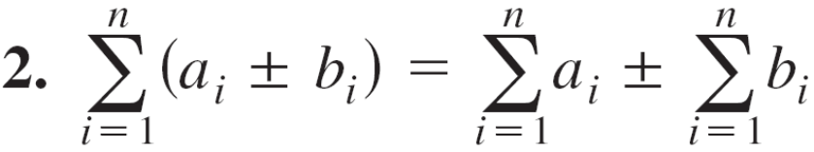
Sigma Notation
The properties of summation shown below can be derived using the Associative and Commutative Properties of Addition and the Distributive Property of Addition over Multiplication. (In the first property, k is a constant.)

Slide 9
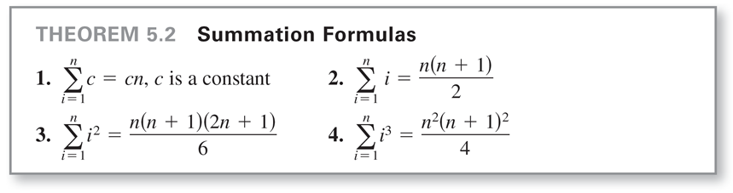
Sigma Notation
The next theorem lists some useful formulas for sums of powers.

Slide 10
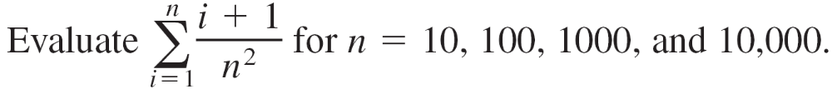
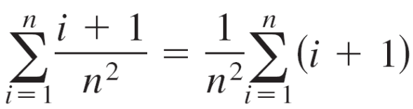
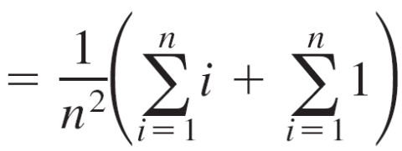

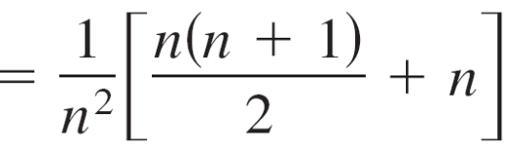

Example 2 – Evaluating a Sum
Solution:

Slide 11
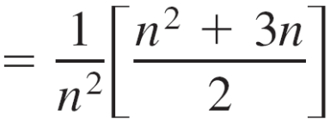

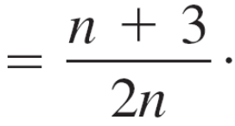
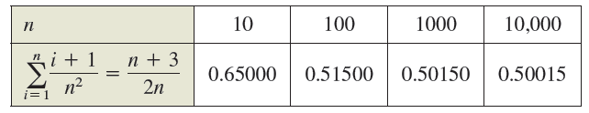
Example 2 – Solution
cont’d
Now you can evaluate the sum by substituting the appropriate values of n, as shown in the table below.

Slide 12
Area

Slide 13
Area
In Euclidean geometry, the simplest type of plane region is a rectangle.
Although people often say that the formula for the area of a rectangle is A = bh it is actually more proper to say that this is the definition of the area of a rectangle.
From this definition, you can develop formulas for the areas of many other plane regions.

Slide 14
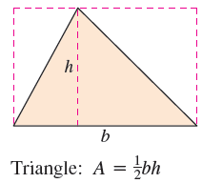
Area
For example, to determine the area of a triangle, you can form a rectangle whose area is twice that of the triangle, as shown in Figure 5.5.
Figure 5.5

Slide 15
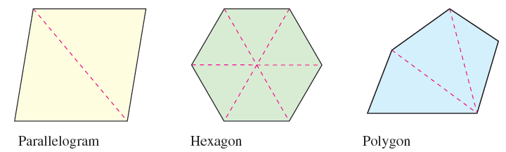
Area
Once you know how to find the area of a triangle, you can determine the area of any polygon by subdividing the polygon into triangular regions, as shown in Figure 5.6.
Figure 5.6

Slide 16
Area
Finding the areas of regions other than polygons is more difficult. The ancient Greeks were able to determine formulas for the areas of some general regions (principally those bounded by conics) by the exhaustion method.
The clearest description of this method was given by Archimedes. Essentially, the method is a limiting process in which the area is squeezed between two polygons—one inscribed in the region and one circumscribed about the region.

Slide 17
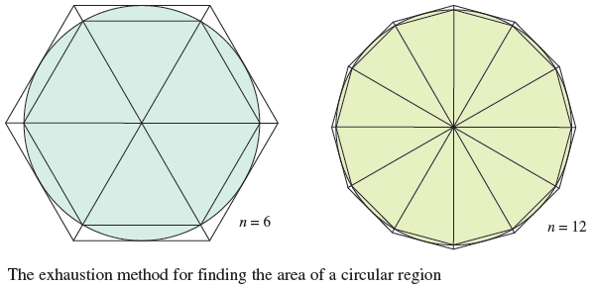
Area
For instance, in Figure 5.7, the area of a circular region is approximated by an n-sided inscribed polygon and an n-sided circumscribed polygon.
Figure 5.7

Slide 18
Area
For each value of n, the area of the inscribed polygon is less than the area of the circle, and the area of the circumscribed polygon is greater than the area of the circle.
Moreover, as n increases, the areas of both polygons become better and better approximations of the area of the circle.

Slide 19
The Area of a Plane Region

Slide 20
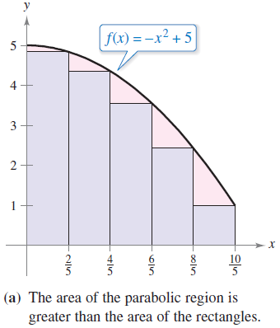
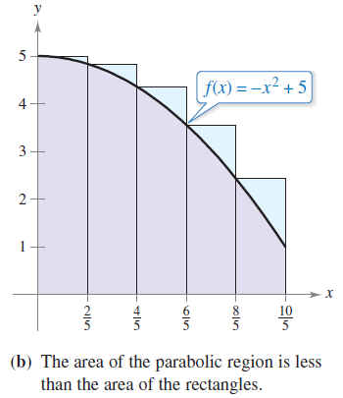
Example 3 – Approximating the Area of a Plane Region
Use the five rectangles in Figures 5.8(a) and (b) to find two approximations of the area of the region lying between the graph of f(x) = –x² + 5 and the x-axis between x = 0 and x = 2.
Figure 5.8

Slide 21


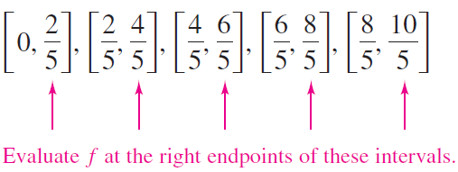
Example 3(a) – Solution
The right endpoints of the five intervals are
where i = 1, 2, 3, 4, 5.
The width of each rectangle is , and the height of each
rectangle can be obtained by evaluating f at the right endpoint of each interval.

Slide 22
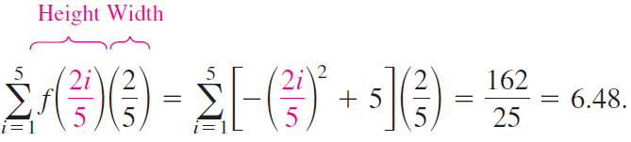
Example 3(a) – Solution
cont’d
The sum of the areas of the five rectangles is
Because each of the five rectangles lies inside the parabolic region, you can conclude that the area of the parabolic region is greater than 6.48.

Slide 23

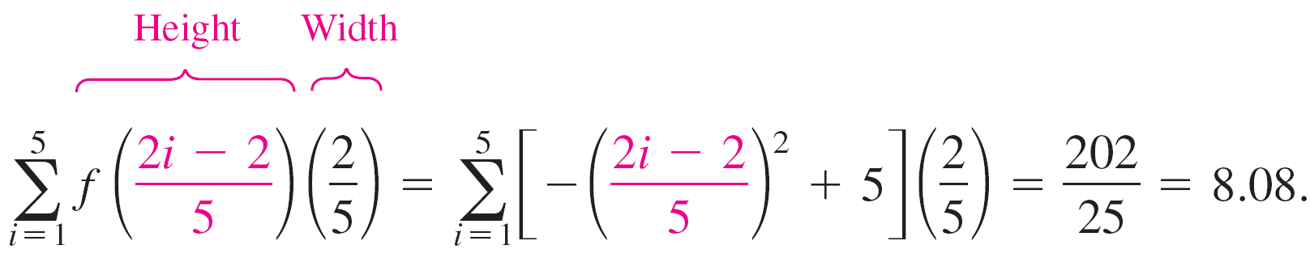
Example 3(b) – Solution
cont’d
The left endpoints of the five intervals are
where i = 1, 2, 3, 4, 5.
The width of each rectangle is , and the height of each
rectangle can be obtained by evaluating f at the left
endpoint of each interval. So, the sum is

Slide 24
Example 3(b) – Solution
cont’d
Because the parabolic region lies within the union of the five rectangular regions, you can conclude that the area of the parabolic region is less than 8.08.
By combining the results in parts (a) and (b), you can conclude that
6.48 < (Area of region) < 8.08.

Slide 25
Finding Area by the Limit Definition

Slide 26
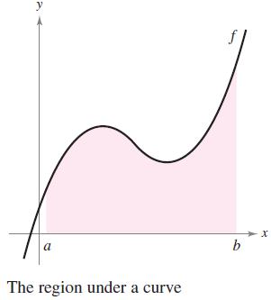
Finding Area by the Limit Definition
Consider a plane region bounded above by the graph of a nonnegative, continuous function y = f (x) as shown in Figure 5.9.
The region is bounded below by the x-axis, and the left and right boundaries of the region are the vertical lines x = a and x = b.
Figure 5.9

Slide 27

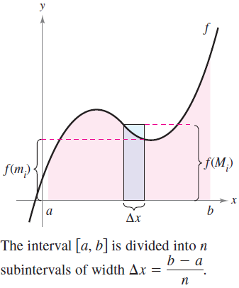
Finding Area by the Limit Definition
To approximate the area of the region, begin by subdividing the interval [a, b] into n subintervals, each of width
as shown in Figure 5.10.
Figure 5.10

Slide 28

Finding Area by the Limit Definition
The endpoints of the intervals are
Because f is continuous, the Extreme Value Theorem
guarantees the existence of a minimum and a maximum
value of f (x) in each subinterval.
f (m_{i}) = Minimum value of f (x) in ith subinterval
f (M_{i}) = Maximum value of f (x) in ith subinterval

Slide 29
Finding Area by the Limit Definition
Next, define an inscribed rectangle lying inside the ith subregion and a circumscribed rectangle extending outside the ith subregion. The height of the ith inscribed rectangle is f(m_{i}) and the height of the ith circumscribed rectangle is f(M_{i}).
For each i, the area of the inscribed rectangle is less than or equal to the area of the circumscribed rectangle.

Slide 30
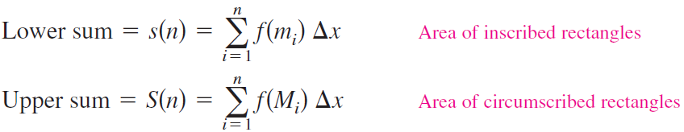
Finding Area by the Limit Definition
The sum of the areas of the inscribed rectangles is called a lower sum, and the sum of the areas of the circumscribed rectangles is called an upper sum.

Slide 31

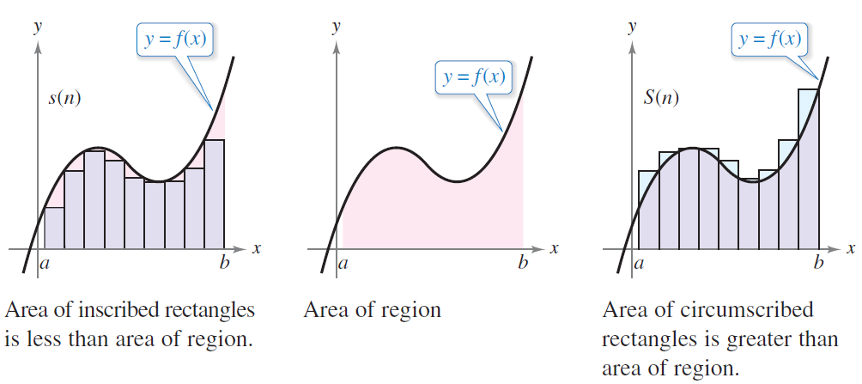
Finding Area by the Limit Definition
From Figure 5.11, you can see that the lower sum s(n) is less than or equal to the upper sum S(n). Moreover, the actual area of the region lies between these two sums.
Figure 5.11

Slide 32

Example 4 – Finding Upper and Lower Sums for a Region
Find the upper and lower sums for the region bounded by the graph of f(x) = x² and the x-axis between x = 0 and x = 2.
Solution:
To begin, partition the interval [0, 2] into n subintervals, each of width

Slide 33
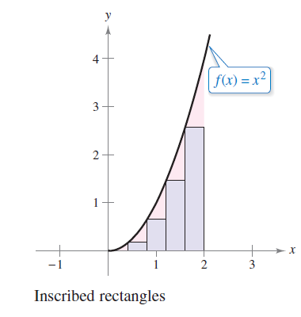
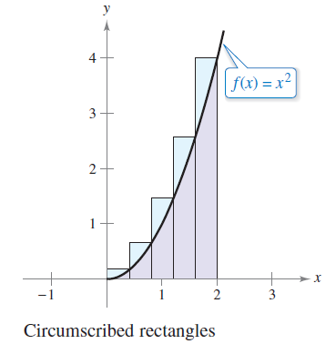
Example 4 – Solution
cont’d
Figure 5.12 shows the endpoints of the subintervals and several inscribed and circumscribed rectangles.
Figure 5.12

Slide 34
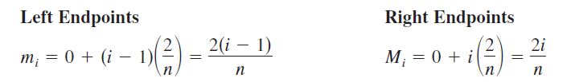
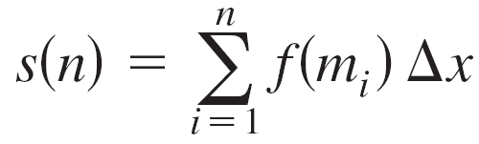
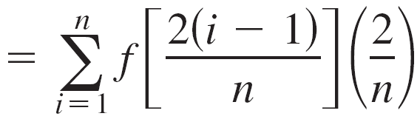
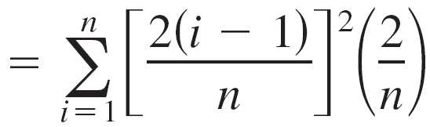
Example 4 – Solution
cont’d
Because f is increasing on the interval [0, 2], the minimum value on each subinterval occurs at the left endpoint, and the maximum value occurs at the right endpoint.
Using the left endpoints, the lower sum is

Slide 35
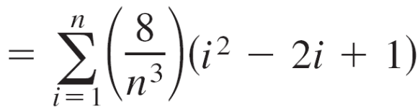
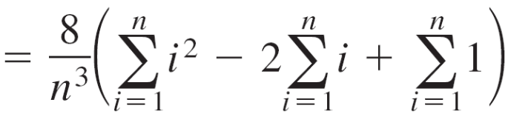
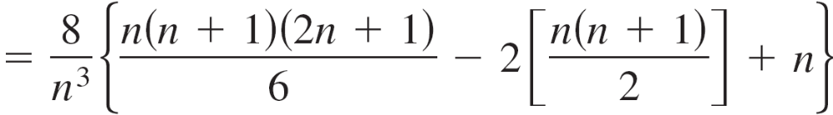
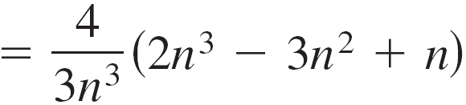
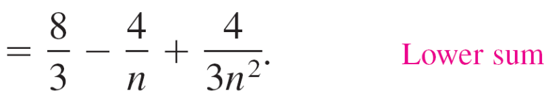
Example 4 – Solution
cont’d

Slide 36
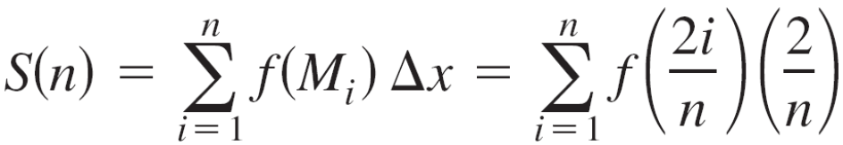
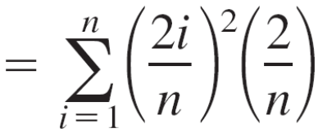
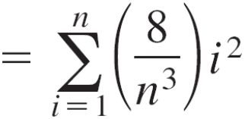
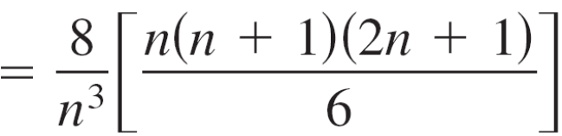
Example 4 – Solution
cont’d
Using the right endpoints, the upper sum is

Slide 37
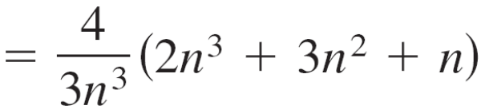
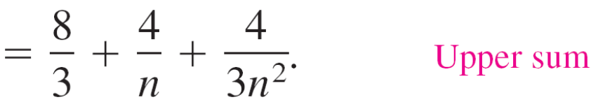
Example 4 – Solution
cont’d

Slide 38
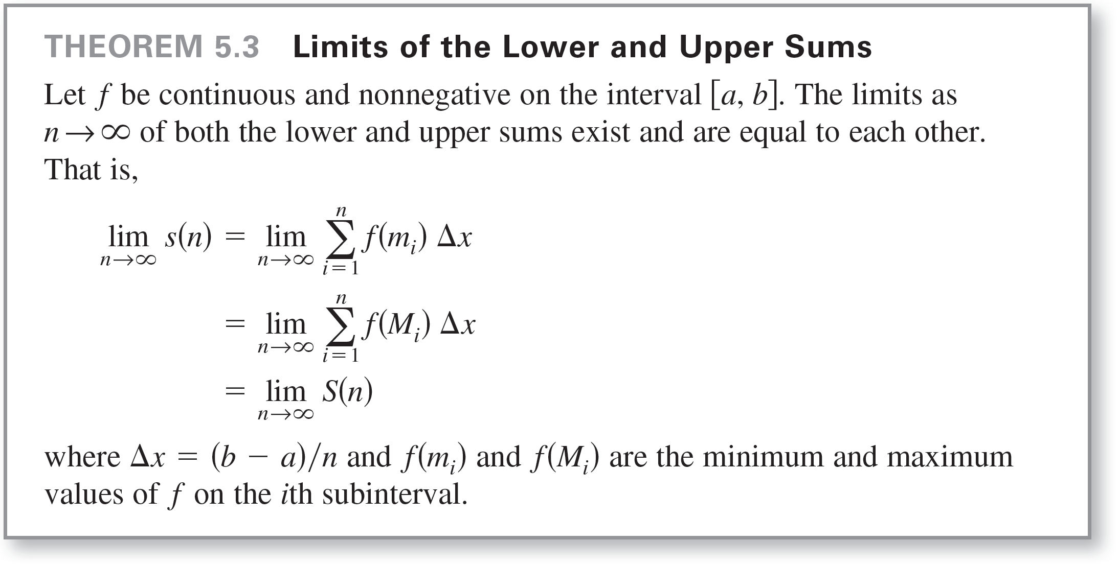
Finding Area by the Limit Definition
The next theorem shows that the equivalence of the limits
(as n → ) of the upper and lower sums is not mere coincidence. It is true for all functions that are continuous
and nonnegative on the closed interval [a, b].

Slide 39
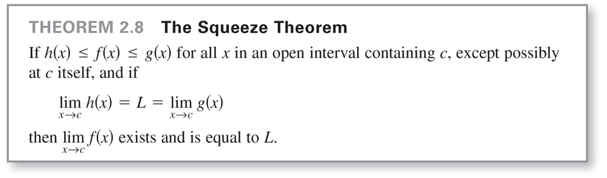
Finding Area by the Limit Definition
In Theorem 5.3, the same limit is attained for both the minimum value f(m_{i}) and the maximum value f(M_{i}).
So, it follows from the Squeeze Theorem (Theorem 2.8) that the choice of x in the ith subinterval does not affect
the limit.

Slide 40
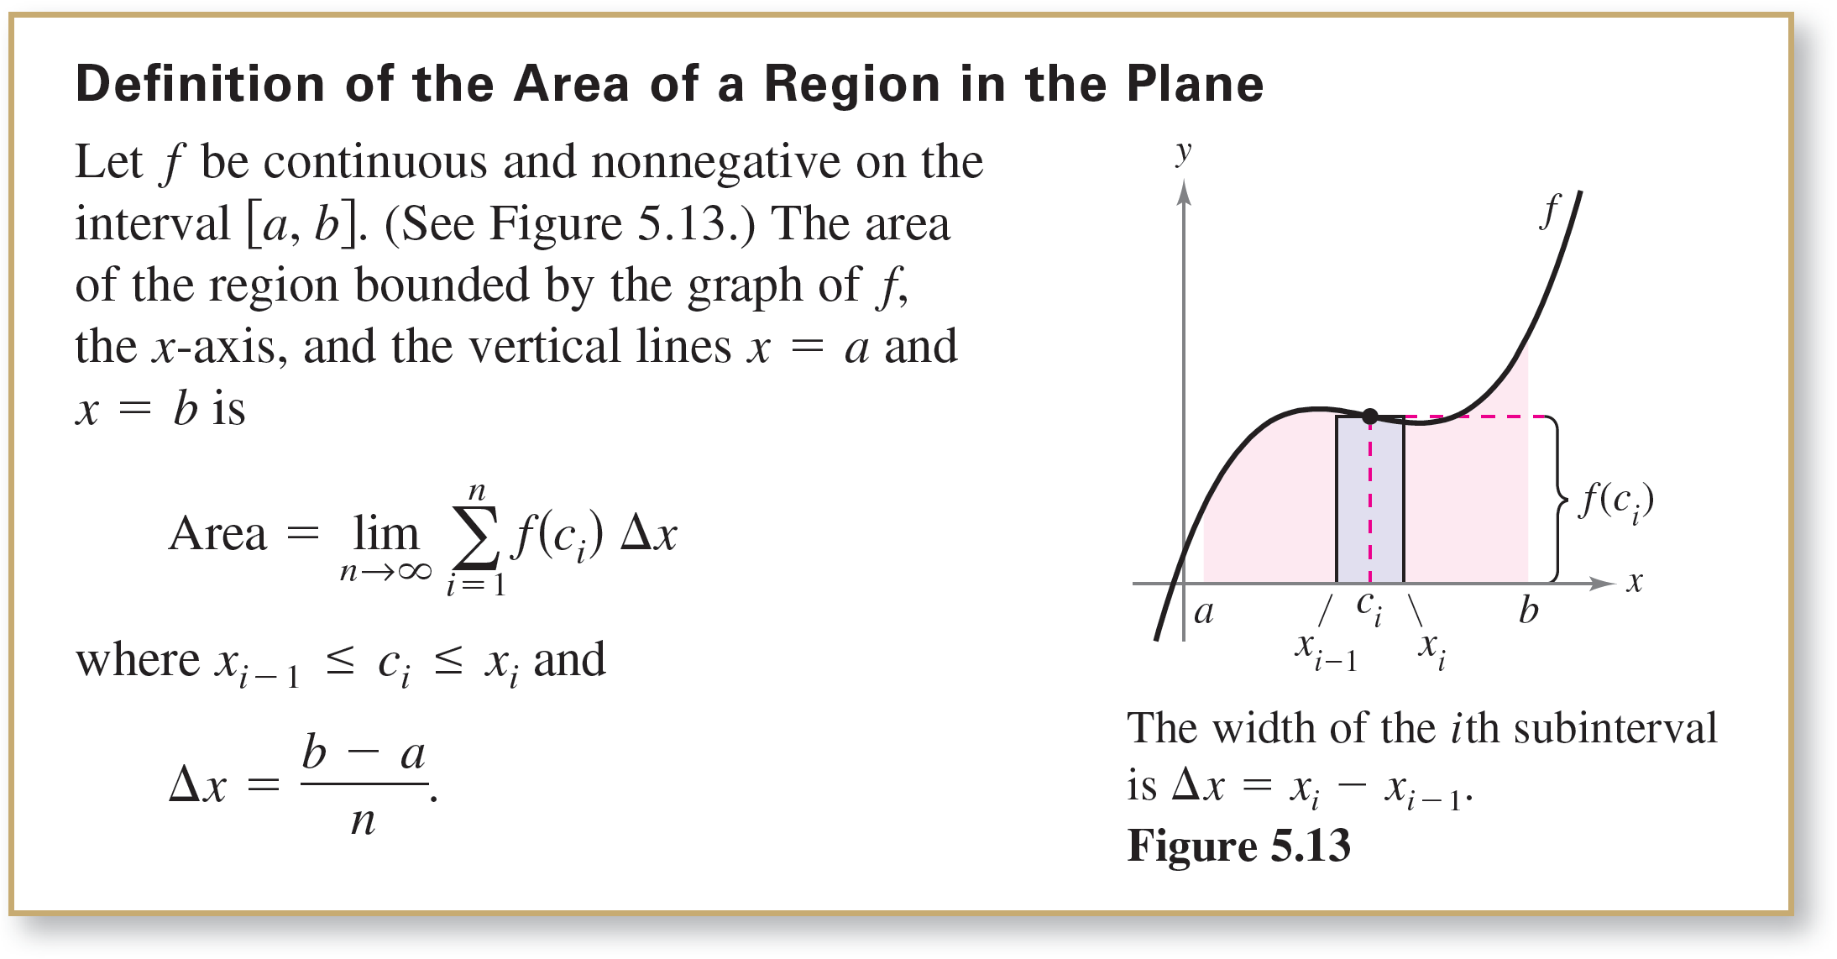
Finding Area by the Limit Definition
This means that you are free to choose an arbitrary x-value in the ith subinterval, as shown in the definition of the area of a region in the plane.

Slide 41
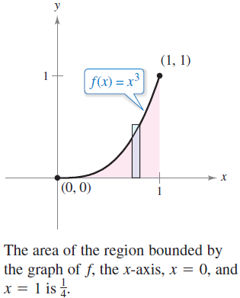
Example 5 – Finding Area by the Limit Definition
Find the area of the region bounded by the graph of
f(x) = x³, the x-axis, and the vertical lines x = 0 and x = 1,
as shown in Figure 5.14.
Figure 5.14

Slide 42
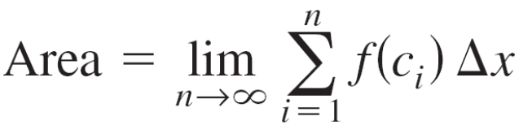
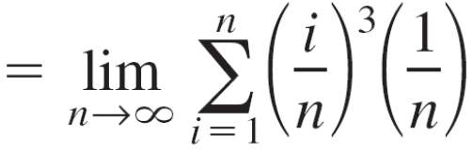
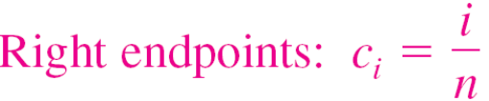
Example 5 – Solution
Begin by noting that f is continuous and nonnegative on
the interval [0, 1]. Next, partition the interval [0, 1] into
n subintervals, each of width Δx = 1/n.
According to the definition of area, you can choose any x-value in the ith subinterval.
For this example, the right endpoints c_{i} = i/n are convenient.

Slide 43

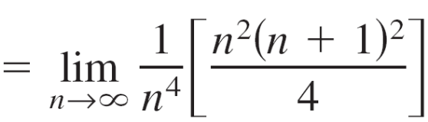
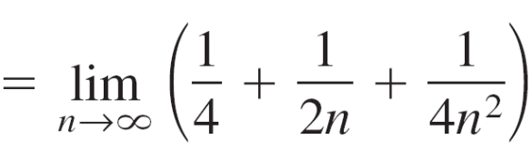
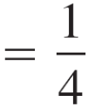
Example 5 – Solution
cont’d
The area of the region is .

Slide 44

Finding Area by the Limit Definition
In general, a good value to choose is the midpoint of the interval, c_{i} = (x_{i – 1} + x_{i}) / 2, and apply the Midpoint Rule.

