Slide 1


P
5
Integration
Copyright © Cengage Learning. All rights reserved.

Slide 2

Riemann Sums and Definite Integrals
5.3
Copyright © Cengage Learning. All rights reserved.

Slide 3
Objectives
Understand the definition of a Riemann sum.
Evaluate a definite integral using limits and geometric formulas.
Evaluate a definite integral using properties of definite integrals.

Slide 4
Riemann Sums

Slide 5

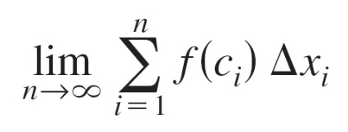
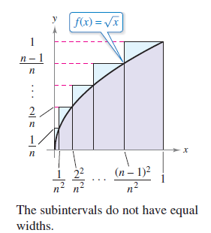
Example 1 – A Partition with Subintervals of Unequal Widths
Consider the region bounded by the graph of and the x-axis for 0 ≤ x ≤ 1, as shown in Figure 5.18. Evaluate the limit
where c_{i} is the right endpoint
of the partition given by
c_{i} = i ²/n² and Δx_{i} is the width
of the i th interval.
Figure 5.18

Slide 6
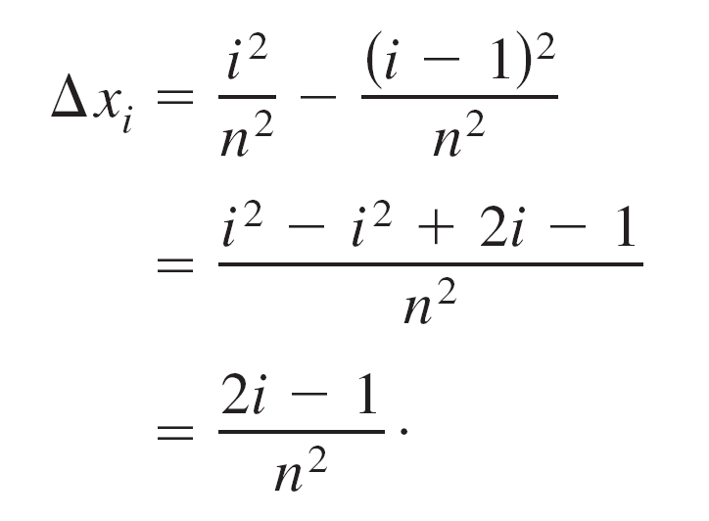
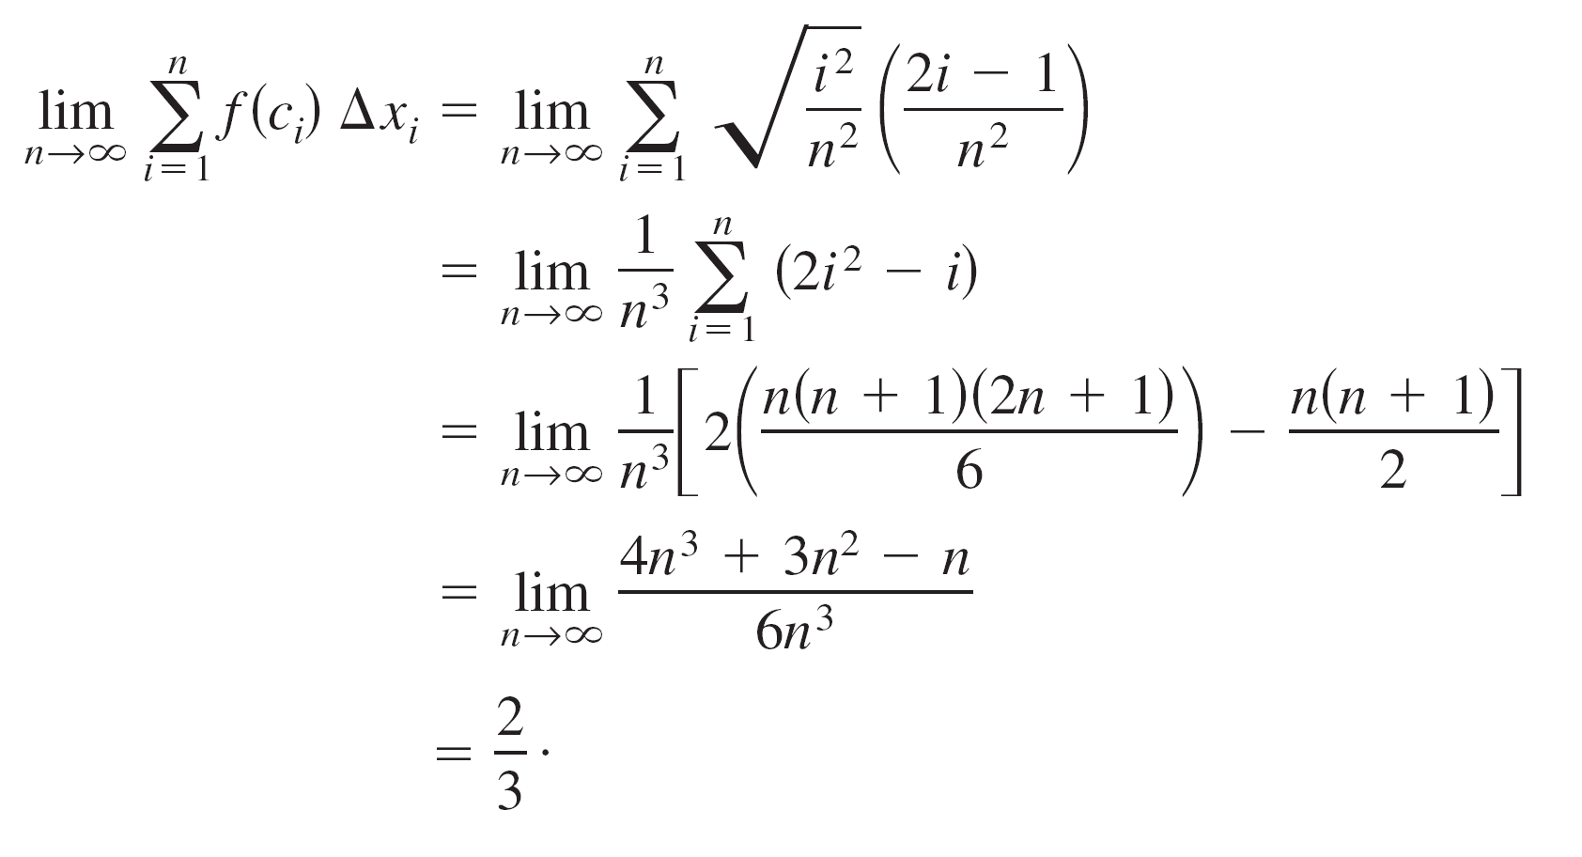
Example 1 – Solution
The width of the i th interval is
So, the limit is

Slide 7

Example 1 – Solution
cont’d

Slide 8

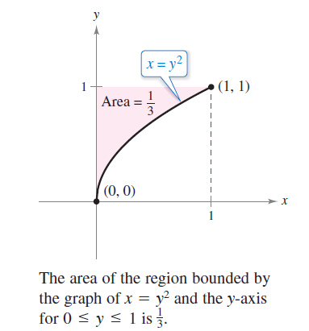
Riemann Sums
We know that the region shown in Figure 5.19 has an area of .
Figure 5.19

Slide 9

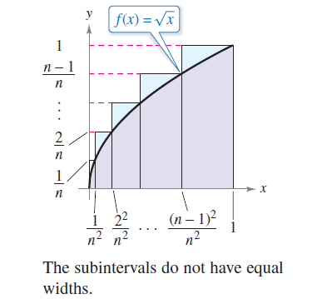
Riemann Sums
Because the square bounded by 0 ≤ x ≤ 1 and 0 ≤ y ≤ 1
has an area of 1, you can conclude that the area of the
region shown in Figure 5.18 has an area of .
Figure 5.18

Slide 10
Riemann Sums
This agrees with the limit found in Example 1, even though that example used a partition having subintervals of unequal widths.
The reason this particular partition gave the proper area is that as n increases, the width of the largest subinterval approaches zero.
This is a key feature of the development of definite integrals.

Slide 11
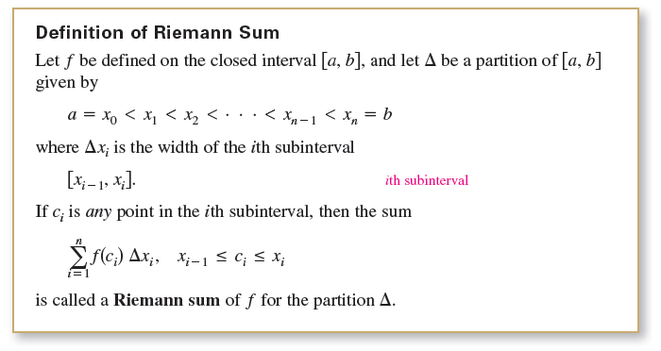
Riemann Sums
In the definition of a Riemann sum below, note that the function f has no restrictions other than being defined on the interval [a, b].

Slide 12


Riemann Sums
The width of the largest subinterval of a partition Δ is the norm of the partition and is denoted by ||Δ||. If every subinterval is of equal width, then the partition is regular and the norm is denoted by
For a general partition, the norm is related to the number of subintervals of [a, b] in the following way.

Slide 13

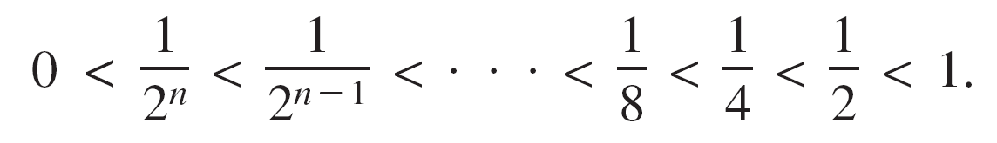
Riemann Sums
So, the number of subintervals in a partition approaches infinity as the norm of the partition approaches 0.
That is, ||Δ||→ 0 implies that
The converse of this statement is not true. For example, let Δ_{n} be the partition of the interval [0, 1] given by

Slide 14


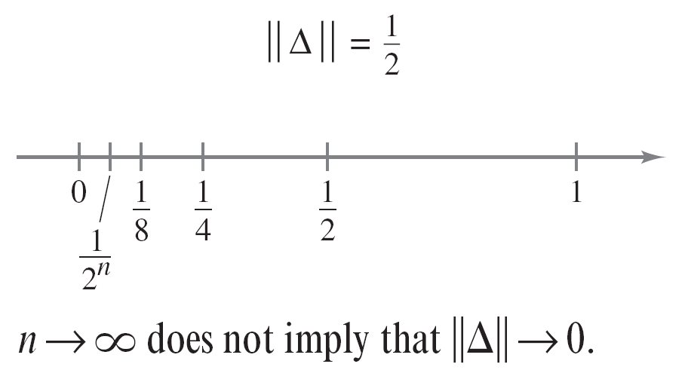
Riemann Sums
As shown in Figure 5.20, for any positive value of n, the norm of the partition Δ_{n} is
So, letting n approach infinity does not force ||Δ|| to approach 0. In a regular partition, however, the statements ||Δ||→ 0 and are equivalent.
Figure 5.20

Slide 15
Definite Integrals

Slide 16

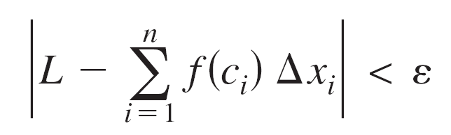
Definite Integrals
To define the definite integral, consider the limit
To say that this limit exists means there exists a real number L such that for each ε > 0, there exists a δ > 0 such that for every partition with ||Δ|| < δ, it follows that
regardless of the choice of c_{i} in the i th subinterval of each partition Δ.

Slide 17
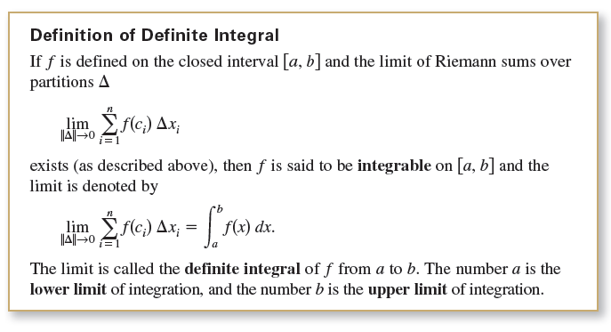
Definite Integrals

Slide 18
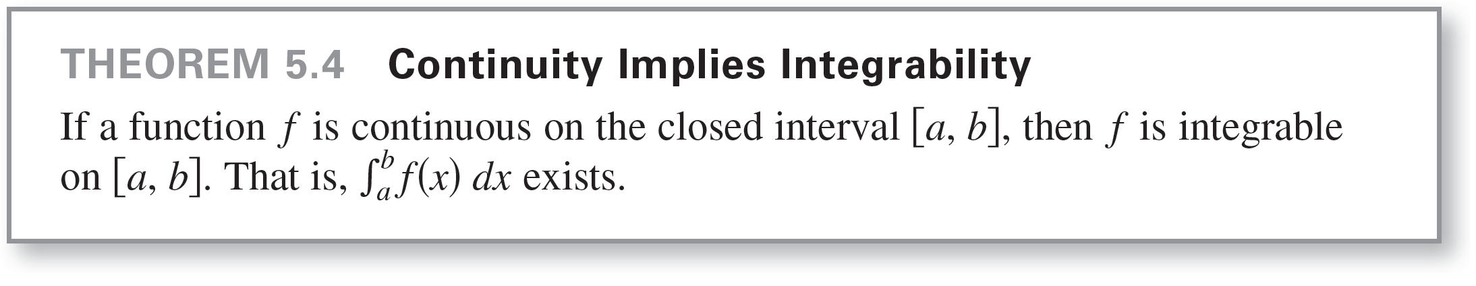
Definite Integrals
Though Riemann sums were defined for functions with very few restrictions, a sufficient condition for a function f to be integrable on [a, b] is that it is continuous on [a, b].

Slide 19
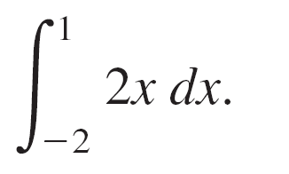
Example 2 – Evaluating a Definite Integral as a Limit
Evaluate the definite integral
Solution:
The function f(x) = 2x is integrable on the interval [–2, 1] because it is continuous on [–2, 1].
Moreover, the definition of integrability implies that any partition whose norm approaches 0 can be used to determine the limit.

Slide 20
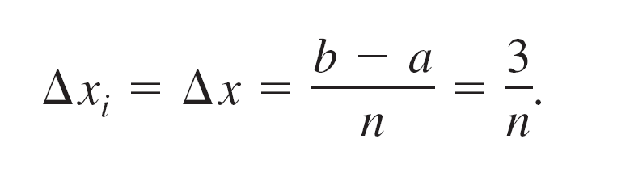
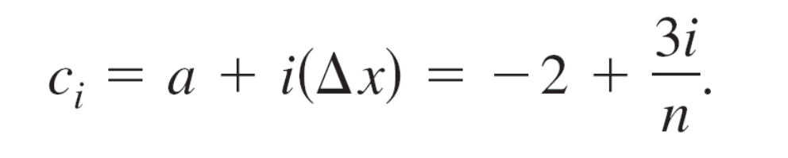
Example 2 – Solution
cont’d
For computational convenience, define Δ by subdividing [–2, 1] into n subintervals of equal width
Choosing c_{i} as the right endpoint of each subinterval produces

Slide 21




Example 2 – Solution
cont’d
So, the definite integral is

Slide 22




Example 2 – Solution
cont’d

Slide 23
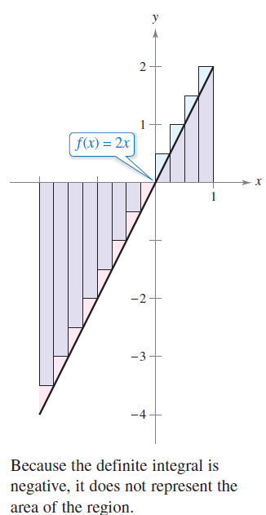
Definite Integrals
Because the definite integral in Example 2 is negative, it does not represent the area of the region shown in
Figure 5.21.
Definite integrals can be
positive, negative, or zero.
For a definite integral to be
interpreted as an area, the
function f must be continuous
and nonnegative on [a, b],
as stated in the next theorem.
Figure 5.21

Slide 24
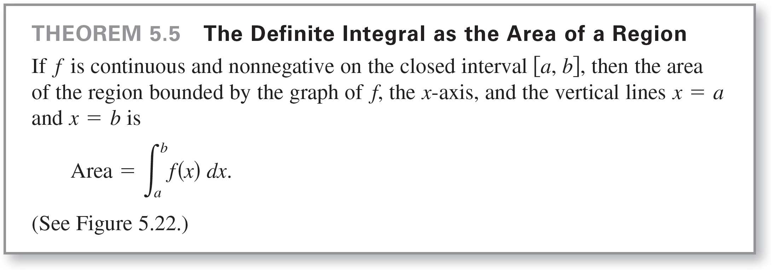
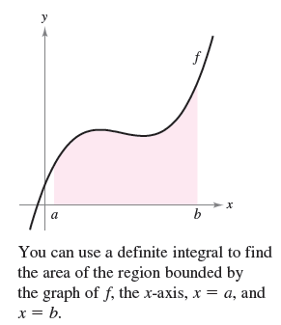
Definite Integrals
Figure 5.22

Slide 25
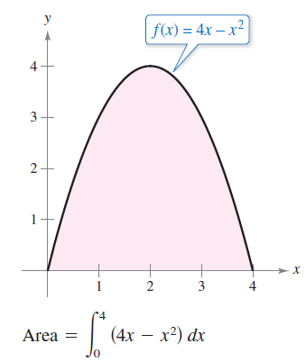
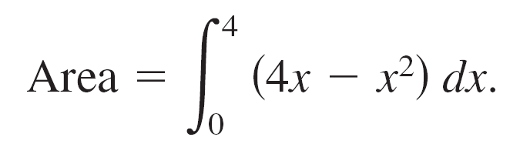
Definite Integrals
As an example of Theorem 5.5, consider the region
bounded by the graph of f(x) = 4x – x² and the x-axis, as
shown in Figure 5.23.
Because f is continuous and
nonnegative on the closed
interval [0, 4], the area of the
region is
Figure 5.23

Slide 26
Definite Integrals
You can evaluate a definite integral in two ways—you can use the limit definition or you can check to see whether the definite integral represents the area of a common geometric region, such as a rectangle, triangle, or semicircle.

Slide 27
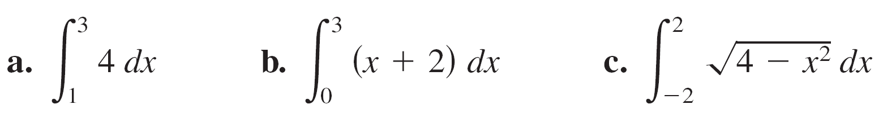
Example 3 – Areas of Common Geometric Figures
Sketch the region corresponding to each definite integral. Then evaluate each integral using a geometric formula.
a.
b.
c.

Slide 28
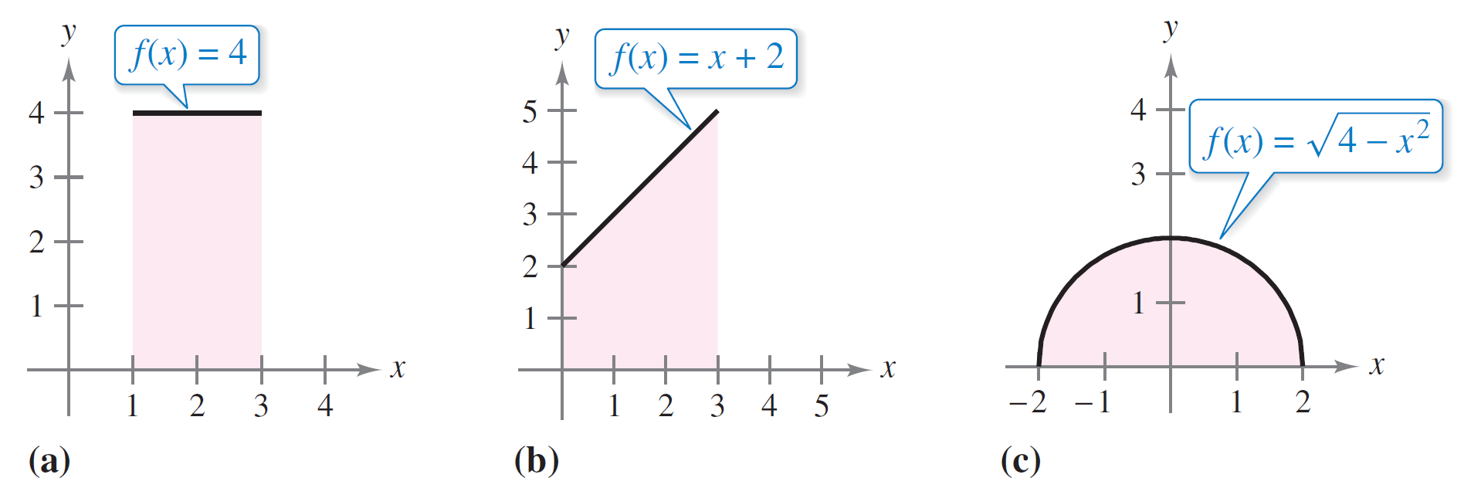
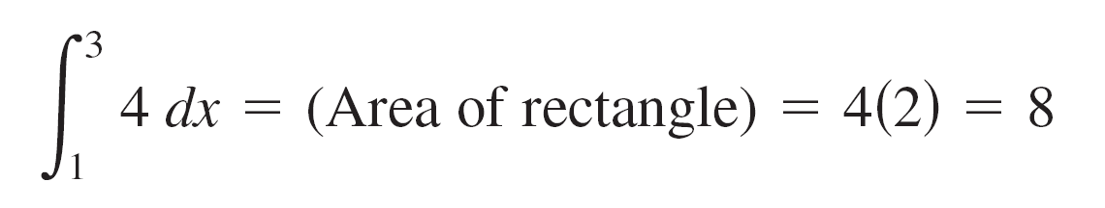
Example 3 – Solution
A sketch of each region is shown in Figure 5.24.
a. This region is a rectangle of height 4 and width 2.
Figure 5.24

Slide 29
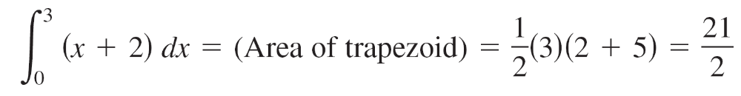

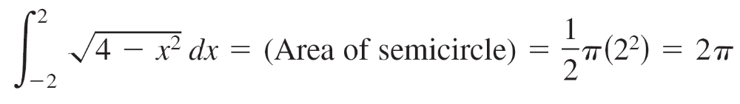
Example 3 – Solution
cont’d
b. This region is a trapezoid with an altitude of 3 and
parallel bases of lengths 2 and 5.
The formula for the area of a trapezoid is h(b₁ + b₂).
c. This region is a semicircle of radius 2. The formula for
the area of a semicircle is

Slide 30

Definite Integrals
The variable of integration in a definite integral is sometimes called a dummy variable because it can be replaced by any other variable without changing the value of the integral.
For instance, the definite integrals
have the same value.

Slide 31
Properties of Definite Integrals

Slide 32
Properties of Definite Integrals
The definition of the definite integral of f on the interval [a, b] specifies that a < b.
Now, however, it is convenient to extend the definition to cover cases in which a = b or a > b.
Geometrically, the next two definitions seem reasonable.
For instance, it makes sense to define the area of a region of zero width and finite height to be 0.

Slide 33
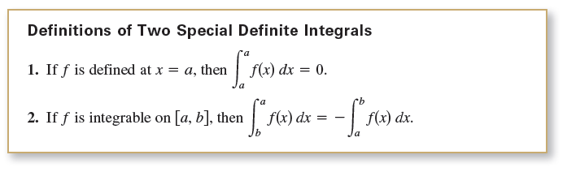
Properties of Definite Integrals

Slide 34

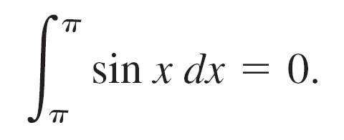
Example 4 – Evaluating Definite Integrals
Evaluate each definite integral.
Solution:
a. Because the sine function is defined at x = π, and the
upper and lower limits of integration are equal, you can
write

Slide 35




Example 4 – Solution
cont’d
b. The integral is the same as that given in Example 3(b) except that the upper and lower limits are interchanged.
Because the integral in Example 3(b) has a value of you can write

Slide 36
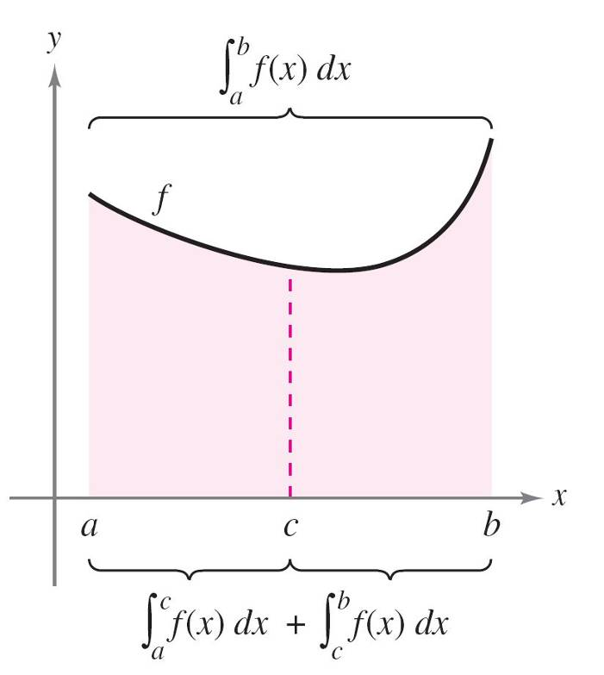
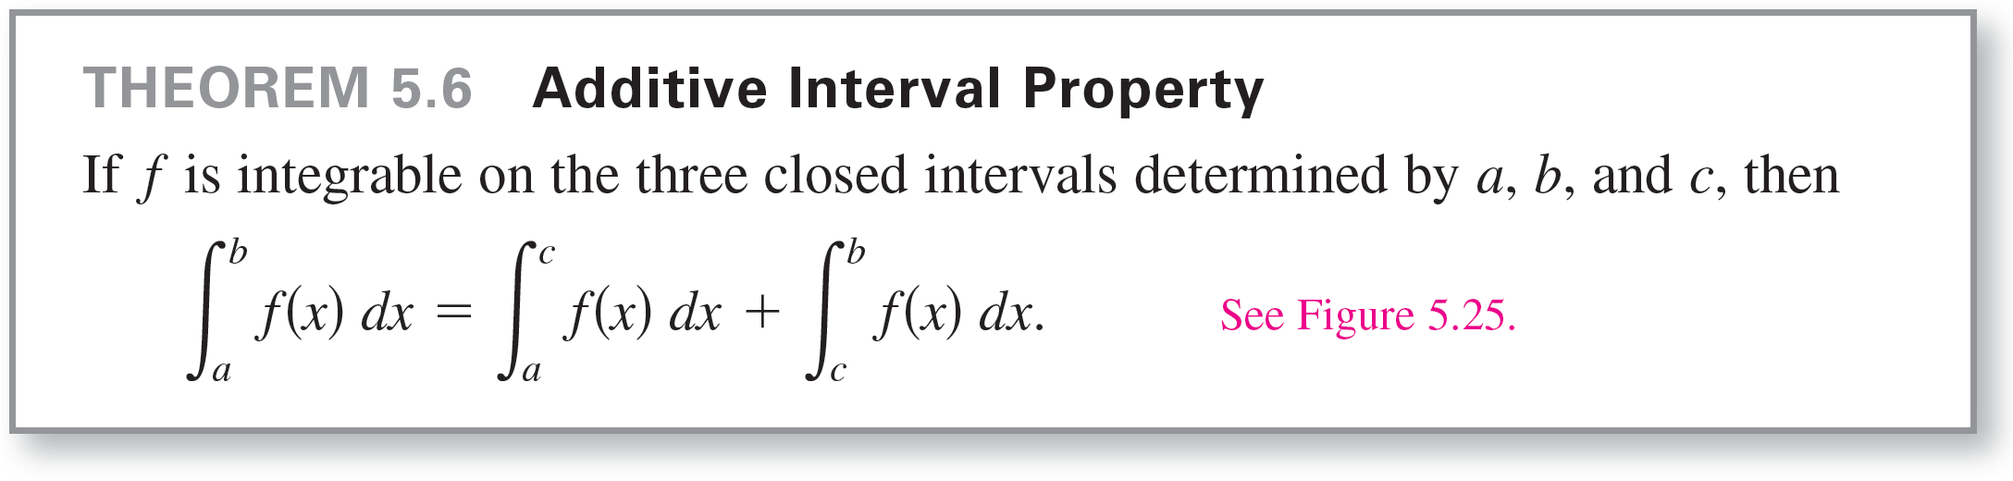
Properties of Definite Integrals
In Figure 5.25, the larger region
can be divided at x = c into two
subregions whose intersection
is a line segment.
Because the line segment has
zero area, it follows that the
area of the larger region is equal
to the sum of the areas of the
two smaller regions.
Figure 5.25

Slide 37
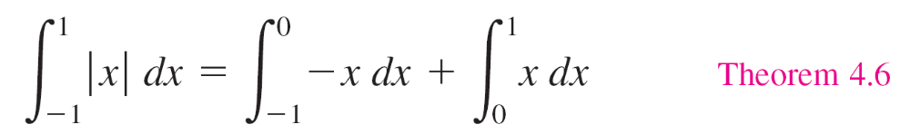
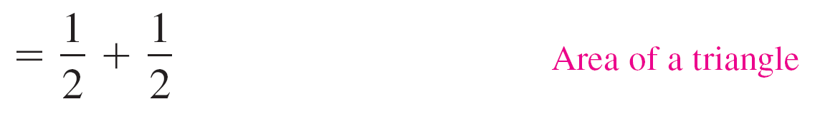

Example 5 – Using the Additive Interval Property

Slide 38
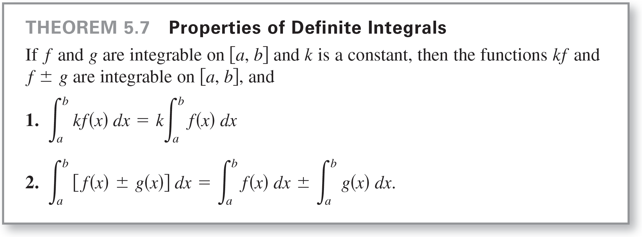
Properties of Definite Integrals
Note that Property 2 of Theorem 5.7 can be extended to cover any finite number of functions.

Slide 39
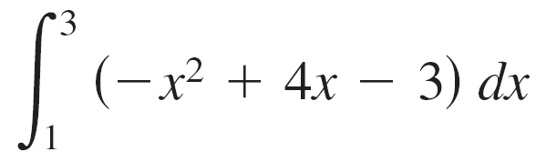
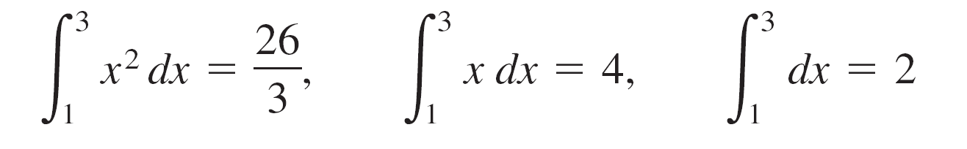
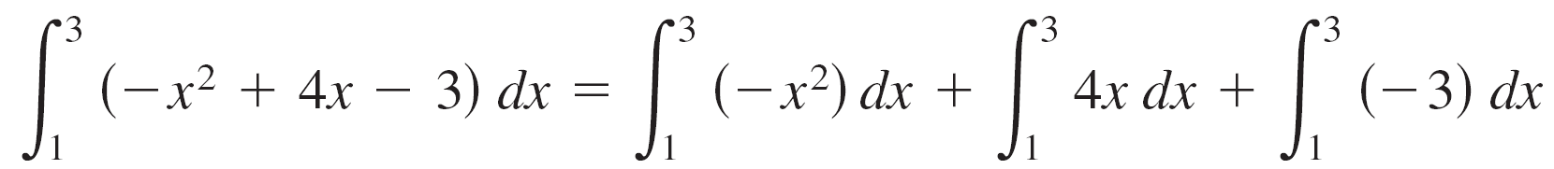
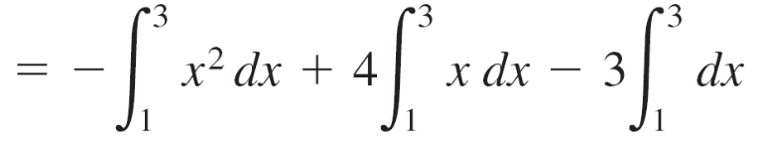
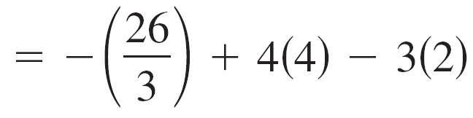
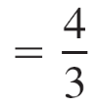
Example 6 – Evaluation of a Definite Integral
Evaluate using each of the following values.
Solution:

Slide 40
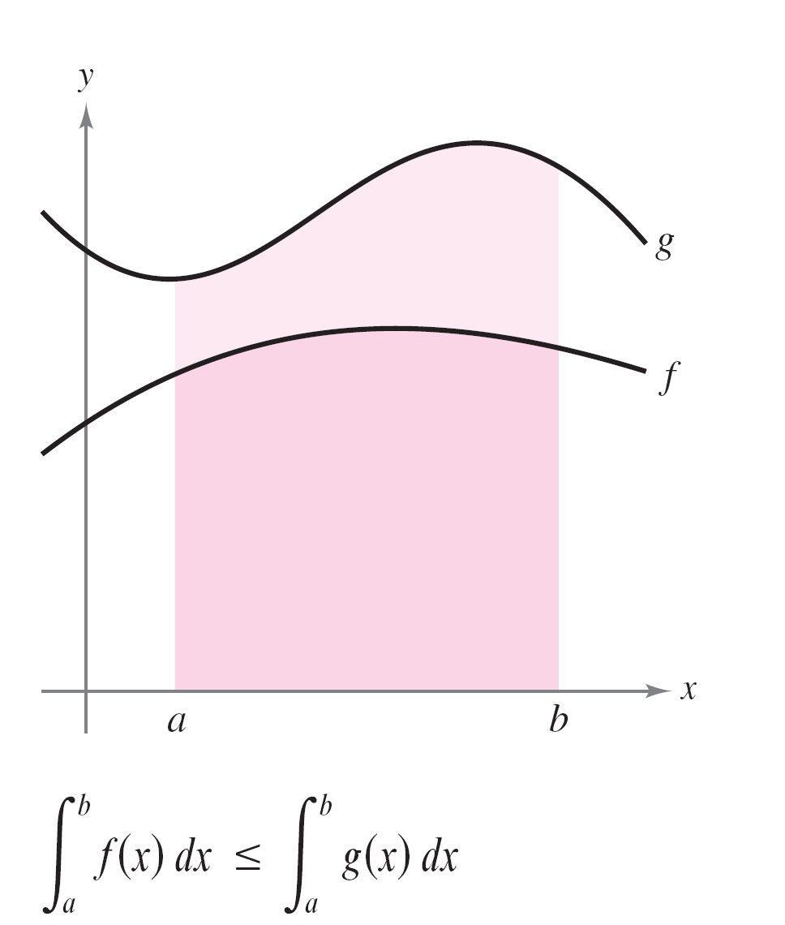
Properties of Definite Integrals
If f and g are continuous on the closed interval [a, b] and
0 ≤ f(x) ≤ g(x) for a ≤ x ≤ b, then the following properties are true.
First, the area of the region
bounded by the graph of f and
the x-axis (between a and b)
must be nonnegative.
Second, this area must be less
than or equal to the area of the
region bounded by the graph of
g and the x-axis (between a and b),
as shown in Figure 5.26.
Figure 5.26

Slide 41
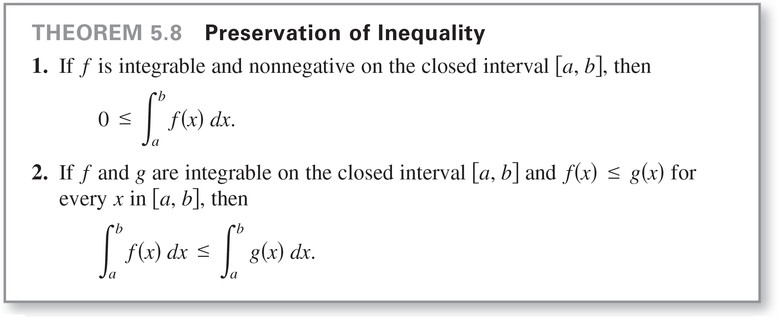
Properties of Definite Integrals
These two properties are generalized in Theorem 5.8.

