Slide 1


P
5
Integration
Copyright © Cengage Learning. All rights reserved.

Slide 2

5.5
Integration by Substitution
Copyright © Cengage Learning. All rights reserved.

Slide 3
Objectives
Use pattern recognition to find an indefinite integral.
Use a change of variables to find an indefinite integral.
Use the General Power Rule for Integration to find an indefinite integral.
Use a change of variables to evaluate a definite integral.
Evaluate a definite integral involving an even or odd function.

Slide 4
Pattern Recognition

Slide 5
Pattern Recognition
In this section, you will study techniques for integrating composite functions.
The discussion is split into two parts—pattern recognition and change of variables. Both techniques involve a u-substitution.
With pattern recognition, you perform the substitution mentally, and with change of variables, you write the substitution steps.
The role of substitution in integration is comparable to the role of the Chain Rule in differentiation.

Slide 6
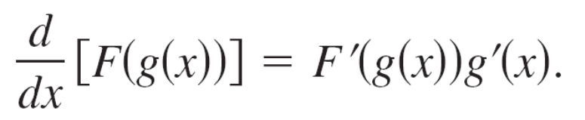
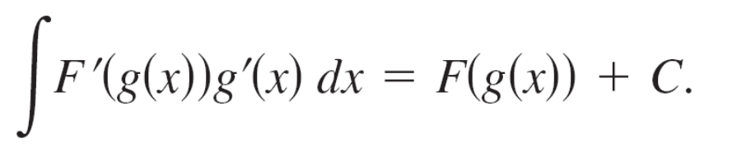
Pattern Recognition
Recall that for the differentiable functions
y = F(u) and u = g(x)
the Chain Rule states that
From the definition of an antiderivative, it follows that

Slide 7
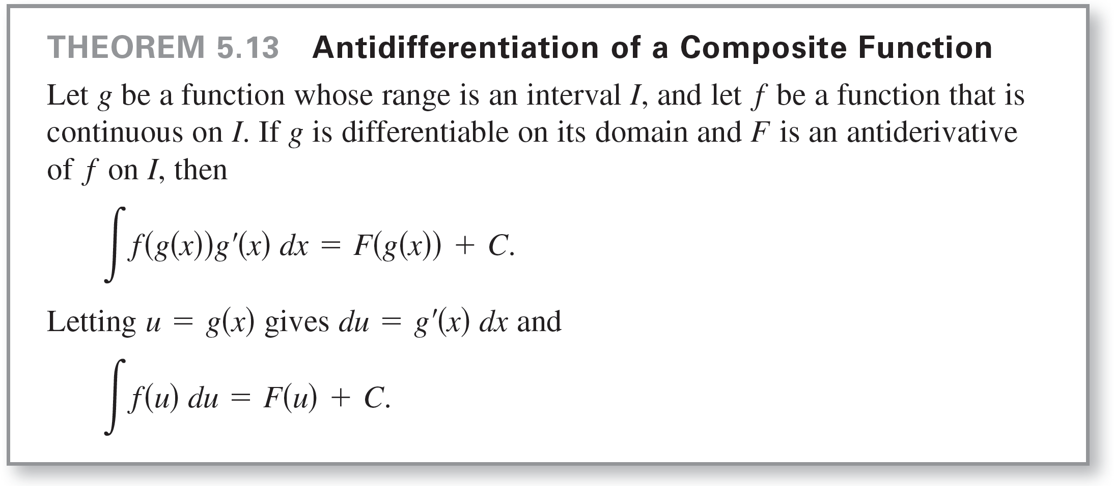
Pattern Recognition
These results are summarized in the following theorem.

Slide 8
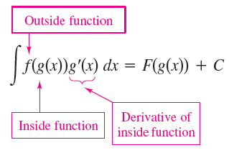
Pattern Recognition
Example 1 shows how to apply Theorem 5.13 directly, by recognizing the presence of f(g(x)) and g'(x).
Note that the composite function in the integrand has an outside function f and an inside function g. Moreover, the derivative g'(x) is present as a factor of the integrand.

Slide 9
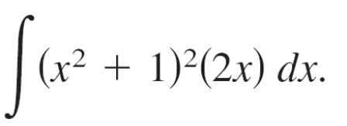
Example 1 – Recognizing the f(g(x))g'(x) Pattern
Find
Solution:
Letting g(x) = x² + 1, you obtain
g'(x) = 2x
and
f(g(x)) = f(x² + 1) = (x² + 1)².
From this, you can recognize that the integrand follows the f(g(x))g'(x) pattern.

Slide 10
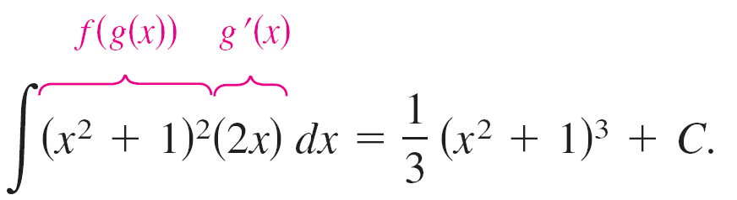
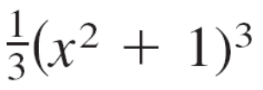
Example 1 – Solution
cont’d
Using the Power Rule for Integration and Theorem 5.13, you can write
Try using the Chain Rule to check that the derivative of
+ C is the integrand of the original integral.

Slide 11
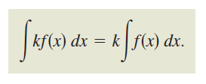
Pattern Recognition
The integrand in Example 1 fits the f(g(x))g'(x) pattern exactly—you only had to recognize the pattern.
You can extend this technique considerably with the Constant Multiple Rule
Many integrands contain the essential part (the variable part) of g'(x) but are missing a constant multiple.
In such cases, you can multiply and divide by the necessary constant multiple, as shown in Example 3.

Slide 12

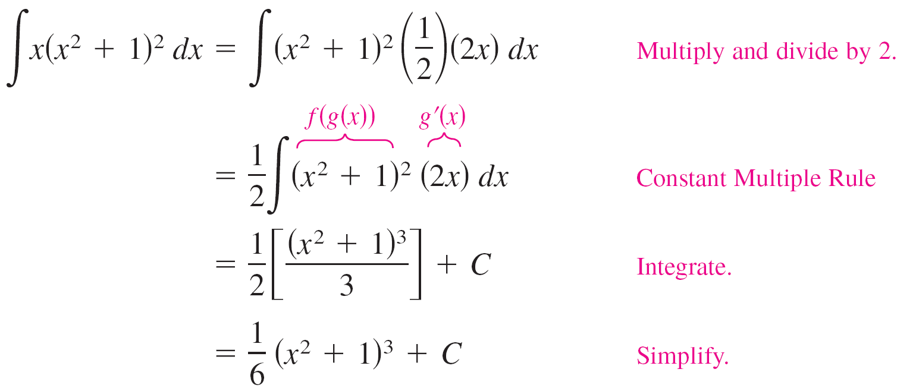
Example 3 – Multiplying and Dividing by a Constant
Find the indefinite integral.
Solution:
This is similar to the integral given in Example 1, except that the integrand is missing a factor of 2.
Recognizing that 2x is the derivative of x² + 1, you can let
g(x) = x² + 1
and supply the 2x as shown.

Slide 13
Example 3 – Solution
cont’d

Slide 14
Change of Variables for
Indefinite Integrals

Slide 15

Change of Variables for Indefinite Integrals
With a formal change of variables, you completely rewrite the integral in terms of u and du (or any other convenient variable).
Although this procedure can involve more written steps than the pattern recognition illustrated in Examples 1 and 3, it is useful for complicated integrands.
The change of variables technique uses the Leibniz notation for the differential. That is, if u = g(x), then du = g'(x)dx, and the integral in Theorem 5.13 takes the form

Slide 16
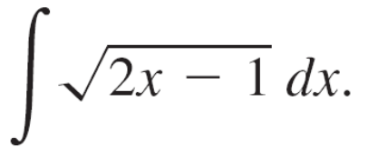


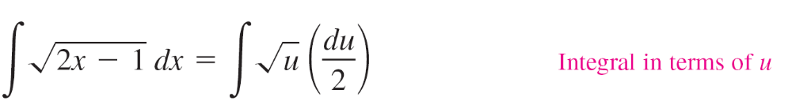
Example 4 – Change of Variables
Find
Solution:
First, let u be the inner function, u = 2x – 1.
Then calculate the differential du to be du = 2dx.
Now, using and substitute to obtain

Slide 17
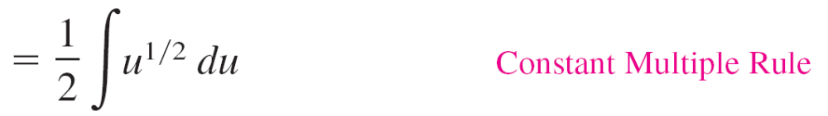
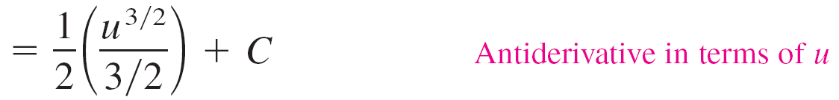
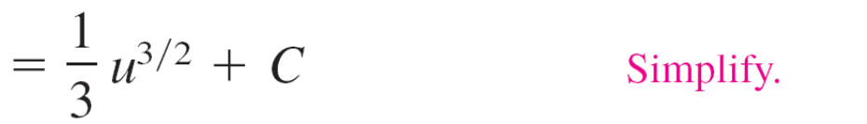
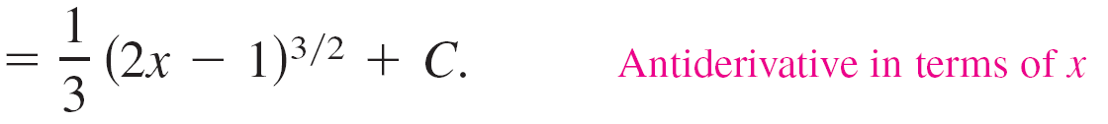
Example 4 – Solution
cont’d

Slide 18
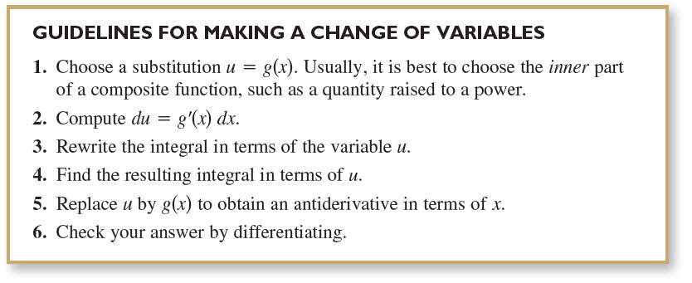
Change of Variables for Indefinite Integrals
The steps used for integration by substitution are summarized in the following guidelines.

Slide 19
The General Power Rule for Integration

Slide 20
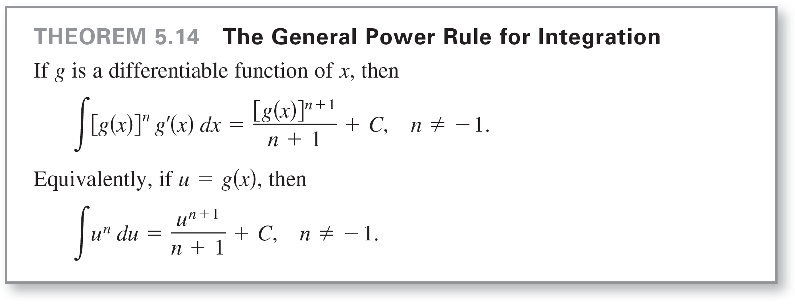
The General Power Rule for Integration
One of the most common u-substitutions involves quantities in the integrand that are raised to a power.
Because of the importance of this type of substitution, it is given a special name—the General Power Rule for Integration.

Slide 21
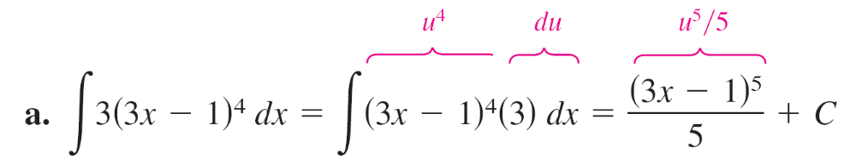
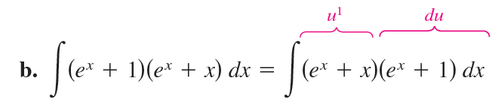
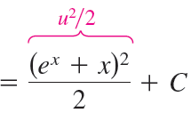
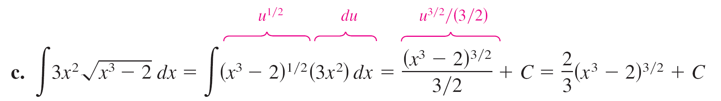
Example 7 – Substitution and the General Power Rule

Slide 22
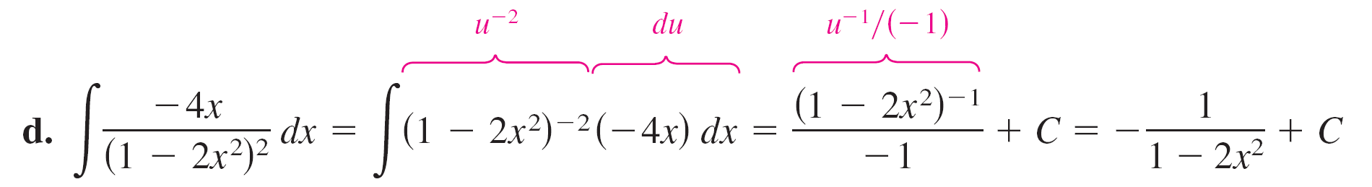
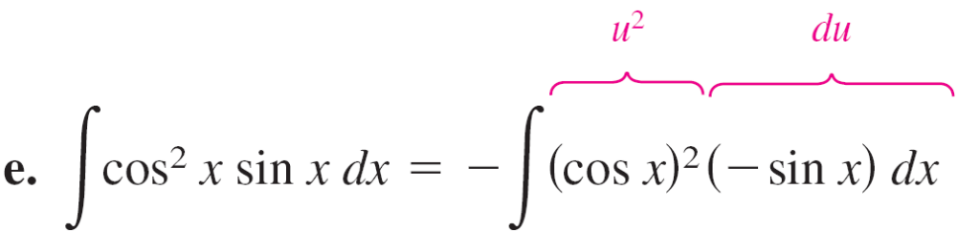
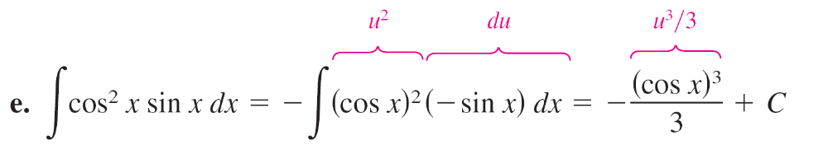
Example 7 – Substitution and the General Power Rule
cont’d

Slide 23
Change of Variables for
Definite Integrals

Slide 24
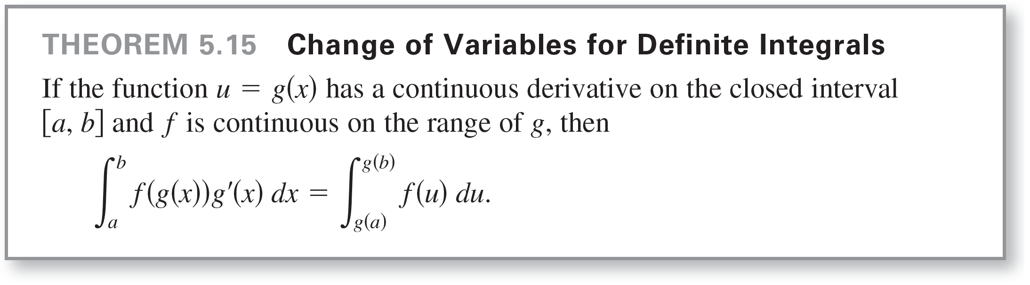
Change of Variables for Definite Integrals
When using u-substitution with a definite integral, it is often convenient to determine the limits of integration for the variable u rather than to convert the antiderivative back to the variable x and evaluate at the original limits.
This change of variables is stated explicitly in the next theorem.

Slide 25
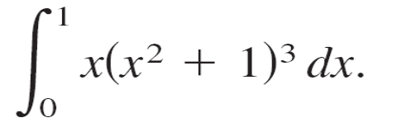


Example 8 – Change of Variables
Evaluate
Solution:
To evaluate this integral, let u = x² + 1.
Then, you obtain
Before substituting, determine the new upper and lower limits of integration.

Slide 26
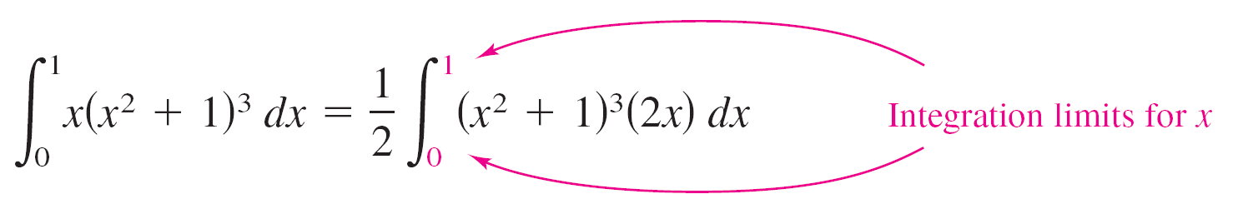
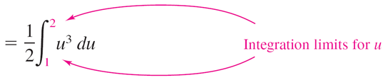
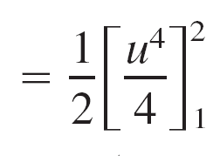
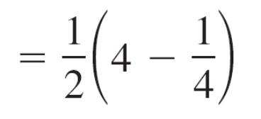
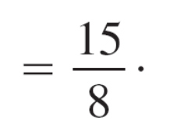
Example 8 – Solution
cont’d
Now, you can substitute to obtain

Slide 27
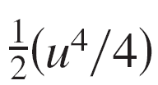
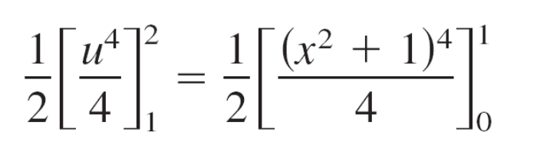


Example 8 – Solution
cont’d
Notice that you obtain the same result when you rewrite the
antiderivative in terms of the variable x and evaluate the definite integral at the original limits of integration, as shown below.

Slide 28
Integration of Even and
Odd Functions

Slide 29
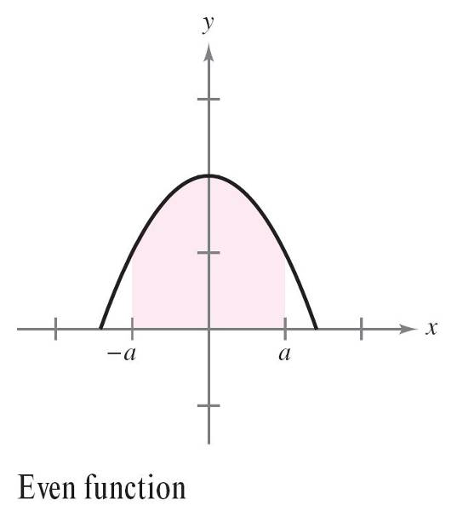
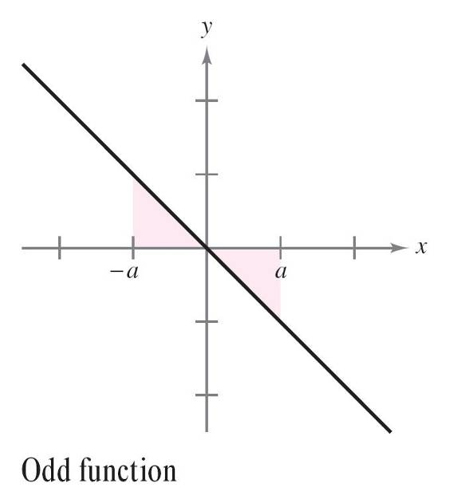
Integration of Even and Odd Functions
Even with a change of variables, integration can be difficult.
Occasionally, you can simplify the evaluation of a definite integral over an interval that is symmetric about the y-axis or about the origin by recognizing the integrand to be an even or odd function (see Figure 5.40).
Figure 5.40

Slide 30
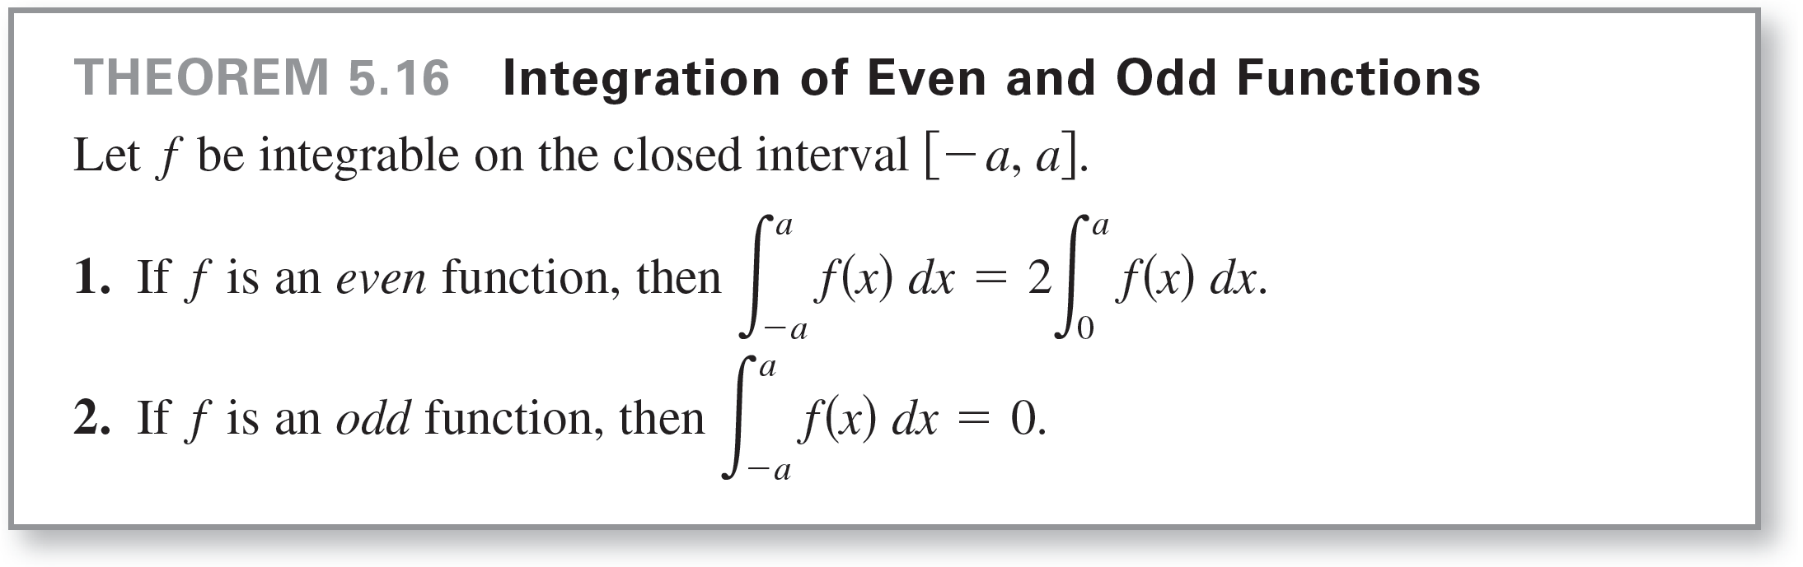
Integration of Even and Odd Functions

Slide 31
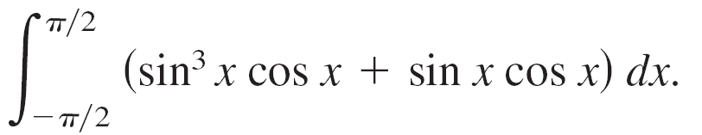
Example 10 – Integration of an Odd Function
Evaluate the definite integral.
Solution:
Letting f(x) = sin³x cos x + sin x cos x produces
f(–x) = sin³(–x) cos (–x) + sin (–x) cos (–x)
= –sin³x cos x – sin x cos x
= –f(x).

Slide 32
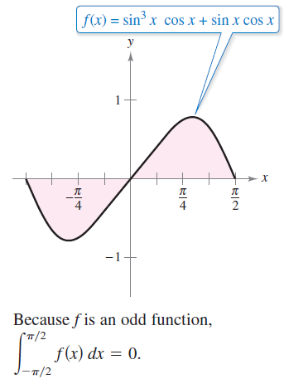

Example 10 – Solution
cont’d
So, f is an odd function, and because f is symmetric about the origin over [–π/2, π/2], you can apply Theorem 5.16 to conclude that
From Figure 5.41, you can see
that the two regions on either side
of the y-axis have the same area.
However, because one lies below the
x-axis and one lies above it, integration
produces a cancellation effect.
Figure 5.41

