Slide 1


P
5
Integration
Copyright © Cengage Learning. All rights reserved.

Slide 2

Indeterminate Forms and L’Hôpital’s Rule
5.6
Copyright © Cengage Learning. All rights reserved.

Slide 3
Objectives
Recognize limits that produce indeterminate forms.
Apply L’Hôpital’s Rule to evaluate a limit.

Slide 4
Indeterminate Forms

Slide 5
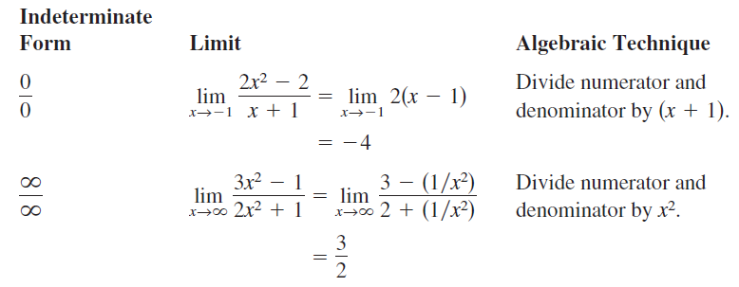
Indeterminate Forms
We know that the forms 0 / 0 and are called indeterminate because they do not guarantee that a limit exists, nor do they indicate what the limit is, if one does exist. When you encountered one of these indeterminate forms, you attempted to rewrite the expression by using various algebraic techniques.

Slide 6



Indeterminate Forms
Occasionally, you can extend these algebraic techniques to find limits of transcendental functions. For instance, the limit
produces the indeterminate form 0 / 0. Factoring and then dividing produces

Slide 7


Indeterminate Forms
Not all indeterminate forms, however, can be evaluated by algebraic manipulation. This is often true when both algebraic and transcendental functions are involved. For instance, the limit
produces the indeterminate form 0 / 0. Rewriting the expression to obtain
merely produces another indeterminate form,

Slide 8
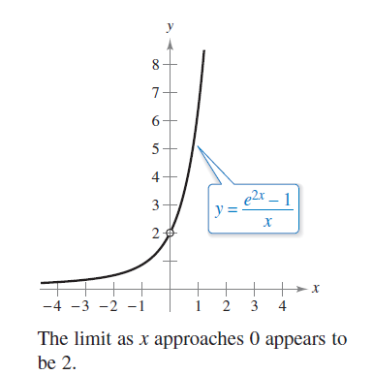
Indeterminate Forms
Of course, you could use technology to estimate the limit, as shown in the table and in Figure 5.42.
Figure 5.42

Slide 9
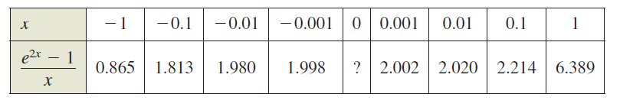
Indeterminate Forms
From the table and the graph, the limit appears to be 2.

Slide 10
L’Hôpital’s Rule

Slide 11

L’Hôpital’s Rule
To find the limit illustrated in Figure 5.42, you can use a
theorem called L’Hôpital’s Rule.
This theorem states that under certain conditions, the limit of the quotient f (x) / g(x) is determined by the limit of the
quotient of the derivatives
Figure 5.42

Slide 12
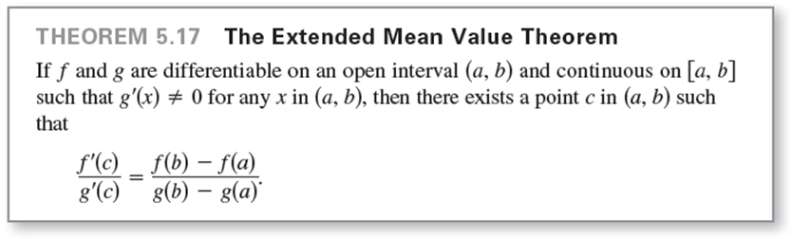
L’Hôpital’s Rule
To prove this theorem, you can use a more general result called the Extended Mean Value Theorem.

Slide 13
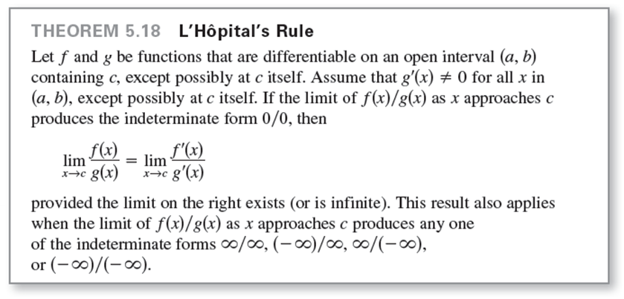
L’Hôpital’s Rule

Slide 14

L’Hôpital’s Rule
L’Hôpital’s Rule can also be applied to one-sided limits. For instance, if the limit of f (x) / g(x) as x approaches c from the right produces the indeterminate form 0 / 0, then
provided the limit exists (or is infinite).

Slide 15

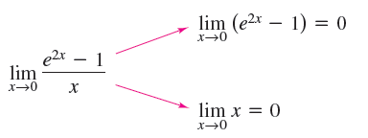
Example 1 – Indeterminate Form 0/0
Evaluate
Solution:
Because direct substitution results in the indeterminate form 0 / 0,

Slide 16
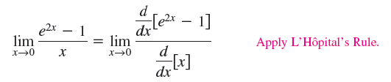

Example 1 – Solution
cont'd
You can apply L’Hôpital’s Rule, as shown below.

Slide 17
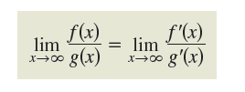
L’Hôpital’s Rule
Another form of L’Hôpital’s Rule states that if the limit of
f (x) / g(x) as x approaches (or ) produces the indeterminate form 0 / 0 or , then
provided the limit on the right exists.

Slide 18


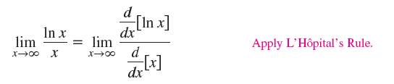

Example 2 – Indeterminate Form ∞ / ∞
Evaluate
Solution:
Because direct substitution results in the indeterminate form you can apply L’Hôpital’s Rule to obtain

Slide 19
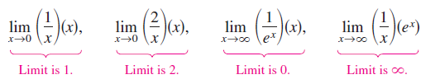
L’Hôpital’s Rule
In addition to the forms 0 / 0 and there are other indeterminate forms such as and
For example, consider the following four limits that lead to the indeterminate form

Slide 20
L’Hôpital’s Rule
Because each limit is different, it is clear that the form is indeterminate in the sense that it does not determine the value (or even the existence) of the limit.
Basically, you attempt to convert each of these forms to
0 / 0 or so that L’Hôpital’s Rule can be applied.

Slide 21


Example 4 – Indeterminate Form 0  ∞
Evaluate
Solution:
Because direct substitution produces the indeterminate form you should try to rewrite the limit to fit the form
0 / 0 or
In this case, you can rewrite the limit to fit the second form.

Slide 22


Example 4 – Solution
cont'd
Now, by L’Hôpital’s Rule, you have

Slide 23

L’Hôpital’s Rule
The indeterminate forms and arise from limits of functions that have variable bases and variable exponents.

Slide 24




Example 5 – Indeterminate Form 1∞
Evaluate
Solution:
Because direct substitution yields the indeterminate form
you can proceed as follows. To begin, assume that the limit exists and is equal to y.
Taking the natural logarithm of each side produces

Slide 25



Example 5 – Solution
cont'd
Because the natural logarithmic function is continuous, you can write

Slide 26

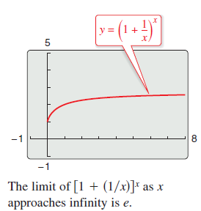

Example 5 – Solution
cont'd
Now, because you have shown that
you can conclude that
and obtain
You can use a graphing utility
to confirm this result,as shown
in the figure at the right.

Slide 27
L’Hôpital’s Rule
L’Hôpital’s Rule can also be applied to one-sided limits, as demonstrated in Examples 6 and 7.

Slide 28



Example 6 – Indeterminate Form 0⁰
Evaluate
Solution:
Because direct substitution produces the indeterminate form you can proceed as shown below. To begin, assume that the limit exists and is equal to y.

Slide 29





Example 6 – Solution
cont'd
Now, because ln y = 0, you can conclude that
and it follows that

Slide 30


Example 7 – Indeterminate Form ∞ − ∞
Evaluate
Solution:
Because direct substitution yields the indeterminate form
you should try to rewrite the expression to produce a form to which you can apply L’Hôpital’s Rule. In this case, you can combine the two fractions to obtain

Slide 31
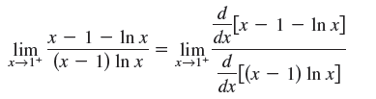


Example 7 – Solution
cont'd
Now, because direct substitution produces the indeterminate form 0 / 0, you can apply L’Hôpital’s Rule
to obtain

Slide 32

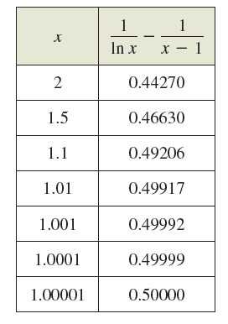
Example 7 – Solution
cont'd
This limit also yields the indeterminate form 0 / 0, so you can apply L’Hôpital’s Rule again to obtain
You can check the reasonableness
of this solution using a table, as
shown at the right.

Slide 33
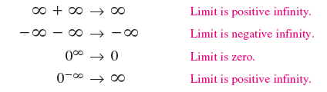
L’Hôpital’s Rule
The forms and have been identified as indeterminate.
There are similar forms that you should recognize as “determinate.”

Slide 34
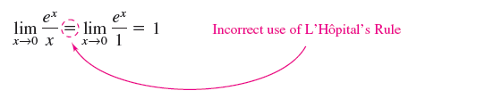
L’Hôpital’s Rule
As a final comment, remember that L’Hôpital’s Rule can be applied only to quotients leading to the indeterminate forms 0 / 0 and For instance, the application of L’Hôpital’s Rule shown below is incorrect.
The reason this application is incorrect is that, even though the limit of the denominator is 0, the limit of the numerator is 1, which means that the hypotheses of L’Hôpital’s Rule have not been satisfied.

