Slide 1


P
5
Integration
Copyright © Cengage Learning. All rights reserved.

Slide 2

The Natural Logarithmic Function: Integration
5.7
Copyright © Cengage Learning. All rights reserved.

Slide 3
Objectives
Use the Log Rule for Integration to integrate a rational function.
Integrate trigonometric functions.

Slide 4
Log Rule for Integration

Slide 5
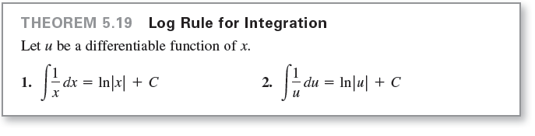
Log Rule for Integration
We have studied two differentiation rules for logarithms. The differentiation rule d/dx [ln x] = 1/x produces the Log Rule for Integration.
The differentiation rule d/dx [ln u] = u ′/u produces the integration rule ∫ 1/u = ln| u | + C. These rules are summarized below.

Slide 6


Log Rule for Integration
Because the second formula can also be written as

Slide 7
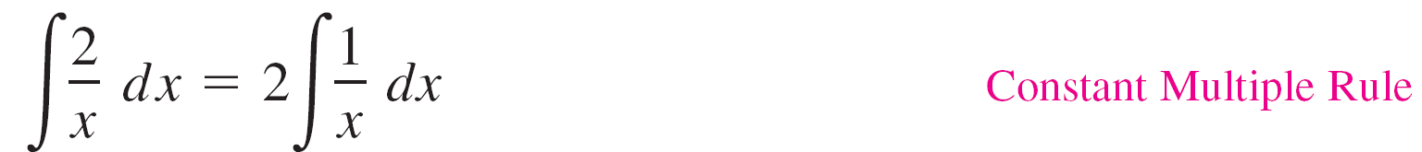
Example 1 – Using the Log Rule for Integration
Because x² cannot be negative, the absolute value notation is unnecessary in the final form of the antiderivative.

Slide 8
Log Rule for Integration
Integrals to which the Log Rule can be applied often appear in disguised form. For instance, when a rational function has a numerator of degree greater than or equal to that of the denominator, division may reveal a form to which you can apply the Log Rule.
This is shown in Example 5.

Slide 9
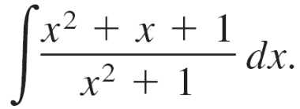
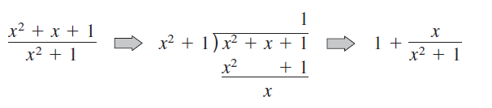
Example 5 – Using Long Division Before Integrating
Find the indefinite integral.
Solution:
Begin by using long division to rewrite the integrand.
Now, you can integrate to obtain

Slide 10
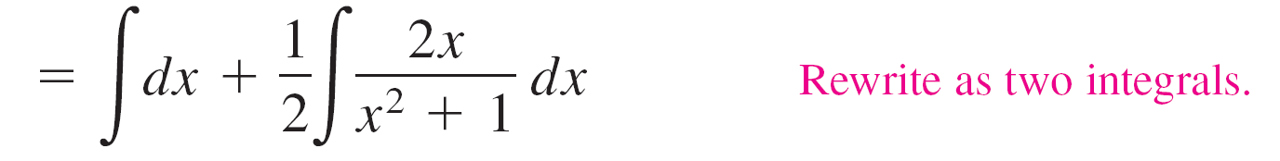
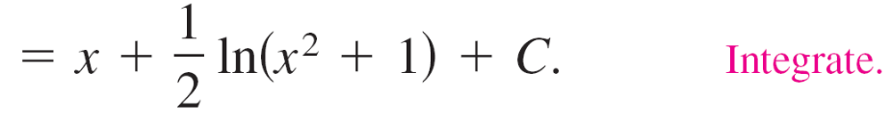
Example 5 – Solution
cont’d
Check this result by differentiating to obtain the original integrand.

Slide 11
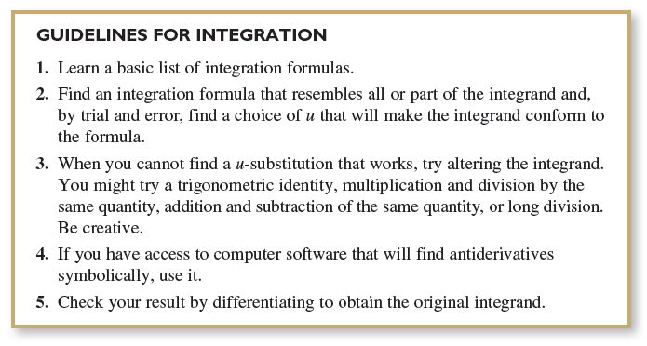
Log Rule for Integration
The following guidelines can be used for integration.

Slide 12
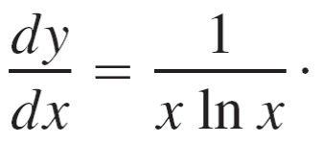
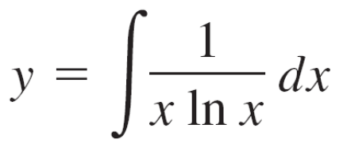
Example 7 – u-Substitution and the Log Rule
Solve the differential equation
Solution:
The solution can be written as an indefinite integral.
Because the integrand is a quotient whose denominator is raised to the first power, you should try the Log Rule.

Slide 13
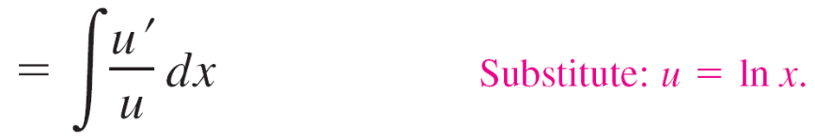



Example 7 – Solution
cont’d
There are three basic choices for u. The choices u = x and u = x ln x fail to fit the u'/u form of the Log Rule.
However, the third choice does fit. Letting u = ln x produces u' = 1/x, and you obtain the following.
So, the solution is

Slide 14
Integrals of Trigonometric Functions

Slide 15
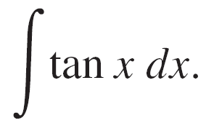
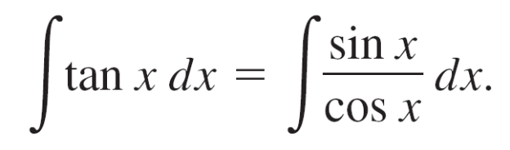
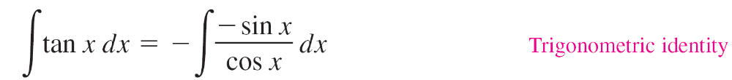

Example 8 – Using a Trigonometric Identity
Find
Solution:
This integral does not seem to fit any formulas on our basic list.
However, by using a trigonometric identity, you obtain
Knowing that D_{x}[cos x] = –sin x, you can let u = cos x and write

Slide 16
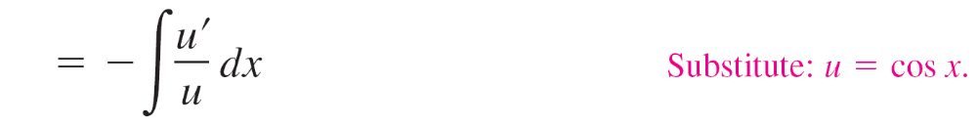
Example 8 – Solution
cont’d

Slide 17
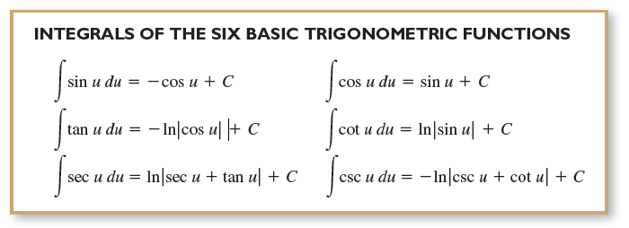
Integrals of Trigonometric Functions
The integrals of the six basic trigonometric functions are summarized below.

