Slide 1


P
5
Integration
Copyright © Cengage Learning. All rights reserved.

Slide 2

5.9
Hyperbolic Functions
Copyright © Cengage Learning. All rights reserved.

Slide 3
Objectives
Develop properties of hyperbolic functions.
Differentiate and integrate hyperbolic functions.
Develop properties of inverse hyperbolic functions.
Differentiate and integrate functions involving inverse hyperbolic functions.

Slide 4
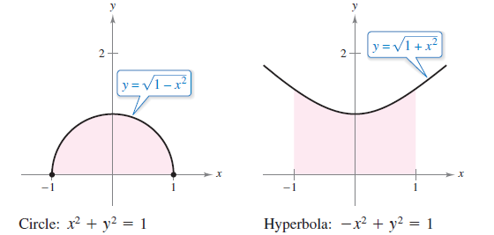
Hyperbolic Functions
You will look at a special class of exponential functions called hyperbolic functions. The name hyperbolic function arose from comparison of the area of a semicircular region, as shown in Figure 5.46, with the area of a region under a hyperbola, as shown in Figure 5.47.
Figure 5.46
Figure 5.47

Slide 5
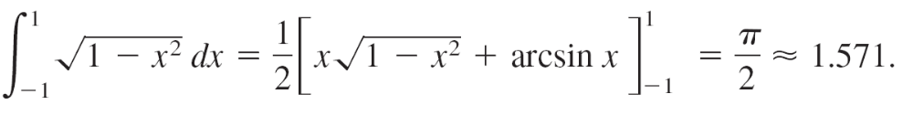
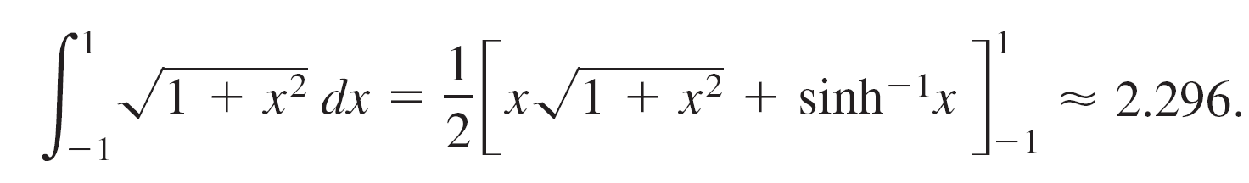
Hyperbolic Functions
The integral for the semicircular region involves an inverse trigonometric (circular) function:
The integral for the hyperbolic region involves an inverse hyperbolic function:
This is only one of many ways in which the hyperbolic functions are similar to the trigonometric functions.

Slide 6
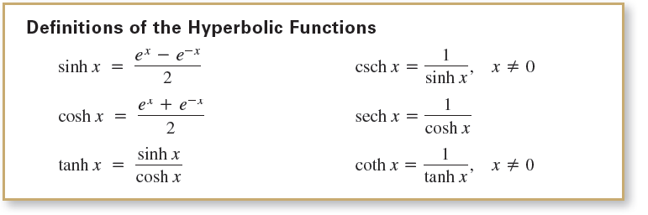
Hyperbolic Functions

Slide 7
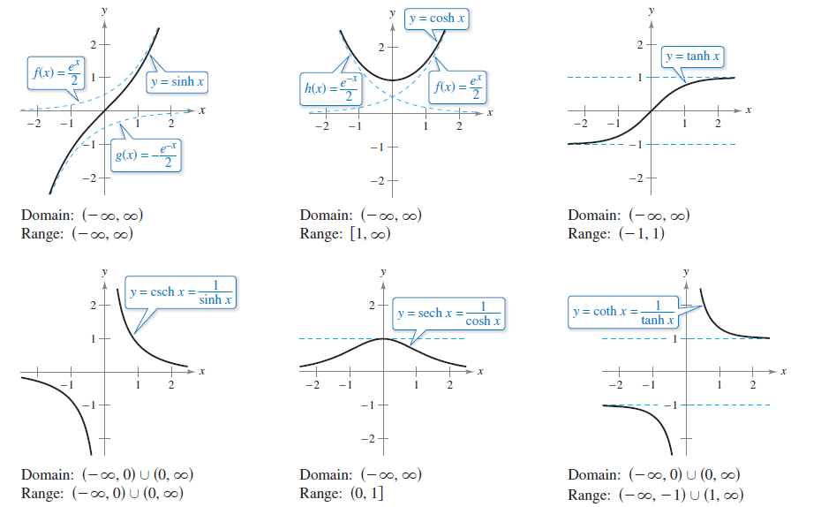
Hyperbolic Functions
The graphs of the six hyperbolic functions and their domains and ranges are shown in Figure 5.48.
Figure 5.48

Slide 8


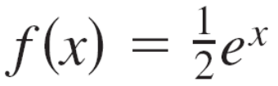

Hyperbolic Functions
Note that the graph of sinh x can be obtained by adding the corresponding y-coordinates of the exponential functions
and
Likewise, the graph of cosh x can be obtained by adding
the corresponding y-coordinates of the exponential
functions and

Slide 9
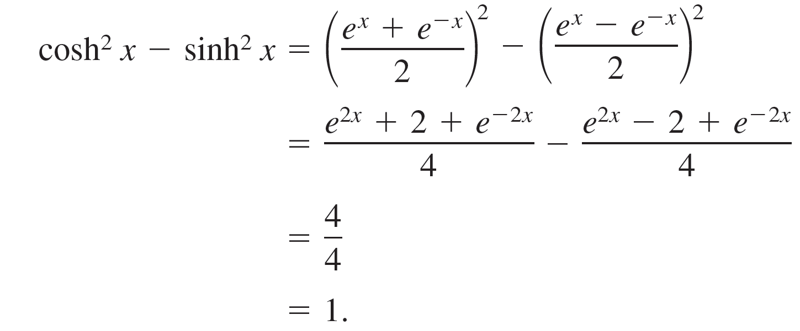
Hyperbolic Functions
Many of the trigonometric identities have corresponding hyperbolic identities.
For instance,

Slide 10
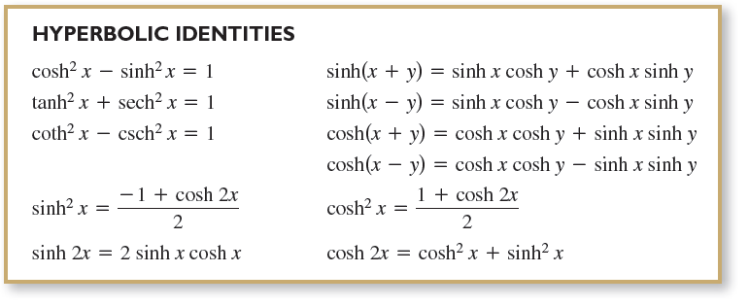
Hyperbolic Functions

Slide 11
Differentiation and Integration of Hyperbolic Functions

Slide 12
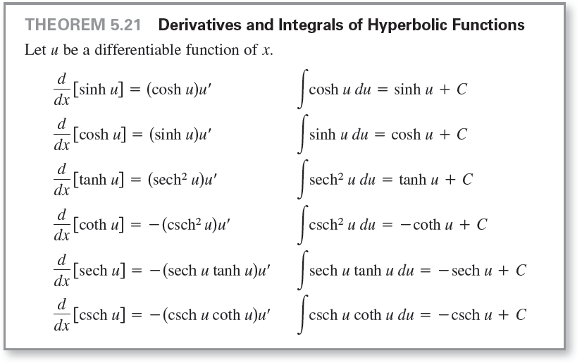
Differentiation and Integration of Hyperbolic Functions
Because the hyperbolic functions are written in terms of e^{x} and e^{–x}, you can easily derive rules for their derivatives. The following theorem lists these derivatives with the corresponding integration rules.

Slide 13
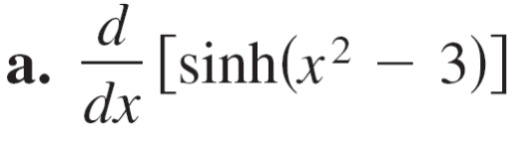
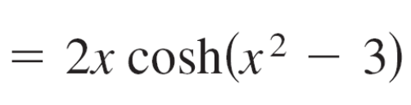
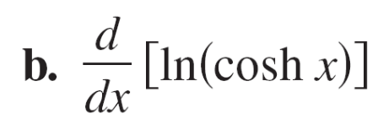
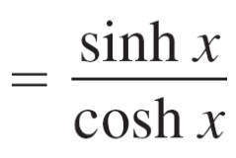
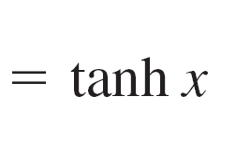
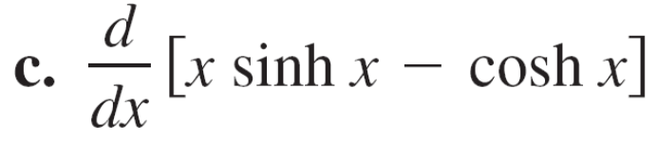
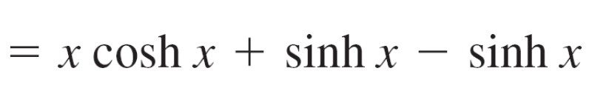
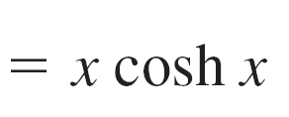

Example 1 – Differentiation of Hyperbolic Functions

Slide 14
Inverse Hyperbolic Functions

Slide 15
Inverse Hyperbolic Functions
Unlike trigonometric functions, hyperbolic functions are not periodic.
You can see that four of the six hyperbolic functions are actually one-to-one (the hyperbolic sine, tangent, cosecant, and cotangent).
So, you can conclude that these four functions have inverse functions.
The other two (the hyperbolic cosine and secant) are
one-to-one when their domains are restricted to the positive real numbers, and for this restricted domain they also have inverse functions.

Slide 16
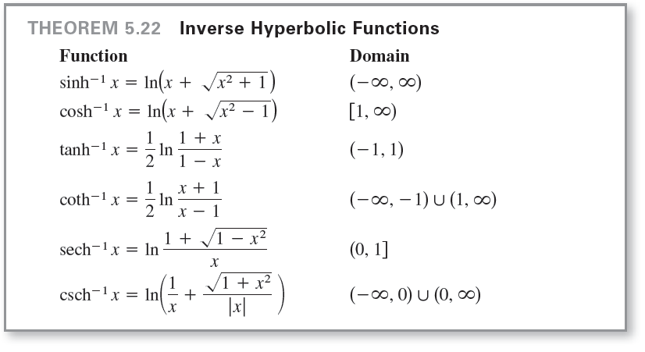
Inverse Hyperbolic Functions
Because the hyperbolic functions are defined in terms of exponential functions, it is not surprising to find that the inverse hyperbolic functions can be written in terms of logarithmic functions, as shown in Theorem 5.22.

Slide 17
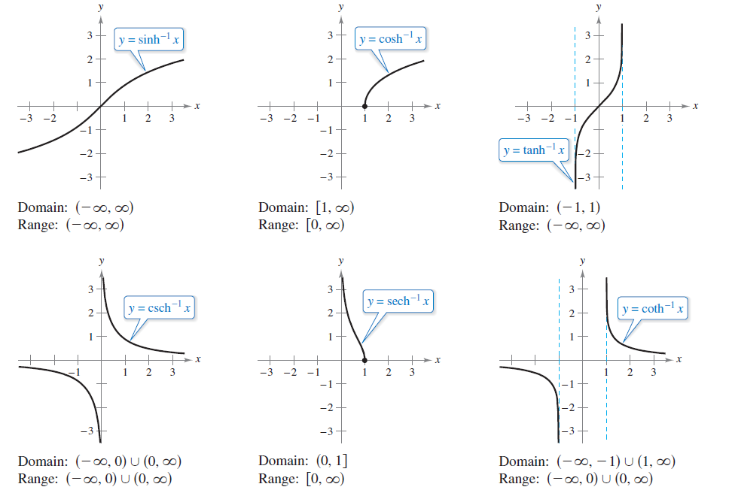
Inverse Hyperbolic Functions
The graphs of the inverse hyperbolic functions are shown in Figure 5.52.
The inverse hyperbolic secant can be used to define a curve called a tractrix or pursuit curve.
Figure 5.52

Slide 18
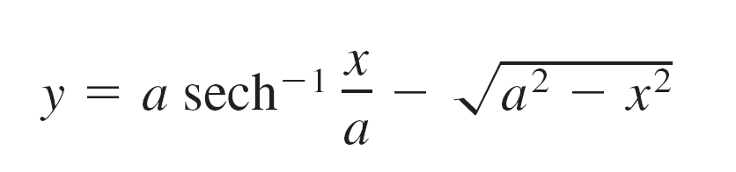
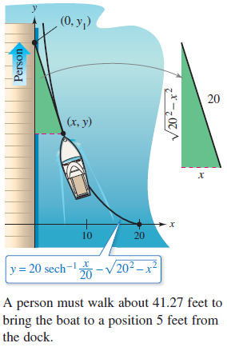
Example 5 – A Tractrix
A person is holding a rope that is tied to a boat, as shown in Figure 5.53. As the person walks along the dock, the boat travels along a tractrix, given by the equation
where a is the length of the rope.
For a = 20 feet, find the distance
the person must walk to bring the
boat to a position 5 feet from the
dock.
Figure 5.53

Slide 19



Example 5 – Solution
In Figure 5.53, notice that the distance the person has walked is
When x = 5, this distance is
So, the person must walk about 41.27 feet to bring the boat to a position 5 feet from the dock.

Slide 20
Inverse Hyperbolic Functions: Differentiation and Integration

Slide 21
Inverse Hyperbolic Functions: Differentiation and Integration
The derivatives of the inverse hyperbolic functions, which resemble the derivatives of the inverse trigonometric functions, are listed in Theorem 5.23 on the next slide with the corresponding integration formulas (in logarithmic form).
You can verify each of these formulas by applying the logarithmic definitions of the inverse hyperbolic functions.

Slide 22
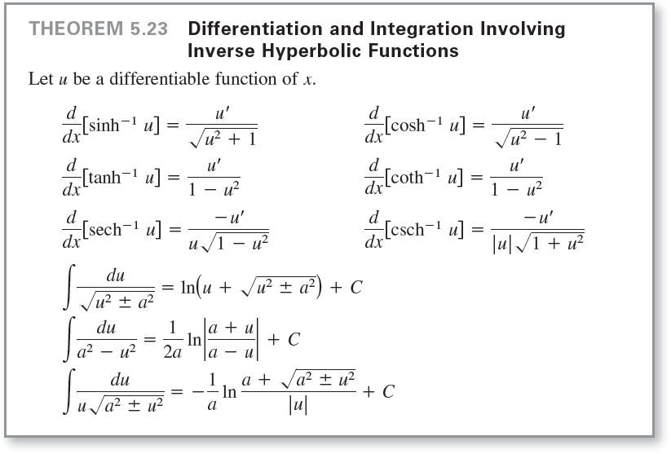
Inverse Hyperbolic Functions: Differentiation and Integration

Slide 23




Example 6 – Differentiation of Inverse Hyperbolic Functions

