Slide 1


6
P
Differential Equations
Copyright © Cengage Learning. All rights reserved.

Slide 2

Slope Fields and Euler’s Method
6.1
Copyright © Cengage Learning. All rights reserved.

Slide 3
Objectives
Use initial conditions to find particular solutions of differential equations.
Use slope fields to approximate solutions of differential equations.
Use Euler’s Method to approximate solutions of differential equations.

Slide 4
General and Particular Solutions

Slide 5
General and Particular Solutions
Physical phenomena can be described by differential equations.
We know that a differential equation in x and y is an equation that involves x, y, and derivatives of y. For example,
is a differential equation.
A function y = f(x) is called a solution of a differential equation if the equation is satisfied when y and its derivatives are replaced by f(x) and its derivatives.

Slide 6
General and Particular Solutions
For example, differentiation and substitution would show that y = e^{–2x} is a solution of the differential equation
y' + 2y = 0.
It can be shown that every solution of this differential equation is of the form
y = Ce^{–2x} General solution of y ' + 2y = 0
where C is any real number.
This solution is called the general solution. Some differential equations have singular solutions that
cannot be written as special cases of the general solution.

Slide 7
General and Particular Solutions
The order of a differential equation is determined by the highest-order derivative in the equation.
For instance, y' = 4y is a first-order differential equation.
The second-order differential equation s''(t) = –32 has the general solution
s(t) = –16t² + C₁t + C₂ General solution of s''(t) = –32
which contains two arbitrary constants.
It can be shown that a differential equation of order n has a general solution with n arbitrary constants.

Slide 8
Example 1 – Determining Solutions
Determine whether each function is a solution of the differential equation y''– y = 0.
a. y = sin x b. y = 4e^{–x} c. y = Ce^{x}
Solution:
a. Because y = sin x, y' = cos x, and y'' = –sin x, it follows that
y'' – y = –sin x – sin x = –2 sin x ≠ 0.
So, y = sin x is not a solution.

Slide 9
Example 1 – Solution
cont’d
b. Because y = 4e^{–x}, y' = –4e^{–x}, and y'' = 4e^{–x}, it follows that
y'' – y = 4e^{–x} – 4e^{–x} = 0.
So, y = 4e^{–x} is a solution.
c. Because y = Ce^{x}, y' = Ce^{x}, and y'' = Ce^{x}, it follows that
y'' – y = Ce^{x} – Ce^{x}= 0.
So, y = Ce^{x} is a solution for any value of C.

Slide 10
General and Particular Solutions
Geometrically, the general solution of a first-order differential equation represents a family of curves known as solution curves, one for each value assigned to the arbitrary constant.
For instance, you can verify that every function of the form
y = Ce^{–2x}
is a solution of the differential equation
y' + 2y = 0.

Slide 11
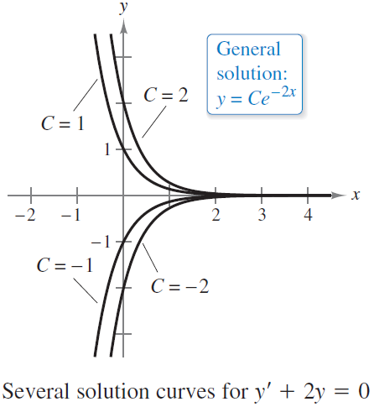
General and Particular Solutions
Figure 6.1 shows four of the solution curves corresponding to different values of C.
Particular solutions of a differential
equation are obtained from initial
conditions that give the values of
the dependent variable or one of its
derivatives for particular values of
the independent variable.
Figure 6.1

Slide 12
General and Particular Solutions
The term “initial condition” stems from the fact that, often in problems involving time, the value of the dependent variable or one of its derivatives is known at the initial time t = 0.
For instance, the second-order differential equation
s''(t) = –32
having the general solution
s(t) = –16t² + C₁t + C₂ General solution of s''(t) = –32
might have the following initial conditions.
s(0) = 80, s'(0) = 64 Initial conditions
In this case, the initial conditions yield the particular solution
s(t) = –16t² + 64t + 80. Particular solution

Slide 13
Example 2 – Finding a Particular Solution
For the differential equation
xy'– 3y = 0
verify that y = Cx³ is a solution. (Assume x > 0.) Then find the particular solution determined by the initial condition
y = 2 when x = 3.
Solution:
You know that y = Cx³ is a solution because y' = 3Cx² and
xy'– 3y = x(3Cx²) – 3(Cx³)
= 0.

Slide 14


Example 2 – Solution
cont’d
Furthermore, the initial condition y = 2 when x = 3 yields
y = Cx³ General solution
2 = C(3)³ Substitute initial condition.
and you can conclude that the particular solution is
Solve for C.
Particular solution

Slide 15
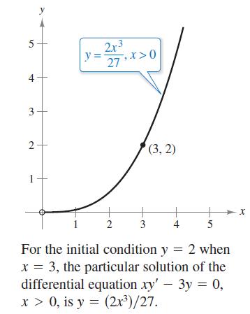
Example 2 – Solution
cont’d
As shown in Figure 6.2.
Try checking this solution by substituting for y and y' in the original differential equation.
Figure 6.2

Slide 16
Slope Fields

Slide 17
Slope Fields
Solving a differential equation analytically can be difficult or even impossible. However, there is a graphical approach you can use to learn a lot about the solution of a differential equation.
Consider a differential equation of the form
y' = F(x, y) Differential equation
where F(x, y) is some expression in x and y.
At each point (x, y) in the xy–plane where F is defined, the differential equation determines the slope y' = F(x, y) of the solution at that point.

Slide 18
Slope Fields
If you draw short line segments with slope F(x, y) at selected points (x, y) in the domain of F, then these line segments form a slope field, or a direction field, for the differential equation y' = F(x, y).
Each line segment has the same slope as the solution curve through that point.
A slope field shows the general shape of all the solutions and can be helpful in getting a visual perspective of the directions of the solutions of a differential equation.

Slide 19
Example 3 – Sketching a Slope Field
Sketch a slope field for the differential equation y' = x – y
for the points (–1, 1), (0, 1), and (1, 1).
Solution:
The slope of the solution curve at any point (x, y) is
So, the slope at each point can be found as shown.

Slide 20
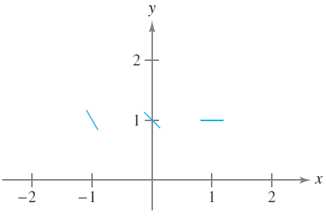
Example 3 – Solution
cont’d
Draw short line segments at the three points with their
respective slopes, as shown in Figure 6.3.
Figure 6.3

Slide 21
Euler’s Method

Slide 22
Euler’s Method
Euler’s Method is a numerical approach to approximating the particular solution of the differential equation
y' = F(x, y)
that passes through the point (x₀, y₀).
From the given information, you know that the graph of the solution passes through the point (x₀, y₀) and has a slope of F(x₀, y₀) at this point.
This gives you a “starting point” for approximating the solution.

Slide 23
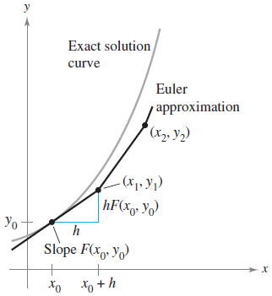
Euler’s Method
From this starting point, you can proceed in the direction indicated by the slope.
Using a small step h, move along the
tangent line until you arrive at the
point (x₁, y₁), where
x₁ = x₀ + h and y₁ = y₀ + hF(x₀, y₀)
as shown in Figure 6.6.
Figure 6.6

Slide 24
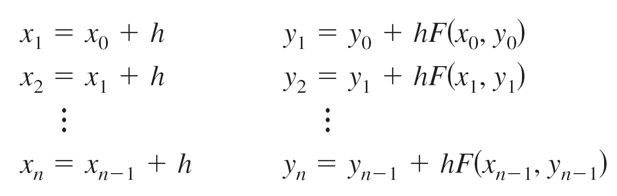
Euler’s Method
Then, using (x₁, y₁) as a new starting point, you can repeat the process to obtain a second point (x₂, y₂).
The values of x_{i} and y_{i} are shown below.
When using this method, note that you can obtain better approximations of the exact solution by choosing smaller and smaller step sizes.

Slide 25
Example 6 – Approximating a Solution Using Euler’s Method
Use Euler’s Method to approximate the particular solution of the differential equation
y' = x – y
passing through the point (0, 1). Use a step of h = 0.1.
Solution:
Using h = 0.1, x₀ = 0, y₀ = 1, and F(x, y) = x – y,
you have
x₀ = 0, x₁ = 0.1, x₂ = 0.2, x₃ = 0.3.

Slide 26
Example 6 – Solution
cont’d
The first three approximations are

Slide 27
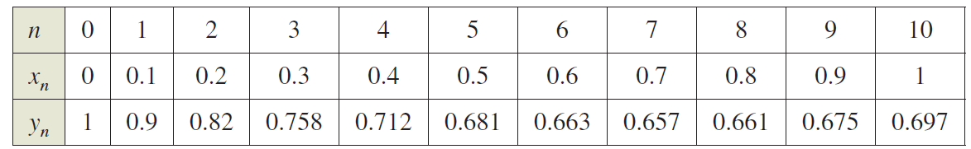
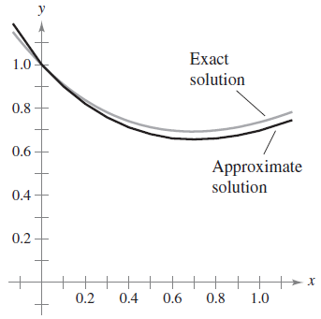
Example 6 – Solution
cont’d
The first ten approximations are shown in the table.
You can plot these values to see a
graph of the approximate solution,
as shown in Figure 6.7.
Figure 6.7

