Slide 1

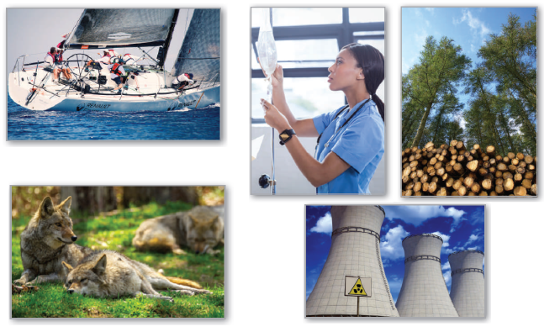
6
P
Differential Equations
Copyright © Cengage Learning. All rights reserved.

Slide 2

6.2
Growth and Decay
Copyright © Cengage Learning. All rights reserved.

Slide 3
Objectives
Use separation of variables to solve a simple differential equation.
Use exponential functions to model growth and decay in applied problems.

Slide 4
Differential Equations

Slide 5
Differential Equations
Analytically, you have learned to solve only two types of
differential equations—those of the forms y' = f(x) and
y'' = f(x).
In this section, you will learn how to solve a more general
type of differential equation.
The strategy is to rewrite the equation so that each variable
occurs on only one side of the equation. This strategy is
called separation of variables.

Slide 6
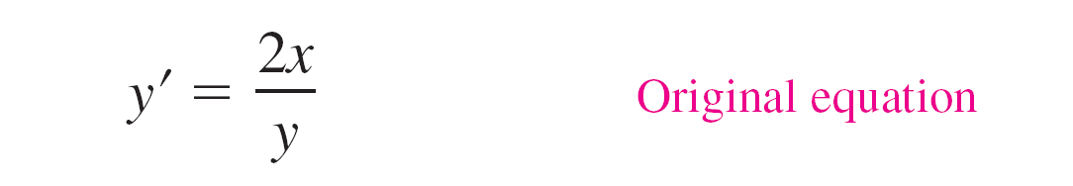
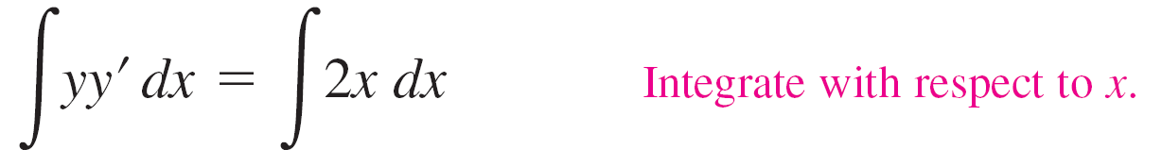
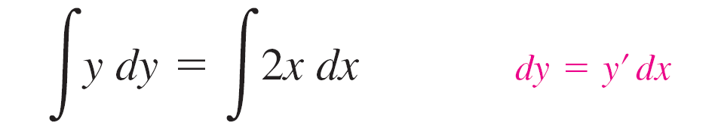
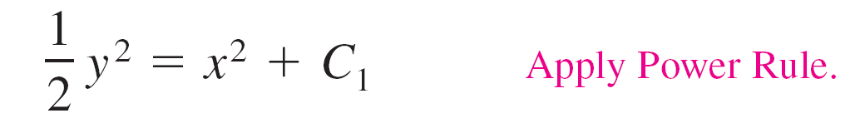
Example 1 – Solving a Differential Equation
So, the general solution is y² – 2x² = C.

Slide 7
Growth and Decay Models

Slide 8
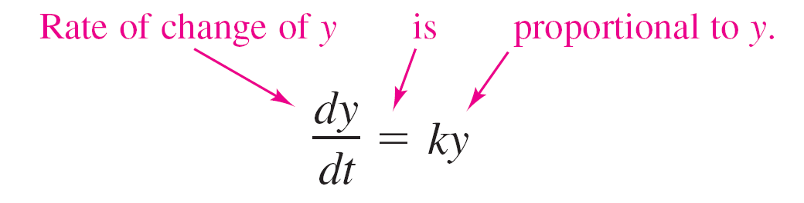
Growth and Decay Models
In many applications, the rate of change of a variable y is proportional to the value of y.
When y is a function of time t, the proportion can be written as follows.

Slide 9
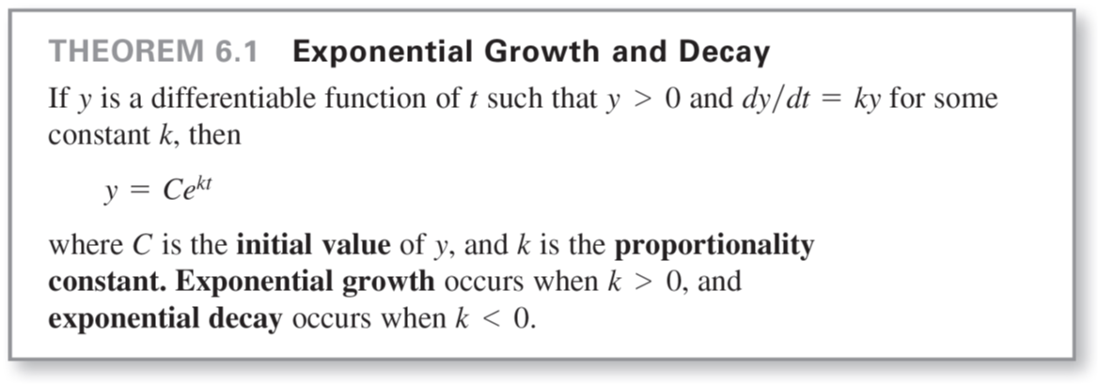
Growth and Decay Models
The general solution of this differential equation is given in
the next theorem.

Slide 10

Example 2 – Using an Exponential Growth Model
The rate of change of y is proportional to y. When t = 0,
y = 2, and when t = 2, y = 4. What is the value of y when
t = 3?
Solution:
Because y' = ky, you know that y and t are related by the
equation y = Ce^{kt}.
You can find the values of the constants C and k by applying the initial conditions.

Slide 11
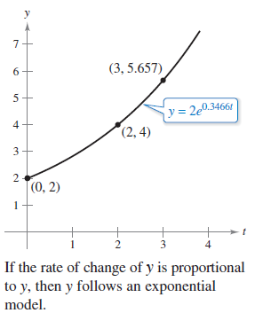
Example 2 – Solution
cont'd
So, the model is y ≈ 2e^{0.3466t} . When t = 3, the value of y is 2e^{0.3466(3)} ≈ 5.657. See Figure 6.8.
Figure 6.8

Slide 12
Growth and Decay Models
In Example 2, you did not actually have to solve the
differential equation dy/dt = ky.
The next example demonstrates a problem whose
solution involves the separation of variables technique.
The example concerns Newton's Law of Cooling, which
states that the rate of change in the temperature of an
object is proportional to the difference between the
object’s temperature and the temperature of the
surrounding medium.

Slide 13
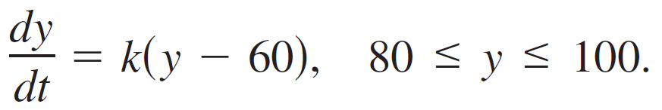
Example 6 – Newton's Law of Cooling
Let y represent the temperature (in ºF) of an object in a room whose temperature is kept at a constant 60ºF. The object cools from 100ºF to 90ºF in 10 minutes. How much longer will it take for the temperature of the object to decrease to 80ºF?
Solution:
From Newton's Law of Cooling, you know that the rate of change of y is proportional to the difference between y and 60.
This can be written as

Slide 14
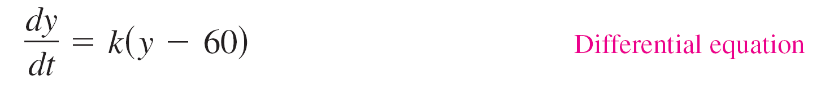
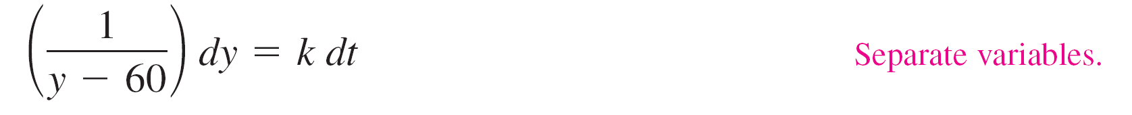
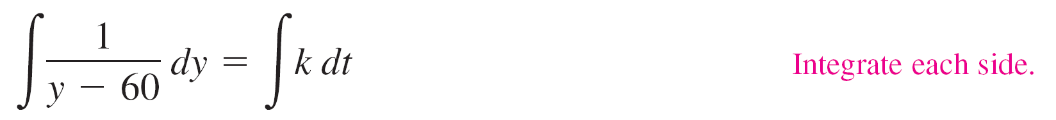
Example 6 – Solution
cont'd
To solve this differential equation, use separation of variables, as shown.

Slide 15

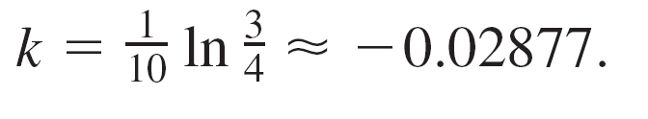
Example 6 – Solution
cont'd
Because y > 60, |y – 60| = y – 60, and you can omit the absolute value signs. Using exponential notation, you have
Using y = 100 when t = 0, you obtain
100 = 60 + Ce^{k(0)} = 60 + C which implies that C = 40.
Because y = 90 when t = 10,
90 = 60 + 40e^{k(10)}
30 = 40e^{10k}
.

Slide 16

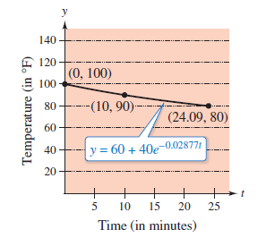





Example 6 – Solution
cont'd
So, and the model is
y = 60 + 40e^{–0.02877t}. Cooling model
When y = 80, you obtain
So, it will require about 14.09 more minutes for the object
to cool to a temperature of 80ºF. See Figure 6.11.
Figure 6.11

