Slide 1

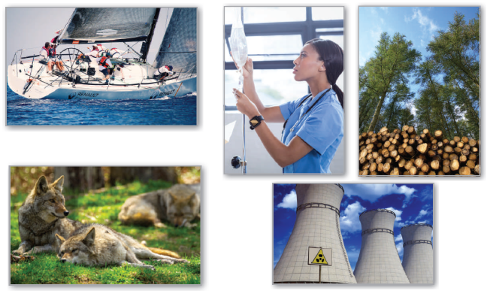
6
P
Differential Equations
Copyright © Cengage Learning. All rights reserved.

Slide 2

6.3
Separation of Variables
Copyright © Cengage Learning. All rights reserved.

Slide 3
Objectives
Recognize and solve differential equations that can be solved by separation of variables.
Use differential equations to model and solve applied problems.

Slide 4
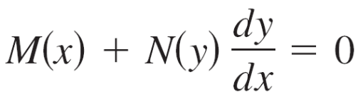
Separation of Variables
Consider a differential equation that can be written in the form
where M is a continuous function of x alone and N is a continuous function of y alone. For this type of equation, all x-terms can be collected with dx and all y-terms with dy, and a solution can be obtained by integration.
Such equations are said to be separable, and the solution procedure is called separation of variables.

Slide 5
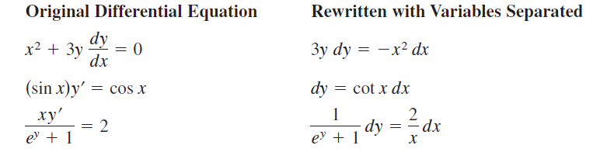
Separation of Variables
Below are some examples of differential equations that are separable.

Slide 6
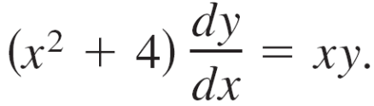
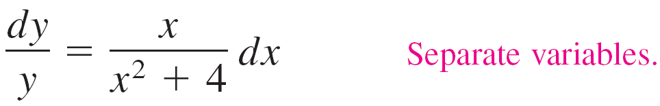
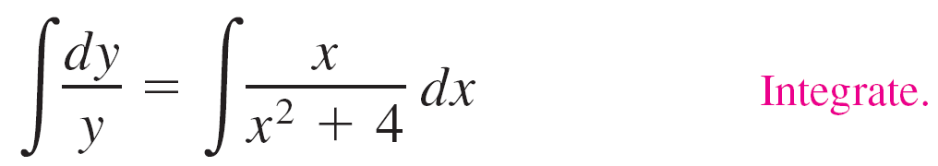
Example 1 – Separation of Variables
Find the general solution of
Solution:
To begin, note that y = 0 is a solution. To find other solutions, assume that y ≠ 0 and separate variables as shown.
Now, integrate to obtain

Slide 7
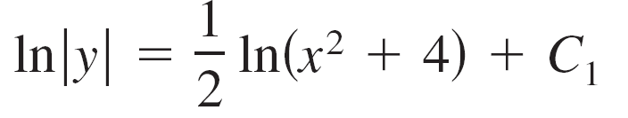




Example 1 – Solution
cont'd
Because y = 0 is also a solution, you can write the general solution as

Slide 8
Applications

Slide 9
Example 4 – Wildlife Population
The rate of change of the number of coyotes N(t) in a population is directly proportional to 650 – N(t), where t is the time in years.
When t = 0, the population is 300, and when t = 2, the population has increased to 500. Find the population when t = 3.

Slide 10
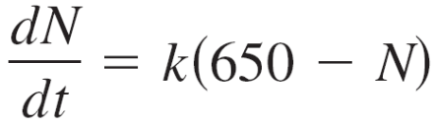
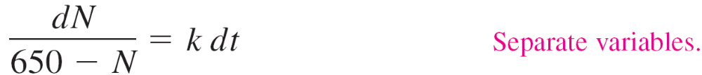

Example 4 – Solution
Because the rate of change of the population is proportional to 650 – N(t), or 650 – N, you can write the differential equation
.
You can solve this equation using separation of variables.

Slide 11


Example 4 – Solution
cont'd
Using N = 300 when t = 0, you can conclude that C = 350, which produces
N = 650 – 350e ^{–kt}.
Then, using N = 500 when t = 2, it follows that
500 = 650 – 350e ^{–2k} k ≈ 0.4236.
So, the model for the coyote population is
N = 650 – 350e ^{–0.4236t}.

Slide 12
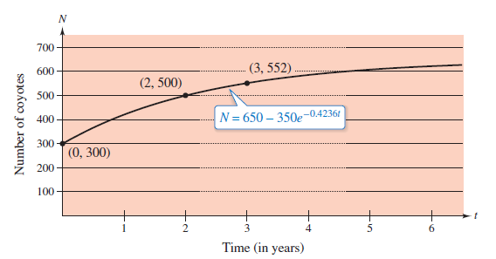
Example 4 – Solution
cont'd
When t = 3, you can approximate the population to be
N = 650 – 350e ^{–0.4236(3)}
≈ 552 coyotes.
The model for the population
is shown in Figure 6.13.
Note that N = 650 is the
horizontal asymptote of the
graph and is the carrying
capacity of the model.
Figure 6.13

Slide 13
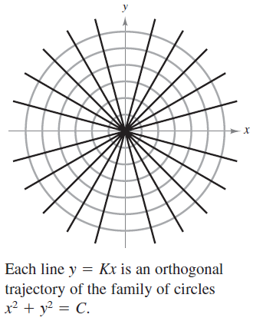
Applications
A common problem in electrostatics, thermodynamics, and hydrodynamics involves finding a family of curves, each of which is orthogonal to all members of a given family of curves. For example, the figure below shows a family of circles
x² + y² = C Family of circles
each of which intersects the lines
in the family
y = Kx Family of lines
at right angles.

Slide 14
Applications
Two such families of curves are said to be mutually orthogonal, and each curve in one of the families is called an orthogonal trajectory of the other family.
In electrostatics, lines of force are orthogonal to the equipotential curves.
In thermodynamics, the flow of heat across a plane surface is orthogonal to the isothermal curves.
In hydrodynamics, the flow (stream) lines are orthogonal trajectories of the velocity potential curves.

Slide 15
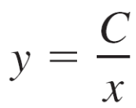
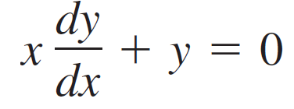
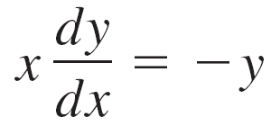
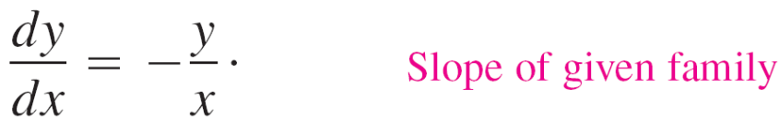
Example 5 – Finding Orthogonal Trajectories
Describe the orthogonal trajectories for the family of curves given by
for C ≠ 0. Sketch several members of each family.
Solution:
First, solve the given equation for C and write xy = C. Then, by differentiating implicitly with respect to x, you obtain the differential equation

Slide 16
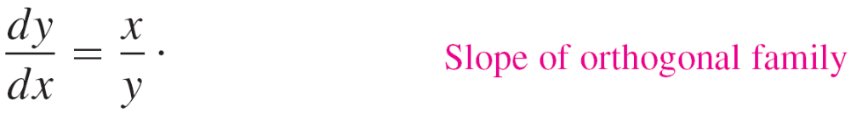
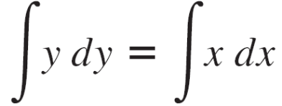
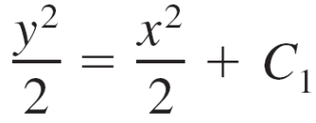
Example 5 – Solution
cont'd
Because dy/dx represents the slope of the given family of curves at (x, y), it follows that the orthogonal family has the negative reciprocal slope x/y. So,
Now you can find the orthogonal family by separating variables and integrating.
y² – x² = K

Slide 17
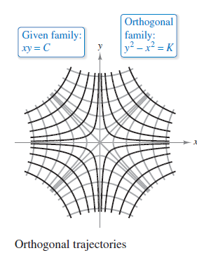
Example 5 – Solution
cont'd
So, the orthogonal trajectories for the family of curves given by y = C/x is the family of curves given by y² − x² = K.
When K ≠ 0, the orthogonal trajectories are hyperbolas with centers at the origin, and the transverse axes are vertical for K > 0 and horizontal for K < 0.
When K = 0, the orthogonal trajectories
are the lines y = ±x. Several trajectories
are shown in Figure 6.14.
Figure 6.14

Slide 18
Applications
A Gompertz growth model assumes that the rate of change of y is proportional to the product of y and the natural log of L/y, where L is the population limit.

