Slide 1


6
P
Differential Equations
Copyright © Cengage Learning. All rights reserved.

Slide 2

6.4
The Logistic Equation
Copyright © Cengage Learning. All rights reserved.

Slide 3
Objectives
Solve and analyze logistic differential equations.
Use logistic differential equations to model and solve applied problems.

Slide 4
Logistic Differential Equation

Slide 5
Logistic Differential Equation
The exponential growth model was derived from the fact that the rate of change of a variable y is proportional to the value of y.
You observed that the differential equation dy/dt = ky has the general solution y = Ce^{kt}.
Exponential growth is unlimited, but when describing a population, there often exists some upper limit L past which growth cannot occur.
This upper limit L is called the carrying capacity, which is the maximum population y(t) that can be sustained or supported as time t increases.

Slide 6
Logistic Differential Equation
A model that is often used to describe this type of growth is the logistic differential equation
where k and L are positive constants. A population that satisfies this equation does not grow without bound, but approaches the carrying capacity L as t increases.
From the equation, you can see that if y is between 0 and the carrying capacity L, then dy/dt > 0, and the population increases. If y is greater than L, then dy/dt < 0, and the population decreases.

Slide 7
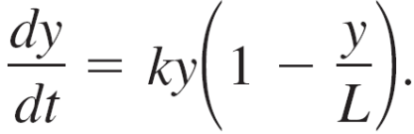
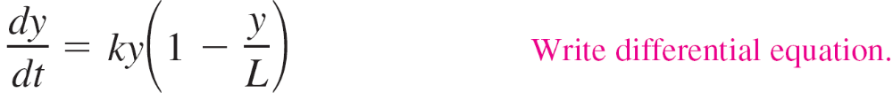
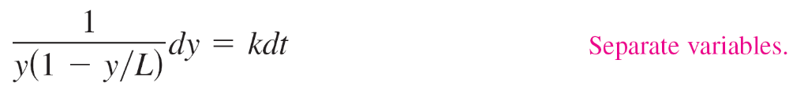
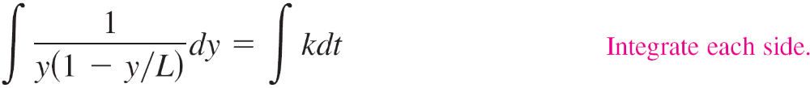
Example 1 – Deriving the General Solution
Solve the logistic differential equation
Solution:
Begin by separating variables.

Slide 8





Example 1 – Solution
cont'd
Solving this equation for y produces

Slide 9
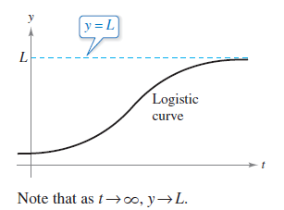
Logistic Differential Equation
The graph of the function y is called the logistic curve, as shown in Figure 6.19.
Figure 6.19

Slide 10
Application

Slide 11

Example 6 – Solving a Logistic Differential Equation
A state game commission releases 40 elk into a game refuge. After 5 years, the elk population is 104.
The commission believes that the environment can support no more than 4000 elk.
The growth rate of the elk population p is
where t is the number of years.

Slide 12
Example 6 – Solving a Logistic Differential Equation
cont'd
a. Write a model for the elk population in terms of t.
b. Graph the slope field for the differential equation and the
solution that passes through the point (0, 40).
c. Use the model to estimate the elk population after 15
years.
d. Find the limit of the model as

Slide 13
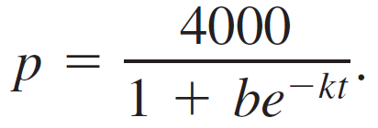


Example 6 – Solution
a. You know that L = 4000. So, the solution of the equation
is of the form
Because p(0) = 40, you can solve for b as follows.
Then, because p = 104 when t = 5, you can solve for k.

Slide 14


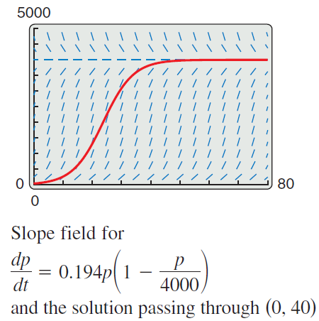
Example 6 – Solution
cont'd
So, a model for the elk population is
b. Using a graphing utility, you can graph the slope field of
and the solution that passes through
(0, 40), as shown in Figure 6.26.
Figure 6.26

Slide 15
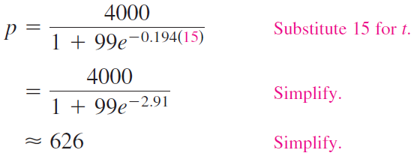
Example 6 – Solution
cont'd
c. To estimate the elk population after 15 years, substitute
15 for t in the model.

Slide 16


Example 6 – Solution
cont'd
d. As t increases without bound, the denominator of
gets closer and closer to 1.
So,

