Slide 1


6
P
Differential Equations
Copyright © Cengage Learning. All rights reserved.

Slide 2

Predator-Prey Differential
Equations
6.6
Copyright © Cengage Learning. All rights reserved.

Slide 3
Objectives
Analyze predator-prey differential equations.
Analyze competing-species differential equations.

Slide 4
Predator-Prey Differential Equations

Slide 5
Predator-Prey Differential Equations
In the 1920s, mathematicians Alfred Lotka (1880–1949) and Vito Volterra (1860–1940) independently developed mathematical models to represent many of the different ways in which two species can interact with each other.
Two common ways in which species interact with each other are as predator and prey, and as competing species.
Consider a predator-prey relationship involving foxes (predators) and rabbits (prey).

Slide 6
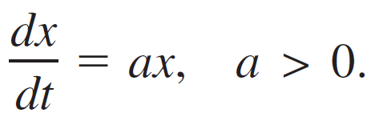
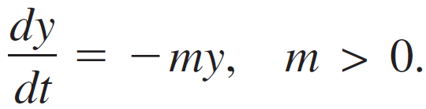
Predator-Prey Differential Equations
Assume that the rabbits are the primary food source for the foxes, the rabbits have an unlimited food supply, and there is no threat to the rabbits other than from the foxes. Let x represent the number of rabbits, let y represent the number of foxes, and let t represent time. When there are no foxes, the rabbit population grows according to the exponential growth model
When there are foxes but no rabbits, the foxes have no food and their population decays according to the exponential decay model

Slide 7
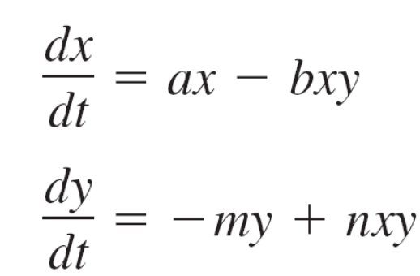
Predator-Prey Differential Equations
When both foxes and rabbits are present, there is an interaction rate of decline for the rabbit population given
by –bxy, and an interaction rate of increase in the fox population given by nxy, where b, n > 0.
So, the rates of change of each population can be modeled by the following predator-prey system of differential equations.
Rate of change of prey
Rate of change of predators

Slide 8
Predator-Prey Differential Equations
These equations are called predator-prey equations or Lotka-Volterra equations.
The equations are autonomous because the rates of change do not depend explicitly on time t.
In general, it is not possible to solve the predator-prey equations explicitly for x and y. However, you can use techniques such as Euler's Method to approximate solutions.
Also, you can discover properties of the solutions by analyzing the differential equations.

Slide 9
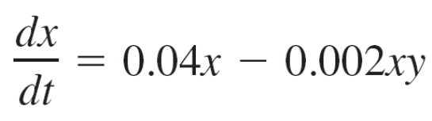
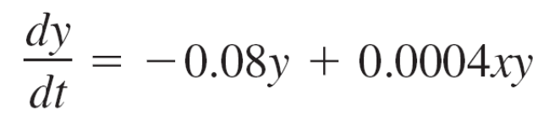
Example 1 – Analyzing Predator-Prey Equations
Write the predator-prey equations for a = 0.04, b = 0.002,
m = 0.08, and n = 0.0004. Then find the values of x and y for which dx/dt = dy/dt = 0.
Solution:
For a = 0.04, b = 0.002, m = 0.08, and n = 0.0004, the predator-prey equations are shown below.
Rate of change of prey
Rate of change of predators

Slide 10
Example 1 – Solution
cont’d
Solving
dx/dt = x(0.04 – 0.002y) = 0
and
dy/dt = y(–0.08 + 0.0004x) = 0,
you can see that
dx/dt = dy/dt = 0 when (x, y) = (0, 0) and when
(x, y) = (200, 20).

Slide 11
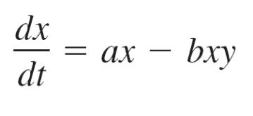
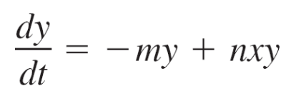
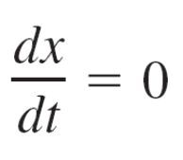
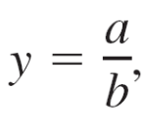
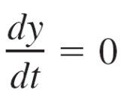
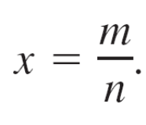
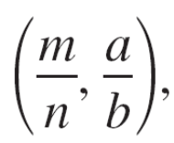
Predator-Prey Differential Equations
There are two points of interest you should consider when analyzing predator-prey equations. Consider the predator-prey equations
and .
when x = 0 or and when y = 0 or
So, at the points (0, 0) and the prey and predator populations are constant.
These points are called critical points or equilibrium points of the predator-prey equations.

Slide 12
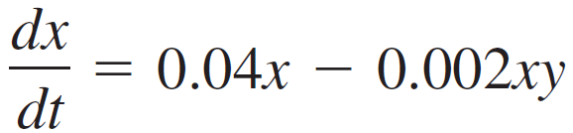
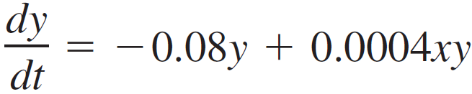
Example 2 – Analyzing Predator-Prey Equations Graphically
Let the predator-prey equations from Example 1
and
model a predator-prey relationship involving foxes and rabbits, where x is the number of rabbits and y is the number of foxes after t months.
Use a graphing utility to graph the functions x and y when
0 ≤ t ≤ 240 and the initial conditions are 200 rabbits and 10 foxes. What do you observe?
Rate of change of rabbit population
Rate of change of fox population

Slide 13
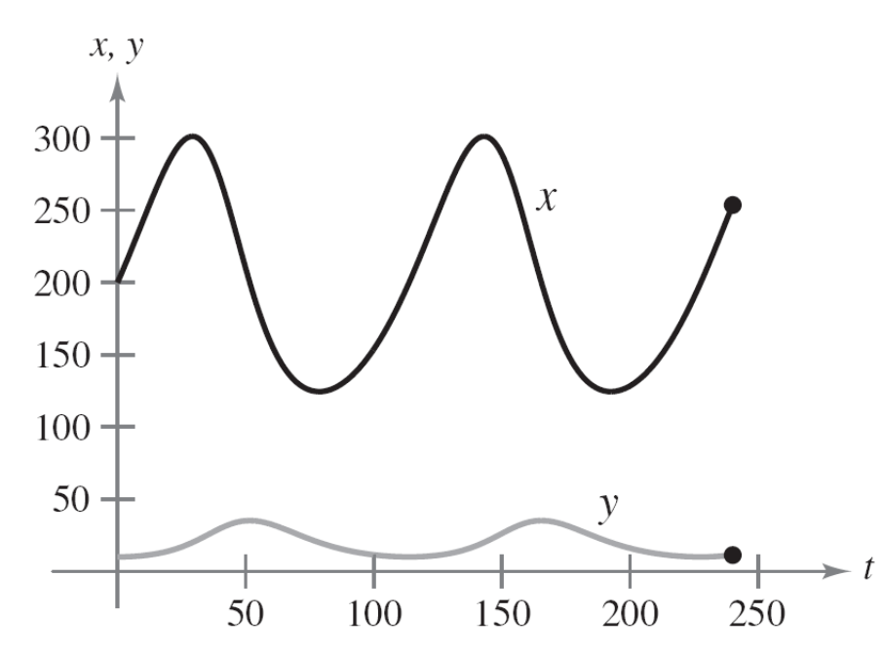
Example 2 – Solution
The graphs of x and y are shown in Figure 6.30.
Figure 6.30

Slide 14
Example 2 – Solution
cont’d
Here are some observations.
The rabbit and fox populations oscillate periodically
between their respective minimum and maximum values.
The rabbit population oscillates from about 125 rabbits to
about 300 rabbits.
The fox population oscillates from about 10 foxes to about
35 foxes.
About 20 months after the rabbit population peaks, the fox
population peaks.
The period of each population appears to be about 115
months.

Slide 15
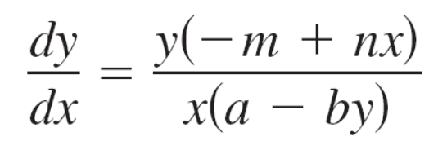
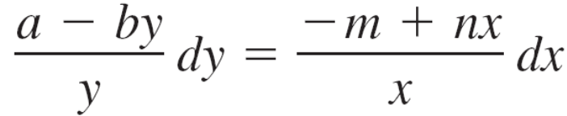
Predator-Prey Differential Equations
Although it is generally not possible to solve predator-prey equations explicitly for x and y, you can separate variables to derive an implicit solution. Begin by writing the equations dy/dt and dx/dt as a function of x.
x(a – by) dy = y(–m + nx) dx
Factor numerator and
denominator.
Differential form
Separate variables.

Slide 16
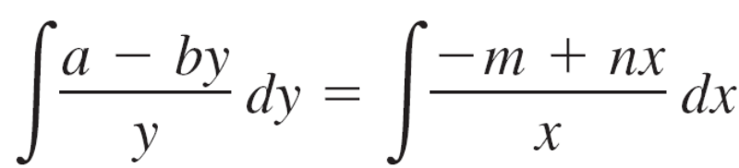
Predator-Prey Differential Equations
a ln y – by = –m ln x + nx + C
a ln y + m ln x – by – nx = C
The constant C is determined by the initial conditions.
Integrate.
Assume x and y are positive.
General solution

Slide 17
Competing Species

Slide 18
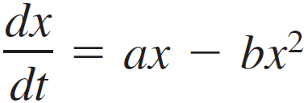
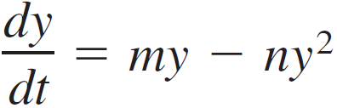
Competing Species
Consider two species that compete with each other for the food available in their common environment. Assume that their populations are given by x and y at time t.
When there is no interaction or competition between the species, the populations x and y each experience logistic growth. So, the populations of the first species x and the second species y can be modeled by the following differential equations.
Rate of change of first species without interaction
Rate of change of second species without interaction

Slide 19
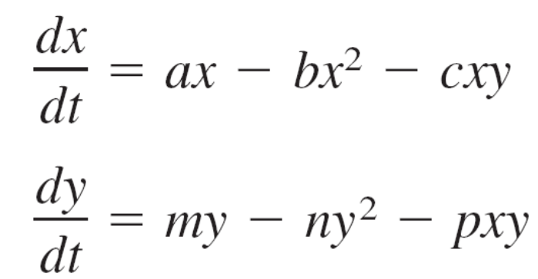
Competing Species
When the species interact, their competition for resources causes a rate of decline in each population proportional to the product xy.
Using a negative interaction factor leads to the following competing-species equations (where a, b, c, m, n, and p are positive constants).
Rate of change of first species with interaction
Rate of change of second species
with interaction

Slide 20
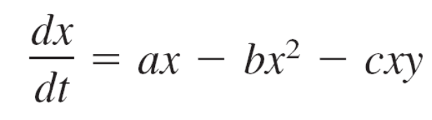
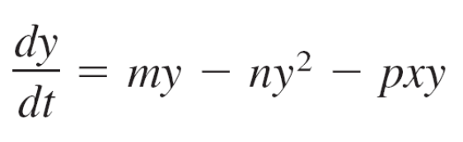
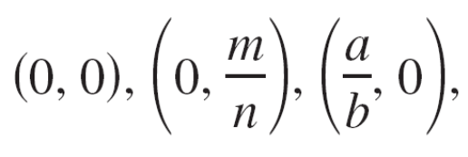
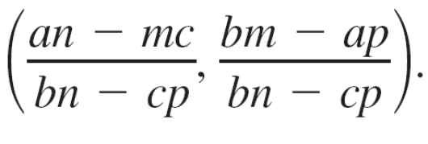
Example 5 – Deriving the Critical Points
Show that the critical points of the competing-species equations
and
are and
Solution:
Set dx/dt and dy/dt equal to 0 and then factor to obtain the following system of equations.
x(a – bx – cy) = 0
y(m – ny – px) = 0
Set dx/dt equal to 0 and factor out x.
Set dy/dt equal to 0 and factor out y.

Slide 21
Example 5 – Solution
cont’d
If x = 0, then y = 0 or y = m/n. If y = 0, then x = 0 or x = a/b.
So, three of the critical points are (0, 0), (0, m/n), and (a/b, 0).
At each of these critical points, one of the populations is 0.
These points represent the possibility that both species cannot coexist.

Slide 22
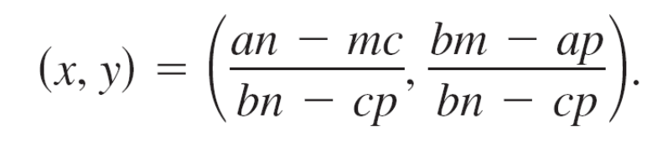
Example 5 – Solution
cont’d
The fourth critical point is obtained by solving the system
a – bx – cy = 0
m – ny – px = 0.
The solution of this system is
Assuming this point exists and lies in Quadrant I of the
xy-plane, the point represents the possibility that both species can coexist.

