Slide 1

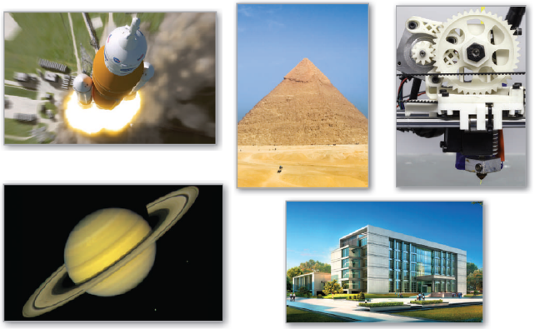
7
P
Applications of Integration
Copyright © Cengage Learning. All rights reserved.

Slide 2

7.5
Work
Copyright © Cengage Learning. All rights reserved.

Slide 3
Objectives
Find the work done by a constant force.
Find the work done by a variable force.

Slide 4
Work Done by a Constant Force

Slide 5
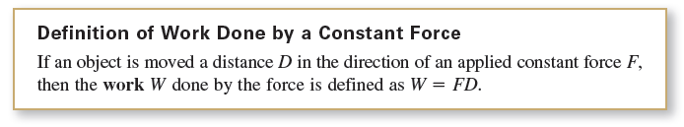
Work Done by a Constant Force
In general, work is done by a force when it moves an object. If the force applied to the object is constant, then the definition of work is as follows.

Slide 6
Work Done by a Constant Force
There are four fundamental types of forces—gravitational, electromagnetic, strong nuclear, and weak nuclear.
A force can be thought of as a push or a pull; a force changes the state of rest or state of motion of a body.
For gravitational forces on Earth, it is common to use units of measure corresponding to the weight of an object.

Slide 7
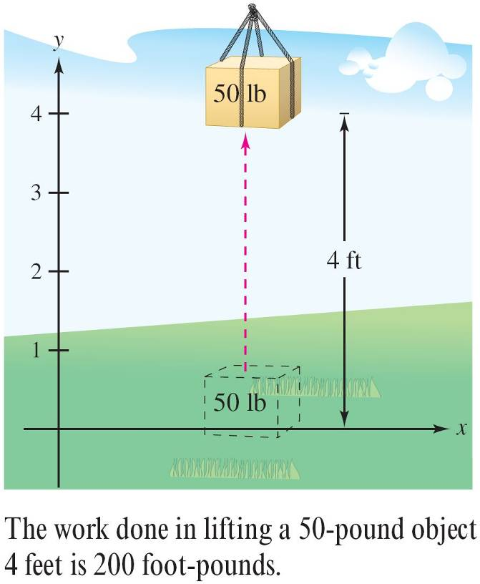

Example 1 – Lifting an Object
Determine the work done in lifting a 50-pound object 4 feet.
Solution:
The magnitude of the required
force F is the weight of the object,
as shown in Figure 7.46.
So, the work done in
lifting the object 4 feet is
Figure 7.46

Slide 8
Work Done by a Constant Force
In the U.S. measurement system, work is typically expressed in foot-pounds (ft-lb), inch-pounds, or foot-tons.
In the International System of Units (SI), the basic unit of force is the newton—the force required to produce an acceleration of 1 meter per second per second on a mass of 1 kilogram. In this system, work is typically expressed in newton-meters, also called joules.

Slide 9
Work Done by a Constant Force
In another system, the centimeter-gram-second (C-G-S) system, the basic unit of force is the dyne—the force required to produce an acceleration of 1 centimeter per second per second on a mass of 1 gram.
In this system, work is typically expressed in
dyne-centimeters, also called ergs, or in joules.

Slide 10
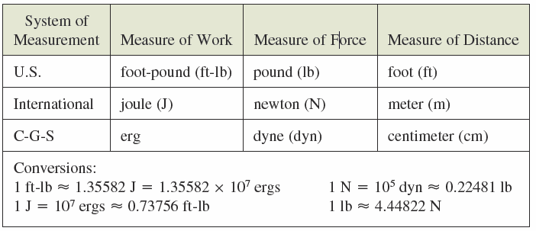
Work Done by a Constant Force
The table below summarizes the units of measure that are commonly used to express the work done and lists several conversion factors.

Slide 11
Work Done by a Variable Force

Slide 12
Work Done by a Variable Force
When a variable force is applied to an object, calculus is needed to determine the work done, because the amount of force changes as the object changes position.
For instance, the force required to compress a spring increases as the spring is compressed.

Slide 13


Work Done by a Variable Force
Consider an object that is moved along a straight line from x = a to x = b by a continuously varying force F(x).
Let Δ be a partition that divides the interval [a, b] into n subintervals determined by
and let Δx_{i} = x_{i} – x_{i – 1}. For each i, choose c_{i} such that

Slide 14

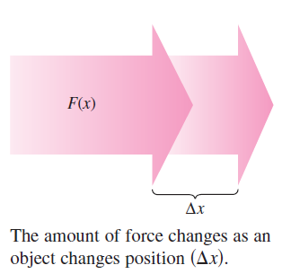


Work Done by a Variable Force
Then at c_{i}, the force is F(c_{i}). Because F is continuous, you can approximate the work done in moving the object through the i th subinterval by the increment
as shown in Figure 7.47. So,
the total work done as the
object moves from x = a to
x = b is approximated by
Figure 7.47

Slide 15



Work Done by a Variable Force
This approximation appears to become better and better as
. So, the work done is

Slide 16
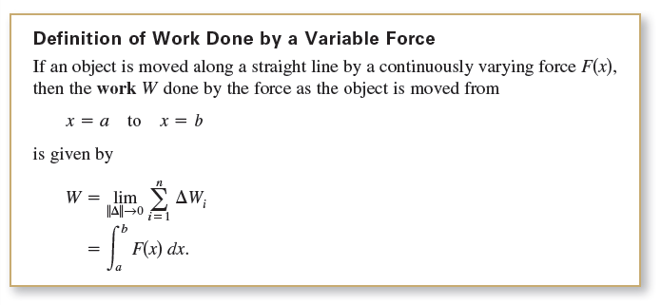
Work Done by a Variable Force

Slide 17

Work Done by a Variable Force
The following three laws of physics were developed by Robert Hooke (1635–1703), Isaac Newton (1642–1727), and Charles Coulomb (1736–1806).
Hooke’s Law: The force F required to compress or stretch a spring (within its elastic limits) is proportional to the distance d that the spring is compressed or stretched from its original length. That is,
where the constant of proportionality k (the spring constant) depends on the specific nature of the spring.

Slide 18

Work Done by a Variable Force
2. Newton’s Law of Universal Gravitation: The force F of attraction between two particles of masses m₁ and m₂ is proportional to the product of the masses and inversely proportional to the square of the distance d between the two particles. That is,
When m₁ and m₂ are in kilograms and d in meters, F will be in newtons for a value of G = 6.67 × 10^{–11} cubic meter per kilogram-second squared, where G is the gravitational constant.

Slide 19

Work Done by a Variable Force
3. Coulomb’s Law: The force F between two charges
q₁ and q₂ in a vacuum is proportional to the product of the charges and inversely proportional to the square of the distance d between the two charges. That is,
When q₁ and q₂ are given in electrostatic units and d in centimeters, F will be in dynes for a value of k = 1.

Slide 20
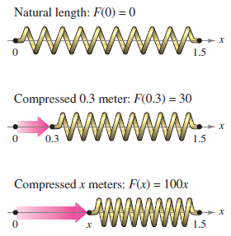
Example 2 – Compressing a Spring
A force of 30 newtons compresses a spring 0.3 meter from its natural length of 1.5 meters. Find the work done in compressing the spring an additional 0.3 meter.
Solution:
By Hooke’s Law, the force F(x) required to compress the spring x units (from its natural length) is F(x) = kx.
Because F(0.3) = 30, it follows that
So, F(x) = 100x, as shown in
Figure 7.48.
Figure 7.48

Slide 21


Example 2 – Solution
cont’d
To find the increment of work, assume that the force required to compress the spring over a small increment Δx is nearly constant.
So, the increment of work is ΔW = (force) (distance increment) = (100x) Δx.
Because the spring is compressed from x = 0.3 to x = 0.6 meter less than its natural length, the work required is

Slide 22
Example 2 – Solution
cont’d
Note that you do not integrate from x = 0 to x = 0.6
because you were asked to determine the work done in compressing the spring an additional 0.3 meter (not including the first 0.3 meter).

Slide 23


Work Done by a Variable Force
The summation of increments in the form
Another way to formulate the increment of work is
This second interpretation of ΔW is useful in problems involving the movement of nonrigid substances such as fluids and chains.

Slide 24
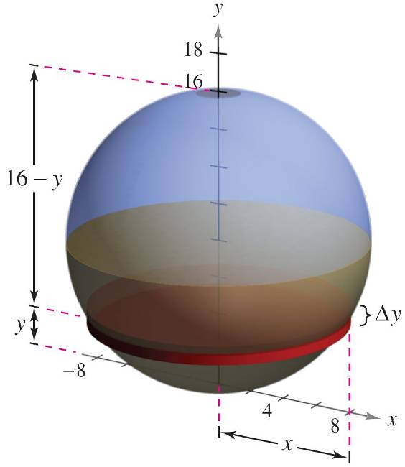
Example 4 – Emptying a Tank of Oil
A spherical tank of radius 8 feet is half full of oil that weighs 50 pounds per cubic foot. Find the work required to pump all of the oil out through a hole in the top of the tank.
Solution:
Consider the oil to be
subdivided into disks of
thickness Δy and radius x,
as shown in Figure 7.50.
Figure 7.50

Slide 25

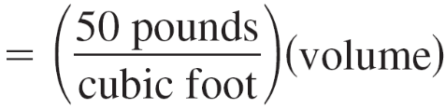

Example 4 – Solution
cont’d
Because the increment of force for each disk is given by its
weight, you have
For a circle of radius 8 and center at (0, 8), you have
x² + (y – 8)² = 8²
x² = 16y – y²
and you can write the force increment as
ΔF = 50(πx²Δy)
= 50π(16y – y²)Δy.

Slide 26
Example 4 – Solution
cont’d
In Figure 7.50, note that a disk y feet from the bottom of the tank must be moved a distance of (16 – y) feet.
So, the increment of work is
ΔW = ΔF(16 – y)
= [50π(16y – y²)Δy](16 – y)
= 50π(256y – 32y² + y³)Δy.
Figure 7.50

Slide 27
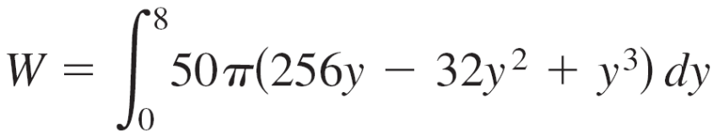
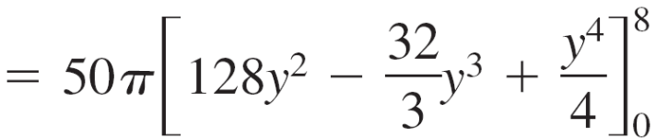
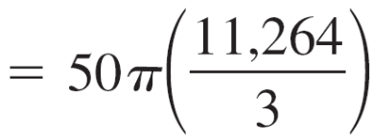

Example 4 – Solution
cont’d
Because the tank is half full, y ranges from 0 to 8 feet, and
the work required to empty the tank is

Slide 28


Work Done by a Variable Force
To estimate the reasonableness of the result in Example 4,
consider that the weight of the oil in the tank is
Lifting the entire half-tank of oil 8 feet would involve work of
Because the oil is actually lifted between 8 and 16 feet, it
seems reasonable that the work done is about 589,782
foot-pounds.

