Slide 1

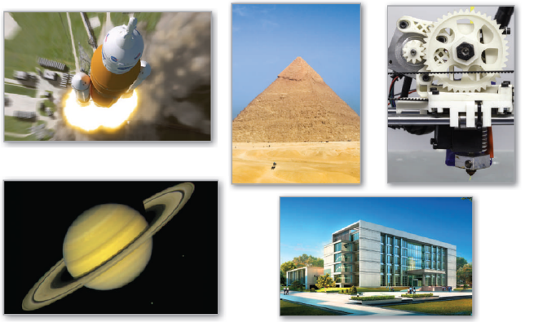
7
P
Applications of Integration
Copyright © Cengage Learning. All rights reserved.

Slide 2

Moments, Centers of Mass, and Centroids
7.6
Copyright © Cengage Learning. All rights reserved.

Slide 3
Objectives
Understand the definition of mass.
Find the center of mass in a one-dimensional system.
Find the center of mass in a two-dimensional system.
Find the center of mass of a planar lamina.
Use the Theorem of Pappus to find the volume of a solid of revolution.

Slide 4
Mass

Slide 5
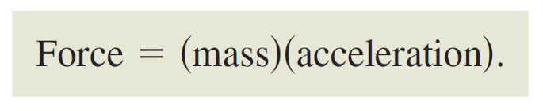
Mass
Several important applications of integration are related to mass. Mass is a measure of a body’s resistance to changes in motion, and is independent of the particular gravitational system in which the body is located.
However, because so many applications involving mass occur on Earth’s surface, an object’s mass is sometimes equated with its weight. This is not technically correct. Weight is a type of force and as such is dependent on gravity. Force and mass are related by the equation

Slide 6
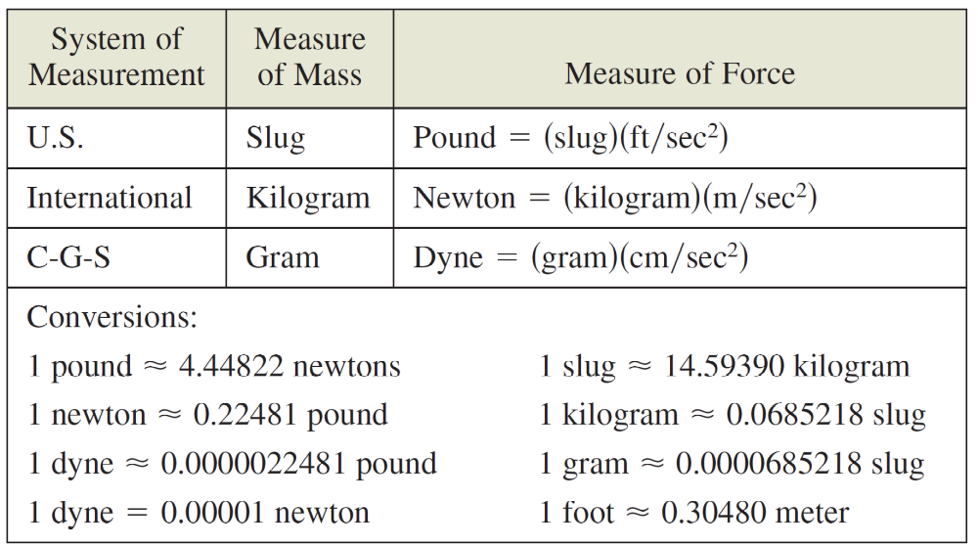
Mass
The table below lists some commonly used measures of mass and force, together with their conversion factors.

Slide 7
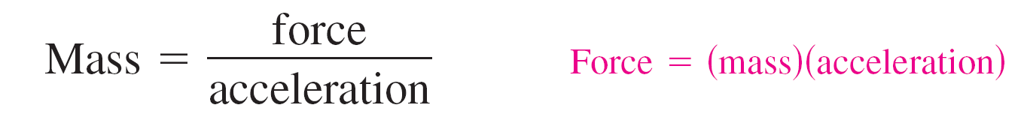
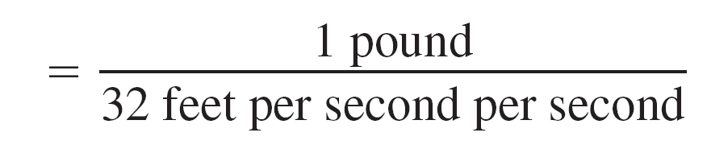
Example 1 – Mass on the Surface of Earth
Find the mass (in slugs) of an object whose weight at sea level is 1 pound.
Solution:
Use 32 feet per second per second as the acceleration due to gravity.

Slide 8
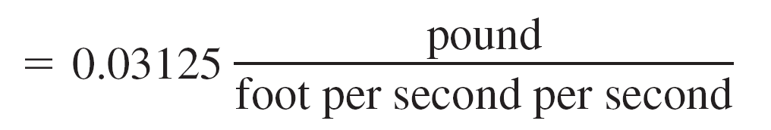
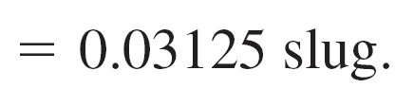
Example 1 – Solution
cont’d
Because many applications involving mass occur on Earth’s surface, this amount of mass is called a pound mass.

Slide 9
Center of Mass in a
One-Dimensional System

Slide 10
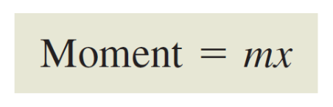
Center of Mass in a One-Dimensional System
You will now consider two types of moments of a mass—the moment about a point and the moment about a line. To define these two moments, consider an idealized situation in which a mass m is concentrated at a point.
If x is the distance between this point mass and another point P, then the moment of m about the point P is
and x is the length of the moment arm.

Slide 11
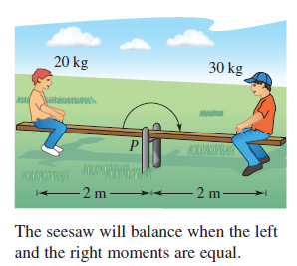
Center of Mass in a One-Dimensional System
The concept of moment can be demonstrated simply by a seesaw, as shown in Figure 7.53.
A child of mass 20 kilograms sits 2 meters to the left of the
fulcrum P, and an older child of
mass 30 kilograms sits 2 meters
to the right of P.
From experience, you know that
the seesaw will begin to rotate
clockwise, moving the larger child
down.
Figure 7.53

Slide 12

Center of Mass in a One-Dimensional System
This rotation occurs because the moment produced by the child on the left is less than the moment produced by the child on the right.
To balance the seesaw, the two moments must be equal. For example, if the larger child moved to a position 4/3 meters from the fulcrum, then the seesaw would balance, because each child would produce a moment of 40 kilogram-meters.

Slide 13
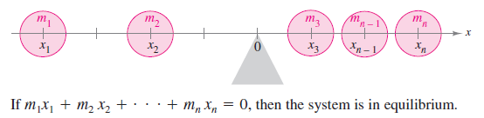
Center of Mass in a One-Dimensional System
You can introduce a coordinate line on which the origin corresponds to the fulcrum, as shown in Figure 7.54.
Several point masses are located on the x-axis. The measure of the tendency of this system to rotate about the origin is the moment about the origin, and it is defined as the sum of the n products m_{i}x_{i}.
Figure 7.54

Slide 14

Center of Mass in a One-Dimensional System
The moment about the origin is denoted by M₀ and can be written as
If M₀ is 0, then the system is said to be in equilibrium.

Slide 15


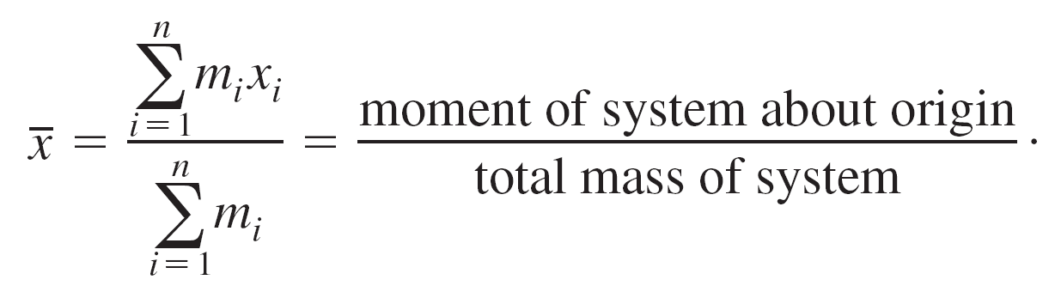
Center of Mass in a One-Dimensional System
For a system that is not in equilibrium, the center of mass is defined as the point at which the fulcrum could be relocated to attain equilibrium. If the system were translated
units, then each coordinate x_{i} would become (x_{i} – ) and because the moment of the translated system is 0, you have
Solving for produces
When m₁x₁ + m₂x₂ + . . . + m_{n}x_{n} = 0, the system is in equilibrium.

Slide 16
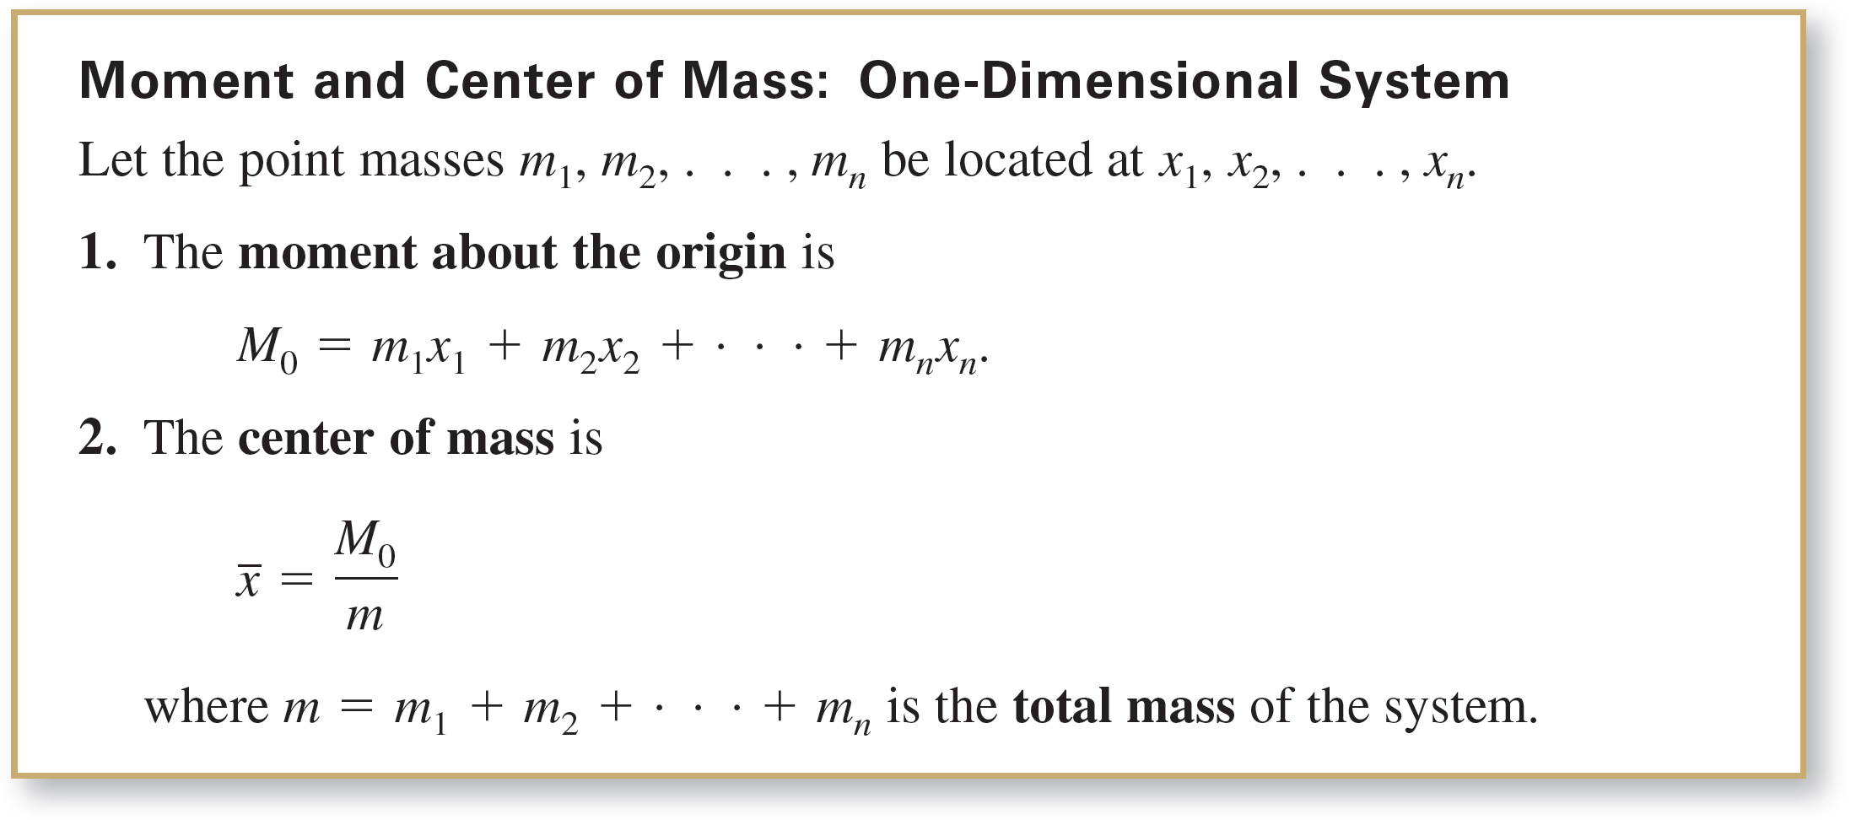
Center of Mass in a One-Dimensional System

Slide 17
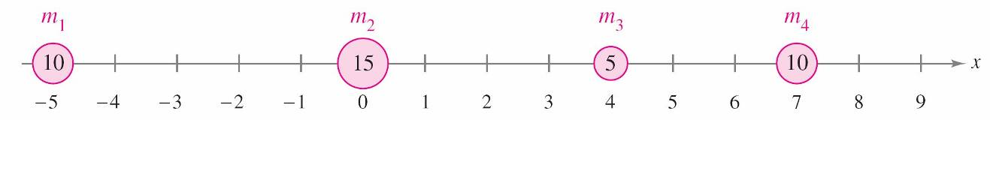

Example 2 – The Center of Mass of a Linear System
Find the center of mass of the linear system shown in Figure 7.55.
Solution:
The moment about the origin is
M₀ = m₁x₁ + m₂x₂ + m₃x₃ + m₄x₄
= 10(–5) + 15(0) + 5(4) + 10(7)
= –50 + 0 + 20 + 70
= 40.
Figure 7.55

Slide 18

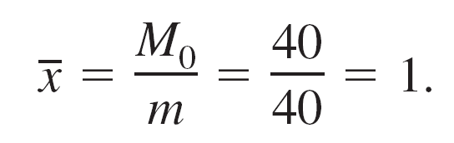

Example 2 – Solution
cont’d
Because the total mass of the system is
m = 10 + 15 + 5 + 10 = 40
the center of mass is
Note that the point masses will be in equilibrium when the fulcrum is located at x = 1.

Slide 19
Center of Mass in a One-Dimensional System
Rather than defining the moment of a mass, you could define the moment of a force. In this context, the center of mass is called the center of gravity.
Consider a system of point masses m₁, m₂, . . . , m_{n} that is located at x₁, x₂, . . . , x_{n} .
Then, because force = (mass)(acceleration)
the total force of the system is
F = m₁a + m₂a + … + m_{n}a = ma.

Slide 20
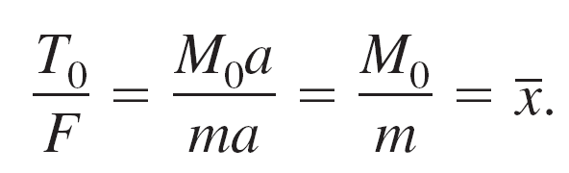
Center of Mass in a One-Dimensional System
The torque (moment) about the origin is
T₀ = (m₁a)x₁ + (m₂a)x₂ + . . . + (m_{n}a)x_{n} = M₀a
and the center of gravity is
So, the center of gravity and the center of mass have the same location.

Slide 21
Center of Mass in a
Two-Dimensional System

Slide 22
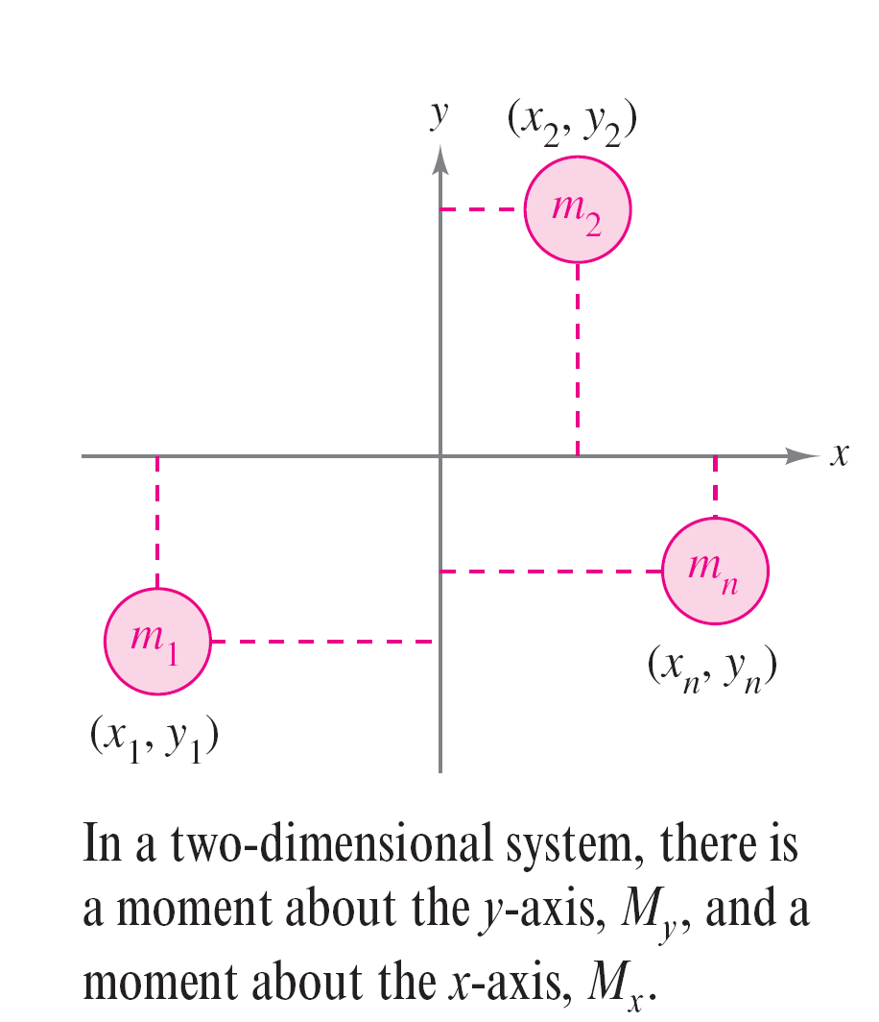
Center of Mass in a Two-Dimensional System
You can extend the concept of moment to two dimensions by considering a system of masses located in the xy-plane at the points
(x₁, y₁), (x₂, y₂),. . . ,(x_{n}, y_{n}), as shown in
Figure 7.56.
Rather than defining a single moment
(with respect to the origin), two moments
are defined—one with respect to the
x-axis and one with respect to the y-axis.
Figure 7.56

Slide 23
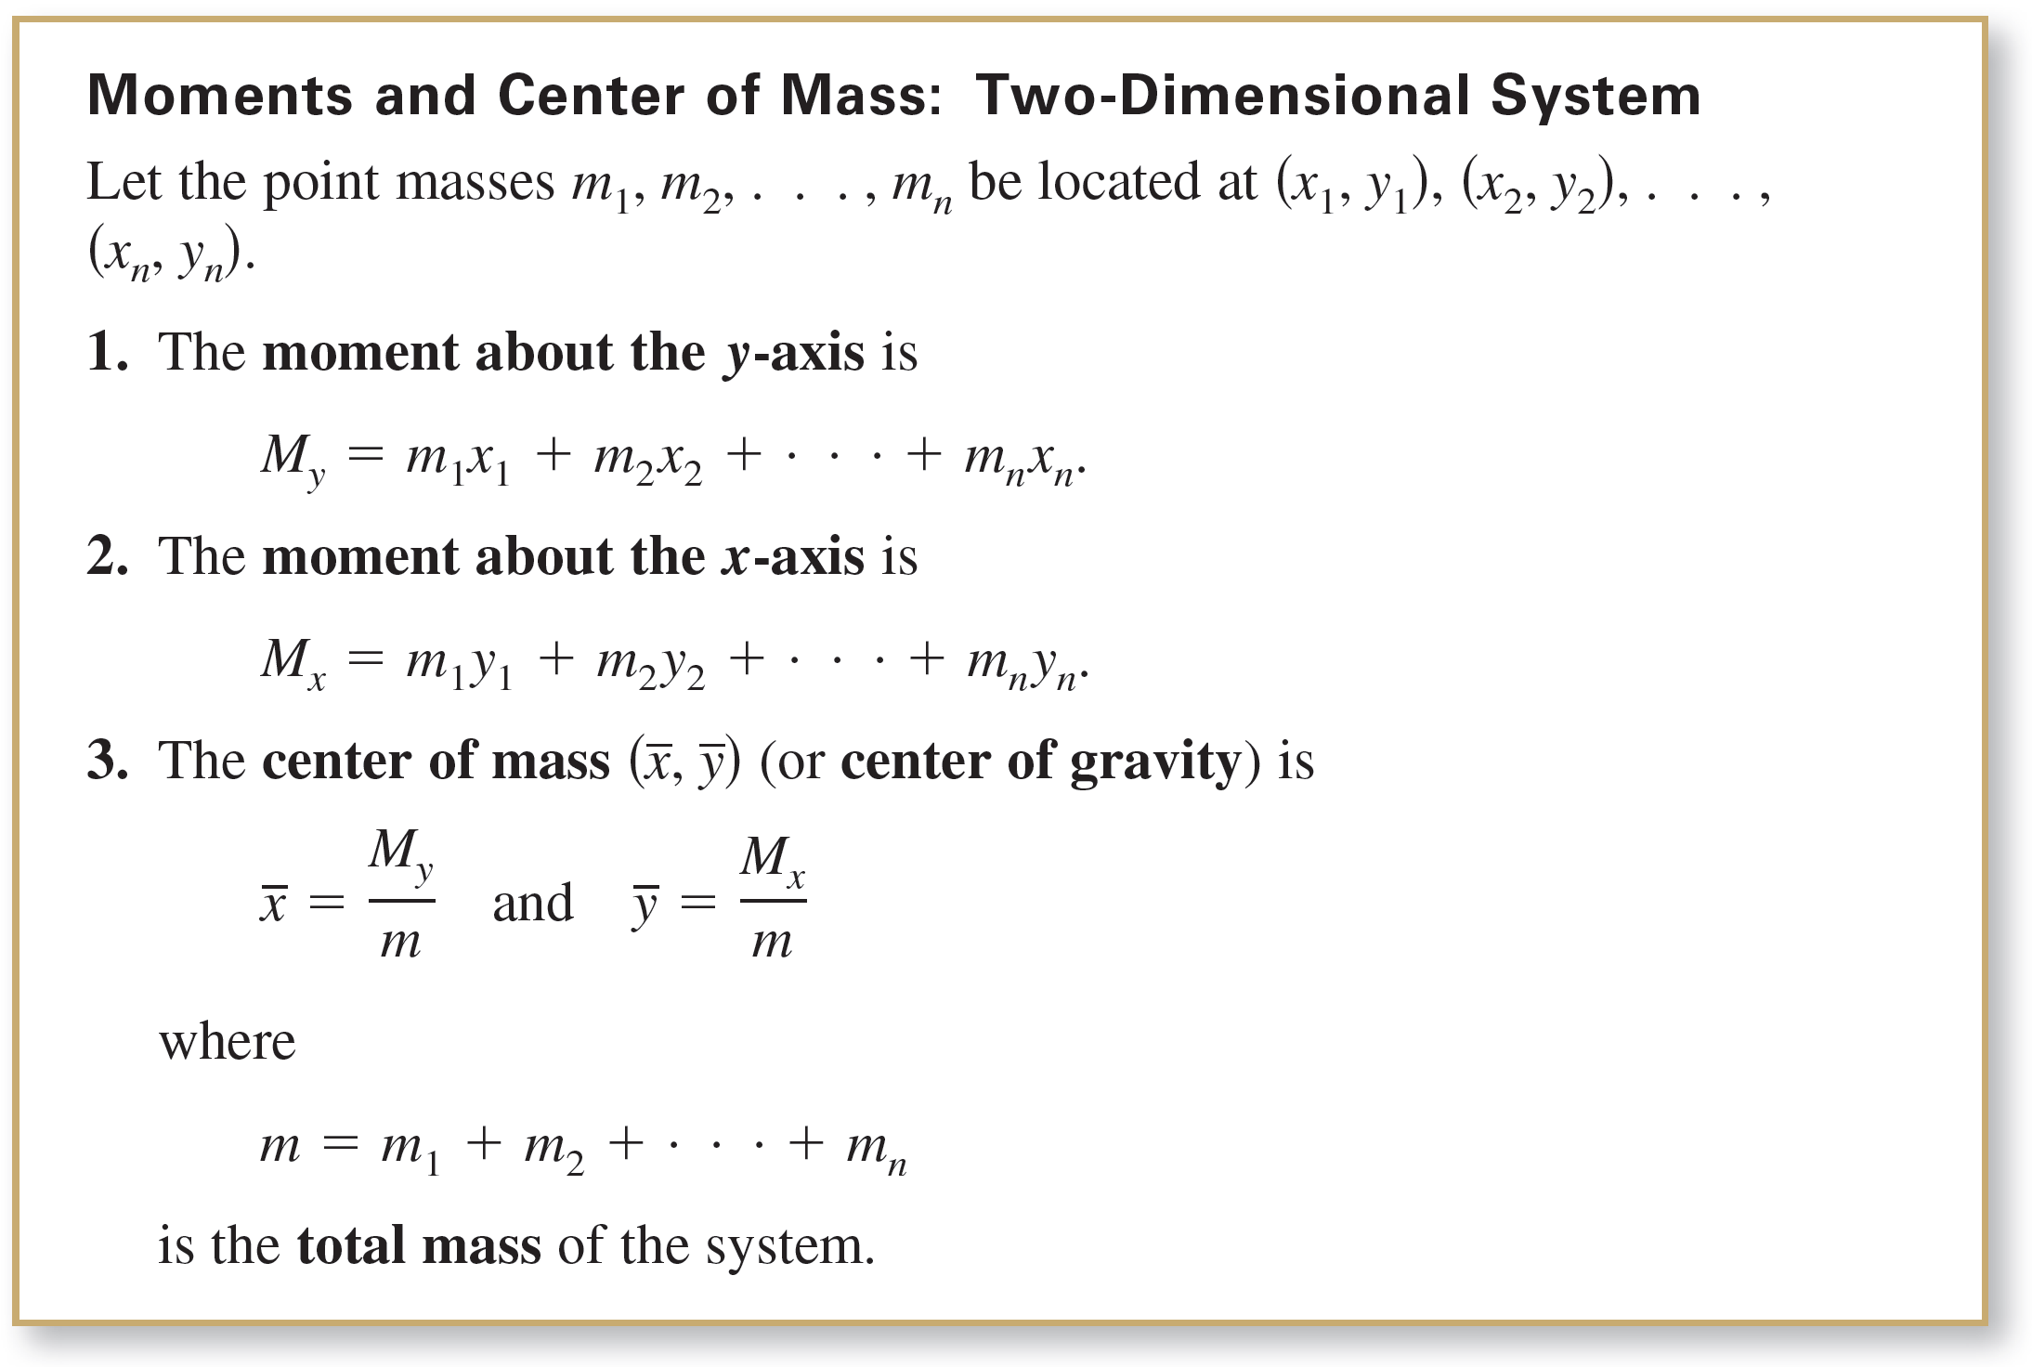
Center of Mass in a Two-Dimensional System

Slide 24
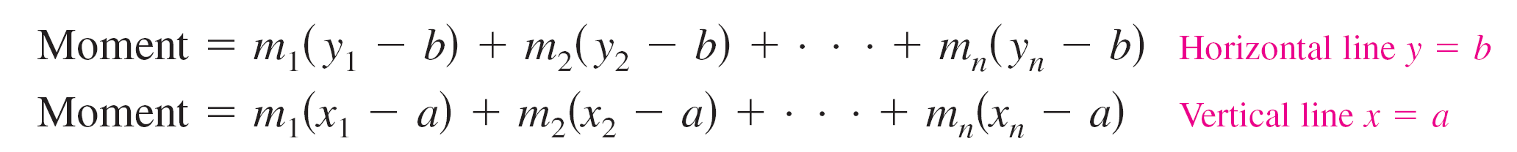
Center of Mass in a Two-Dimensional System
The moment of a system of masses in the plane can be taken about any horizontal or vertical line. In general, the moment about a line is the sum of the product of the masses and the directed distances from the points to the line.

Slide 25
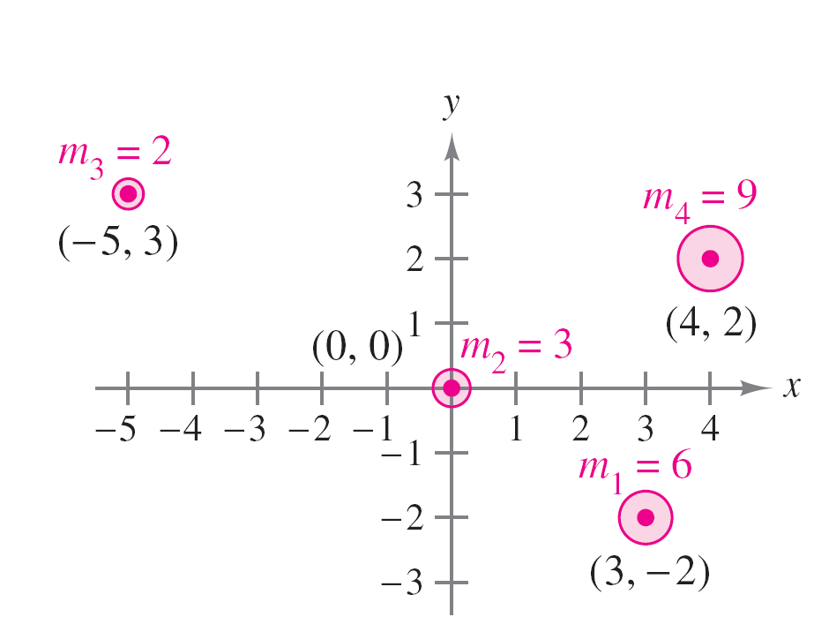
Example 3 – The Center of Mass of a Two-Dimensional System
Find the center of mass of a system
of point masses
m₁ = 6, m₂ = 3, m₃ = 2, and m₄ = 9,
located at
(3, –2), (0, 0), (–5, 3), and (4, 2)
as shown in Figure 7.57.
Solution:
Figure 7.57

Slide 26
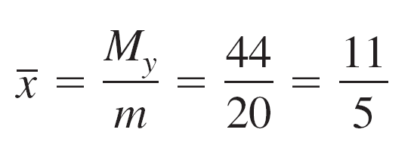
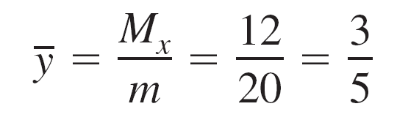

Example 3 – Solution
cont’d
So,
and
The center of mass is

Slide 27
Center of Mass of a Planar Lamina

Slide 28
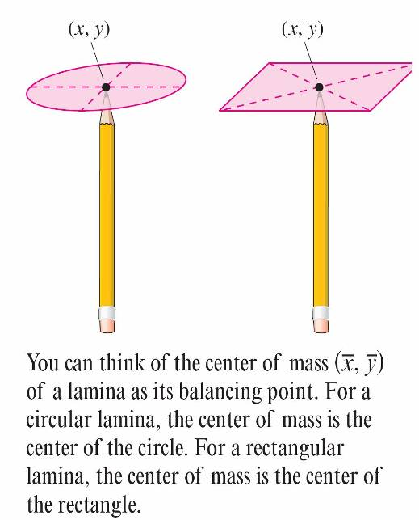
Center of Mass of a Planar Lamina
Consider a thin, flat plate of material of constant density called a planar lamina (see Figure 7.58).
Density is a measure of mass per
unit of volume, such as grams per
cubic centimeter. For planar laminas,
however, density is considered to
be a measure of mass per unit of
area. Density is denoted by ρ, the
lowercase Greek letter rho.
Figure 7.58

Slide 29
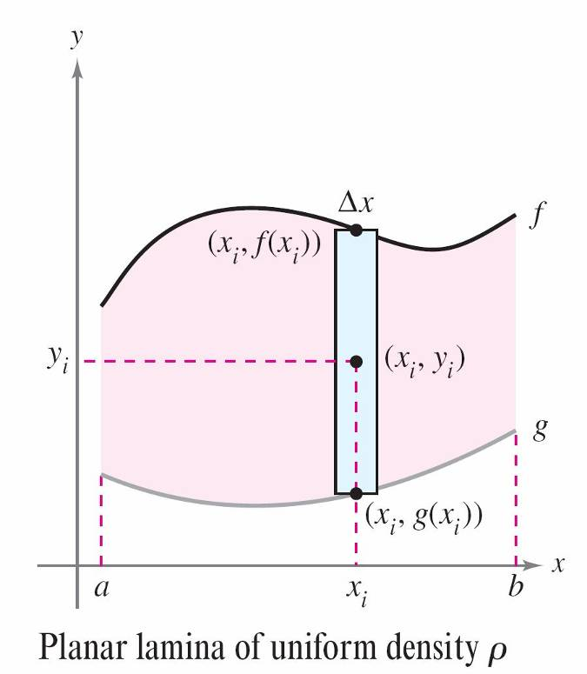
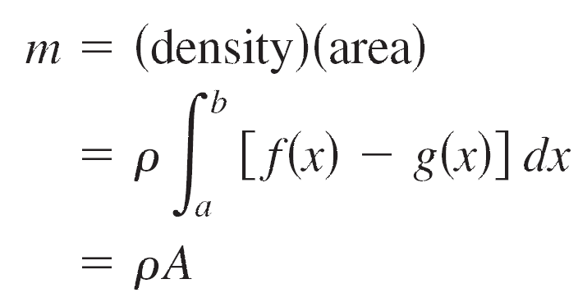
Center of Mass of a Planar Lamina
Consider an irregularly shaped planar lamina of uniform density ρ, bounded by the graphs of
y = f(x), y = g(x), and a ≤ x ≤ b,
as shown in Figure 7.59.
The mass of this region is
where A is the area of the region.
Figure 7.59

Slide 30

Center of Mass of a Planar Lamina
To find the center of mass of this lamina, partition the interval [a, b] into n subintervals of equal width Δx.
Let x_{i} be the center of the ith subinterval. You can approximate the portion of the lamina lying in the ith subinterval by a rectangle whose height is h = f (x_{i}) – g(x_{i}).
Because the density of the rectangle is ρ, its mass is

Slide 31



Center of Mass of a Planar Lamina
Now, considering this mass to be located at the center
(x_{i,} y_{i,}) of the rectangle, the directed distance from the x-axis to (x_{i,} y_{i,}) is y_{i} = [f (x_{i}) + g(x_{i})]/2. So, the moment of
m_{i} about the x-axis is

Slide 32
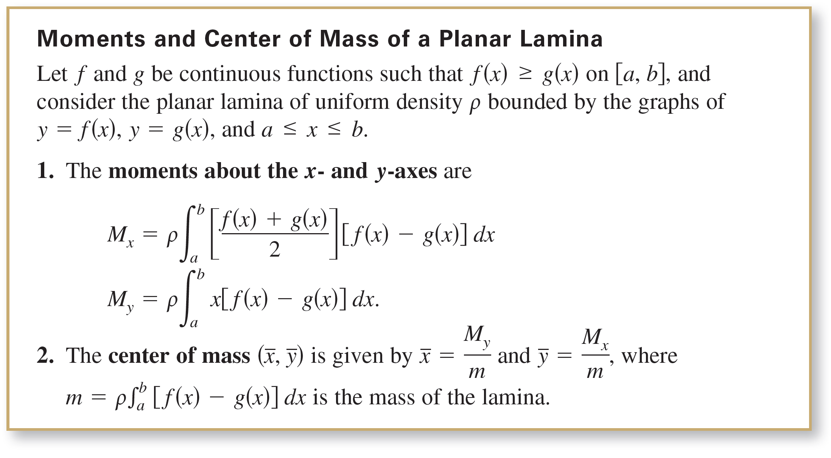
Center of Mass of a Planar Lamina

Slide 33

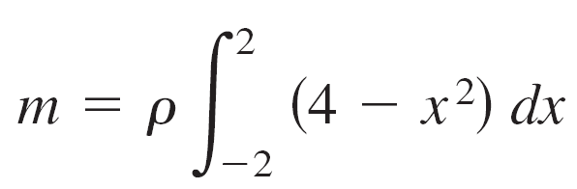
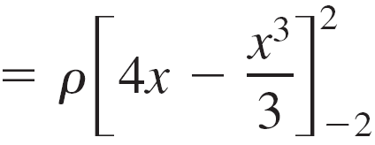
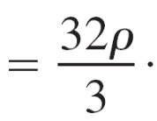
Example 4 – The Center of Mass of a Planar Lamina
Find the center of mass of the lamina of uniform density ρ bounded by the graph of f(x) = 4 – x² and the x-axis.
Solution:
Because the center of mass lies on the axis of symmetry, you know that = 0.
Moreover, the mass of the lamina is

Slide 34
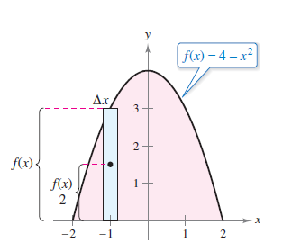
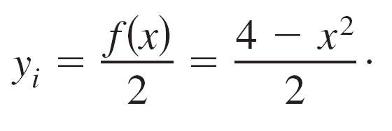
Example 4 – Solution
cont’d
To find the moment about the x-axis, place a representative rectangle in the region, as shown in the figure below.
The distance from the x-axis to the
center of this rectangle is

Slide 35
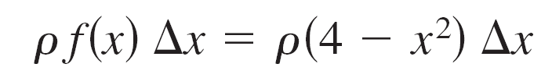
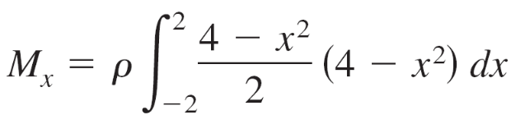
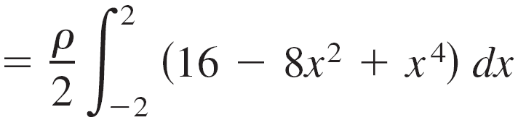
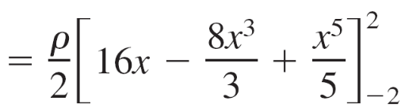
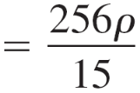

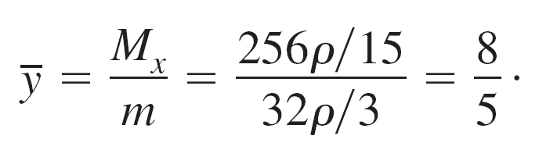
Example 4 – Solution
cont’d
Because the mass of the representative rectangle is
you have
and is

Slide 36

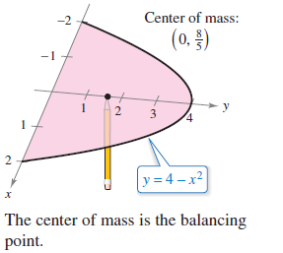
Example 4 – Solution
cont’d
So, the center of mass (the balancing point) of the lamina
is as shown in Figure 7.60.
Figure 7.60

Slide 37
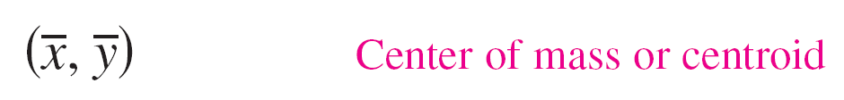
Center of Mass of a Planar Lamina
The center of mass of a lamina of uniform density depends only on the shape of the lamina and not on its density. For this reason, the point
is sometimes called the center of mass of a region in the plane, or the centroid of the region.
In other words, to find the centroid of a region in the plane, you simply assume that the region has a constant density of ρ = 1 and compute the corresponding center of mass.

Slide 38
Theorem of Pappus

Slide 39
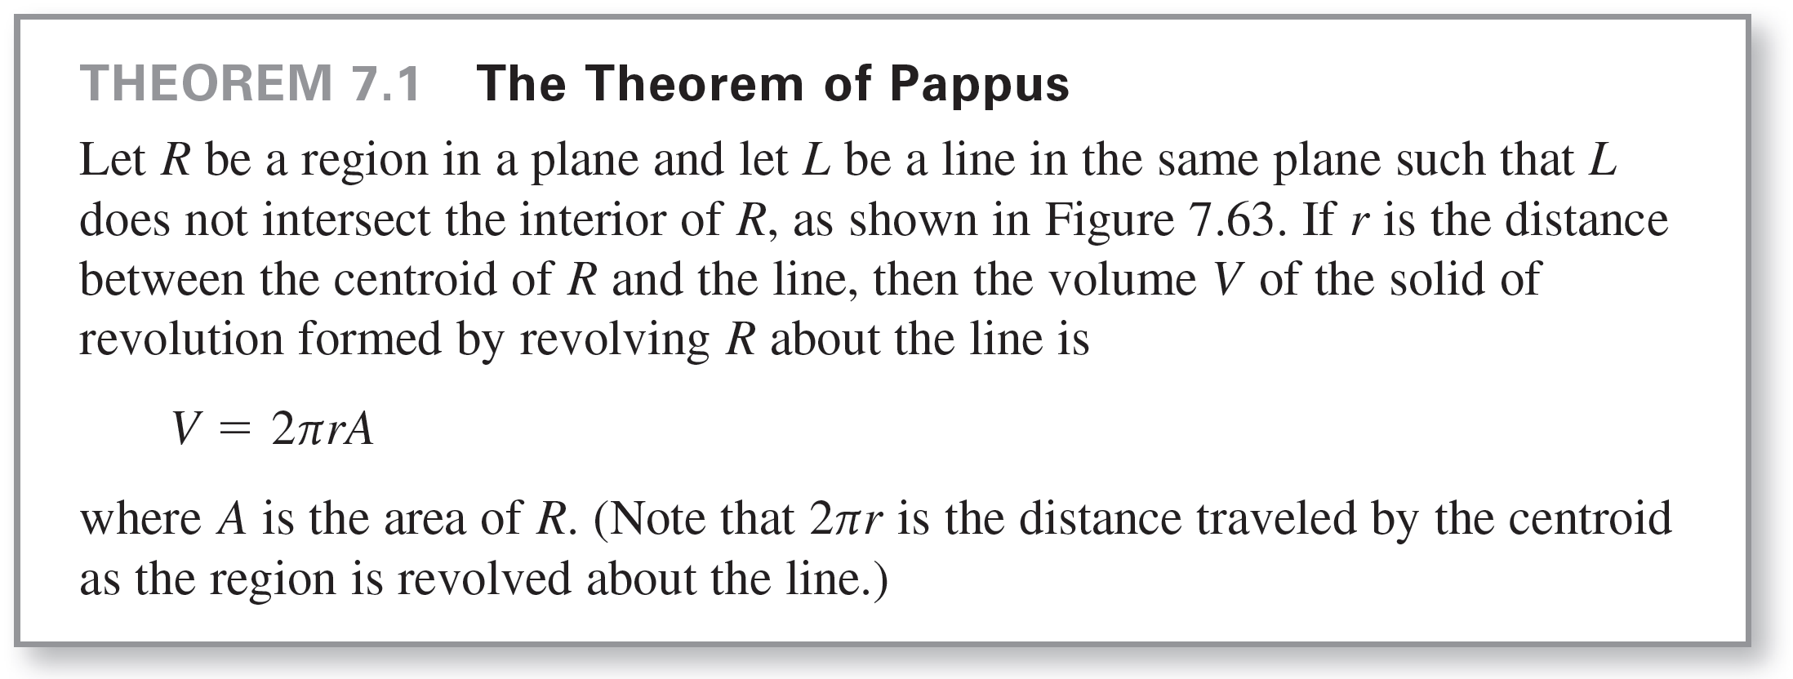
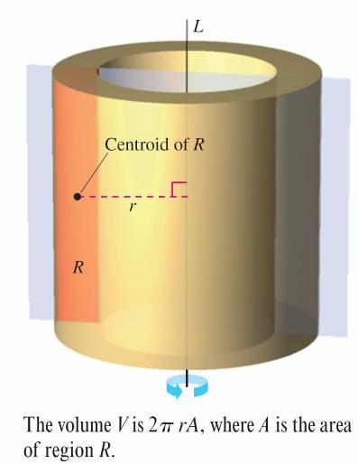
Theorem of Pappus
Figure 7.63

Slide 40
Theorem of Pappus
The Theorem of Pappus can be used to find the volume of a torus, as shown in the next example.
A torus is a doughnut-shaped solid formed by revolving a circular region about a line that lies in the same plane as the circle (but does not intersect the circle).

Slide 41
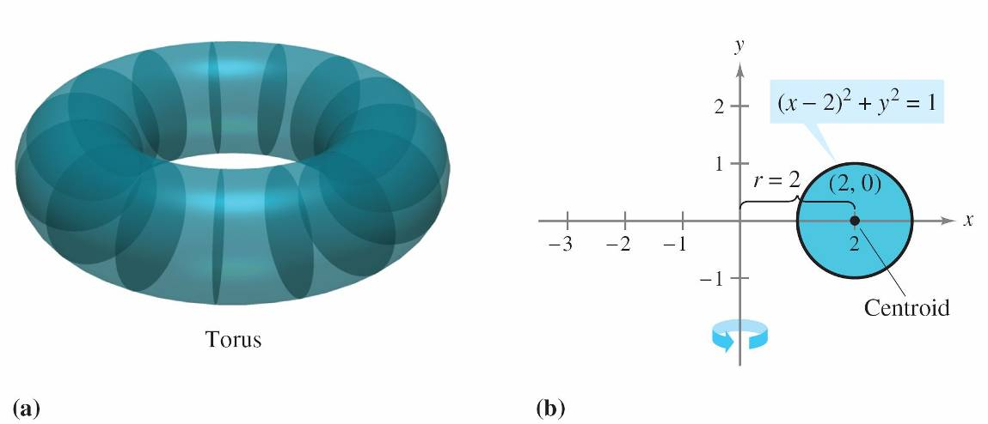
Example 7 – Finding Volume by the Theorem of Pappus
Find the volume of the torus shown in Figure 7.64(a), which was formed by revolving the circular region bounded by
(x – 2)² + y² = 1
about the y-axis, as shown in Figure 7.64(b).
Figure 7.64

Slide 42
Example 7 – Solution
In Figure 7.64(b), you can see that the centroid of the circular region is (2, 0).
So, the distance between the centroid and the axis of revolution is r = 2.
Because the area of the circular region is A = π, the volume of the torus is
V = 2πrA
= 2π(2)(π)
= 4π²
≈ 39.5.

