Slide 1


7
P
Applications of Integration
Copyright © Cengage Learning. All rights reserved.

Slide 2

7.7
Fluid Pressure and Fluid Force
Copyright © Cengage Learning. All rights reserved.

Slide 3
Objective
Find fluid pressure and fluid force.

Slide 4
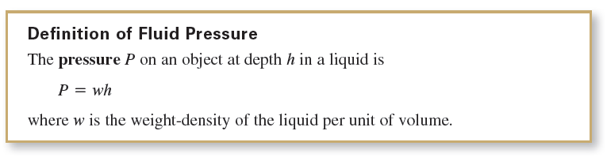
Fluid Pressure and Fluid Force
Pressure is defined as the force per unit of area over the surface of a body.
In general the pressure is proportional to the depth of the object in the fluid.

Slide 5
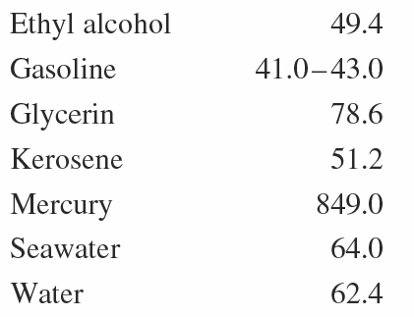
Fluid Pressure and Fluid Force
Below are some common weight-densities of fluids in pounds per cubic foot.

Slide 6
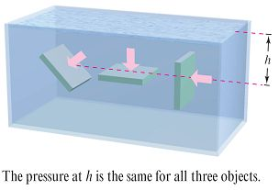
Fluid Pressure and Fluid Force
When calculating fluid pressure, you can use an important physical law called Pascal’s Principle, named after the French mathematician Blaise Pascal.
Pascal’s Principle states that the pressure exerted by a fluid at a depth h is transmitted equally in all directions.
For example, in Figure 7.65,
the pressure at the indicated depth
is the same for all three objects.
Figure 7.65

Slide 7
Fluid Pressure and Fluid Force
Because fluid pressure is given in terms of force per unit area (P = F/A), the fluid force on a submerged horizontal surface of area A is
Fluid force = F = PA = (pressure)(area).

Slide 8
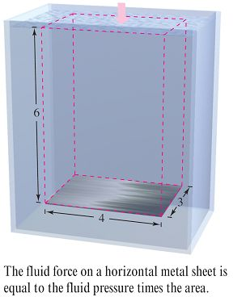
Example 1 – Fluid Force on a Submerged Sheet
Find the fluid force on a rectangular metal sheet measuring 3 feet by 4 feet that is submerged in 6 feet of water, as shown in Figure 7.66.
Figure 7.66

Slide 9



Example 1 – Solution
Because the weight-density of water is 62.4 pounds per cubic foot and the sheet is submerged in 6 feet of water, the fluid pressure is
P = (62.4)(6)
= 374.4 pounds per square foot.
Because the total area of the sheet is A = (3)(4) = 12 square feet, the fluid force is
This result is independent of the size of the body of water. The fluid force would be the same in a swimming pool or lake.

Slide 10
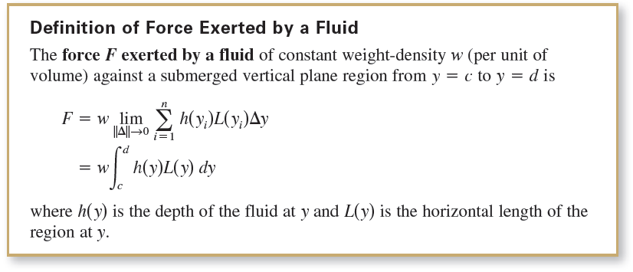
Fluid Pressure and Fluid Force

Slide 11
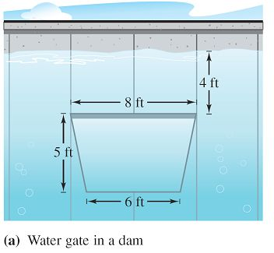
Example 2 – Fluid Force on a Vertical Surface
A vertical gate in a dam has the shape of an isosceles trapezoid 8 feet across the top and 6 feet across the bottom, with a height of 5 feet, as shown in Figure 7.68(a). What is the fluid force on the gate when the top of the gate is 4 feet below the surface of the water?
Figure 7.68(a)

Slide 12
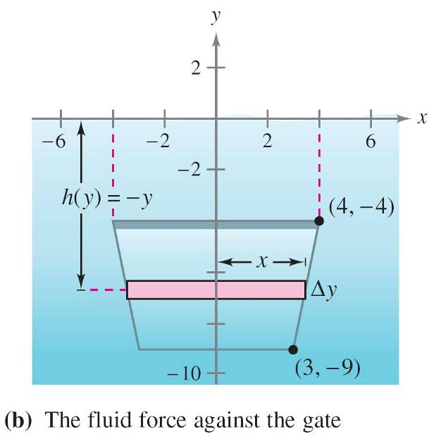
Example 2 – Solution
In setting up a mathematical model for this problem, you are at liberty to locate the x- and y-axes in several different ways.
A convenient approach is to let the y-axis bisect the gate and place the x-axis at the surface of the water, as shown in Figure 7.68(b).
So, the depth of the water at y in feet is
Depth = h(y) = –y.
To find the length L(y) of the region at y,
find the equation of the line forming
the right side of the gate.
Figure 7.68(b)

Slide 13
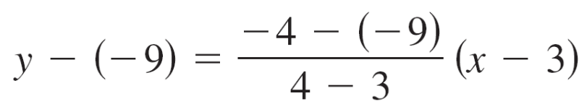


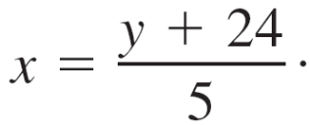

Example 2 – Solution
cont’d
Because this line passes through the points (3, –9) and (4, –4), its equation is
In Figure 7.68(b), you can see that the length of the region at y is

Slide 14

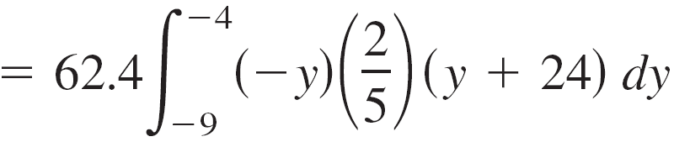
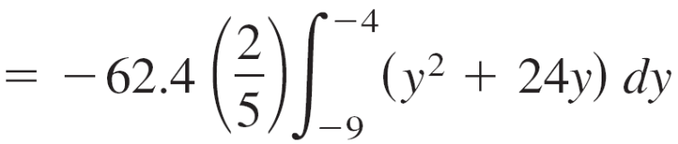
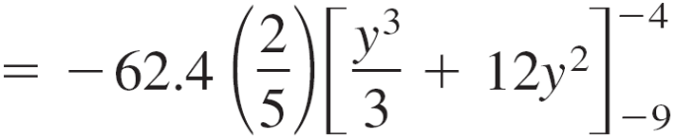
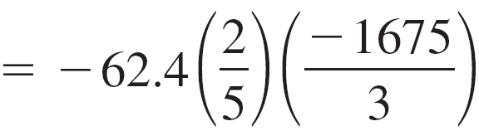

Example 2 – Solution
cont’d
Finally, by integrating from y = –9 to y = –4, you can calculate the fluid force to be

