Slide 1


8
Integration Techniques and Improper Integrals
P
Copyright © Cengage Learning. All rights reserved.

Slide 2

8.2
Integration by Parts
Copyright © Cengage Learning. All rights reserved.

Slide 3
Objective
Find an antiderivative using integration by parts.

Slide 4

Integration by Parts
In this section you will study an important integration technique called integration by parts. This technique can be applied to a wide variety of functions and is particularly useful for integrands involving products of algebraic and transcendental functions.
For instance, integration by parts works well with integrals such as

Slide 5


Integration by Parts
Integration by parts is based on the formula for the derivative of a product
where both u and v are differentiable functions of x.

Slide 6


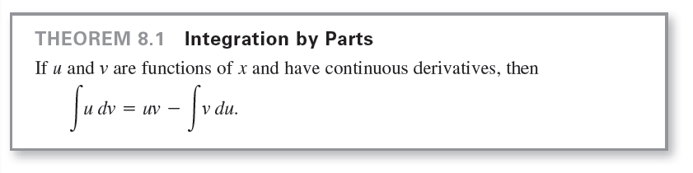
Integration by Parts
When u' and v' are continuous, you can integrate both sides of the equation to obtain
By rewriting this equation, you obtain the next theorem.

Slide 7
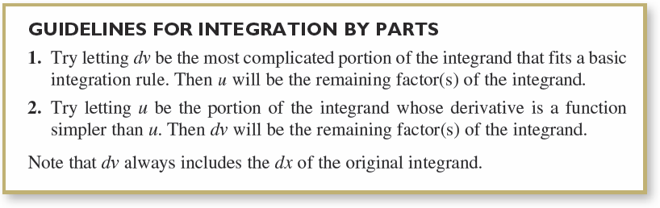
Integration by Parts
The formula expresses the original integral in terms of another integral. Depending on the choices of u and dv, it may be easier to find the second integral than the original one.
Because the choices of u and dv are critical in the integration by parts process, the guidelines below are provided.

Slide 8
Integration by Parts
When using integration by parts, note that you can first choose dv or first choose u.
After you choose, however, the choice of the other factor is determined—it must be the remaining portion of the integrand.
Also note that dv must contain the differential dx of the original integral.

Slide 9


Example 1 – Integration by Parts
Find
Solution:
To apply integration by parts, you need to write the integral in the form
There are several ways to do this.
The guidelines for integration by parts in earlier slide
suggest the first option because the derivative of u = x is
simpler than x, and dv = e^{x} dx is the most complicated
portion of the integrand that fits a basic integration formula.

Slide 10


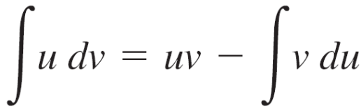

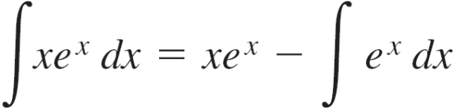


Example 1 – Solution
cont’d
Now, integration by parts produces
To check this, differentiate xe^{x} – e^{x} + C to see that you
obtain the original integrand.

Slide 11
Integration by Parts
As you gain experience in using integration by parts, your skill in determining u and dv will increase.
The next summary lists several common integrals with suggestions for the choices of u and dv.

Slide 12
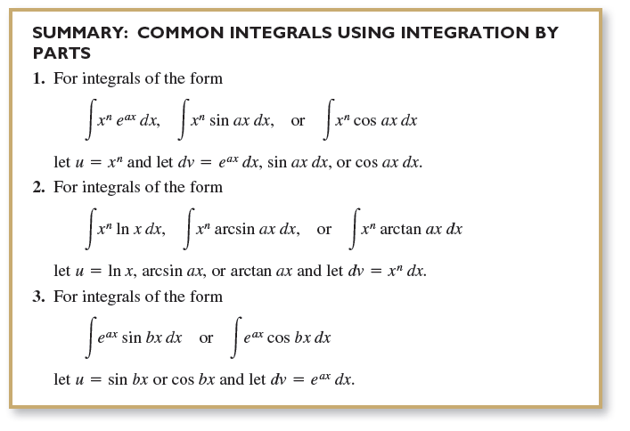
Integration by Parts

Slide 13

Integration by Parts
In problems involving repeated applications of integration by parts, a tabular method, illustrated in Example 7, can help to organize the work. This method works well for integrals of the form

Slide 14

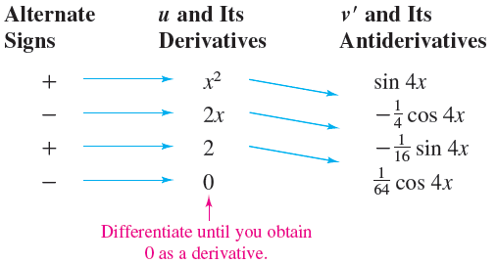
Example 7 – Using the Tabular Method
Find
Solution:
Begin as usual by letting u = x² and dv = v' dx = sin 4x dx. Next, create a table consisting of three columns, as shown.

Slide 15


Example 7 – Solution
cont’d
The solution is obtained by adding the signed products of the
diagonal entries:

