Slide 1


8
Integration Techniques and Improper Integrals
P
Copyright © Cengage Learning. All rights reserved.

Slide 2

Integration by Tables and Other Integration Techniques
8.7
Copyright © Cengage Learning. All rights reserved.

Slide 3
Objectives
Find an indefinite integral using a table of integrals.
Find an indefinite integral using reduction formulas.
Find an indefinite integral involving rational functions of sine and cosine.

Slide 4
Integration by Tables

Slide 5
Integration by Tables
Many people find tables of integrals to be a valuable supplement to the integration techniques discussed in this chapter. Tables of common integrals can be found in Appendix B.
Integration by tables is not a “cure-all” for all of the difficulties that can accompany integration—using tables of integrals requires considerable thought and insight and often involves substitution.
Each integration formula in Appendix B can be developed using one or more of the techniques to verify several of the formulas.

Slide 6



Integration by Tables
For instance, Formula 4
can be verified using the method of partial fractions,
Formula 19
can be verified using integration by parts, and Formula 84
can be verified using substitution.

Slide 7
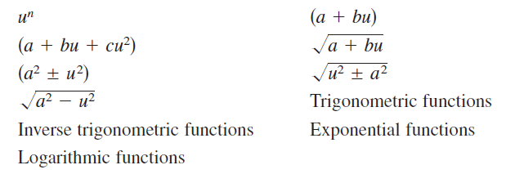
Integration by Tables
Note that the integrals in Appendix B are classified according to the form of the integrand. Several of the forms are listed below.

Slide 8
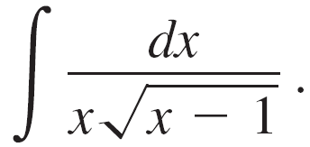

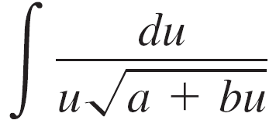
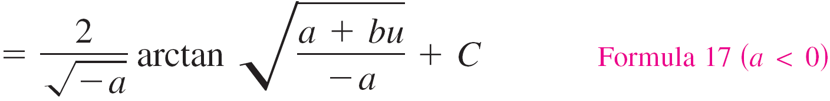
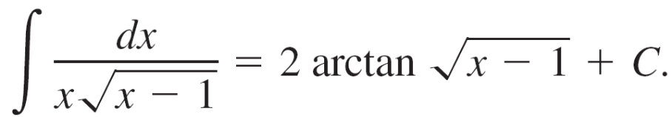
Example 1 – Integration by Tables
Find
Solution:
Because the expression inside the radical is linear, you should consider forms involving
Let a = –1, b = 1, and u = x.
Then du = dx, and you can write

Slide 9
Reduction Formulas

Slide 10

Reduction Formulas
Several of the integrals in the integration tables have the form
Such integration formulas are called reduction formulas because they reduce a given integral to the sum of a function and a simpler integral.

Slide 11

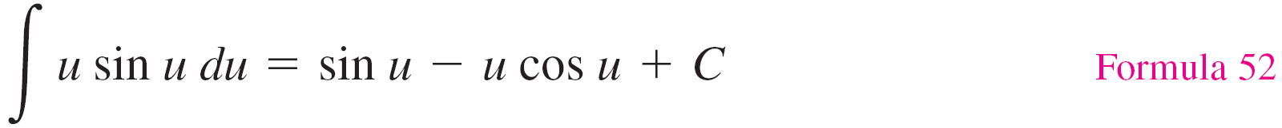
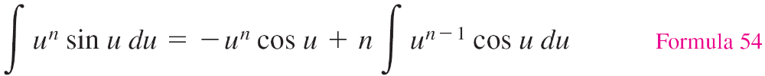
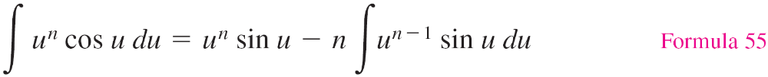
Example 4 – Using a Reduction Formula
Find
Solution:
Consider the three formulas listed below.

Slide 12


Example 4 – Solution
cont’d
Using Formula 54, Formula 55, and then Formula 52 produces

Slide 13
Rational Functions of Sine and Cosine

Slide 14
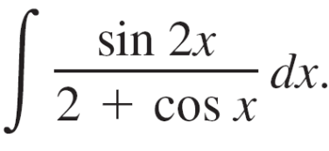
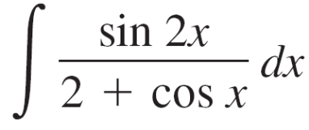
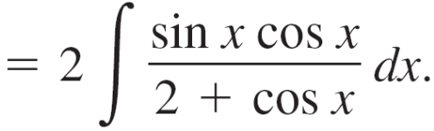
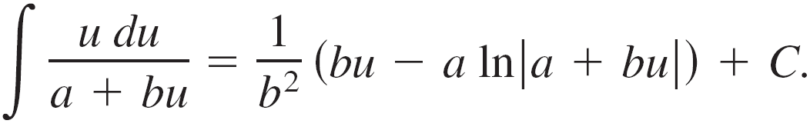

Example 6 – Integration by Tables
Find
Solution:
Substituting 2 sin x cos x for sin 2x produces
A check of the forms involving sin u or cos u in Appendix B shows that those listed do not apply.
So, you can consider forms involving a + bu. For example,

Slide 15
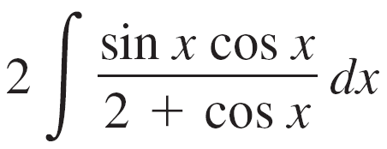

Example 6 – Solution
cont’d
Let a = 2, b = 1, and u = cos x.
Then du = –sin x dx, and you have

Slide 16
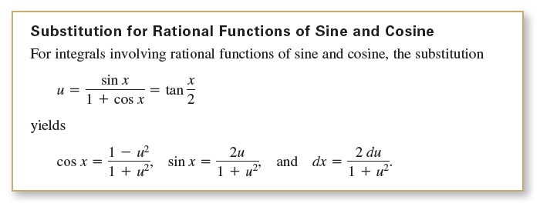
Rational Functions of Sine and Cosine

